Slide 1
ECEN 615, Fall 2023
Methods of Electric Power System Analysis
Class 6: Power Flow Complexities, Part 2
Prof. Adam Birchfield
Dept. of Electrical and Computer Engineering
Texas A&M University
abirchfield@tamu.edu

Slide 2
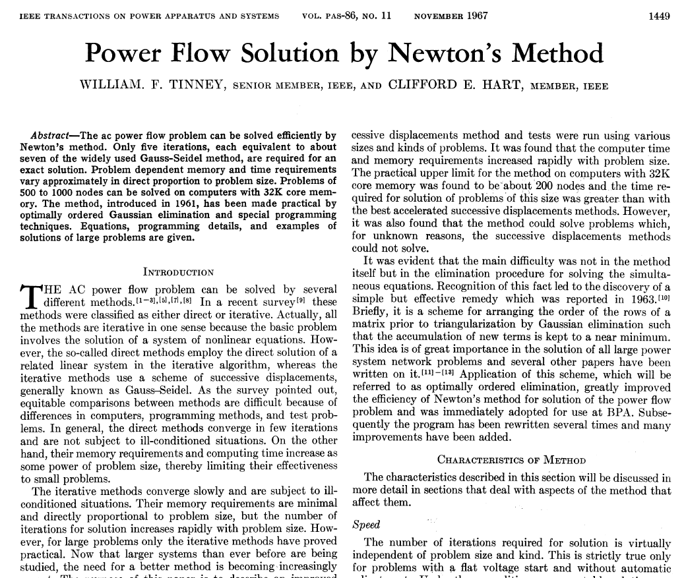
Discussion: Tinney-Hart Paper
What do you find in here that we have talked about still applying today?
What is somewhat out of date now?
What is the response of the discussants?

Slide 3
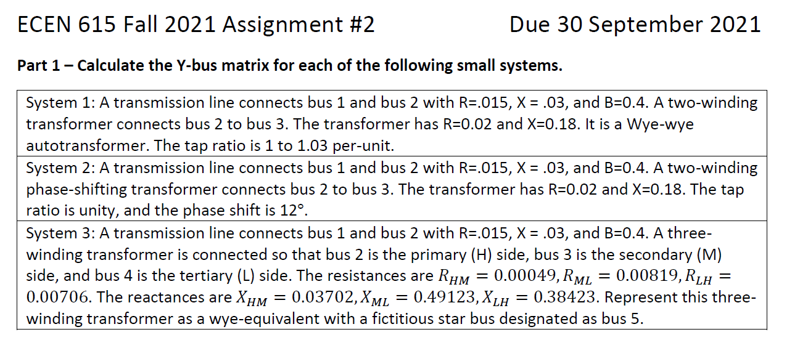
Exercise: Assignment 2 Part 1
Due 27 September 2023

Slide 4
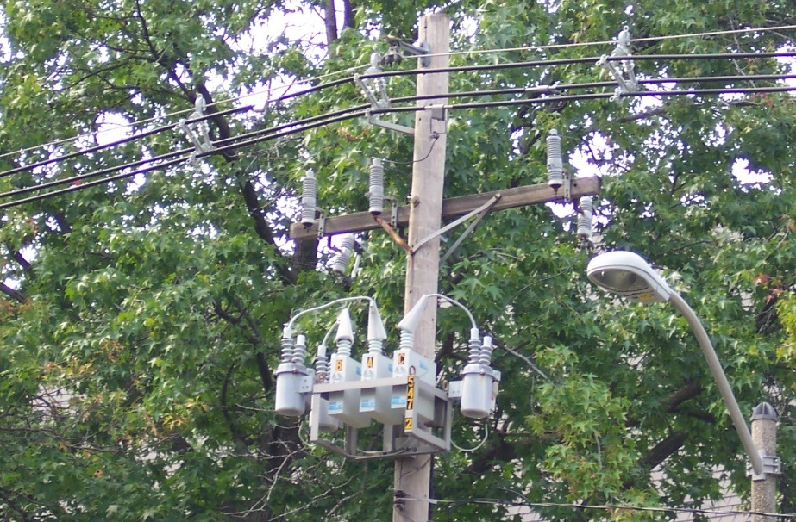
Switched Shunts and SVCs
Switched capacitors and
sometimes reactors are
widely used at both the
transmission and
distribution levels to
supply or (for reactors)
absorb discrete amounts of
reactive power
Static var compensators (SVCs) are also used to supply continuously varying amounts of reactive power
In the power flow SVCs are sometimes represented as PV buses with zero real power

Slide 5
Switched Shunt System Design
Because switched shunts tend to have a local impact, there needs to be a coordinated design in their implementation at the transmission level
  Shunt capacitors used to raise the voltage, shunt reactors used to lower the voltage; used with LTCs and gens
Often in the transmission system they are switched manually by a system operator
The size and number of banks depends
  Change in the system voltages caused by bank switching
  The availability of different sizes
  Cost for the associated switchgear and protection system

Slide 6
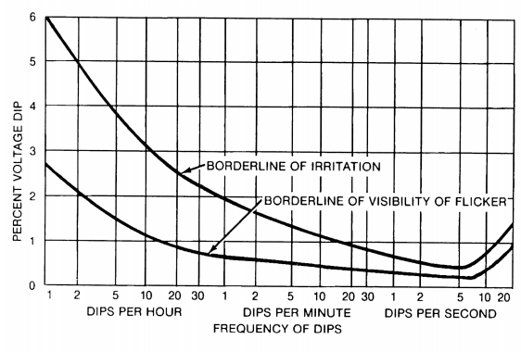
Switched Shunt Sizing
A goal with switched shunt sizing is to avoid human irritation caused by excessive changes in lighting
IEEE Std 1453-2015 gives guidance on the percentage of voltage changes as a
function of time; Table 3
of the standard suggests
keeping the voltage
changes below about 3%
We determine analytic
methods to calculate this
percentage later in the semester
Image from IEEE Std. 1453-2015, “IEEE Recommended Practice for Measurement and Limits of Voltage Fluctuations
and Associated Light Flicker on AC Power Systems”

Slide 7
Dynamic Reactive Capability
Switched shunts are often used to maintain adequate dynamic reactive power from generators and SVCs
FERC Order 827 (from June 2016, titled “Reactive Power Requirements for Non-Synchronous Generation”) states that the power factor of generators should be between 0.95 leading to 0.95 lagging
  Hence the absolute value of the Mvar output of the machines should be no more than 31% of the MW output
  Often a value substantially better for reactive reserves
Switched shunts are used to keep the generator power factor within this range

Slide 8
Switched Shunt Control
The status of switched shunts can be handled in an outer loop algorithm, similar to what is done for LTCs and phase shifters
  Because they are discrete they need to regulate a value to a voltage range
Switches shunts often have multiple levels that need to be simulated
Switched shunt control also interacts with the LTC and PV control
The power flow modeling needs to take into account the control time delays associated with the various devices

Slide 9
Generator Control

Slide 10
Generator Volt/Reactive Control
Simplest situation is a single generator at a bus regulating its own terminal
  Either PV, modeled as a voltage magnitude constraint, or as a PQ with reactive power fixed at a limit value. If PQ the reactive power limits can vary with the generator MW output
Next simplest is multiple generators at a bus. Obviously they need to be regulating the bus to the same voltage magnitude
  From a power flow solution perspective, it is similar to a single generator, with limits being the total of the individual units
  Options for allocation of vars among generators; this can affect the transient stability results

Slide 11
Generator Remote Bus Voltage Control
Next complication is generators at a single bus regulating a remote bus; usually this is the high side of their generator step-up (GSU) transformer
  When multiple generators regulate a single point their exciters need to have a dual input
  This can be implemented in the power flow for the generators at bus j regulating the voltage at bus k by changing the bus j voltage constraint equation to be
  (however, this does create a zero on the diagonal of the Jacobian)
  Helps with power system voltage stability

Slide 12
Generator Remote Bus Voltage Control
The next complication is to have the generators at multiple buses doing coordinated voltage control
  Controlled bus may or may not be one of the terminal buses
There must be an a priori decision about how much reactive power is supplied by each bus; example allocations are a fixed percentage or placing all generators at the same place in their regulation range
Implemented by designating one bus as the master; this bus models the voltage constraint
All other buses are treated as PQ, with the equation including a percent of the total reactive power output of all the controlling bus generators

Slide 13
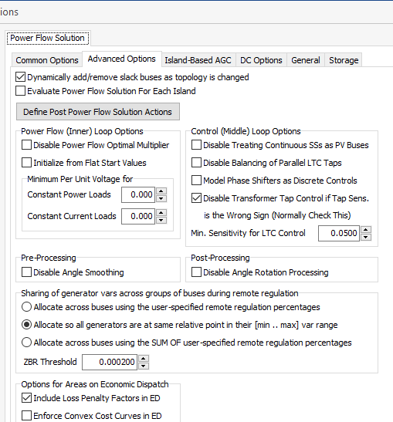
Reactive Power Sharing Options
Different software
packages use
different approaches
for allocating
the reactive power;
PowerWorld has
several options.

Slide 14
Generator Voltage Control
This example
uses the case
PSC_37Bus
with a voltage
contour. Try
varying the
voltage
setpoint for
the generator
at PEAR69

Slide 15
Reactive Power Sharing
In this example, case PSC_37Bus_Varsharing,
the two generators at
Elm345 are jointly controlling Elms138

Slide 16
Remote and Coordinated Var Control Example
Here the generators at Elm and the one at Birch are jointly controlling the voltage at the Lemon bus.
Case is PSC_37Bus_Varsharing_MultipleBuses

