Slide 1
ECEN 615, Fall 2023
Methods of Electric Power System Analysis
Class 5: Power Flow Complexities, Part 1
Prof. Adam Birchfield
Dept. of Electrical and Computer Engineering
Texas A&M University
abirchfield@tamu.edu

Slide 2
Reading for Next Class
Tinney/Hart Power Flow Analysis by Newton’s Method, Nov. 1967. Read this classic paper including the discussion.
    What do you find in here that we have talked about still applying today?
    What is somewhat out of date now?
    What is the response of the discussants?
T.J. Overbye, J.D. Weber, “Visualizing the Electric Grid,” IEEE Spectrum, Feb 2001. You don’t need to read the paper, just the inset on “History of Power Flow.”

Slide 3
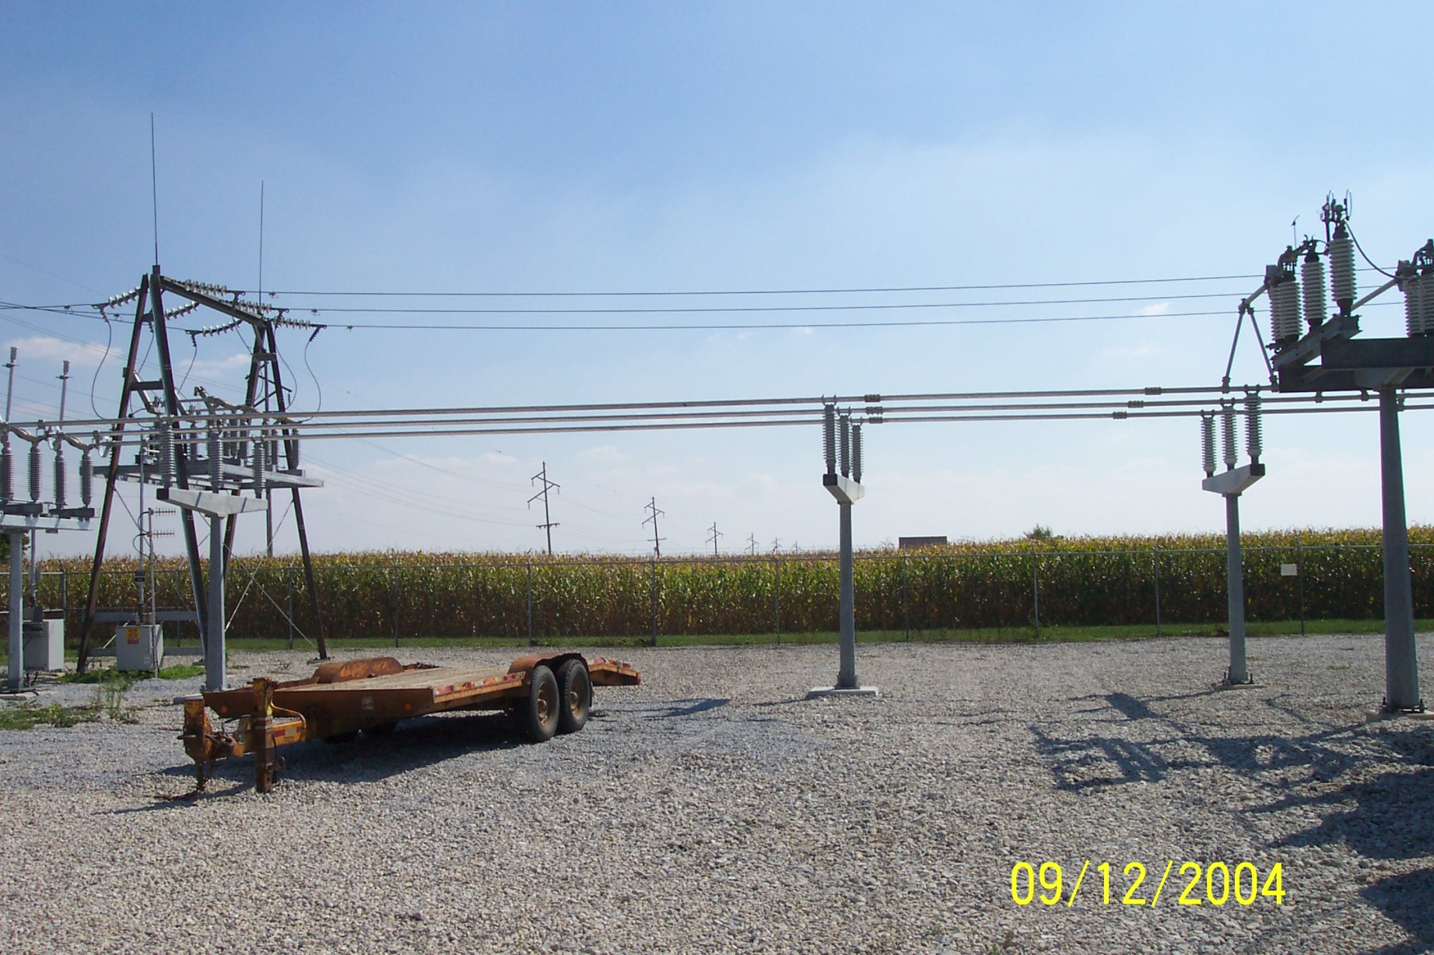
Power Flow Topology

Slide 4
Circuit Breakers and Disconnects
Circuit breakers are devices that are designed to clear fault current, which can be many times normal operating current
  AC circuit breakers take advantage of the current going through zero twice per cycle
  Transmission faults can usually be cleared in less than three cycles
Disconnects cannot clear fault current, and usually not normal current. They provide a visual indication the line is open. Can be manual or motorized.
In the power flow they have essentially no impedance; concept of a zero branch reactance (ZBR)

Slide 5
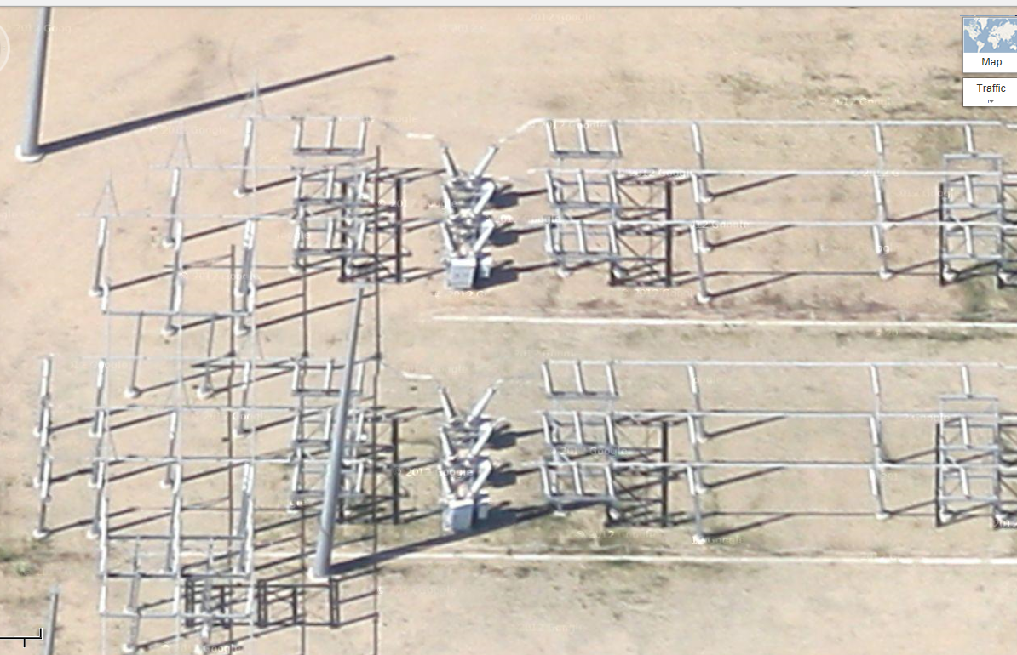
Google View of a 345 kV Substation

Slide 6
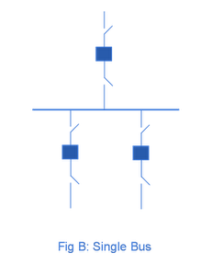
Substation Configurations
Several different substation breaker/disconnect configurations are common:
Single bus: simple but a fault
any where requires taking out the
entire substation; also doing breaker
or disconnect maintenance requires
taking out the associated line
Source: http://www.skm-eleksys.com/2011/09/substation-bus-schemes.html

Slide 7
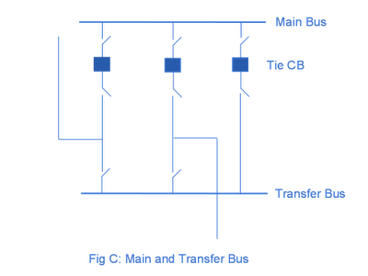
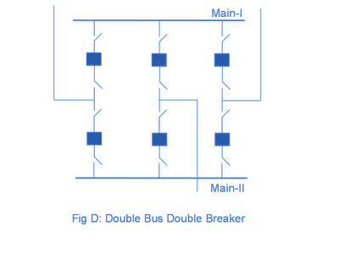
Substation Configurations, cont.
Main and Transfer Bus:
Now the breakers can be taken
out for maintenance without
taking out a line, but protection
is more difficult, and a fault
on one line will take out at least two
Double Bus Breaker:
Now each line is fully protected
when a breaker is out, so high
reliability, but more costly
Source: http://www.skm-eleksys.com/2011/09/substation-bus-schemes.html

Slide 8
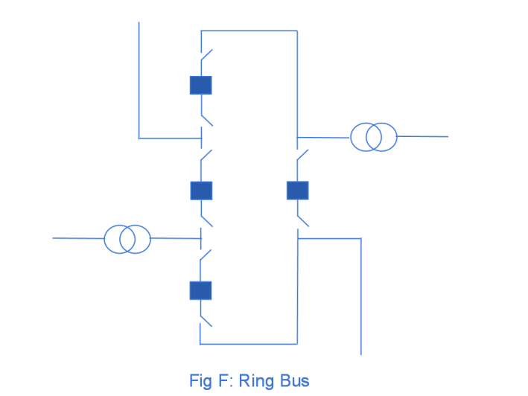
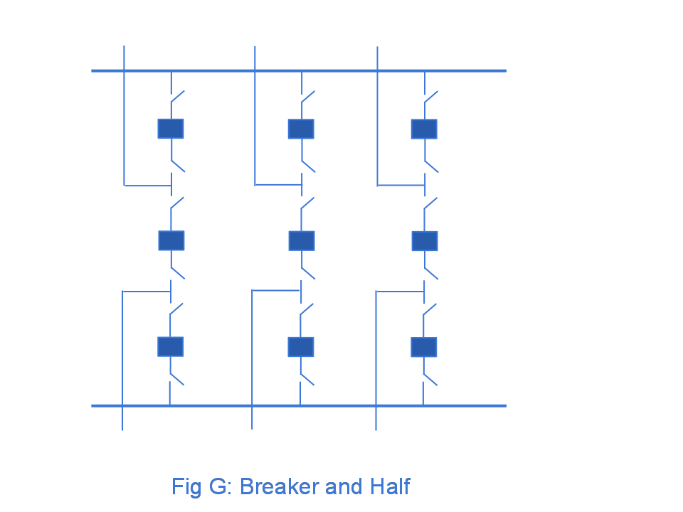
Ring Bus, Breaker and Half
As the name implies with a ring
bus the breakers form a ring;
number of breakers is same as
number of devices; any breaker can
be removed for maintenance
The breaker and half has two buses
and uses three breakers for two
devices; both breakers and buses
can be removed for maintenance
Source: http://www.skm-eleksys.com/2011/09/substation-bus-schemes.html

Slide 9
EMS and Planning Models
EMS Model
  Used for real-time operations
  Called full topology model
  Has node-breaker detail
Planning Model
  Used for off-line analysis
  Called consolidated model by PowerWorld
  Has bus/branch detail
-30 MW
-18 Mvar
-30 MW
-18 Mvar
50 MW
20 Mvar
10 MW
3 Mvar
10 MW
3 Mvar
-40 MW
-10 Mvar
10 MW
5 Mvar
-40 MW
-10 Mvar
10 MW
5 Mvar

Slide 10
Node-Breaker Consolidation
One approach to modeling systems with large numbers of ZBRs (zero branch reactances, such as from circuit breakers) is to just assume a small reactance and solve
  This results in lots of buses and branches, resulting in a much larger problem
  This can cause numerical problems in the solution
The alterative is to consolidate the nodes that are connected by ZBRs into a smaller number of buses
  After solution all nodes have the same voltage; use logic to determine the device flows

Slide 11
Bus Branch versus Node Breaker
Due to a variety of issues during the 1970’s and 1980’s the real-time operations and planning stages of power systems adopted different modeling approaches
Real-Time Operations
Use detailed node/breaker model
EMS system as a set of integrated applications and processes
Real-time operating system
Real-time databases
Planning
Use simplified bus/branch model
PC approach
Use of files
Stand-alone applications
  Entire data sets and software tools developed around these two distinct power system models

Slide 12
Power Flow Topology Processing
Commercial power flow software must have algorithms to determine the number of asynchronous, interconnected systems in the model
  These separate systems are known as Islands
  In large system models such as the Eastern Interconnect it is common to have multiple islands in the base case (one recent EI model had nine islands)
  Islands can also form unexpectedly as a result of contingencies
  Power can be transferred between islands using dc lines
  Each island must have a slack bus

Slide 13
Power Flow Topology Processing
Anytime a status change occurs the power flow must perform topology processing to determine whether there are either 1) new islands or 2) islands have merged
Determination is needed to determine whether the island is “viable.” That is, could it truly function as an independent system, or should the buses just be marked as dead
  A quite common occurrence is when a single load or generator is isolated; in the case of a load it can be immediately killed; generators are more tricky

Slide 14
Topology Processing Algorithm
Since topology processing is performed often, it must be quick (order n ln(n))!
Simple, yet quick topology processing algoritm
  Set all buses as being in their own island (equal to bus number)
  Set ChangeInIslandStatus true
  While ChangeInIslandStatus Do
    Go through all the in-service lines, setting the islands for each of the buses to be the smaller island number; if the island numbers are different set ChangeInIslandStatus true
  Determine which islands are viable, assigning a slack bus as necessary
This algorithm does depend on the depth of the system

Slide 15
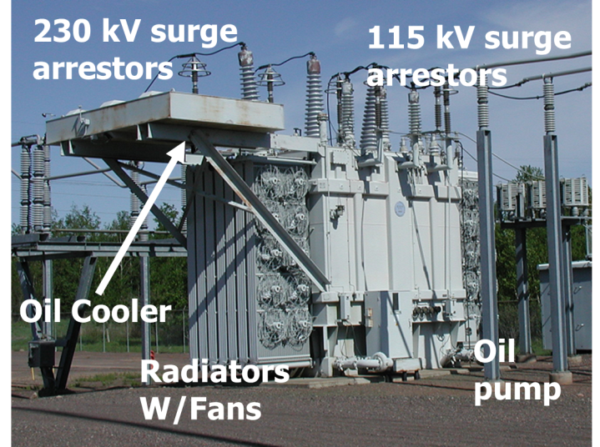
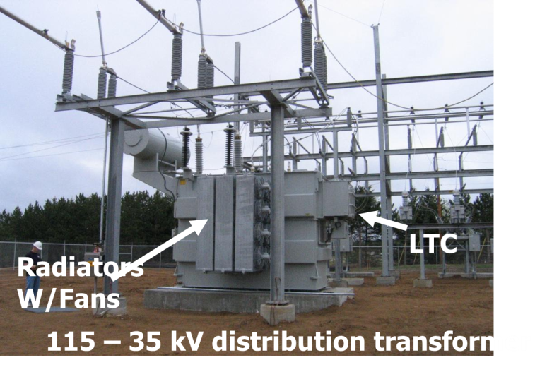
Transmission Level Transformers

Slide 16
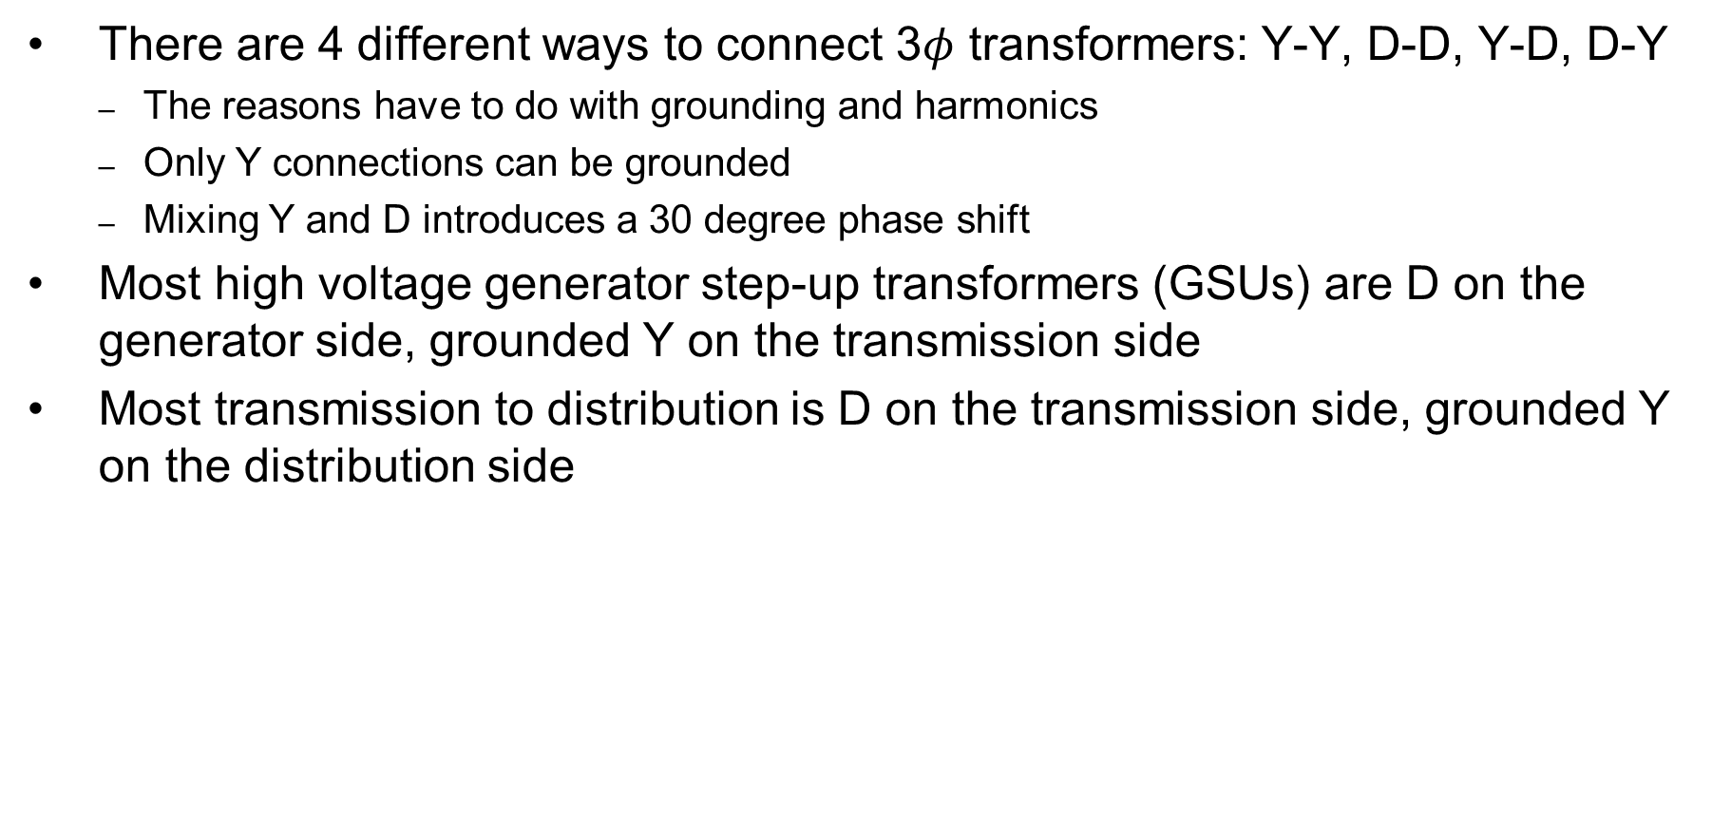
Three Phase Transformers
There are 4 different ways to connect 3$φ$ transformers: Y-Y, D-D, Y-D, D-Y
  The reasons have to do with grounding and harmonics
  Only Y connections can be grounded
  Mixing Y and D introduces a 30 degree phase shift
Most high voltage generator step-up transformers (GSUs) are D on the generator side, grounded Y on the transmission side
Most transmission to distribution is D on the transmission side, grounded Y on the distribution side

Slide 17
Autotransformers
Autotransformers are transformers in which the primary and secondary windings are coupled magnetically and electrically.
This results in lower cost, and smaller size and weight.
Most transmission level transformers are autotransformers, connected Y-Y with the low side grounded
The key disadvantage is loss of electrical isolation between the voltage levels; not used when a is large. For example in stepping down 7160/240 V we do not ever want 7160 on the low side!

Slide 18
Three-Winding Transformers
Three-winding transformers are very common, with the third winding called the tertiary
  The tertiary is often a delta winding
Three-winding transformers have various benefits
  Providing station service
  Place for a capacitor connection
  Reduces third-harmonics
  Allows for three different transmission level voltages
  Better handling of fault current

Slide 19
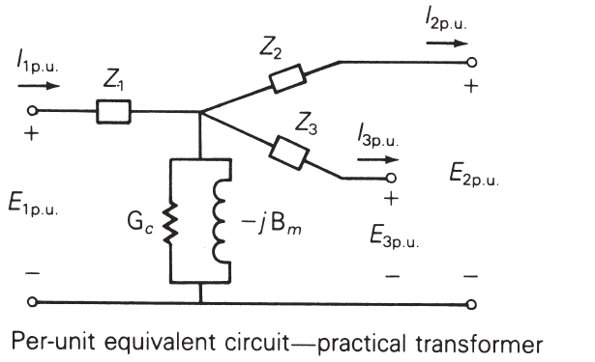
Three-Winding Transformers
Usually modeled in the power flow with a star equivalent; the internal “star” bus does not really exist
Star bus is often given a voltage of 1.0 or 999 kV
Impedances calculated using the wye-delta transform can result in negative resistance (about 900 out of 97,000 in EI model)
The winding impedances are measured between the windings with one winding shorted and the other open; for example Z₁₂ is measured from 1 with winding 2 shorted, 3 open
Image from Power System Analysis and Design, by Glover, Overbye, and Sarma 6th Edition

Slide 20
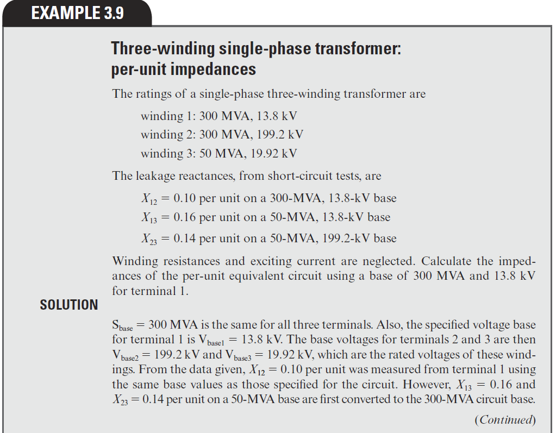
Three-Winding Transformer Example
Z₁₂ = Z₁ + Z₂
Z₁₃ = Z₁ + Z₃
Z₂₃ = Z₂ + Z₃
Hence
Z₁=0.5(Z₁₂+Z₁₃-Z₂₃)
Z₂=0.5(Z₁₂+Z₂₃-Z₁₃)
Z₃=0.5(Z₁₃+Z₂₃-Z₁₂)
Image from Power System Analysis and Design, by Glover, Overbye, and Sarma 6th Edition

Slide 21
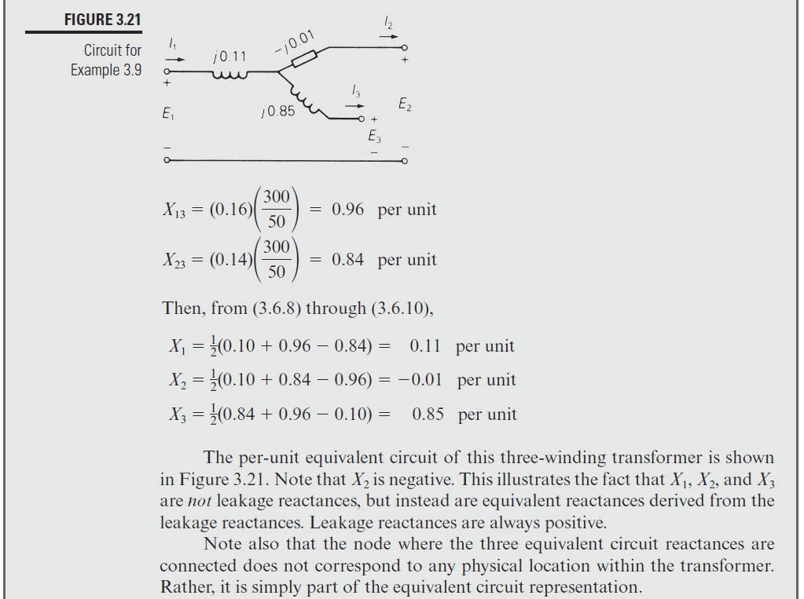
Three-Winding Transformer Example, cont.
Image from Power System Analysis and Design, by Glover, Overbye, and Sarma 6th Edition

Slide 22
Modeling Transformers with Off-Nominal Taps and Phase Shifts
If transformers have a turns ratio that matches the ratio of the per unit voltages than transformers are modeled in a manner similar to transmission lines.
However it is common for transformers to have a variable tap ratio; this is known as an “off-nominal” tap ratio
  The off-nominal tap is t, initially we’ll consider it a real number
  We’ll cover phase shifters shortly in which t is complex

Slide 23
Transformer Representation
The one–line diagram of a branch with a variable tap transformer
The network representation of a branch with off–nominal turns ratio transformer is
k
m
t :1
k
the tap is on
the side of bus k

Slide 25
Transformer Nodal Equations
From the network representation
Also

Slide 26
Transformer Nodal Equations
We may rewrite these two equations as
Y_{bus} is still symmetric
here (though this will
change with phase
shifters)
This approach was first presented in F.L. Alvarado, “Formation of Y-Node using the Primitive Y-Node Concept,” IEEE Trans. Power App. and Syst., December 1982

Slide 27
The pi-Equivalent Circuit for a Transformer Branch
k
m

Slide 28
Variable Tap Voltage Control
A transformer with a variable tap, i.e., the variable t is not constant, may be used to control the voltage at either the bus on the side of the tap or at the bus on the side away from the tap
This constitutes an example of single criterion control since we adjust a single control variable (i.e., the transformer tap t) to achieve a specified criterion: the maintenance of a constant voltage at a designated bus
Names for this type of control are on-load tap changer (LTC) transformer or tap changing under load (TCUL)
Usually on low side; there may also be taps on high side that can be adjusted when it is de-energized

Slide 29
Variable Tap Voltage Control
An LTC is a discrete control, often with 32 incremental steps of 0.625% each, giving an automatic range of ± 10%
It follows from the π – equivalent model for the transformer that the transfer admittance between the buses of the transformer branch and the contribution to the self admittance at the bus away from the tap explicitly depend on t
However, the tap changes in discrete steps; there is also a built in time delay in how fast they respond
Voltage regulators are devices with a unity nominal ratio, and then a similar tap range

Slide 30
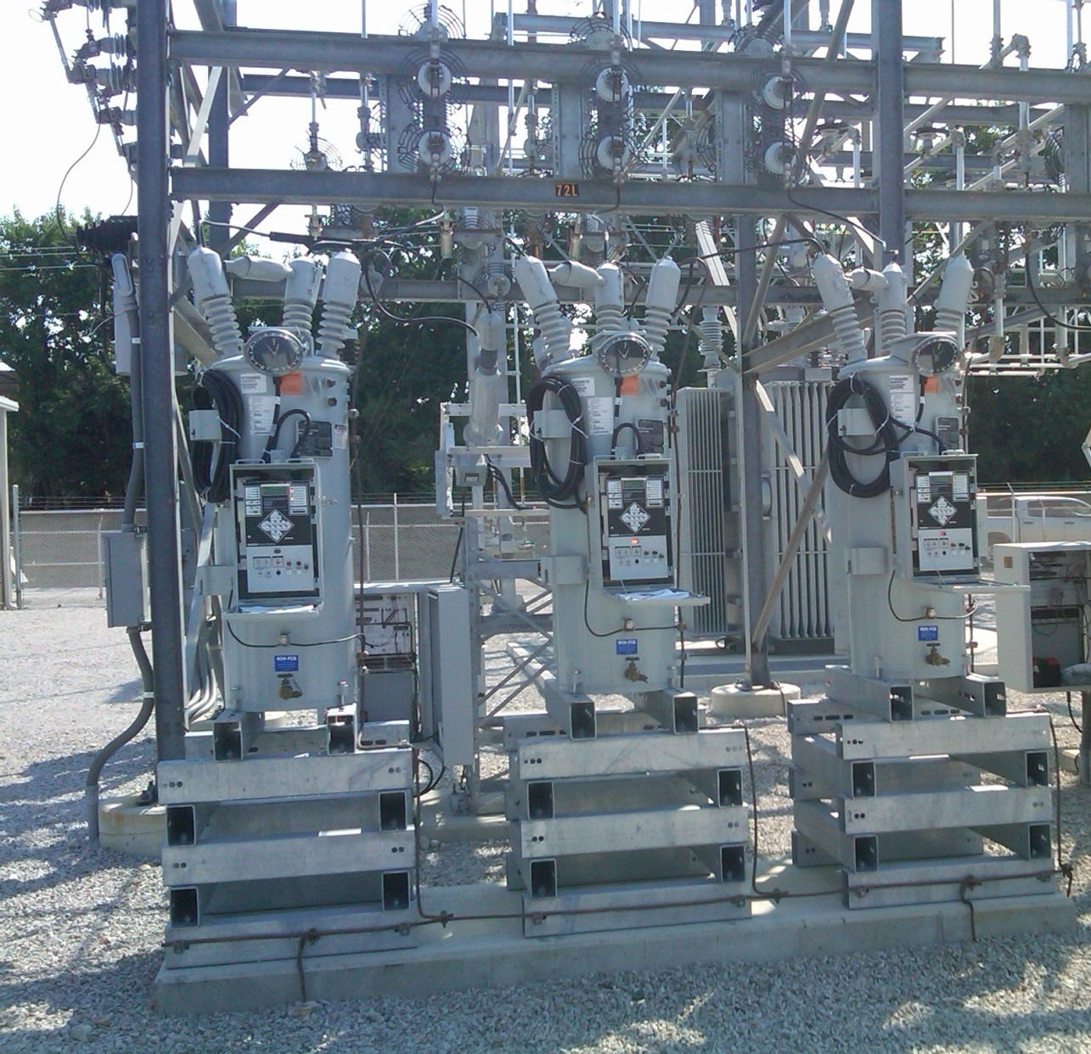
Ameren Champaign (IL) Test Facility Voltage Regulators
These are connected
on the low side of a
69/12.4 kV
transformer; each
phase can be
regulated separately

Slide 31
Variable Tap Voltage Control in the Power Flow
LTCs (or voltage regulators) can be directly included
in the power flow equations by modifying the
Ybus entries; that is by scaling the terms by 1, 1/t or 1/t2 as appropriate
If t is fixed then there is no change in the number of equations
If t is variable, such as to enforce a voltage equality, then it can be included either by adding an additional equation and variable (t) directly, or by doing an “outer loop” calculation in which t is varied outside of the NR solution
  The outer loop is used in PowerWorld because of limit issues

Slide 32
Circulating Reactive Power
Unbalanced transformer taps can cause large amounts of reactive power to circulating, increasing power system losses and overloading transformers
PowerWorld Case:
Bus3CirculatingVars

Slide 33
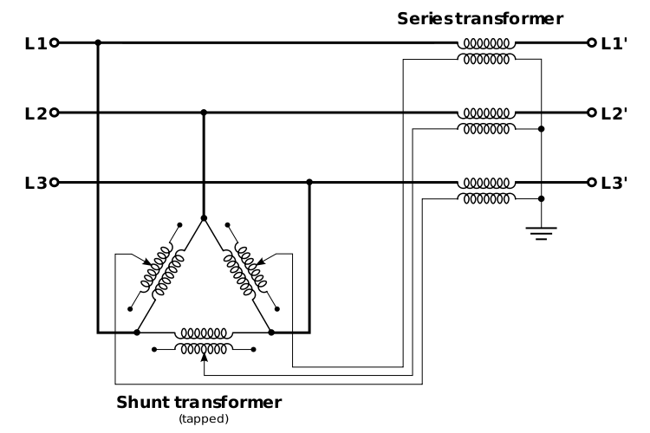
Phase-Shifting Transformers
Phase shifters are transformers in which the phase angle across the transformer can be varied in order to
control real power flow
  Sometimes they are called phase angle regulars (PAR)
  Quadrature booster (evidently British though I’ve never heard this term)
They are constructed
by include a delta-
connected winding
that introduces a 90º
phase shift that is added
to the output voltage
Image: http://en.wikipedia.org/wiki/Quadrature_booster

Slide 34
Phase-Shifter Model
We develop the mathematical model of a phase shifting transformer as a first step toward our study of its simulation
Let buses k and m be the terminals of the phase–shifting transformer, then define the phase shift angle as Φ_{km}
The latter differs from an off–nominal turns ratio LTC transformer in that its tap ratio is a complex quantity, i.e., a complex number, t_{km}∠Φ_{km}
The phase shift angle is a discrete value, with one degree a typical increment

Slide 35
Phase-Shifter Model
For a phase shifter located on the branch (k, m), the admittance matrix representation is obtained analogously to that for the LTC
Note, if there is a phase shift then Ybus is no longer
symmetric!! In a large case there are almost always some phase shifters. Y-D transformers also introduce a phase shift that is often not modeled

Slide 36
Integrated Phase-Shifter Control
Phase shifters are usually used to control the real power flow on a device
Similar to LTCs, phase-shifter control can either be directly integrated into the power flow equations (adding an equation for the real power flow equality constraint, and a variable for the phase shifter value), or they can be handled in with an outer loop approach
As was the case with LTCs, limit enforcement often makes the outer loop approach preferred
Coordinated control is needed when there are multiple, close by phase shifters

Slide 37
Large Case Phase Shifter Limits and Step Size

Slide 38
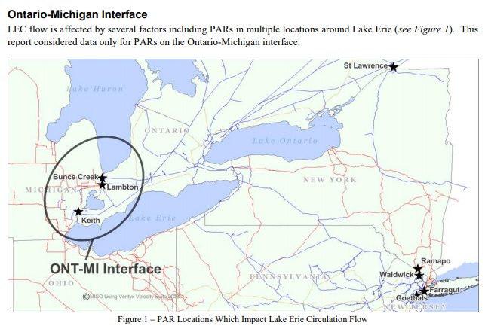
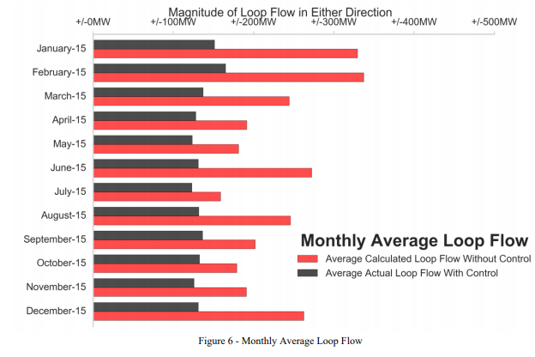
Example of Phase Shifters in Practice
https://www.nyiso.com/public/webdocs/markets_operations/committees/bic_miwg/meeting_materials/2017-02-28/2016%20Ontario-Michigan%20Interface%20PAR%20Evaluation%20Final%20Report.pdf

Slide 39
Impedance Correction Tables
With taps the impedance of the transformer changes; sometimes the changes are relatively minor and sometimes they are dramatic
  A unity turns ratio phase shifter is a good example with essentially no impedance when the phase shift is zero
  Often modeled with piecewise linear function with impedance correction varying with tap ratio or phase shift
  Next lines give several examples, with format being (phase shift or tap ratio, impedance correction)
    (-60,1), (0,0.01), (60,1)
    (-25,2.43),(0,1),(25,2.43)
    (0.941,0.5), (1.04,1), (1.15,2.45)
    (0.937,1.64), (1,1), (1.1, 1.427)

