Slide 1
ECEN 615, Fall 2023 Methods of Electric Power System Analysis
Class 4: Power Flow
Prof. Adam Birchfield
Dept. of Electrical and Computer Engineering
Texas A&M University
abirchfield@tamu.edu

Slide 2
Solution to Practice Problem 1
Real power = $RI^{2}=\left(8\right){\left(10\right)}^{2}=800 W.$ Reactive power = $XI^{2}=ωLI^{2}=377∗0.004∗{10}^{2}=150.8 var$.
${\overline{V}}_{an}=\frac{500}{\sqrt{3}}∠\left(45−30°\right)=288.6∠15°$kV. As a cosine function, this is 408.1 cos(377t + 15$°$) kV
$φ=\cos^{−1}{0.8=36.87°}$ $Q=\frac{200 kW}{0.8}\sin\left(36.87°\right)=150 kVar$.

Slide 3
Solution to Practice Problem 2
a.
b.
c. Vgen = 0.978∠0, Ztx1 = j0.0526, Zline = 0.0158 + j0.0420, Yline = j0.0381, Ztx2 = j0.0525, Sload = 0.18 +j0.04
d.
Base | Left | Middle | Right
S | 100 MVA | 100 MVA | 100 MVA
V | 13.8 kV | 138 kV | 69 kV
I | 4183 A | 418 A | 837 A
Z | 1.90 $Ω$ | 190.44 $Ω$ | 47.61 $Ω$
-j19.01 | j19.01 | 0 | 0
j19.01 | 7.846-j39.848 | -7.846+j20.857 | 0
0 | -7.846+j20.857 | 7.845-j39.888 | j19.05
0 | 0 | j19.05 | -j19.05

Slide 4
Power Flow Bus Types
Each bus has one of three basic types, and for each one there are two known variables and two unknown variables:
Load (PQ) bus
Assume P/Q are fixed at most buses in the system
Known:$P$ and $Q$, Unknown: $V$ and $θ$
Slack bus
Only one in the whole system
Usually assigned to a large generator bus
Known: $V$ and $θ$, Unknown: $P$ and $Q$
Provides angle reference ($θ=0$) and picks up the slack P
Generator (PV) bus
Other generators (5-10% of buses in a large system)
Assume generator is controlling power output and voltage
Known: $V$ and $P$, Unknown: $θ$ and $Q$

Slide 5
Newton-Raphson Power Flow Procedure
Build the Y-bus matrix
Write the list of variables and power balance equations
Make the power flow Jacobian
Make an initial guess of $x$
While $\left\|f\left(x^{\left(ν\right)}\right)\right\|>ε$
$x^{(v+1)} = x^{(v)}−J(x^{\left(v\right)})^{−1}f(x^{\left(v\right)})$
$v = v+1$
$$P_{i} = \sum_{k=1}^{n}{\left|V_{i}\right|\left|V_{k}\right|}(g_{ik}\cos{θ_{ik}}+b_{ik}\sin{θ_{ik}})=P_{Gi}−P_{Di} \\ Q_{i} = \sum_{k=1}^{n}{\left|V_{i}\right|\left|V_{k}\right|}(g_{ik}\sin{θ_{ik}}−b_{ik}\cos{θ_{ik}})=Q_{Gi}−Q_{Di}$$

Slide 6
Solution to Practice Problem 3
$Y_{bus}=\left[\begin{matrix}−j16 & j16 \\ j16 & −j16\end{matrix}\right]$
$P_{2}=\left(1.06\right)V_{2}\left(16\right)\sin{θ_{2}}+4.0$
$Q_{2}=\left(1.06\right)V_{2}\left(−16\right)\cos{θ_{2}}+16V_{2}^{2}+2.6$
$J=\left[\begin{matrix}\left(1.06\right)V_{2}\left(16\right)\cos{θ_{2}} & \left(1.06\right)\left(16\right)\sin{θ_{2}} \\ \left(1.06\right)V_{2}\left(−16\right)\left(−\sin{θ_{2}}\right) & \left(1.06\right)\left(−16\right)\left(\cos{θ_{2}}\right)+\left(2\right)\left(16\right)V_{2}\end{matrix}\right]$
$$x^{\left(0\right)}=\left[\begin{matrix}0 \\ 1\end{matrix}\right];f\left(x^{\left(0\right)}\right)=\left[\begin{matrix}4 \\ 1.640\end{matrix}\right]$$ $J\left(x^{\left(0\right)}\right)=\left[\begin{matrix}16.96 & 0 \\ 0 & 15.04\end{matrix}\right]; J{\left(x^{\left(0\right)}\right)}^{−1}=\left[\begin{matrix}0.05896 & 0 \\ 0 & 0.06659\end{matrix}\right]$
$x^{\left(1\right)}=x^{\left(0\right)}−J{\left(x^{\left(0\right)}\right)}^{−1}f\left(x^{\left(0\right)}\right)=\left[\begin{matrix}0 \\ 1\end{matrix}\right]−\left[\begin{matrix}0.05896 & 0 \\ 0 & 0.06659\end{matrix}\right]\left[\begin{matrix}4 \\ 1.640\end{matrix}\right]=\left[\begin{matrix}−0.2358 \\ 0.8901\end{matrix}\right]$
$f\left(x^{\left(1\right)}\right)=\left[\begin{matrix}0.4691 \\ 0.6086\end{matrix}\right];J\left(x^{\left(1\right)}\right)=\left[\begin{matrix}14.69 & −3.96 \\ −3.53 & 12.02\end{matrix}\right];x^{\left(2\right)}=\left[\begin{matrix}−0.2854 \\ 0.8258\end{matrix}\right];f\left(x^{\left(2\right)}\right)=\left[\begin{matrix}0.0575 \\ 0.0718\end{matrix}\right]$

Slide 7
More Practice Problems
Textbook “Power System Analysis and Design” by Glover/Overbye/Sarma
ECEN 460 Quizzes/Exams/Homework
https://birchfield.engr.tamu.edu/460s23/

Slide 8
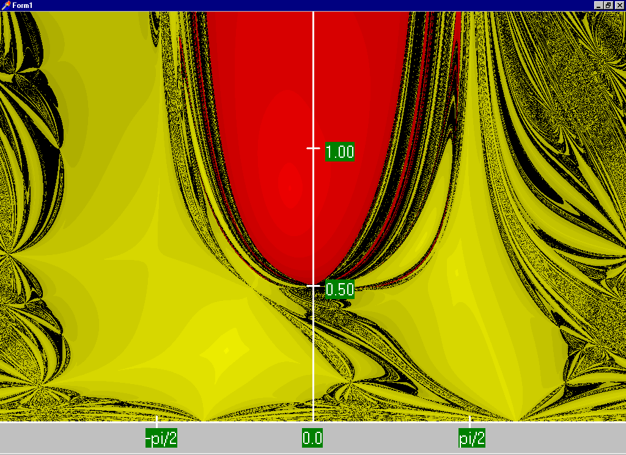
Fractals!
C.L DeMarco and T.J. Overbye, “Low Voltage Power Flow Solutions and Their Role in Exit Time Bases Security Measures for Voltage Collapse,” Proc. 27th IEEE CDC, December 1988
J.S. Thorp, S.A. Naqavi, “Load-Flow Fractals Draw Clues to Erratic Behavior,” IEEE Computer Applications in Power, January 1997
Red region converges to the high voltage solution, while the yellow region converges to the low voltage solution

Slide 9
The N-R Power Flow: 5-bus Example
T2
800 MVA
345/15 kV
1
T1
5
4
3
520 MVA
Line 3 345 kV
50 mi
400 MVA
15 kV
800 MVA
15 kV
400 MVA
15/345 kV
345 kV 100 mi
345 kV 200 mi
40 Mvar
80 MW
Line 2
Line 1
2
280 Mvar
800 MW
Single-line diagram

Slide 10
The N-R Power Flow: 5-bus Example
Bus | Type | V per unit | δ degrees | P_{G} per unit | Q_{G} per unit | P_{L} per unit | Q_{L} per unit | Q_{Gmax} per unit | Q_{Gmin} per unit
1 | Swing | 1.0 | 0 | ⎯ | ⎯ | 0 | 0 | ⎯ | ⎯
2 | Load | ⎯ | ⎯ | 0 | 0 | 8.0 | 2.8 | ⎯ | ⎯
3 | Constant voltage | 1.05 | ⎯ | 5.2 | ⎯ | 0.8 | 0.4 | 4.0 | -2.8
4 | Load | ⎯ | ⎯ | 0 | 0 | 0 | 0 | ⎯ | ⎯
5 | Load | ⎯ | ⎯ | 0 | 0 | 0 | 0 | ⎯ | ⎯
Table 1.
Bus input
data
Bus-to-Bus | R’ per unit | X’ per unit | G’ per unit | B’ per unit | Maximum MVA per unit
2-4 | 0.0090 | 0.100 | 0 | 1.72 | 12.0
2-5 | 0.0045 | 0.050 | 0 | 0.88 | 12.0
4-5 | 0.00225 | 0.025 | 0 | 0.44 | 12.0
Table 2.
Line input data
Notes:
10

Slide 11
The N-R Power Flow: 5-bus Example
Bus-to-Bus | R per unit | X per unit | G_{c} per unit | B_{m} per unit | Maximum MVA per unit | Maximum TAP Setting per unit
1-5 | 0.00150 | 0.02 | 0 | 0 | 6.0 | —
3-4 | 0.00075 | 0.01 | 0 | 0 | 10.0 | —
Table 3.
Transformer
input data
Bus | Input Data | Unknowns
1 | V₁ = 1.0, δ₁ = 0 | P₁, Q₁
2 | P₂ = P_{G2}-P_{L2} = -8 Q₂ = Q_{G2}-Q_{L2} = -2.8 | V₂, δ₂
3 | V₃ = 1.05 P₃ = P_{G3}-P_{L3} = 4.4 | Q₃, δ₃
4 | P₄ = 0, Q₄ = 0 | V₄, δ₄
5 | P₅ = 0, Q₅ = 0 | V₅, δ₅
Table 4. Input data
and unknowns
Notes:
11

Slide 12
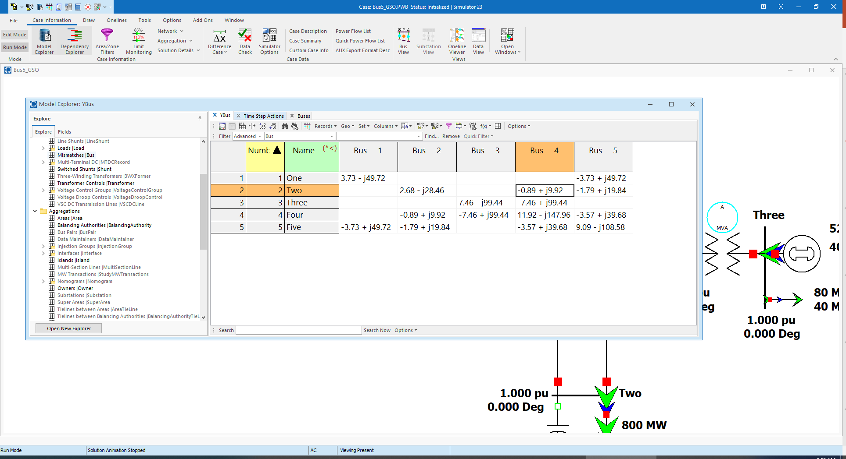
Time to Close the Hood: Let the Computer Do the Math! (Ybus Shown)
Notes:
12

Slide 13
Ybus Details
Elements of Ybus connected to bus 2
$$Y_{21}=Y_{23}=0$$
$$Y_{24}=\frac{−1}{R_{24}^{′}+jX_{24}^{′}}=\frac{−1}{0.009+j0.1}=−0.89276+j9.91964 per unit$$
$$Y_{25}=\frac{−1}{R_{25}^{′}+jX_{25}^{′}}=\frac{−1}{0.0045+j0.05}=−1.78552+j19.83932 per unit$$
$$Y_{22}=\frac{1}{R_{24}^{′}+jX_{24}^{′}}+\frac{1}{R_{25}^{′}+jX_{25}^{′}}+j\frac{B_{24}^{′}}{2}+j\frac{B_{25}^{′}}{2}$$
$$=(0.89276−j9.91964)+(1.78552−j19.83932)+j\frac{1.72}{2}+j\frac{0.88}{2}$$
$$=2.67828−j28.4590=28.5847∠−84.624° per unit$$
Notes:
13

Slide 14
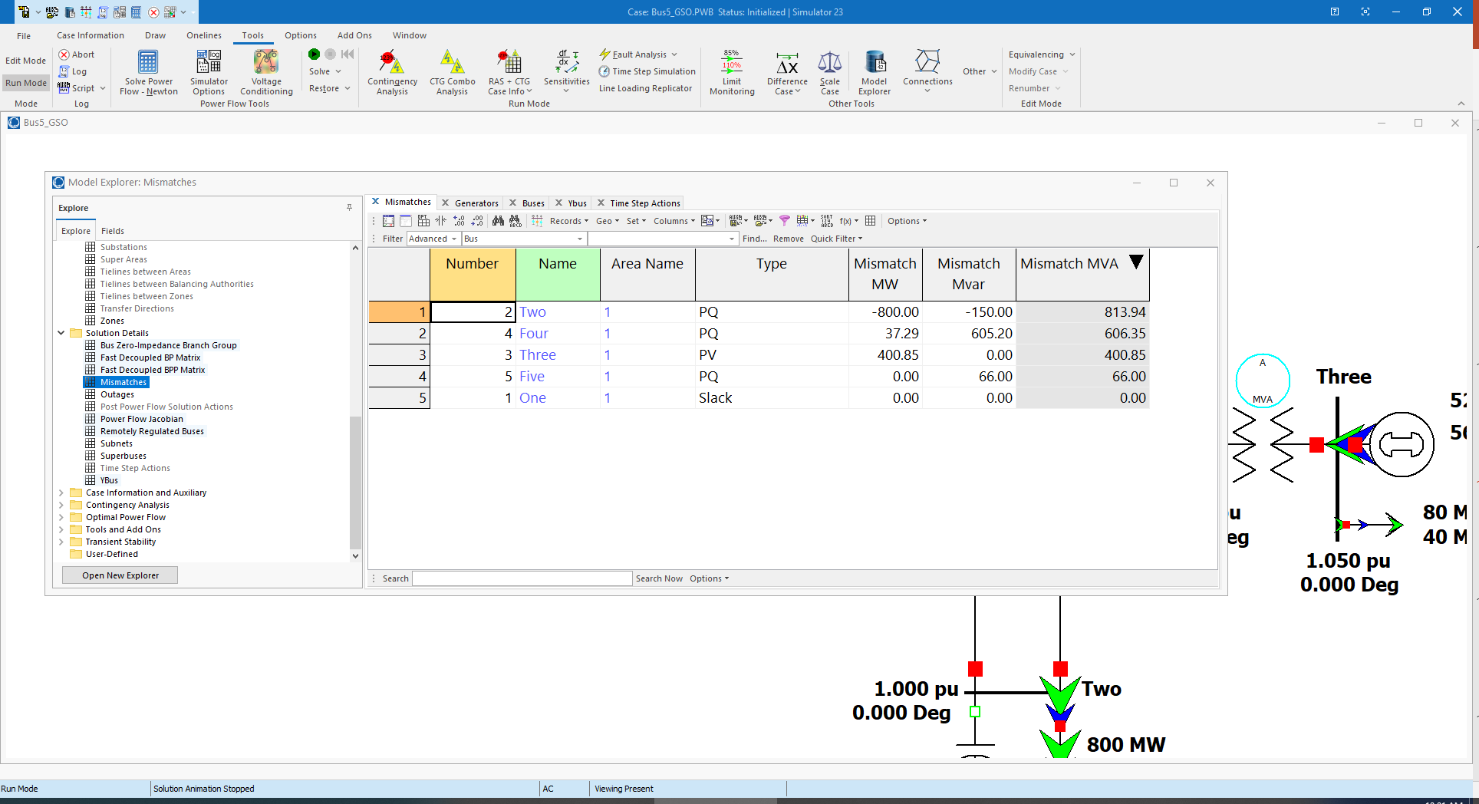
Here Are the Initial Bus Mismatches
Notes:
14

Slide 15
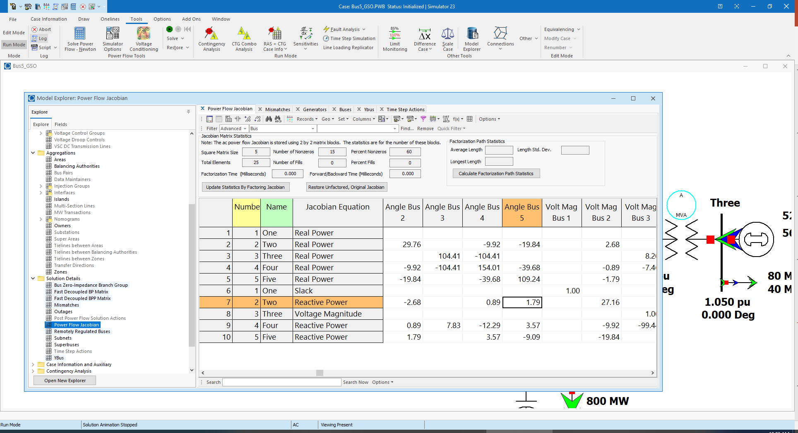
And the Initial Power Flow Jacobian
Notes:
15

Slide 16
And the Hand Calculation Details!
$$ΔP_{2}(0)=P_{2}−P_{2}(x)=P_{2}−V_{2}(0)\{Y_{21}V_{1}\cos{[}δ_{2}(0)−δ_{1}(0)−θ_{21}]$$
$$+Y_{22}V_{2}\cos{[}−θ_{22}]+Y_{23}V_{3}\cos{[}δ_{2}(0)−δ_{3}(0)−θ_{23}]$$
$$+Y_{24}V_{4}\cos{[}δ_{2}(0)−δ_{4}(0)−θ_{24}]$$
$$+Y_{25}V_{5}\cos{[}δ_{2}(0)−δ_{5}(0)−θ_{25}]\}$$
$$=−8.0−1.0\{28.5847(1.0)\cos{(}84.624°)$$
$$+9.95972(1.0)\cos{(}−95.143°)$$
$$+19.9159(1.0)\cos{(}−95.143°)\}$$
$$=−8.0−(−2.89×10^{−4})=−7.99972 per unit$$
$$J1_{24}(0)=V_{2}(0)Y_{24}V_{4}(0)\sin{[}δ_{2}(0)−δ_{4}(0)−θ_{24}]$$
$$=(1.0)(9.95972)(1.0)\sin{[}−95.143°]$$
$$=−9.91964 per unit$$
Notes:
16

Slide 17
Five Bus Power System Solved
Notes:
17

Slide 18
Generator Reactive Power Limits
The reactive power output of generators varies to maintain the terminal voltage; on a real generator this is done by the exciter
To maintain higher voltages requires more reactive power
Generators have reactive power limits, which are dependent upon the generator's MW output
These limits must be considered during the power flow solution
During power flow, once a solution is obtained, check to make generator reactive power output is within its limits
If the reactive power is outside of the limits, fix Q at the max or min value, and resolve treating the generator as a PQ bus
this is know as "type-switching"
also need to check if a PQ generator can again regulate
Rule of thumb: to raise system voltage we need to supply more vars

Slide 19
Modeling Voltage Dependent Load
So far we′ve assumed that the load is independent of the bus voltage (i.e., constant power). However, the power flow can be easily extended to include voltage dependence with both the real and reactive load. This is done by making $P_{Di}$ and $Q_{Di}$ a function of $\left|V_{i}\right|$ $\sum_{k=1}^{n}{\left|V_{i}\right|\left|V_{k}\right|}(G_{ik}{cosθ}_{ik}{+}B_{ik}{sinθ}_{ik}{)}−P_{Gi}+P_{Di}(\left|V_{i}\right|)=0$ $\sum_{k=1}^{n}{\left|V_{i}\right|\left|V_{k}\right|}(G_{ik}{sinθ}_{ik}{−}B_{ik}{cosθ}_{ik}{)}−Q_{Gi}+Q_{Di}(\left|V_{i}\right|)=0$

Slide 20
Voltage Dependent Load Example
In previous two bus example now assume the load is constant impedance, so $P_{2}(x) = \left|V_{2}\right|(10{sinθ}_{2}{)}+2.0{\left|V_{2}\right|}^{2} = 0$ $Q_{2}(x) = \left|V_{2}\right|(−10{cosθ}_{2}{)}+{\left|V_{2}\right|}^{2}(10)+1.0{\left|V_{2}\right|}^{2}=0$
Now calculate the power flow Jacobian $J(x) = \left[\begin{matrix}10\left|V_{2}\right|{cosθ}_{2} & 10{sinθ}_{2}{+}4.0\left|V_{2}\right| \\ 10\left|V_{2}\right|{sinθ}_{2} & −10{cosθ}_{2}{+}20\left|V_{2}\right|+2.0\left|V_{2}\right|\end{matrix}\right]$

Slide 21
Assignment 1
On the website
Due 9/13/23 at 4pm
You are encouraged to add additional features and experiment
We will discuss your results in class on Sept. 13

