Slide 1
ECEN 615, Fall 2023 Methods of Electric Power System Analysis
Class 3: Power Calculations Review
Prof. Adam Birchfield
Dept. of Electrical and Computer Engineering
Texas A&M University
abirchfield@tamu.edu

Slide 2
Announcements
Get PowerWorld installed
Watch the videos on the website if you need more background review
RSVP to the EPG dinner if you’d like to join
Distance students, send your paragraphs for class discussion to me by email by 5pm Mondays for the prior week. If you haven’t sent last weeks, go ahead and send it by tomorrow.

Slide 3
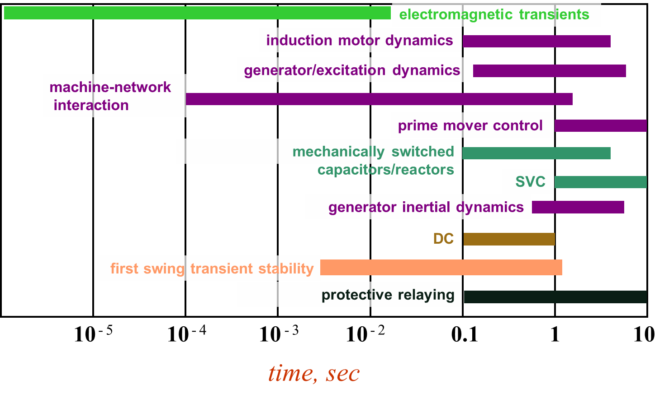
Power Systems Operate on Many Time Scales
Slide source: Prof. George Gross UIUC ECE 530

Slide 4
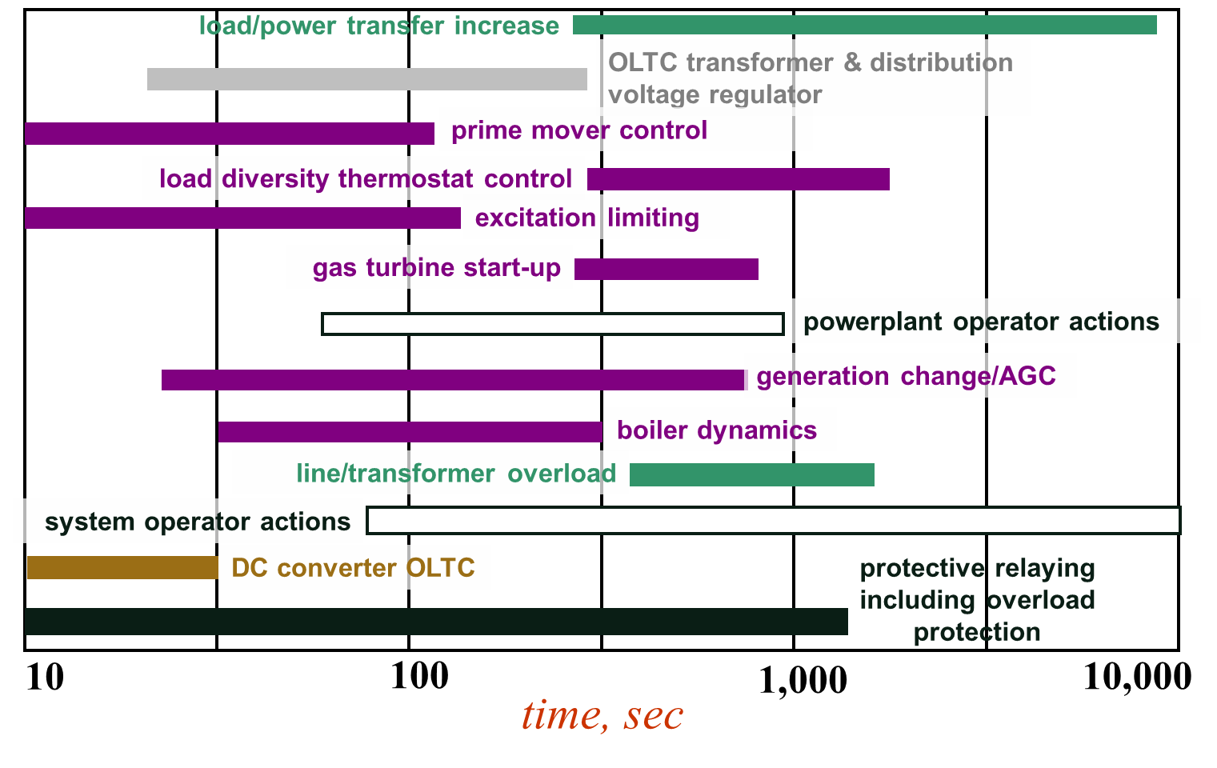
Power Systems Operate on Many Time Scales
Slide source: Prof. George Gross UIUC ECE 530

Slide 5
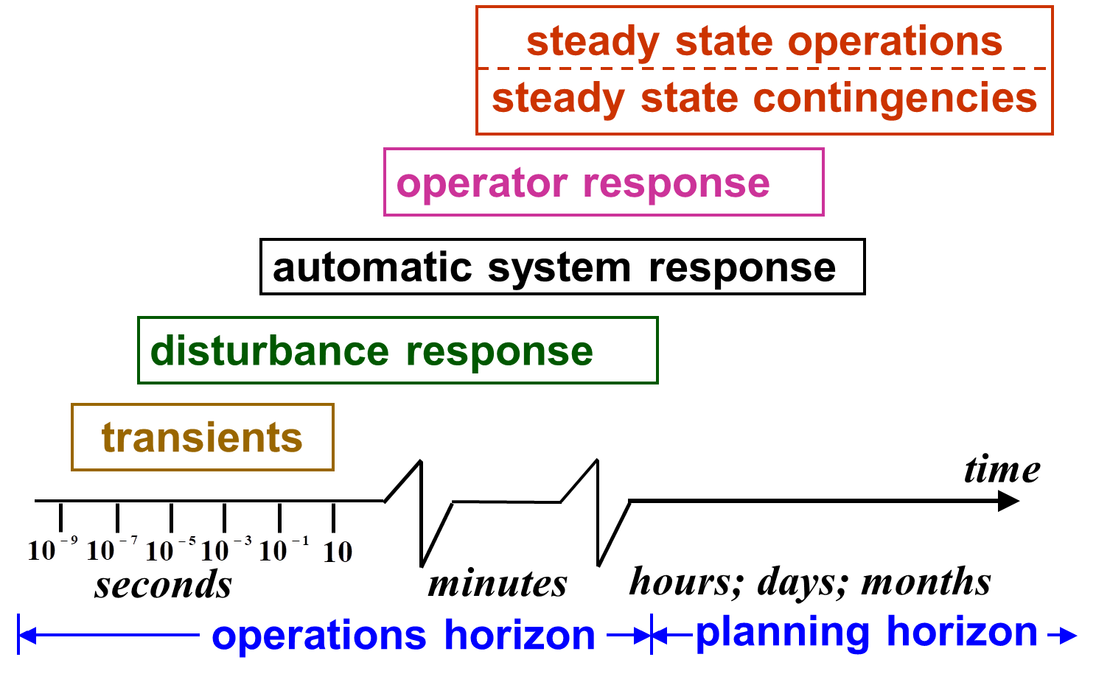
Power System Operation Regimes
Slide source: Prof. George Gross UIUC ECE 530

Slide 6
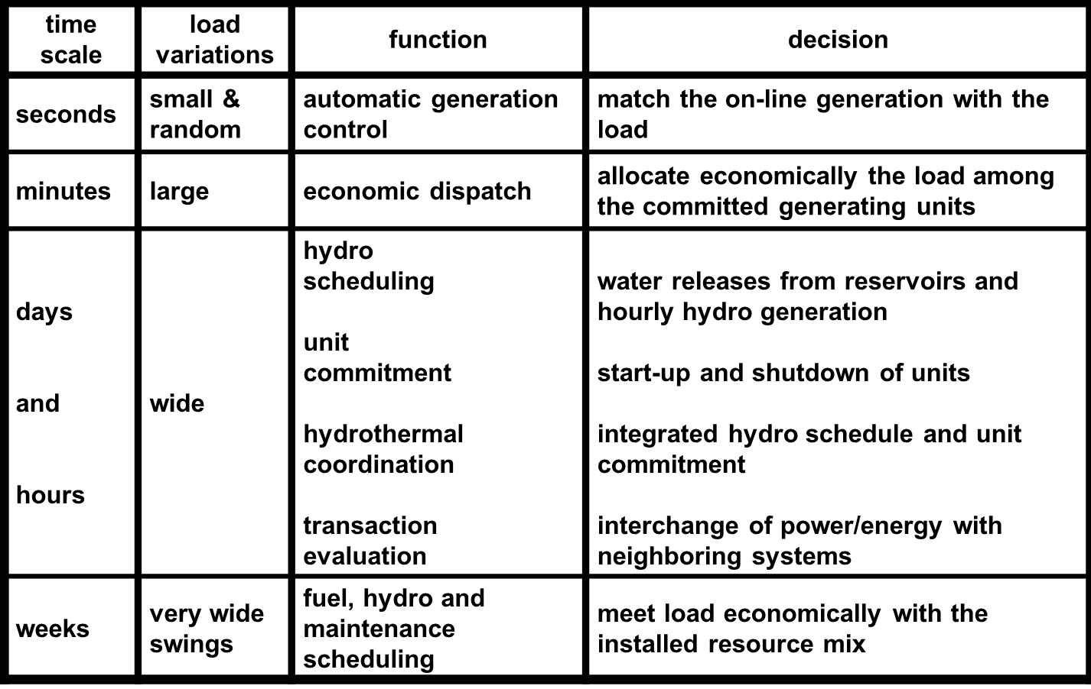
Generation Control and Scheduling Example
Slide source: Prof. George Gross UIUC ECE 530

Slide 7
Static Power System Analysis
One of the most common power system analysis tools is the power flow, which tells how power flows through a power system in the quasi-steady state time frame
Load flow is an alternative name for power flow; both terms have been used interchangeably for at least 50 years. I prefer power flow because the power flows, not the load
The power flow can be used to model the full, three-phase system, but usually (practically always) for transmission system analysis the system is assumed to be balanced. Hence a per phase equivalent model is used.

Slide 8
Exercise: Solve This Circuit
How do we solve this DC circuit for different values of P?
P | Load voltage and current
0 W
1 W
2 W
4 W
5 W
6 W
10 W

Slide 9
Exercise: Problem 1
The current through an impedance $\overline{Z}$ is $\overline{I}=10∠13°$A. The impedance consists of a $8 Ω$ resistor in series with a $4$mH inductor. Assume the system is operated at 60 Hz. What are the real power and reactive power consumed by this element?
A transmission bus voltage, measured from phase a to phase b, is ${\overline{V}}_{ab}=500∠45° \text{kV}$. What is the phase a to neutral voltage? Assume system is operated in a-b-c phase sequence. Give the answer both as a phasor and as a cosine-based time function.
A load draws 200 kW with a lagging pf of 0.8. What is the reactive power drawn by the load?

Slide 10
Workspace

Slide 11
Workspace

Slide 12
Workspace

Slide 13
Exercise: Problem 2
A three-phase power system consists of four buses. There is a generator at bus 1 operating at voltage $V=13.5∠0° \text{kV}$. There is a load at bus 4 consuming 18 + j4 MVA. Between buses 1 and 2 there is a 13.8 kV : 138 kV transformer with impedance j0.1 $Ω$ on the bus 1 side. There is a 138 kV transmission line connecting buses 2 and 3 with series impedance 3 + j8 $Ω$ and shunt capacitance with admittance j200 $μS$. There is a 138 kV : 69 kV transformer between buses 3 and 4 with impedance j10 $Ω$ on the bus 3 side.
Draw a one-line diagram of this system
Write out the table of per-unit bases
Convert all the values given above to per-unit
Write the y-bus matrix for this system

Slide 14
Workspace

Slide 15
Workspace

Slide 16
Workspace

Slide 17
Workspace

Slide 18
Exercise: Problem 3
For a two-bus system, bus 1 is the slack generator bus with $\overline{V_{1}}=1.06∠0°$. Bus 2 is a PQ bus with a constant power load of $P=400 \text{MW}$ and $Q=260 \text{Mvar}$. A branch connects the two buses with series impedance $\overline{Z}=j0.0625$. $S_{base}=100 \text{MVA}$
Starting with an initial guess of $1.00∠0°$, use the Newton-Raphson power flow method to obtain the load bus voltage angle $θ_{2}$ and magnitude $V_{2}$ after two iterations.

Slide 19
Workspace

Slide 20
Workspace

Slide 21
Reference Notes from the Videos

Slide 31
The Power Flow Problem
What we know:
Generator real power
Generator voltage magnitude
Load real and reactive power
What we don't know:
Bus voltage angles
Non-generator bus voltage magnitude
Generator reactive power
Current injections of generators or loads
Note that the problem is formulated with power values, not current, so we cannot use the Y-bus equations directly
Power flow problem is non-linear

Slide 33
Power Flow Problem Variables
These two equations must be satisfied for all buses in the system
Total of 2n equations
Parameters g and b are known from the Y-bus
Each bus has four variables:
Bus voltage magnitude $V_{i}$
Bus voltage angle $θ_{i}$
Bus real power injection $P_{i}$
Bus reactive power injection $Q_{i}$
So in general, we need to pre-specify 2 additional variables at each bus before we can solve
$$P_{i} = \sum_{k=1}^{n}{\left|V_{i}\right|\left|V_{k}\right|}(g_{ik}\cos{θ_{ik}}+b_{ik}\sin{θ_{ik}})=P_{Gi}−P_{Di} \\ Q_{i} = \sum_{k=1}^{n}{\left|V_{i}\right|\left|V_{k}\right|}(g_{ik}\sin{θ_{ik}}−b_{ik}\cos{θ_{ik}})=Q_{Gi}−Q_{Di}$$

Slide 34
Power Flow Bus Types
Each bus has one of three basic types, and for each one there are two known variables and two unknown variables:
Load (PQ) bus
Assume P/Q are fixed at most buses in the system
Known:$P$ and $Q$, Unknown: $V$ and $θ$
Slack bus
Only one in the whole system
Usually assigned to a large generator bus
Known: $V$ and $θ$, Unknown: $P$ and $Q$
Provides angle reference ($θ=0$) and picks up the slack P
Generator (PV) bus
Other generators (5-10% of buses in a large system)
Assume generator is controlling power output and voltage
Known: $V$ and $P$, Unknown: $θ$ and $Q$

Slide 35
Newton-Raphson Method
Method:
Write equation as f($\hat{x}$)=0
Make an initial guess of $\hat{x}$, $x^{\left(0\right)}$
For iteration $ν$, define $Δx=\hat{x}−x^{\left(ν\right)}$
Write Taylor series expansion:
$$f\left(\hat{x}\right)=f\left(x^{\left(ν\right)}\right)+\frac{df\left(x^{\left(ν\right)}\right)}{dx}Δx^{\left(ν\right)}$$ $+ \text{higher} \text{order} \text{terms}$
Approximate with only first two terms:
$0=f\left(x^{\left(ν\right)}\right)+\frac{df\left(x^{\left(ν\right)}\right)}{dx}Δx^{\left(ν\right)}$
Solve for $Δx^{\left(ν\right)}=−{\left[\frac{df\left(x^{\left(ν\right)}\right)}{dx}\right]}^{−1}f\left(x^{\left(ν\right)}\right)$
Solve for new estimate of $\hat{x}$
$x^{\left(ν+1\right)}=x^{\left(ν\right)}+Δx^{\left(ν\right)}$

Slide 36
Multi-Variable Newton-Raphson
Next, we generalize to the case where $x$ is an n-dimension vector, and f(x)=0 is an n-dimensional function
$$x = \left[\begin{matrix}x_{1} \\ x_{2} \\ ⋮ \\ x_{n}\end{matrix}\right] f(x) = \left[\begin{matrix}f_{1}(x) \\ f_{2}(x) \\ ⋮ \\ f_{n}(x)\end{matrix}\right]$$
Again, define $Δx=\hat{x}−\text{x}$
Taylor series for $f\left(x\right)$
$f_{1}(\hat{x}) = f_{1}(x)+\frac{∂f_{1}(x)}{∂x_{1}}Δx_{1}+\frac{∂f_{1}(x)}{∂x_{2}}Δx_{2}+… \frac{∂f_{1}(x)}{∂x_{n}}Δx_{n}+\text{higher} \text{order} \text{terms}$
$⋮$ $f_{n}\left(\hat{x}\right) = f_{n}\left(x\right)+\frac{∂f_{n}\left(x\right)}{∂x_{1}}Δx_{1}+\frac{∂f_{n}\left(x\right)}{∂x_{2}}Δx_{2}+… \frac{∂f_{n}(x)}{∂x_{n}}Δx_{n}+\text{higher} \text{order} \text{terms}$

Slide 37
Jacobian Matrix
We can write the truncated Taylor series in Matrix form as the Jacobian matrix
$$J(x) = \left[\begin{matrix}\frac{∂f_{1}(x)}{∂x_{1}} & \frac{∂f_{1}(x)}{∂x_{2}} & ⋯ & \frac{∂f_{1}(x)}{∂x_{n}} \\ \frac{∂f_{2}(x)}{∂x_{1}} & \frac{∂f_{2}(x)}{∂x_{2}} & ⋯ & \frac{∂f_{2}(x)}{∂x_{n}} \\ ⋮ & ⋱ & ⋱ & ⋮ \\ \frac{∂f_{n}(x)}{∂x_{1}} & \frac{∂f_{n}(x)}{∂x_{2}} & ⋯ & \frac{∂f_{n}(x)}{∂x_{n}}\end{matrix}\right]$$
$f\left(\hat{x}\right)=f\left(x^{\left(ν\right)}\right)+J\left(x\right)⋅Δx^{\left(ν\right)}=0$
So, $Δx^{\left(ν\right)}=−J{\left(x\right)}^{−1}⋅f\left(x^{\left(ν\right)}\right)$
And so $x^{(ν+1)}=x^{\left(ν\right)}$ $− J{\left(x\right)}^{−1}⋅f\left(x^{\left(ν\right)}\right)$

Slide 38
Multi-Variable Newton-Raphson Example
Solve for $x_{1}$ and $x_{2}$ such that
$f_{1}\left(x_{1},x_{2}\right)=2x_{1}^{2}+x_{2}^{2}−8=0$
$f_{2}\left(x_{1},x_{2}\right)=x_{1}^{2}−x_{2}^{2}+x_{1}x_{2}−4=0$
$x^{(ν+1)}=x^{\left(ν\right)}$ $− J{\left(x\right)}^{−1}⋅f\left(x^{\left(ν\right)}\right)$

