Slide 1
ECEN 615, Fall 2023 Methods of Electric Power System Analysis
Class 2: Power System Overview and History
Prof. Adam Birchfield
Dept. of Electrical and Computer Engineering
Texas A&M University
abirchfield@tamu.edu

Slide 2
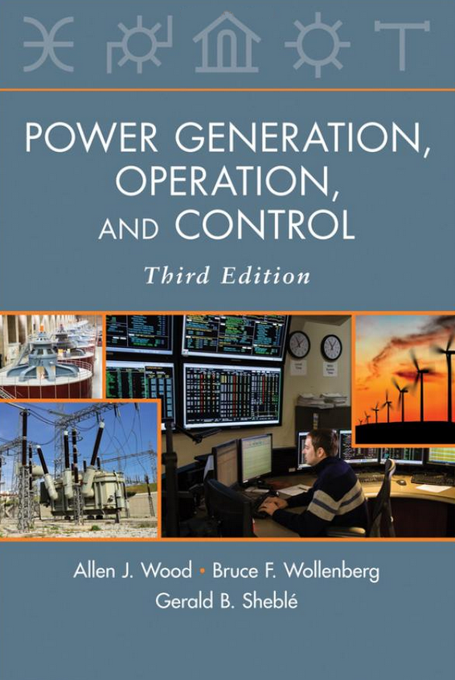
Syllabus
There's an in-person and a distance learning section
Syllabus on website gives more info
Textbook is Wood/Wollenberg/Sheble
Materials on the website:
Grading policy
30% - Written Exam #1 Tentative date Wednesday, October 4th
30% - Written Exam #2 Tentative date Wednesday, November 29th
20% - Homework assignments (4-6)
10% - Class participation
In-person students should actively participate in class discussion
Distance students write a 100-300 word paragraph once per week
10% - Oral exam. Scheduled 30-minute meeting, either in-person or on Zoom, in October.

Slide 3
EPG (Energy and Power Group) Dinner!
You are invited to the energy and power group dinner at Prof. Begovic’s house on Saturday, September 9
Sign up using the link I sent by email, which also has the address
Great way to meet others in the energy and power group (EPG) – students, faculty, and staff

Slide 4
Power Calculations Video Series
For next week, your assignment is to review these concepts to be familiar with them. You might not need to watch all 12 videos in detail, or you may use other resources.
AC Circuit Analysis, Complex Power, Three-Phase (and 3 example videos)
Transmission Line and transformer models
The per-unit system (with example)
Power flow y-bus and example
Power balance equations
Newton Raphson Method
Three-Bus Newton-Raphson Example

Slide 5
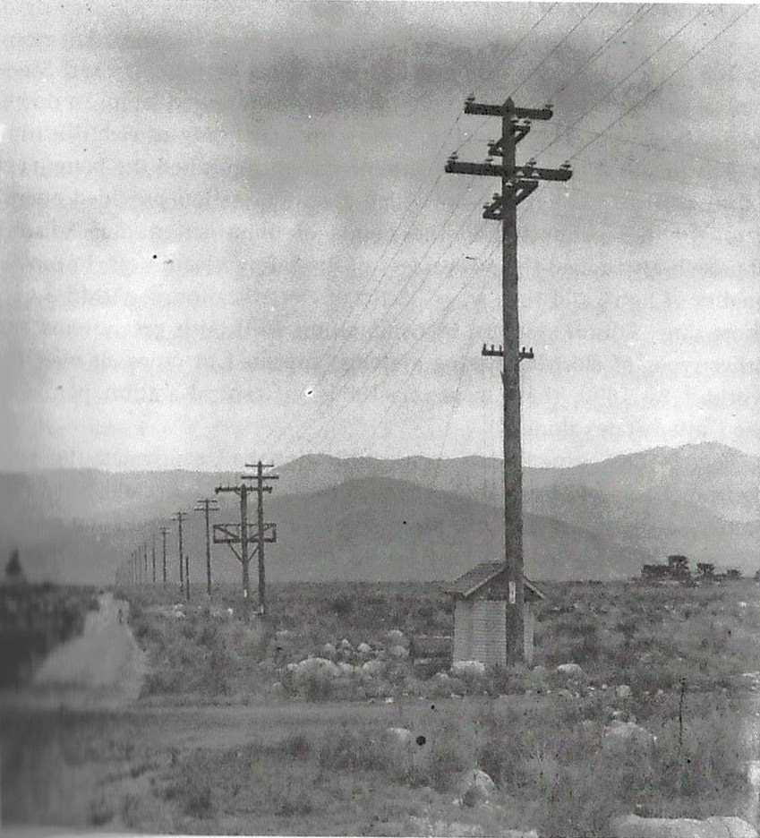
The Far Past: Origins of the Electric Grid
First practical use of electricity 1860s-70s, mainly telegraph and lighting
1880s – Edison dc system in Manhattan, Westinghouse/Tesla ac system, invention of practical motors and transformers
1890s-1920s – Local three-phase ac systems (mainly coal and hydro) develop and expand to become large interstate holding companies
1930s-40s – Industry standardizes on 60 Hz ac (in the US), load growth with air conditioning, rural electrification and big hydro projects with the New Deal
1950s-60s – Interconnection into major grids
Santa Ana River 33 kV Line, circa 1899. This was the longest power line in the world at the time at 83 miles. (SCE Photograph, from The Grid by Julie Cohn)

Slide 6
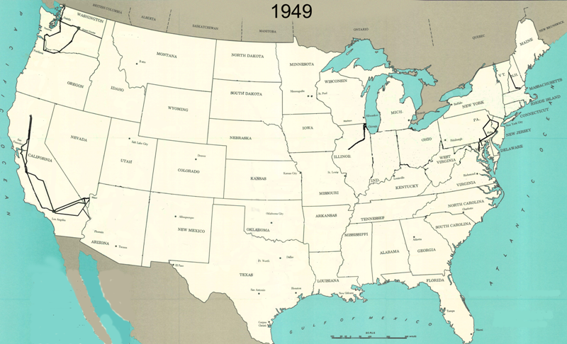
345 kV+ Transmission Growth at a Glance (From Jay Caspary)

Slide 7
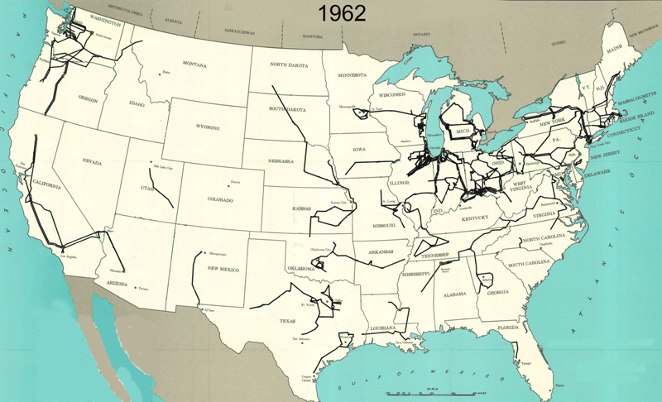
345 kV+ Transmission Growth at a Glance (From Jay Caspary)

Slide 8
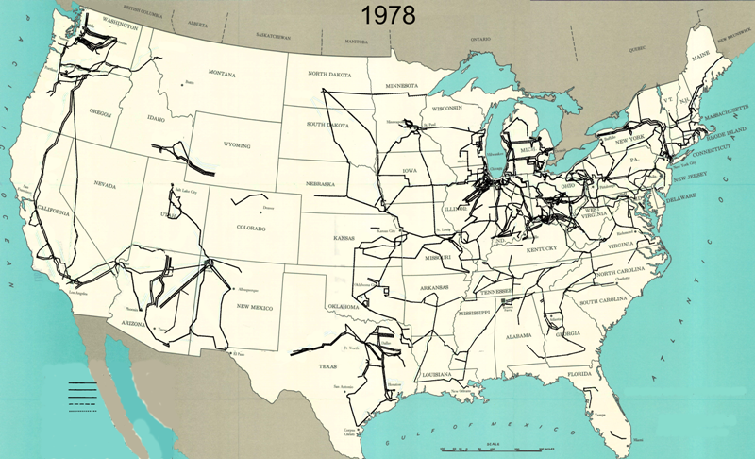
345 kV+ Transmission Growth at a Glance (From Jay Caspary)

Slide 9
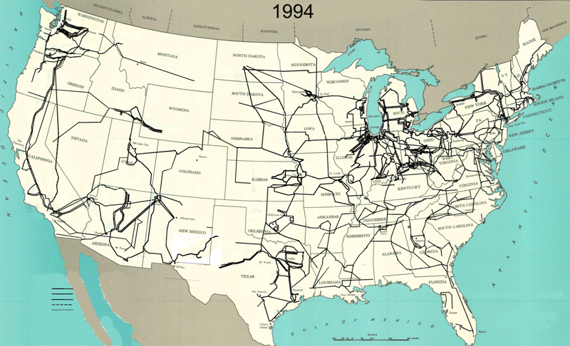
345 kV+ Transmission Growth at a Glance (From Jay Caspary)

Slide 10
Vertical Monopolies
Within a particular geographic market, the electric utility had an exclusive franchise
Generation
In return for this exclusive
franchise, the utility had the
obligation to serve all
existing and future customers
at rates determined jointly
by utility and regulators
It was a “cost plus” business
Transmission
Distribution
Customer Service

Slide 11
Vertical Monopolies
Within its service territory each utility was the only game in town
Neighboring utilities functioned more as colleagues than competitors
Utilities gradually interconnected their systems so by 1970 transmission lines crisscrossed North America, with voltages up to 765 kV
Economies of scale keep resulted in decreasing rates, so most every one was happy

Slide 12
The More Recent Past – Restructuring
1970’s brought inflation, increased fossil-fuel prices, calls for conservation and growing environmental concerns
Increasing rates replaced decreasing ones
As a result, U.S. Congress passed Public Utilities Regulator Policies Act (PURPA) in 1978, which mandated utilities must purchase power from independent generators located in their service territory (modified 2005)
Major opening of industry to competition occurred as a result of National Energy Policy Act of 1992, mandating that utilities provide “nondiscriminatory” access to the high voltage transmission
Result over the last few years has been a dramatic restructuring of electric utility industry
Energy Bill 2005 repealed PUHCA; modified PURPA

Slide 13
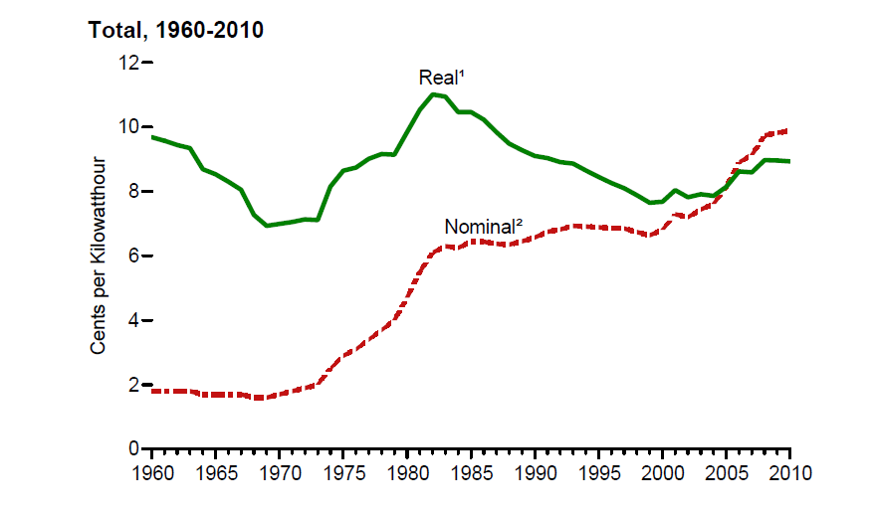
Electricity Prices, 1960-2010
Source: EIA, Annual Energy Review, 2010, Figure 8.10

Slide 14
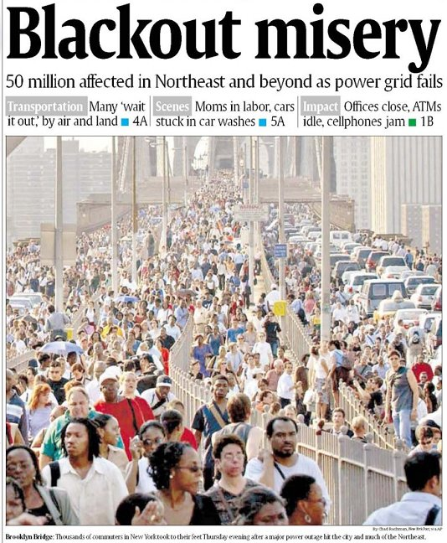
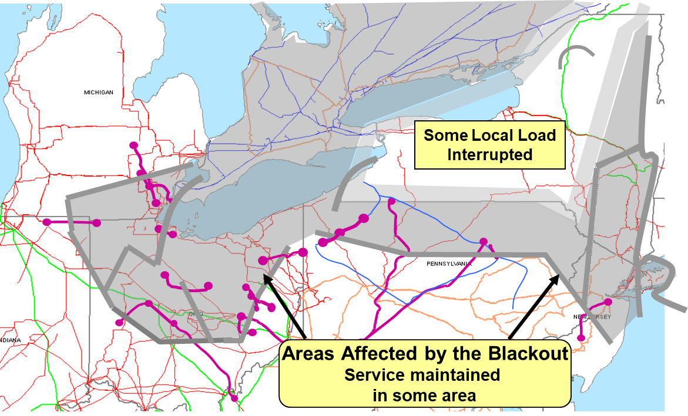
August 14th, 2003 Blackout
Above image from energy.gov, August 14, 2003 Blackout Final Report

Slide 15
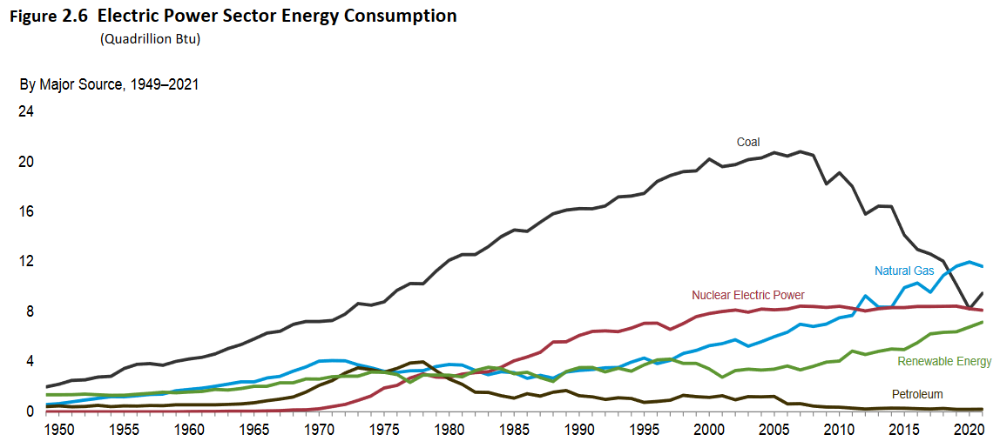
The Present: Changing Generation Mix
Fuel Source | 2021 US Electric Usage | Change from 2020 to 2021 | Change from 2011 to 2021
Coal | 25.8 % | + 15 % | - 47 %
Natural Gas | 31.6 % | - 3 % | + 51 %
Petroleum | 0.5 % | + 7 % | - 33 %
Nuclear | 22.1 % | - 1 % | - 2 %
Hydro | 6.2 % | - 9 % | - 26 %
Solar | 2.7 % | + 29 % | + 5700 %
Wind | 9.0 % | + 12 % | + 185 %
Source: US EIA Monthly Energy Review, August 2022

Slide 16
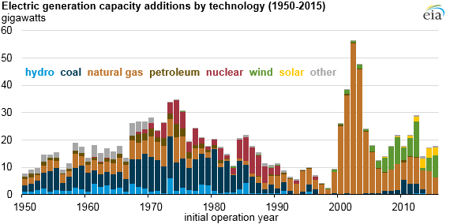
The Present: Changing Generation Mix
Texas is #1 in wind energy, with over 32,000 MW installed
Retirements in Texas from 2017-2021 included 4400 MW of coal, 2000 MW of natural gas, and small amounts of petroleum and wind
Proposed generation additions in Texas in 2023-2025 include 3600 MW natural gas, 7100 MW wind, 13,600 MW of solar! Also 3100 MW of battery storage
Source: US EIA Monthly Energy Review, EIA annual energy outlook

Slide 17
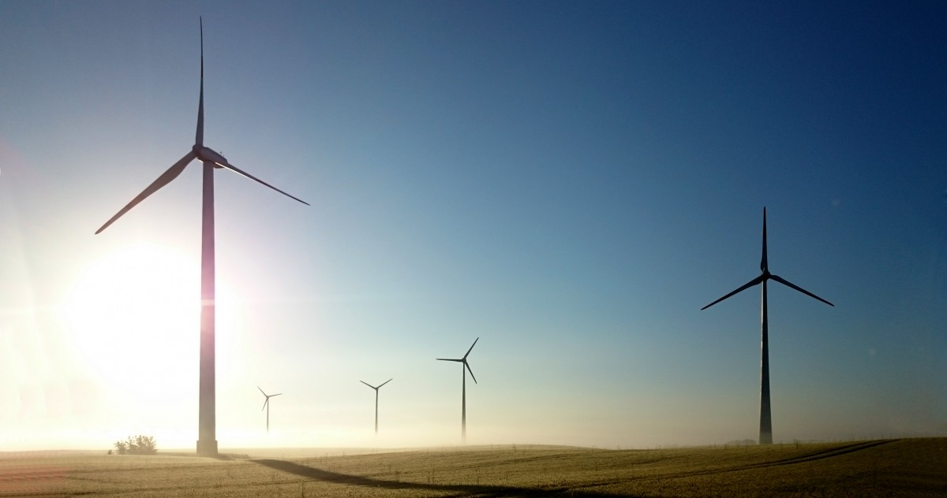
The Future: New Paradigms for Control
Inverter-based resources (such as wind and solar) introduce major paradigm shift in power system control
Decreasing impact of large synchronous machines with their stabilizing inertia
Resources are less dispatchable
Changes at the “edge” of the grid
Electric vehicles (major load increase)
Data centers
More controllable or price-sensitive demand resources
What do all of these have in common? Need for high-quality electric grid modeling and simulation to prepare for a resilient and sustainable future.

Slide 18
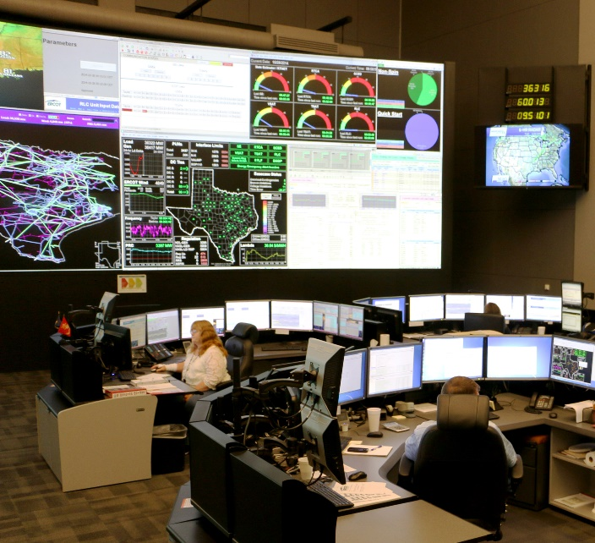
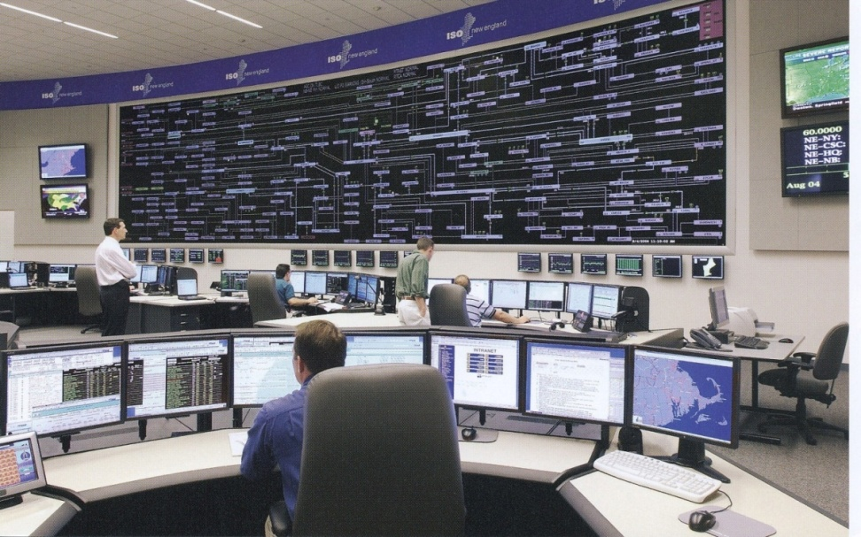
The Smart Grid
The term “Smart Grid” dates officially to the 2007 “Energy Independence and Security Act”, Title 13 (“Smart Grid”)
Use of digital information and control techniques
Dynamic grid optimization with cyber-security
Deployment of distributed resources including
Customer participation and smart appliances
Integration of storage including PHEVs
Development of interoperability standards

Slide 19
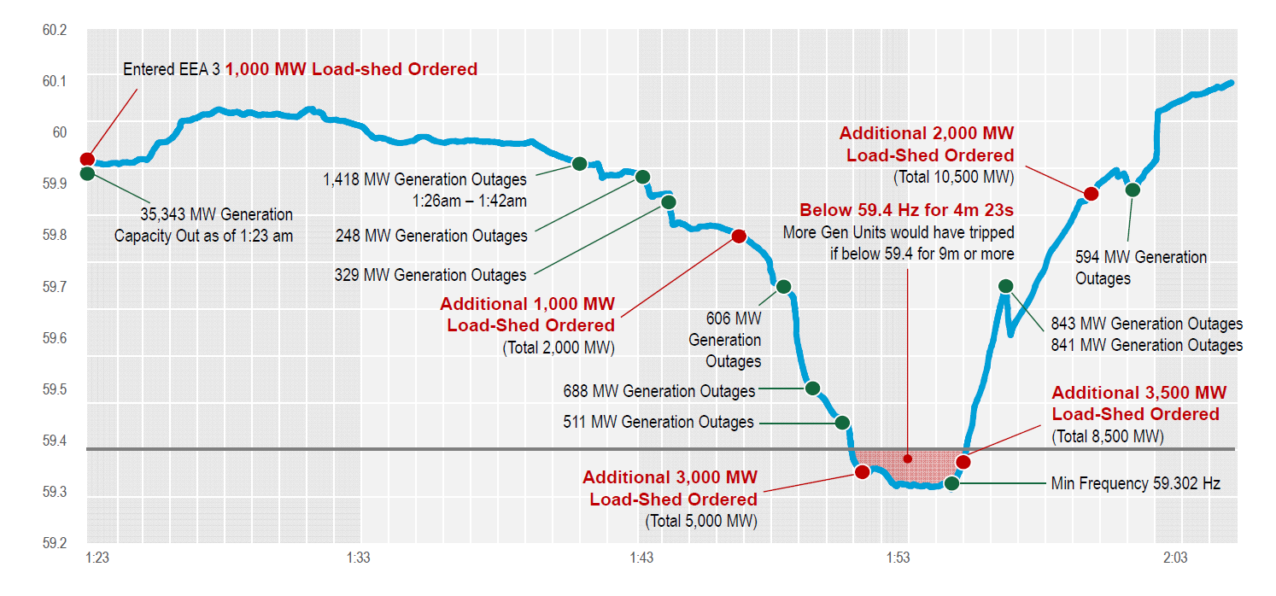
Winter Storm Uri (February 14-17, 2021)
resulted in 20,000 MW of shed load in Texas

Slide 20
Winter Storm Uri (February 14-17, 2021)
Pre-Event Conditions
Significant number of natural gas units unavailable because of restrictions on gas supply system
Many wind turbines unavailable because of icing buildup
Very high demand predicted, customers requested to reduce usage
Event Sequence
New winter peak demand 7-8 PM Feb. 14: 69,222 MW. The demand stayed high through the night.
Around 11pm Feb. 14, multiple thermal units, such as natural gas, rapidly tripped offline due to cold weather. At highest point, total of 34,000 MW generation forced offline.
Due to diminishing reserves, emergency operation plan was implemented (energy emergency alert plan, EEA).
By 1:25 am Feb. 15, ERCOT entered highest level of emergency alert, EEA 3, which includes controlled outages.
Each transmission owner is instructed by ERCOT to reduce demand by a certain amount proportional to size.
In this case, total load reduction maximum was 16,500 MW on Monday morning.
Procedure is to rotate outages and avoid critical loads like hospitals and emergency services.
The magnitude of the outages meant that usual outage duration of 15-45 minutes could not be maintained. Many blackouts lasted much longer.
Blackouts longer and larger than any in the past.
Mid-morning on Feb. 19, ERCOT finally ended emergency conditions and was no longer instructing transmission owners to reduce load
Any remaining outages are localized issues
Source: ERCOT, 2/15/21 media call, news releases

Slide 21
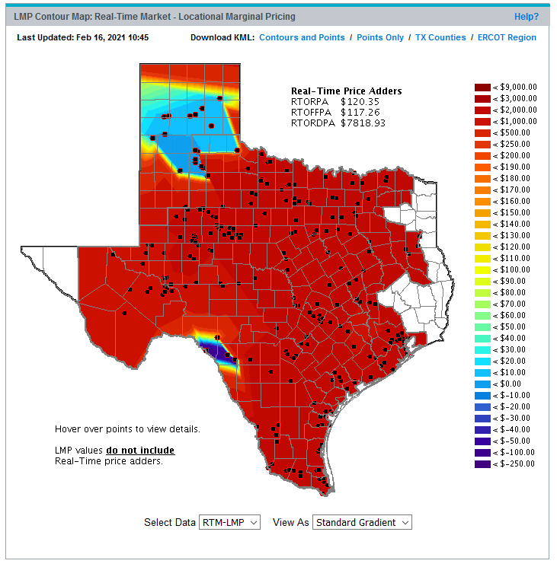
Discussion: Summary Timeline and Your Historical Papers
Rural electrification
Chicago World’s Fair demonstrates ac power
Beginnings of restructuring
Public Utility Holding Company Act
Edison’s Pearl Street dc system in Manhattan
First three-phase transmission line
Large blackout of 1965
PURPA
1860
1880
1900
1920
1940
1960
1980
2000
2020

Slide 22
Electricity Supply
The basic function of a power system is to convert energy from one source to the electrical form; a key characteristic is that energy is not consumed as electricity but converted into heat, light, sound, mechanical energy or information
The widespread use of electricity is due to its ability to transport and control efficiently and reliably
Electricity is, by and large, a relatively clean source of energy
Most forms of renewable energy are created in the form of electricity; examples include hydro, wind and solar.

Slide 23
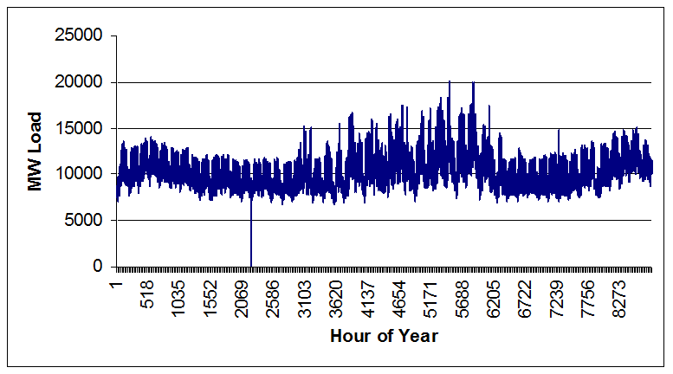
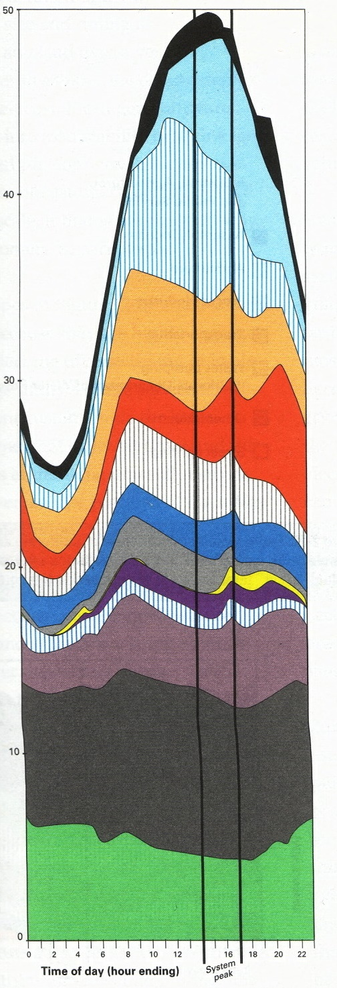
Fundamental Power System Requirements
System must be able to track load continuously: continuous balance of supply and demand
System must provide reliable supply of electricity at least cost
System must have least environmental impacts in providing electricity to meet its customers’ demands
Yearly Load Variation
Daily Load Variation

Slide 24
Fundamental Requirements of a Power System
Electric power delivery by the system must meet minimum standards of power quality
constant frequency
constant voltage
adequate reliability
System must be able to supply electricity even when subjected to a variety of unexpected contingencies, such as the loss of a transmission line or generator
A key focus of this course is the control capability to meet these requirements

Slide 25
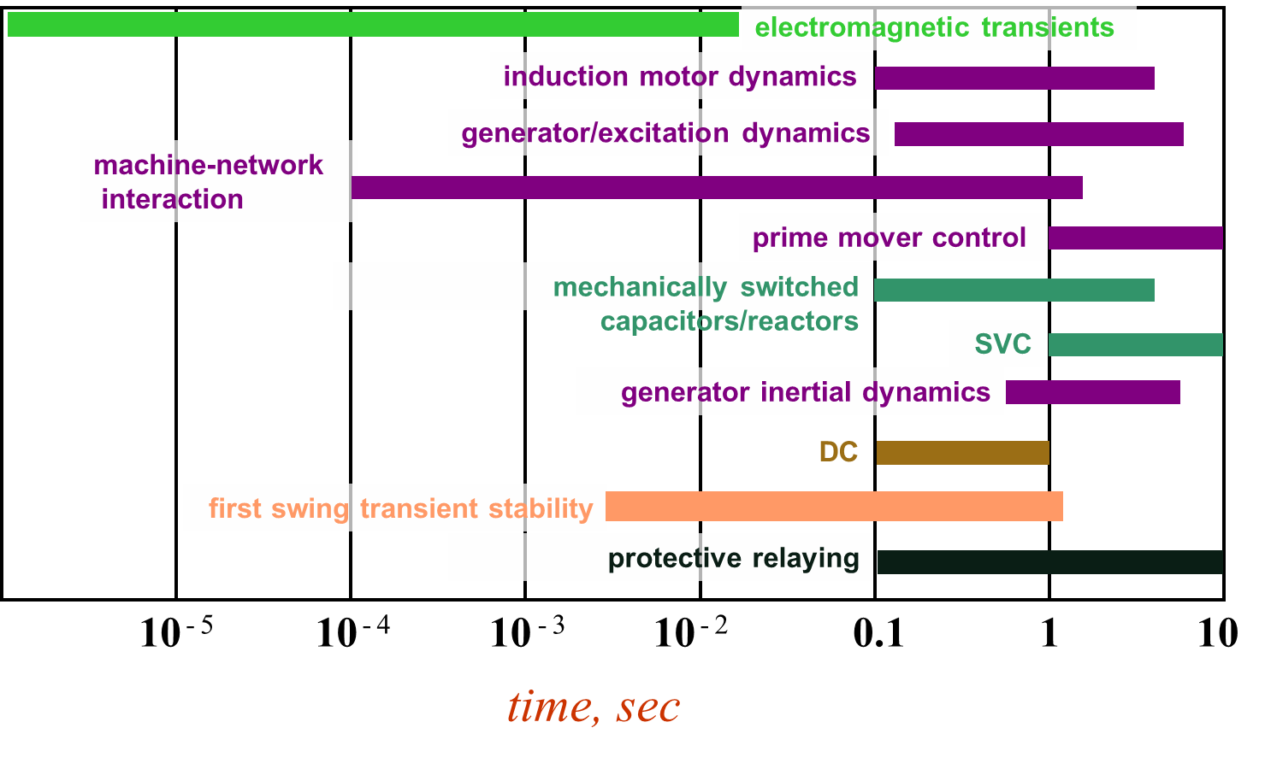
Power Systems Operate on Many Time Scales
Slide source: Prof. George Gross UIUC ECE 530

Slide 26
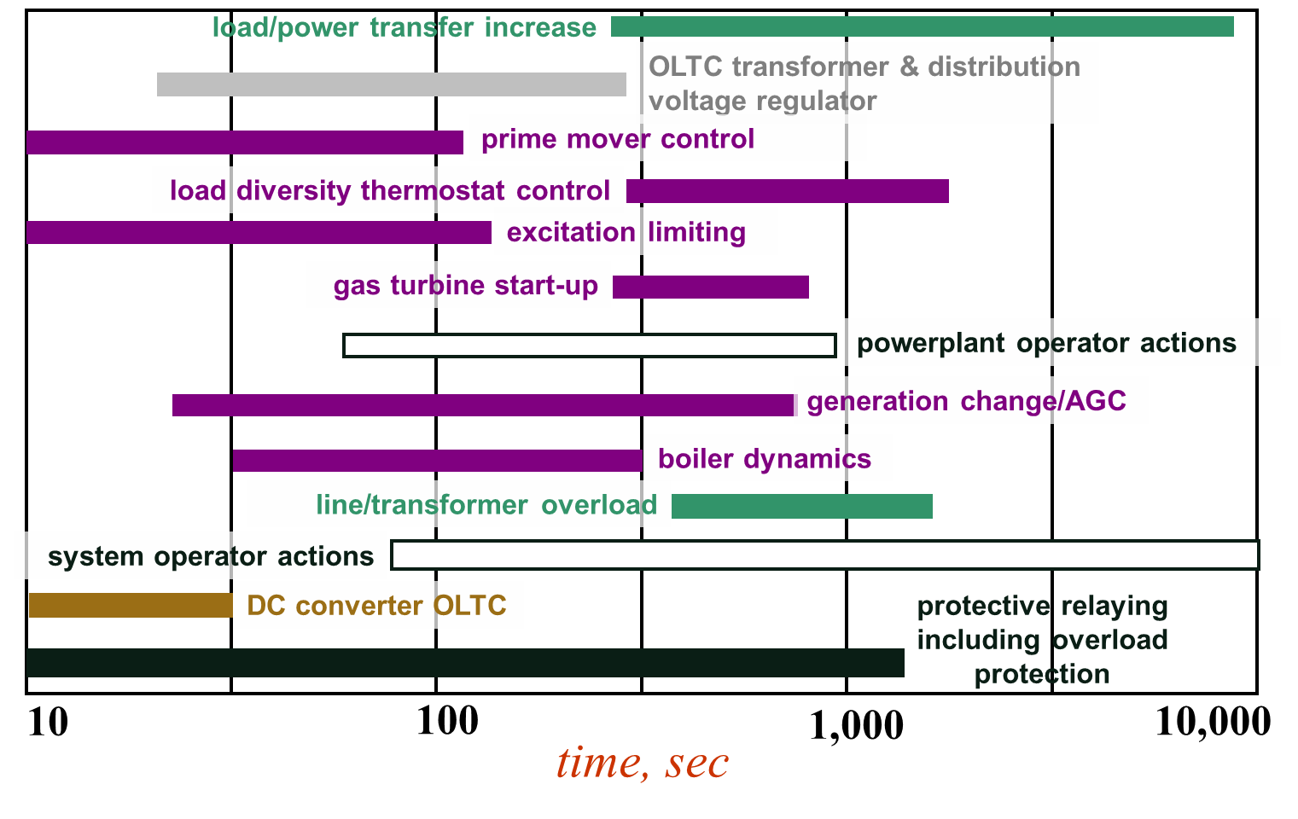
Power Systems Operate on Many Time Scales
Slide source: Prof. George Gross UIUC ECE 530

Slide 27
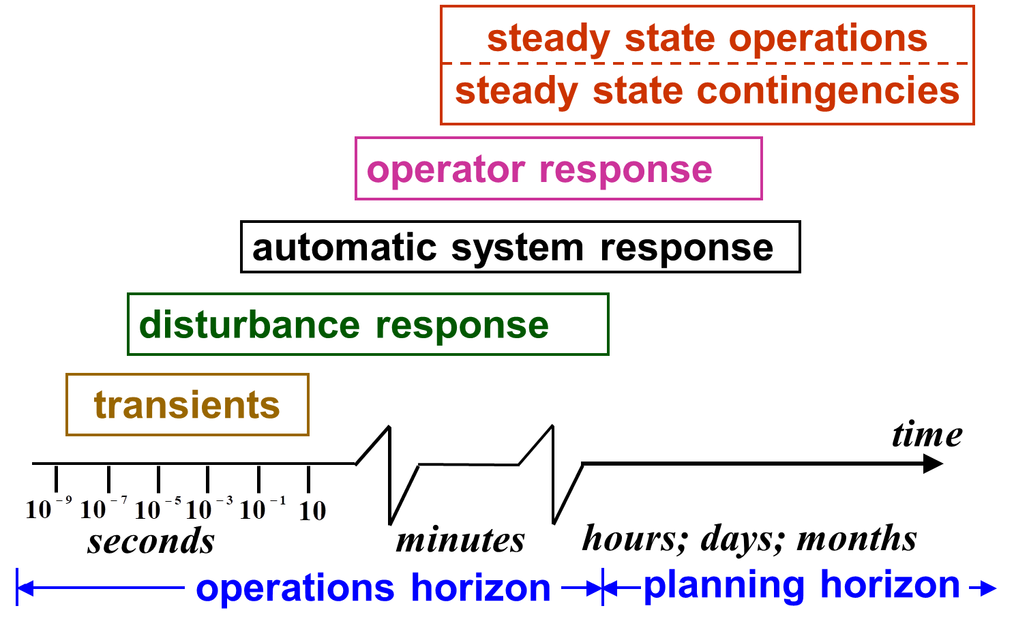
Power System Operation Regimes
Slide source: Prof. George Gross UIUC ECE 530

Slide 28
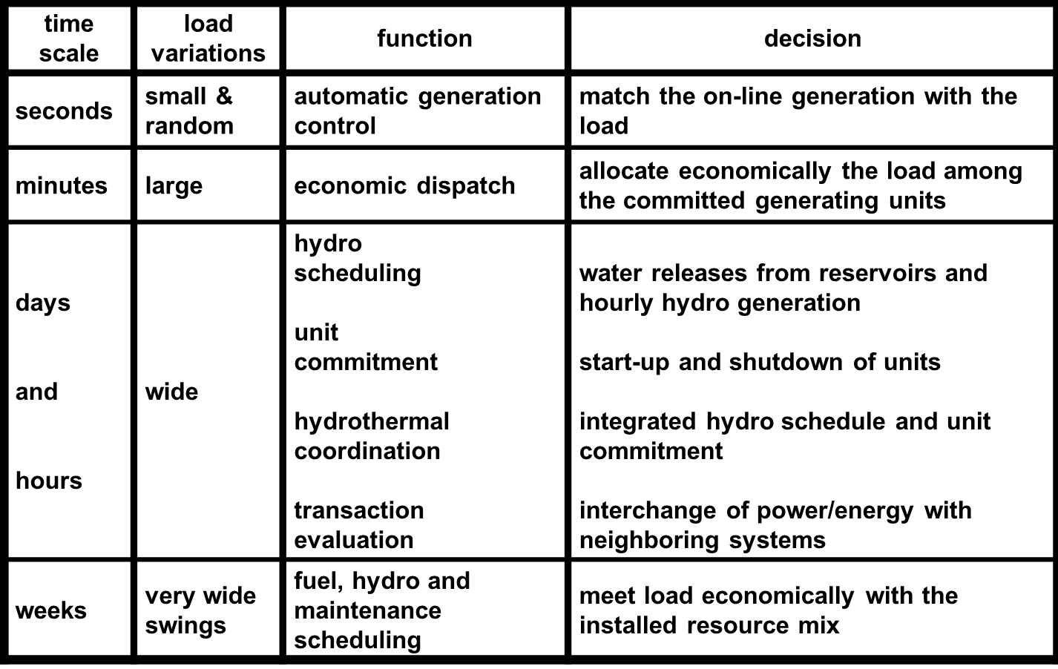
Generation Control and Scheduling Example
Slide source: Prof. George Gross UIUC ECE 530

Slide 29
Static Power System Analysis
One of the most common power system analysis tools is the power flow, which tells how power flows through a power system in the quasi-steady state time frame
Load flow is an alternative name for power flow; both terms have been used interchangeably for at least 50 years. I prefer power flow because the power flows, not the load
The power flow can be used to model the full, three-phase system, but usually (practically always) for transmission system analysis the system is assumed to be balanced. Hence a per phase equivalent model is used.

Slide 30
Exercise: Solve This Circuit
How do we solve this DC circuit for different values of P?
P | Load voltage and current
0 W
1 W
2 W
4 W
5 W
6 W
10 W

