Slide 1
ECEN 615, Fall 2023 Methods of Electric Power System Analysis
Class 1: Introduction
Prof. Adam Birchfield
Dept. of Electrical and Computer Engineering
Texas A&M University
abirchfield@tamu.edu

Slide 2
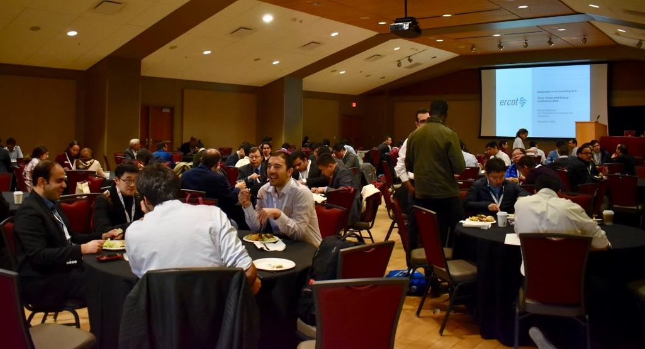
Energy and Power Group at Texas A&M
Texas A&M is a leader in power and energy research!
13+ Faculty members in various expertise areas of power systems, power electronics, and electric machines
Smart grid control center facility in the center for infrastructure renewal on the RELLIS campus
TPEC is our graduate student-led IEEE technical conference that happens every year in February.
If you’re interested in getting involved, I can help you connect!

Slide 3
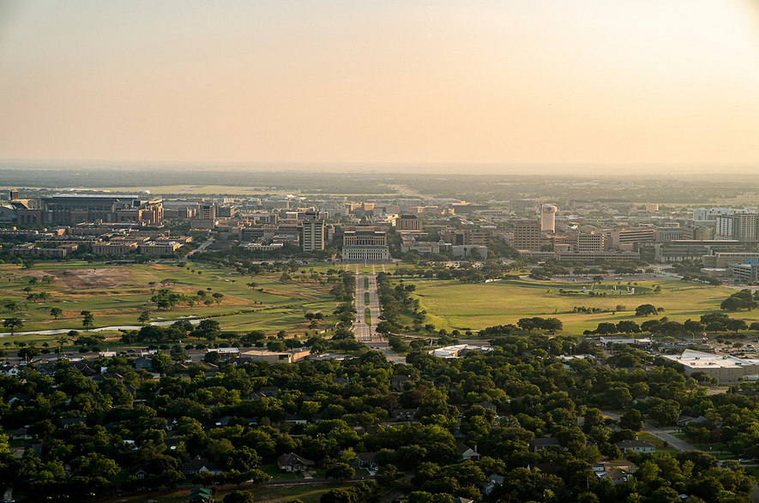
Discussion: Introduce Yourself
Name
What program you're in
What you're interested in getting out of graduate school and this class
Favorite dessert / sweet food
Try to remember each others' names

Slide 4
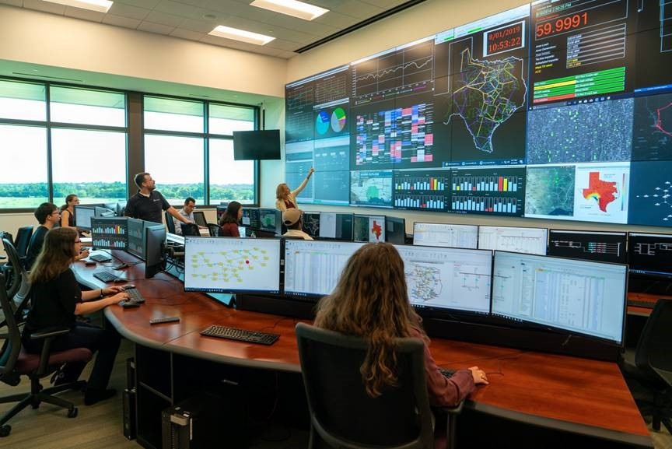
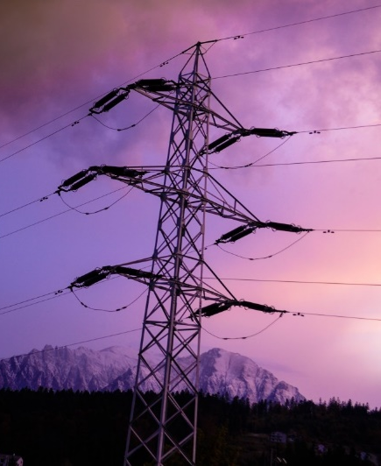
Motivation for this Class
Electrification has changed the world!
In 2000 the US National Academy of Engineering (NAE) named Electrification (the vast networks of electricity that power the developed world) as the top engineering technology of the 20th century
Beating automobiles, airplanes, water, space flight
Power systems are critical to our way of life, and the 21st century is full of new challenges
Increased and varying electric load
Need for affordable electricity around the world
Sustainability and environmental responsibility
Resilience to natural and man-made threats

Slide 5
What this Class will Cover
Part 1: Advanced Power Flow Problem Topics
The structure, history, and design of power transmission systems
Review of AC circuits, complex power, three-phase system analysis, power flow problem and solution methods
Advanced power flow: XFMR off-nominal, phase shifters, quasi-newton approximations, switched shunts, remote regulation
Part 2: Other Large Power System Analysis Topics
Sparse Matrix Methods
Sensitivities and Distribution Factors
Power Flow Optimization
State Estimation and Least Squares
Kron Reductions and Ward equivalents
Blackouts and Restoration
GMD and GIC Calculations

Slide 6
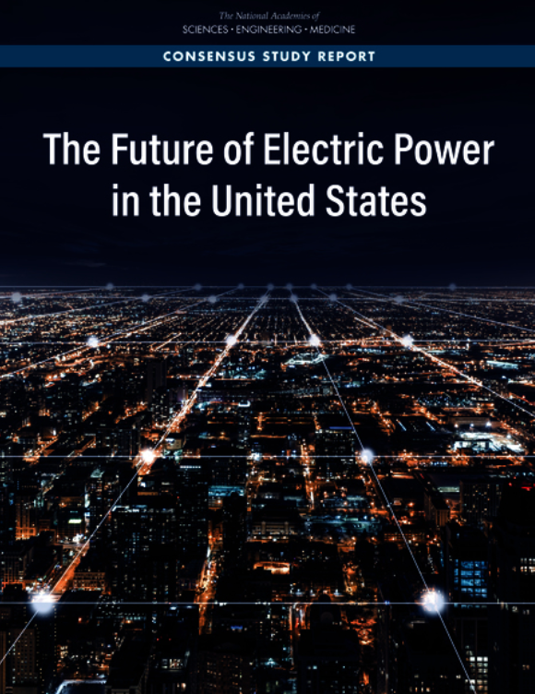
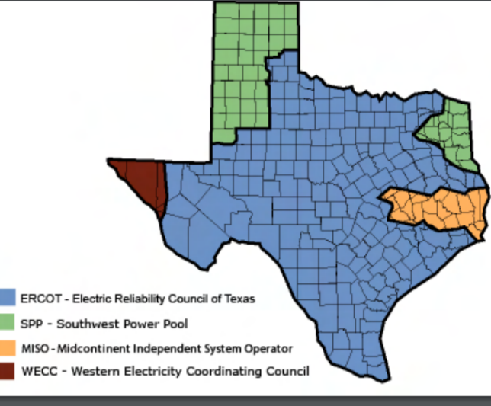
Discussion: NAE Report on The Future of the Electric Grid
What did you observe?
What is the electric grid?
What are key challenges today?
Source: www.puc.texas.gov/industry/maps/maps/ERCOT.pdf
https://nap.nationalacademies.org/catalog/25968/the-future-of-electric-power-in-the-united-states

Slide 8
Syllabus
There's an in-person and a distance learning section
Syllabus on website gives more info
Textbook is Wood/Wollenberg/Sheble
Materials on the website:
Grading policy
30% - Written Exam #1 Tentative date Wednesday, October 4th
30% - Written Exam #2 Tentative date Wednesday, November 29th
20% - Homework assignments (4-6)
10% - Class participation
In-person students should actively participate in class discussion
Distance students write a 100-300 word paragraph once per week
10% - Oral exam. Scheduled 30-minute meeting, either in-person or on Zoom, in October.

Slide 9
Assignment for Next Class
Find a history paper related to the electric grid. Read it and be ready to share something interesting that you found or learned. Ideas:
The IEEE PES Magazine has a regular history column
Search for an IEEE paper from before 1950 that has something interesting
Find a paper by Julie Cohn, a grid historian at University of Houston
There will be videos posted to review power engineering concepts. Watch these by next week if you need a refresher. We'll be building on these extensively in class.
Get PowerWorld simulator installed on your laptop, bring laptop to class.
If you need accommodation for a disability, talk to the Disability Resources office and me as soon as you can.
Take advantage of office hours Wednesday 2:30-4:00 pm in person or on Zoom (link in Canvas)

Slide 10
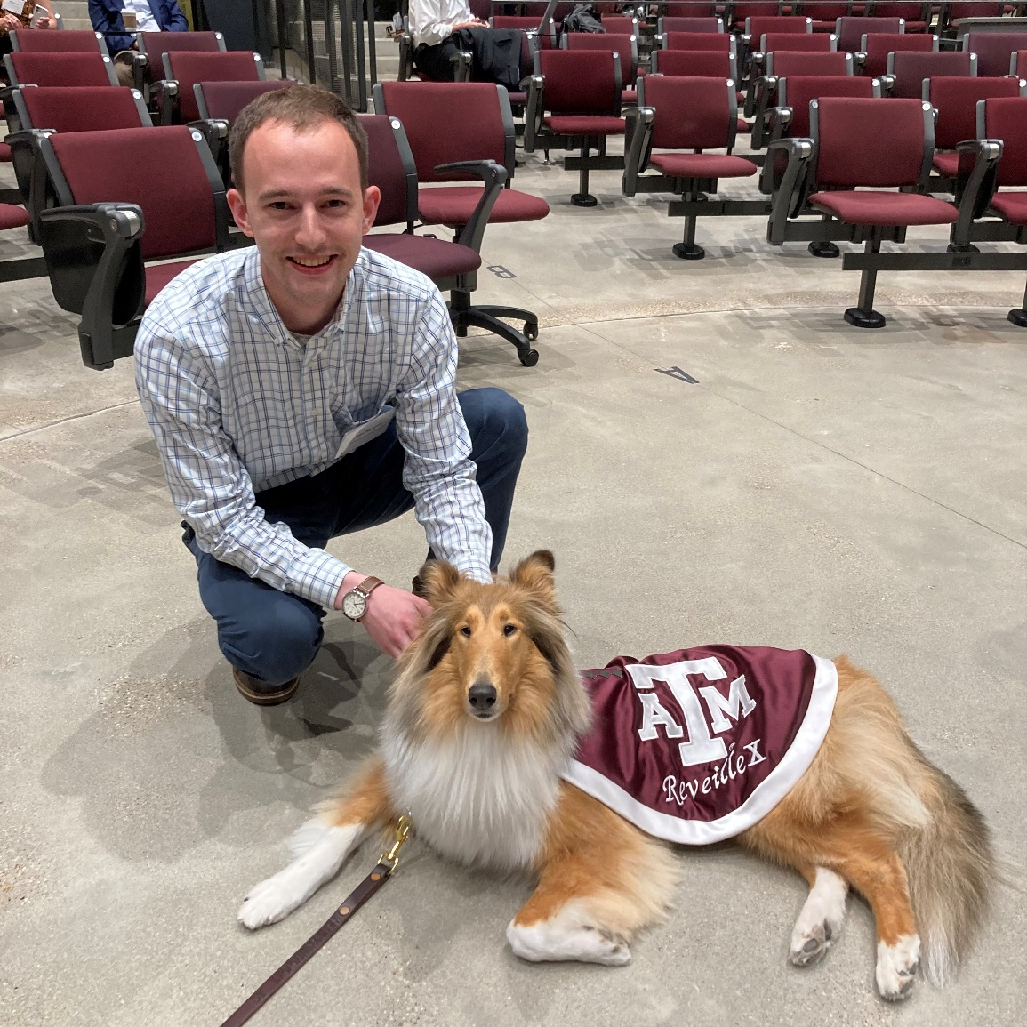
Aggie Core Values and Aggie Honor Code
Aggie Core Values
Respect
Excellence
Leadership
Loyalty
Integrity
Selfless Service
Aggie Honor Code: An Aggie does not lie, cheat, or steal, or tolerate those who do.
Reveille and I hope you have a great semester!

