Slide 1
ECEN 460, Spring 2023
Power System Operation and Control
Class 25: High-Impact, Low-Frequency Events
Prof. Adam Birchfield
Dept. of Electrical and Computer Engineering
Texas A&M University
abirchfield@tamu.edu

Slide 2
Announcements
Final exam May 9th at 3:30pm

Slide 3

End-of-Semester Feedback
Please fill out your end-of-semester feedback if you haven't already!
End-of-semester student survey is used by instructors, TAs, ECEN department, College of Engineering, and the university for improving this course
We greatly value your feedback!
There is no grade associated with any of the student surveys
tamu.aefis.net

Slide 4
High-Impact, Low-Frequency Events
In 2010 the North American Electric Reliability
Corporation (NERC) identified some severe grid threads called High-Impact, Low-Frequency Events (HILFs); others call them black swan events or black sky days
  Large-scale, potentially long duration blackouts
HILFs identified by NERC were
  a coordinated cyber, physical or blended attacks,
  pandemics,
  geomagnetic disturbances (GMDs), and
  high altitude electromagnetics pulses (HEMPs)

Slide 5
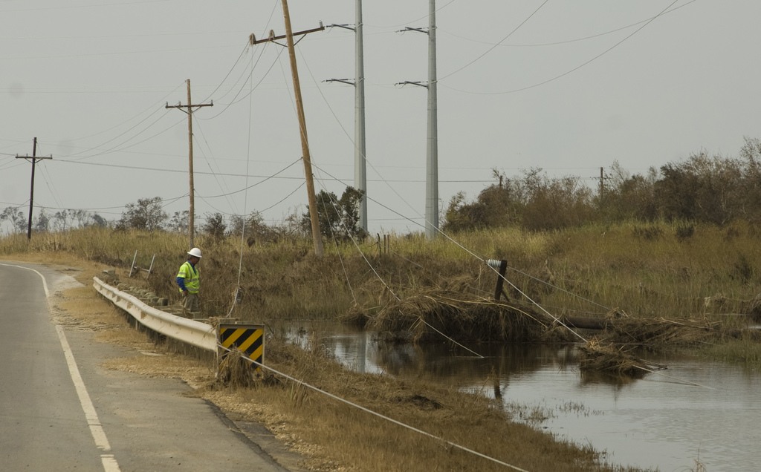
Extreme Weather
Types of extreme weather events
  Hurricanes
  Heat waves
  Thunderstorms/tornados
  Freezing weather/snowstorms
  Wildfires
  Dust storms
  Earthquakes
Impacts can include: lines down out of service, transformer damage, reduced load, generation unavailability, lack of measurement data and system situational awareness

Slide 6
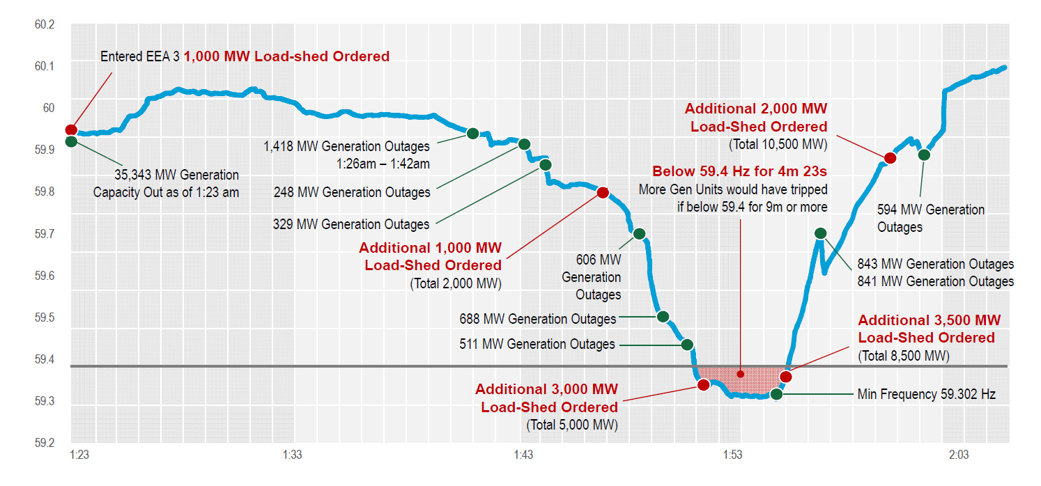
Winter Storm Uri – February 2021
Source: ERCOT

Slide 7
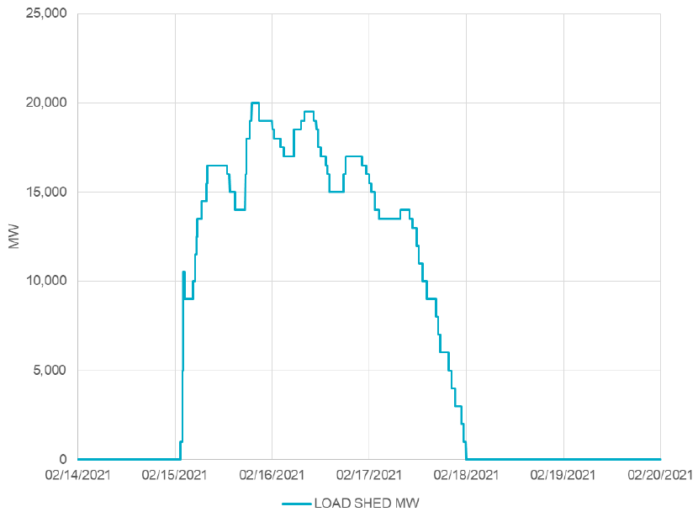
Winter Storm Uri – February 2021
Extreme winter weather, record-setting low temperatures across Texas and neighboring states
Generation supply lost
Controlled load outages for 3 days up to 20,000 MW
  Far more than had been done historically, restricting proper rotation
System operators avoided an uncontrolled blackout, but did involve load restoration
Source: ERCOT

Slide 8
Winter Storm Uri – February 2021
Pre-Event Conditions
  Significant number of natural gas units unavailable because of restrictions on gas supply system
  Many wind turbines unavailable because of icing buildup
  Very high demand predicted, customers requested to reduce usage
Event Sequence
  New winter peak demand 7-8 PM Feb. 14: 69,222 MW. The demand stayed high through the night.
  Around 11pm Feb. 14, multiple thermal units, such as natural gas, rapidly tripped offline due to cold weather. At highest point, total of 34,000 MW generation forced offline.
  Due to diminishing reserves, emergency operation plan was implemented (energy emergency alert plan, EEA).
  By 1:25 am Feb. 15, ERCOT entered highest level of emergency alert, EEA 3, which includes controlled outages.
    Each transmission owner is instructed by ERCOT to reduce demand by a certain amount proportional to size.
    In this case, total load reduction maximum was 16,500 MW on Monday morning.
    Procedure is to rotate outages and avoid critical loads like hospitals and emergency services.
    The magnitude of the outages meant that usual outage duration of 15-45 minutes could not be maintained. Many blackouts lasted much longer.
    Blackouts longer and larger than any in the past.
  Mid-morning on Feb. 19, ERCOT finally ended emergency conditions and was no longer instructing transmission owners to reduce load
    Any remaining outages are localized issues
  May be months before full investigation and report is out
Source: ERCOT, 2/15/21 media call, news releases

Slide 9
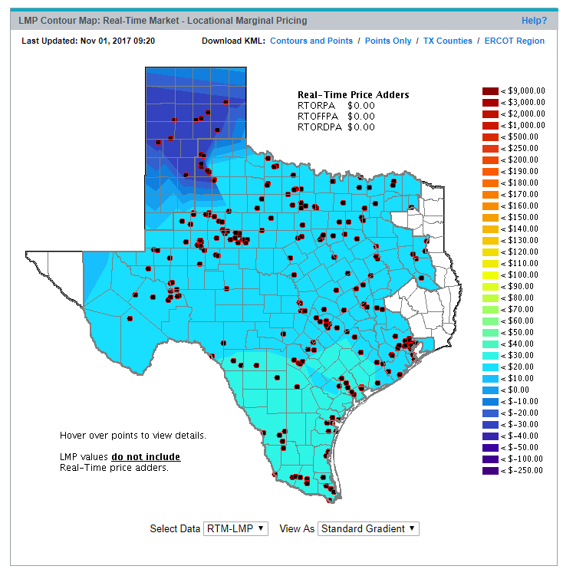
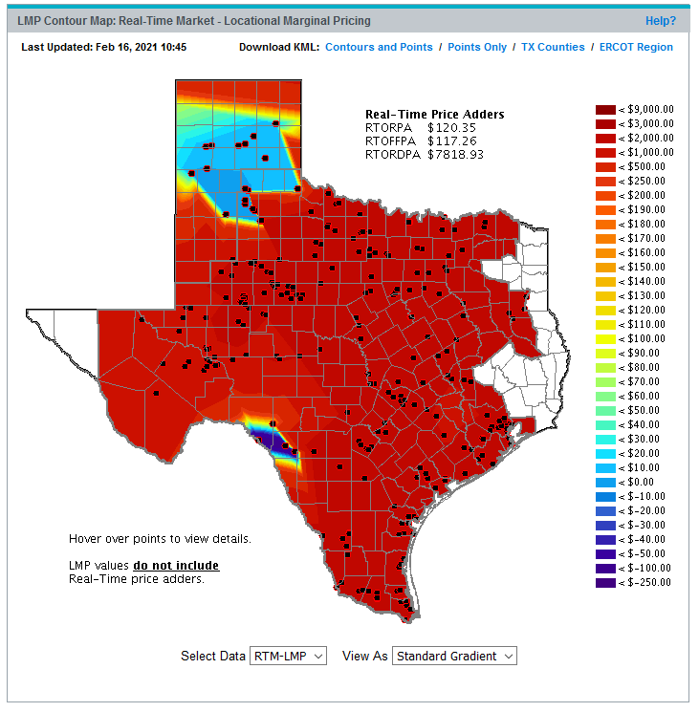
Texas Electric Market Prices Exceed $9000/MWh
Extreme Event Pricing Map
Typical Pricing Map
http://www.ercot.com/content/cdr/contours/rtmLmp.html

Slide 10
Comparing to Prior Controlled Outages in TX
Dec. 22-23, 1989 event was a similar extreme cold weather scenario, resulting in first-ever ERCOT interruption to customers. After 7 units tripped in rapid succession, 500 MW of load was shed at 10:21 am, restored within about 30 minutes.
Apr. 17, 2006 event was due to a spring heat wave that resulted in underestimating in the load forecast. 14,500 MW of generation unavailable due to planned maintenance. Around 4:00 PM multiple units trip offline. Rolling blackouts of up to 1000 MW are implemented from 4:13 pm to 6:10 pm.
Feb. 2, 2011 event was another winter storm, resulting in up to 4000 MW load shed from 5:43 am to 1:07 pm.
Feb 14-16, 2021 event: at maximum, 10,600 MW of load shed, rolling controlled blackouts from 1:25 am Feb. 15, still in-progress as of noon Feb. 16.
Source: ERCOT reports

Slide 11
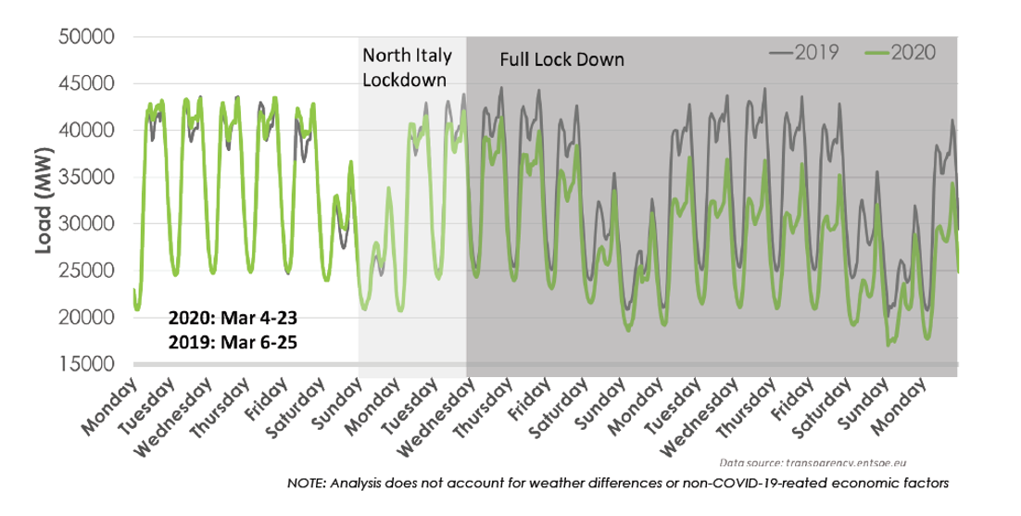
Impact of COVID-19 Lockdown on Italy Load
Image source: EPRI 3002018602

Slide 12
Impact of COVID-19 on Utility Practices
During the initial phases of the COVID-19 pandemic, like many companies, utilities identified essential staff and had non-essential staff work from home. Meetings became virtual.
Reduce unnecessary field work, such as preventative maintenance
A key concern is grid control centers, which must be manned 24/7 and only certain people are qualified to operate. It is also crucial to have several people in control centers with many years of experience, who tend to be older and part of the more vulnerable populations.
Sterilizing control centers, testing operators and in some cases sequestering operations teams to avoid contamination
Utilities often have main and back-up control centers
Concern is that in a more severe pandemic, there may not be enough healthy people to operate the grid

Slide 13
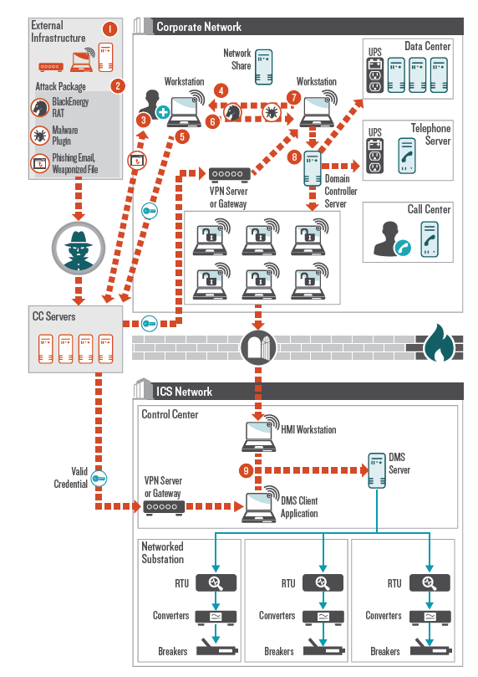
Dec. 23, 2015 Ukraine Blackout
The Dec 23, 2015 Ukraine blackout affected 225,000 customers
It was the first one determined to be caused by cyber attack
Attackers used malware tool to enable unauthorized network access to the control center and shut down electricity distribution
Cybersecurity research efforts seek to understand threats, improve protection, and mitigate the impacts of attacks
https://www.boozallen.com/content/dam/boozallen/documents/2016/09/ukraine-report-when-the-lights-went-out.pdf

Slide 14
Geomagnetic Disturbances (GMDs)
GMDs are caused by corona mass ejections (CMEs) from the sun; a GMD caused the Quebec blackout in 1989
They have the potential to severely disrupt the electric grid by causing quasi-dc geomagnetically induced currents (GICs) in the high voltage grid
Until recently power engineers had few tools to help them assess the impact of GMDs
GMD assessment tools are now moving into the realm of power system planning and operations engineers
Wide industry interest in GMD assessment

Slide 15
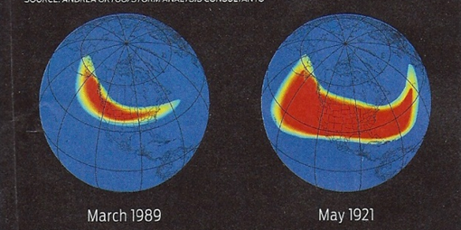
GMD Overview
Solar corona mass ejections (CMEs) can cause changes in the earth’s magnetic field (i.e., dB/dt). These changes in turn produce a non-uniform electric fields
  Changes in the magnetic flux are usually expressed in nT/minute; from a 60 Hz perspective
  they produce an almost dc electric field
  1989 North America storm produced a
  change of 500 nT/minute, while a stronger storm, such as the ones in 1859 or 1921, could produce 2500 nT/minute variation
  Storm “footprint” can be continental in scale
  Earth’s magnetic field is normally between 25,000 and 65,000 nT, with higher values near the poles
Image source: J. Kappenman, “A Perfect Storm of Planetary Proportions,” IEEE Spectrum, Feb 2012, page 29

Slide 16
Electric Fields and Geomagnetically Induced Currents (GICs)
The induced electric field at the surface is dependent on deep earth (hundreds of km) conductivity
  Electric fields are vectors (magnitude and angle); values expressed in units of volts/mile (or volts/km);
  A 2400 nT/minute storm could produce 5 to 10 volts/mile.
The electric fields cause GICs to flow in the high voltage transmission grid
The induced voltages that drive the GICs can be modeled as dc voltages in the transmission lines.

Slide 17
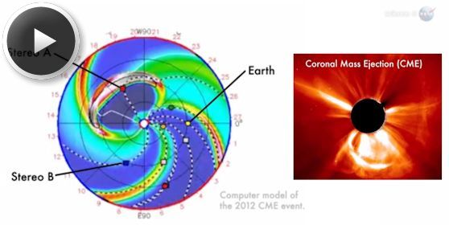
July 2012 GMD near miss
In July 2014 NASA said in July of 2012 there was a solar CME that barely missed the earth
  It would likely have
  caused the largest
  GMD that we have
  seen in the last 150
  years
There is still lots of
uncertainly about
how large a storm
is reasonable to
consider in electric utility planning
Image Source: science.nasa.gov/science-news/science-at-nasa/2014/23jul_superstorm/

Slide 18
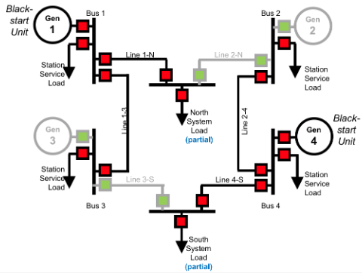
Black Start
Restoring a system from a full outage (blackout) is a process known as black start
Most generators require external power to get started (lights, control systems, protection, pumps, compressors, etc.)
There is a dedicated black start plan utilities have prepared to restore the system
  Smaller black start units (such as hydro) can start with a diesel generator or battery located on-site
  Then these units provide "cranking paths" to supply the larger generators with auxiliary power
  Multiple islands are reenergized in parallel
  Then, the islands are connected to reform the interconnected grid.
DOE, Hydropower Plants as Black Start Resources, 2019

Slide 19
Background On Power System Black Start
Key NERC Standard is EOP-005, 2009
  Transmission operators must have black start plans, verify them with steady-state and dynamic simulations, and run training exercises and testing
  Parts of a black start plan
    High level strategy for coordination and restoration
    Nuclear power plant off-site power supply
    Black start generating resources
    Cranking paths to next-start units
    Acceptable limits to voltage and frequency during restoration
    Load restoration and prioritization process
    Communication process and transfer of operational control
Recent report covering black start:
  J. G. O’Brien, M. Cassiadoro, T. Becejac, G. B. Sheble, J. D. Follum, U. Agrawal, E. S. Andersen, M. Touhiduzzaman, and J. E. Dagle, “Electric grid blackstart: Trends, challenges, and opportunities,” Pacific Northwest National Lab, Richland, WA, Tech. Rep., 2021

Slide 20
Issues in Black Start Procedure Design
Active power balance
  Need to maintain system frequency within limits by system stability and protection settings
  Accomplished by picking up loads in increments
Frequency control
  Initial black start islands are in isochronous control mode
  Transition to droop control with AGC and appropriate frequency bias
  Synchronizing islands, need to control frequency appropriately
Reactive power balance and overvoltage control
  Energizing few high voltage lines
  Operating generators at minimum voltage levels
  Deactivating switched shunt capacitors, connecting shunt reactors
  Adjusting transformer taps, picking up reactive loads

Slide 21
General Stages of Black Start Restoration
Ensure breakers are opened up to isolate the system
Start up black start units in separate islands, energizing associated buses on isochronous control
Add balancing loads and energize cranking paths to next-start units
Start up additional units and expand areas, transitioning to AGC control
Synchronize islands to reform transmission network
Continue to add load as additional generation comes online
Island 2
10 MW
300 MW Capacity
70 MW Output
Island 1
20 MW Capacity
8 MW Output
Next Start D
Black Start 1
15 MW
House Load
400 MW Capacity
70 MW Output
10 MW
Next Start 2
400 MW Capacity
12 MW Output
15 MW
Island 2: Now with 3 generators on line. Prepare for Constant Frequency Control.
Black Start A
60 MW Capacity
30 MW Output
Island 1:
420 MW Capacity
20 MW Load
Island 2:
760 MW Capacity
170 MW Load
100 MW
40 MW
Source: ERCOT, Frequency Control During Black Start Operations, 2014

Slide 22
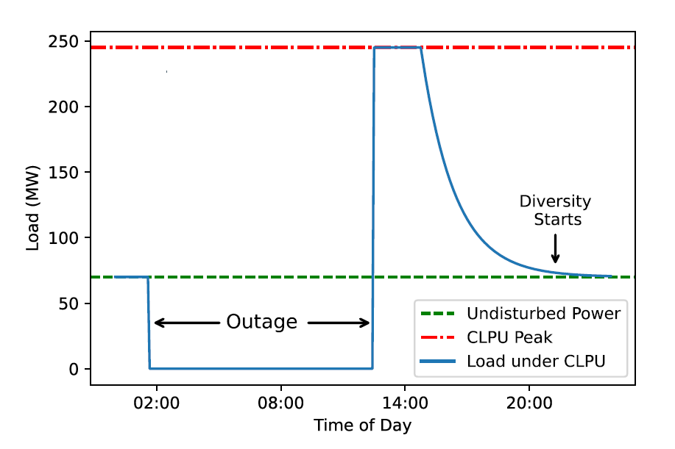
Cold Load Pick-Up Modeling
When loads are energized after an extended outage, cold load pick-up (CLPU) is in effect
This means the load’s consumed power may be 3-10 times as large as the undisturbed load value
The reason for CLPU effects is the loss of load “diversity” – that is, loads such as air conditioners that ordinarily operate at different, small intervals will instead be operating all at the same time
This increased load may last for 30 minutes or longer, until load diversity starts back again
If an outage is shorter, the CLPU effects will not be as severe because there is not enough time for full loss of diversity
J. Penaranda and A. B. Birchfield, "Application and Parameter Sensitivities of a State-Space Cold Load Pickup Model for a Synthetic Restoration Test Case," 2022 North American Power Symposium (NAPS), Salt Lake City, UT, USA, 2022, pp. 1-6

