Slide 1
ECEN 460, Spring 2023
Power System Operation and Control
Class 24: Additional Stability Topics
Prof. Adam Birchfield
Dept. of Electrical and Computer Engineering
Texas A&M University
abirchfield@tamu.edu

Slide 2
Announcements
Quiz next class on dynamics – single machine, infinite bus calculations
Final exam May 9th at 3:30pm

Slide 3

End-of-Semester Feedback
Please fill out your end-of-semester feedback if you haven't already!
End-of-semester student survey is used by instructors, TAs, ECEN department, College of Engineering, and the university for improving this course
We greatly value your feedback!
There is no grade associated with any of the student surveys
tamu.aefis.net

Slide 4
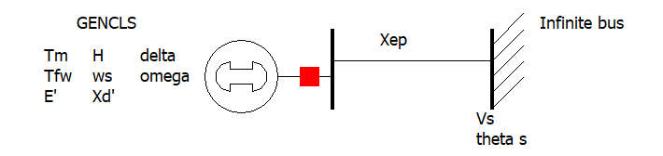

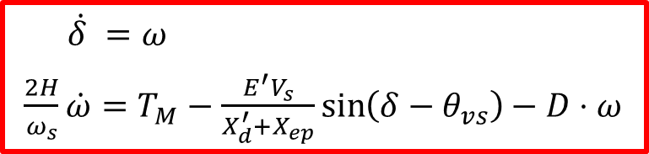
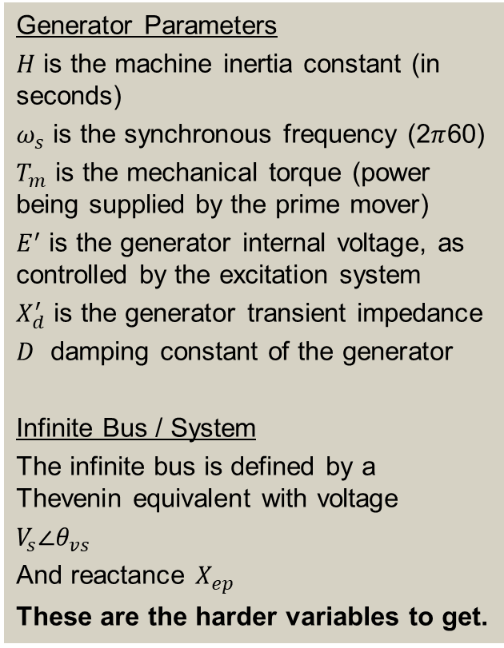
The Generator Dynamic Equations We Will Use
Example power system problem with differential algebraic equations (DAEs) is the classical synchronous generator connected to an infinite bus.
The two differential variables are $δ$ and $ω$; in practice dynamic models can have many more.
Generator Parameters
$H$ is the machine inertia constant (in seconds)
$ω_{s}$ is the synchronous frequency (2$π$60)
$T_{m}$ is the mechanical torque (power being supplied by the prime mover)
$E^{′}$ is the generator internal voltage, as controlled by the excitation system
$X_{d}^{′}$ is the generator transient impedance
$D$ damping constant of the generator
Infinite Bus / System
The infinite bus is defined by a Thevenin equivalent with voltage
$V_{s}∠θ_{vs}$
And reactance $X_{ep}$
These are the harder variables to get.
$\dot{δ} =ω$
$\frac{2H}{ω_{s}}\dot{ω}=T_{M}−\frac{E^{′}V_{s}}{X_{d}^{′}+X_{ep}}\sin\left(δ−θ_{vs}\right)−D⋅ω$

Slide 5

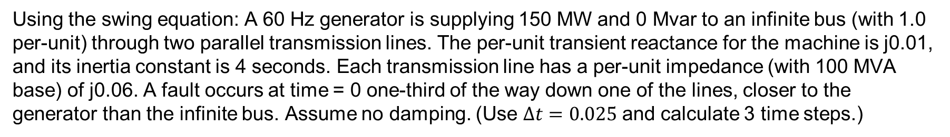
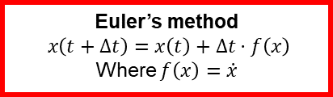
Homework Problem 3
$\dot{δ} =ω$
$\frac{2H}{ω_{s}}\dot{ω}=T_{M}−\frac{E^{′}V_{s}}{X_{d}^{′}+X_{ep}}\sin\left(δ−θ_{vs}\right)−D⋅ω$
Euler’s method
$$x\left(t+Δt\right)=x\left(t\right)+Δt⋅f\left(x\right)$$
Where $f\left(x\right)=\dot{x}$
Using the swing equation: A 60 Hz generator is supplying 150 MW and 0 Mvar to an infinite bus (with 1.0 per-unit) through two parallel transmission lines. The per-unit transient reactance for the machine is j0.01, and its inertia constant is 4 seconds. Each transmission line has a per-unit impedance (with 100 MVA base) of j0.06. A fault occurs at time = 0 one-third of the way down one of the lines, closer to the generator than the infinite bus. Assume no damping. (Use $Δt=0.025$ and calculate 3 time steps.)

Slide 6
Homework Problem 3
$\dot{δ} =ω$
$\frac{2H}{ω_{s}}\dot{ω}=T_{M}−\frac{E^{′}V_{s}}{X_{d}^{′}+X_{ep}}\sin\left(δ−θ_{vs}\right)−D⋅ω$
Euler’s method
$$x\left(t+Δt\right)=x\left(t\right)+Δt⋅f\left(x\right)$$
Where $f\left(x\right)=\dot{x}$
Using the swing equation: A 60 Hz generator is supplying 150 MW and 0 Mvar to an infinite bus (with 1.0 per-unit) through two parallel transmission lines. The per-unit transient reactance for the machine is j0.01, and its inertia constant is 4 seconds. Each transmission line has a per-unit impedance (with 100 MVA base) of j0.06. A fault occurs at time = 0 one-third of the way down one of the lines, closer to the generator than the infinite bus. Assume no damping. (Use $Δt=0.025$ and calculate 3 time steps.)

Slide 7
Homework Problem 3
$\dot{δ} =ω$
$\frac{2H}{ω_{s}}\dot{ω}=T_{M}−\frac{E^{′}V_{s}}{X_{d}^{′}+X_{ep}}\sin\left(δ−θ_{vs}\right)−D⋅ω$
Euler’s method
$$x\left(t+Δt\right)=x\left(t\right)+Δt⋅f\left(x\right)$$
Where $f\left(x\right)=\dot{x}$
Using the swing equation: A 60 Hz generator is supplying 150 MW and 0 Mvar to an infinite bus (with 1.0 per-unit) through two parallel transmission lines. The per-unit transient reactance for the machine is j0.01, and its inertia constant is 4 seconds. Each transmission line has a per-unit impedance (with 100 MVA base) of j0.06. A fault occurs at time = 0 one-third of the way down one of the lines, closer to the generator than the infinite bus. Assume no damping. (Use $Δt=0.025$ and calculate 3 time steps.)

Slide 8

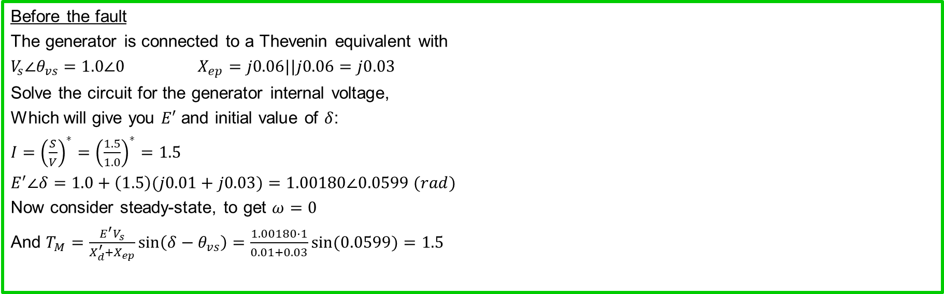



Homework Problem 3
$\dot{δ} =ω$
$\frac{2H}{ω_{s}}\dot{ω}=T_{M}−\frac{E^{′}V_{s}}{X_{d}^{′}+X_{ep}}\sin\left(δ−θ_{vs}\right)−D⋅ω$
Euler’s method
$$x\left(t+Δt\right)=x\left(t\right)+Δt⋅f\left(x\right)$$
Where $f\left(x\right)=\dot{x}$
Using the swing equation: A 60 Hz generator is supplying 150 MW and 0 Mvar to an infinite bus (with 1.0 per-unit) through two parallel transmission lines. The per-unit transient reactance for the machine is j0.01, and its inertia constant is 4 seconds. Each transmission line has a per-unit impedance (with 100 MVA base) of j0.06. A fault occurs at time = 0 one-third of the way down one of the lines, closer to the generator than the infinite bus. Assume no damping.
Before the fault
The generator is connected to a Thevenin equivalent with
$V_{s}∠θ_{vs}=1.0∠0$ $X_{ep}=j0.06||j0.06=j0.03$
Solve the circuit for the generator internal voltage,
Which will give you $E′$ and initial value of $δ$:
$I={\left(\frac{S}{V}\right)}^{∗}={\left(\frac{1.5}{1.0}\right)}^{∗}=1.5$
$E^{′}∠δ=1.0+\left(1.5\right)(j0.01+j0.03)=1.00180∠0.0599 (rad)$
Now consider steady-state, to get $ω=0$
And $T_{M}=\frac{E^{′}V_{s}}{X_{d}^{′}+X_{ep}}\sin\left(δ−θ_{vs}\right)=\frac{1.00180⋅1}{0.01+0.03}\sin{(0.0599)}=1.5$
$H=4$seconds $X_{d}^{′}=0.01$
j0.06
j0.01
+
+
E$∠δ°$
j0.06
1$∠0°$
_
_
Initial values:
$δ\left(0\right)=0.0599$
$ω\left(0\right)=0$

Slide 9

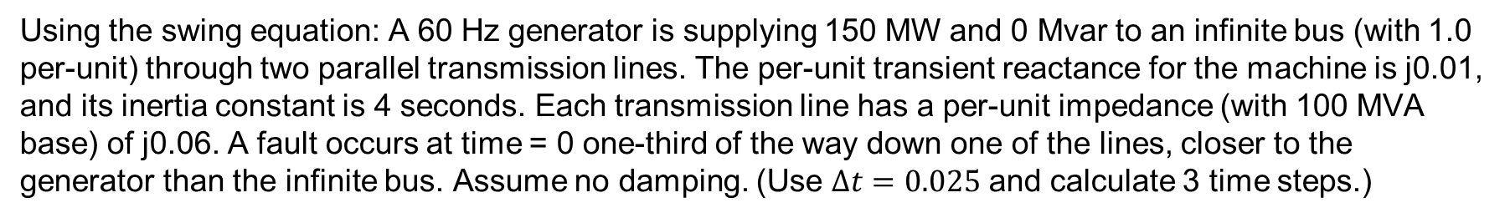



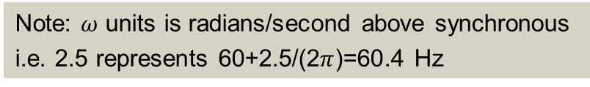
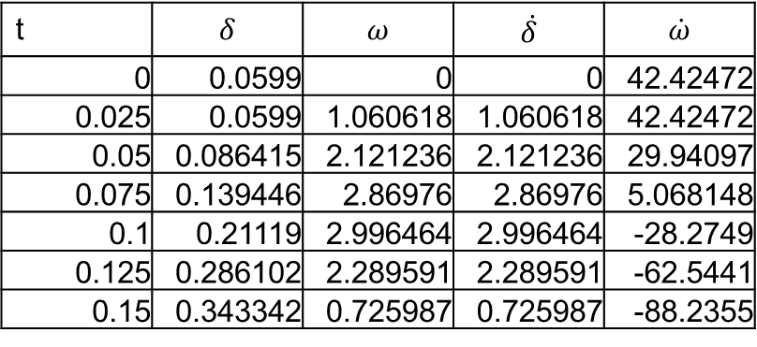
Homework Problem 3
$\dot{δ} =ω$
$\frac{2H}{ω_{s}}\dot{ω}=T_{M}−\frac{E^{′}V_{s}}{X_{d}^{′}+X_{ep}}\sin\left(δ−θ_{vs}\right)−D⋅ω$
Euler’s method
$$x\left(t+Δt\right)=x\left(t\right)+Δt⋅f\left(x\right)$$
Where $f\left(x\right)=\dot{x}$
Using the swing equation: A 60 Hz generator is supplying 150 MW and 0 Mvar to an infinite bus (with 1.0 per-unit) through two parallel transmission lines. The per-unit transient reactance for the machine is j0.01, and its inertia constant is 4 seconds. Each transmission line has a per-unit impedance (with 100 MVA base) of j0.06. A fault occurs at time = 0 one-third of the way down one of the lines, closer to the generator than the infinite bus. Assume no damping. (Use $Δt=0.025$ and calculate 3 time steps.)
After the fault
The Thevenin equivalent changes.
$V_{s}∠θ_{vs}=1.0 \left(\frac{0.02}{0.02+0.06}\right)=0.25∠0$
$X_{ep}=j0.06||j0.02=j0.015$
Now rewrite the swing equation
$\frac{8}{2π60}\dot{ω}=1.5−\frac{1.00180⋅0.25}{0.01+0.015}\sin\left(δ\right)$
$H=4$seconds $X_{d}^{′}=0.01$
t | $$δ$$ | $$ω$$ | $$\dot{δ}$$ | $$\dot{ω}$$
0 | 0.0599 | 0 | 0 | 42.42472
0.025 | 0.0599 | 1.060618 | 1.060618 | 42.42472
0.05 | 0.086415 | 2.121236 | 2.121236 | 29.94097
0.075 | 0.139446 | 2.86976 | 2.86976 | 5.068148
0.1 | 0.21119 | 2.996464 | 2.996464 | -28.2749
0.125 | 0.286102 | 2.289591 | 2.289591 | -62.5441
0.15 | 0.343342 | 0.725987 | 0.725987 | -88.2355
j0.06
j0.01
+
+
E$∠δ°$
1$∠0°$
_
j0.02
j0.04
_
Note: $ω$ units is radians/second above synchronous
i.e. 2.5 represents 60+2.5/(2$π$)=60.4 Hz

Slide 10
Transient Stability Load Modeling
Load modeling is certainly challenging!
For large system models an aggregate load can consist of many thousands of individual devices
The load is constantly changing, with key diurnal and temperature variations
  For example, a higher percentage of lighting load at night, more air conditioner load on hot days
Load model behavior can be quite complex during the low voltages that may occur in transient stability
Testing aggregate load models for extreme conditions is not feasible – we need to wait for disturbances!

Slide 11
Transient Stability Load Modeling
Traditionally load models have been divided into two groups
  Static: load is a algebraic function of bus voltage and sometimes frequency
  Dynamic: load is represented with a dynamic model, with induction motor models the most common
The simplest load model is a static constant impedance
  Has been widely used
  Allowed the Ybus to be reduced, eliminating essentially all non-generator buses
  Presents no issues as voltage falls to zero
  Is rapidly falling out of favor

Slide 12
Induction Motor Models
Induction motors, both three phase and single phase, make up a very large percentage of the load
Term induction machine is used to indicate either generator or motor; most uses are as motors
Induction machines have two major components
  A stationary stator, which is supplied with an ac voltage; windings in stator create a rotating magnetic field
  A rotating rotor, in which an ac current is induced (hence the name)
Two basic design types based on rotor design
  Squirrel-cage: rotor consists of shorted conducting bars laid into magnetic material in a cage structure
  Wound-rotor: rotor has windings similar to stator, with slip rings used to provide external access to the rotor windings

Slide 13
Torque-Speed Curves
To help understand the behavior of an induction machine it is useful to plot various values as a function of speed (or equivalently, slip)
  Solve the equivalent circuit for a specified terminal voltage, and varying values of slip
  Plot results
  Recall torque times speed = power
    Here speed is the rotor speed
  When using per unit, the per unit speed is just 1-s, so
  PE = TE(1-s)

Slide 14
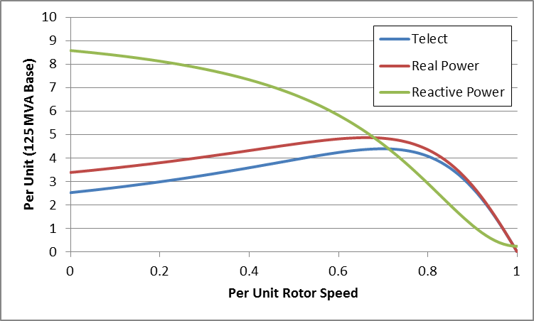
Induction Motor Example Torque-speed Curves
The below graph shows the torque-speed curve for this induction machine; note the high reactive power consumption on starting (which is why the lights may dim when starting a clothes dryer!)
From the graph
you can see with
a 100 MW load
(0.8 pu on the
125 MW base),
the slip is about
0.025

Slide 15
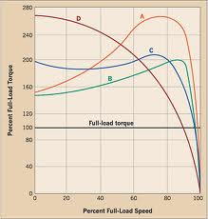
Induction Motor Classes
Four major classes of induction motors, based on application. Key values are starting torque, pull-out torque, full-load torque, and starting current
In steady-state the motor will operate on the right side
of the curve at the point at which the electrical torque
matches the mechanical torque
A: Fans, pumps machine tools
B: Similar to A
C: Compressors, conveyors
D: High inertia such as hoists
Image source: ecmweb.com/motors/understanding-induction-motor-nameplate-information

Slide 16
Induction Motor Stalling
The maximum of the torque-speed curve varies with the square of the terminal voltage
When the terminal voltage decreases, such as during a fault, the mechanical torque can exceed the electrical torque
  This causes the motor to decelerate, perhaps quite quickly, with the rate proportional to its inertia
  This deceleration causing the slip to increase, perhaps causing the motor to stall with s=1, resulting in a high reactive current draw
  Too many stalled motors can prevent the voltage from recovering

Slide 17
Motor Stalling Example
Using case WSCC_CIM5, which models the WSCC 9 bus case with 100% induction motor load
Change the fault scenario to say a fault midway between buses 5 and 7, cleared by opening the line
Results are for a 0.1 second fault
Usually motor load
is much less than 100%

Slide 18
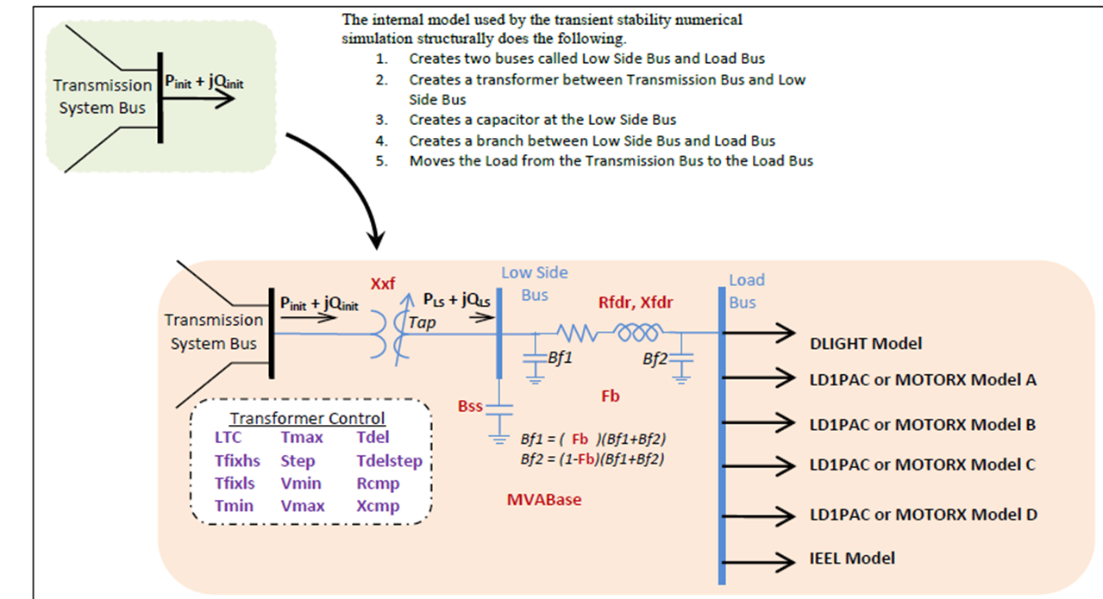
Composite Load Model
Contains up to four motors or single phase induction motor models; also includes potential for solar PV

Slide 19
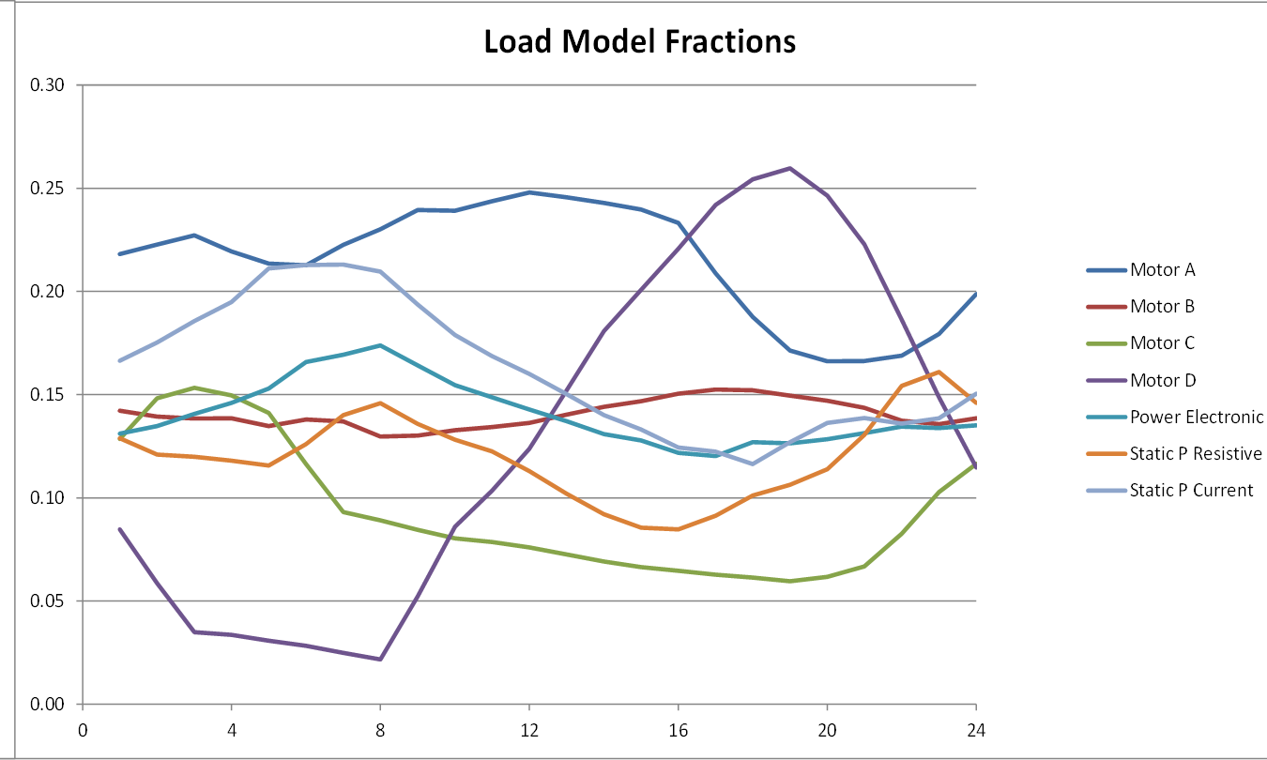
Modeling Time Variation in Load
Different time varying composite model parameters are now being used
Example of varying composite load percentages over a day

