Slide 1
ECEN 460, Spring 2023
Power System Operation and Control
Class 21: Power System Dynamics Models
Prof. Adam Birchfield
Dept. of Electrical and Computer Engineering
Texas A&M University
abirchfield@tamu.edu

Slide 2
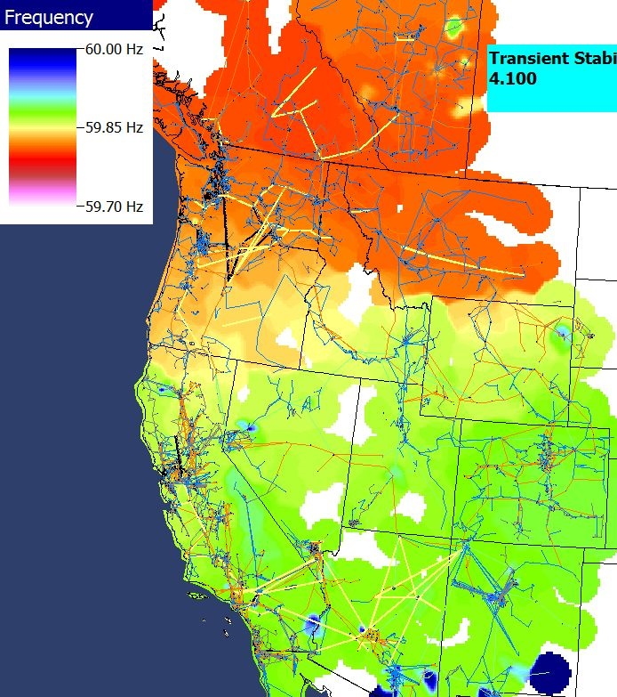
Power Grid Disturbance Example
Figures show the frequency change as a result of the sudden loss of a large amount of generation in the Southern WECC
Green is bus quite close to location of generator trip while blue and red are quite distant.
Frequency in HZ
Frequency contour
Time in seconds

Slide 3
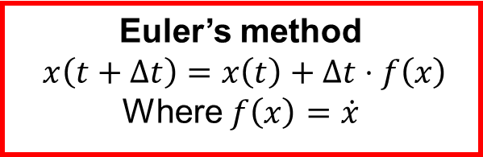
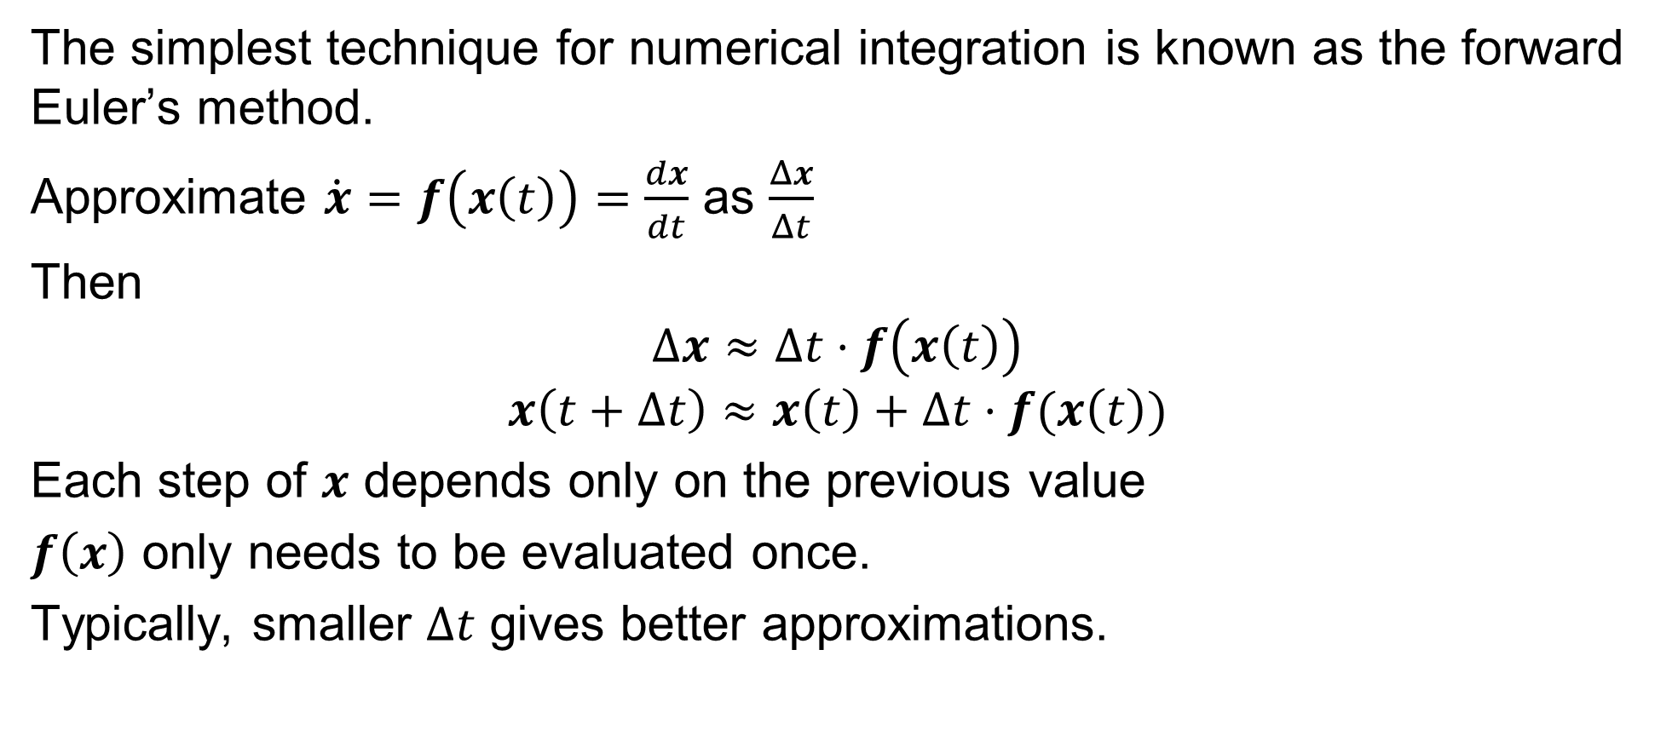
Euler’s Method
The simplest technique for numerical integration is known as the forward Euler’s method.
Approximate $\dot{x}=f\left(x\left(t\right)\right)=\frac{dx}{dt}$ as $\frac{Δx}{Δt}$
Then
$$Δx≈Δt⋅f\left(x\left(t\right)\right)$$
$$x\left(t+Δt\right)≈x\left(t\right)+Δt⋅f(x\left(t\right))$$
Each step of $x$ depends only on the previous value
$f\left(x\right)$ only needs to be evaluated once.
Typically, smaller $Δt$ gives better approximations.
Euler’s method
$$x\left(t+Δt\right)=x\left(t\right)+Δt⋅f\left(x\right)$$
Where $f\left(x\right)=\dot{x}$

Slide 4
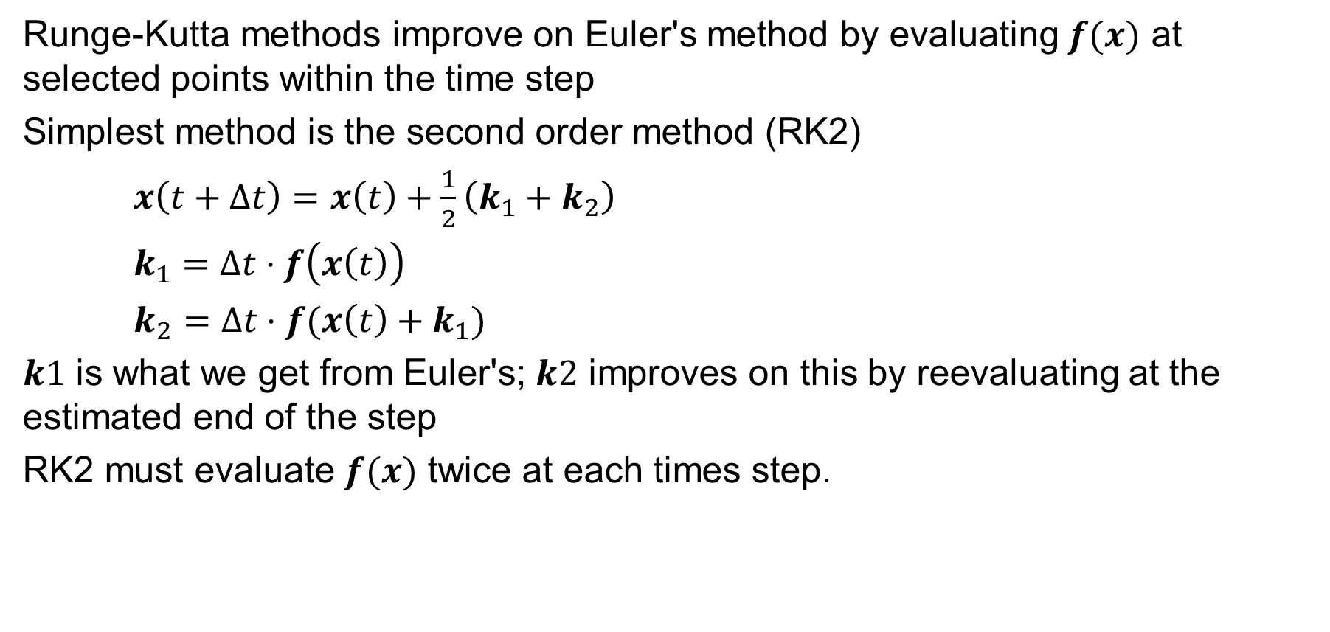
Runge-Kutta Methods
Runge-Kutta methods improve on Euler's method by evaluating $f(x)$ at selected points within the time step
Simplest method is the second order method (RK2)
$x\left(t+Δt\right)=x\left(t\right)+\frac{1}{2}\left(k_{1}+k_{2}\right)$
$k_{1}=Δt⋅f\left(x\left(t\right)\right)$
$k_{2}=Δt⋅f(x\left(t\right)+k_{1})$
$k1$ is what we get from Euler's; $k2$ improves on this by reevaluating at the estimated end of the step
RK2 must evaluate $f(x)$ twice at each times step.

Slide 5
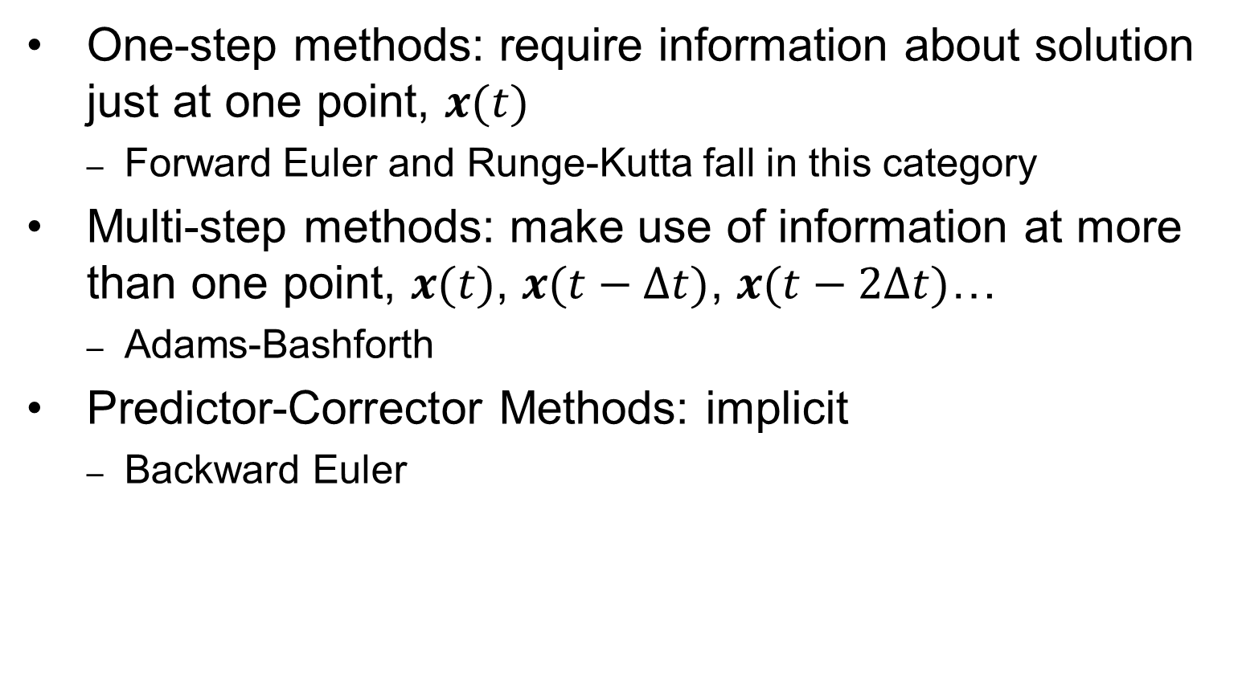
Other Numerical Solution Methods
One-step methods: require information about solution just at one point, $x(t)$
  Forward Euler and Runge-Kutta fall in this category
Multi-step methods: make use of information at more than one point, $x(t)$, $x(t−Δt)$, $x(t−2Δt)$…
  Adams-Bashforth
Predictor-Corrector Methods: implicit
  Backward Euler

Slide 6
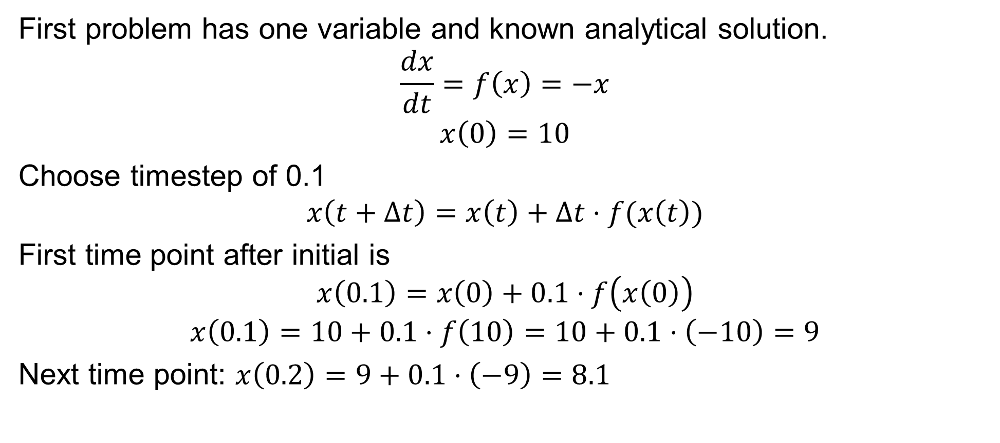
Example #1
First problem has one variable and known analytical solution.
$$\frac{dx}{dt}=f\left(x\right)=−x$$
$$x\left(0\right)=10$$
Choose timestep of 0.1
$$x\left(t+Δt\right)=x\left(t\right)+Δt⋅f(x\left(t\right))$$
First time point after initial is
$$x\left(0.1\right)=x\left(0\right)+0.1⋅f\left(x\left(0\right)\right)$$
$$x\left(0.1\right)=10+0.1⋅f\left(10\right)=10+0.1⋅\left(−10\right)=9$$
Next time point: $x\left(0.2\right)=9+0.1⋅\left(−9\right)=8.1$

Slide 7
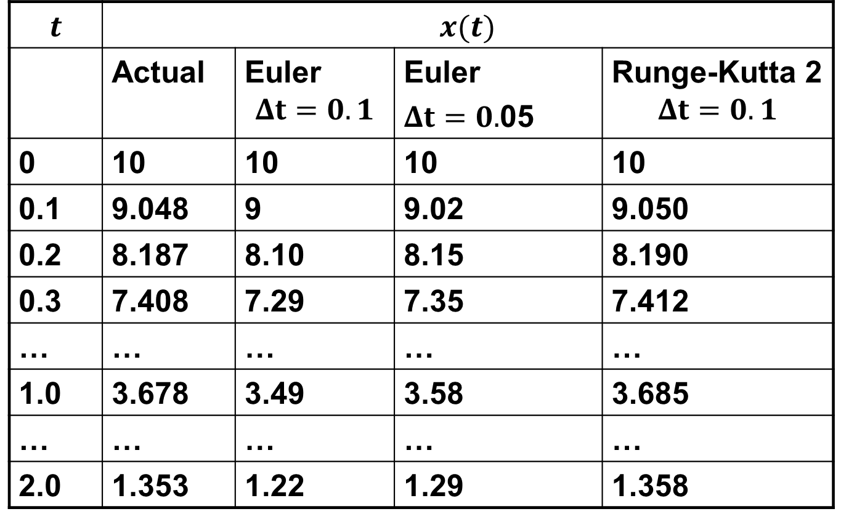
Example #1, Cont.
$$t$$ | $$x(t)$$
 | Actual | Euler $$Δt=0.1$$ | Euler $Δt=0.$05 | Runge-Kutta 2 $$Δt=0.1$$
0 | 10 | 10 | 10 | 10
0.1 | 9.048 | 9 | 9.02 | 9.050
0.2 | 8.187 | 8.10 | 8.15 | 8.190
0.3 | 7.408 | 7.29 | 7.35 | 7.412
… | … | … | … | …
1.0 | 3.678 | 3.49 | 3.58 | 3.685
… | … | … | … | …
2.0 | 1.353 | 1.22 | 1.29 | 1.358

Slide 8
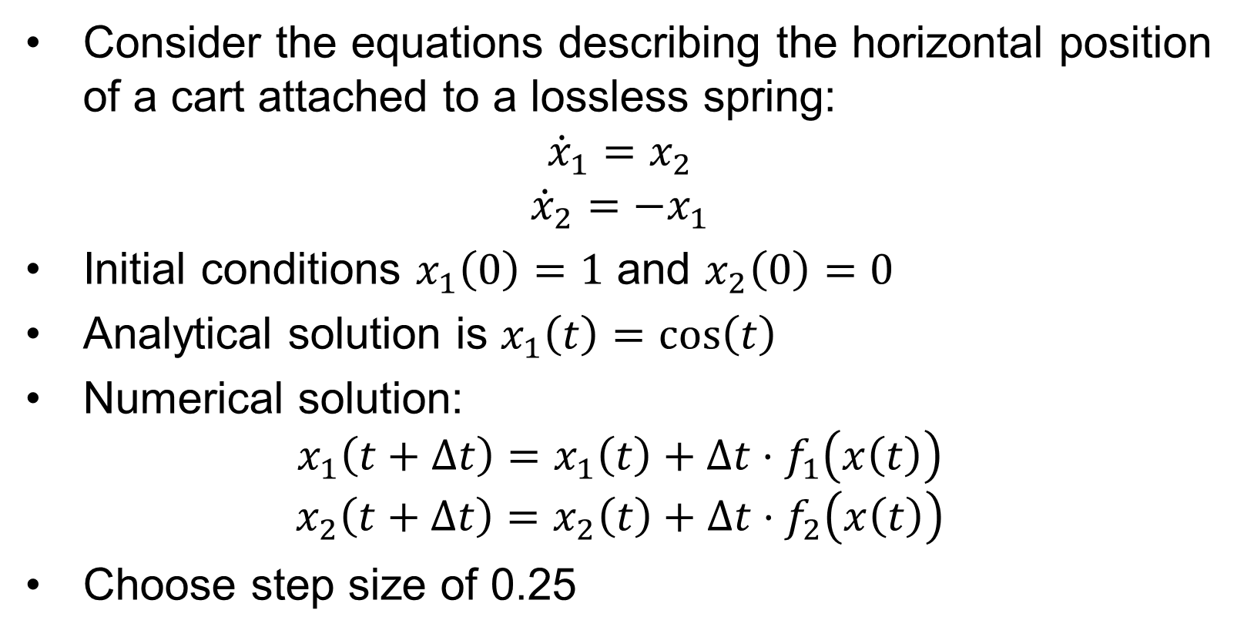
Example #2
Consider the equations describing the horizontal position of a cart attached to a lossless spring:
$${\dot{x}}_{1}=x_{2}$$
$${\dot{x}}_{2}=−x_{1}$$
Initial conditions $x_{1}\left(0\right)=1$ and $x_{2}\left(0\right)=0$
Analytical solution is $x_{1}\left(t\right)=\cos\left(t\right)$
Numerical solution:
$$x_{1}\left(t+Δt\right)=x_{1}\left(t\right)+Δt⋅f_{1}\left(x\left(t\right)\right)$$
$$x_{2}\left(t+Δt\right)=x_{2}\left(t\right)+Δt⋅f_{2}\left(x\left(t\right)\right)$$
Choose step size of 0.25

Slide 9
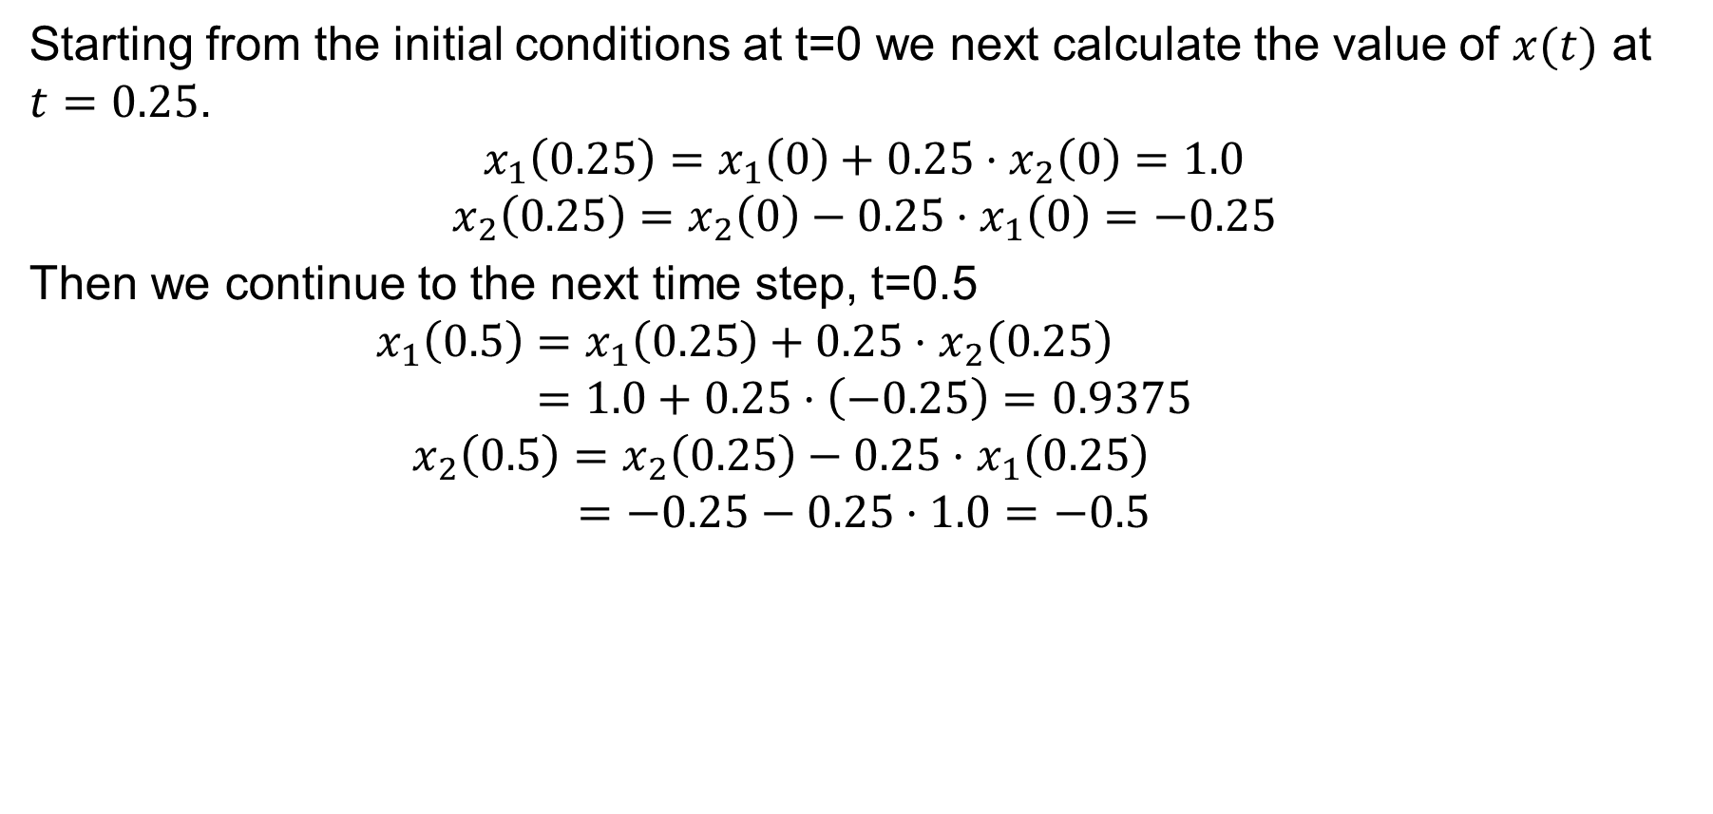
Example #2, Cont.
Starting from the initial conditions at t=0 we next calculate the value of $x(t)$ at $t=0.25$.
$$x_{1}\left(0.25\right)=x_{1}\left(0\right)+0.25⋅x_{2}\left(0\right)=1.0$$
$$x_{2}\left(0.25\right)=x_{2}\left(0\right)−0.25⋅x_{1}\left(0\right)=−0.25$$
Then we continue to the next time step, t=0.5
$$x_{1}\left(0.5\right)=x_{1}\left(0.25\right)+0.25⋅x_{2}\left(0.25\right)$$
$$=1.0+0.25⋅\left(−0.25\right)=0.9375$$
$$x_{2}\left(0.5\right)=x_{2}\left(0.25\right)−0.25⋅x_{1}\left(0.25\right)$$
$$=−0.25−0.25⋅1.0=−0.5$$

Slide 10
Example #2, Cont.
t | x₁^{actual}(t) | x₁(t) Dt=0.25
0 | 1 | 1
0.25 | 0.9689 | 1
0.50 | 0.8776 | 0.9375
0.75 | 0.7317 | 0.8125
1.00 | 0.5403 | 0.6289
… | … | …
10.0 | -0.8391 | -3.129
100.0 | 0.8623 | -151,983
Since we know from
the exact solution that
x₁ is bounded between
-1 and 1, clearly the
method is numerically
unstable

Slide 11
Example #2, Cont.
Below is a comparison of the solution values for x₁(t)
at time t = 10 seconds
Dt | x₁(10)
actual | -0.8391
0.25 | -3.129
0.10 | -1.4088
0.01 | -0.8823
0.001 | -0.8423

Slide 12
Generator Transient Stability Models
In order to study the transient response of a power system we need to develop models for the generator valid during the transient time frame of several seconds following a system disturbance
We need to develop both electrical and mechanical models for the generators

Slide 13
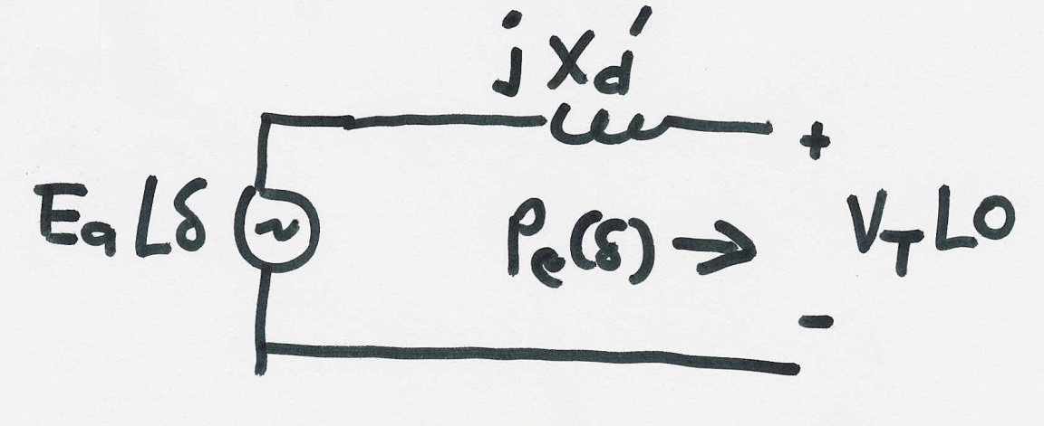


Generator Electrical Model
The simplest generator model, known as the classical model, treats the generator as a voltage source behind the direct-axis transient reactance; the voltage magnitude $E^{′}$ is fixed, but its angle $δ$ changes according to the mechanical dynamics
$$P_{e}(δ)=\frac{V_{T}E′}{X_{d}^{′}}\sin{δ}$$

Slide 14
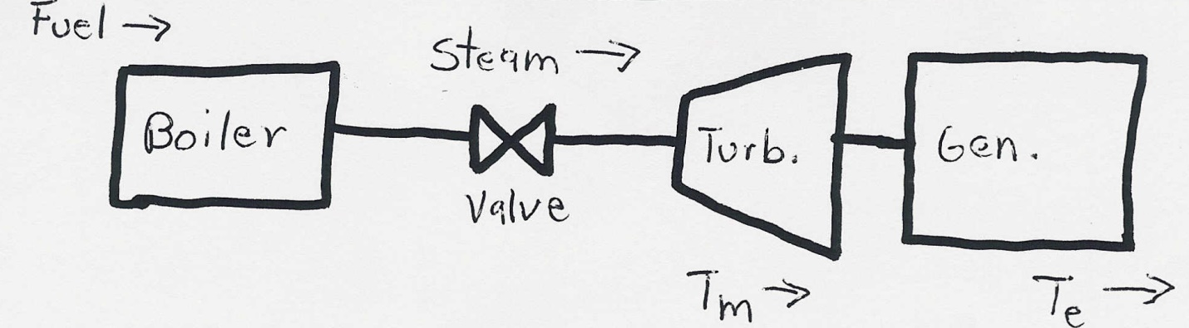
Generator Mechanical Model
Generator Mechanical Block Diagram

Slide 15
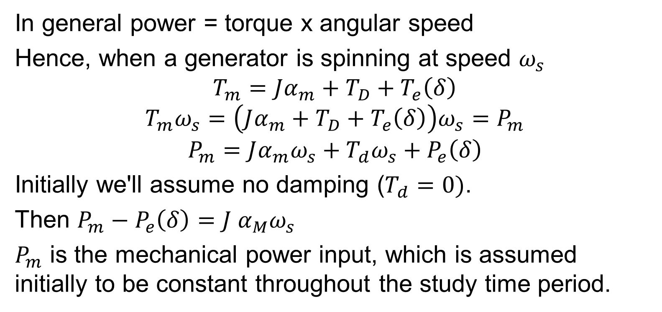
Generator Mechanical Model, Cont’d
In general power = torque x angular speed
Hence, when a generator is spinning at speed $ω_{s}$
$$T_{m}=Jα_{m}+T_{D}+T_{e}\left(δ\right)$$
$$T_{m}ω_{s}=\left(Jα_{m}+T_{D}+T_{e}\left(δ\right)\right)ω_{s}=P_{m}$$
$$P_{m}=Jα_{m}ω_{s}+T_{d}ω_{s}+P_{e}\left(δ\right)$$
Initially we'll assume no damping ($T_{d}=0)$.
Then $P_{m}−P_{e}\left(δ\right)=J α_{M}ω_{s}$
$P_{m}$ is the mechanical power input, which is assumed initially to be constant throughout the study time period.

Slide 16
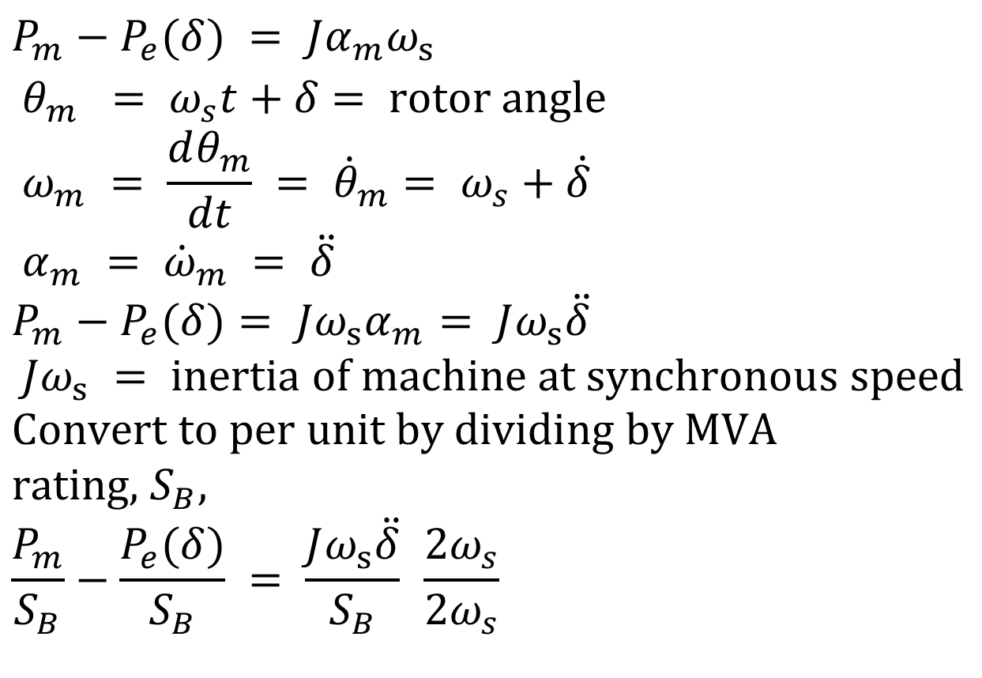
Generator Mechanical Model, Cont’d
$$P_{m}−P_{e}(δ) = Jα_{m}ω_{s} \\ θ_{m} = ω_{s}t+δ = \text{rotor} \text{angle} \\ ω_{m} = \frac{dθ_{m}}{dt} = {\dot{θ}}_{m}= ω_{s}+\dot{δ} \\ α_{m} = {\dot{ω}}_{m} = \ddot{δ} \\ P_{m}−P_{e}(δ)= Jω_{s}α_{m}= Jω_{s}\ddot{δ} \\ Jω_{s} = \text{inertia} \text{of} \text{machine} \text{at} \text{synchronous} \text{speed} \\ \text{Convert} \text{to} \text{per} \text{unit} \text{by} \text{dividing} \text{by} \text{MVA} \text{rating}\text{, }S_{B}, \\ \frac{P_{m}}{S_{B}}−\frac{P_{e}(δ)}{S_{B}} = \frac{Jω_{s}\ddot{δ}}{S_{B}} \frac{2ω_{s}}{2ω_{s}}$$

Slide 17
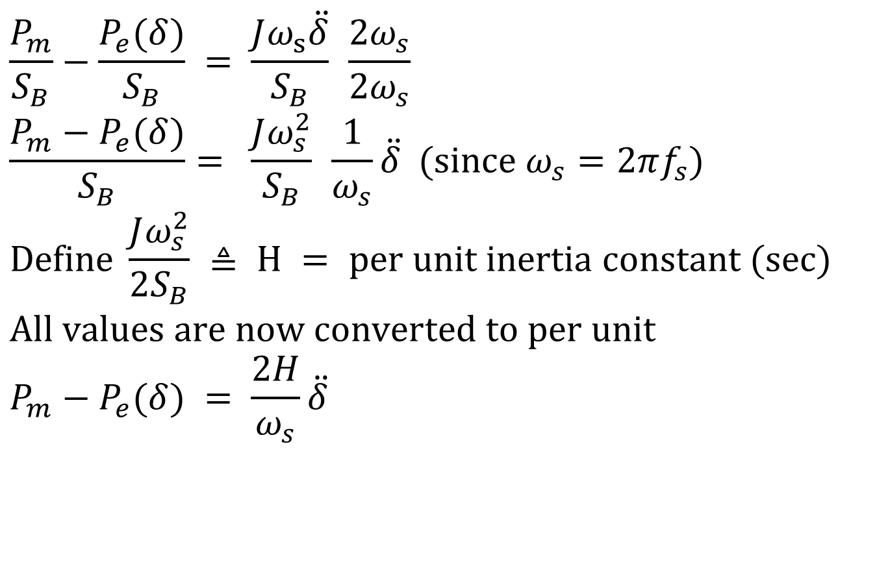
Generator Mechanical Model, Cont’d
$$\frac{P_{m}}{S_{B}}−\frac{P_{e}(δ)}{S_{B}} = \frac{Jω_{s}\ddot{δ}}{S_{B}} \frac{2ω_{s}}{2ω_{s}} \\ \frac{P_{m}−P_{e}(δ)}{S_{B}}= \frac{Jω_{s}^{2}}{S_{B}} \frac{1}{ω_{s}}\ddot{δ} (\text{since} ω_{s}=2πf_{s}) \\ \text{Define} \frac{Jω_{s}^{2}}{2S_{B}} ≜ H = \text{per} \text{unit} \text{inertia} \text{constant} (\text{sec}) \\ \text{All} \text{values} \text{are} \text{now} \text{converted} \text{to} \text{per} \text{unit} \\ P_{m}−P_{e}(δ) = \frac{2H}{ω_{s}}\ddot{δ}$$

Slide 18
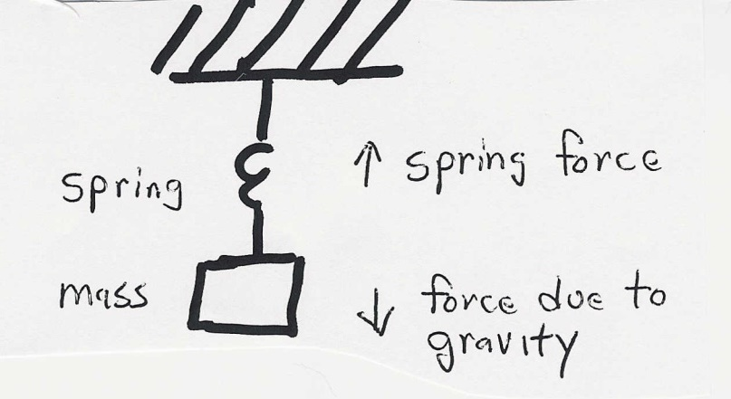
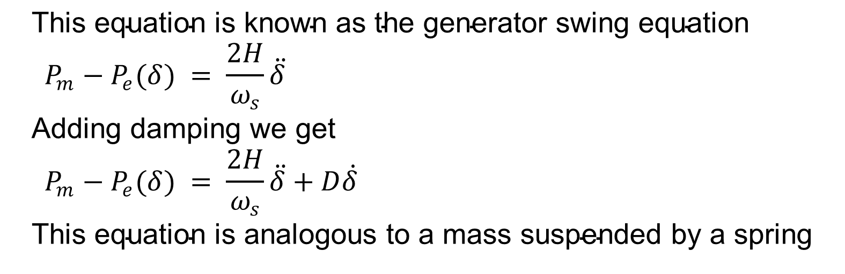
Generator Swing Equation
$$\text{This} \text{equation} \text{is} \text{known} \text{as} \text{the} \text{generator} \text{swing} \text{equation} \\ P_{m}−P_{e}(δ) = \frac{2H}{ω_{s}}\ddot{δ} \\ \text{Adding} \text{damping} \text{we} \text{get} \\ P_{m}−P_{e}(δ) = \frac{2H}{ω_{s}}\ddot{δ}+D\dot{δ} \\ \text{This} \text{equation} \text{is} \text{analogous} \text{to} \text{a} \text{mass} \text{suspended} \text{by} \text{a} \text{spring}$$

Slide 19
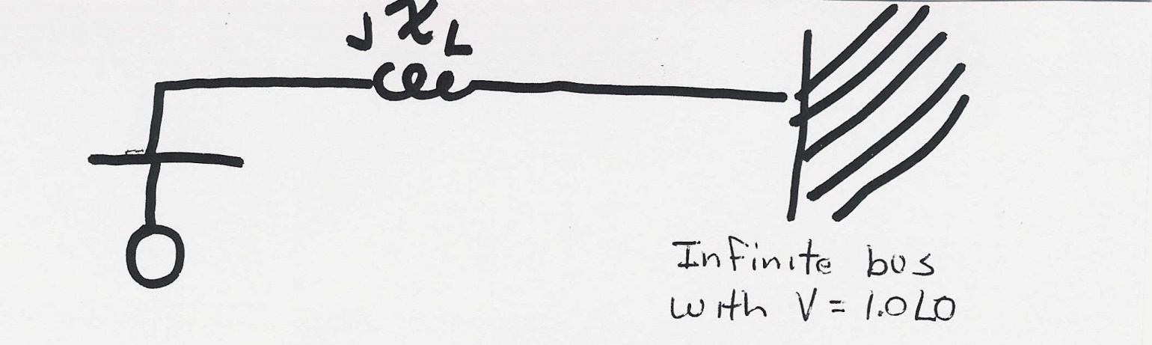
Single Machine Infinite Bus (SMIB)
To understand the transient stability problem we’ll first consider the case of a single machine (generator) connected to a power system bus with a fixed voltage magnitude and angle (known as an infinite bus) through a transmission line with impedance jXL

Slide 20
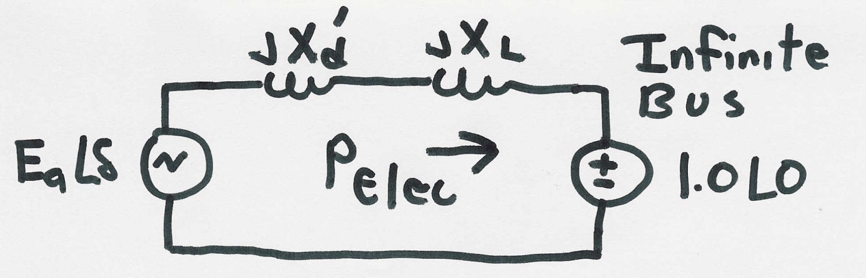
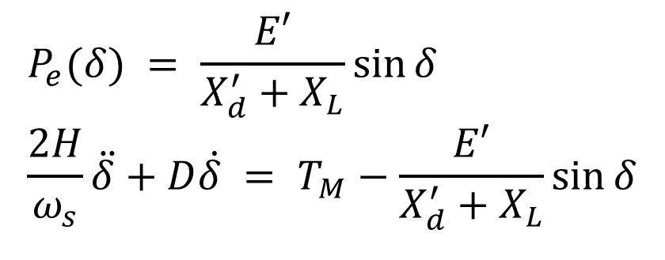
SMIB, Cont’d
$$P_{e}(δ) = \frac{E′}{X_{d}^{′}+X_{L}}\sin{δ} \\ \frac{2H}{ω_{s}}\ddot{δ}+D\dot{δ} = T_{M}−\frac{E′}{X_{d}^{′}+X_{L}}\sin{δ}$$

Slide 21
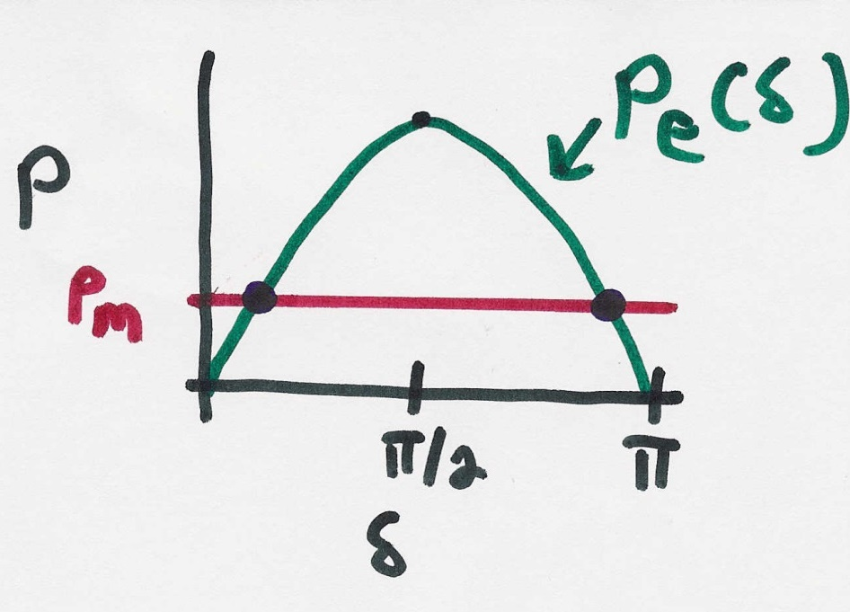
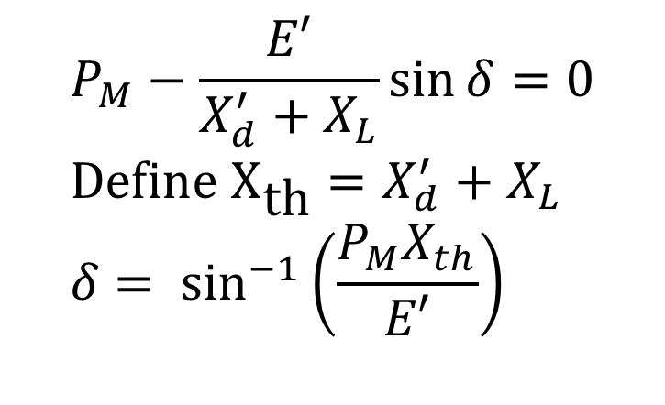
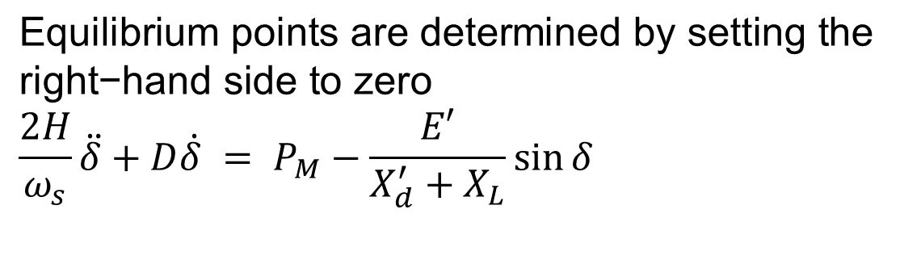
SMIB Equilibrium Points
$$\text{Equilibrium} \text{points} \text{are} \text{determined} \text{by} \text{setting} \text{the} \\ \text{right}\text{−}\text{hand} \text{side} \text{to} \text{zero} \\ \frac{2H}{ω_{s}}\ddot{δ}+D\dot{δ} = P_{M}−\frac{E′}{X_{d}^{′}+X_{L}}\sin{δ}$$
$$P_{M}−\frac{E′}{X_{d}^{′}+X_{L}}\sin{δ}=0 \\ \text{Define} {\text{X}}_{\text{th}}=X_{d}^{′}+X_{L} \\ δ = \sin^{−1}\left(\frac{P_{M}X_{th}}{E′}\right)$$

Slide 22
Transient Stability Analysis
For transient stability analysis we need to consider three systems
  Prefault - before the fault occurs the system is assumed to be at an equilibrium point
  Faulted - the fault changes the system equations, moving the system away from its equilibrium point
  Postfault - after fault is cleared the system hopefully returns to a new operating point
Actual transient stability studies can have
multiple events

Slide 23
Transient Stability Solution Methods
There are two methods for solving the transient stability problem
  Numerical integration
    this is by far the most common technique, particularly for large systems; during the fault and after the fault the power system differential equations are solved using numerical methods
  Direct or energy methods; for a two bus system this method is known as the equal area criteria
    mostly used to provide an intuitive insight into the transient stability problem

Slide 24
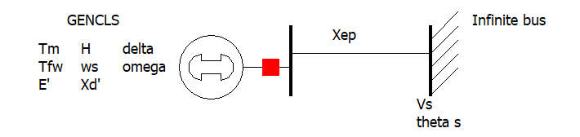

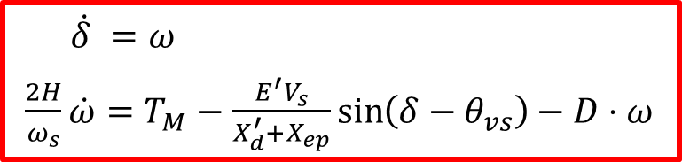
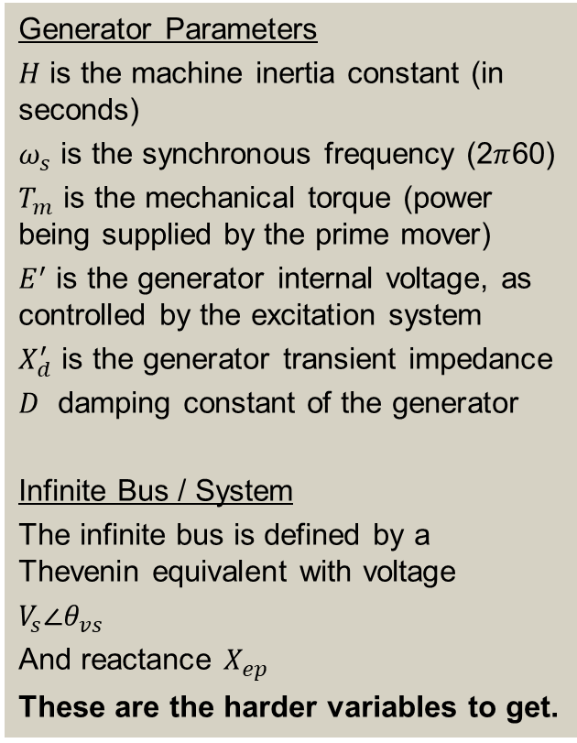
The Generator Dynamic Equations We Will Use
Example power system problem with differential algebraic equations (DAEs) is the classical synchronous generator connected to an infinite bus.
The two differential variables are $δ$ and $ω$; in practice dynamic models can have many more.
Generator Parameters
$H$ is the machine inertia constant (in seconds)
$ω_{s}$ is the synchronous frequency (2$π$60)
$T_{m}$ is the mechanical torque (power being supplied by the prime mover)
$E^{′}$ is the generator internal voltage, as controlled by the excitation system
$X_{d}^{′}$ is the generator transient impedance
$D$ damping constant of the generator
Infinite Bus / System
The infinite bus is defined by a Thevenin equivalent with voltage
$V_{s}∠θ_{vs}$
And reactance $X_{ep}$
These are the harder variables to get.
$\dot{δ} =ω$
$\frac{2H}{ω_{s}}\dot{ω}=T_{M}−\frac{E^{′}V_{s}}{X_{d}^{′}+X_{ep}}\sin\left(δ−θ_{vs}\right)−D⋅ω$

Slide 25
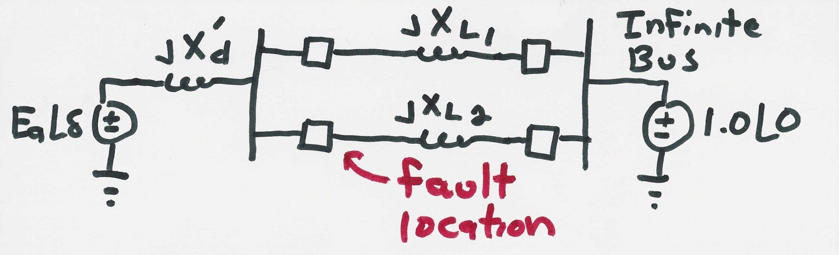
SMIB Example
Assume a generator is supplying power to an infinite bus through two parallel transmission lines. Then a balanced three phase fault occurs at the terminal of one of the lines. The fault is cleared by the opening of this line’s circuit breakers.

Slide 26
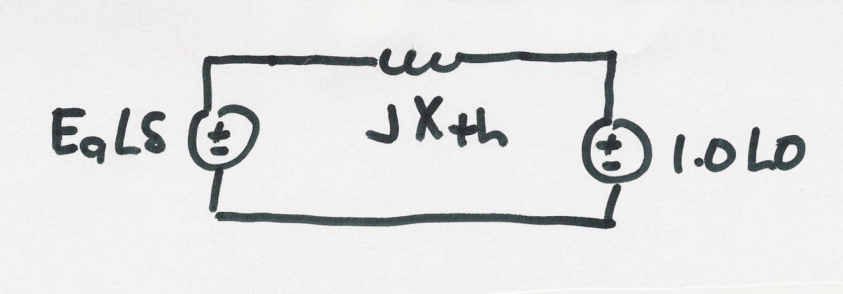
SMIB Example, Cont’d
Simplified prefault system, with $X_{th}=X_{d}^{′}+\left(X_{L1} | X_{L2}\right)$

Slide 27
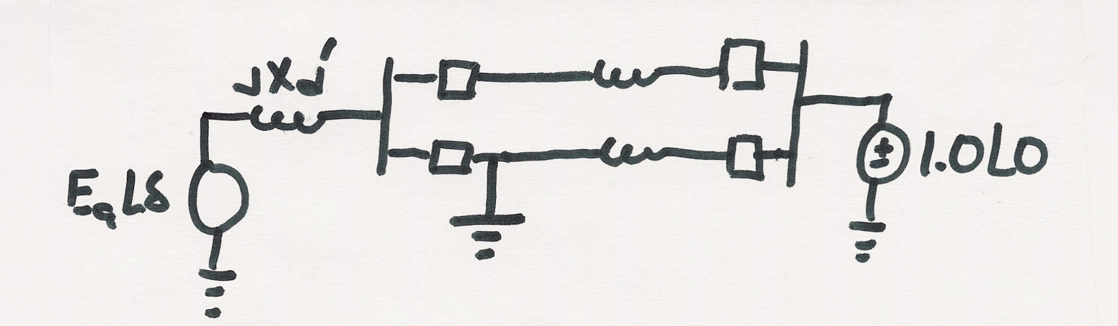
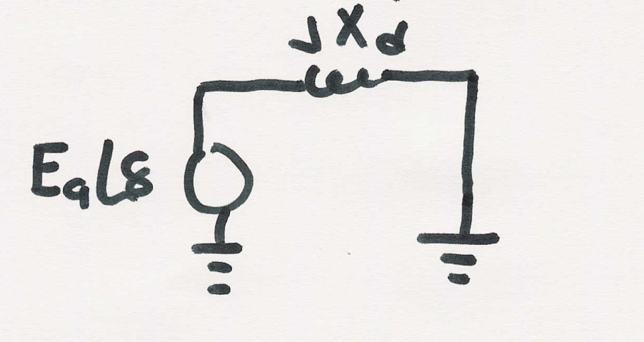
SMIB Example, Faulted System
During the fault the system changes
The equivalent system during the fault is then
During this fault no
power can be transferred
from the generator to
the system

Slide 28
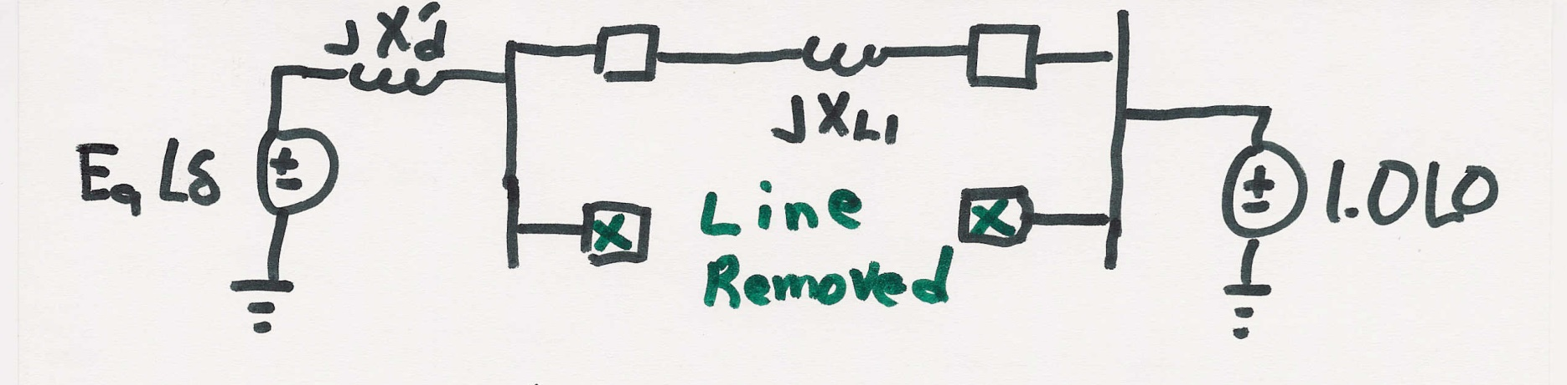

SMIB Example, Post Fault System
After the fault the system again changes
The equivalent system after the fault is then

Slide 29
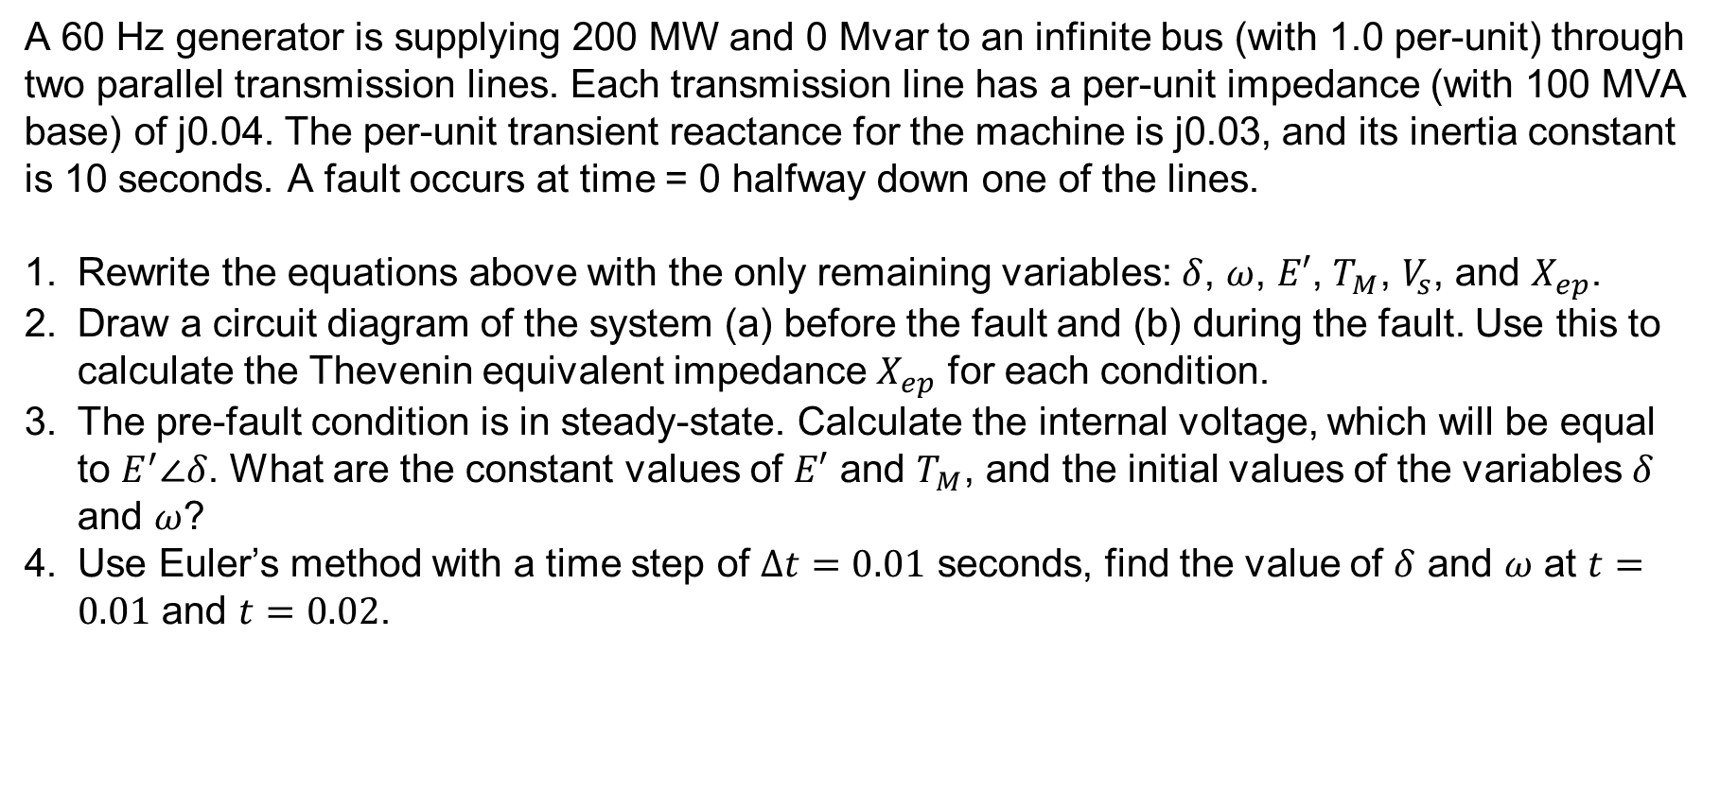
Handout Example
A 60 Hz generator is supplying 200 MW and 0 Mvar to an infinite bus (with 1.0 per-unit) through two parallel transmission lines. Each transmission line has a per-unit impedance (with 100 MVA base) of j0.04. The per-unit transient reactance for the machine is j0.03, and its inertia constant is 10 seconds. A fault occurs at time = 0 halfway down one of the lines.
Rewrite the equations above with the only remaining variables: $δ$, $ω$, $E′$, $T_{M}$, $V_{s}$, and $X_{ep}$.
Draw a circuit diagram of the system (a) before the fault and (b) during the fault. Use this to calculate the Thevenin equivalent impedance $X_{ep}$ for each condition.
The pre-fault condition is in steady-state. Calculate the internal voltage, which will be equal to $E^{′}∠δ$. What are the constant values of $E′$ and $T_{M}$, and the initial values of the variables $δ$ and $ω$?
Use Euler’s method with a time step of $Δt=0.01$ seconds, find the value of $δ$ and $ω$ at $t=0.01$ and $t=0.02$.

Slide 30
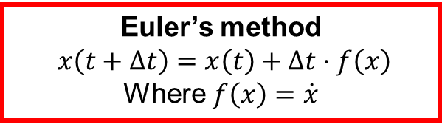
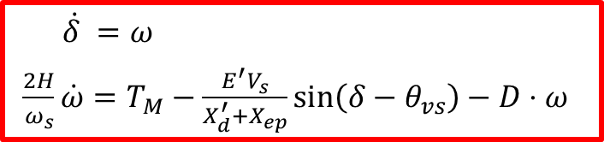
$\dot{δ} =ω$
$\frac{2H}{ω_{s}}\dot{ω}=T_{M}−\frac{E^{′}V_{s}}{X_{d}^{′}+X_{ep}}\sin\left(δ−θ_{vs}\right)−D⋅ω$
Euler’s method
$$x\left(t+Δt\right)=x\left(t\right)+Δt⋅f\left(x\right)$$
Where $f\left(x\right)=\dot{x}$
A 60 Hz generator is supplying 200 MW and 0 Mvar to an infinite bus (with 1.0 per-unit) through two parallel transmission lines. Each transmission line has a per-unit impedance (with 100 MVA base) of j0.04. The per-unit transient reactance for the machine is j0.03, and its inertia constant is 10 seconds. A fault occurs at time = 0 halfway down one of the lines.

Slide 31
$\dot{δ} =ω$
$\frac{2H}{ω_{s}}\dot{ω}=T_{M}−\frac{E^{′}V_{s}}{X_{d}^{′}+X_{ep}}\sin\left(δ−θ_{vs}\right)−D⋅ω$
Euler’s method
$$x\left(t+Δt\right)=x\left(t\right)+Δt⋅f\left(x\right)$$
Where $f\left(x\right)=\dot{x}$
A 60 Hz generator is supplying 200 MW and 0 Mvar to an infinite bus (with 1.0 per-unit) through two parallel transmission lines. Each transmission line has a per-unit impedance (with 100 MVA base) of j0.04. The per-unit transient reactance for the machine is j0.03, and its inertia constant is 10 seconds. A fault occurs at time = 0 halfway down one of the lines.

Slide 33
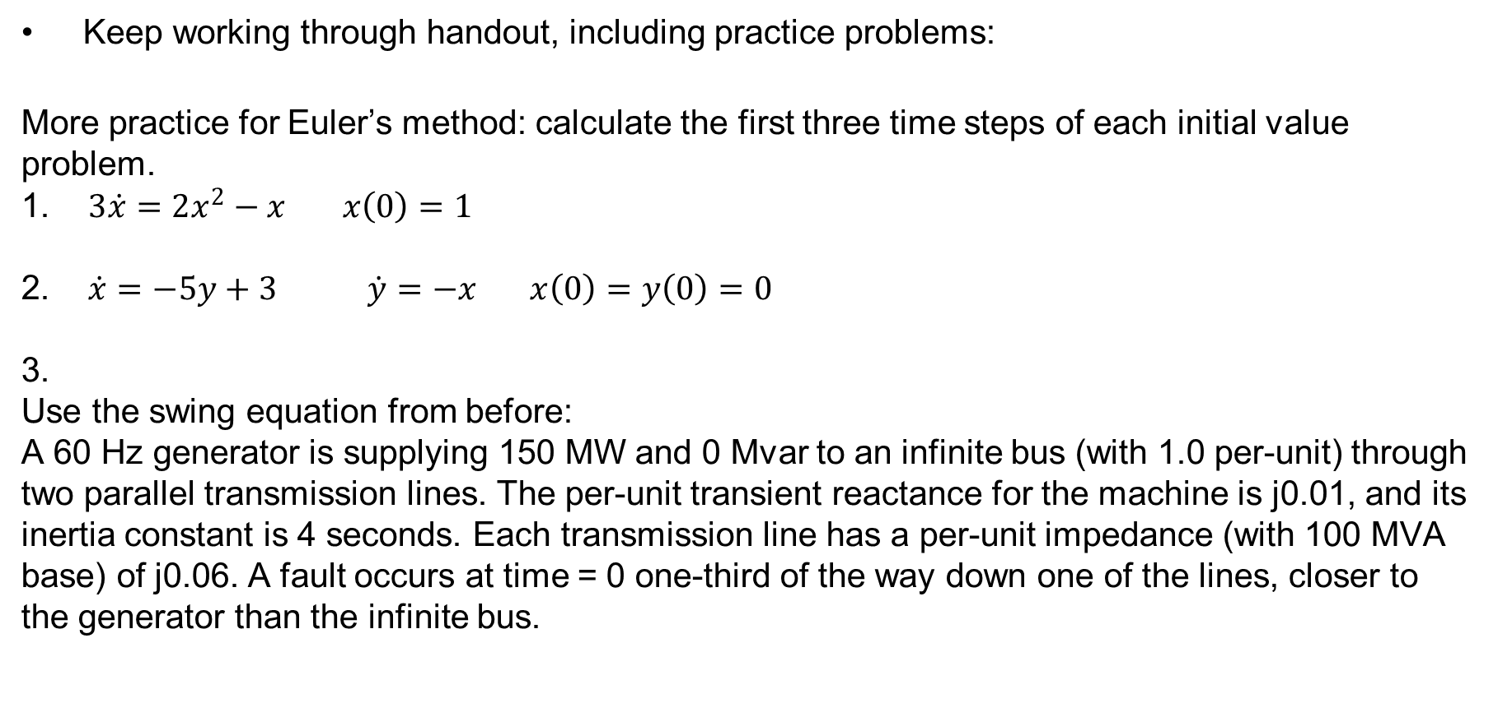
Homework
Keep working through handout, including practice problems:
More practice for Euler’s method: calculate the first three time steps of each initial value problem.
1. $3\dot{x}=2x^{2}−x$ $x\left(0\right)=1$
2. $\dot{x}=−5y+3 \dot{y}=−x x\left(0\right)=y\left(0\right)=0$
3.
Use the swing equation from before:
A 60 Hz generator is supplying 150 MW and 0 Mvar to an infinite bus (with 1.0 per-unit) through two parallel transmission lines. The per-unit transient reactance for the machine is j0.01, and its inertia constant is 4 seconds. Each transmission line has a per-unit impedance (with 100 MVA base) of j0.06. A fault occurs at time = 0 one-third of the way down one of the lines, closer to the generator than the infinite bus.

