Slide 1
ECEN 460, Spring 2023
Power System Operation and Control
Class 19: Optimal Power Flow and Energy Markets
Prof. Adam Birchfield
Dept. of Electrical and Computer Engineering
Texas A&M University
abirchfield@tamu.edu

Slide 2
Homework
Continue to study economic dispatch
Generator paper due next class, April 4th

Slide 3
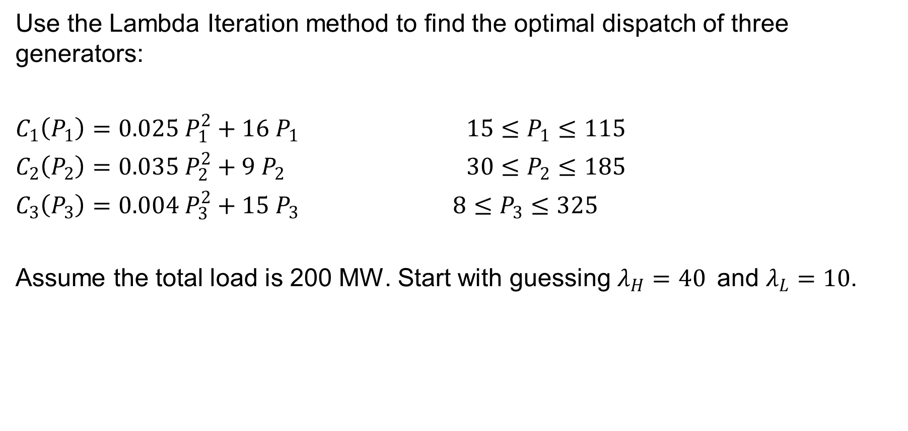
Economic Dispatch, Exercise 3
Use the Lambda Iteration method to find the optimal dispatch of three generators:
$C_{1}\left(P_{1}\right)=0.025 P_{1}^{2}+16{ P}_{1}$ $15≤P_{1}≤115$
$C_{2}\left(P_{2}\right)=0.035 P_{2}^{2}+9 P_{2}$ $30≤P_{2}≤185$
$C_{3}\left(P_{3}\right)=0.004 P_{3}^{2}+15 P_{3}$ $8≤P_{3}≤325$
Assume the total load is 200 MW. Start with guessing $λ_{H}=40$and $λ_{L}=10$.

Slide 4
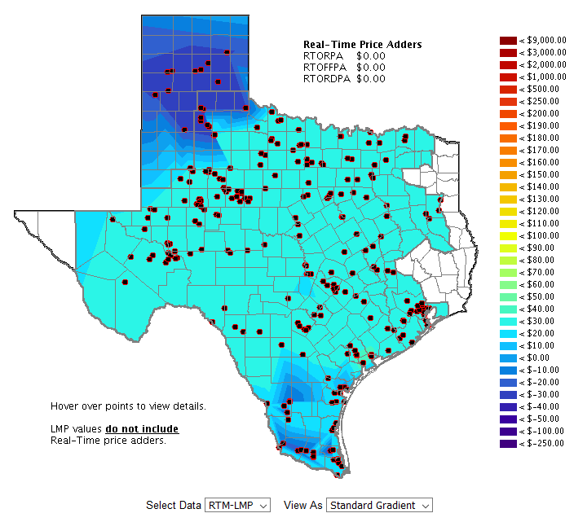
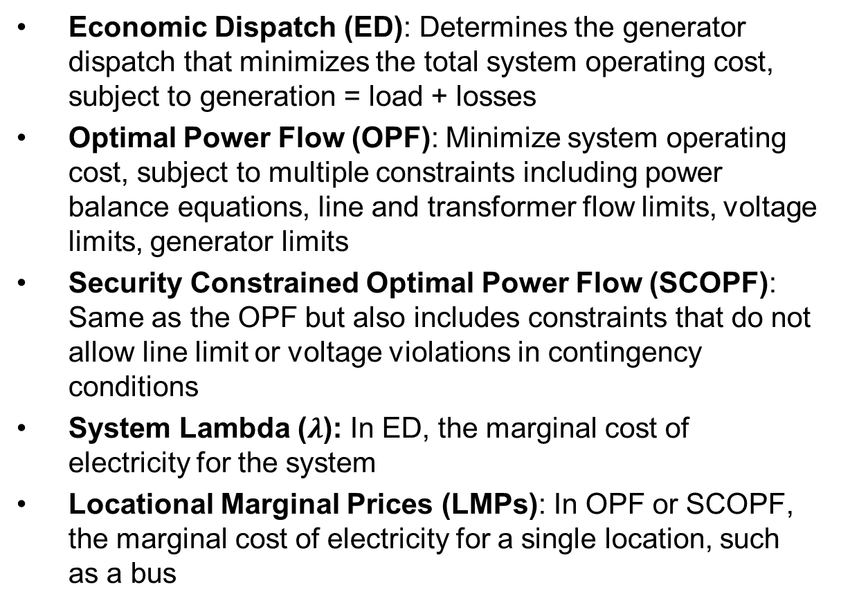
Key Terms
Economic Dispatch (ED): Determines the generator dispatch that minimizes the total system operating cost, subject to generation = load + losses
Optimal Power Flow (OPF): Minimize system operating cost, subject to multiple constraints including power balance equations, line and transformer flow limits, voltage limits, generator limits
Security Constrained Optimal Power Flow (SCOPF): Same as the OPF but also includes constraints that do not allow line limit or voltage violations in contingency conditions
System Lambda ($λ$): In ED, the marginal cost of electricity for the system
Locational Marginal Prices (LMPs): In OPF or SCOPF, the marginal cost of electricity for a single location, such as a bus
An LMP map from ERCOT yesterday

Slide 5
Optimal Power Flow (OPF)
Next we’ll consider OPF and SCOPF
OPF functionally combines the power flow with economic dispatch
SCOPF adds in contingency analysis
In both minimize a cost function, such as operating cost, taking into account realistic equality and inequality constraints
Equality constraints
  bus real and reactive power balance
  generator voltage setpoints
  area MW interchange

Slide 6
OPF, Cont’d
Inequality constraints
  transmission line/transformer/interface flow limits
  generator MW limits
  generator reactive power capability curves
  bus voltage magnitudes (not yet implemented in Simulator OPF)
Available Controls
  generator MW outputs
  transformer taps and phase angles

Slide 7
Two Example OPF Solution Methods
Non-linear approach using Newton’s method
  handles marginal losses well, but is relatively slow and has problems determining binding constraints
Linear Programming
  fast and efficient in determining binding constraints, but can have difficulty with marginal losses.
  used in PowerWorld Simulator

Slide 8
LP OPF Solution Method
Solution iterates between
  solving a full ac power flow solution
    enforces real/reactive power balance at each bus
    enforces generator reactive limits
    system controls are assumed fixed
    takes into account non-linearities
  solving a primal LP
    changes system controls to enforce linearized constraints while minimizing cost

Slide 9
Two Bus with Unconstrained Line
Transmission line is not overloaded
With no overloads the OPF matches the economic
dispatch
Marginal cost of supplying
power to each bus (locational marginal costs)

Slide 10
Two Bus with Constrained Line
With the line loaded to its limit, additional load at Bus A must be supplied locally, causing the marginal costs to diverge.

Slide 11
Three Bus (B3) Example
Consider a three bus case (bus 1 is system slack), with all buses connected through 0.1 pu reactance lines, each with a 100 MVA limit
Let the generator marginal costs be
  Bus 1: 10 $ / MWhr; Range = 0 to 400 MW
  Bus 2: 12 $ / MWhr; Range = 0 to 400 MW
  Bus 3: 20 $ / MWhr; Range = 0 to 400 MW
Assume a single 180 MW load at bus 2

Slide 12
B3 with Line Limits Not Enforced
Line between Bus 1and Bus 3 is over-loaded;
all buses have the same
marginal cost

Slide 13
B3 with Line Limits Enforced
LP OPF changes generation to remove violation. Bus marginal costs are now different.

Slide 14
Verify Bus 3 Marginal Cost
One additional MW of load at bus 3 raised total cost by 14 $/hr, as G2 went up by 2 MW and G1 went down by 1 MW

Slide 15
Why is Bus 3 LMP = $14 /MWh?
All lines have equal impedance. Power flow in a simple network distributes inversely to impedance of path.
  For bus 1 to supply 1 MW to bus 3, 2/3 MW would take direct path from 1 to 3, while 1/3 MW would “loop around” from 1 to 2 to 3.
  Likewise, for bus 2 to supply 1 MW to bus 3, 2/3MW would go from 2 to 3, while 1/3 MW would go from 2 to 1to 3.

Slide 16
Why is Bus 3 LMP $ 14 / MWh?, cont’d
With the line from 1 to 3 limited, no additional power flows are allowed on it.
To supply 1 more MW to bus 3 we need
  Pg1 + Pg2 = 1 MW
  2/3 Pg1 + 1/3 Pg2 = 0; (no more flow on 1-3)
Solving requires we up Pg2 by 2 MW and drop Pg1 by 1 MW -- a net increase of $14.

Slide 17
Both Lines into Bus 3 Congested
For bus 3 loads above 200 MW, the load must be supplied locally. Then what if the bus 3 generator opens?

Slide 18
Security Constrained OPF
Security constrained optimal power flow (SCOPF) is similar to OPF except it also includes contingency constraints
  Again the goal is to minimize some objective function, usually the current system cost, subject to a variety of equality and inequality constraints
  This adds significantly more computation, but is required to simulate how the system is actually operated (with N-1 reliability)
A common solution is to alternate between solving a power flow and contingency analysis, and an LP

Slide 19
Security Constrained OPF, Cont.
With the inclusion of contingencies, there needs to be a distinction between what control actions must be done pre-contingent, and which ones can be done post-contingent
  The advantage of post-contingent control actions is they would only need to be done in the unlikely event the contingency actually occurs
Pre-contingent control actions are usually done for line overloads, while post-contingent control actions are done for most reactive power control and generator outage re-dispatch

Slide 20
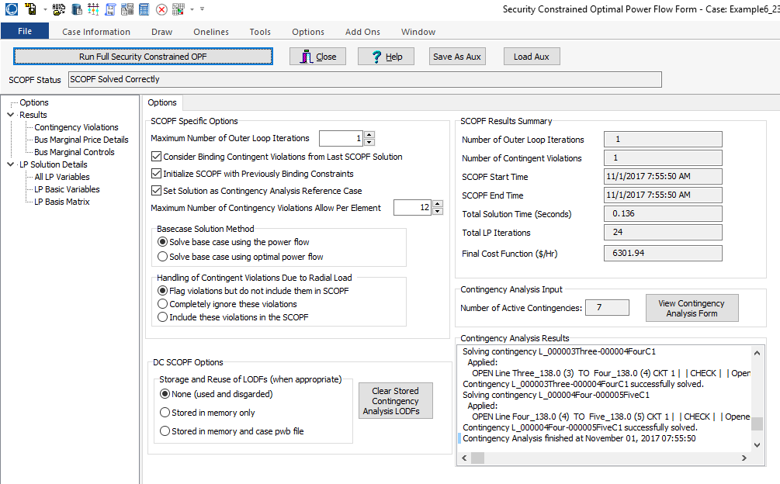
PowerWorld SCOPF Application
Just click the button to solve
Number of times
to redo contingency
analysis

Slide 21
DC OPF and SCOPF
Solving a full ac OPF or SCOPF on a large system is difficult, so most electricity markets actually use the more approximate, but much simpler DCOPF, in which a dc power flow is used
  Interested students can learn more about what is actually done by reading the below paper (this is completely optional)
We’ll be using this approach with lab 8
PowerWorld includes this option in the Options, Power Flow Solution, DC Options
https://www.ferc.gov/legal/staff-reports/2017/marginallosscalculations.pdf

Slide 22
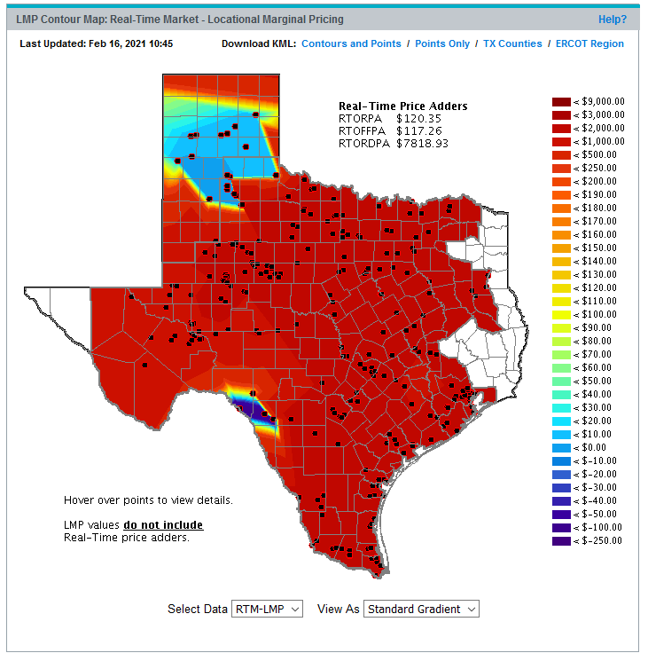
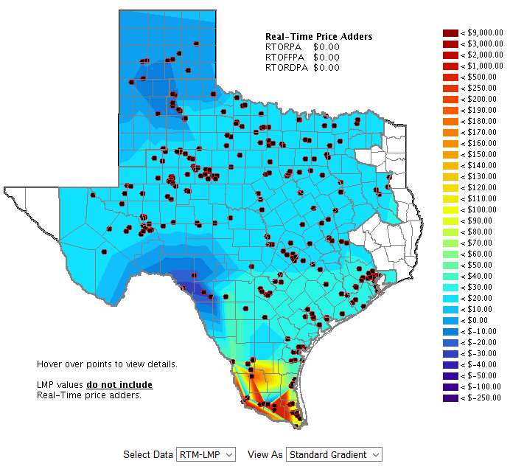
Actual ERCOT LMPs on Feb. 16 vs Mar. 23, 2021
Source: www.ercot.com/content/cdr/contours/rtmLmp.html

Slide 23
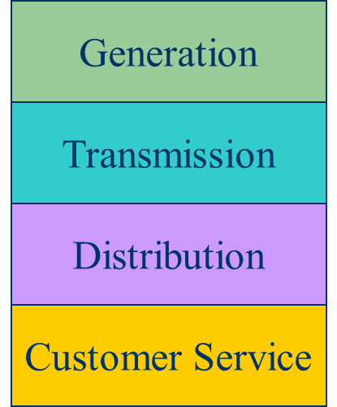
Electricity Markets Versus Centralized Planning
For decades electric utilities operated as vertical monopolies, with their rates set by state regulators. Utilities had an obligation to serve and customers had no choice.
Major change in US occurred in 1992 with the National Energy Policy Act that mandated utilities provide “nondiscriminatory” access to the high voltage grid
  Goal was to setup true competition in generation
With the vertically integrated utility, a small number of entities (typically utilities) did most of the planning
  For example, which new generators and lines to build
  Planning was coordinated and governed by regulators
  Regulators needed to know the utilities actual costs so they could provide them with a fixed rate of return
With markets the larger number of participants often make individual decisions in reaction to prices
  For example, whether to build new generation
  Generator owners in general to not need to reveal their true costs; rather they make offers into the market

Slide 24
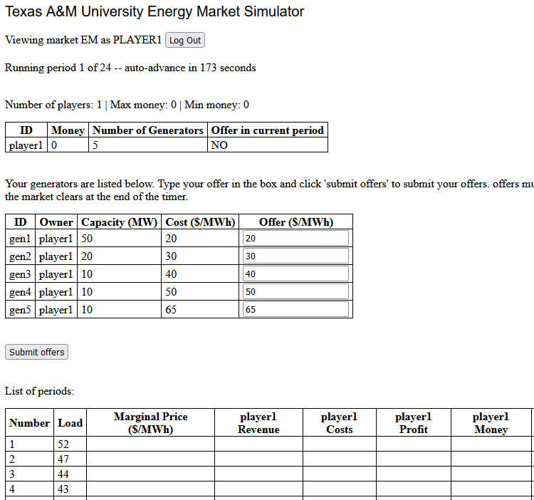
Lab 8 Introduction
Lab 8 involves simulating a (friendly) competitive energy market between students in the lab
TA will be operating a market to supply a certain amount of load per period
Students own 5 generators each with varying costs and MW capacities
Each period, bid a price for each generator
Two payment methods: last-accepted offer (LAO) and pay-as-offered (PAO)

Slide 25
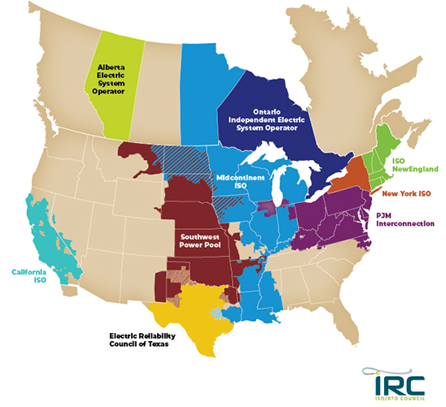
Electricity Markets Today
Starting in about 1995 electricity markets gradually started to develop, both in the US and elsewhere
In North America more than 60% of the load is supplied
via wholesale electricity markets
Markets differ but they all have certain common features
Image: https://isorto.org/#about-section

Slide 26
Market Design and Structure
What needs to be considered in designing an electricity market?
  How often do participants put in offers or bids to buy or sell electricity?
  What happens when actual demand doesn't match forecast?
  What about non-dispatchable generation like wind?
  Who's going to pay for transmission construction?
  Some generators are expensive to turn on and off and take a while to ramp their generation.
  Some generators support the grid with reactive power, transient inertia, or reserves, even though they are more expensive.
  What if participants attempt to manipulate the market?

Slide 27
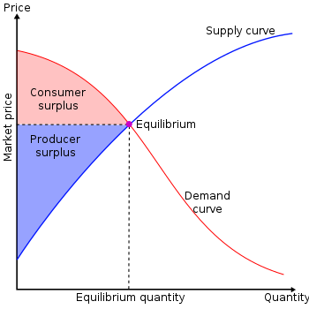
Overall Goal
Goal is to maximize the economic surplus (or total welfare), which is the sum of the consumer surplus and the producer surplus (i.e., their profit)
Generation owners have to decide their offer prices
If their price is too high, they are not selected to generate
At the wholesale level, the consumers often just see a price, though there can be price responsive load bids
Image Source: en.wikipedia.org/wiki/Economic_surplus#/media/File:Economic-surpluses.svg

Slide 28
Electricity Markets Common Features
Day ahead market – this is needed because time is required to make decisions about committing generators
  Generation owners submit offers for how much generation they can supply and at what price; accepted offers are binding
Real-time energy market – needed because day ahead forecasts are never perfect, and unexpected events can occur
Co-optimization with other “ancillary services” such as reserves
The source for much of this material “Analytic Research Foundations for the Next-Generation Electric Grid” (Chapter 2), The National Academies Press, 2016 (free download available)

Slide 29
Electricity Markets Common Features
Pricing is done using locational marginal prices, determined by an SCOPF
  Most markets include a marginal losses component
LMP markets are designed to send transparent price signal so people can make short and long-term decisions
  Generators are free to offer their electricity at whatever price they desire; they do not have to reveal their “true” costs
  Most of the times markets work as planned, and prices are competitive
  During times of shortages (scarcity) there are limits on LMPs; ERCOT’s is $9000/MWh
  Markets are run by independent system operators (ISOs)

Slide 30
LMP Energy Markets
In an LMP energy market the generation is paid the LMP at the bus, and the loads pay the LMP at the bus
  This is done in both the day ahead market and in the real-time market (which makes up the differences between actual and the day ahead)
The generator surplus (profit) is the difference between the LMP and the actual cost of generation
Generators that offer too high are not selected to run, and hence make no profit
A key decision for the generation owners is what values to offer

Slide 31
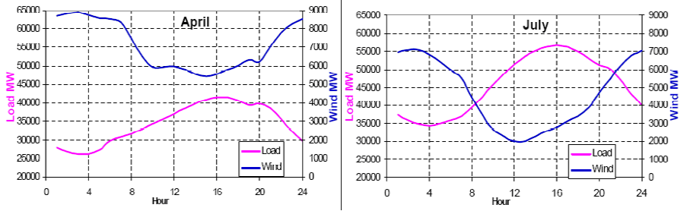
Wind Generation in ERCOT
Challenges: 1) intermittent, 2) wind and load patterns, 3) forecasting wind, 4) transmission system limitations
Source: www.ercot.com/content/wcm/training_courses/55/wind_operations_41111.pdf

Slide 32
ERCOT Congestion Revenue Rights
Congestion revenue rights (CRRs) are financial instruments that result in a charge or payment to the owner when the ERCOT transmission system is congested in the day ahead market
They are tradable financial instruments for hedging of transmission congestion charges
There is a payment to the owner (or perhaps payment from the owner) when there are LMP cost differences
  Options (only payments), Obligations (payments or charges)
Can be acquired by CRR auction, bilateral trades or allocation
Source: www.ercot.com/mktinfo/crr

Slide 33
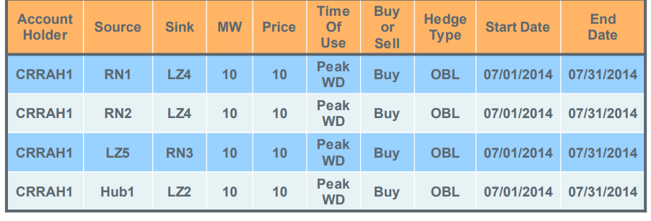
ERCOT Congestion Revenue Rights
Prior to auction ERCOT determines its system capacity
  Set on a monthly basis
  Modified based on pre-assigned CRRs (e.g., long-term supply)
They use a dc power flow model in the analysis
Auctioned or allocated in one month strips in time-of-use blocks (off-peak, peak weekday, peak weekend)
Source: www.ercot.com/content/wcm/training_courses/109553/CRR_2017_May.pdf

Slide 34
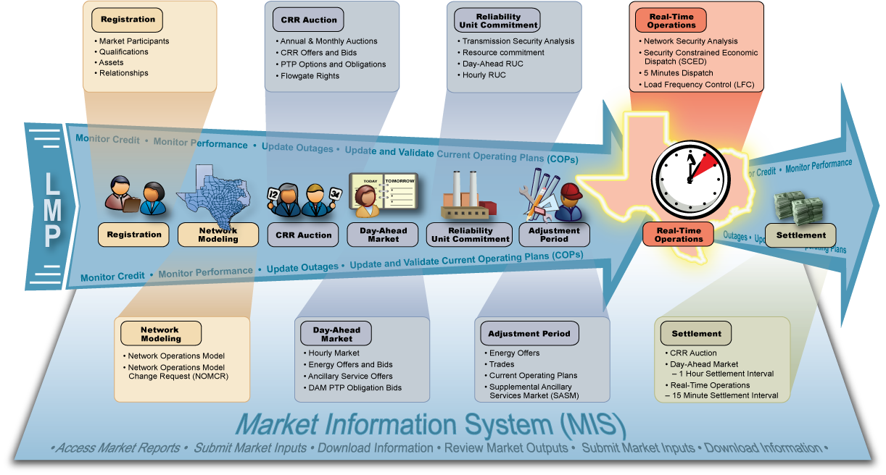
ERCOT Nodal Market Overview
Image source: ERCOT market education, transmission 101

Slide 35
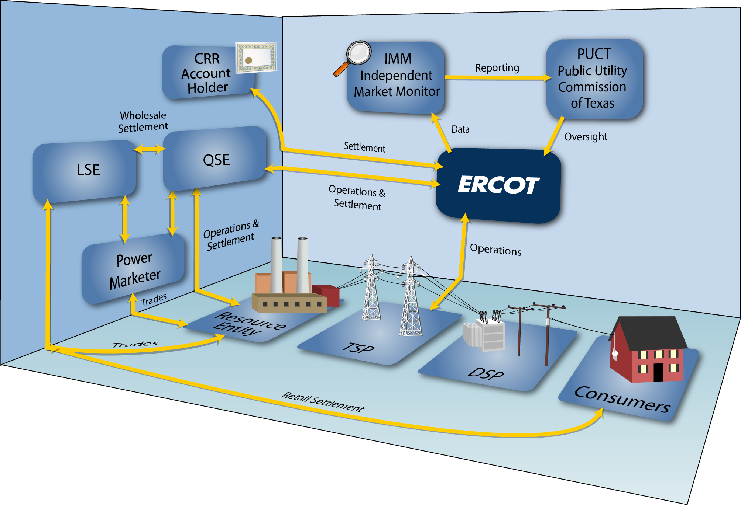
ERCOT Market Relationships
LSE is load
serving entity;
QSE is
qualified
scheduling
entity
Image source: ERCOT market education, transmission 101

