Slide 1
ECEN 460, Spring 2023
Power System Operation and Control
Class 18: Economic Dispatch, Part 2
Prof. Adam Birchfield
Dept. of Electrical and Computer Engineering
Texas A&M University
abirchfield@tamu.edu

Slide 2
Homework
Homework due next class:
  6th edition: Problems 6.62, 6.63, 6.65
  7th edition: Problems 7.1, 7.2, 7.4
The next few quizzes will be on economic dispatch
Generator paper due in 1 week, April 4th

Slide 3
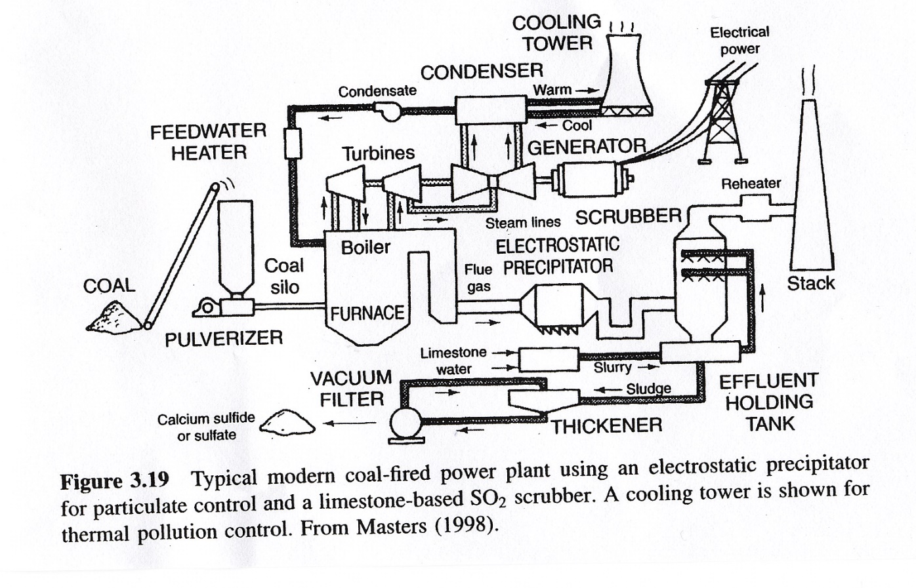
Steam Plant (Coal)
Source: Masters, Renewable and Efficient Electric Power Systems, 2004

Slide 4
Natural Gas Simple Cycle and Combined Cycle
Combined Cycle
Simple Cycle
Efficiencies of up to 60% can be achieved, with even higher values when the steam is used for heating. Fuel is usually natural gas
Typical efficiency is around 30 to 35%

Slide 5
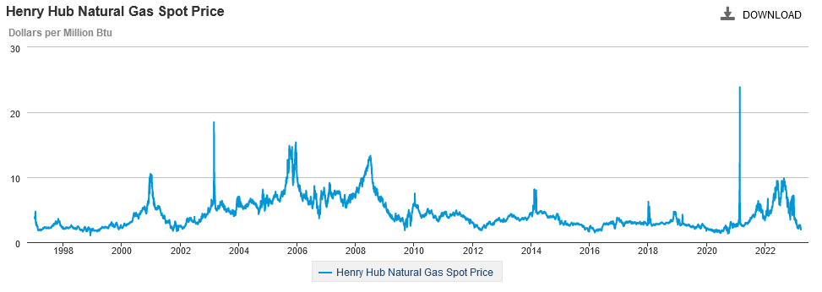
Variation in Natural Gas Prices
Our Feb 14, 2021 event set a 12-year record. Marginal cost for natural gas fired electricity price in $/MWh is about 7-10 times gas price.
Source: EIA

Slide 6
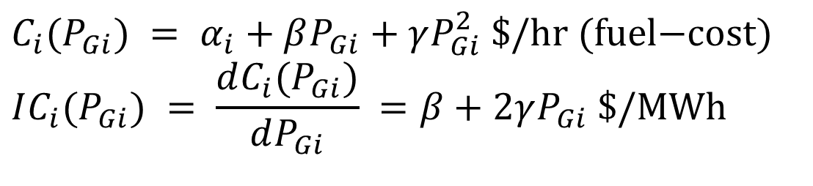
Mathematical Formulation of Costs
Generator cost curves are usually not smooth. However the curves can usually be adequately approximated using piece-wise smooth, functions.
Two representations predominate
  quadratic or cubic functions
  piecewise linear functions
In 460 we’ll generally assume a quadratic representation
$$C_{i}(P_{Gi}) = α_{i}+βP_{Gi}+γP_{Gi}^{2} \text{\$/}\text{hr} (\text{fuel}\text{−}\text{cost}) \\ IC_{i}(P_{Gi}) = \frac{dC_{i}(P_{Gi})}{dP_{Gi}} =β+2γP_{Gi} \text{\$/}\text{MWh}$$

Slide 7
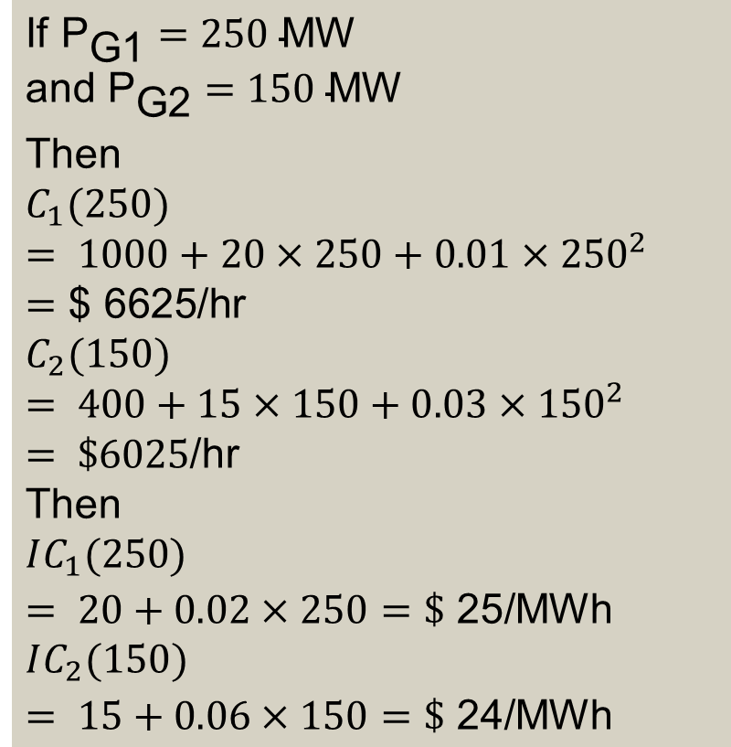
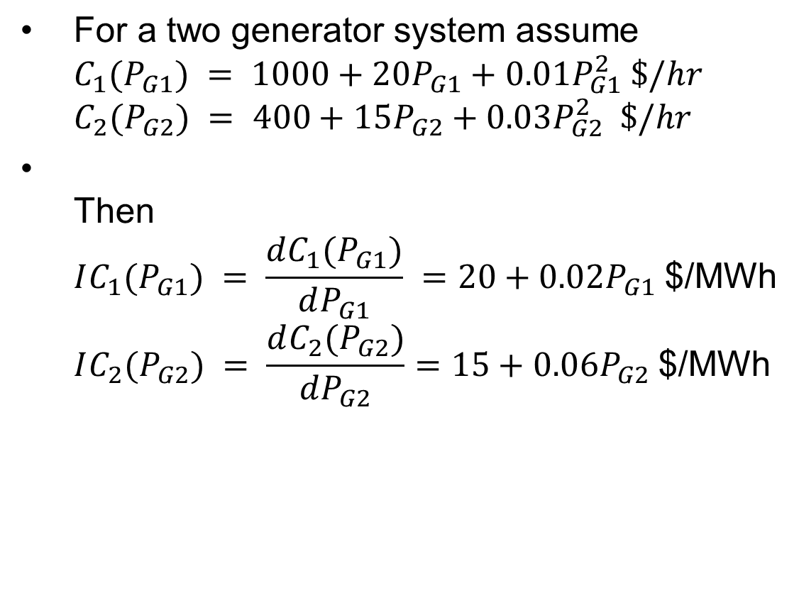
Incremental Cost Example
$\text{For} \text{a} \text{two} \text{generator} \text{system} \text{assume}$
$C_{1}(P_{G1}) = 1000+​20P_{G1}+0.01P_{G1}^{2} \$/hr$
$C_{2}(P_{G2}) = 400+​15P_{G2}+0.03P_{G2}^{2} \$/hr$
$\text{Then}$
$IC_{1}(P_{G1}) = \frac{dC_{1}(P_{G1})}{dP_{G1}} =20+0.02P_{G1} \text{\$/}\text{MWh}$
$IC_{2}(P_{G2}) = \frac{dC_{2}(P_{G2})}{dP_{G2}}=15+0.06P_{G2} \text{\$/}\text{MWh}$
$$\text{If} {\text{P}}_{\text{G}\text{1}}=250 \text{MW}$$
$$\text{and} {\text{P}}_{\text{G}\text{2}}=150 \text{MW}​$$
Then
$$C_{1}(250) = 1000+​20×250+0.01×250^{2} =\text{\$ 6625/}\text{hr} \\ C_{2}(150) = 400+​15×150+0.03×150^{2} = \$6025\text{/}\text{hr} \\ \text{Then} \\ IC_{1}(250) = 20+0.02×250 =\$\text{ 25/}\text{MWh} \\ IC_{2}(150) = 15+0.06×150 =\$\text{ 24/}\text{MWh}$$

Slide 8
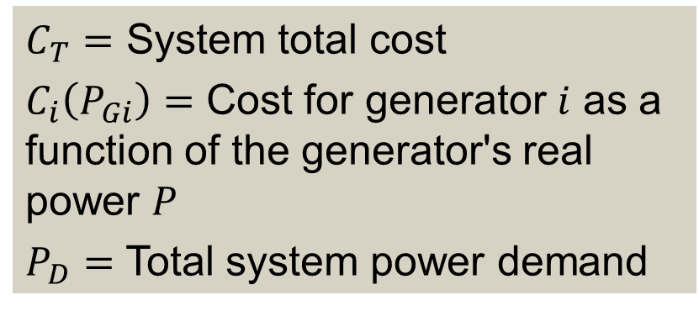
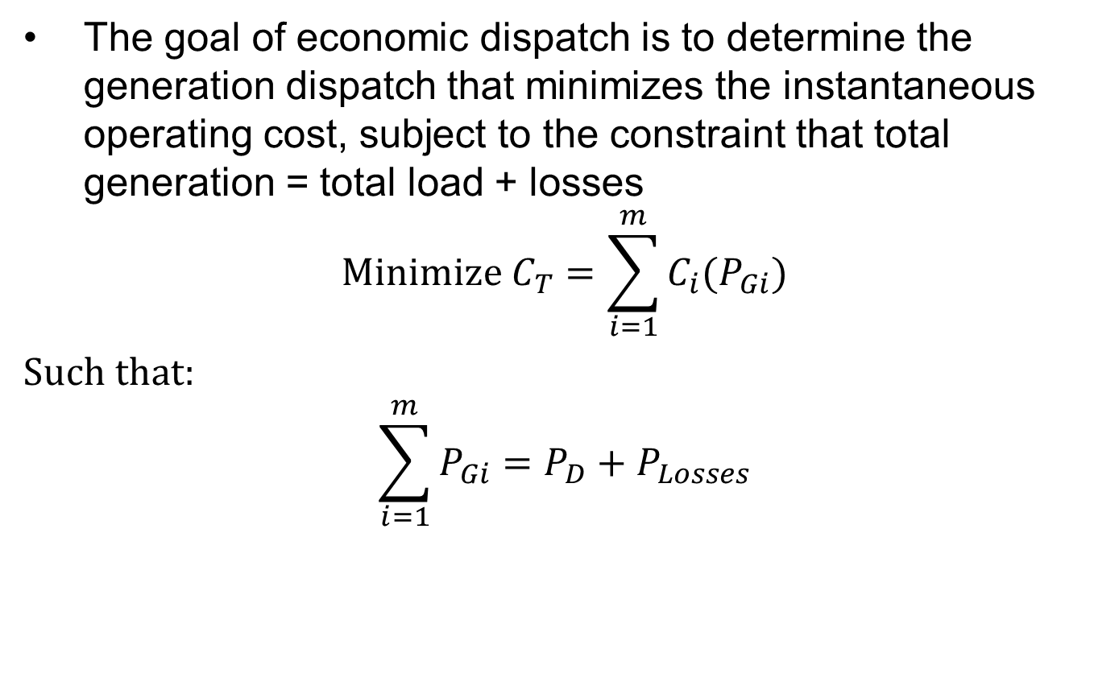
Economic Dispatch Problem
The goal of economic dispatch is to determine the generation dispatch that minimizes the instantaneous operating cost, subject to the constraint that total generation = total load + losses
$$\text{Minimize} C_{T}=\sum_{i=1}^{m}{C_{i}(P_{Gi})}$$
$\text{S}\text{uch} \text{that}\text{:}$
$$\sum_{i=1}^{m}{P_{Gi}}=P_{D}+P_{Losses}$$
$C_{T}=$ System total cost
$C_{i}\left(P_{Gi}\right)=$ Cost for generator $i$ as a function of the generator's real power $P$
$P_{D}=$ Total system power demand

Slide 9
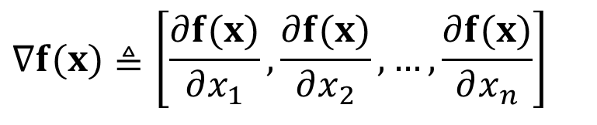
Unconstrained Minimization
This is a minimization problem with a single equality constraint
For an unconstrained minimization a necessary (but not sufficient) condition for a minimum is the gradient of the function must be zero,
The gradient generalizes the first derivative for multi-variable problems:
$$∇f(x)≜\left[\frac{∂f(x)}{∂x_{1}},\frac{∂f(x)}{∂x_{2}},…,\frac{∂f(x)}{∂x_{n}}\right]$$

Slide 10
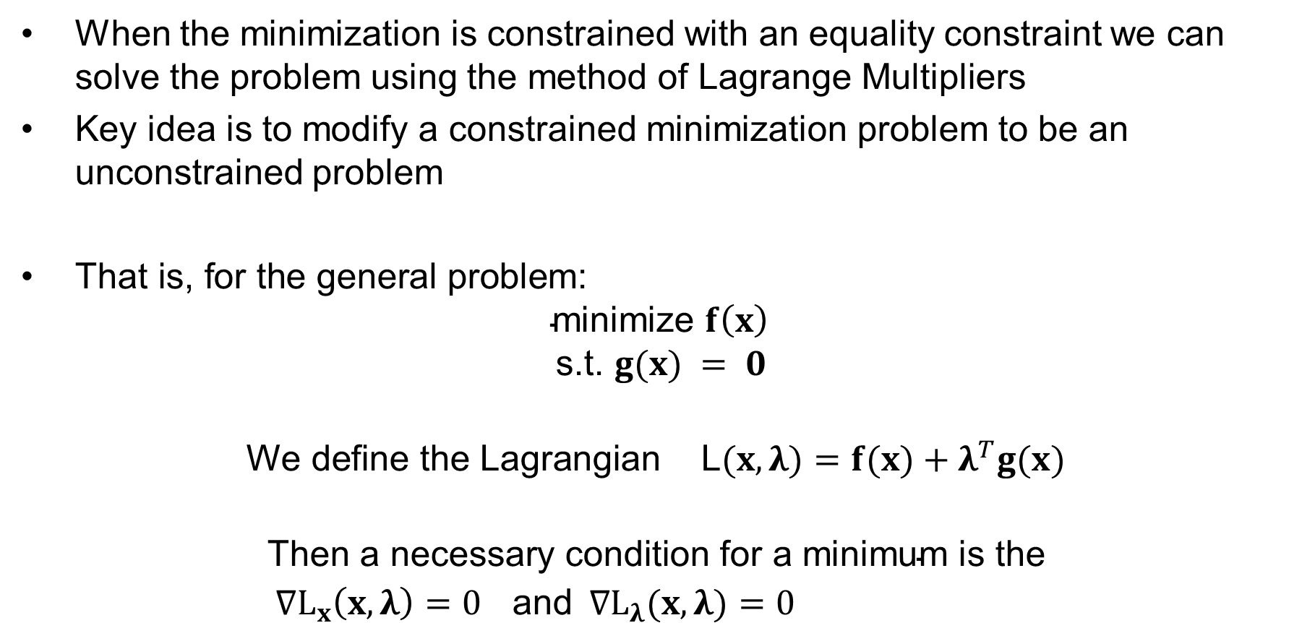
Minimization with Equality Constraint
When the minimization is constrained with an equality constraint we can solve the problem using the method of Lagrange Multipliers
Key idea is to modify a constrained minimization problem to be an unconstrained problem
$\text{That} \text{is}\text{, }\text{for} \text{the} \text{general} \text{problem}$:
$$\text{minimize} f\left(x\right)$$
$$\text{s}\text{.}\text{t}\text{. }g(x) = 0$$
$$\text{We} \text{define} \text{the} \text{Lagrangian} \text{L}(x,λ)=f(x)+λ^{T}g(x)$$
$$\text{Then} \text{a} \text{necessary} \text{condition} \text{for} \text{a} \text{minimum} \text{is} \text{the} \\ ∇L_{x}\left(x,λ\right)=0 \text{and} ∇L_{λ}(x,λ)=0$$

Slide 11
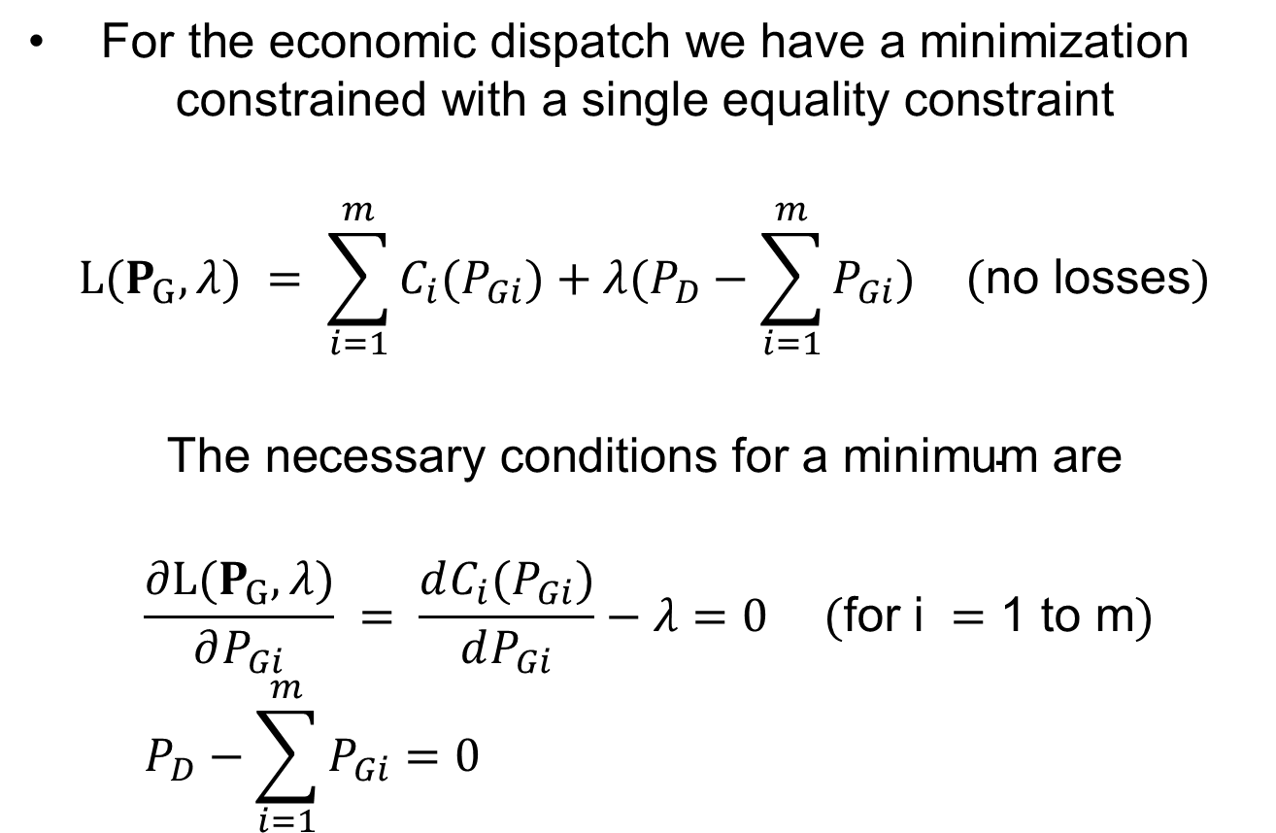
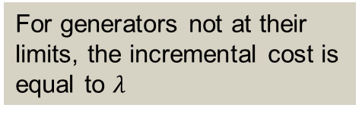
Economic Dispatch Lagrangian
$\text{For} \text{the} \text{economic} \text{dispatch} \text{we} \text{have} \text{a} \text{minimization}$
$\text{constrained} \text{with} \text{a} \text{single} \text{equality} \text{constraint}$
$$L(P_{G},λ) = \sum_{i=1}^{m}{C_{i}(P_{Gi})+λ(P_{D}−\sum_{i=1}^{m}{P_{Gi})}} (\text{no} \text{losses})$$
$$\text{The} \text{necessary} \text{conditions} \text{for} \text{a} \text{minimum} \text{are}$$
$$\frac{∂L(P_{G},λ)}{∂P_{Gi}} = \frac{dC_{i}(P_{Gi})}{dP_{Gi}}−λ=0 (\text{for} \text{i} =\text{1 }\text{to} \text{m}) \\ P_{D}−\sum_{i=1}^{m}{P_{Gi}=0}$$
For generators not at their limits, the incremental cost is equal to $λ$

Slide 12

Economic Dispatch Example
Calculate the economic dispatch for a two-generator system:
$${\text{P}}_{D}=P_{G1}+P_{G2}=500 \text{MW} \text{and} \\ C_{1}(P_{G1}) = 1000+​20P_{G1}+0.01P_{G1}^{2} \$/hr \\ C_{2}(P_{G2}) = 400+​15P_{G2}+0.03P_{G2}^{2} \$/hr$$

Slide 13
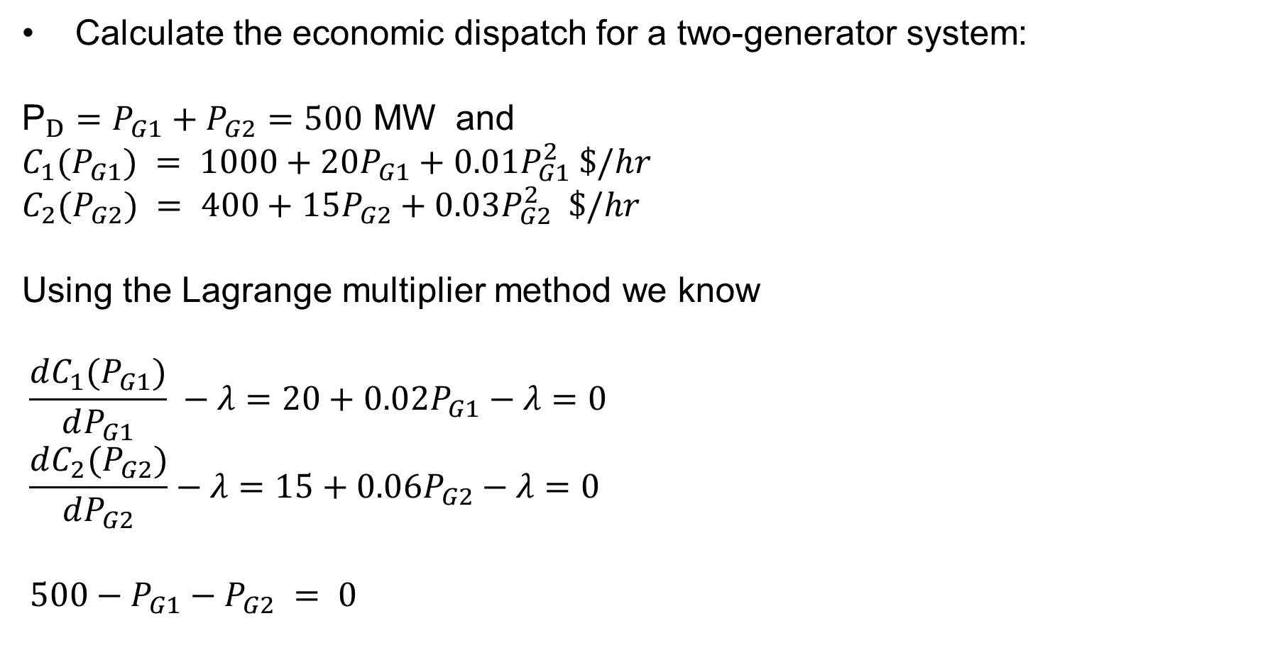
Economic Dispatch Example Solution
Calculate the economic dispatch for a two-generator system:
$${\text{P}}_{D}=P_{G1}+P_{G2}=500 \text{MW} \text{and} \\ C_{1}(P_{G1}) = 1000+​20P_{G1}+0.01P_{G1}^{2} \$/hr \\ C_{2}(P_{G2}) = 400+​15P_{G2}+0.03P_{G2}^{2} \$/hr$$
Using the Lagrange multiplier method we know
$$\frac{dC_{1}(P_{G1})}{dP_{G1}} −λ =20+0.02P_{G1}−λ =0 \\ \frac{dC_{2}(P_{G2})}{dP_{G2}}−λ =15+0.06P_{G2}−λ =0$$
$$500−P_{G1}−P_{G2} = 0$$

Slide 14
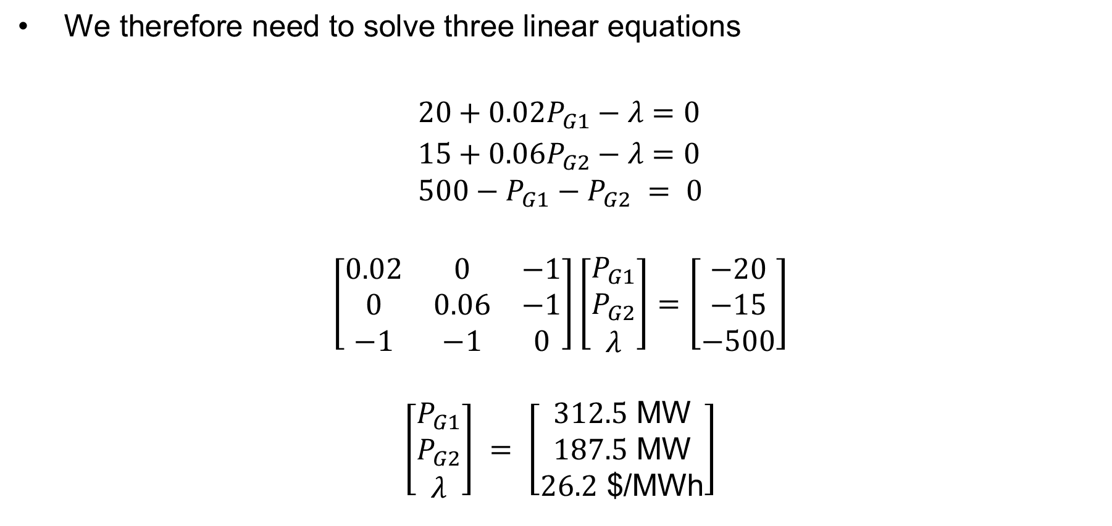
Economic Dispatch Example Solution, Cont’d
$\text{We} \text{therefore} \text{need} \text{to} \text{solve} \text{three} \text{linear} \text{equations}$
$$20+0.02P_{G1}−λ =0 \\ 15+0.06P_{G2}−λ =0 \\ 500−P_{G1}−P_{G2} = 0$$
$$\left[\begin{matrix}0.02 & 0 & −1 \\ 0 & 0.06 & −1 \\ −1 & −1 & 0\end{matrix}\right]\left[\begin{matrix}P_{G1} \\ P_{G2} \\ λ\end{matrix}\right]=\left[\begin{matrix}−20 \\ −15 \\ −500\end{matrix}\right]$$
$$\left[\begin{matrix}P_{G1} \\ P_{G2} \\ λ\end{matrix}\right] = \left[\begin{matrix}312.5 \text{MW} \\ 187.5 \text{MW} \\ 26.2\text{ \$/}\text{MWh}\end{matrix}\right]$$

Slide 15
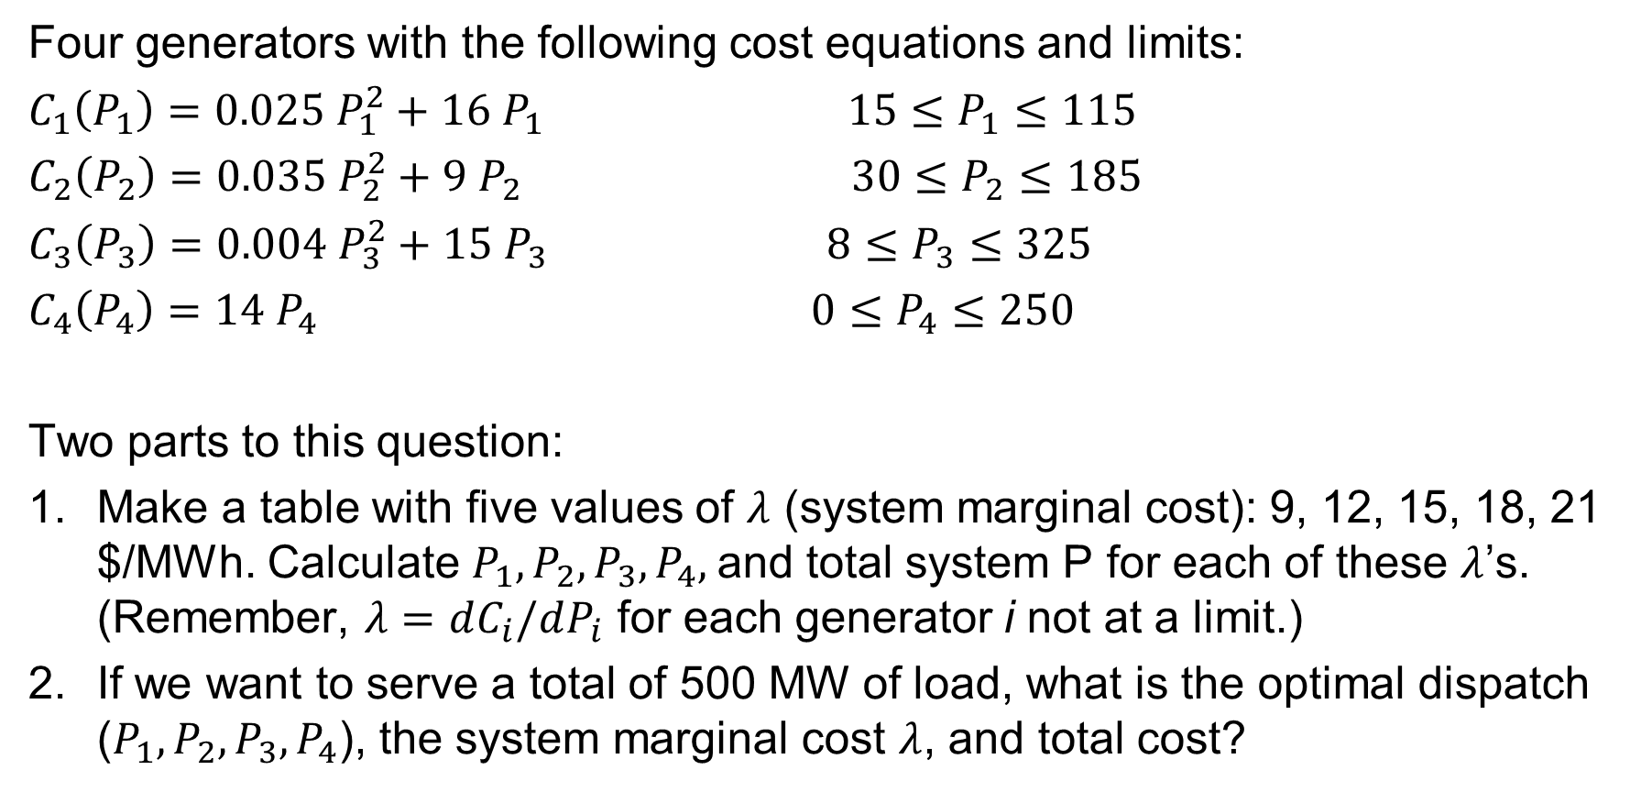
Worksheet -- Economic Dispatch, Exercise 2
Four generators with the following cost equations and limits:
$C_{1}\left(P_{1}\right)=0.025 P_{1}^{2}+16{ P}_{1}$ $15≤P_{1}≤115$
$C_{2}\left(P_{2}\right)=0.035 P_{2}^{2}+9 P_{2}$ $30≤P_{2}≤185$
$C_{3}\left(P_{3}\right)=0.004 P_{3}^{2}+15 P_{3}$ $8≤P_{3}≤325$
$C_{4}\left(P_{4}\right)=14 P_{4}$ $0≤P_{4}≤250$
Two parts to this question:
Make a table with five values of $λ$ (system marginal cost): 9, 12, 15, 18, 21 $/MWh. Calculate $P_{1}, P_{2}, P_{3},P_{4},$and total system P for each of these $λ$’s. (Remember, $λ=dC_{i}/dP_{i}$ for each generator i not at a limit.)
If we want to serve a total of 500 MW of load, what is the optimal dispatch ($P_{1}, P_{2}, P_{3},P_{4}$), the system marginal cost $λ$, and total cost?

Slide 16
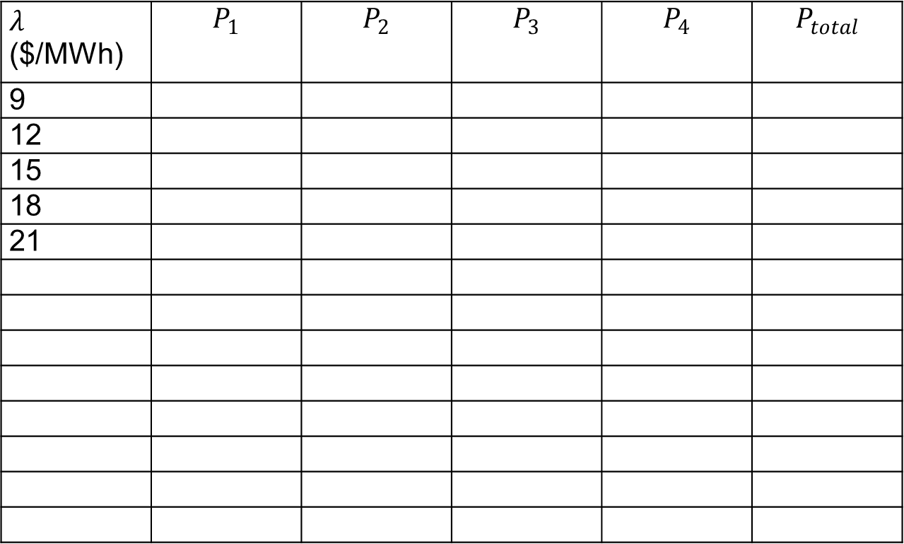
Economic Dispatch, Exercise 2
$λ$ ($/MWh) | $$P_{1}$$ | $$P_{2}$$ | $$P_{3}$$ | $$P_{4}$$ | $$P_{total}$$
9
12
15
18
21

Slide 17
Lambda-Iteration Solution Method
The direct solution only works well if the incremental cost curves are linear and no generators are at their limits
A more general method is known as the lambda-iteration
  the method requires that there be a unique mapping between a value of lambda and each generator’s MW output
  the method then starts with values of lambda below and above the optimal value, and then iteratively brackets the optimal value

Slide 18
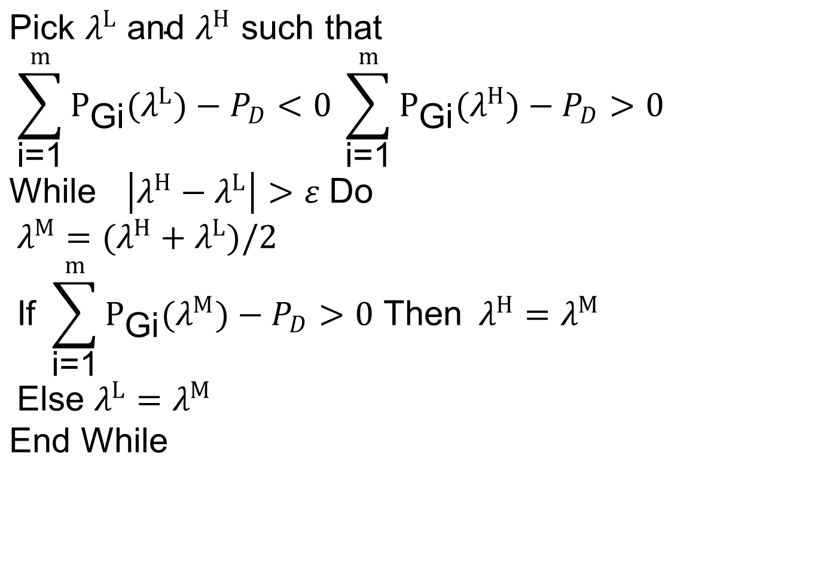
Lambda-Iteration Algorithm
$$\text{Pick} λ^{L} \text{and} λ^{H} \text{such} \text{that} \\ \sum_{\text{i}\text{=1}}^{m}{P_{\text{Gi}}(λ^{L})−P_{D}<0} \sum_{\text{i}\text{=1}}^{m}{P_{\text{Gi}}(λ^{H})−P_{D}>0} \\ \text{While} \left|λ^{H}−λ^{L}\right|>ε \text{Do} \\ λ^{M}=(λ^{H}+λ^{L})/2 \\ \text{If} \sum_{\text{i}\text{=1}}^{m}{P_{\text{Gi}}(λ^{M})−P_{D}>0 \text{Then} }λ^{H}=λ^{M} \\ \text{Else} λ^{L}=λ^{M} \\ \text{End} \text{While}$$

Slide 19

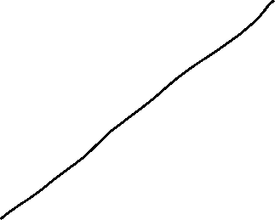


Lambda-Iteration: Graphical View
In the graph shown, for each value of lambda
there is a unique P_{Gi} for each generator. This
relationship is the P_{Gi}(λ) function.

Slide 20

Lambda-Iteration Example
$$\text{Consider} \text{a} three−generator \text{system} \text{with} \\ IC_{1}(P_{G1}) = 15+0.02P_{G1} =λ \text{\$/}\text{MWh} \\ IC_{2}(P_{G2}) = 20+0.01P_{G2} =λ \text{\$/}\text{MWh} \\ IC_{3}(P_{G3}) = 18+0.025P_{G3} =λ \text{\$/}\text{MWh} \\ \text{and} \text{with} \text{constraint} P_{G1}+P_{G2}+P_{G3}=1000\text{MW}$$

Slide 21
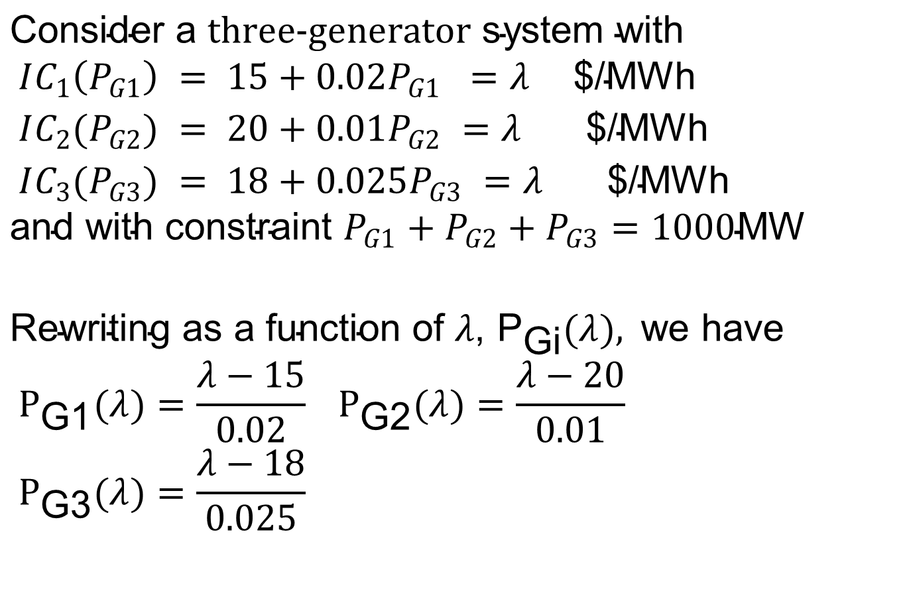
Lambda-Iteration Example
$$\text{Consider} \text{a} three−generator \text{system} \text{with} \\ IC_{1}\left(P_{G1}\right) = 15+0.02P_{G1} =λ \text{\$/}\text{MWh} \\ IC_{2}(P_{G2}) = 20+0.01P_{G2} =λ \text{\$/}\text{MWh} \\ IC_{3}(P_{G3}) = 18+0.025P_{G3} =λ \text{\$/}\text{MWh} \\ \text{and} \text{with} \text{constraint} P_{G1}+P_{G2}+P_{G3}=1000\text{MW}$$
$$\text{Rewriting} \text{as} \text{a} \text{function} \text{of} λ\text{, }{\text{P}}_{\text{Gi}}(λ), \text{we} \text{have} \\ P_{\text{G}\text{1}}(λ)=\frac{λ−15}{0.02} P_{\text{G}\text{2}}(λ)=\frac{λ−20}{0.01} \\ P_{\text{G}\text{3}}(λ)=\frac{λ−18}{0.025}$$

Slide 22
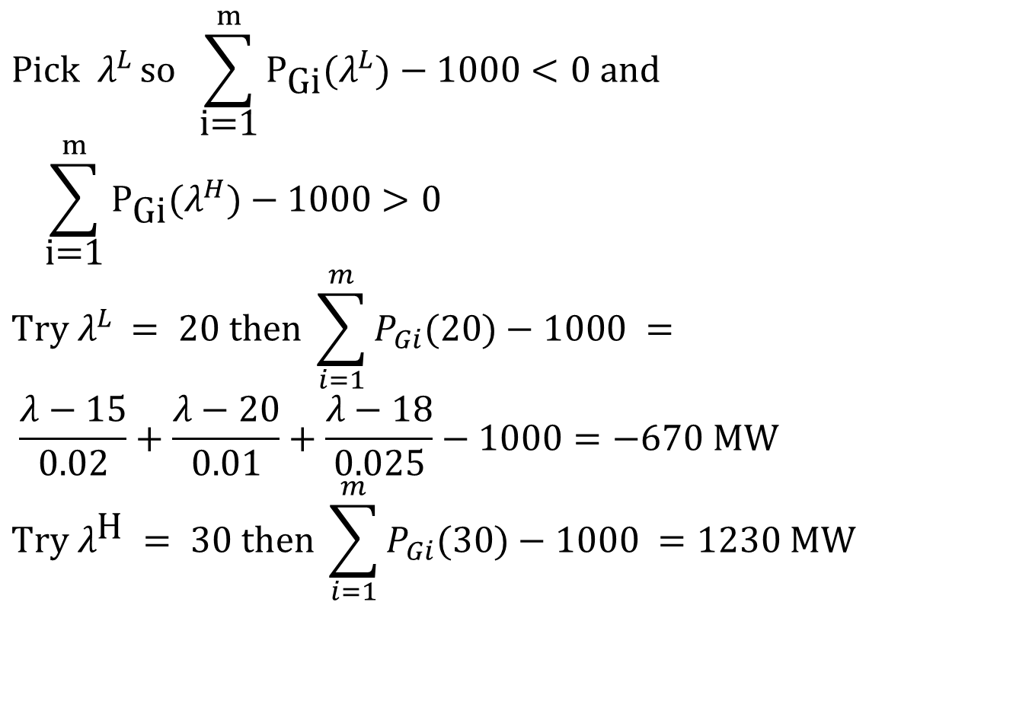
Lambda-Iteration Example, Cont’d
$$\text{Pick} λ^{L }\text{so} \sum_{\text{i}\text{=1}}^{m}{P_{\text{Gi}}(λ^{L})}−1000<0 \text{and} \\ \sum_{\text{i}\text{=1}}^{m}{P_{\text{Gi}}(λ^{H})}−1000>0 \\ \text{Try} λ^{L }=\text{ 20 }\text{then} \sum_{i=1}^{m}{P_{Gi}(20)}−1000 = \\ \frac{λ−15}{0.02}+\frac{λ−20}{0.01}+\frac{λ−18}{0.025}−1000=−670 \text{MW} \\ \text{Try} λ^{\text{H} }=\text{ 30 }\text{then} \sum_{i=1}^{m}{P_{Gi}(30)}−1000 =1230 \text{MW}$$

Slide 23
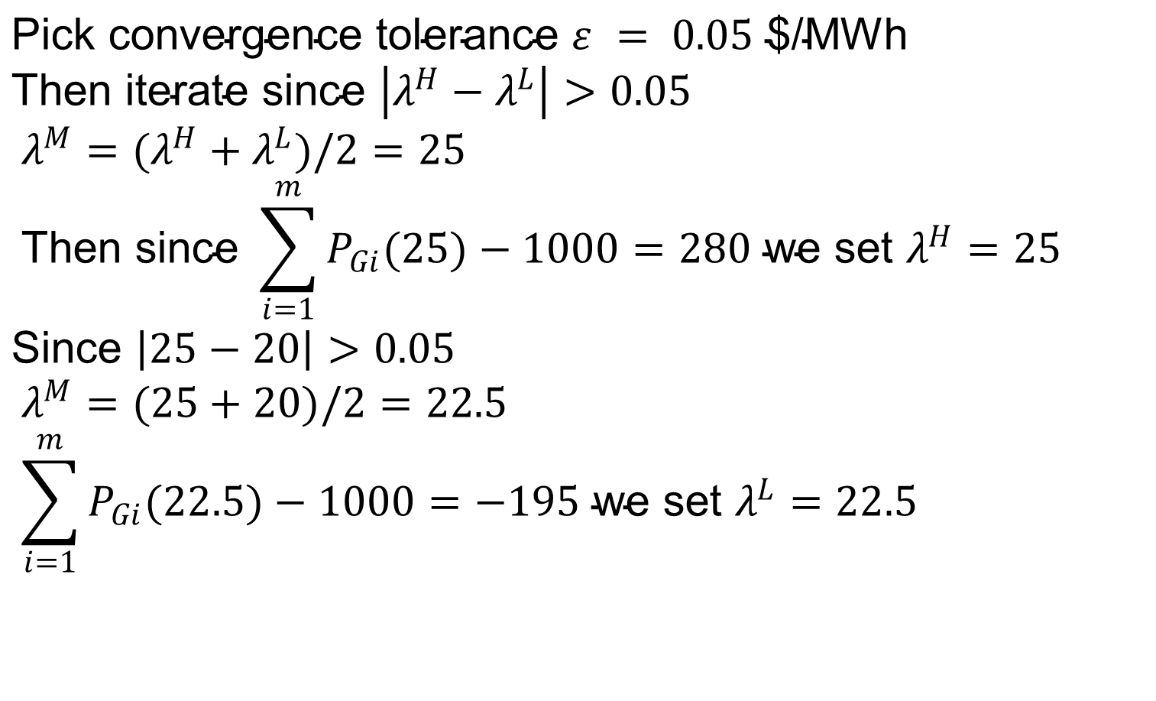
Lambda-Iteration Example, Cont’d
$$\text{Pick} \text{convergence} \text{tolerance} ε = 0.05\text{ \$/}\text{MWh} \\ \text{Then} \text{iterate} \text{since} \left|λ^{H}−λ^{L}\right|>0.05 \\ λ^{M}=(λ^{H}+λ^{L})/2=25 \\ \text{Then} \text{since} \sum_{i=1}^{m}{P_{Gi}(25)}−1000=280 \text{we} \text{set} λ^{H}=25 \\ \text{Since} \left|25−20\right|>0.05 \\ λ^{M}=(25+20)/2=22.5 \\ \sum_{i=1}^{m}{P_{Gi}(22.5)}−1000=−195 \text{we} \text{set} λ^{L}=22.5$$

Slide 24
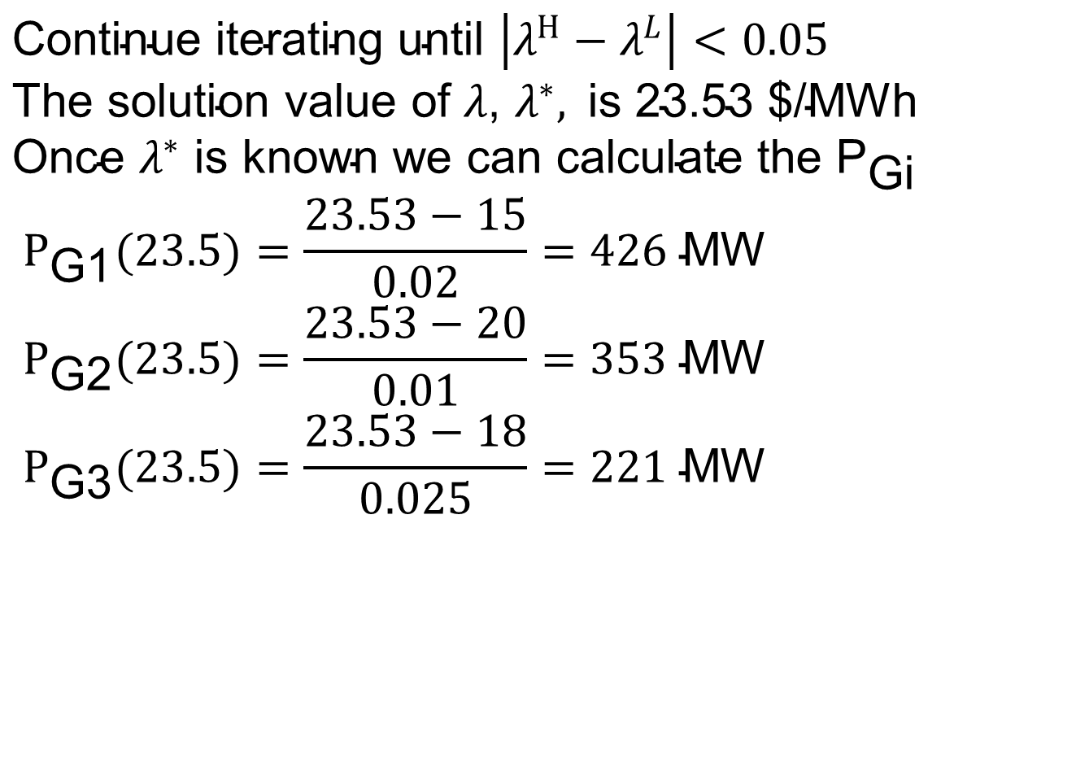
Lambda-Iteration Example, Cont’d
$$\text{Continue} \text{iterating} \text{until} \left|λ^{H}−λ^{L}\right|<0.05 \\ \text{The} \text{solution} \text{value} \text{of} λ\text{, }λ^{∗}, \text{is}\text{ 23.53 \$/}\text{MWh} \\ \text{Once} λ^{∗} \text{is} \text{known} \text{we} \text{can} \text{calculate} \text{the} {\text{P}}_{\text{Gi}} \\ P_{\text{G}\text{1}}(23.5)=\frac{23.53−15}{0.02}=426 \text{MW} \\ P_{\text{G}\text{2}}(23.5)=\frac{23.53−20}{0.01}=353 \text{MW} \\ P_{\text{G}\text{3}}(23.5)=\frac{23.53−18}{0.025}=221 \text{MW}$$

