Slide 1
ECEN 460, Spring 2023
Power System Operation and Control
Class 17: Economic Dispatch
Prof. Adam Birchfield
Dept. of Electrical and Computer Engineering
Texas A&M University
abirchfield@tamu.edu

Slide 2
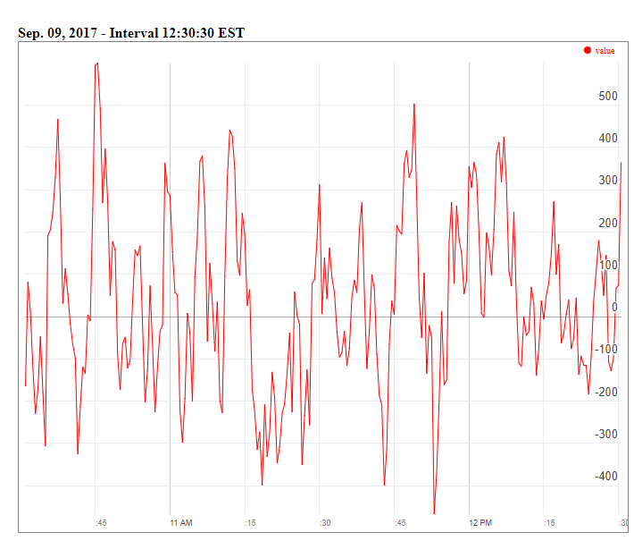
MISO Real-Time ACE Example
MISO's real-time ACE is available online (along with lots of other data)
https://www.misoenergy.org/MARKETSOPERATIONS/REALTIMEMARKETDATA/Pages/ACEChart.aspx

Slide 3
Multi-Area Operation
Statement 20. Areas have an automatic generator control (AGC) system that sends signals to generators to change their MW outputs to help control the ACE and make sure load and generation balance with scheduled interchanges.
Most utilities use automatic generation control (AGC) to automatically change their generation to keep their ACE close to zero
Usually the utility control center calculates ACE based upon tie-line flows; then the AGC module sends control signals out to the generators every couple seconds.

Slide 4
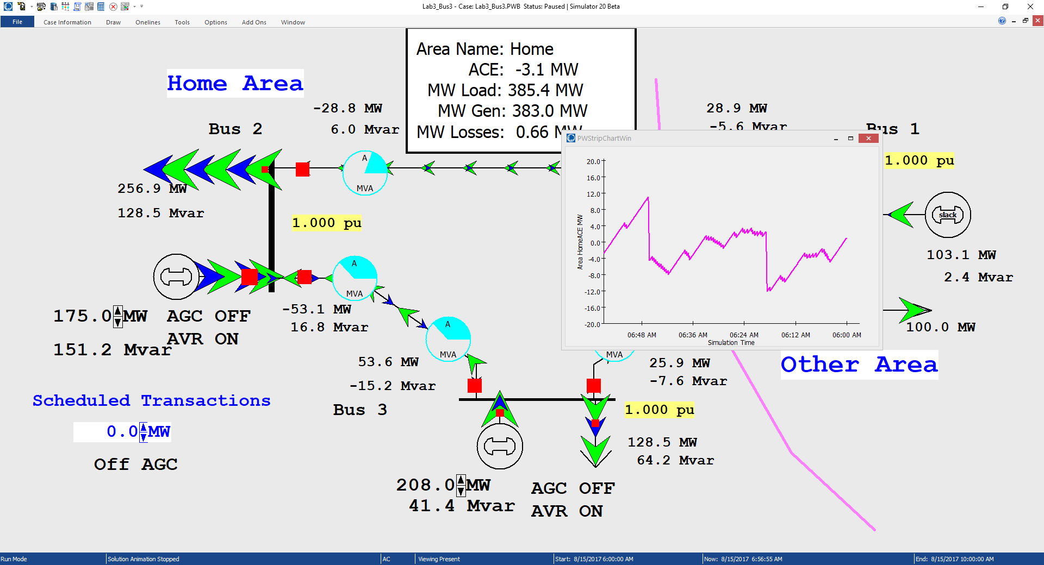
Three Bus Case with Manual ACE Control
Generation is manually
changed to match
change in load, keep
ACE close to zero

Slide 5
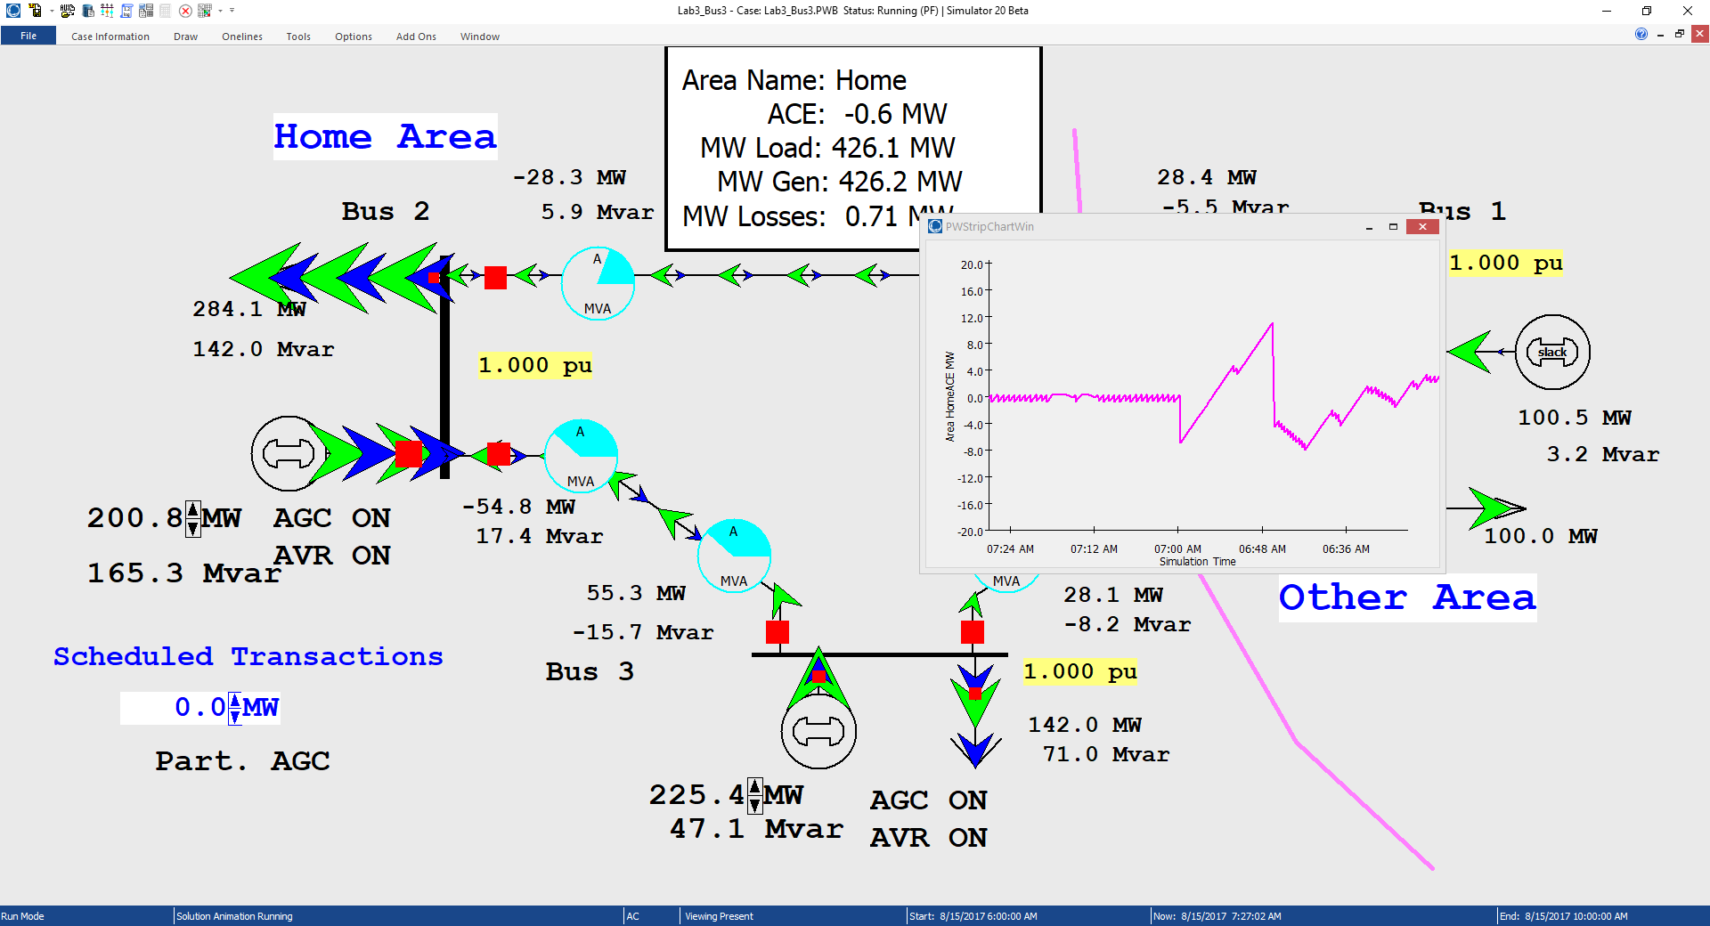
Three Bus Case with AGC
Ripple is due to the deadband, used to prevent excessive change in the generation
Generation real power is now being automatically controlled

Slide 6
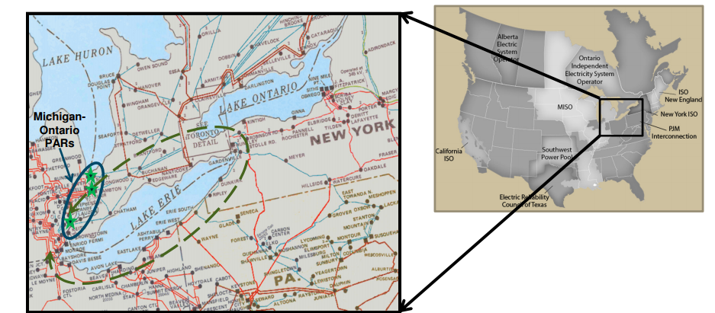
Multi-Area Operation
Statement 21. Transactions within areas and between areas will not exclusively follow the direct paths and may sometimes create loop flows through non-participating areas.

Slide 7
Seven Bus Case: One-line
System has
three areas
Area top
has five
buses
Area left has one bus
Area right has one bus

Slide 8
Seven Bus Case: Area View
Actual
flow
between
areas
System has
40 MW of
“Loop Flow”
Scheduled
flow
Loop flow can result in higher losses

Slide 9
Seven Bus - Loop Flow?
Note that
Top’s
Losses have
increased
from
7.09MW to
9.44 MW
100 MW Transaction
between Left and Right
Transaction has actually decreased
the loop flow

Slide 10
Generator Dispatch and Electricity Pricing
Statement 22. The actual generator dispatch is by economics, but it is subject to constraints associated with transmission system, including contingency constraints.
Dispatch is no longer optimal due to need to keep line
from bus 2 to bus 3 from overloading

Slide 11
Security Constrained Economic Dispatch
Transmission constraints often limit system economics.
Such limits required a constrained dispatch in order to maintain system security.
In three bus case the generation at bus 3 must be constrained to avoid overloading the line from bus 2 to bus 3.

Slide 12
Generator Dispatch and Electricity Pricing
Statement 23. Electricity is priced locationally through locational marginal prices (LMPs).
Cost to supply electricity to bus is called the locational marginal price (LMP)
Presently some electric markets post LMPs on the web
In an ideal electricity market with no transmission limitations the LMPs are equal
Transmission constraints can segment a market, resulting in differing LMP
Determination of LMPs requires the solution on an Optimal Power Flow (OPF)

Slide 13
Three Bus LMPs with Overload Ignored
Gen 2’s
cost
is $12
per
MWh
Gen 1’s
cost
is $10
per
MWh
Line from Bus 1 to Bus 3 is over-loaded; all buses have same marginal cost

Slide 14
Now with the Line Limit Enforced
Line from 1 to 3 is no longer overloaded, but now
the marginal cost of electricity at 3 is $14 / MWh

Slide 15
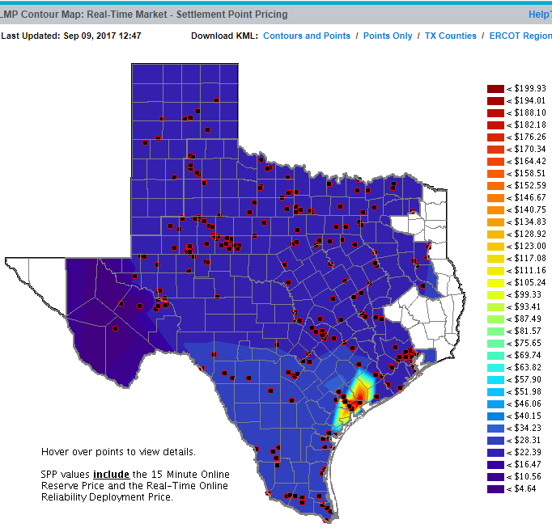
ERCOT LMPs 9/9/17 at 12:47 PM
http://www.ercot.com/content/cdr/contours/rtmLmpHg.html

Slide 16
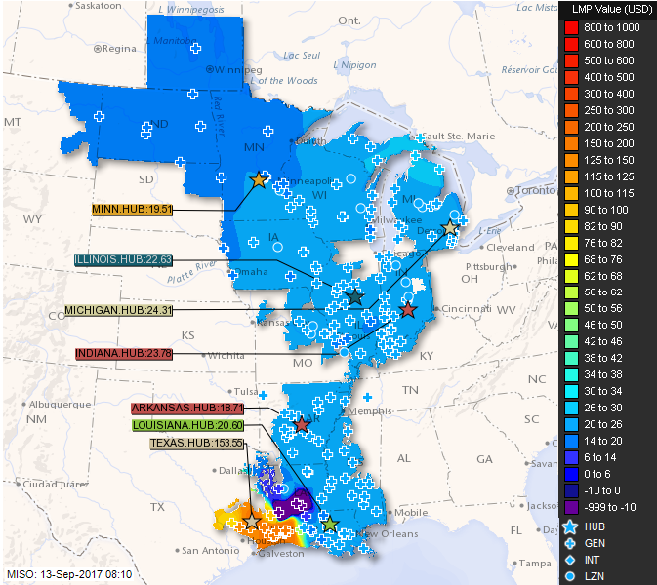
MISO LMPs 9/13/17 at 8:10 AM
https://www.misoenergy.org/LMPContourMap/MISO_All.html

Slide 17
Generator Dispatch and Electricity Pricing
Statement 24. Flowgates are constraints in the dispatch under base or contingency conditions, restricting the allowed flow through one or more parallel transmission paths.
The real-time loading of the power grid is accessed via “flowgates”
A flowgate “flow” is the real power flow on one or more transmission element for either base case conditions or a single contingency
  contingent flows are determined using LODFs
Flowgates are used as proxies for other types of limits, such as voltage or stability limits
Flowgates could be calculated using a spreadsheet
A list of the MISO flowgates is given at
http://www.oatioasis.com/woa/docs/MISO/MISOdocs/MISO-COORDINATED_FLOWGATES.pdf

Slide 18
Line Outage Distribution Factors (LODFS)
LODFs are used to approximate the change in the flow on one line caused by the outage of a second line
  typically they are only used to determine the change in the MW flow
  LODFs are used extensively in real-time operations
  LODFs are state-independent but do dependent on the assumed network topology

Slide 19
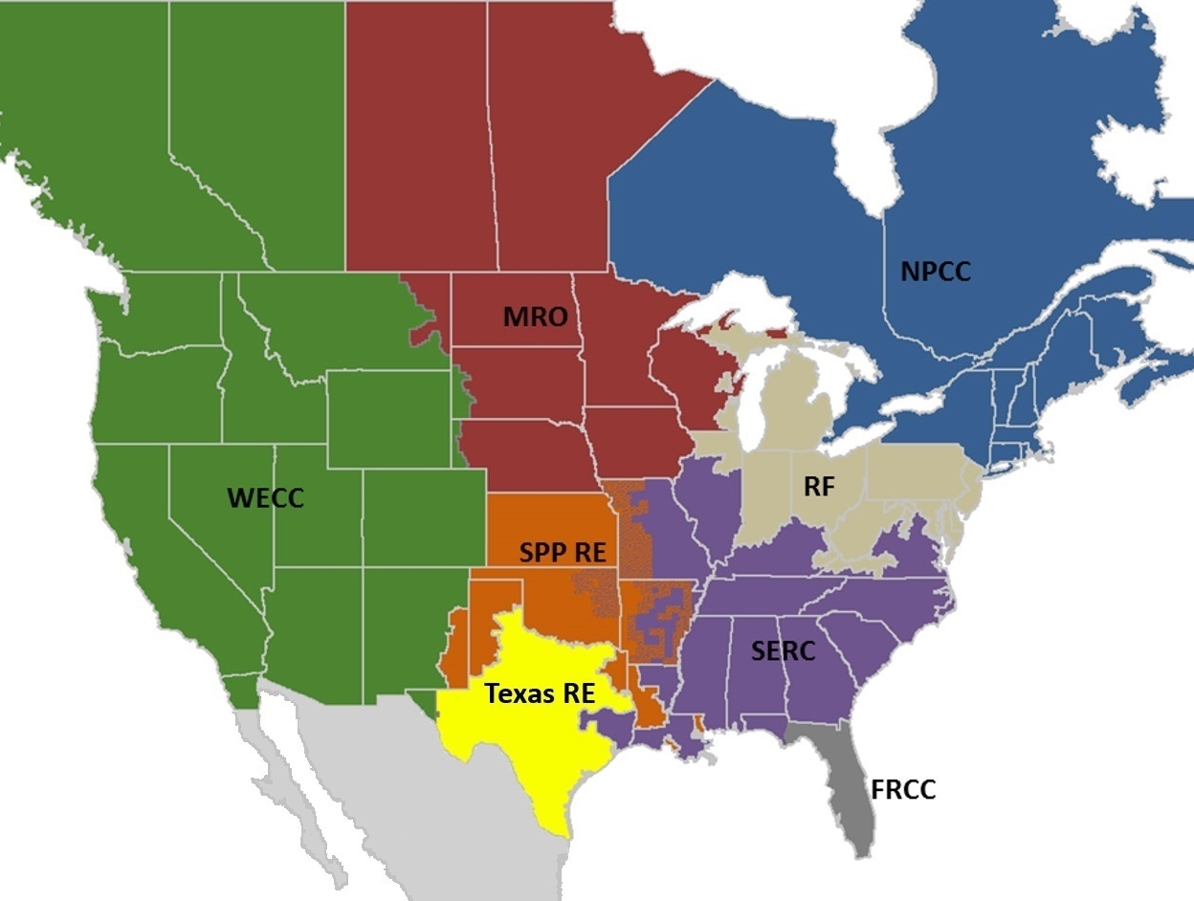
NERC Regional Reliability Councils
NERC is the
North American
Electric Reliability
Council
Image: www.nerc.com/AboutNERC/keyplayers/PublishingImages/2017_NERC_Regions_May2017.jpg

Slide 20
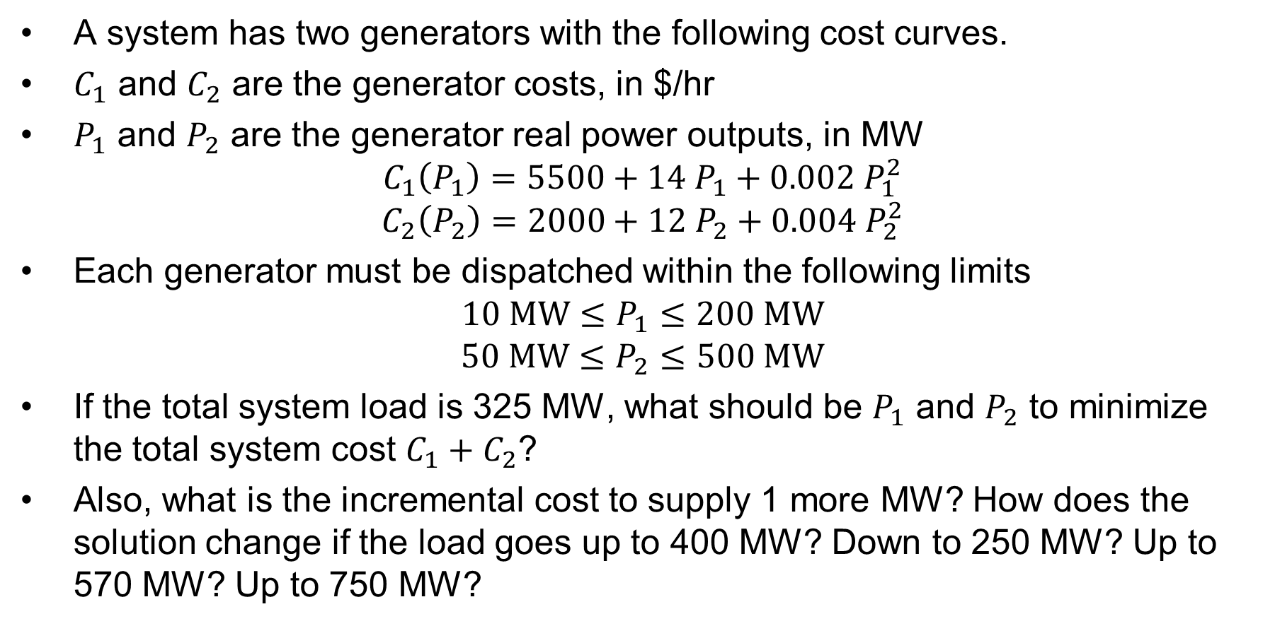
Economic Dispatch Problem, Example 1
A system has two generators with the following cost curves.
$C_{1}$ and $C_{2}$ are the generator costs, in $/hr
$P_{1}$ and $P_{2}$ are the generator real power outputs, in MW
$$C_{1}\left(P_{1}\right)=5500+14 P_{1}+0.002 P_{1}^{2}$$
$$C_{2}\left(P_{2}\right)=2000+12 P_{2}+0.004 P_{2}^{2}$$
Each generator must be dispatched within the following limits
$$10 \text{MW}≤P_{1}≤200 \text{MW}$$
$$50 \text{MW}≤P_{2}≤500 \text{MW}$$
If the total system load is 325 MW, what should be $P_{1}$ and $P_{2}$ to minimize the total system cost $C_{1}+C_{2}$?
Also, what is the incremental cost to supply 1 more MW? How does the solution change if the load goes up to 400 MW? Down to 250 MW? Up to 570 MW? Up to 750 MW?

Slide 21
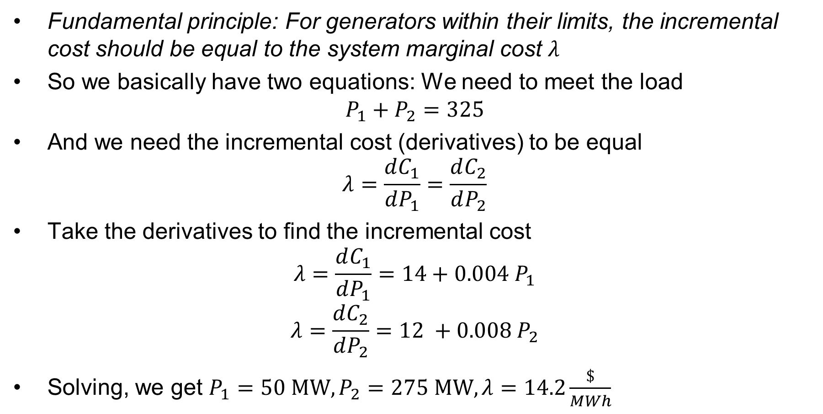
Economic Dispatch Problem, Example 1
Fundamental principle: For generators within their limits, the incremental cost should be equal to the system marginal cost $λ$
So we basically have two equations: We need to meet the load
$$P_{1}+P_{2}=325$$
And we need the incremental cost (derivatives) to be equal
$$λ=\frac{dC_{1}}{dP_{1}}=\frac{dC_{2}}{dP_{2}}$$
Take the derivatives to find the incremental cost
$$λ=\frac{dC_{1}}{dP_{1}}=14+0.004 P_{1}$$
$$λ=\frac{dC_{2}}{dP_{2}}=12 +0.008 P_{2}$$
Solving, we get $P_{1}=50 \text{MW}, P_{2}=275 \text{MW}, λ=14.2\frac{\$}{MWh}$

Slide 22
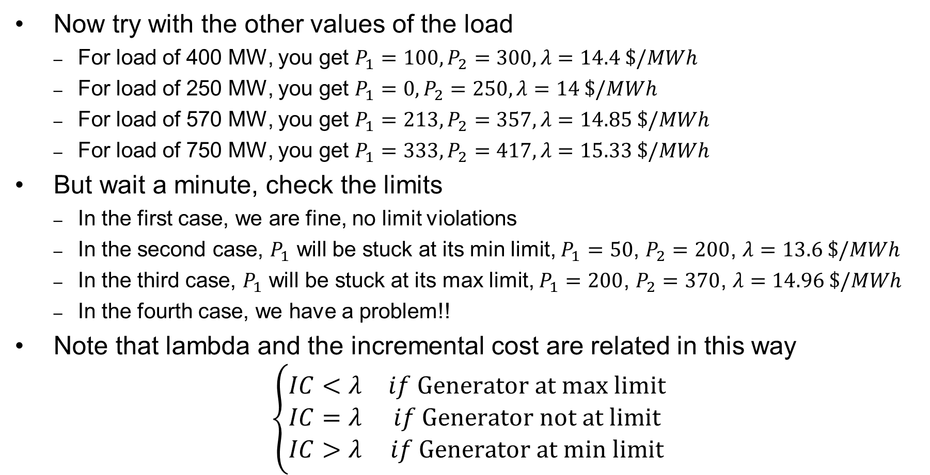
Economic Dispatch Problem, Example 1
Now try with the other values of the load
  For load of 400 MW, you get $P_{1}=100, P_{2}=300, λ=14.4 \$/MWh$
  For load of 250 MW, you get $P_{1}=0, P_{2}=250, λ=14 \$/MWh$
  For load of 570 MW, you get $P_{1}=213, P_{2}=357, λ=14.85 \$/MWh$
  For load of 750 MW, you get $P_{1}=333, P_{2}=417, λ=15.33 \$/MWh$
But wait a minute, check the limits
  In the first case, we are fine, no limit violations
  In the second case, $P_{1}$ will be stuck at its min limit, $P_{1}=50$, $P_{2}=200$, $λ=13.6 \$/MWh$
  In the third case, $P_{1}$ will be stuck at its max limit, $P_{1}=200$, $P_{2}=370$, $λ=14.96 \$/MWh$
  In the fourth case, we have a problem!!
Note that lambda and the incremental cost are related in this way
$$\left\{\begin{matrix}IC<λ & if \text{Generator} \text{at} \text{max} \text{limit} \\ IC=λ & if \text{Generator} \text{not} \text{at} \text{limit} \\ IC>λ & if \text{Generator} \text{at} \text{min} \text{limit}\end{matrix}\right.$$

Slide 23
Homework
For next class – review DC power flow again
Homework due 3/30/23:
  6th edition: Problems 6.62, 6.63, 6.65
  7th edition: Problems 7.1, 7.2, 7.4

