Slide 1
ECEN 460, Spring 2023
Power System Operation and Control
Class 14: Large Power System Analysis
Prof. Adam Birchfield
Dept. of Electrical and Computer Engineering
Texas A&M University
abirchfield@tamu.edu

Slide 2

Mid-Term Survey
Today instead of a quiz we have a mid-term survey to get student feedback on this course
Your instructor and TAs greatly value your feedback for improving the course this semester and in the future.
There is no grade associated with this mid-term survey.
For each statement, give a numerical rating 1-5 based on how much you agree with it, where 1 is strongly disagree and 5 is strongly agree.
Then add any comments, including specific things that are good about the class or can be improved.

Slide 3
Announcements
Sign up for power plant tour March 24th
Be working on your generator paper due April 4th

Slide 4
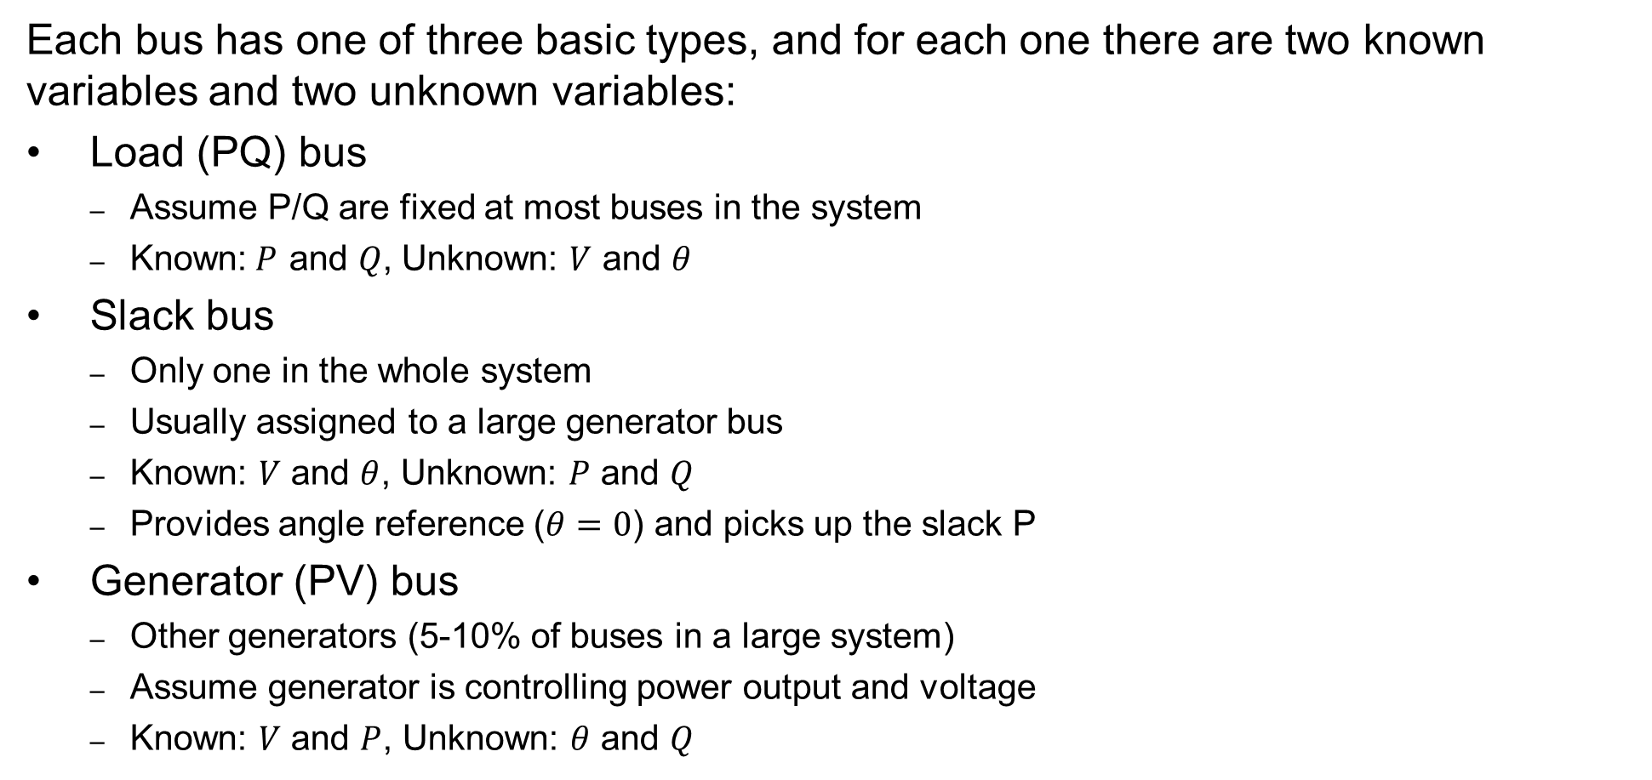
Power Flow Bus Types
  Each bus has one of three basic types, and for each one there are two known variables and two unknown variables:
Load (PQ) bus
  Assume P/Q are fixed at most buses in the system
  Known:$P$ and $Q$, Unknown: $V$ and $θ$
Slack bus
  Only one in the whole system
  Usually assigned to a large generator bus
  Known: $V$ and $θ$, Unknown: $P$ and $Q$
  Provides angle reference ($θ=0$) and picks up the slack P
Generator (PV) bus
  Other generators (5-10% of buses in a large system)
  Assume generator is controlling power output and voltage
  Known: $V$ and $P$, Unknown: $θ$ and $Q$
For slack bus: no power balance equations (P, Q pick up the slack)
For Load (PQ) buses: 2 power balance equations (P, Q must balance)
For Generator (PV) buses: only need 1 power balance equation (P must balance, V magnitude remains fixed by controlling generator reactive power)

Slide 5
Generator Reactive Power Limits
The reactive power output of generators varies to maintain the terminal voltage; on a real generator this is done by the exciter
To maintain higher voltages requires more reactive power
Generators have reactive power limits, which are dependent upon the generator's MW output
These limits must be considered during the power flow solution
  During power flow, once a solution is obtained, check to make generator reactive power output is within its limits
  If the reactive power is outside of the limits, fix Q at the max or min value, and resolve treating the generator as a PQ bus
    this is know as "type-switching"
    also need to check if a PQ generator can again regulate
Rule of thumb: to raise system voltage we need to supply more vars

Slide 6
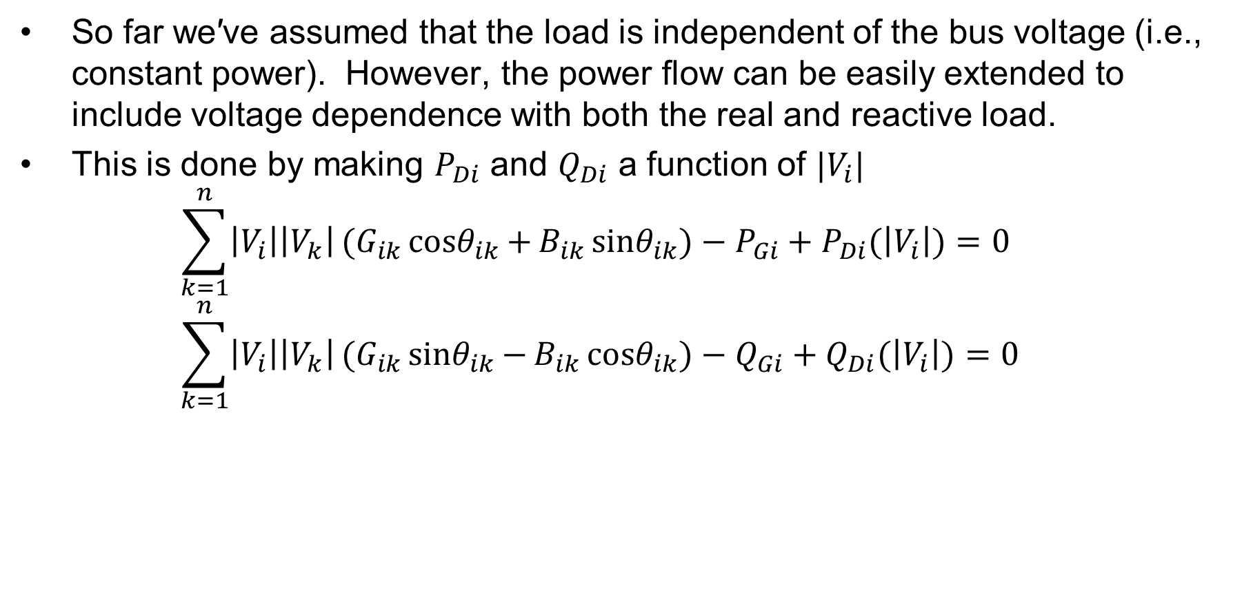
Modeling Voltage Dependent Load
So far we′ve assumed that the load is independent of the bus voltage (i.e., constant power). However, the power flow can be easily extended to include voltage dependence with both the real and reactive load.
This is done by making $P_{Di}$ and $Q_{Di}$ a function of $|V_{i}|$⁡
$\sum_{k=1}^{n}{\left|V_{i}\right|\left|V_{k}\right|}(G_{ik}{cosθ}_{ik}{+}B_{ik}{sinθ}_{ik}{)}−P_{Gi}+P_{Di}(\left|V_{i}\right|)=0$
$\sum_{k=1}^{n}{\left|V_{i}\right|\left|V_{k}\right|}(G_{ik}{sinθ}_{ik}{−}B_{ik}{cosθ}_{ik}{)}−Q_{Gi}+Q_{Di}(\left|V_{i}\right|)=0$

Slide 7
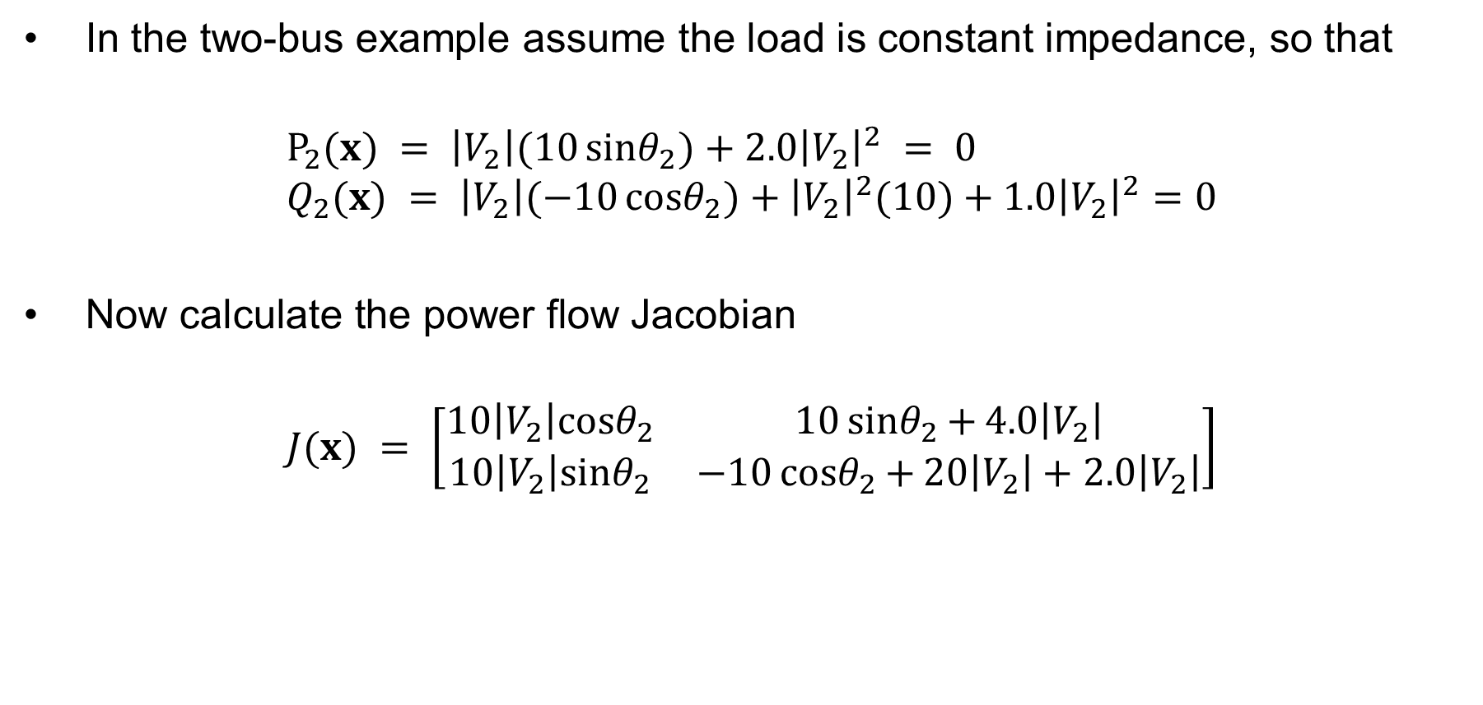
Voltage Dependent Load Example
In the two-bus example assume the load is constant impedance, so that
$$P_{2}(x) = \left|V_{2}\right|(10{sinθ}_{2}{)}+2.0{\left|V_{2}\right|}^{2} = 0 \\ Q_{2}(x) = \left|V_{2}\right|(−10{cosθ}_{2}{)}+{\left|V_{2}\right|}^{2}(10)+1.0{\left|V_{2}\right|}^{2}=0$$
$\text{Now} \text{calculate} \text{the} \text{power} \text{flow} \text{Jacobian}$
$$J(x) = \left[\begin{matrix}10\left|V_{2}\right|{cosθ}_{2} & 10{sinθ}_{2}{+}4.0\left|V_{2}\right| \\ 10\left|V_{2}\right|{sinθ}_{2} & −10{cosθ}_{2}{+}20\left|V_{2}\right|+2.0\left|V_{2}\right|\end{matrix}\right]$$

Slide 8
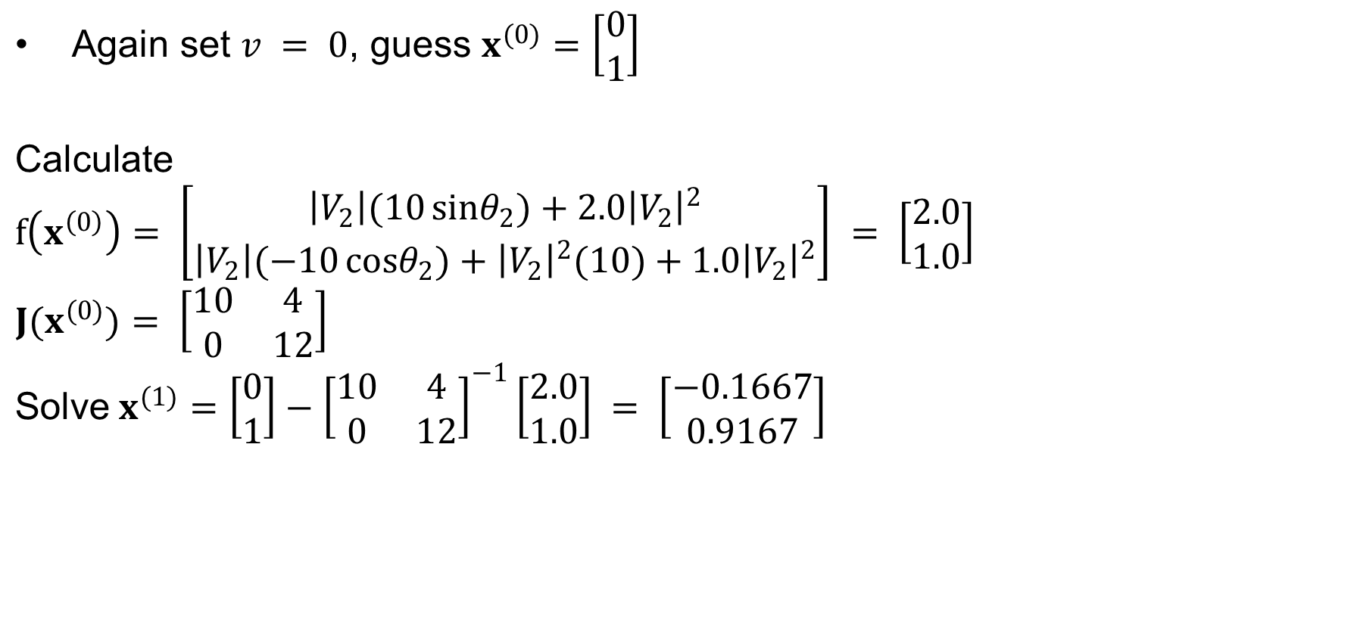
Voltage Dependent Load, cont'd
$\text{Again} \text{set} v = 0\text{, }\text{guess} x^{(0)}=\left[\begin{matrix}0 \\ 1\end{matrix}\right]$
$$\text{Calculate}$$
$$f\left(x^{\left(0\right)}\right)= \left[\begin{matrix}\left|V_{2}\right|(10{sinθ}_{2}{)}+2.0{\left|V_{2}\right|}^{2} \\ \left|V_{2}\right|(−10{cosθ}_{2}{)}+{\left|V_{2}\right|}^{2}(10)+1.0{\left|V_{2}\right|}^{2}\end{matrix}\right] = \left[\begin{matrix}2.0 \\ 1.0\end{matrix}\right]$$
$$J(x^{(0)})= \left[\begin{matrix}10 & 4 \\ 0 & 12\end{matrix}\right]$$
$$\text{Solve} x^{(1)}=\left[\begin{matrix}0 \\ 1\end{matrix}\right]−{\left[\begin{matrix}10 & 4 \\ 0 & 12\end{matrix}\right]}^{−1}\left[\begin{matrix}2.0 \\ 1.0\end{matrix}\right] = \left[\begin{matrix}−0.1667 \\ 0.9167\end{matrix}\right]$$

Slide 9
Voltage Dependent Load, cont'd
With constant impedance load the MW/Mvar load at bus 2 varies with the square of the bus 2 voltage magnitude. This if the voltage level is less than 1.0, the load is lower than 200/100 MW/Mvar

Slide 10
Speeding up the Power Flow
The most computationally complex part of power flow is building and inverting (or factorizing) the Jacobian, so most of the approximations are designed to speed it up by reducing that work

Slide 11
Power Flow Approximations
Methods used to approximate the power flow and potentially speed it up:
  Dishonest Newton-Raphson: just keep the same Jacobian from the first iteration to use in all iterations. (Or only update occasionally.)
  Decoupled Power Flow: Assume the off-diagonal Jacobian matrices are zero (they are usually quite small)
  Fast Decoupled Power Flow: Same as decoupled but only build and invert the Jacobian once (like in the Dishonest Newton-Raphson method)
  Linearized or "DC" power flow: ignore reactive power completely and assume all bus voltages are 1.0 per-unit.

Slide 12
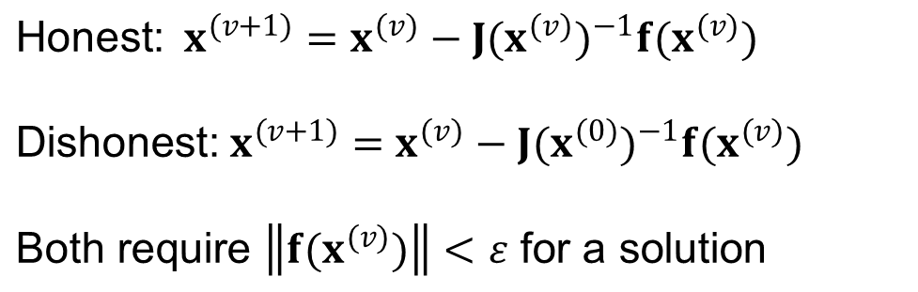
Dishonest Newton-Raphson
Since most of the time in the Newton-Raphson iteration is spend calculating the inverse of the Jacobian, one way to speed up the iterations is to only calculate/inverse the Jacobian occasionally
  known as the “Dishonest” Newton-Raphson
  an extreme example is to only calculate the Jacobian for the first iteration
$$\text{Honest}\text{:} x^{(v+1)}=x^{(v)}−J(x^{(v)})^{−1}f(x^{(v)})$$
$$\text{Dishonest}\text{:} x^{(v+1)}=x^{(v)}−J(x^{(0)})^{−1}f(x^{(v)})$$
$$\text{Both} \text{require} \left\|f(x^{(v)})\right\|<ε \text{for} \text{a} \text{solution}$$

Slide 13

Dishonest Newton-Raphson Example
$\text{Use} \text{the} \text{Dishonest} \text{Newton}\text{−}\text{Raphson} \text{to} \text{solve}$
$$f(x) = x^{2}−2=0 \\ Δx^{(v)} = −{\left[\frac{df(x^{(0)})}{dx}\right]}^{−1}f(x^{(v)}) \\ Δx^{(v)} = −\left[\frac{1}{2x^{(0)}}\right]((x^{(v)})^{2}−2) \\ x^{(v+1)} = x^{(v)}−\left[\frac{1}{2x^{(0)}}\right]((x^{(v)})^{2}−2)$$

Slide 14

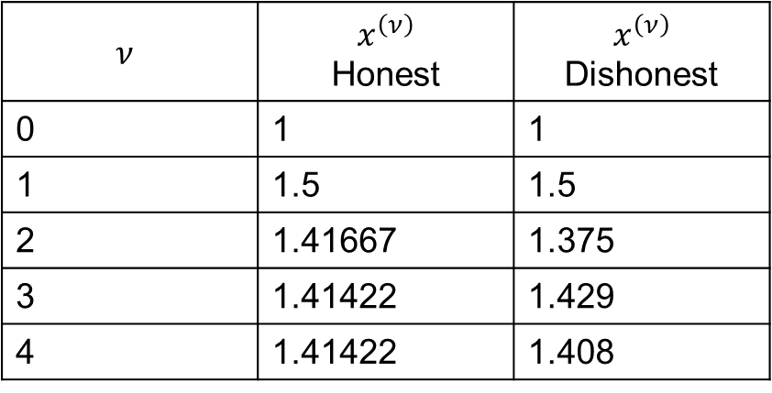
Dishonest N-R Example, cont’d
$x^{(v+1)} = x^{(v)}−\left[\frac{1}{2x^{(0)}}\right]((x^{(v)})^{2}−2)$
$$\text{Guess} {\text{x}}^{(0)}=1. \text{Iteratively} \text{solving} \text{we} \text{get}$$
$$ν$$ | $$x^{\left(ν\right)}$$ Honest | $$x^{\left(ν\right)}$$ Dishonest
0 | 1 | 1
1 | 1.5 | 1.5
2 | 1.41667 | 1.375
3 | 1.41422 | 1.429
4 | 1.41422 | 1.408
We pay a price
in increased
iterations, but
with decreased
computation
per iteration

Slide 15
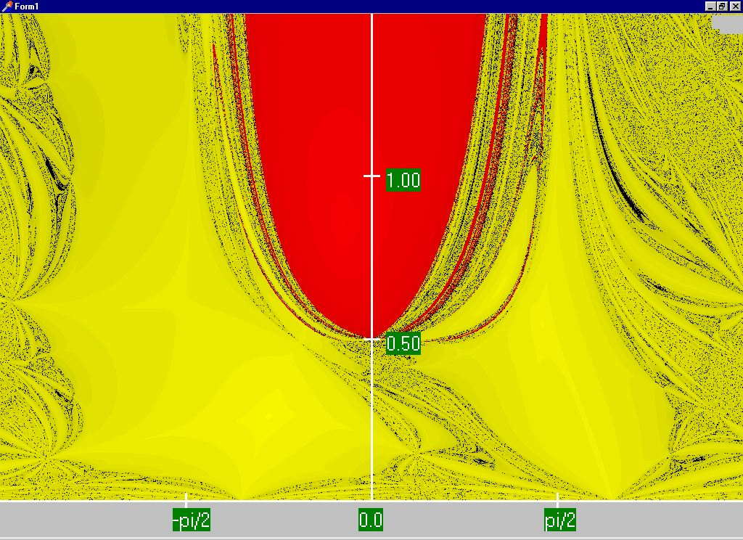
Regular Newton-Raphson Region of Convergence
For a two-bus system, this plot is graphing the initial guess: horizontal axis is theta and vertical axis is V.
Red region converges to the high voltage solution, while the yellow region converges to the low voltage solution
Maximum of 15 iterations

Slide 16
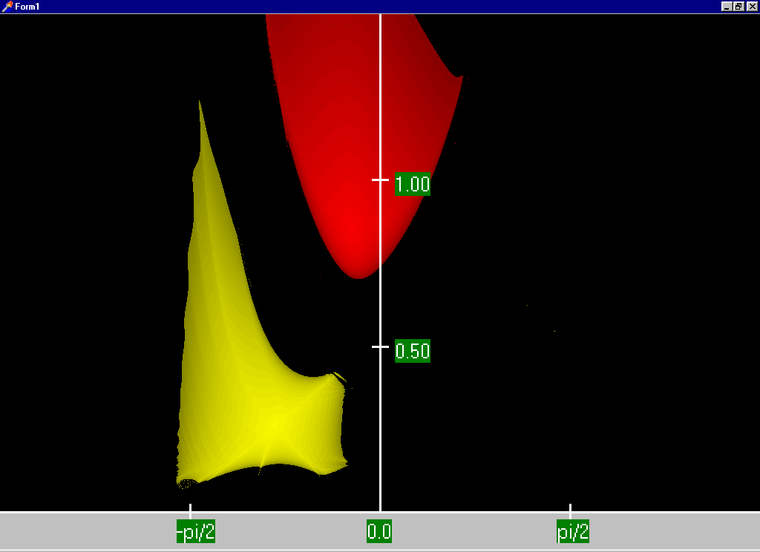
Dishonest Newton-Raphson Region of Convergence
For a two-bus system, this plot is graphing the initial guess: horizontal axis is theta and vertical axis is V.
Red region converges to the high voltage solution, while the yellow region converges to the low voltage solution
Maximum of 15 iterations

Slide 17
Decoupled Power Flow
The completely Dishonest Newton-Raphson is not used for power flow analysis. However several approximations of the Jacobian matrix are used.
One common method is the decoupled power flow. In this approach approximations are used to decouple the real and reactive power equations.

Slide 18
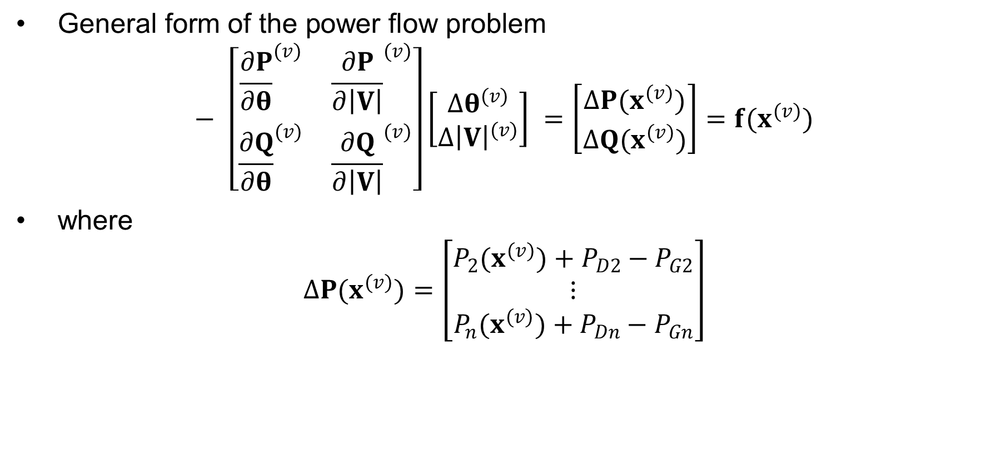
Decoupled Power Flow Formulation
$\text{General} \text{form} \text{of} \text{the} \text{power} \text{flow} \text{problem}$
$− \left[\begin{matrix}{\frac{∂P}{∂θ}}^{(v)} & {\frac{∂P}{∂\left|V\right|}}^{(v)} \\ {\frac{∂Q}{∂θ}}^{(v)} & {\frac{∂Q}{∂\left|V\right|}}^{(v)}\end{matrix}\right]\left[\begin{matrix}Δθ^{(v)} \\ Δ{\left|V\right|}^{(v)}\end{matrix}\right] =\left[\begin{matrix}ΔP(x^{(v)}) \\ ΔQ(x^{(v)})\end{matrix}\right]=f(x^{(v)})$
$\text{where}$
$ΔP(x^{(v)})=\left[\begin{matrix}P_{2}(x^{(v)})+P_{D2}−P_{G2} \\ ⋮ \\ P_{n}(x^{(v)})+P_{Dn}−P_{Gn}\end{matrix}\right]$

Slide 19
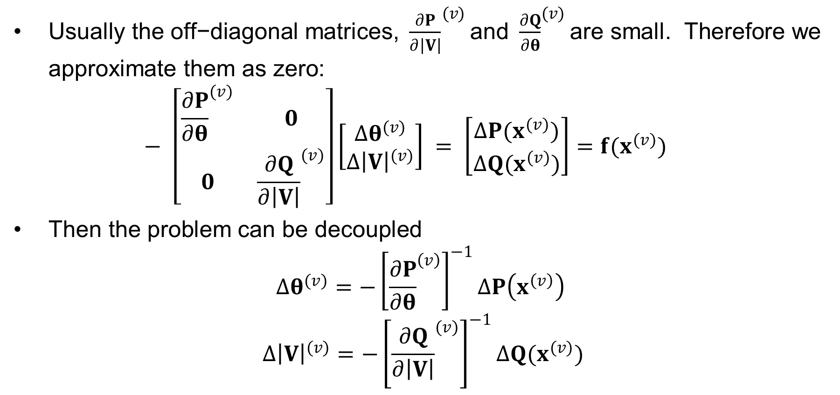
Decoupling Approximation
$\text{Usually} \text{the} \text{off}\text{−}\text{diagonal} \text{matrices}\text{, }{\frac{∂P}{∂\left|V\right|}}^{(v)}\text{and} {\frac{∂Q}{∂θ}}^{(v)}\text{are} \text{small}\text{. }\text{Therefore} \text{we} \text{approximate} \text{them} \text{as} \text{zero}\text{:}$
$− \left[\begin{matrix}{\frac{∂P}{∂θ}}^{(v)} & 0 \\ 0 & {\frac{∂Q}{∂\left|V\right|}}^{(v)}\end{matrix}\right]\left[\begin{matrix}Δθ^{(v)} \\ Δ{\left|V\right|}^{(v)}\end{matrix}\right] = \left[\begin{matrix}ΔP(x^{(v)}) \\ ΔQ(x^{(v)})\end{matrix}\right]=f(x^{(v)})$
$\text{Then} \text{the} \text{problem} \text{can} \text{be} \text{decoupled}$
$$Δθ^{(v)}=−{\left[{\frac{∂P}{∂θ}}^{\left(v\right)}\right]}^{−1}ΔP\left(x^{\left(v\right)}\right)$$
$$Δ{\left|V\right|}^{(v)}=−{\left[{\frac{∂Q}{∂\left|V\right|}}^{(v)}\right]}^{−1}ΔQ(x^{(v)})$$

Slide 20
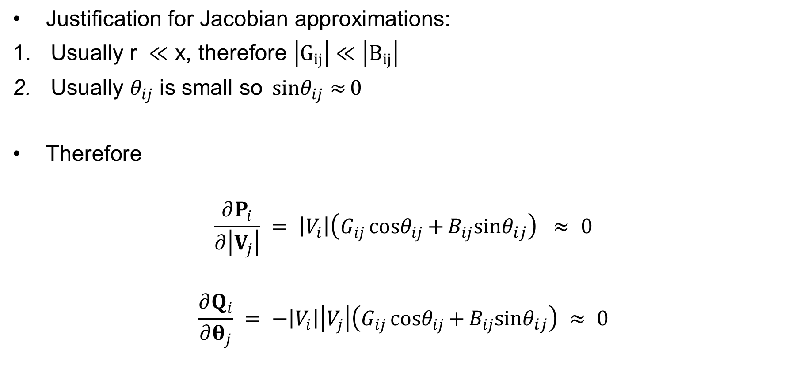
Off-diagonal Jacobian Terms
$\text{Justification} \text{for} \text{Jacobian} \text{approximations}\text{:}$
$\text{Usually} \text{r} ≪\text{x}\text{, }\text{therefore} \left|G_{ij}\right|≪\left|B_{ij}\right|$
$\text{Usually} θ_{ij} \text{is} \text{small} \text{so} {sinθ}_{ij}{≈}0$
$\text{Therefore}$
$$\frac{∂P_{i}}{∂\left|V_{j}\right|} = \left|V_{i}\right|\left(G_{ij}{cosθ}_{ij}{+}B_{ij}{sinθ}_{ij}\right) ≈ 0$$
$$\frac{∂Q_{i}}{∂θ_{j}} = −\left|V_{i}\right|\left|V_{j}\right|\left(G_{ij}{cosθ}_{ij}{+}B_{ij}{sinθ}_{ij}\right) ≈ 0$$

Slide 21
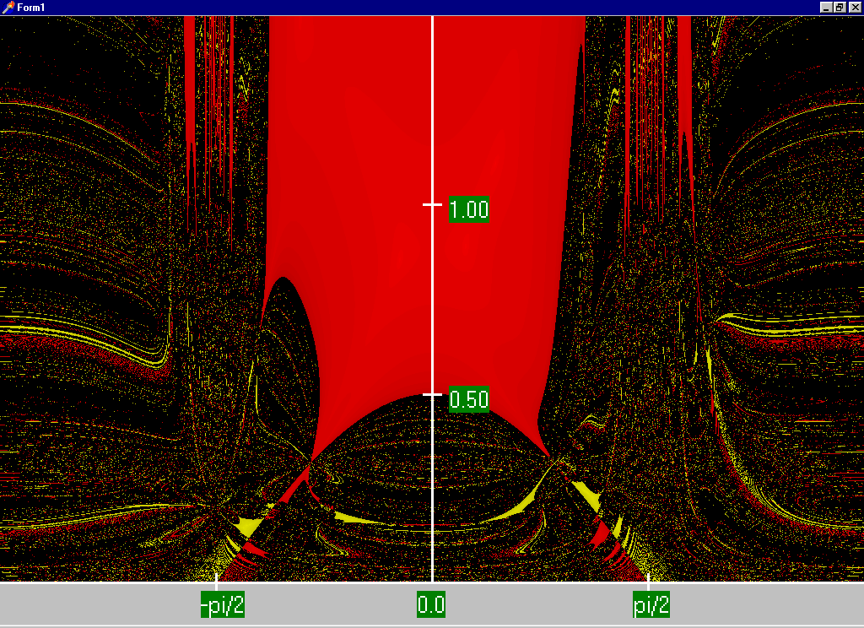
Decoupled Power Flow Region of Convergence
For a two-bus system, this plot is graphing the initial guess: horizontal axis is theta and vertical axis is V.
Red region converges to the high voltage solution, while the yellow region converges to the low voltage solution
Maximum of 15 iterations

Slide 22
Fast Decoupled Power Flow
By continuing with our Jacobian approximations we can actually obtain a reasonable approximation that is independent of the voltage magnitudes/angles.
The Jacobian need only be built/inverted once.
This approach is known as the fast decoupled power flow (FDPF)
FDPF uses the same mismatch equations as standard power flow so it should have same solution
The FDPF is widely used, particularly when we only need an approximate solution such as in contingency analysis

Slide 23
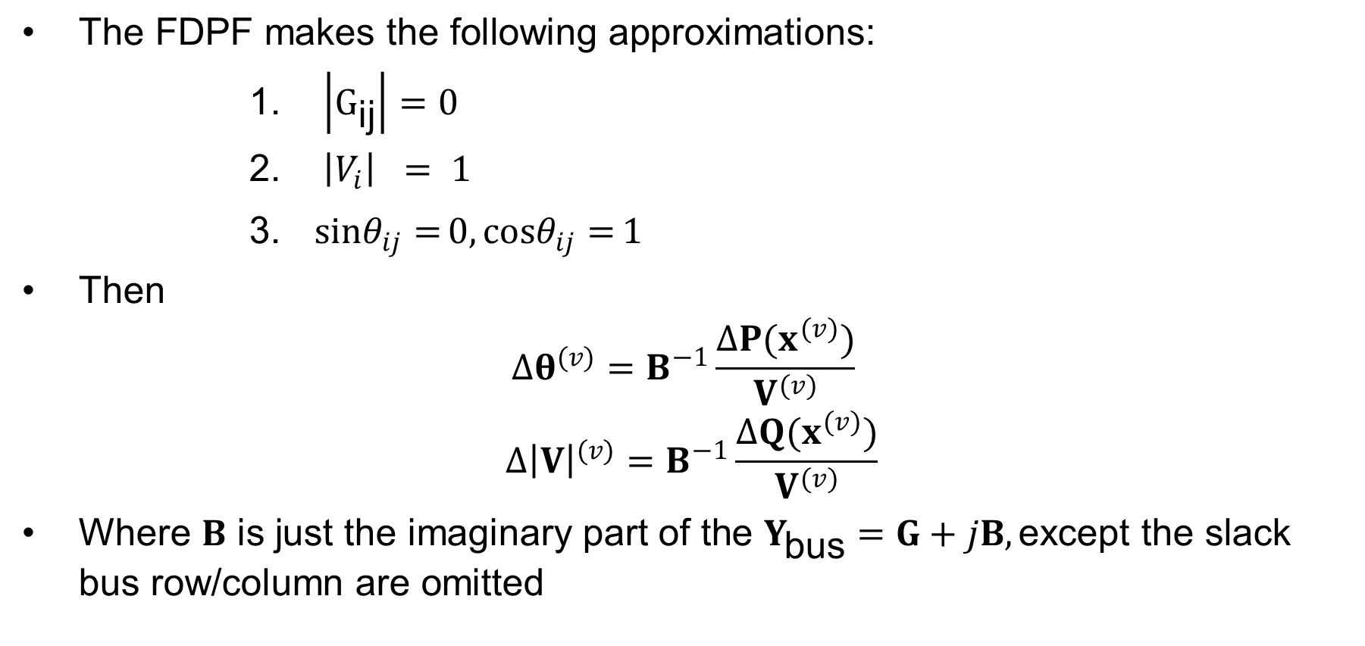
FDPF Approximations
$\text{The} \text{FDPF}​ \text{makes} \text{the} \text{following} \text{approximations}\text{:}$
$\left|G_{\text{ij}}\right|=0$
$\left|V_{i}\right| = 1$
${sinθ}_{ij}{=}0 , {cosθ}_{ij}{=}1$
$\text{Then}$
$$Δθ^{(v)}=B^{−1}\frac{ΔP(x^{(v)})}{V^{(v)}}$$
$$Δ{\left|V\right|}^{(v)}=B^{−1}\frac{ΔQ(x^{(v)})}{V^{(v)}}$$
$\text{Where} B \text{is} \text{just} \text{the} \text{imaginary} \text{part} \text{of} \text{the} Y_{\text{bus}}=G+jB,\text{except} \text{the} \text{slack} \text{bus} \text{row}\text{/}\text{column} \text{are} \text{omitted}$

Slide 24

FDPF Three Bus Example
Use the FDPF to solve the following three bus system
$$Y_{bus}=j\left[\begin{matrix}−34.3 & 14.3 & 20 \\ 14.3 & −24.3 & 10 \\ 20 & 10 & −30\end{matrix}\right]$$

Slide 25

FDPF Three Bus Example, cont’d
$$Y_{bus}=j\left[\begin{matrix}−34.3 & 14.3 & 20 \\ 14.3 & −24.3 & 10 \\ 20 & 10 & −30\end{matrix}\right] → B = \left[\begin{matrix}−24.3 & 10 \\ 10 & −30\end{matrix}\right] \\ B^{−1} = \left[\begin{matrix}−0.0477 & −0.0159 \\ −0.0159 & −0.0389\end{matrix}\right] \\ \text{Iteratively} \text{solve}\text{, }\text{starting} \text{with} \text{an} \text{initial} \text{voltage} \text{guess} \\ {\left[\begin{matrix}θ_{2} \\ θ_{3}\end{matrix}\right]}^{(0)}= \left[\begin{matrix}0 \\ 0\end{matrix}\right] {\left[\begin{matrix}{\left|V\right|}_{2} \\ {\left|V\right|}_{3}\end{matrix}\right]}^{(0)}= \left[\begin{matrix}1 \\ 1\end{matrix}\right] \\ {\left[\begin{matrix}θ_{2} \\ θ_{3}\end{matrix}\right]}^{(1)}= \left[\begin{matrix}0 \\ 0\end{matrix}\right]+\left[\begin{matrix}−0.0477 & −0.0159 \\ −0.0159 & −0.0389\end{matrix}\right]\left[\begin{matrix}2 \\ 2\end{matrix}\right]=\left[\begin{matrix}−0.1272 \\ −0.1091\end{matrix}\right]$$

Slide 26
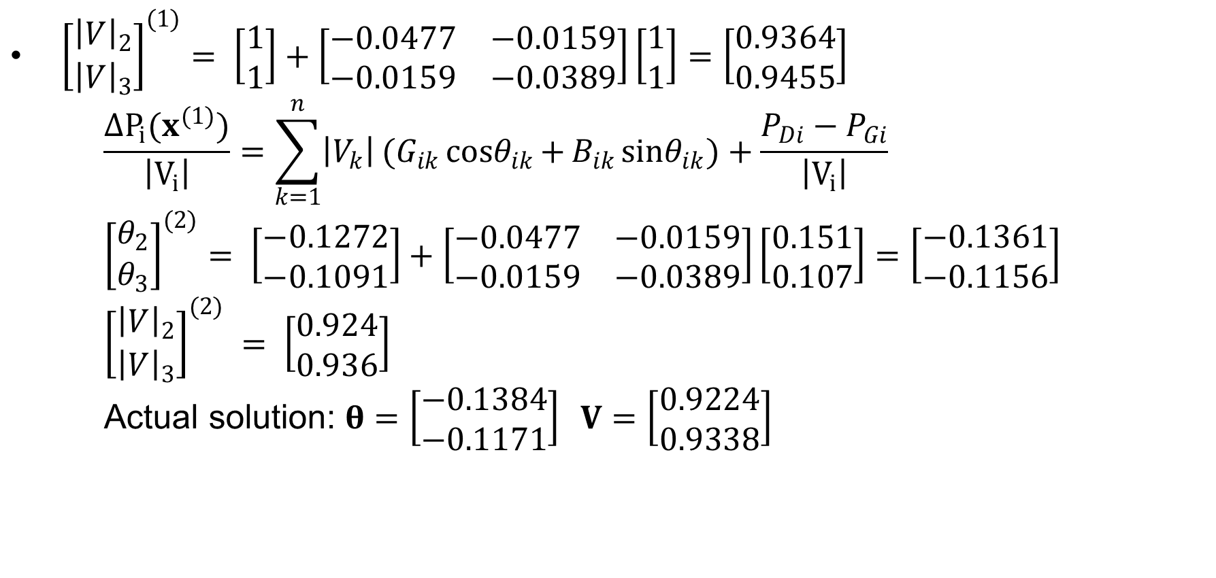
FDPF Three Bus Example, cont’d
${\left[\begin{matrix}{\left|V\right|}_{2} \\ {\left|V\right|}_{3}\end{matrix}\right]}^{(1)}= \left[\begin{matrix}1 \\ 1\end{matrix}\right]+\left[\begin{matrix}−0.0477 & −0.0159 \\ −0.0159 & −0.0389\end{matrix}\right]\left[\begin{matrix}1 \\ 1\end{matrix}\right]=\left[\begin{matrix}0.9364 \\ 0.9455\end{matrix}\right]$
$\frac{ΔP_{i}(x^{(1)})}{\left|V_{i}\right|}=\sum_{k=1}^{n}{\left|V_{k}\right|}(G_{ik}{cosθ}_{ik}{+}B_{ik}{sinθ}_{ik}{)}+\frac{P_{Di}−P_{Gi}}{\left|V_{i}\right|}$
${\left[\begin{matrix}θ_{2} \\ θ_{3}\end{matrix}\right]}^{(2)}= \left[\begin{matrix}−0.1272 \\ −0.1091\end{matrix}\right]+\left[\begin{matrix}−0.0477 & −0.0159 \\ −0.0159 & −0.0389\end{matrix}\right]\left[\begin{matrix}0.151 \\ 0.107\end{matrix}\right]=\left[\begin{matrix}−0.1361 \\ −0.1156\end{matrix}\right]$
${\left[\begin{matrix}{\left|V\right|}_{2} \\ {\left|V\right|}_{3}\end{matrix}\right]}^{(2)} = \left[\begin{matrix}0.924 \\ 0.936\end{matrix}\right]$
$\text{Actual} \text{solution}\text{: }θ=\left[\begin{matrix}−0.1384 \\ −0.1171\end{matrix}\right] V=\left[\begin{matrix}0.9224 \\ 0.9338\end{matrix}\right]$

Slide 27

“DC” Power Flow
The “DC” power flow makes the most severe approximations:
  completely ignore reactive power, assume all the voltages are always 1.0 per unit, ignore line conductance
This makes the power flow a linear set of equations, which can be solved directly
The advantage is it is fast, and it has a guaranteed solution. The disadvantage is the degree of approximation. However, it is used sometimes.
Note that even though it is called “DC” we are still solving an AC system. This is different from including HVDC lines in the power flow.
$$θ=B^{−1} P$$

Slide 28
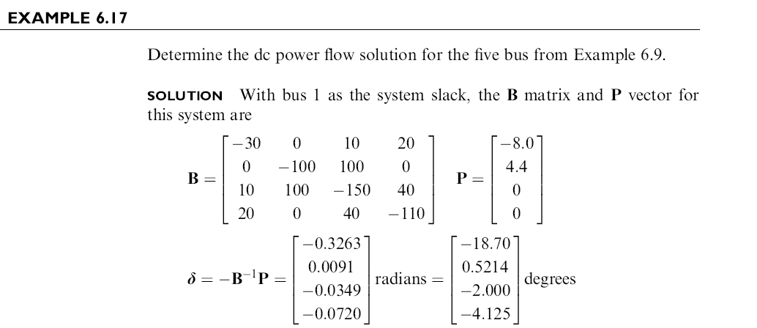
DC Power Flow Example
Notes:
28

Slide 29
DC Power Flow 5 Bus Example
Notice with the dc power flow all of the voltage magnitudes are 1 per unit.
Notes:
29

Slide 30
August 14, 2003 Day-Ahead Power Flow Low Voltage Solution Contour
The day ahead model had 65
energized 15,138, or 230 kV buses with voltages below 0.90 pu
The lowest 138 kV voltage was 0.836 pu; lowest 34.5 kV was 0.621 pu; case contained 42,766 buses; case had been used daily all summer

Slide 31
Brief Coverage of Sparse Matrices
A problem that occurs in many is fields is the solution of linear systems
Ax = b
where
A is an n by n matrix with elements a_{ij},
and x and b are n-vectors with elements x_{i} and b_{i} respectively
In power systems we are particularly interested in systems when n is relatively large and A is sparse
  How large is large is changing
A matrix is sparse if a large percentage of its elements have zero values
Goal is to be aware of the computational issues (including complexity) associated with the solution of these systems

Slide 32
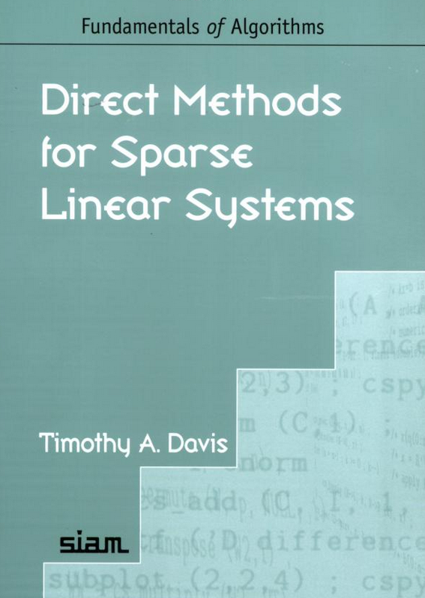
Brief Coverage of Sparse Matrices
Sparse matrices arise in many areas, and can have domain specific structures
Much of the early sparse matrix work was done in power!
Great book on modern methods for solving sparse matrices is by Texas A&M professor Tim Davis

Slide 33
Inverse of a Sparse Matrix
The inverse of a sparse matrix is NOT in general a sparse matrix
We never (or at least very, very, very seldom) explicitly invert a sparse matrix
  Individual columns of the inverse of a sparse matrix can be obtained by solving x = A⁻¹b with b set to all zeros except for a single nonzero in the position of the desired column
  If a few desired elements of A⁻¹ are desired (such as the diagonal values) they can usually be computed quite efficiently using sparse vector methods
We can’t invert a singular matrix (with sparse or not)

Slide 34
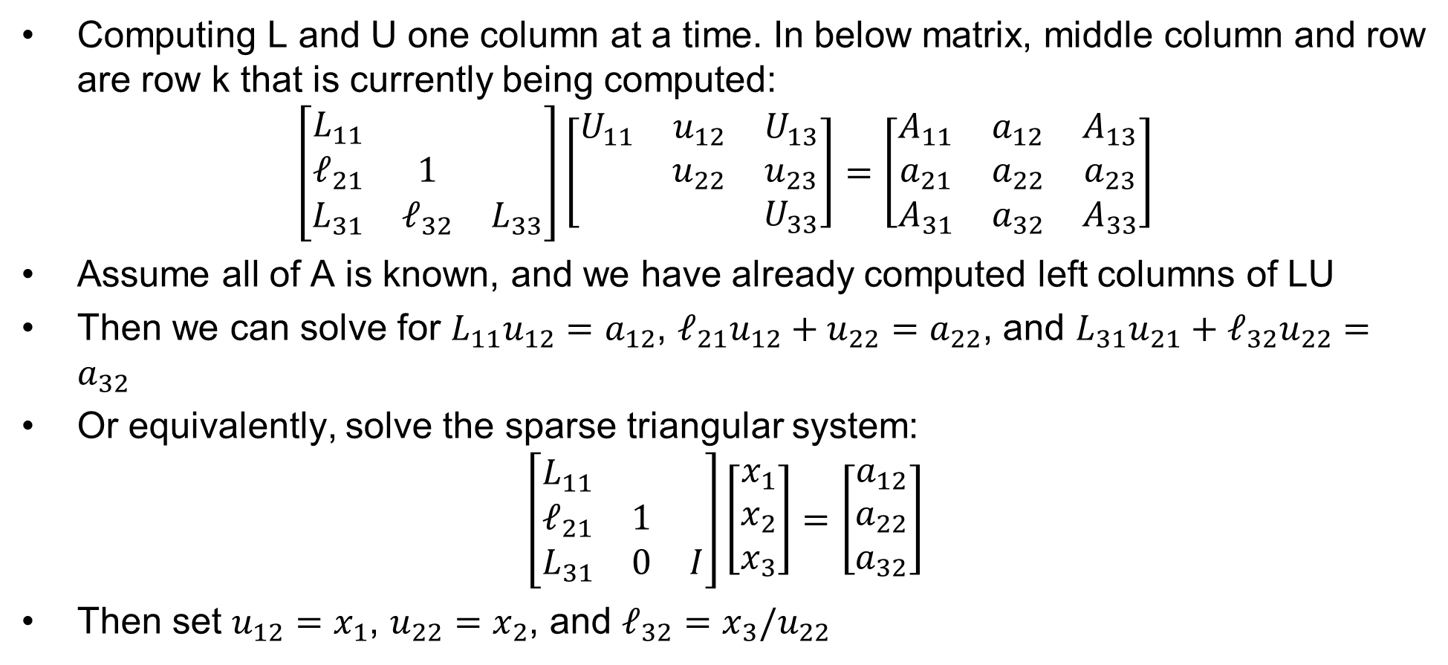
Example Algorithm: Left-looking LU Factorization
Computing L and U one column at a time. In below matrix, middle column and row are row k that is currently being computed:
$$\left[\begin{matrix}L_{11} & & \\ ℓ_{21} & 1 & \\ L_{31} & ℓ_{32} & L_{33}\end{matrix}\right]\left[\begin{matrix}U_{11} & u_{12} & U_{13} \\ & u_{22} & u_{23} \\ & & U_{33}\end{matrix}\right]=\left[\begin{matrix}A_{11} & a_{12} & A_{13} \\ a_{21} & a_{22} & a_{23} \\ A_{31} & a_{32} & A_{33}\end{matrix}\right]$$
Assume all of A is known, and we have already computed left columns of LU
Then we can solve for $L_{11}u_{12}=a_{12}$, $ℓ_{21}u_{12}+u_{22}=a_{22}$, and $L_{31}u_{21}+ℓ_{32}u_{22}=a_{32}$
Or equivalently, solve the sparse triangular system:
$$\left[\begin{matrix}L_{11} & & \\ ℓ_{21} & 1 & \\ L_{31} & 0 & I\end{matrix}\right]\left[\begin{matrix}x_{1} \\ x_{2} \\ x_{3}\end{matrix}\right]=\left[\begin{matrix}a_{12} \\ a_{22} \\ a_{32}\end{matrix}\right]$$
Then set $u_{12}=x_{1}$, $u_{22}=x_{2}$, and $ℓ_{32}=x_{3}/u_{22}$

