Slide 1
ECEN 460, Spring 2023
Power System Operation and Control
Class 13: Introduction to Power System Economics
Prof. Adam Birchfield
Dept. of Electrical and Computer Engineering
Texas A&M University
abirchfield@tamu.edu

Slide 2
Announcements
Exam 1 average was 82.7
Lab 6 next week
Look for email tomorrow about power plant tour signup for March 24th. There will be limited space, first-come, first-served.
Projects due April 4th – Generator paper (discussed on next slide) – counts as two quiz grades

Slide 3
Project – Generator Paper
Pick a real electric generator project and write a one-page technical description of the project. You can add a small picture but it should still be about 1 page of text.
Any generator > 1 MW that is connected to the grid, past present or future
Potential topics for your description (just ideas, not a checklist)
  The plant’s story: when was it constructed, by whom, who owns it now, where is it located, any retirement plans
  Facts: how many units, how much power it can generate, something unique
  About the technology in general: how it works, efficiency, typical controls, environmental considerations, economic considerations
If you go on the power plant tour, instead you can just write ¼ page about a technical question you asked on the tour and the answer.
Due April 4th. Two quiz grades. 80% Completion and following directions 10% Technical excellence and creativity 10% Quality and clarity of writing

Slide 4
Resources for the Project
US Energy Information Administration
  https://www.eia.gov/
  Form 860 has power plant registration data every year for every plant in the US https://www.eia.gov/electricity/data/eia860/
ERCOT data (and similar for other parts of the country)
  https://www.ercot.com/gridinfo
News articles on new construction or retirements
Many plants have a profile page on either the manufacturer or utility website, or both.
Be creative and learn something interesting!

Slide 5
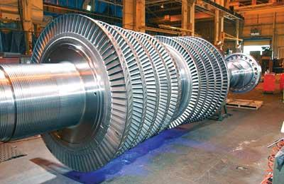
Introduction to Power System Economics
Today first, we're going to have an initial discussion of power system economics as a background for Labs 6-7
The key challenge is the economic dispatch (ED) problem, which asks how we can
  Serve all of the load
  Using the cheapest dispatch of generators
  Subject to other reliability and efficiency constraints
The Optimal Power Flow problem (OPF), which we'll discuss in a few weeks, combines ED with the Power Flow.
Source: http://images.pennnet.com/articles/pe/cap/cap_gephoto.jpg

Slide 6
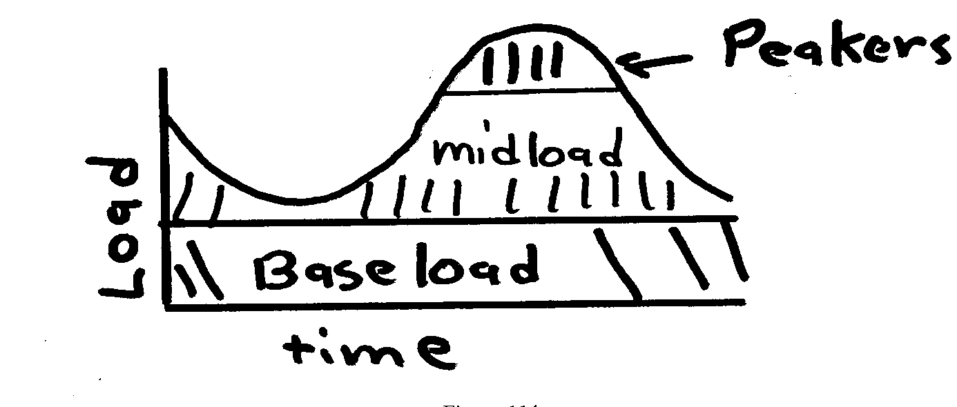
Generator Costs and Types
Generator costs depend on the fuel type, unit design,
and system conditions
Traditionally there are three broad categories
  Baseload: large coal and nuclear,
  operated 24/7 at maximum
  Cycling or Midload: coal and gas plants
  that cycle on and off daily
  Peakers: smaller gas, petroleum, hydro units that are
  mainly used during periods of high demand
Non-dispatchable sources such as wind and solar can be quite variable, but have a low incremental cost. Usually they are operated at the maximum available power.
For hydro the fuel (water) is free but there may be many constraints on operation: total water availability, reservoir level coordination, downstream flow for wildlife

Slide 7
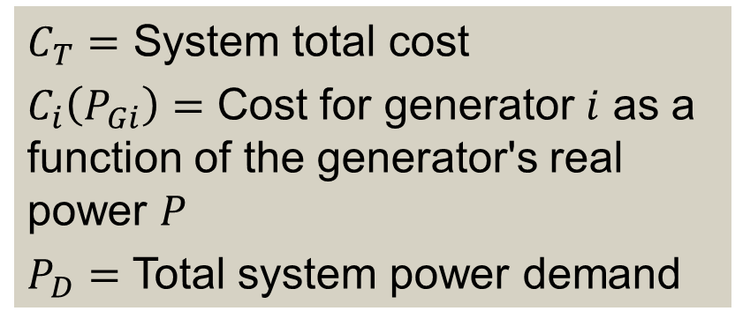
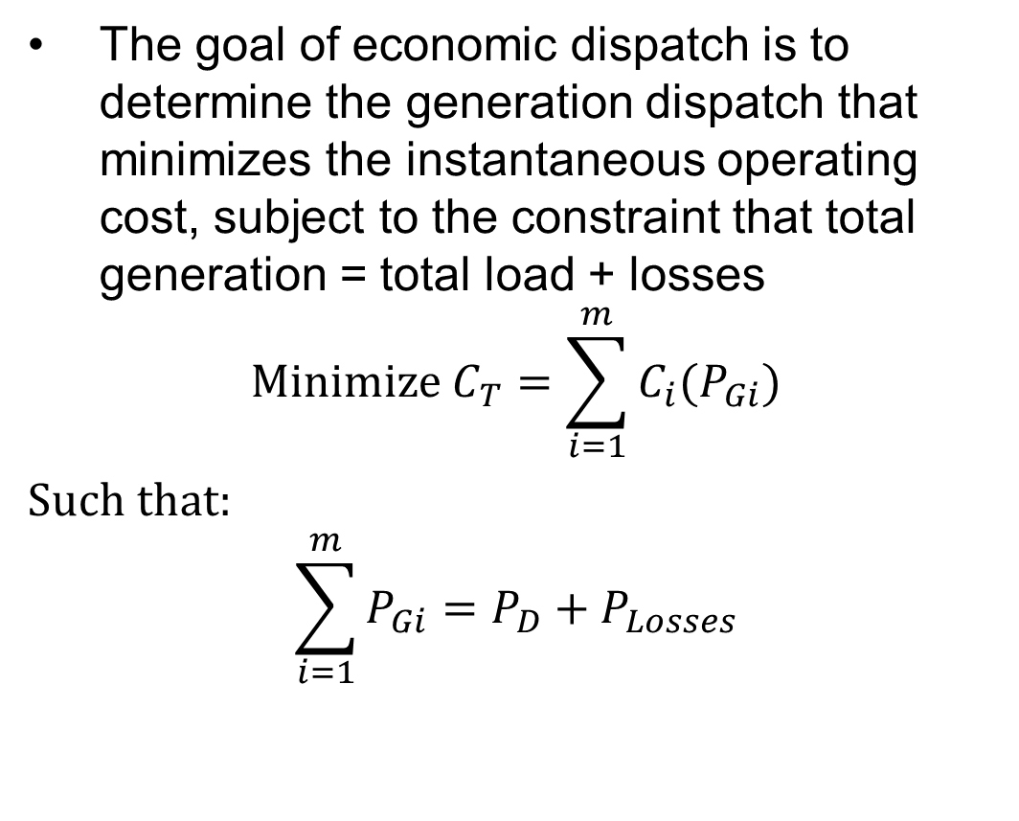
Economic Dispatch Problem
The goal of economic dispatch is to determine the generation dispatch that minimizes the instantaneous operating cost, subject to the constraint that total generation = total load + losses
$$\text{Minimize} C_{T}=\sum_{i=1}^{m}{C_{i}(P_{Gi})}$$
$\text{S}\text{uch} \text{that}\text{:}$
$$\sum_{i=1}^{m}{P_{Gi}}=P_{D}+P_{Losses}$$
$C_{T}=$ System total cost
$C_{i}\left(P_{Gi}\right)=$ Cost for generator $i$ as a function of the generator's real power $P$
$P_{D}=$ Total system power demand
Techniques for solving these problems will be discussed in coming weeks.

Slide 8
System Lambda and Generator Limits
When the ED problem is solved, part of the solution is the incremental cost $λ$ in $/MWh. This would be the cost to serve one more MW of power. Higher $λ$ is typical for a more constrained or higher-load situation.
Generators have limits on the minimum and maximum amount of power they can produce
  Often times the minimum limit is not zero. This represents a limit on the generator’s operation with the desired fuel type
  Because of varying system economics usually many generators in a system are operated at their maximum MW limits.
Each generator has an incremental cost
  If the generator's incremental cost is < $λ$, the generator should be operated at its maximum.
  If the generator's incremental cost is > $λ$, it should be operated at its minimum.
  Some generators may have their incremental cost = $λ$, these are the marginal units operated somewhere between minimum and maximum.

Slide 9
Penalty Factors
The losses on the transmission system are a function of the generation dispatch. In general, using generators closer to the load results in lower losses
This impact on losses should be included when doing the economic dispatch, and can be done by using what are known as penalty factors
A penalty factor is multiplied by the generator cost to represent the effect of losses: i.e. a generator that increases the losses by operating has a penalty factor > 1.0
For Lab 6 we will look at the effect of penalty factors

Slide 10
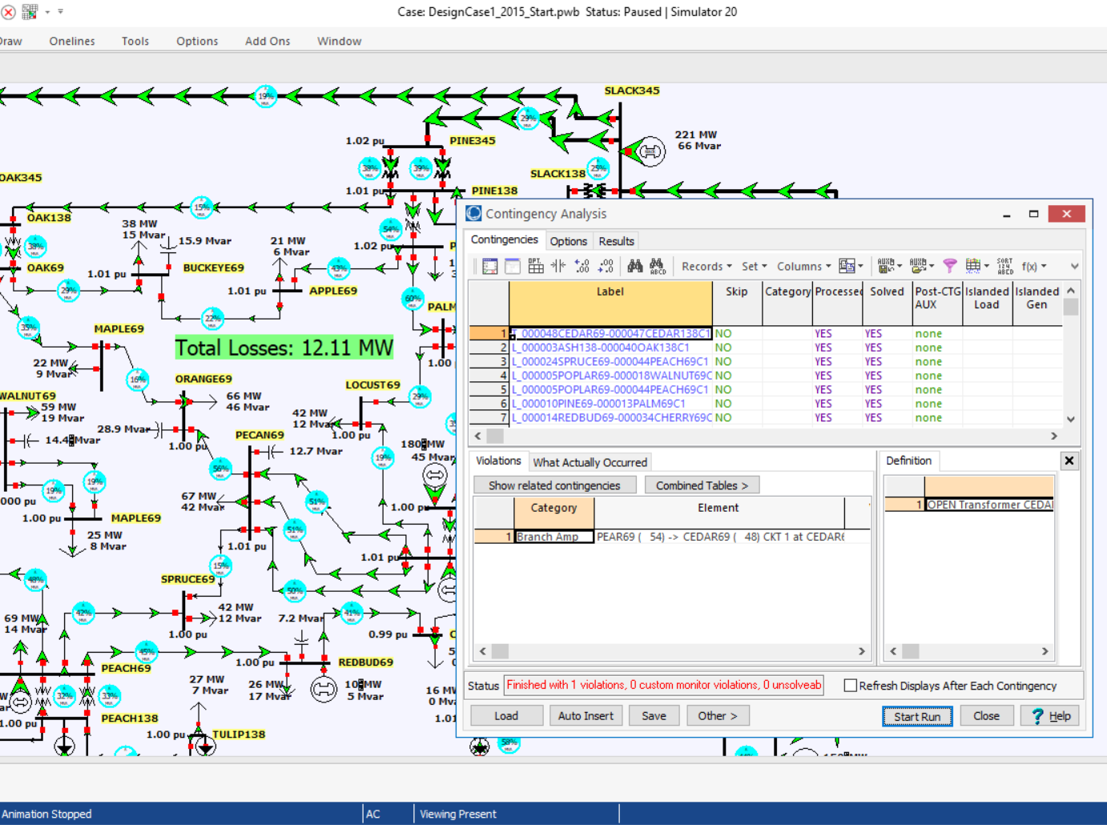
Contingency Analysis
Contingency analysis provides an automatic way of looking at all the statistically likely contingencies. In this example the contingency set is all the single line and transformer outages
Notes:
10

Slide 11
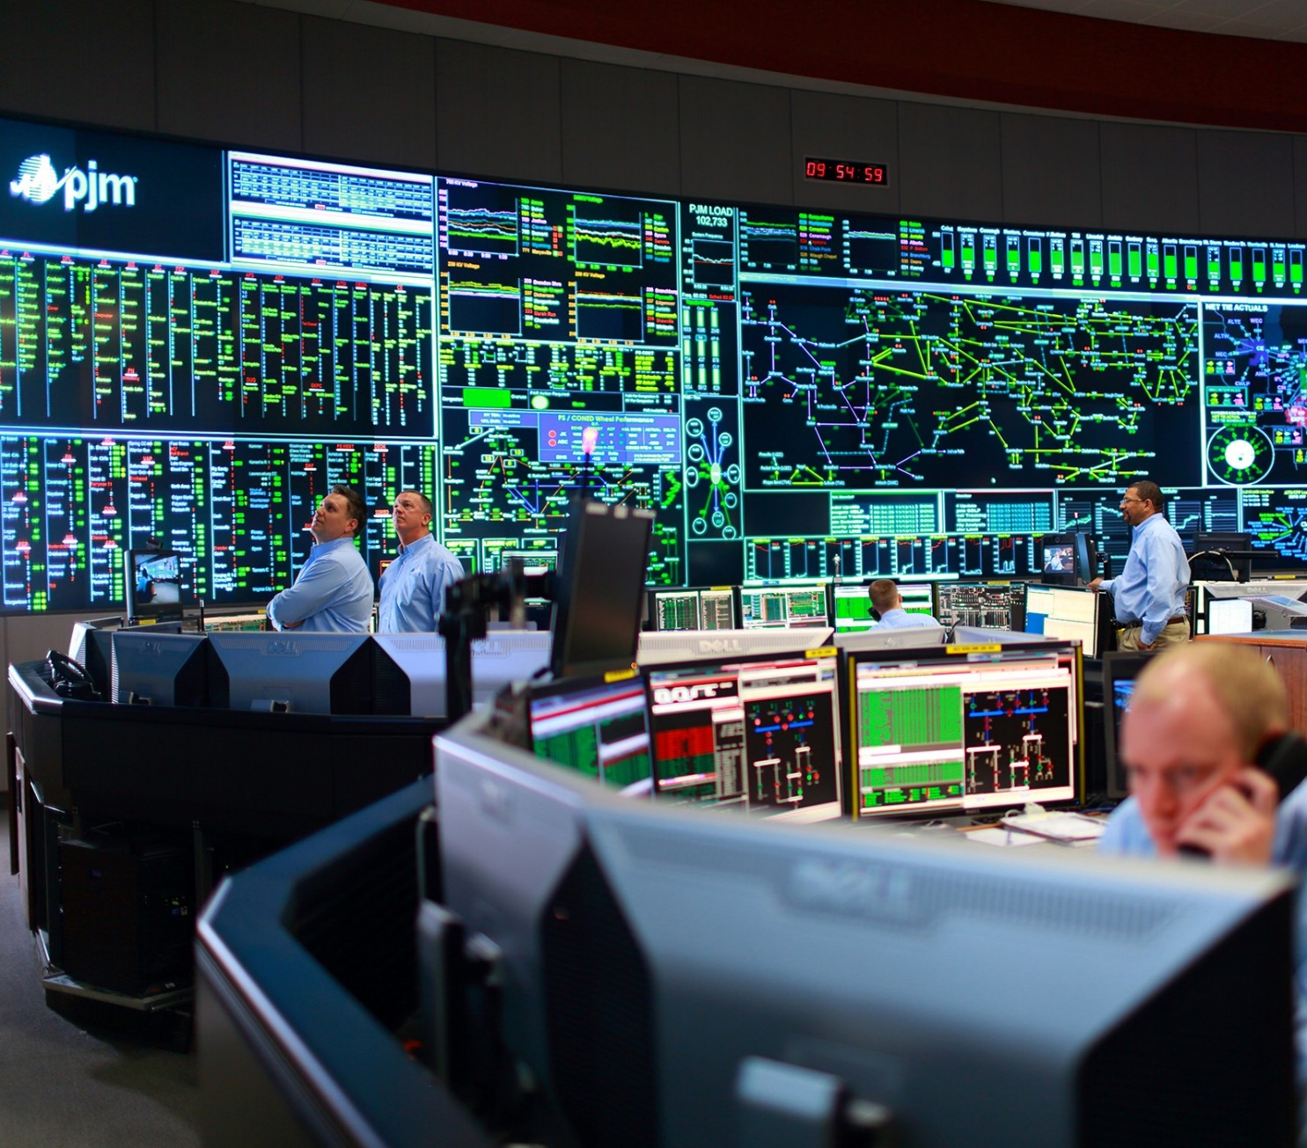
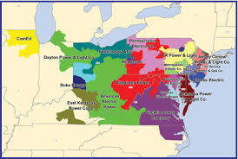
Power Flow Application - PJM Control Center
Their generation capacity is about 177 GW

Slide 12
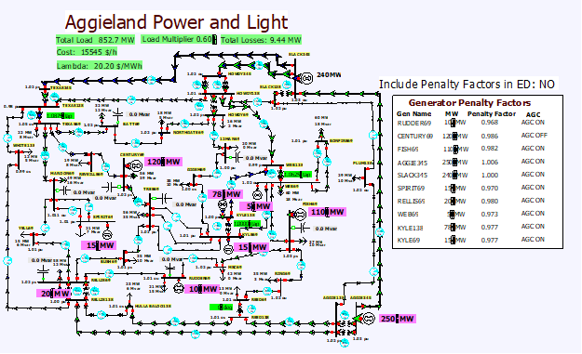
Lab 6 Introduction: 37 Bus
Lab 6 considers the system economic dispatch under varying load conditions, using a uniform load scalar
In first part of lab you’ll observe how values change without consideration of losses
Second part is a repeat considering the impact of marginal losses
Third part looks at contingency analysis, with the goal to fix voltage and flow violations
Last part looks at loss minimization

Slide 13
Contingency Analysis and the Reference Case
Contingency analysis works by first storing a reference case, then sequentially applying each contingency to the reference case, reloading the reference case between contingencies
In PowerWorld the reference case can be changed by either closing and reopening the contingency analysis form, or using an option on the form
This allows you to easily look at of individual contingency cases
  Right click on the contingencies and select Contingency Records, Solve Selected Contingency

Slide 14
Lab 6 Introduction: 2000 Bus Case, Operating North Central Texas
The North
Central Texas
Area has 483
Buses
Case for lab is
setup with just
77 500 kV line
contingencies

