Slide 1
ECEN 460, Spring 2023
Power System Operation and Control
Class 8: Transmission Lines, Part 2
Prof. Adam Birchfield
Dept. of Electrical and Computer Engineering
Texas A&M University
abirchfield@tamu.edu

Slide 2
Homework 4 Due Next Week
No homework on generators. Make sure you understand the lecture notes and labs 3 and 4 (starting next week).
Homework 3 on transformers: book problems 3.4, 3.23, due Feb. 7th.
Homework 4 on transmission lines: book regular problems 4.10, 4.11, 4.20, and 4.41, 5.14 (a,b), 5.38, and 5.41 (a,b), due Feb. 14th.

Slide 3
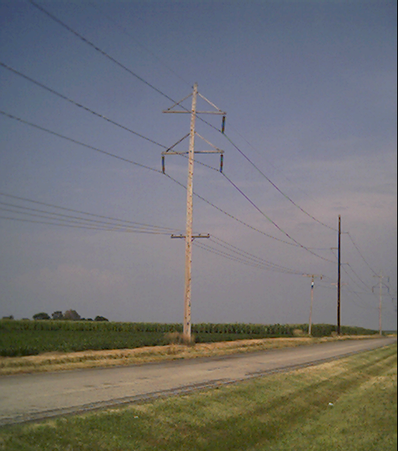
Transmission Lines
In this class, we give an overview of line and transformer modeling
  More detailed coverage of some models is in ECEN 459
  Our focus is on how to use the models to study power systems
Primary methods for long distance electric power transfer
  Overhead ac
  Underground ac
  HVDC – overhead or underground

Slide 4
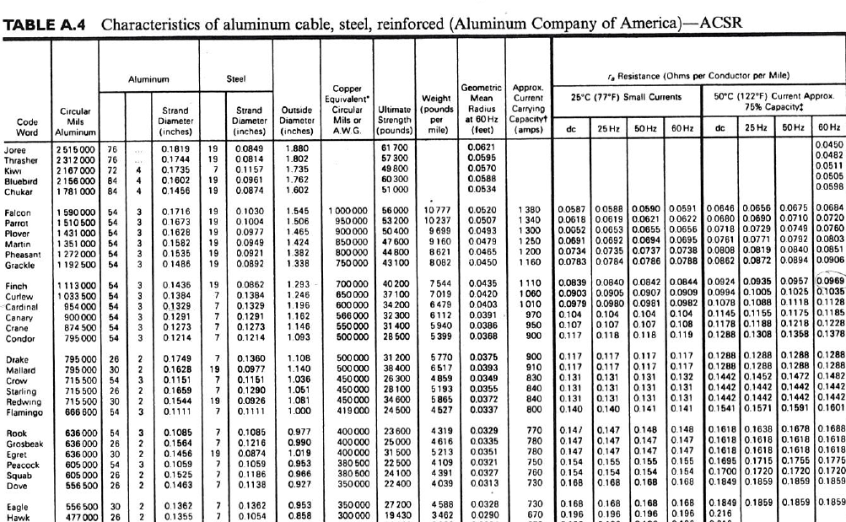
Conductor Table Example

Slide 5
Additional Transmission Topics
Multi-circuit lines: Multiple lines often share a common transmission right-of-way. This does cause mutual inductance and capacitance, but that is often ignored in system analysis.
Cables: There are about 3000 miles of underground ac cables in U.S. Cables are primarily used in urban areas. In a cable the conductors are tightly spaced, (< 1ft) with oil impregnated paper commonly used to provide insulation
  inductance is lower
  capacitance is higher, greatly limiting cable length
Ground wires: Transmission lines are usually protected from lightning strikes with a ground wire. This topmost wire (or wires) helps to attenuate the transient voltages/currents that arise during a lighting strike. The ground wire is typically grounded at each pole.

Slide 6
Additional Transmission Topics
Corona discharge: Due to high electric fields around lines, the air molecules become ionized. This causes a crackling sound and may cause the line to glow!
Shunt conductance: Usually ignored. A small current may flow through contaminants on insulators.
DC Transmission: Because of the large fixed cost necessary to convert ac to dc and then back to ac, dc transmission is only practical for several specialized applications
  long distance overhead power transfer (> 400 miles)
  long cable power transfer such as underwater
  providing an asynchronous means of joining different power systems (such as ERCOT to Eastern or Western grids)
Line insulation: Driven by voltage, including the 60-Hz power voltage as well as surge voltages caused by lightning and switching. Key concept is avoiding flashover of the insulation. The basic lightning impulse insulation level (BIL) is often 4-8 times the nominal rated voltage.

Slide 7
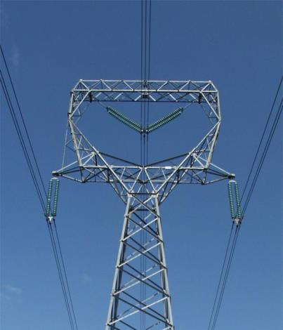
Transmission Line Models
Previous slides have covered how to calculate the distributed inductance, capacitance and resistance of transmission lines.
In this section we will use these distributed parameters to develop the transmission line models used in power system analysis.

Slide 8
Transmission Line Equivalent Circuit
Our current model of a transmission line is shown below
Units on z and y are per unit length!
$$\text{For} \text{operation} \text{at} \text{frequency} ω\text{, }\text{let} \text{z}\text{ = }\text{r}\text{ + }\text{j}ω\text{L} \\ \text{and} \text{y}\text{ = }\text{g}\text{ +}​jω\text{C} (\text{with} \text{g} \text{usually} \text{equal}\text{ 0})$$

Slide 9
Propagation Constant, Characteristic and Surge Impedance
$$\text{Define} \text{the} \text{propagation} \text{constant} γ \text{as} \\ γ=\sqrt{yz} = α+jβ \\ \text{where} \\ α = \text{the} \text{attenuation} \text{constant} \\ β = \text{the} \text{phase} \text{constant} \\ \text{Define} {\text{Z}}_{c} = \sqrt{\frac{z}{y}} = \text{characteristic} \text{impedance}$$

Slide 10
Lossless Transmission Lines
$$\text{For} \text{a} \text{lossless} \text{line} \text{the} \text{characteristic} \text{impedance}\text{, }{\text{Z}}_{c}\text{, } \\ \text{is} \text{known} \text{as} \text{the} \text{surge} \text{impedance}\text{.} \\ Z_{c} = \sqrt{\frac{jwl}{jwc}} =\sqrt{\frac{l}{c}} Ω (\text{a} \text{real} \text{value}) \\ \text{If} \text{a} \text{lossless} \text{line} \text{is} \text{terminated} \text{at} \text{bus} \text{R} \text{in} \text{impedance} \\ Z_{c}= \frac{V_{R}}{I_{R}} \\ \text{Then} I_{R}Z_{c}= V_{R} \text{so} \text{we} \text{get}\text{...}$$

Slide 11
Lossless Transmission Lines
$$V(x) = V_{R}\cosh{γ}x+V_{R}\sinh{γ}x \\ I(x) = I_{R}\cosh{γ}x+I_{R}\sinh{γ}x \\ \frac{V(x)}{I(x)} = Z_{c} \\ \text{Define} \frac{{\left|V(x)\right|}^{2}}{Z_{c}}\text{as} \text{the} \text{surge} \text{impedance} \text{load} (\text{SIL}). \\ \text{Since} \text{the} \text{line} \text{is} \text{lossless} \text{this} \text{implies} \\ \left|V(x)\right| = \left|V_{R}\right| \\ \left|I(x)\right| = \left|I_{R}\right|$$
This equation is derived in Chapter 5, but this derivation is not part of ECEN 460
If P > SIL then line consumes
vars; otherwise line generates vars.

Slide 12
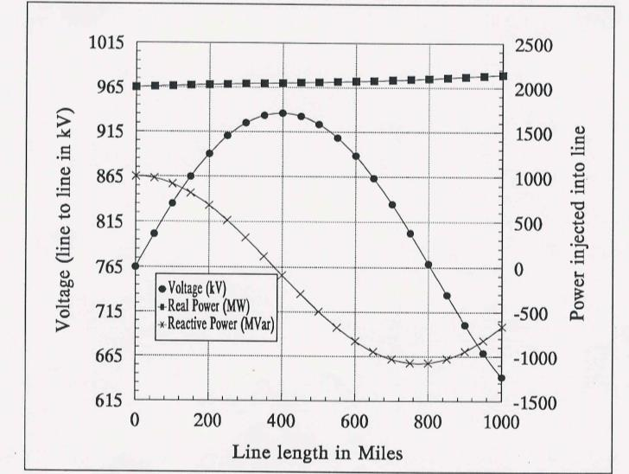
Transmission Line Example, cont’d

Slide 13
Example 5.4
The 2199 MW represents the surge impedance loading;
for values above this the line consumes reactive power,
for values below this it generates reactive power.

Slide 14
Equivalent Circuit Model
$$\text{The} \text{common} \text{representation} \text{is} \text{the} π \text{equivalent} \text{circuit}$$
Next, we’ll present simplified ways to determine the parameters Z' and Y'.

Slide 15
Simplified Parameters
$$\text{These} \text{values} \text{can} \text{be} \text{derived} \text{to} \text{be} \\ Z′ = Z_{C}\sinh{γ}l = \sqrt{\frac{zlz}{ylz}}\sinh{γ}l \\ =Z\frac{\sinh{γ}l}{γl} \text{with} \text{Z}≜\text{zl} (\text{recalling} γ=\sqrt{zy}) \\ \frac{Y′}{2} = \frac{1}{Z_{c}}\tanh{\frac{γl}{2}} = \sqrt{\frac{yly}{zly}}\tanh{\frac{γl}{2}} \\ = \frac{Y}{2}\frac{\tanh{\frac{γl}{2}}}{\frac{γl}{2}} \text{with} \text{Y}≜yl$$

Slide 16
Simplified Parameters, cont.
$$\text{For} \text{most} \text{lines} \text{make} \text{the} \text{following} \text{approximations}\text{:} \\ Z′ = Z (\text{assumes} \frac{\sinh{γ}l}{γl}≈1) \\ \frac{Y′}{2} =\frac{Y}{2} (\text{assumes} \frac{\tanh{(}γl/2)}{γl/2}≈1)$$
Length | $$\frac{sinhγl}{γl}$$ | $$\frac{tanh(γl/2)}{γl/2}$$
50 miles | $$\text{0.998}∠\text{0.02}°$$ | $$1.001∠−\text{0.01}°$$
100 miles | $$\text{0.993}∠\text{0.09}°$$ | $$1.004∠−\text{0.04}°$$
200 miles | $$\text{0.972}∠\text{0.35}°$$ | $$1.014∠−0.18°$$

Slide 17
Three Line Models
$$Long Line Model (\text{longer} \text{than}\text{ 250 }\text{miles}) \\ \text{use} Z′=Z\frac{\sinh{γ}l}{γl}, \frac{Y′}{2}=\frac{Y}{2}\frac{\tanh{\frac{γl}{2}}}{\frac{γl}{2}} \\ Medium Line Model (\text{less} \text{than}\text{ 250 }\text{miles}) \\ \text{use} Z \text{and} \frac{Y}{2} \\ Short Line Model (\text{not} \text{used} \text{much} \text{but} \text{useful} \text{for} \text{insight}) \\ \text{use} Z (\text{i}\text{.}\text{e}\text{., }\text{assume} \text{Y} \text{is} \text{zero}\text{; }\text{it} \text{small} \text{for} \text{short} \text{or} \text{low} \text{voltage} \text{lines})$$

Slide 18
Power Transfer in Short Lines
Often we'd like to know the maximum power that could be transferred through a short transmission line
I₁
I₁
+
Transmission
Line with
Impedance Z
+
V₁
S₁₂
S₂₁
V₂
-
-
$$S_{12} = V_{1}I_{1}^{∗} = V_{1}{\left(\frac{V_{1}−V_{2}}{Z}\right)}^{∗} \\ \text{with} V_{1}=\left|V_{1}\right|∠θ_{1}, V_{2}=\left|V_{2}\right|∠θ_{2} Z=\left|Z\right|∠θ_{Z} \\ S_{12} =\frac{{\left|V_{1}\right|}^{2}}{\left|Z\right|}∠θ_{Z}−\frac{\left|V_{1}\right|\left|V_{2}\right|}{\left|Z\right|}∠θ_{Z}+θ_{12}$$

Slide 19
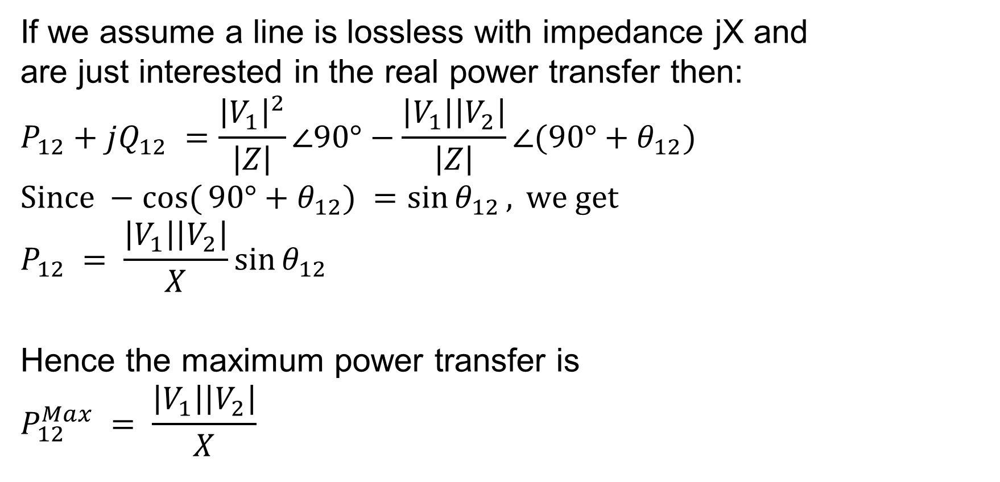
Power Transfer in Lossless Lines
If we assume a line is lossless with impedance jX and
are just interested in the real power transfer then:
$$P_{12}+jQ_{12} =\frac{{\left|V_{1}\right|}^{2}}{\left|Z\right|}∠90°−\frac{\left|V_{1}\right|\left|V_{2}\right|}{\left|Z\right|}∠(90°+θ_{12}) \\ \text{Since} −\cos{(}90°+θ_{12}) =\sin{θ_{12}}, \text{we} \text{get} \\ P_{12} = \frac{\left|V_{1}\right|\left|V_{2}\right|}{X}\sin{θ_{12}}$$
Hence the maximum power transfer is
$$P_{12}^{Max} = \frac{\left|V_{1}\right|\left|V_{2}\right|}{X}$$

Slide 20
Limits Affecting Max. Power Transfer
Thermal limits
  limit is due to heating of conductor and hence depends heavily on ambient conditions.
  For many lines, sagging is the limiting constraint.
  Newer conductors limit can limit sag. For example 3M has lines with a core consisting of ceramic Nextel fibers. These lines can operate at 200 degrees C.
    Higher currents and operating temperatures mean higher losses!
  Trees grow, and many will eventually hit lines if they are planted under the line.

Slide 21

Other Limits Affecting Power Transfer
Angle limits
  while the maximum power transfer occurs when line angle difference is 90 degrees, actual limit is substantially less due to multiple lines in the system
Voltage stability limits
  as power transfers increases, reactive losses increase as $I^{2}X$. As reactive power increases the voltage falls, resulting in a potentially cascading voltage collapse.

Slide 22
Example 5.8

Slide 23
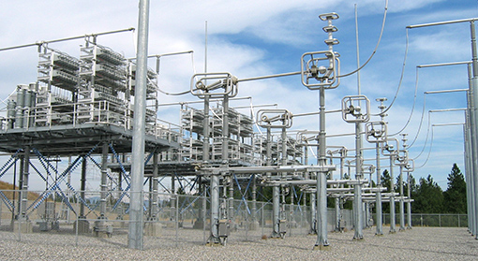
Transmission Line Series Compensation
One way to increase the transmission capacity of a transmission line that is limited by its reactance is to add series compensation
  Capacitors are placed in series with the transmission line
  (covered in Example 5.10)
Image shows BPA series capacitors in a 500 kV line
Image: https://www.bpa.gov/news/newsroom/Pages/Chief-engineers-reunite-reminisce-for-BPAs-75th.aspx

Slide 24
Transmission Line Series Compensation
Amount of series compensation is expressed as a percentage of the total line reactance (e.g., 50%)
The series capacitance is usually setup so that it can be bypassed sometimes
  There can be excessive reactive power generation on the system during light loads, like at night
There can be a concern with sub-synchronous interactions (SSI)
$$f_{n}=\frac{1}{\sqrt{LC}}=f_{0}\sqrt{\frac{X_{C}}{X_{L}}}$$

Slide 25
Example 5.10

