Slide 1
ECEN 460, Spring 2023
Power System Operation and Control
Class 2: Power Systems Structure and History
Prof. Adam Birchfield
Dept. of Electrical and Computer Engineering
Texas A&M University
abirchfield@tamu.edu

Slide 2
Reminders
Review these topics
  Complex number math – by hand and calculator
  Phasors – representing AC voltage and current
  Impedance – for AC circuit solving
  Complex power – including power factor, reactive power
  Three phase – wye/delta, line-to-line/line-to-neutral voltage, per-phase analysis
Homework #1 and #2 are practice problems on these topics
  Homework #1 due next Tuesday (Jan 24) and Homework #2 due Tuesday Jan 31
There are five videos on the website that can help as well
Take advantage of the textbook, and office hours (me and TAs)
We’re going to have quizzes most classes to review

Slide 3
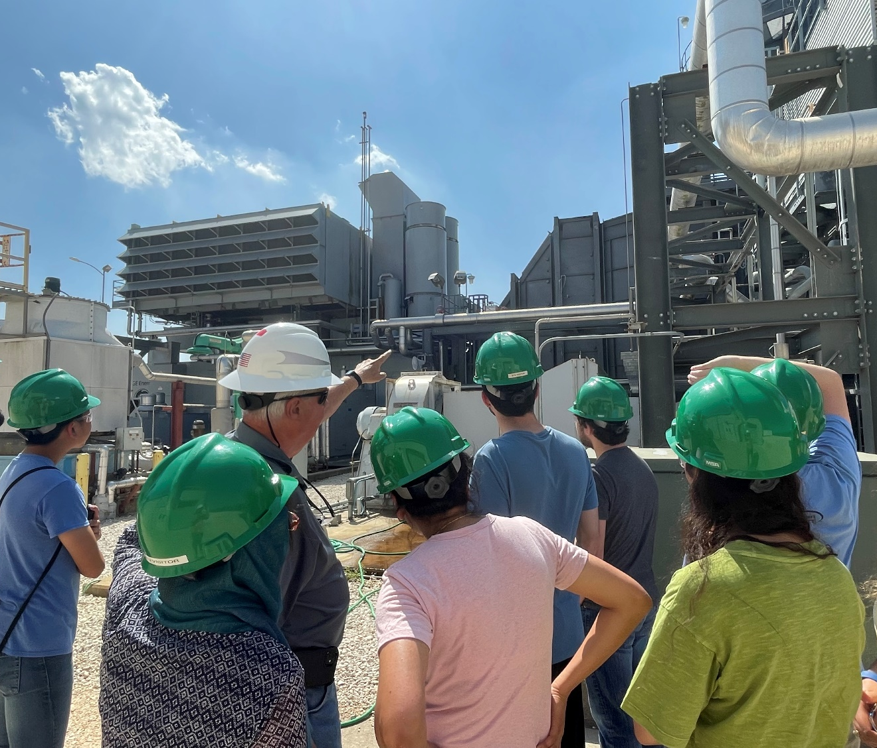
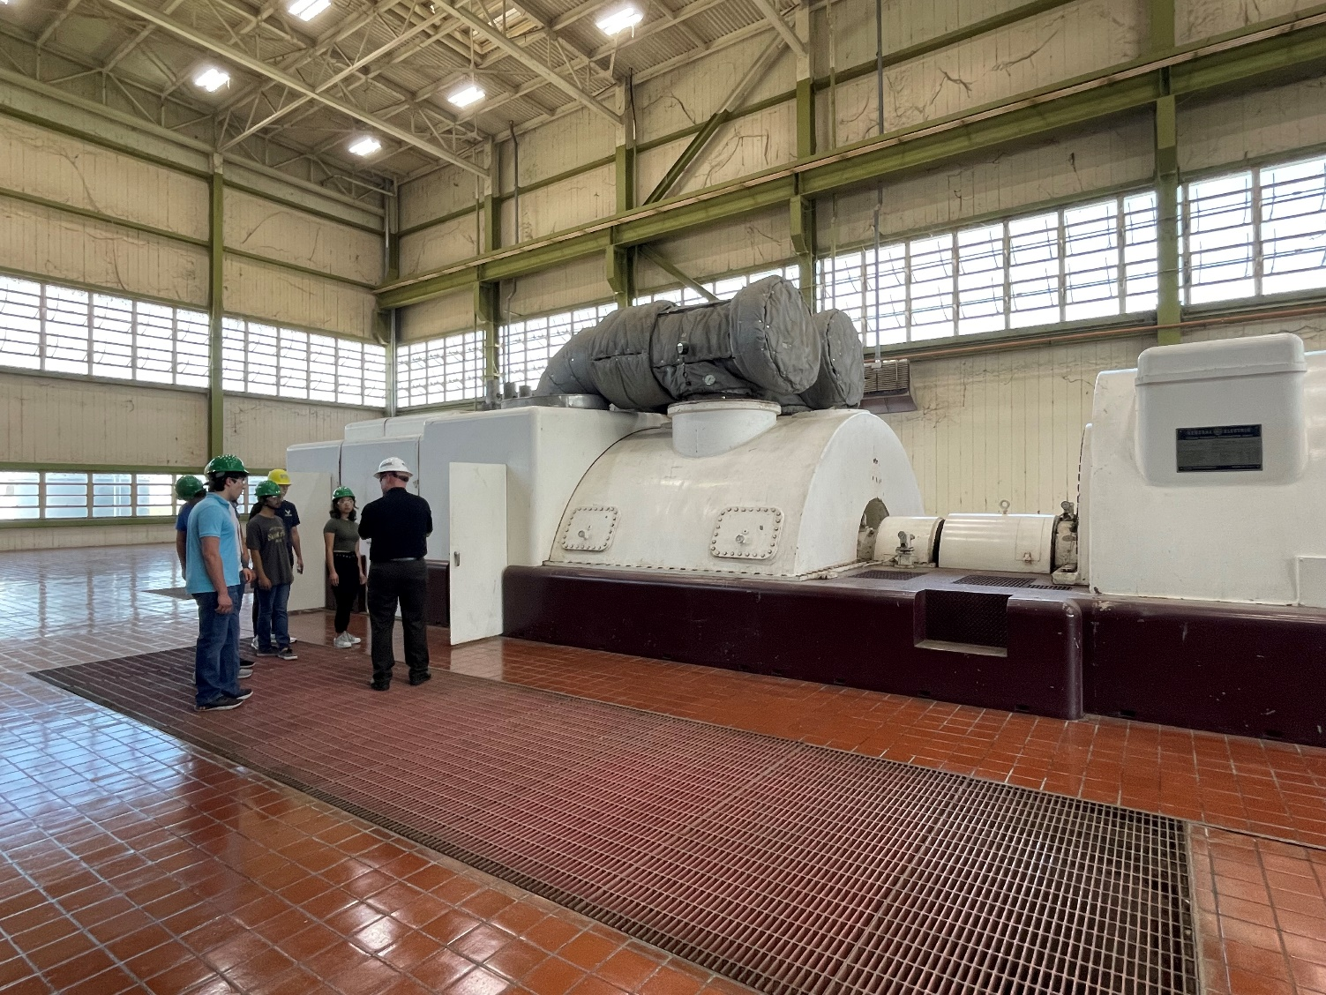
Save the Date – Power Plant Tour! (Optional)
March 24th, 1pm in Bryan (More information coming soon)

Slide 4
Energy and Power
Energy is A property of matter that quantifies its ability to perform useful work.
  Forms: kinetic, gravitational, heat, light, sound, magnetic, nuclear, chemical, and electric
  Units for energy: 1 MWh = 1000 kWh
  1 kWh = 3.6 million Joules = 3412.14 Btu
Power is Energy on the move from form to form or place to place.
  Time derivative of energy as it is transferred
  Units for power: Watt (Volt-Ampere)
  kW = 1000 W, MW, GW, 1 Hp = 746 Watts
One gallon of gasoline has about 0.125 MBtu (36.5 kWh) of energy stored in chemical form
U.S. annual electric energy consumption is about 3600 billion kWh
  This is about 13,333 kWh per person, which means on average we each use 1.5 kW of power continuously
Installed U.S. generation capacity is about 1000 GW (about 3 kW per person)
Maximum load of Bryan/College Station is about 500 MW

Slide 5
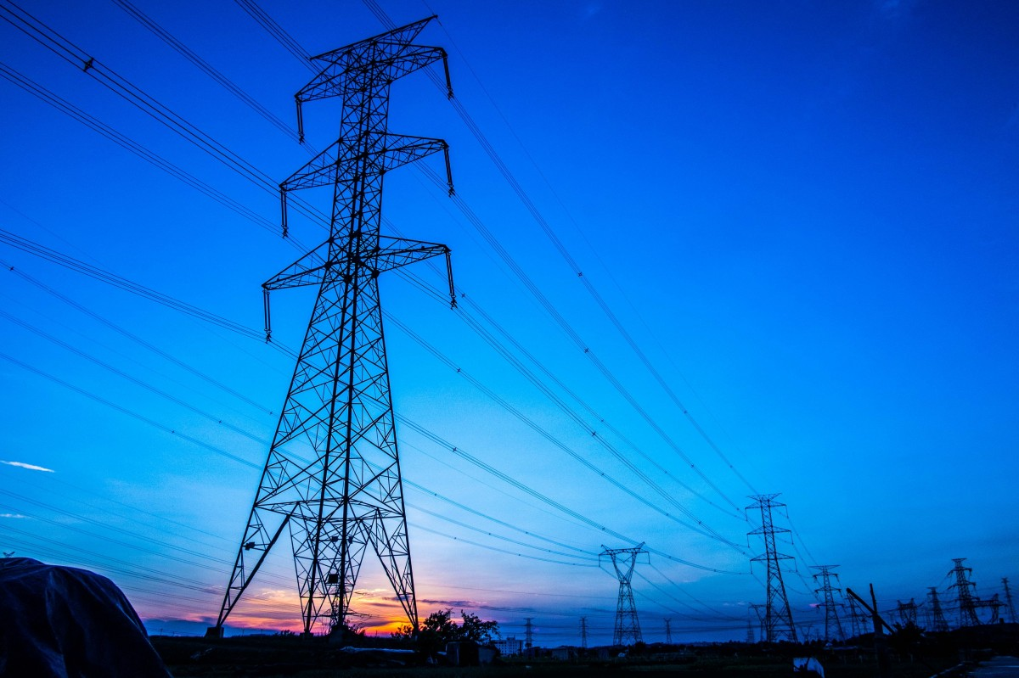
Electric Power Systems
Electricity has many advantages for delivering the energy used by humankind
  Conversion to and from other forms is convenient and efficient (such as motors and generators)
  Transmission in bulk can be done quickly and efficiently over long distances (power lines)
  About 40% of U.S. energy consumption is electric
Power systems range in size
  Large: four major interconnections in North America
  Medium: islands, militarily installations, ships
  Small: airplanes, automobiles, portable battery systems

Slide 6
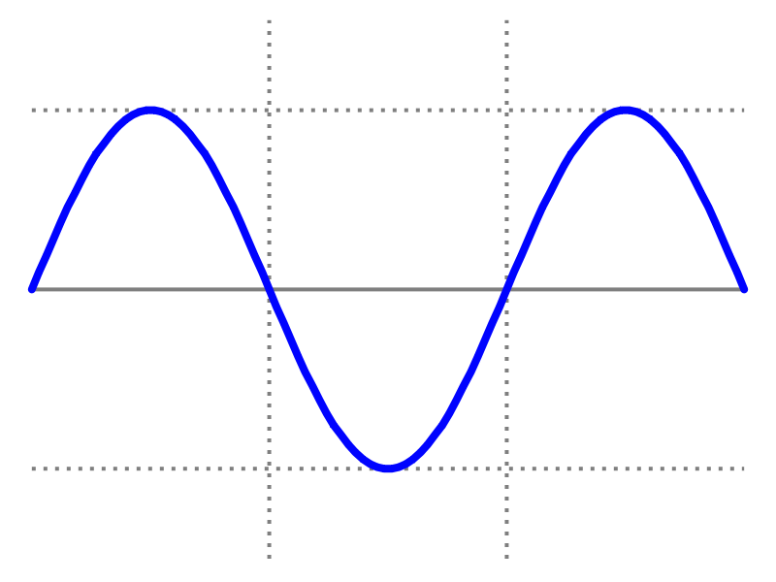
Alternating Current Power Systems
Alternating current (ac) systems have sinusoidal voltage and current wave forms, as opposed to direct current (dc)
Small, battery-based systems such as automobiles are typically dc, and historically some larger systems have used dc
Ac is nearly exclusively used now for medium and large power system
  Better performance of motors and generators
  Allows use of transformers to step-up voltage for efficient long-distance transmission
Voltage (V)
Time (s)

Slide 7
Choosing the AC Frequency
Lower frequency systems (10-40 Hz) require larger motors and transformers and can introduce flicker in some lighting technologies.
  These historically were used some for railroads
Higher frequency systems (100 Hz – 1 kHz) have higher voltage drops over long distances and can introduce more audible noise
  400 Hz is common in airplanes and spaceships, where weight is a primary consideration
Today, most large power systems use 50 or 60 Hz (60 Hz is used in the USA)
60 Hz
North America, about half of South America, half of Japan, a few other countries
50 Hz
Europe, most of Africa and Asia, part of South America

Slide 8
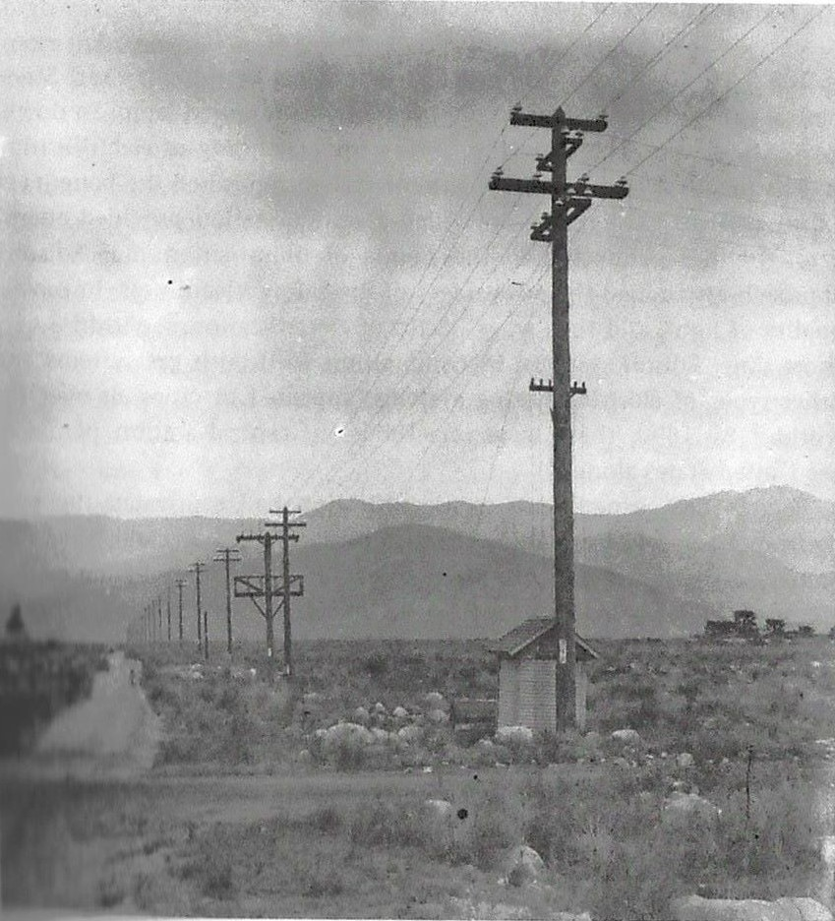
The Far Past: Origins of the Electric Grid
First practical use of electricity 1860s-70s, mainly telegraph and lighting
1880s – Edison dc system in Manhattan, Westinghouse/Tesla ac system, invention of practical motors and transformers
1890s-1920s – Local three-phase ac systems (mainly coal and hydro) develop and expand to become large interstate holding companies
1930s-40s – Industry standardizes on 60 Hz ac (in the US), load growth with air conditioning, rural electrification and big hydro projects with the New Deal
1950s-60s – Interconnection into major grids
Santa Ana River 33 kV Line, circa 1899. This was the longest power line in the world at the time at 83 miles. (SCE Photograph, from The Grid by Julie Cohn)

Slide 9
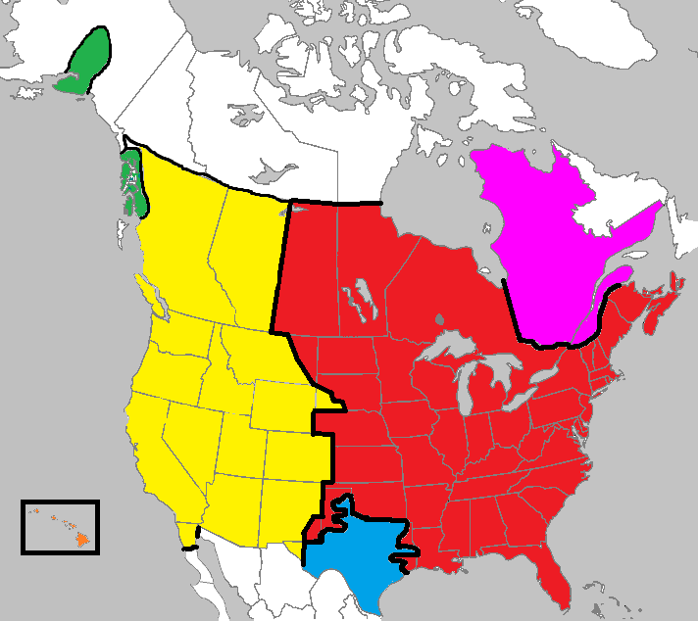
Major Grids in North America
Eastern Interconnect (EI)
Western Interconnect (WECC)
  EI and WECC were briefly interconnected in the 1970s
Texas Interconnect (ERCOT)
  Connected to East and Mexico with small AC-DC-AC interties
Quebec Interconnect
Smaller “island” grids in various places like Alaska and Hawaii

Slide 10
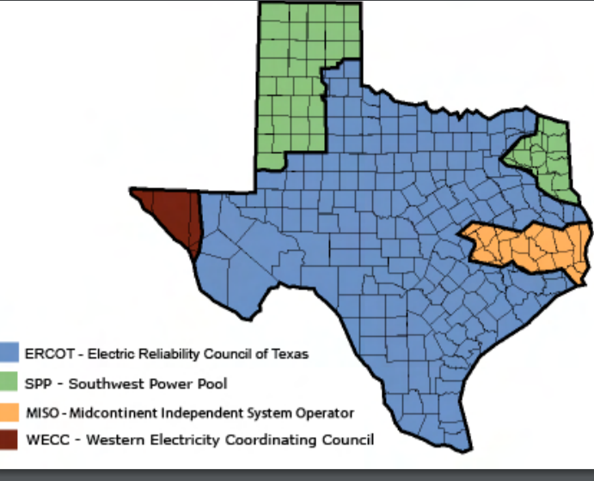
The Three US Grids are All in Texas
Source: www.puc.texas.gov/industry/maps/maps/ERCOT.pdf

Slide 11
Balanced Three-Phase (φ) Systems
A balanced three-phase (φ) system has
  three voltage sources with equal magnitude, but with an angle shift of 120°
  equal loads on each phase
  equal impedance on the lines connecting the generators to the loads
Bulk power systems are almost exclusively 3φ
Single-phase is used primarily only in low voltage, low power settings, such as residential and some commercial

Slide 12
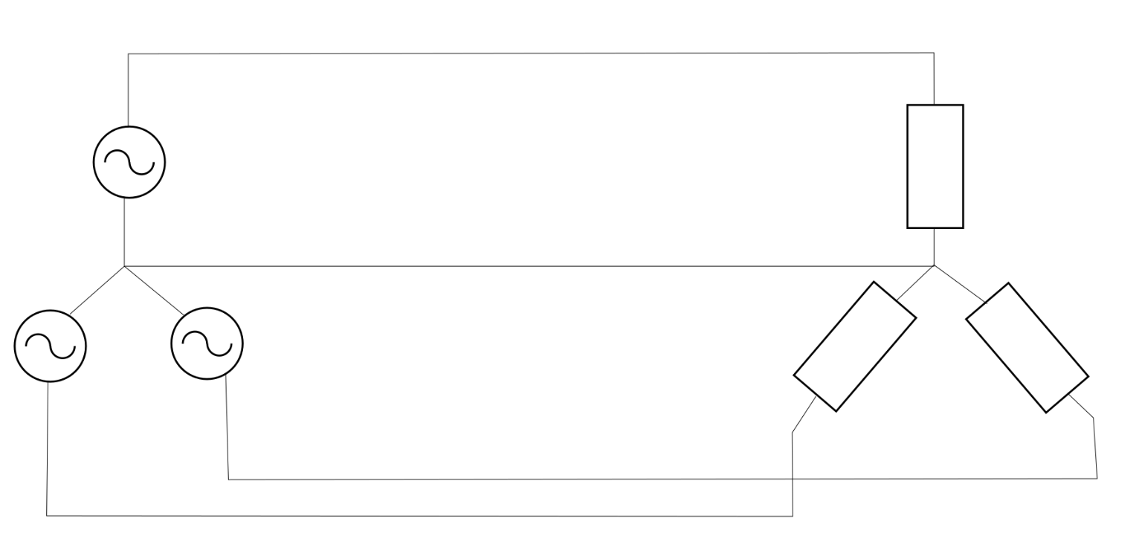
Balanced 3φ -- No Neutral Current
Phase “a”
$$I_{a} →$$
+
$$V_{an}=V∠0°$$
$$Z$$
–
Neutral “n”
$$←I_{n}$$
–
–
$$V_{cn}=V∠120°$$
$$(=V∠−240°)$$
$$V_{bn}=V∠−120°$$
$$Z$$
$$Z$$
+
+
Phase “b”
$$I_{b}→$$
Phase “c”
$$I_{c}→$$
$I_{n}=I_{a}+I_{b}+I_{c}$
$I_{n}=\frac{V}{Z}\left(1∠0°+1∠−120°+1∠120°\right)=0$
$S=V_{an}I_{an}^{∗}+V_{bn}I_{bn}^{∗}+V_{cn}I_{cn}^{∗}=3V_{an}I_{an}^{∗}$

Slide 13
Advantages of 3φ Power
Can transmit more power for same amount of wire (twice as much as single phase)
Torque produced by 3φ machines is constant
Three-phase machines use less material for same power rating
Three-phase machines start more easily than single-phase machines

Slide 14
Vertical Monopolies
Within a particular geographic market, the electric utility had an exclusive franchise
Generation
In return for this exclusive
franchise, the utility had the
obligation to serve all
existing and future customers
at rates determined jointly
by utility and regulators
It was a “cost plus” business
Transmission
Distribution
Customer Service

Slide 15
Vertical Monopolies
Within its service territory each utility was the only game in town
Neighboring utilities functioned more as colleagues than competitors
Utilities gradually interconnected their systems so by 1970 transmission lines crisscrossed North America, with voltages up to 765 kV
Economies of scale keep resulted in decreasing rates, so most every one was happy

Slide 16
The More Recent Past – Restructuring
1970’s brought inflation, increased fossil-fuel prices, calls for conservation and growing environmental concerns
Increasing rates replaced decreasing ones
As a result, U.S. Congress passed Public Utilities Regulator Policies Act (PURPA) in 1978, which mandated utilities must purchase power from independent generators located in their service territory (modified 2005)
Major opening of industry to competition occurred as a result of National Energy Policy Act of 1992, mandating that utilities provide “nondiscriminatory” access to the high voltage transmission
Result over the last few years has been a dramatic restructuring of electric utility industry
Energy Bill 2005 repealed PUHCA; modified PURPA

Slide 17
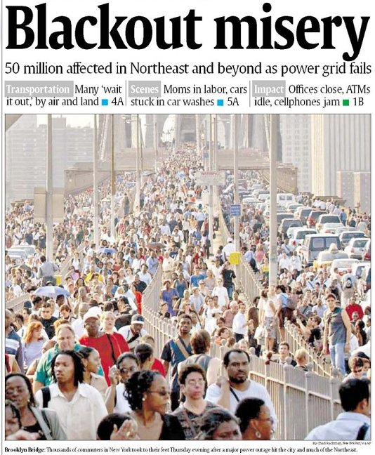
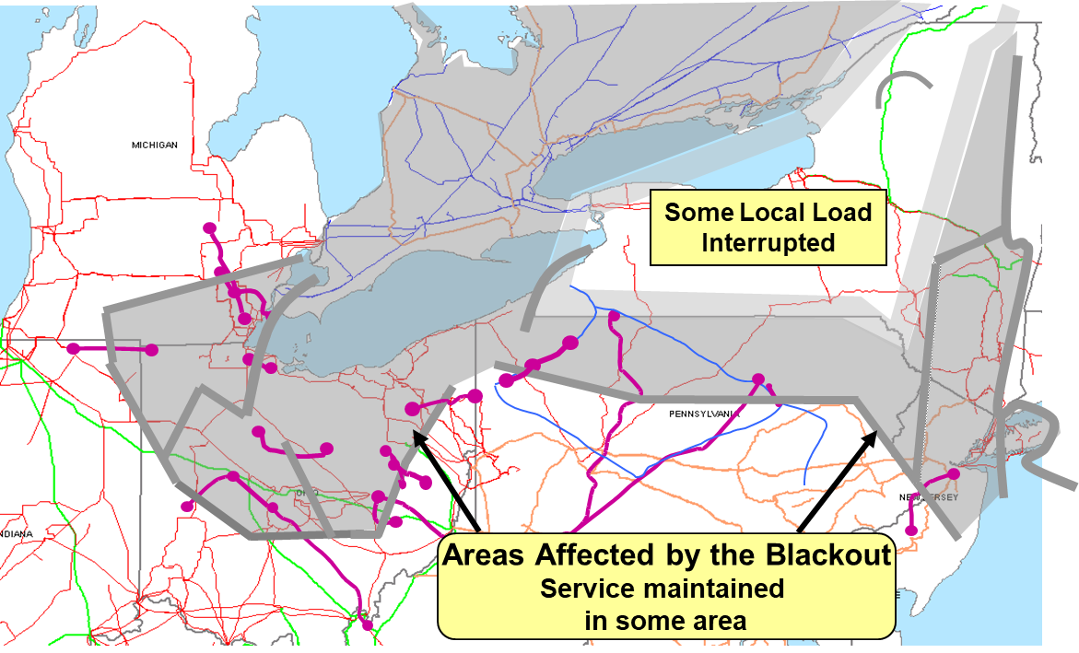
August 14th, 2003 Blackout
Above image from energy.gov, August 14, 2003 Blackout Final Report

Slide 18
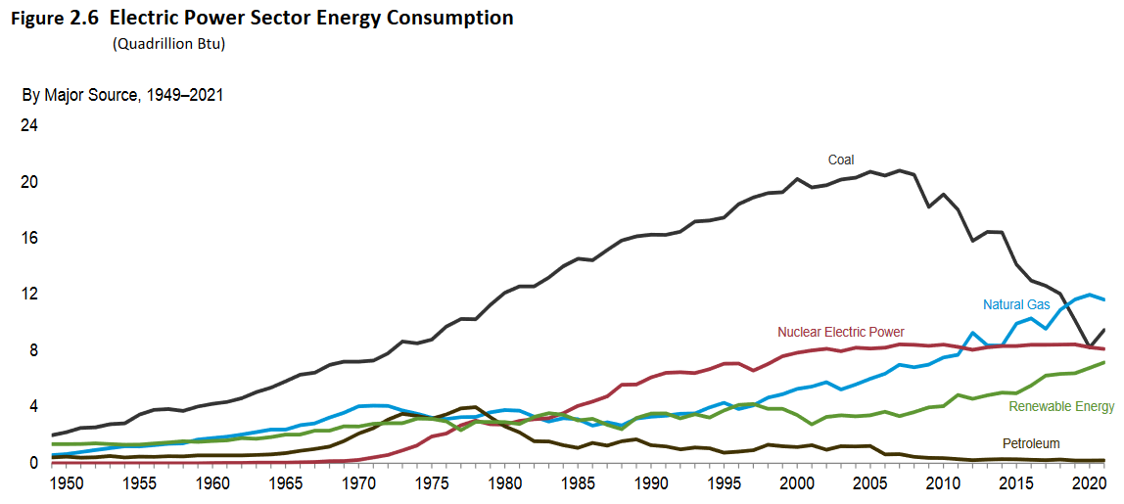
The Present: Changing Generation Mix
Fuel Source | 2021 US Electric Usage | Change from 2020 to 2021 | Change from 2011 to 2021
Coal | 25.8 % | + 15 % | - 47 %
Natural Gas | 31.6 % | - 3 % | + 51 %
Petroleum | 0.5 % | + 7 % | - 33 %
Nuclear | 22.1 % | - 1 % | - 2 %
Hydro | 6.2 % | - 9 % | - 26 %
Solar | 2.7 % | + 29 % | + 5700 %
Wind | 9.0 % | + 12 % | + 185 %
Source: US EIA Monthly Energy Review, August 2022

Slide 19
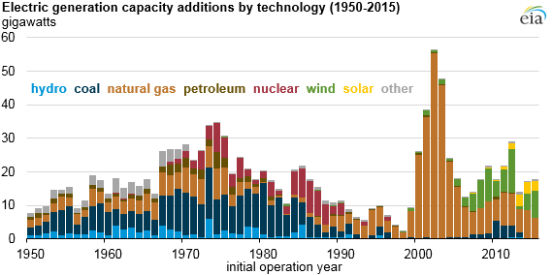
The Present: Changing Generation Mix
Texas is #1 in wind energy, with over 32,000 MW installed
Retirements in Texas from 2017-2021 included 4400 MW of coal, 2000 MW of natural gas, and small amounts of petroleum and wind
Proposed generation additions in Texas in 2023-2025 include 3600 MW natural gas, 7100 MW wind, 13,600 MW of solar! Also 3100 MW of battery storage
Source: US EIA Monthly Energy Review, EIA annual energy outlook

Slide 20
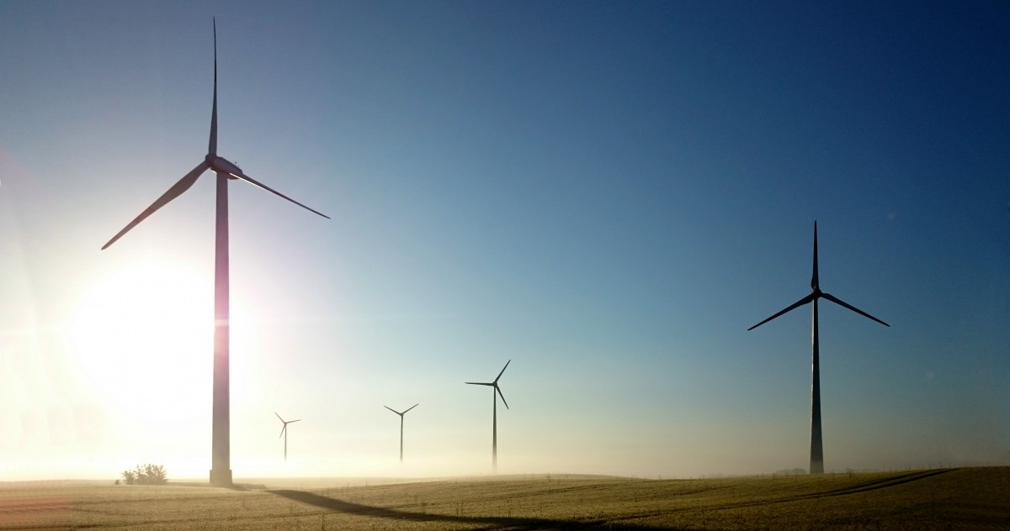
The Future: New Paradigms for Control
Inverter-based resources (such as wind and solar) introduce major paradigm shift in power system control
  Decreasing impact of large synchronous machines with their stabilizing inertia
  Resources are less dispatchable
Changes at the “edge” of the grid
  Electric vehicles (major load increase)
  Data centers
  More controllable or price-sensitive demand resources
What do all of these have in common? Need for high-quality electric grid modeling and simulation to prepare for a resilient and sustainable future.

Slide 21
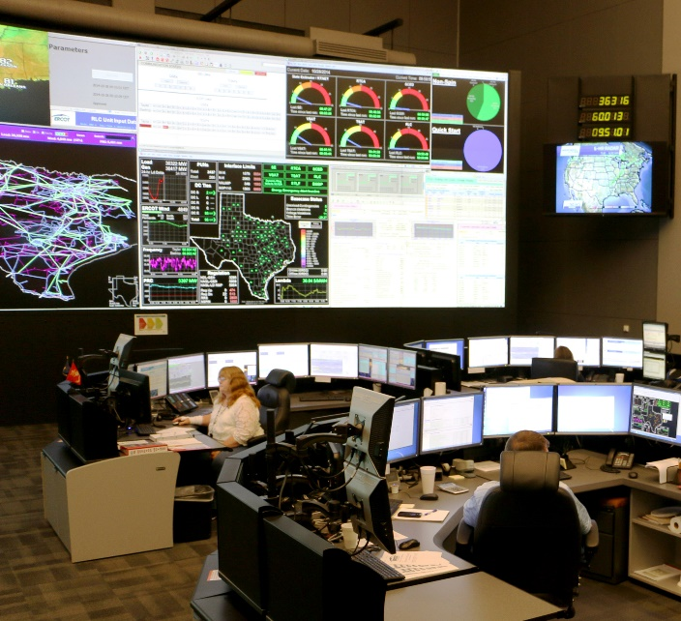
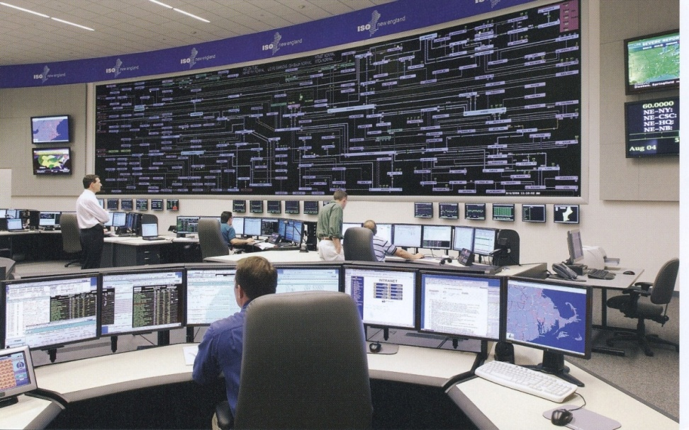
The Smart Grid
The term “Smart Grid” dates officially to the 2007 “Energy Independence and Security Act”, Title 13 (“Smart Grid”)
  Use of digital information and control techniques
  Dynamic grid optimization with cyber-security
  Deployment of distributed resources including
  Customer participation and smart appliances
  Integration of storage including PHEVs
  Development of interoperability standards

Slide 22
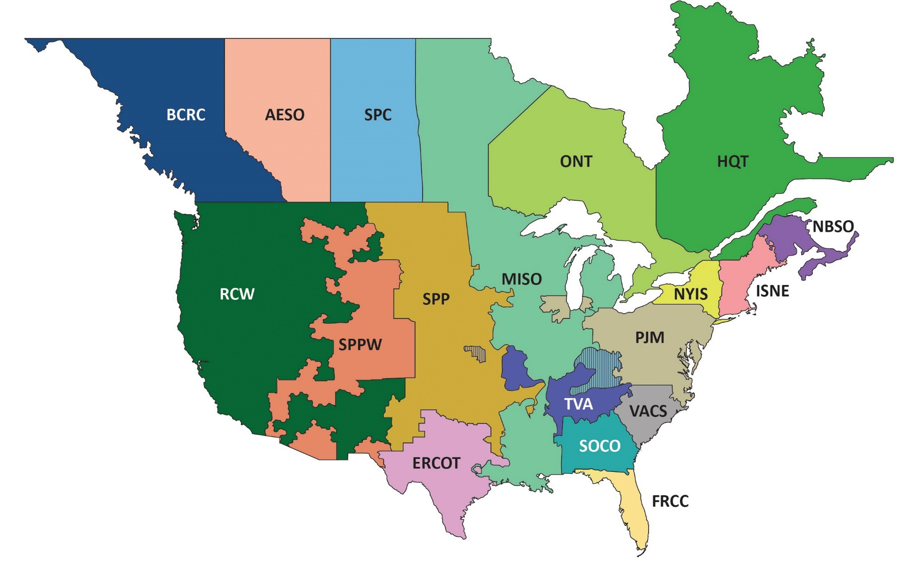

NERC Reliability Coordinators
NERC is the North American Electric Reliability Corporation
https://www.nerc.com/pa/rrm/TLR/Pages/Reliability-Coordinators.aspx

Slide 23

The Real Cause of Most Blackouts!
But mostly only the small ones in the distribution system
Photo source: http://save-the-squirrels.com

Slide 24
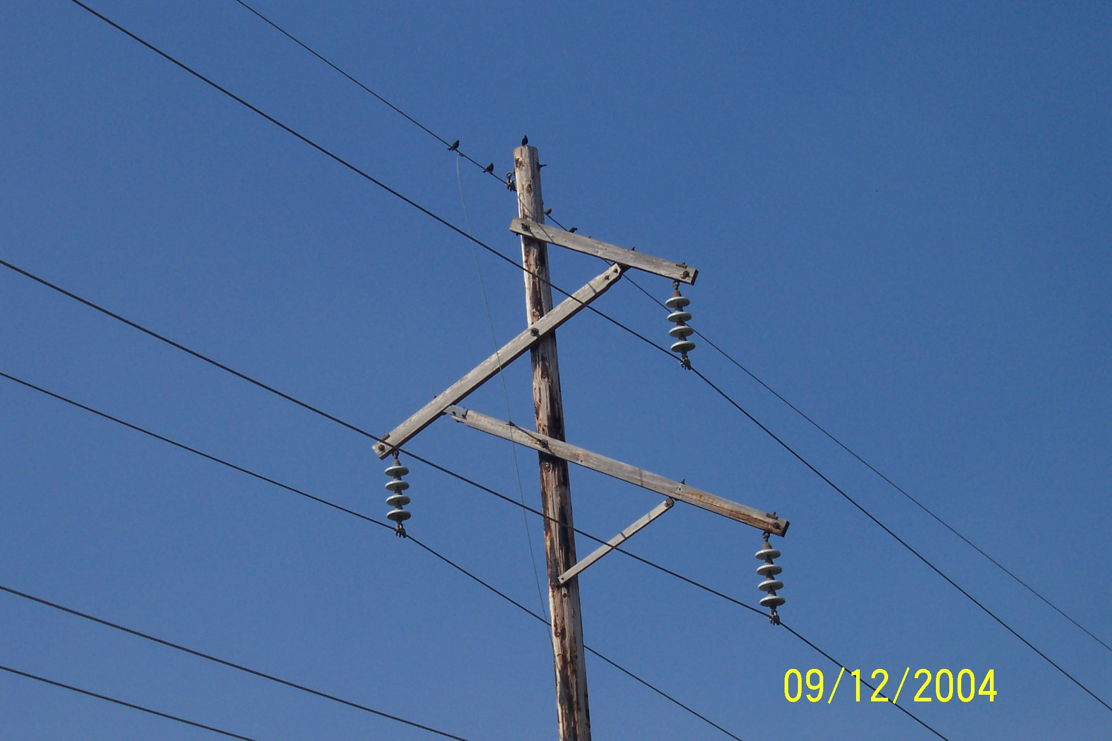
Birds Do Not Sit on Transmission Level Lines, Just Distribution Lines

Slide 25
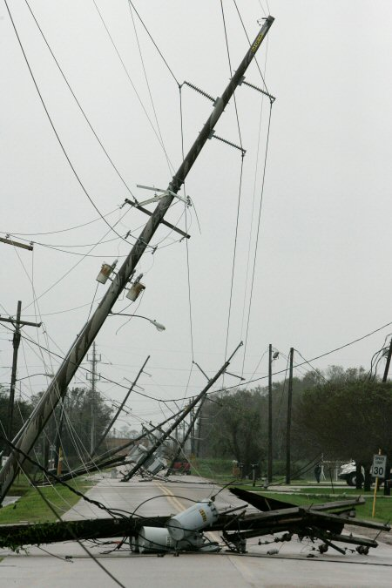
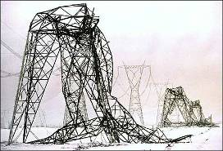
Transmission Lines and the Elements
Ike in Beaumont
Quebec Ice Storm

Slide 26
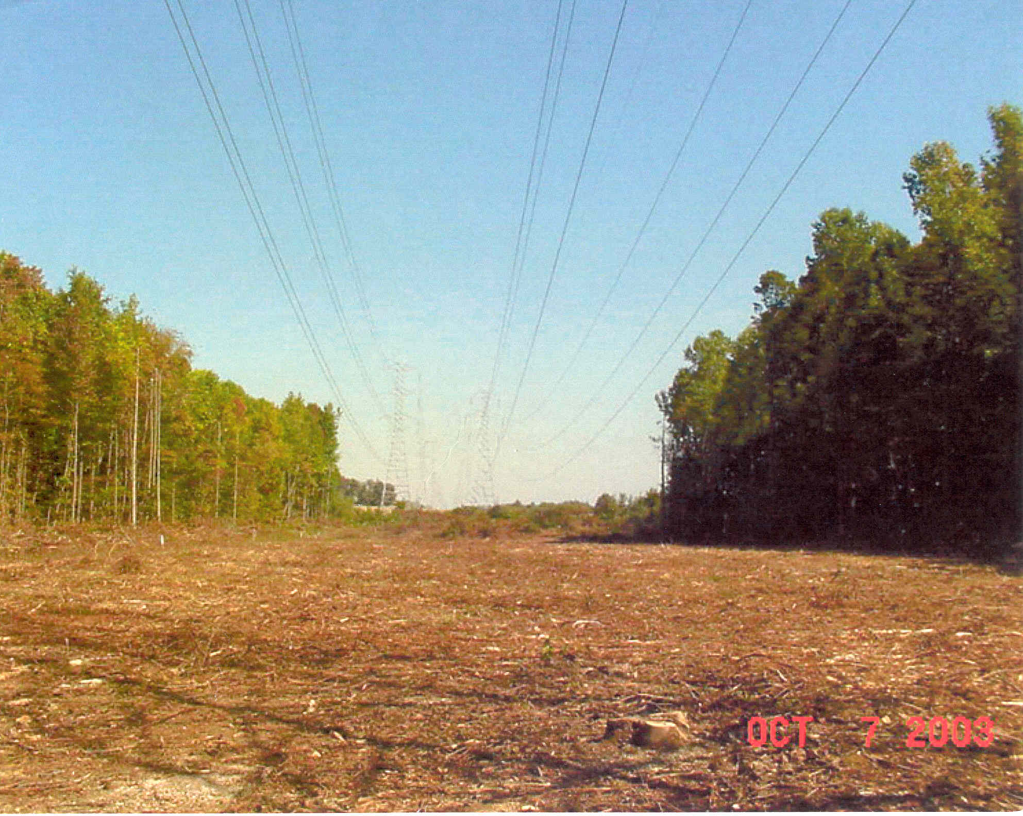
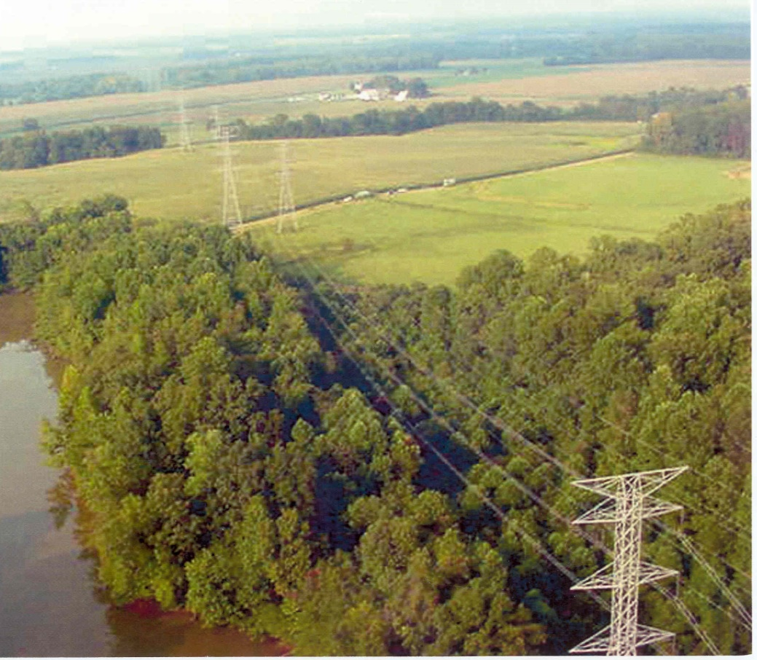
Transmission Lines and Trees
We like trees, and they grow; but when trees get close to lines bad things can occur.
Before “Trimming”
After “Trimming”

Slide 27
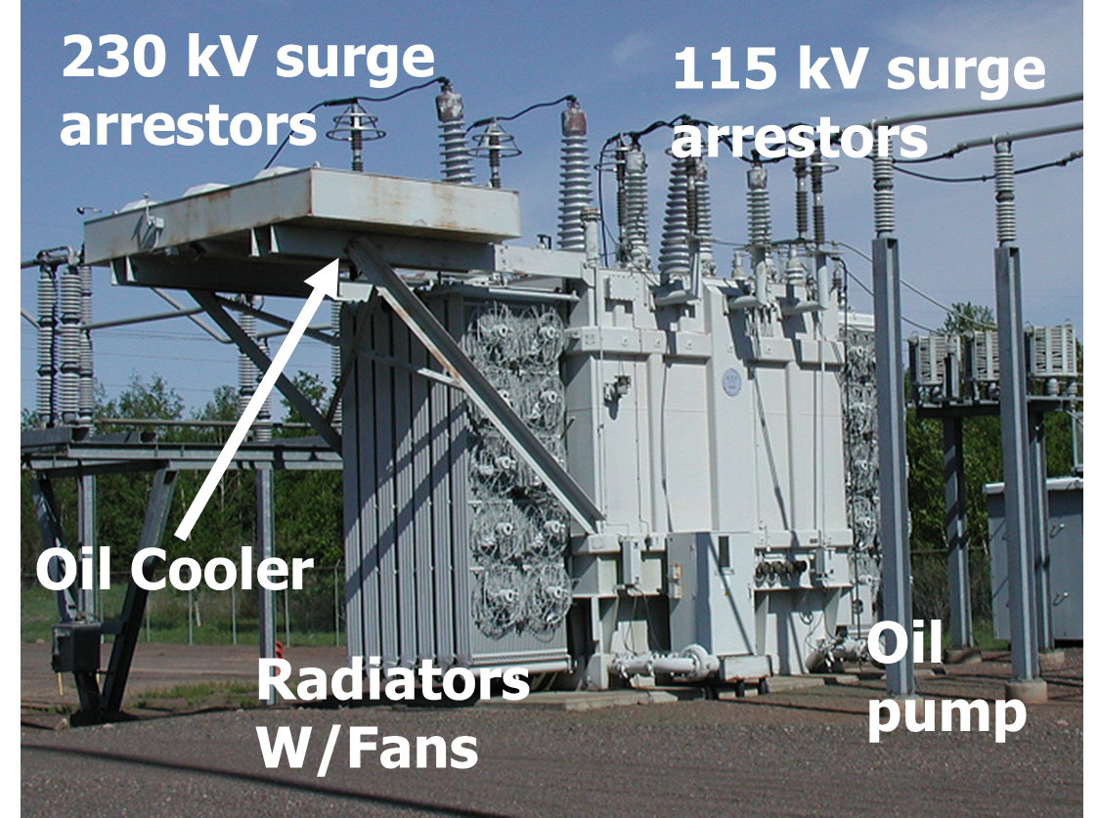
230/115 kV Transformer Picture

Slide 28
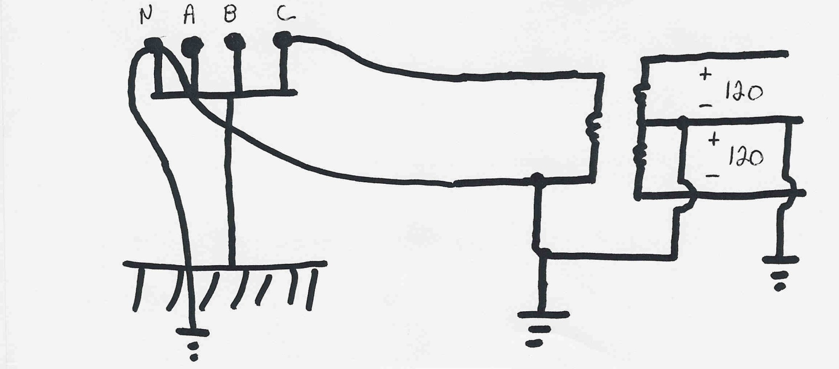
Residential Distribution Transformers
Residential single phase electric service uses a center tapped transformer to provide 240/120 volt service; a separate ground is used for safety

Slide 29
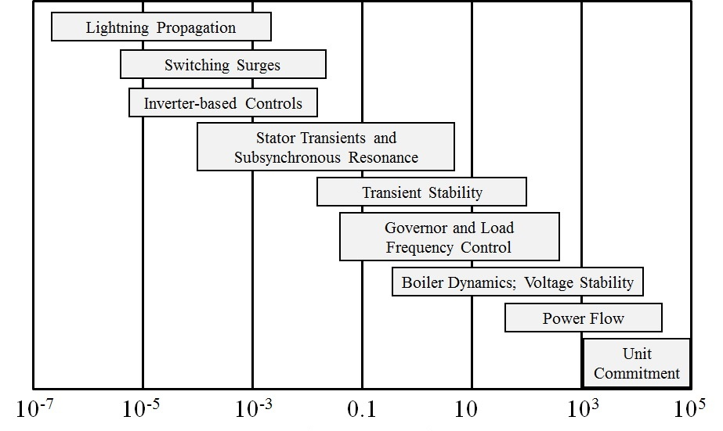
Power System Time Frames
Image source: P.W. Sauer, M.A. Pai, Power System Dynamics and Stability, 1997, Fig 1.2, modified

Slide 30
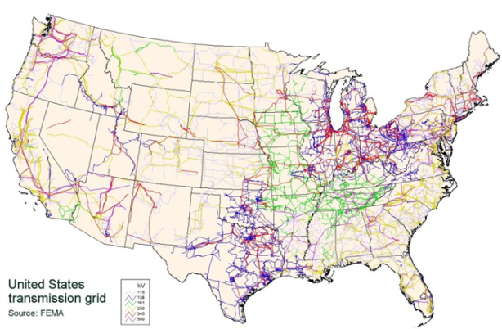
Important Electric Grid Considerations
Electricity cannot be economically stored
  Generation must be continually adjusted to match changes in electric load and losses
Electric power flows on high
voltage transmission lines
cannot usually be
directly controlled
  Control is mostly indirect,
  by changing generation
Customers have been in control of
their load
Transmission system has finite limits;
often operated close to its limit for
economic reasons

Slide 31
Power System Components
Major Components:
  Generators
    Power conversion technology, regulation and control
  Transmission System (69 kV and above)
    Substations, transmission lines, power transformers, control devices
  Distribution System (below 69 kV)
    Distribution feeders, service transformers, metering and control
  Loads
    Customer electricity demands, patterns, quality

Slide 32
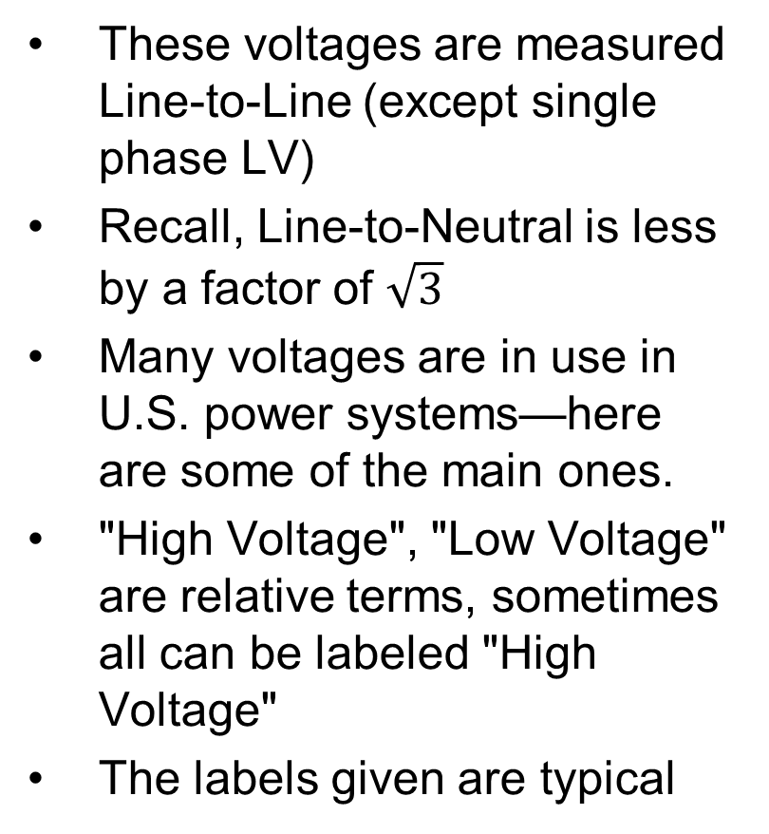
Voltage Levels Usage Table
These voltages are measured Line-to-Line (except single phase LV)
Recall, Line-to-Neutral is less by a factor of $\sqrt{3}$
Many voltages are in use in U.S. power systems—here are some of the main ones.
"High Voltage", "Low Voltage" are relative terms, sometimes all can be labeled "High Voltage"
The labels given are typical
Level | Typical Voltages | Usage
Low Voltage | 120 V, 208 V, 240 V, 600 V | Customer-level loads, residential, commercial, smaller industrial
Medium Voltage | 4.16 kV, 12.47 kV, 13.8 kV, 20 kV, 22 kV, 34.5 kV | Distribution feeders, generator step-up, larger industrial motors
High Voltage | 69 kV, 100 kV, 115 kV, 138 kV, 161 kV, 230 kV | Transmission system network
Extra High Voltage (EHV) | 345 kV, 500 kV, 765 kV | Backbone of large transmission systems

Slide 33
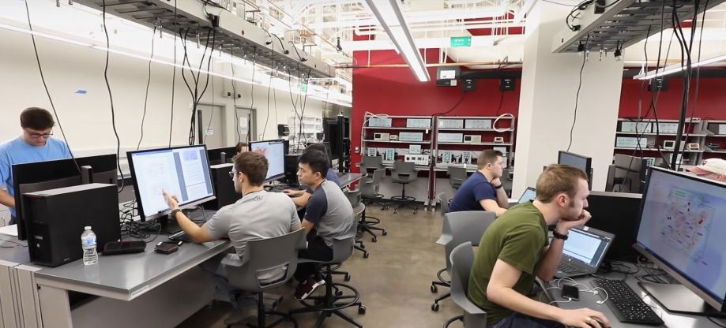
Labs
The first two labs (and most of the others) will involve power system simulation on PowerWorld Simulator
This will be in the labs in Zach 230
TAs will introduce more
lab policies on the first
week, which is next
week
The main objective of
the first two labs is to
get familiar with the
software and learn some
basics about power
system operations on
smaller and medium-sized grid models

Slide 34
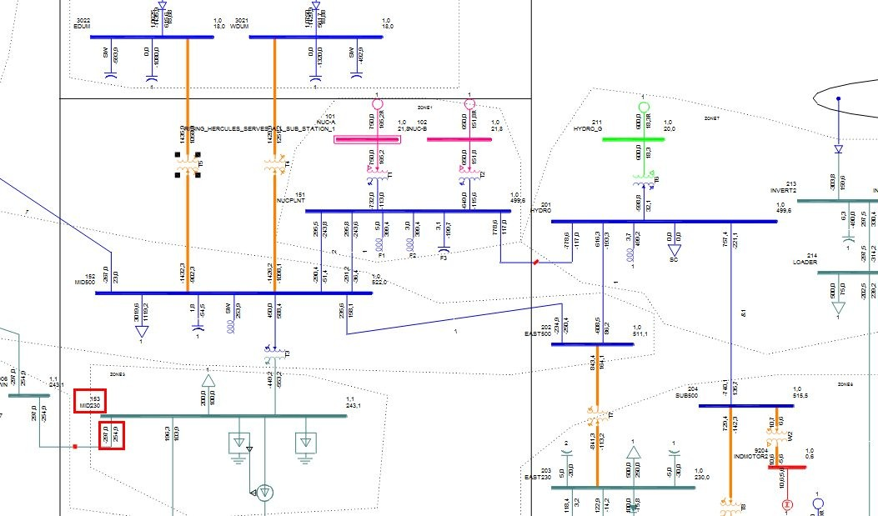
Computer Tools for Power System Analysis
Positive Sequence Transmission Simulation
  Siemens PSSE – Common in East
  GE PSLF – Common in West
  PowerWorld
  ETAP
  Matpower - free, mostly in academia
Distribution, Unbalanced
  OpenDSS – free, open source
  GridLabD
  CYME
Electromagnetic Transients
  EMTP-RV
  PSCAD
Custom code – your own or in-house
https://new.siemens.com/global/en/products/energy/energy-automation-and-smart-grid/pss-software/pss-e.html

Slide 35
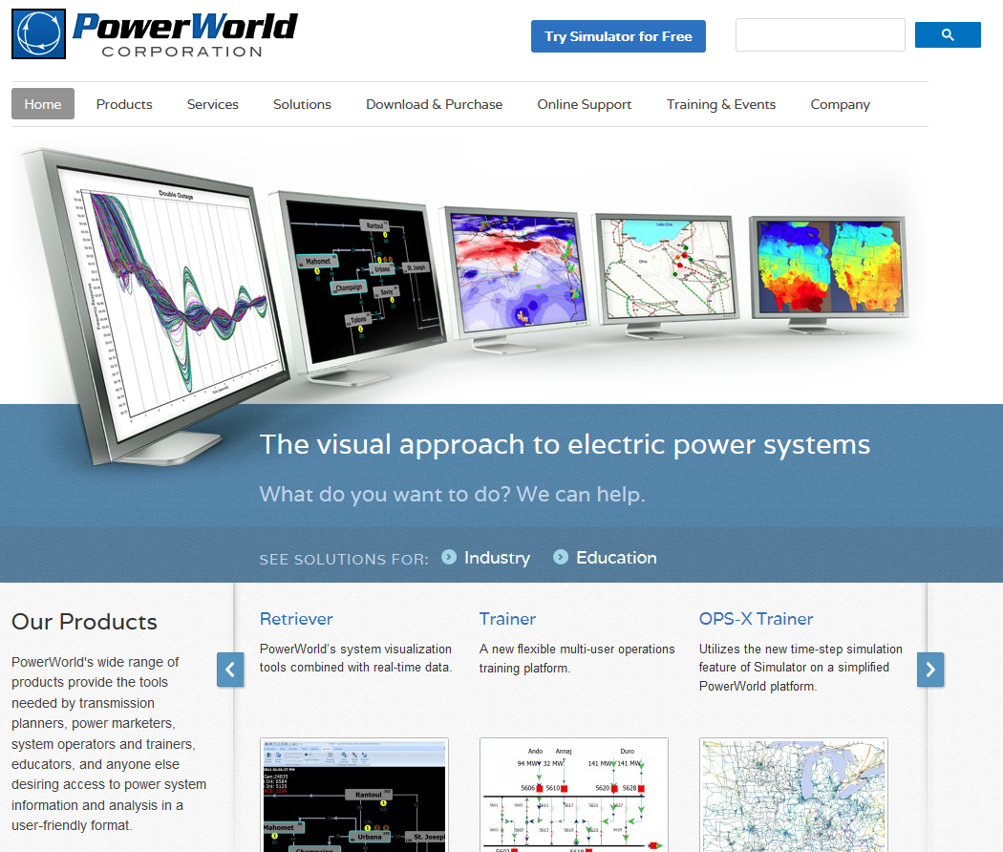
PowerWorld Simulator
Commercial tool in actual use by utilities
and others (1000+ customers in 70
countries)
Originally developed in 1996 by Prof.
Overbye (formerly at University of Illinois,
now at Texas A&M)
Originally designed to be well-suited to
teaching students about power systems.
Still has that capability while being
full-featured for industry use
Strengths are user-friendliness and
advanced data visualization
There is a free student 42-bus version.
We will use full (unlimited bus) version for labs in this class.
powerworld.com

Slide 36
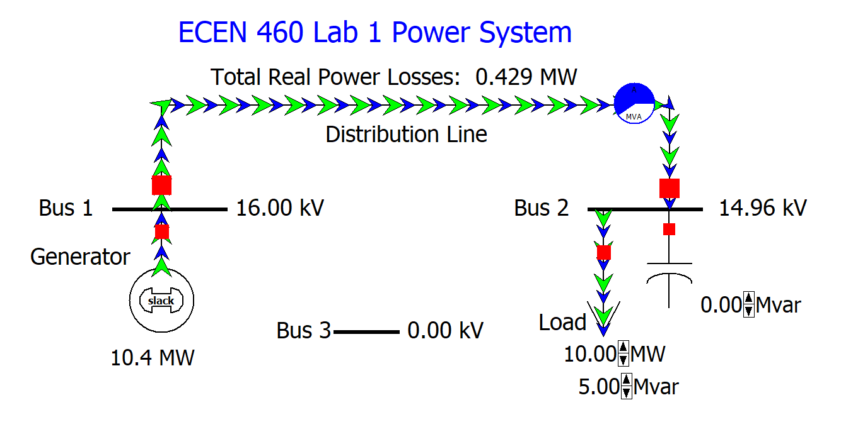
Lab 1 – Part A
Objectives:
  Learn the basics of using PowerWorld Simulator to model balanced three-phase systems.
  Correct the power factor of three-phase
  load by proper placement of shunt
  capacitors.
  Learn the basics of power system
  operations in the quasi-steady-state
  (power flow) time frame
Tasks
  Explore impact of capacitor on different
  system metrics: losses, voltage.
  Add two additional lines to connect bus 3.

Slide 37
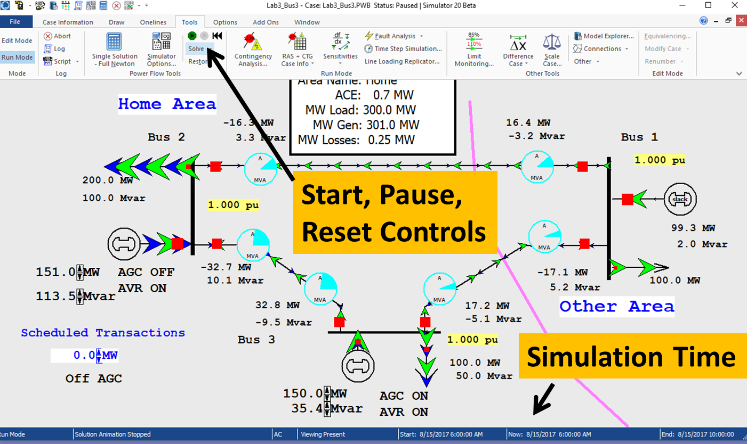
Lab 1 – Part B
Tasks
  Run system and observe how
  load increases and flows and
  generation respond in a
  two-area system
Manually adjust generation
during load increase
Attempt to manage area
control error (ACE)
Observe the operation of
automated ACE control by
the generators

Slide 38
Lab 1 – Last Step
Extreme loading of
42 bus system

Slide 39
Lab 2 – Aggieland Power and Light
Fix problems on this grid using
various control options
  Generator setpoints
  Phase shifting transformer
  Capacitor bank switching
  Transformer tap switching
Use a sensitivity-based
approach to estimate impacts
of control variables

Slide 40
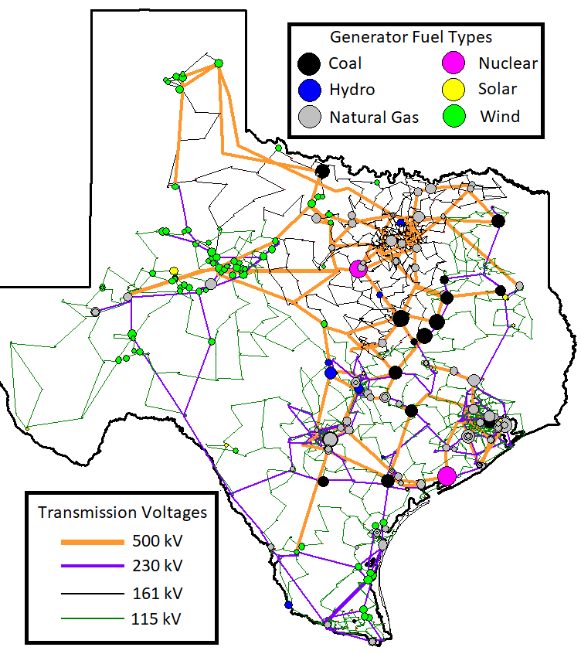
Synthetic Texas Grid
This 2000 bus grid will be used a lot in class
and lab this semester
It is similar in some ways to the actual Texas
grid: similar generation, load patterns, same
geography. However, it is a fictitious (synthetic)
transmission network: different voltages, all
fictional lines and substations.
Data on actual Texas grid is too confidential to
be used in class
This grid model was developed by researchers
here in the Texas A&M Power and Energy
research group and is being used in a lot of
research projects.

