Slide 1
ECEN 616, Fall 2022 Electromagnetic Transients in Power Systems
Class 27: Power Electronics
Prof. Adam Birchfield
Dept. of Electrical and Computer Engineering
Texas A&M University
abirchfield@tamu.edu

Slide 2
Example Power Electronics Applications
Batteries
HVDC
Inverters
Rectifiers
Motor drives
PV
Harmonics
Controllers

Slide 3
DC Circuit Analysis
Batteries
Short circuit function
HVDC
Breaker interruption

Slide 4
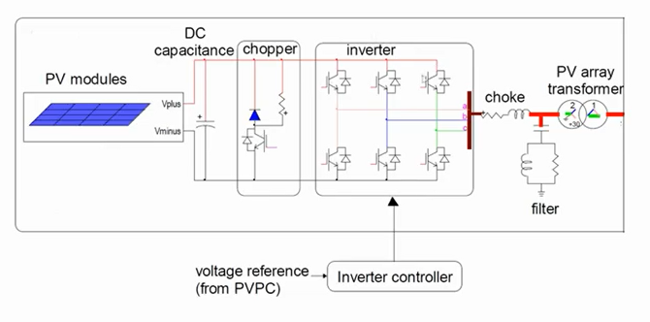
PV Controller Example

Slide 5
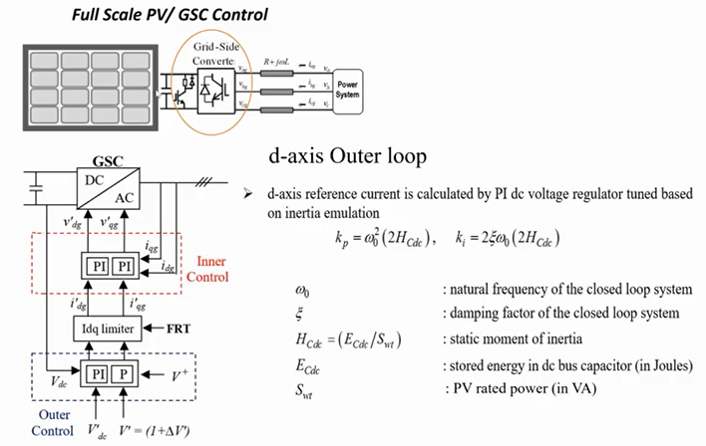
PV Controller Example, Cont.

Slide 6
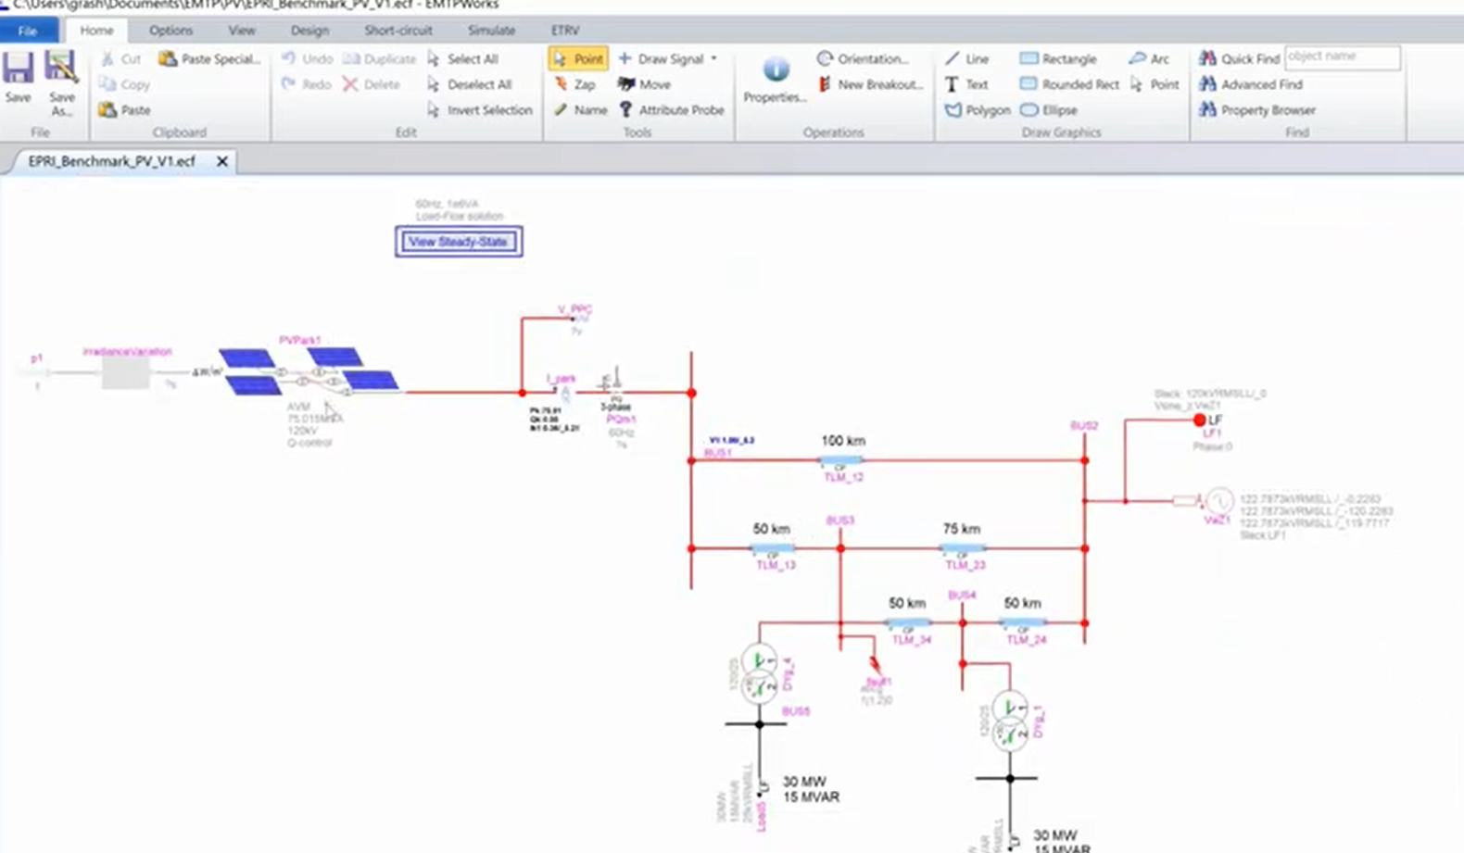
PV Controller Example, Cont.

Slide 7
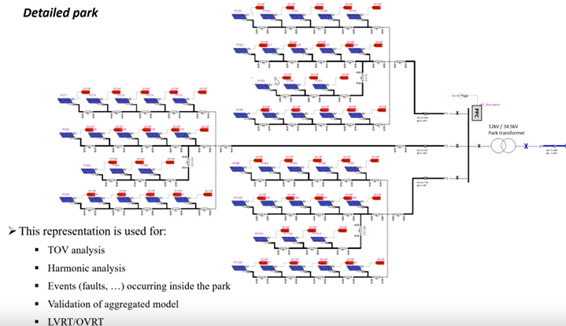
PV Controller Example, Cont.

