Slide 1
ECEN 616, Fall 2022 Electromagnetic Transients in Power Systems
Class 26: Electric Machines
Prof. Adam Birchfield
Dept. of Electrical and Computer Engineering
Texas A&M University
abirchfield@tamu.edu

Slide 2
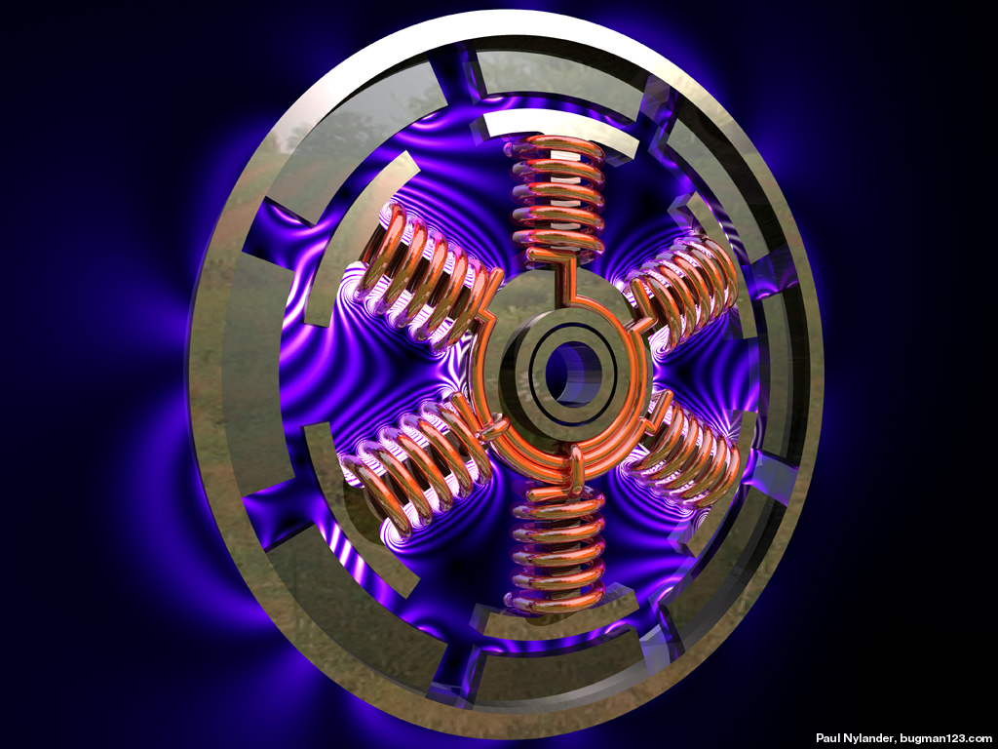
Electric Machines
Machines are used to convert between mechanical and electrical energy (motors and generators)
A much more thorough coverage of electric machine modeling is in other ECEN classes such as 667
Today we’ll hit the highlights and focus on a few issues germane to electromagnetic transient analysis
From presentation by Tcheslavski

Slide 3
The Basics of Electric Machines
Stator – the part that is stationary and does not move
Rotor – the part that rotates (moves)
Armature windings – windings on the “power side” that hook up to the grid
Field or excitation windings – the other windings, connected differently for different types of machines
Direct and quadrature axes – reference frame related to main field winding direction using Park’s transformation
Mechanical speed and angle – physical angular rotation and position of the rotor relative to the stator
Electrical speed and angle – frequency and phase offset of voltages and current sin the armature windings

Slide 4
Types of Machines
Synchronous machine – mechanical speed is equal to the electrical speed in steady-state. Armature windings are usually on the stator, and the rotor windings / field windings are connected to a separate DC excitation source
Induction machine – armature windings are on the stator, with the rotor/field windings short circuited. Power transfer is determined by the difference in mechanical speed or “slip” depending on the torque curve
DC machine – armature windings connected to dc source, usually on the rotor and connected through a commutator that swaps polarity
Doubly-fed induction machine – ac field windings that are externally connected to the grid as well via a back-to-back ac-dc-ac converter

Slide 5
Synchronous Machine Modeling
Vast majority of electric energy is generated with synch. machines
Fundamental relationship between flux (voltage) and currents via inductance matrices

Slide 6
EMTP Modeling of Synchronous Machines
Remember our principles! We can’t make the same power flow assumptions that were made in the derivations of 667 for stability studies
Not assuming balanced three-phase
Not assuming stator transients are too fast to consider

Slide 7
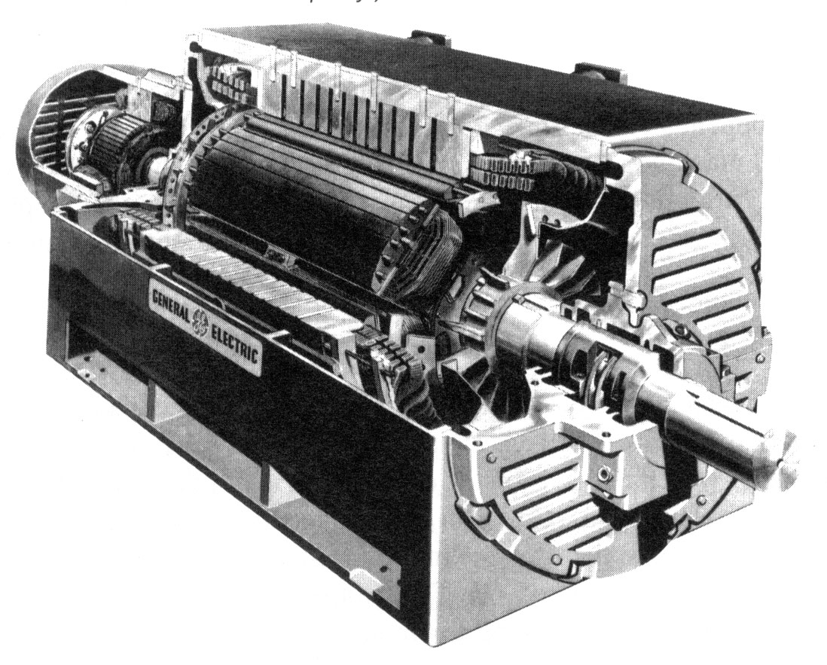
Control Systems
Exciters
Turbine-Governors
Stabilizers

Slide 8
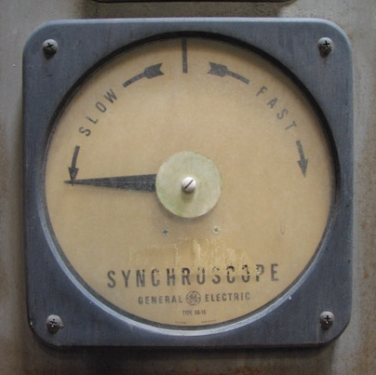
Issues for Transient Analysis in Electrical Machines
Motor / generator starting
Synchronizing/parallelizing
Surge effects
Controls
Unbalanced faults
Oscillations

