Slide 1
ECEN 616, Fall 2022 Electromagnetic Transients in Power Systems
Examples 2-7
Prof. Adam Birchfield
Dept. of Electrical and Computer Engineering
Texas A&M University
abirchfield@tamu.edu

Slide 2
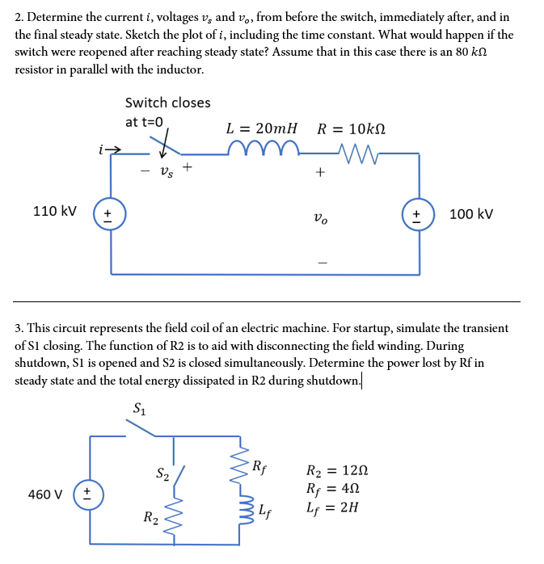
Example 2
Before the switch: $i=0$, $v_{0}=100 kV$, $v_{s}=−10 kV$
Immediately after: $i=0$, $v_{0}=100 kV$, $v_{s}=0$
Final steady state: $i=1 A$, $v_{0}=110 kV$, $v_{s}=0$
Immediately after reopening (with 80k R): $i=0$, $v_{0}=100 kV$, $v_{s}=−90 kV$

Slide 3
Example 2, cont.
Differential equation from KVL
$110 −L\frac{di}{dt}−Ri−100=0$
Solution
$i\left(t\right)=I_{ss}(1−e^{−t/τ})$, where $I_{ss}=\frac{10}{R}=1 A$ and $τ=\frac{L}{R}=2μs$

Slide 4
Example 3
In steady-state, S1 closed and S2 open, $i=\frac{v}{R}=\frac{460}{4}=115 A. P_{rf}=vi=460⋅115=52.9 kW$
Energy dissipated during shutdown: energy stored in inductor is ½ L$i^{2}=13.2 kJ$, dissipated proportional to resistance, so $E_{R2}=\frac{12}{16}13.2=9.9 kJ$
Another way to do part 2: $i\left(t\right)=115⋅e^{−t/τ}$, where $τ=\frac{L}{R}=0.125 s$. $P_{R2}=i^{2}R_{2}$, so
$$E_{R2}={115}^{2}R_{2}\int_{0}^{∞}{e^{−2t/τ}}dt={115}^{2}R_{2} \left(−\frac{τ}{2}\right)\left[e^{−∞}−e^{0}\right]=9.9 kJ$$

Slide 5
Example 4
We want to solve for $i(t)$ after the switch closes.
Pre-switch condition: $i\left(t\right)=0$
Immediately following the switch: $i\left(0^{+}\right)=0$ as well, because inductor cannot change current instantaneously
$v\left(t\right)=V⋅\sin\left(ωt+θ\right)$
Using steady-state AC circuit theory, the steady-state value of $i\left(t\right)$ can be found, recognizing that $Z=R+jωL$ so that $I=\frac{V}{Z}=\frac{V}{\sqrt{R^{2}+ω^{2}L^{2}}}∠\left(θ−\tan^{−1}\left(\frac{ωL}{R}\right)\right)$
So, $i\left(∞\right)=$ $\frac{V}{\sqrt{R^{2}+ω^{2}L^{2}}}sin \left(ωt+θ−\tan^{−1}\left(\frac{ωL}{R}\right)\right)$
$$i$$
+
$$R$$
$$V∠θ$$
_
$$L$$

Slide 6
Example 4, cont
But what happens in the transient time period? Write a differential equation using KVL and the definition of R and L
$$v\left(t\right)−Ri−L\frac{di}{dt}=0$$
$$V\sin\left(ωt+θ\right)=Ri−L\frac{di}{dt}$$
$$V\cos{θ}\sin{ωt}+V\sin{θ}\cos{ωt}=Ri−L\frac{di}{dt}$$
Ok, now we just need to solve this differential equation
Use the Laplace transform, convert to the s domain
$$V\frac{ω\cos{θ}+s\sin{θ}}{s^{2}+ω^{2}}=RI+sLI−Li(0)$$
Recognize $i(0)=0$and isolate I(s)
$$I\left(s\right)=\frac{V}{L}\frac{ω\cos{θ}+s\sin{θ}}{\left(s^{2}+ω^{2}\right)\left(s+R/L\right)}$$
$$=\frac{V}{L}\frac{ω\cos{θ}}{\left(s^{2}+ω^{2}\right)\left(s+R/L\right)}+\frac{V}{L}\frac{s\sin{θ}}{\left(s^{2}+ω^{2}\right)\left(s+R/L\right)}$$
We need to convert this back to time domain, which requires algebraic manipulation and splitting into partial fractions (whoop!)

Slide 7
Example 4, cont
Redefine to easier variables and do partial fraction decomposition on the first term
$$I\left(s\right)=\frac{V}{L}\frac{ω\cos{θ}}{\left(s^{2}+ω^{2}\right)\left(s+R/L\right)}+\frac{V}{L}\frac{s\sin{θ}}{\left(s^{2}+ω^{2}\right)\left(s+R/L\right)}=\frac{A_{1}}{\left(s^{2}+ω^{2}\right)\left(s+α\right)}+\frac{sA_{2}}{\left(s^{2}+ω^{2}\right)\left(s+α\right)}$$
$$\frac{1}{\left(s^{2}+ω^{2}\right)\left(s+α\right)}=\frac{B_{1}}{s+α}+\frac{B_{2}}{s^{2}+ω^{2}}+\frac{sB_{3}}{s^{2}+ω^{2}}$$
Solve for the three B terms and you finally get (for the first term of I(s))
$$\frac{Vω\cos{θ}}{L\left(ω^{2}+α^{2}\right)}\left(\frac{1}{s+α}+\frac{α}{s^{2}+ω^{2}}+\frac{−s}{s^{2}+ω^{2}}\right)$$
Which, in the time domain, is
$$\frac{Vω\cos{θ}}{L\left(ω^{2}+α^{2}\right)}\left(e^{−αt}+\frac{α}{ω}\sin\left(ωt\right)−\cos\left(ωt\right)\right)$$

Slide 8
Example 4, cont
The second term is just the first term times s (which is derivative in the time domain)
$$\frac{V}{L}\frac{s\sin{θ}}{\left(s^{2}+ω^{2}\right)\left(s+R/L\right)}=\frac{V\sin{θ}}{L\left(ω^{2}+α^{2}\right)}s(\frac{1}{s+α}+\frac{α}{s^{2}+ω^{2}}+\frac{−s}{s^{2}+ω^{2}})$$
$$\frac{V\sin{θ}}{L\left(ω^{2}+α^{2}\right)}⋅\frac{d}{dt}\left(e^{−αt}+\frac{α}{ω}\sin\left(ωt\right)−\cos\left(ωt\right)\right)$$
$$=\frac{V\sin{θ}}{L\left(ω^{2}+α^{2}\right)}\left(−αe^{−at}+α\cos\left(ωt\right)+ω\sin\left(ωt\right)\right)$$
Add the two terms and pull out like terms,
$$i\left(t\right)=\frac{V}{L\left(ω^{2}+α^{2}\right)}\left(\left(ω\cos{θ}−α\sin{θ}\right)e^{−at}+α\sin\left(ωt+θ\right)−ω\cos\left(ωt+θ\right)\right)$$

Slide 9
Example 4, cont
$$i\left(t\right)=\frac{V}{L\left(ω^{2}+α^{2}\right)}\left(\left(ω\cos{θ}−α\sin{θ}\right)e^{−at}+α\sin\left(ωt+θ\right)−ω\cos\left(ωt+θ\right)\right)$$
Define $φ=\tan^{−1}\left(\frac{ω}{α}\right)=\tan^{−1}\left(\frac{ωL}{R}\right), so that \frac{α}{\sqrt{ω^{2}+α^{2}}}=\cos{φ}and\frac{ω}{\sqrt{ω^{2}+α^{2}}}=\sin{φ}$
Now we can use our trig sum and difference formulas
$$i\left(t\right)=\frac{V}{L\sqrt{ω^{2}+α^{2}}}\left(−\sin{(θ−φ)}e^{−αt}+\sin\left(ωt+θ−φ\right)\right)$$
Remember our definitions for $α$ and $φ$?
$$i\left(t\right)=\frac{V}{\sqrt{L^{2}ω^{2}+R^{2}}}\left(−\sin\left(θ−\tan^{−1}\left(\frac{ωL}{R}\right)\right)e^{−\frac{R}{L}t}+\sin\left(ωt+θ−\tan^{−1}\left(\frac{ωL}{R}\right)\right)\right)$$
Check our boundary conditions
$$i\left(0\right)=0; i\left(∞\right)=\frac{V}{\sqrt{R^{2}+ω^{2}L^{2}}}sin \left(ωt+θ−\tan^{−1}\left(\frac{ωL}{R}\right)\right)$$

Slide 10
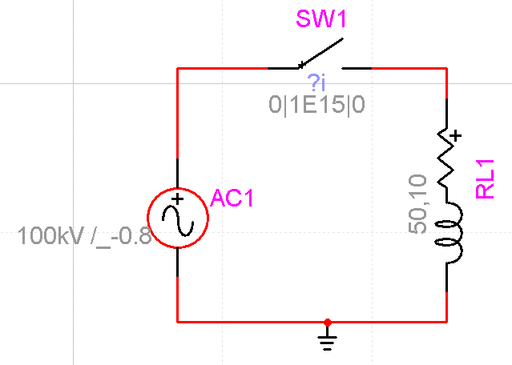
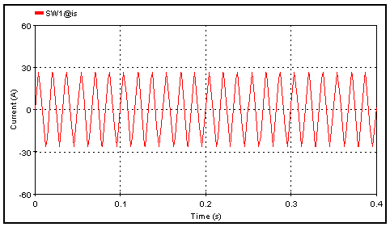
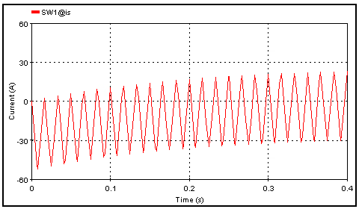
EMTP Version of Example 4
Let's use V=100 kV, $f=60 \text{Hz}$, $R=50 Ω$, $L=10 \text{H}$
Steady-state current is 26.5 A
EMTP ac source is cosine-based, not sine-based
This means the time constant will be $\frac{L}{R}=0.2s$
Ideal closing angle would be about 89.2$°$ with sine function, with cosine it is about -0.8$°$
Left: ideal closing angle
Right: worst-case closing angle

Slide 11
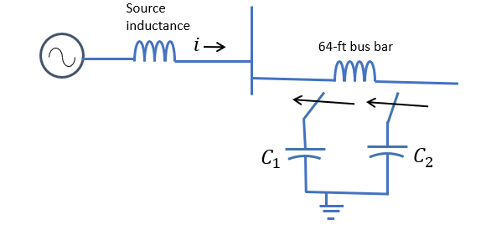
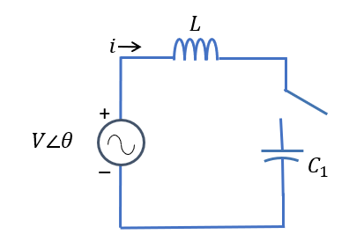
Example 5
Start with the problem of switching in C1
Draw an equivalent circuit (below)
V = 34.5 kV (changed from document)
$X_{L}=\frac{34500}{\sqrt{3}}×25=0.797 Ω$; $L=2100 μH$
$X_{C1}=\frac{{34500}^{2}}{18000000}=66.13 Ω;C=40.1 μF$
Consider the pre-transient steady-state condition. No load is given, so $i=0$.
Particular solution. I = $\frac{V∠θ}{Z_{L}+Z_{C}}=306∠(θ+90°)$ A
Differential equation: $V\cos\left(ωt+θ\right)=L\frac{di}{dt}+\frac{1}{C}\int{i\left(t\right)dt}$
Can solve with Laplace (with much difficulty)! But first consider the characteristic frequency $\frac{1}{\sqrt{LC}}=548 Hz$
This is much faster than the fundamental frequency.

Slide 12
Example 5, continued
So, consider the source to be at constant peak voltage (dc source)
Now the differential equation is much easier to solve: $i\left(t\right)=\frac{V\left(0\right)}{Z_{0}}\sin{(ω_{0}t)}$
For this example: $V\left(0\right)=34.5kV∗\frac{\sqrt{2}}{\sqrt{3}}=28.2 kV$, $Z_{0}=\sqrt{\frac{L}{C}}=7.23 Ω$, and $ω_{0}=3446$
$i\left(t\right)=3900\sin\left(3446t\right)A$ If there were any load current, it would be much smaller.
In building our EMTP model, start with the simplest version and add complexity
Single equivalent phase with DC source and L + C combination
Make it an AC source
Make a three-phase version

Slide 13
Example 5, EMTP single phase

Slide 14
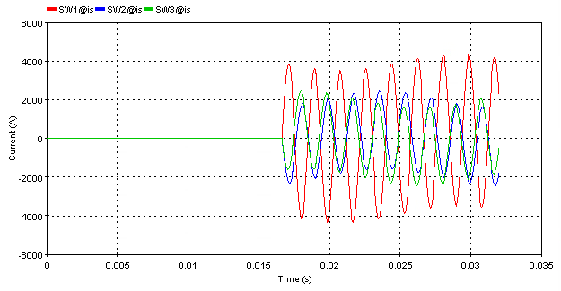
Example 5, EMTP three phase
This is for completeness, each phase is independent in this example. Which phase has the highest transient current depends on the phase angle at which the switches close.

Slide 15
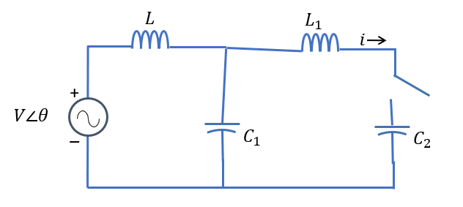
Example 5, part two
Now we consider the case of switching C2 with C1 already in place. Equivalent circuit shown. $L_{1}=19.2 μH$, $C_{2}=22.8 μF$
Differential equation(s) will be even more complicated! What can we neglect for our analytical calculations?
L1 is small compared to L, but important
Current will be coming from both the source and the stored voltage in C1.
Consider characteristic frequency of L1 in parallel with the C1 and C2 combination
C = 1/(1/C1 + 1/C2) = 14.32 $μF$
$ω_{0}=9.6 kHz$(way faster than other two)
$Z_{01}=1.158 Ω$

Slide 16
Example 5, part two, continued
The maximum current coming from the source is about 4 kA
But the inrush current based on the fact that C1 could be charged to peak voltage of 28.2 kV would be
$$i_{peak}=\frac{V_{0}}{Z_{01}}=\frac{28.2 kV}{1.158Ω}=22.33 kA$$
So we can neglect the source and we are back to Example 1 (with L)!!
Sinusoidal transient with peak value of about 22 kA
Let's see if EMTP agrees

Slide 17
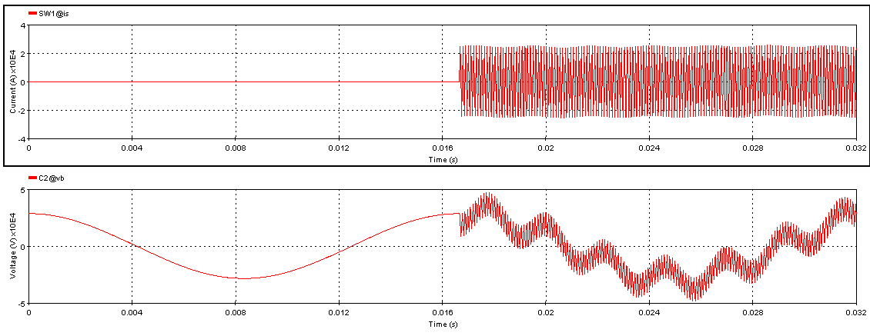
Example 5, part two, EMTP analysis
Note there are three frequencies visible: 60 Hz, 548 Hz, and 9.6 kHz
Maximum current 25 kA

Slide 18
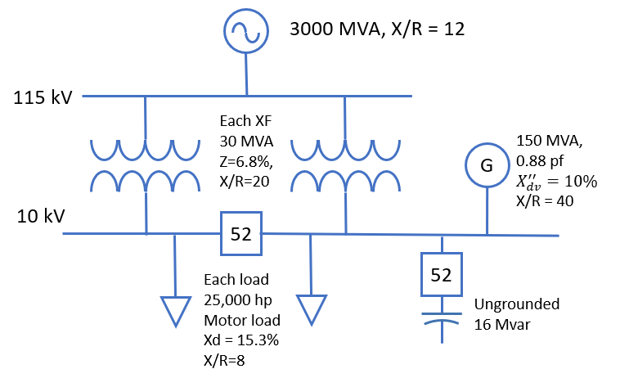
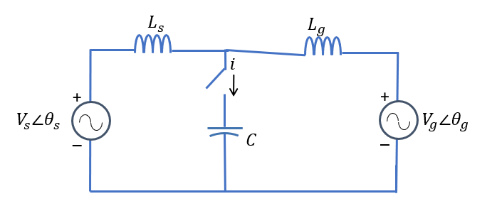
Example 6
For the distribution system shown below, assuming the bus breaker is open, what are the transients associated with switching the capacitor in? (52 means breaker)
Neglect loads, resistances, generator current
For transformer, assume ideal for now and create equivalent source of Vs = 10 kV (three-phase)
$X_{source}=\frac{{\left(115 kV\right)}^{2}}{3000 MVA}=4.41Ω→11.7 \text{mH}$
$X_{XF}=0.068⋅\frac{{\left(10 \text{kV}\right)}^{2}}{30 MVA}=0.23 Ω→601 \text{μH}$
$L_{s}=\frac{L_{source}}{a^{2}}+L_{XF}=689 \text{μH}$
$V_{g}=10 kV$
$L_{g}=0.1⋅\frac{{\left(10 kV\right)}^{2}}{150 \text{MVA}}=66.6 mΩ→177 \text{μH}$
$$C=\frac{{10}^{2}}{16}=6.25Ω→424μF$$

Slide 19
Example 6
Consider this L-C combination, with the two inductors in parallel.
Frequency is $ω=4092$ (644 Hz), $z_{0}=0.576 Ω$
Consider both the sources to be DC at the peak line-to-neutral voltage of 8.16 kV
Solve using Laplace or other method
Peak voltage ends up being 16.32 kV
Peak current ends up being 8.16/z0 = 14000 A
Verify with EMTP

Slide 20
Example 7
What happens if we assume the bus breaker is closed?
Now two identical transformers in parallel
Including another motor load (neglect for hand calculations)
So, $L_{s}=\frac{L_{source}}{a^{2}}+\frac{1}{2}L_{XF}=388 \text{μH}$
New $ω_{LC}=4405$ (701 Hz)
New $z_{0}=0.535 Ω$
Peak voltage is unchanged
Peak current is slightly lower, 15200 A

