Slide 1
ECEN 616: Electromagnetic Transients in Power Systems
Solution to Example 8a
Adam Birchfield
Dept. of Electrical and Computer Engineering
Texas A&M University
abirchfield@tamu.edu

Slide 2
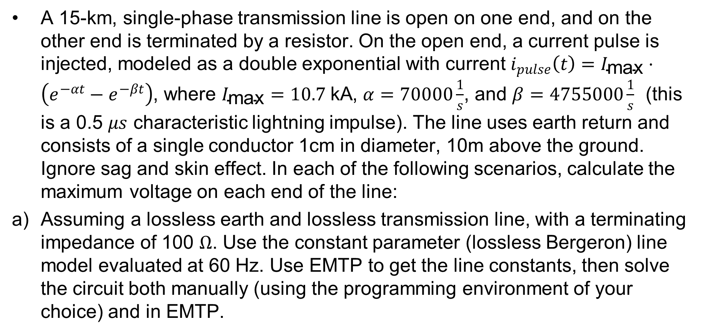
Example 8a
A 15-km, single-phase transmission line is open on one end, and on the other end is terminated by a resistor. On the open end, a current pulse is injected, modeled as a double exponential with current $i_{pulse}\left(t\right)=I_{\text{max}}⋅\left(e^{−αt}−e^{−βt}\right)$, where $I_{\text{max}}=10.7 \text{kA}$, $α=70000\frac{1}{s}$, and $β=4755000\frac{1}{s}$ (this is a 0.5 $μs$ characteristic lightning impulse). The line uses earth return and consists of a single conductor 1cm in diameter, 10m above the ground. Ignore sag and skin effect. In each of the following scenarios, calculate the maximum voltage on each end of the line:
a) Assuming a lossless earth and lossless transmission line, with a terminating impedance of 100 $Ω$. Use the constant parameter (lossless Bergeron) line model evaluated at 60 Hz. Use EMTP to get the line constants, then solve the circuit both manually (using the programming environment of your choice) and in EMTP.

Slide 3
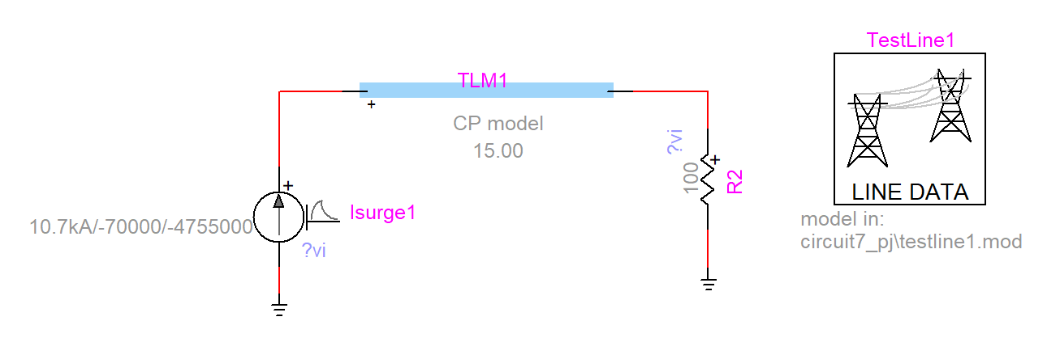
Getting Line Parameters from EMTP
Line Data
1 conductor: Phase 1, 0 resistance, 1cm diameter, 0 horizontal, 10 vertical, no sag or skin effect
Model: constant parameter at 60 Hz
Line length: 15 km and 0 ground return resistivity
Generate data
Line model
Load data from file
R = 0
$Z_{c}=497 Ω$
$τ=50 μs$

Slide 4
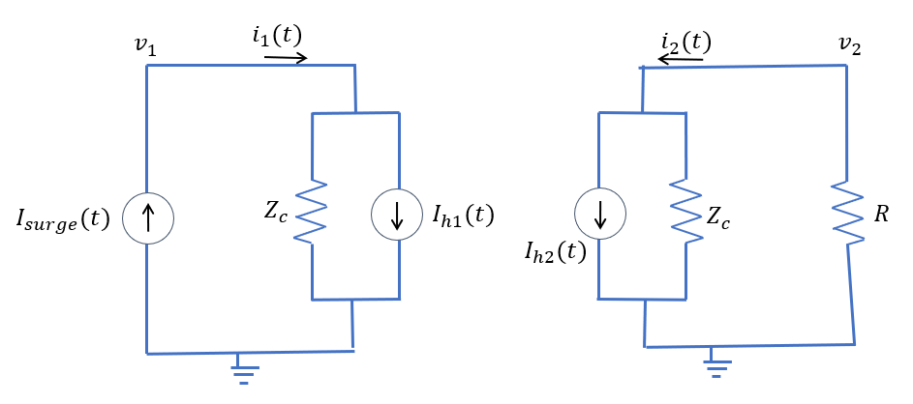
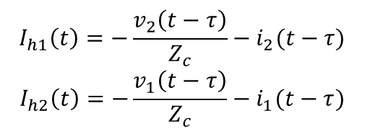
Setting up the Equivalent Circuit
The line becomes two Norton sources, with resistance $Z_{c}$ and current source $I_{h1}$ and $I_{h2}$ which depend on prior values on other end of the line
$I_{surge}(t)$ comes from double exponential equations and $=i_{1}$
$R$ is $100Ω$, the terminating impedance
$$I_{h1}\left(t\right)=−\frac{v_{2}\left(t−τ\right)}{Z_{c}}−i_{2}(t−τ)$$
$$I_{h2}\left(t\right)=−\frac{v_{1}\left(t−τ\right)}{Z_{c}}−i_{1}(t−τ)$$

Slide 5
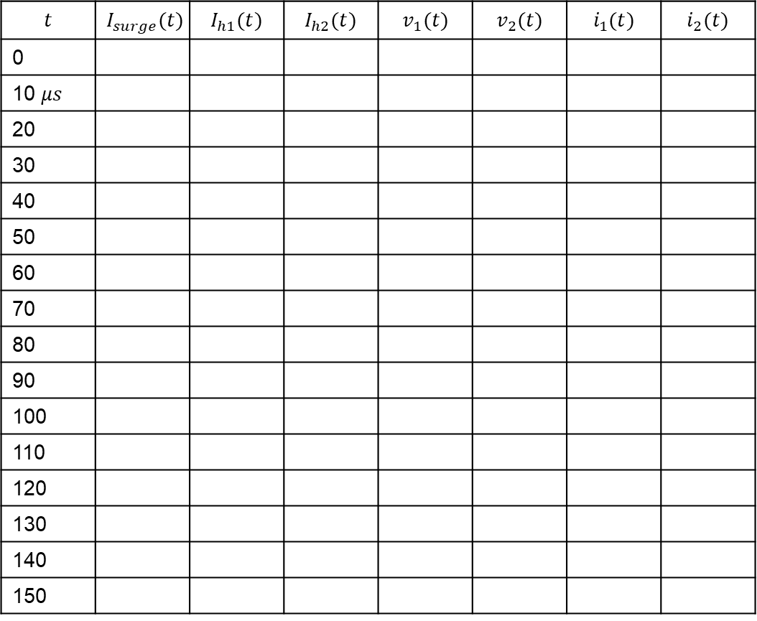
Setting up the Time Chart
$$t$$ | $$I_{surge}(t)$$ | $$I_{h1}(t)$$ | $$I_{h2}(t)$$ | $$v_{1}(t)$$ | $$v_{2}(t)$$ | $$i_{1}(t)$$ | $$i_{2}(t)$$
0
10 $μs$
20
30
40
50
60
70
80
90
100
110
120
130
140
150
Chooose $10μs$ as $Δt$ for hand example
(in your actual code use a much smaller time step, 0.1$μs$ should do.)

Slide 6
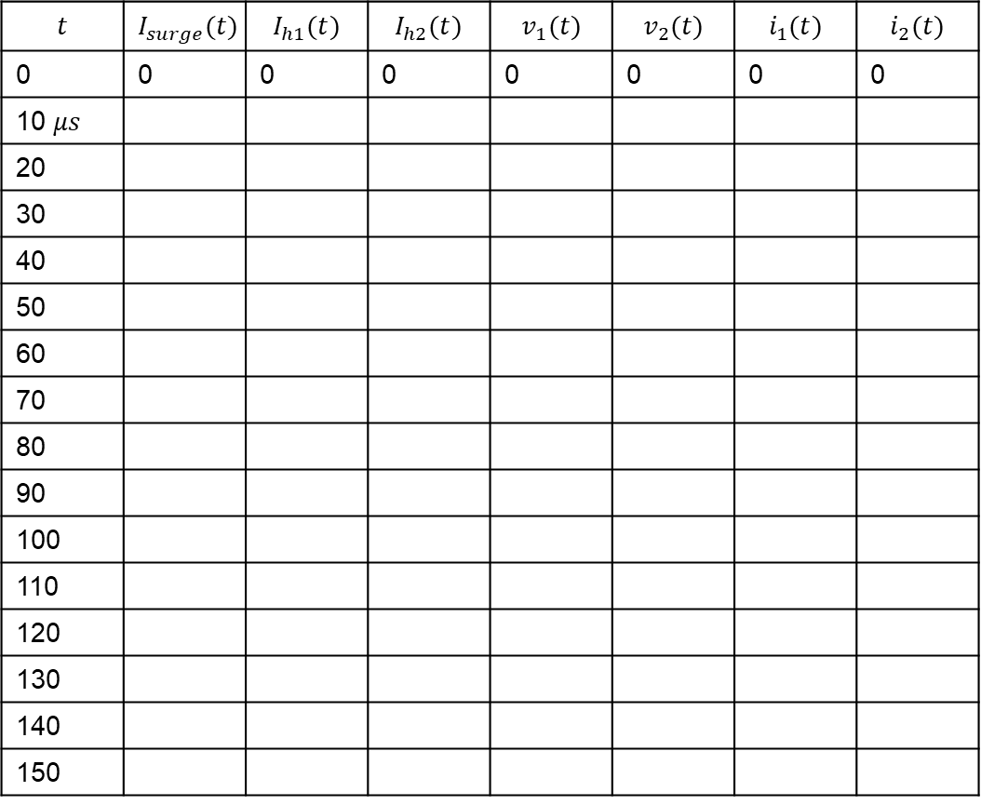
Initial Values
$$t$$ | $$I_{surge}(t)$$ | $$I_{h1}(t)$$ | $$I_{h2}(t)$$ | $$v_{1}(t)$$ | $$v_{2}(t)$$ | $$i_{1}(t)$$ | $$i_{2}(t)$$
0 | 0 | 0 | 0 | 0 | 0 | 0 | 0
10 $μs$
20
30
40
50
60
70
80
90
100
110
120
130
140
150
Assume the line is initially unloaded

Slide 7
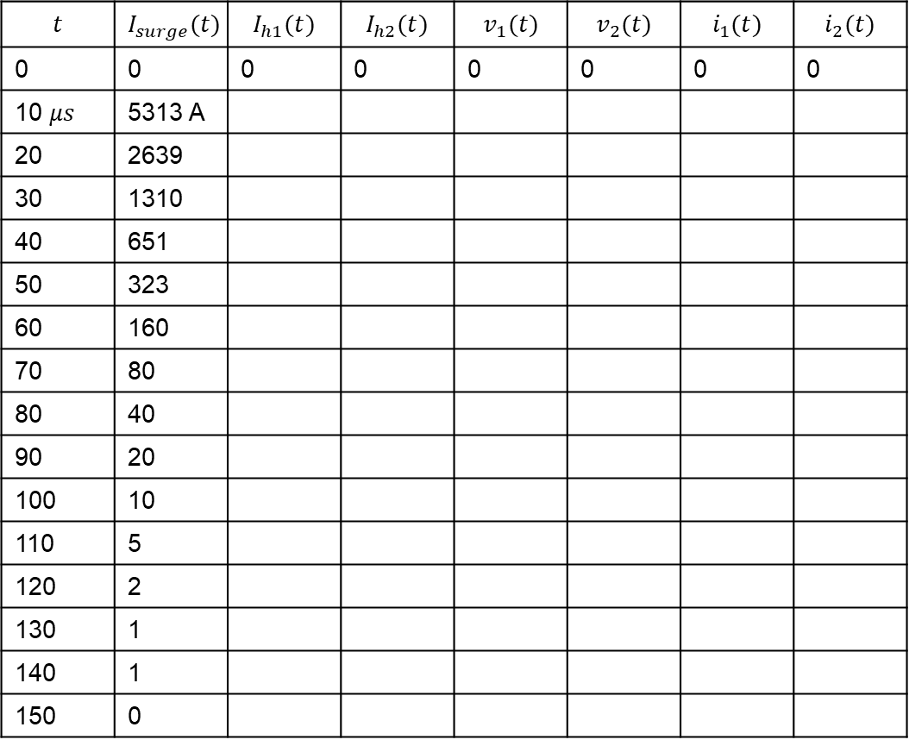
Surge Current
$$t$$ | $$I_{surge}(t)$$ | $$I_{h1}(t)$$ | $$I_{h2}(t)$$ | $$v_{1}(t)$$ | $$v_{2}(t)$$ | $$i_{1}(t)$$ | $$i_{2}(t)$$
0 | 0 | 0 | 0 | 0 | 0 | 0 | 0
10 $μs$ | 5313 A
20 | 2639
30 | 1310
40 | 651
50 | 323
60 | 160
70 | 80
80 | 40
90 | 20
100 | 10
110 | 5
120 | 2
130 | 1
140 | 1
150 | 0
Surge current is just a function of $t$ and does not depend on the rest of the circuit. Use the equation $i_{pulse}\left(t\right)=I_{\text{max}}⋅\left(e^{−αt}−e^{−βt}\right)$

Slide 8
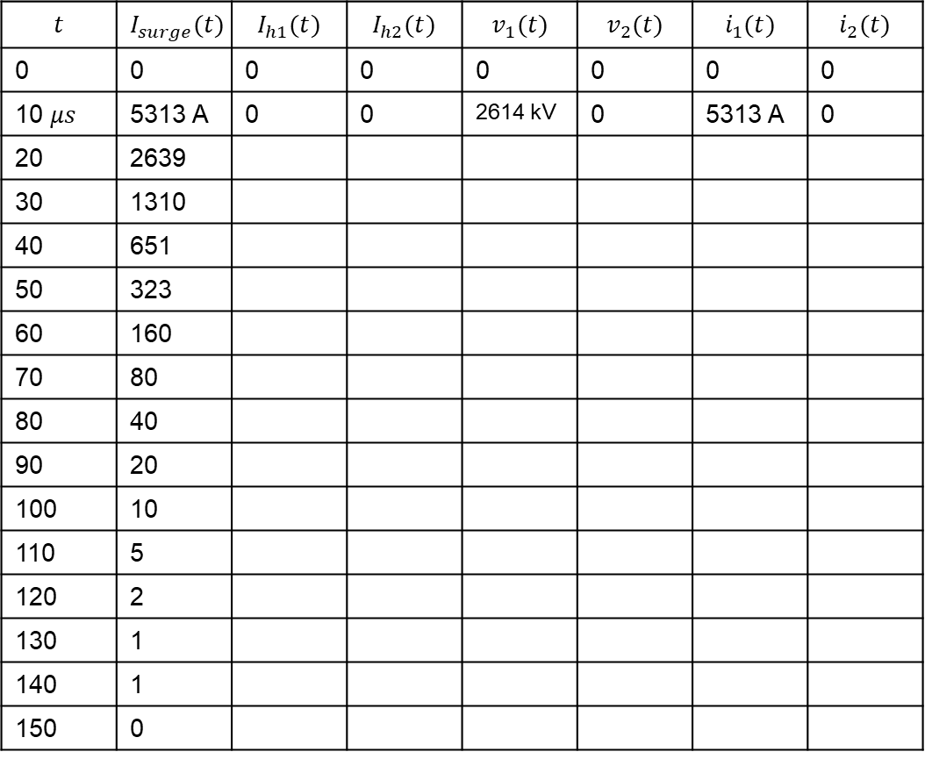
First Time Step
$$t$$ | $$I_{surge}(t)$$ | $$I_{h1}(t)$$ | $$I_{h2}(t)$$ | $$v_{1}(t)$$ | $$v_{2}(t)$$ | $$i_{1}(t)$$ | $$i_{2}(t)$$
0 | 0 | 0 | 0 | 0 | 0 | 0 | 0
10 $μs$ | 5313 A | 0 | 0 | 2614 kV | 0 | 5313 A | 0
20 | 2639
30 | 1310
40 | 651
50 | 323
60 | 160
70 | 80
80 | 40
90 | 20
100 | 10
110 | 5
120 | 2
130 | 1
140 | 1
150 | 0
Assume that voltages and currents have been 0 for negative time, so historical values are 0.
Because right hand side current source is 0 ${(I}_{H2})$, the current and voltage there will be 0 as well.
$i_{1}=I_{surge}=5313 A$
$v_{1}=\left(I_{surge}−I_{H1}\right)⋅Z_{c}=\left(5313−0\right)\left(497\right)=2614 kV$

Slide 9
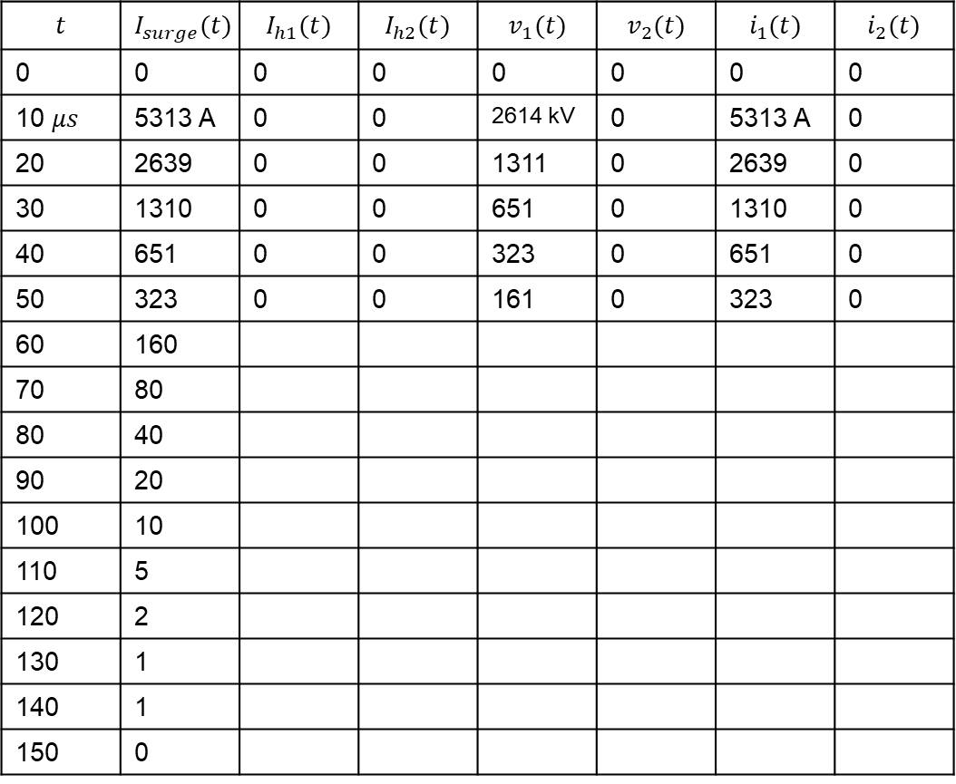
Time Steps 20-50 $μs$
$$t$$ | $$I_{surge}(t)$$ | $$I_{h1}(t)$$ | $$I_{h2}(t)$$ | $$v_{1}(t)$$ | $$v_{2}(t)$$ | $$i_{1}(t)$$ | $$i_{2}(t)$$
0 | 0 | 0 | 0 | 0 | 0 | 0 | 0
10 $μs$ | 5313 A | 0 | 0 | 2614 kV | 0 | 5313 A | 0
20 | 2639 | 0 | 0 | 1311 | 0 | 2639 | 0
30 | 1310 | 0 | 0 | 651 | 0 | 1310 | 0
40 | 651 | 0 | 0 | 323 | 0 | 651 | 0
50 | 323 | 0 | 0 | 161 | 0 | 323 | 0
60 | 160
70 | 80
80 | 40
90 | 20
100 | 10
110 | 5
120 | 2
130 | 1
140 | 1
150 | 0
Assume that voltages and currents have been 0 for negative time, so historical values are 0. For time step $50μs$, historical values are zero as well.
Because right hand side current source is 0 ${(I}_{H2})$, the current and voltage there will be 0 as well.
$i_{1}=I_{surge}$
$v_{1}=\left(I_{surge}−I_{H1}\right)⋅Z_{c}=I_{surge}⋅Z_{c}$

Slide 10
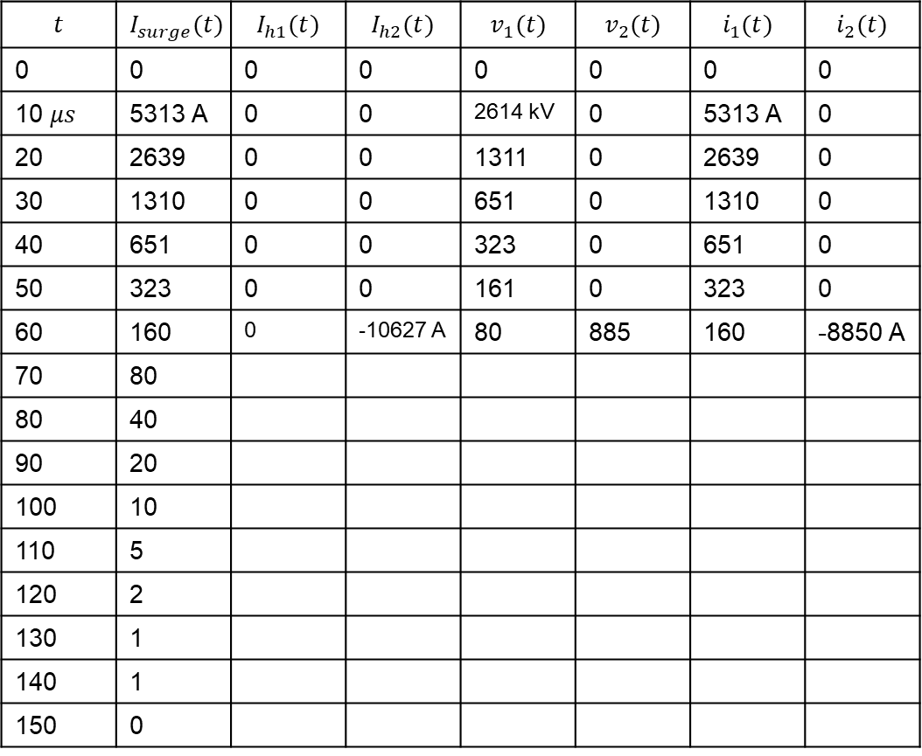
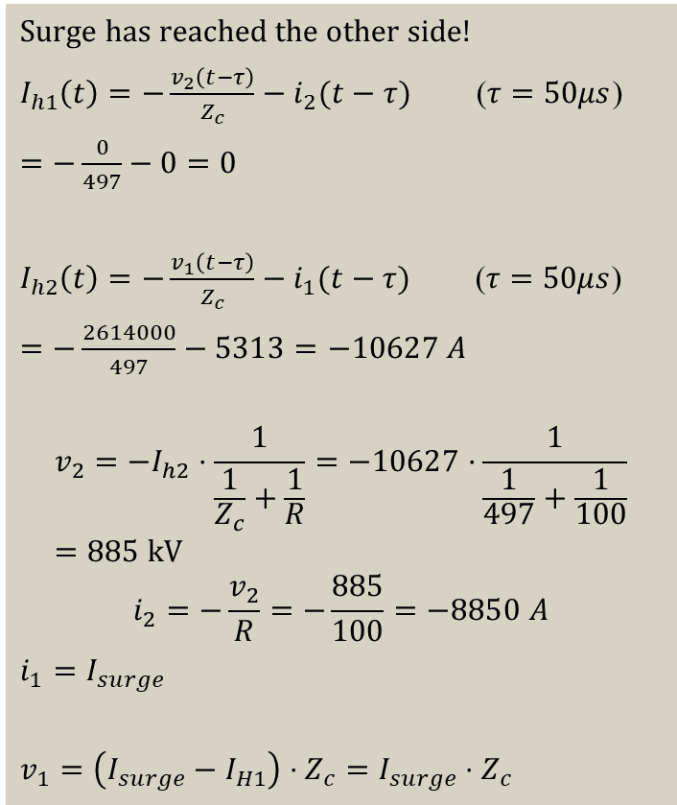
Time Step 60 $μs$
$$t$$ | $$I_{surge}(t)$$ | $$I_{h1}(t)$$ | $$I_{h2}(t)$$ | $$v_{1}(t)$$ | $$v_{2}(t)$$ | $$i_{1}(t)$$ | $$i_{2}(t)$$
0 | 0 | 0 | 0 | 0 | 0 | 0 | 0
10 $μs$ | 5313 A | 0 | 0 | 2614 kV | 0 | 5313 A | 0
20 | 2639 | 0 | 0 | 1311 | 0 | 2639 | 0
30 | 1310 | 0 | 0 | 651 | 0 | 1310 | 0
40 | 651 | 0 | 0 | 323 | 0 | 651 | 0
50 | 323 | 0 | 0 | 161 | 0 | 323 | 0
60 | 160 | 0 | -10627 A | 80 | 885 | 160 | -8850 A
70 | 80
80 | 40
90 | 20
100 | 10
110 | 5
120 | 2
130 | 1
140 | 1
150 | 0
Surge has reached the other side!
$I_{h1}\left(t\right)=−\frac{v_{2}\left(t−τ\right)}{Z_{c}}−i_{2}(t−τ)$ ($τ=50μs$)
$=−\frac{0}{497}−0=0$
$I_{h2}\left(t\right)=−\frac{v_{1}\left(t−τ\right)}{Z_{c}}−i_{1}(t−τ)$ ($τ=50μs$)
$=−\frac{2614000}{497}−5313=−10627 A$
$$v_{2}=−I_{h2}⋅\frac{1}{\frac{1}{Z_{c}}+\frac{1}{R}}=−10627⋅\frac{1}{\frac{1}{497}+\frac{1}{100}}=885 \text{kV}$$
$$i_{2}=−\frac{v_{2}}{R}=−\frac{885}{100}=−8850 A$$
$i_{1}=I_{surge}$
$v_{1}=\left(I_{surge}−I_{H1}\right)⋅Z_{c}=I_{surge}⋅Z_{c}$

Slide 11
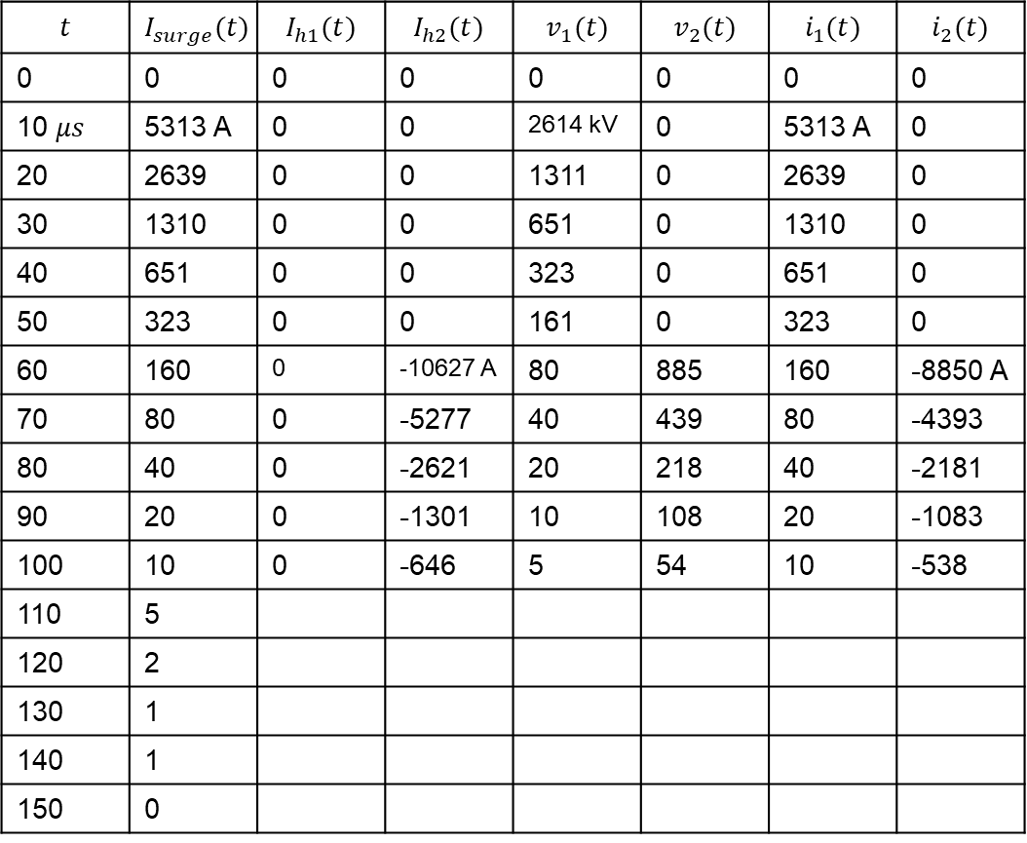
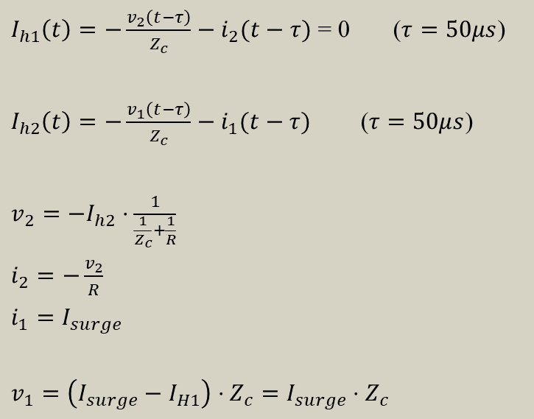
Time Steps 70-100 $μs$
$$t$$ | $$I_{surge}(t)$$ | $$I_{h1}(t)$$ | $$I_{h2}(t)$$ | $$v_{1}(t)$$ | $$v_{2}(t)$$ | $$i_{1}(t)$$ | $$i_{2}(t)$$
0 | 0 | 0 | 0 | 0 | 0 | 0 | 0
10 $μs$ | 5313 A | 0 | 0 | 2614 kV | 0 | 5313 A | 0
20 | 2639 | 0 | 0 | 1311 | 0 | 2639 | 0
30 | 1310 | 0 | 0 | 651 | 0 | 1310 | 0
40 | 651 | 0 | 0 | 323 | 0 | 651 | 0
50 | 323 | 0 | 0 | 161 | 0 | 323 | 0
60 | 160 | 0 | -10627 A | 80 | 885 | 160 | -8850 A
70 | 80 | 0 | -5277 | 40 | 439 | 80 | -4393
80 | 40 | 0 | -2621 | 20 | 218 | 40 | -2181
90 | 20 | 0 | -1301 | 10 | 108 | 20 | -1083
100 | 10 | 0 | -646 | 5 | 54 | 10 | -538
110 | 5
120 | 2
130 | 1
140 | 1
150 | 0
$I_{h1}\left(t\right)=−\frac{v_{2}\left(t−τ\right)}{Z_{c}}−i_{2}(t−τ)$ = 0 ($τ=50μs$)
$I_{h2}\left(t\right)=−\frac{v_{1}\left(t−τ\right)}{Z_{c}}−i_{1}(t−τ)$ ($τ=50μs$)
$v_{2}=−I_{h2}⋅\frac{1}{\frac{1}{Z_{c}}+\frac{1}{R}}$
$i_{2}=−\frac{v_{2}}{R}$
$i_{1}=I_{surge}$
$v_{1}=\left(I_{surge}−I_{H1}\right)⋅Z_{c}=I_{surge}⋅Z_{c}$

Slide 12
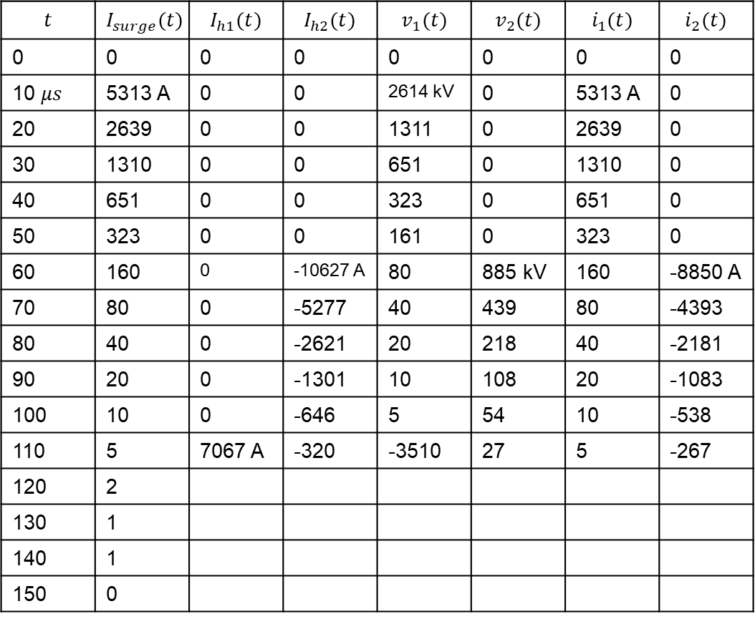
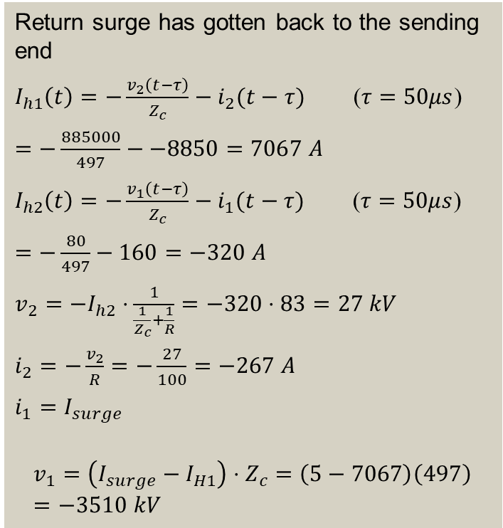
Time Step 110 $μs$
$$t$$ | $$I_{surge}(t)$$ | $$I_{h1}(t)$$ | $$I_{h2}(t)$$ | $$v_{1}(t)$$ | $$v_{2}(t)$$ | $$i_{1}(t)$$ | $$i_{2}(t)$$
0 | 0 | 0 | 0 | 0 | 0 | 0 | 0
10 $μs$ | 5313 A | 0 | 0 | 2614 kV | 0 | 5313 A | 0
20 | 2639 | 0 | 0 | 1311 | 0 | 2639 | 0
30 | 1310 | 0 | 0 | 651 | 0 | 1310 | 0
40 | 651 | 0 | 0 | 323 | 0 | 651 | 0
50 | 323 | 0 | 0 | 161 | 0 | 323 | 0
60 | 160 | 0 | -10627 A | 80 | 885 kV | 160 | -8850 A
70 | 80 | 0 | -5277 | 40 | 439 | 80 | -4393
80 | 40 | 0 | -2621 | 20 | 218 | 40 | -2181
90 | 20 | 0 | -1301 | 10 | 108 | 20 | -1083
100 | 10 | 0 | -646 | 5 | 54 | 10 | -538
110 | 5 | 7067 A | -320 | -3510 | 27 | 5 | -267
120 | 2
130 | 1
140 | 1
150 | 0
Return surge has gotten back to the sending end
$I_{h1}\left(t\right)=−\frac{v_{2}\left(t−τ\right)}{Z_{c}}−i_{2}(t−τ)$ ($τ=50μs$)
$=−\frac{885000}{497}−−8850=7067 A$
$I_{h2}\left(t\right)=−\frac{v_{1}\left(t−τ\right)}{Z_{c}}−i_{1}(t−τ)$ ($τ=50μs$)
$=−\frac{80}{497}−160=−320 A$
$v_{2}=−I_{h2}⋅\frac{1}{\frac{1}{Z_{c}}+\frac{1}{R}}=−320⋅83=27 kV$
$i_{2}=−\frac{v_{2}}{R}=−\frac{27}{100}=−267 A$
$i_{1}=I_{surge}$
$$v_{1}=\left(I_{surge}−I_{H1}\right)⋅Z_{c}=\left(5−7067\right)\left(497\right)=−3510 kV$$

Slide 13
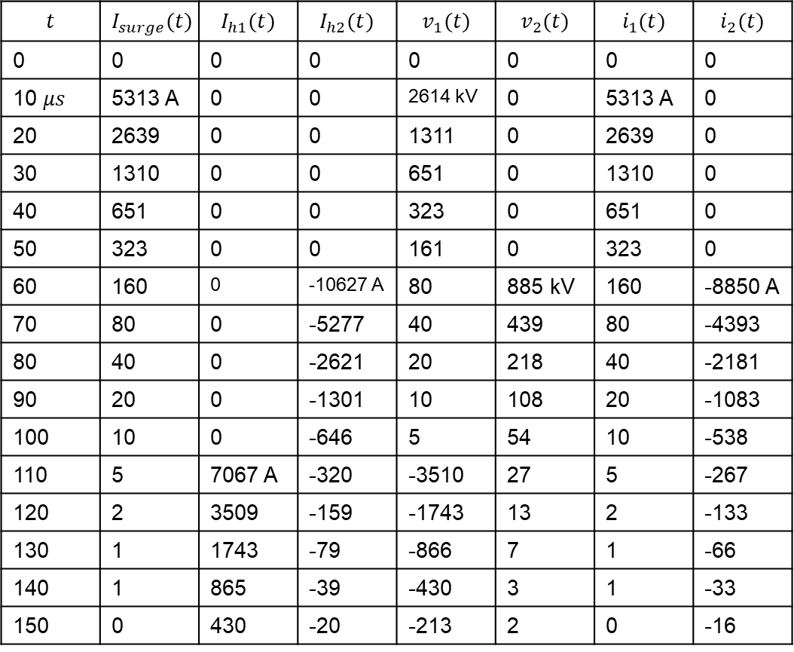
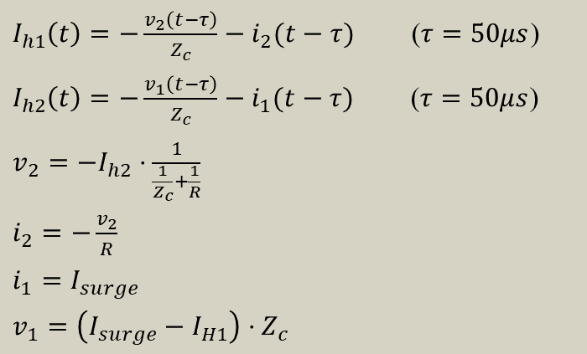
Time Steps 120-150 $μs$
$$t$$ | $$I_{surge}(t)$$ | $$I_{h1}(t)$$ | $$I_{h2}(t)$$ | $$v_{1}(t)$$ | $$v_{2}(t)$$ | $$i_{1}(t)$$ | $$i_{2}(t)$$
0 | 0 | 0 | 0 | 0 | 0 | 0 | 0
10 $μs$ | 5313 A | 0 | 0 | 2614 kV | 0 | 5313 A | 0
20 | 2639 | 0 | 0 | 1311 | 0 | 2639 | 0
30 | 1310 | 0 | 0 | 651 | 0 | 1310 | 0
40 | 651 | 0 | 0 | 323 | 0 | 651 | 0
50 | 323 | 0 | 0 | 161 | 0 | 323 | 0
60 | 160 | 0 | -10627 A | 80 | 885 kV | 160 | -8850 A
70 | 80 | 0 | -5277 | 40 | 439 | 80 | -4393
80 | 40 | 0 | -2621 | 20 | 218 | 40 | -2181
90 | 20 | 0 | -1301 | 10 | 108 | 20 | -1083
100 | 10 | 0 | -646 | 5 | 54 | 10 | -538
110 | 5 | 7067 A | -320 | -3510 | 27 | 5 | -267
120 | 2 | 3509 | -159 | -1743 | 13 | 2 | -133
130 | 1 | 1743 | -79 | -866 | 7 | 1 | -66
140 | 1 | 865 | -39 | -430 | 3 | 1 | -33
150 | 0 | 430 | -20 | -213 | 2 | 0 | -16
$I_{h1}\left(t\right)=−\frac{v_{2}\left(t−τ\right)}{Z_{c}}−i_{2}(t−τ)$ ($τ=50μs$)
$I_{h2}\left(t\right)=−\frac{v_{1}\left(t−τ\right)}{Z_{c}}−i_{1}(t−τ)$ ($τ=50μs$)
$v_{2}=−I_{h2}⋅\frac{1}{\frac{1}{Z_{c}}+\frac{1}{R}}$
$i_{2}=−\frac{v_{2}}{R}$
$i_{1}=I_{surge}$
$v_{1}=\left(I_{surge}−I_{H1}\right)⋅Z_{c}$

Slide 14
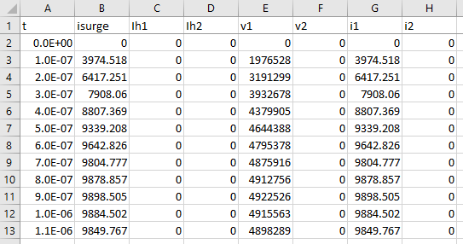
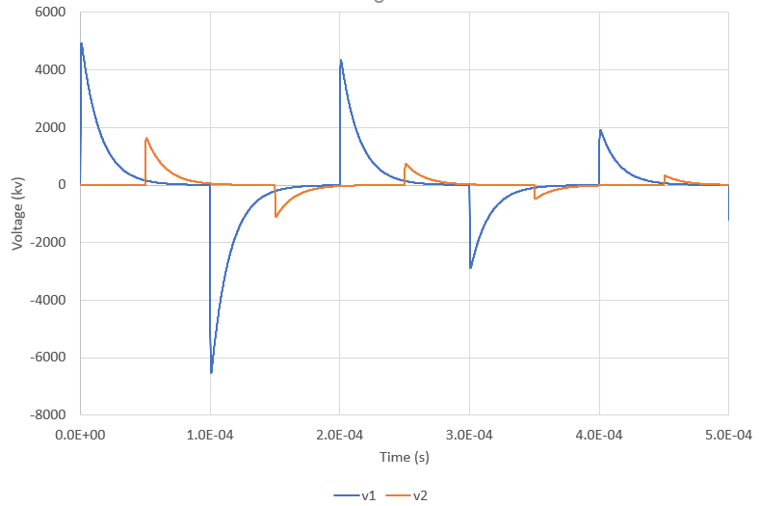
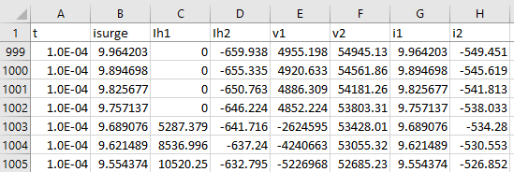
Results with $Δt=0.1μs$
Surge doesn’t get to the other end until 500th time step, doesn’t return until the 1000th
Can now see the rise and fall of the pulse, capture true peak

Slide 15
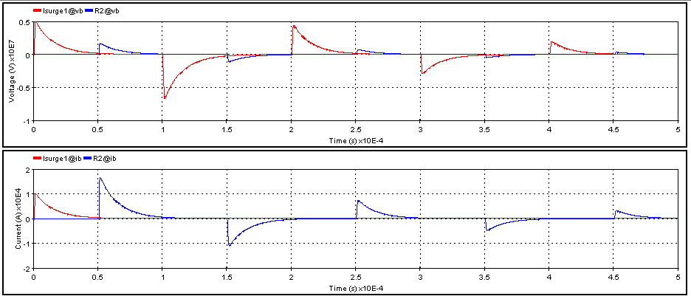
EMTP Results

