Slide 1
ECEN 616, Fall 2022
Electromagnetic Transients in Power Systems
Class 24: Transformers
Prof. Adam Birchfield
Dept. of Electrical and Computer Engineering
Texas A&M University
abirchfield@tamu.edu

Slide 2
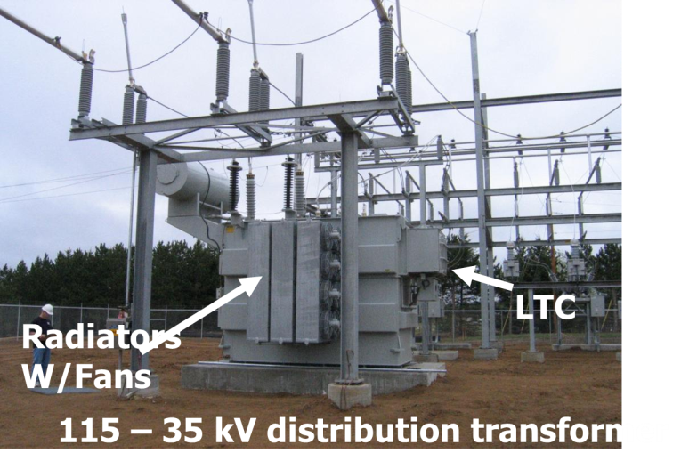
Transformers Overview
Power systems are characterized by many different voltage levels, ranging from 765 kV down to 240/120 volts.
Transformers are used to transfer power between different voltage levels.
Today we’re talking about modeling transformers for EMT-type studies

Slide 3
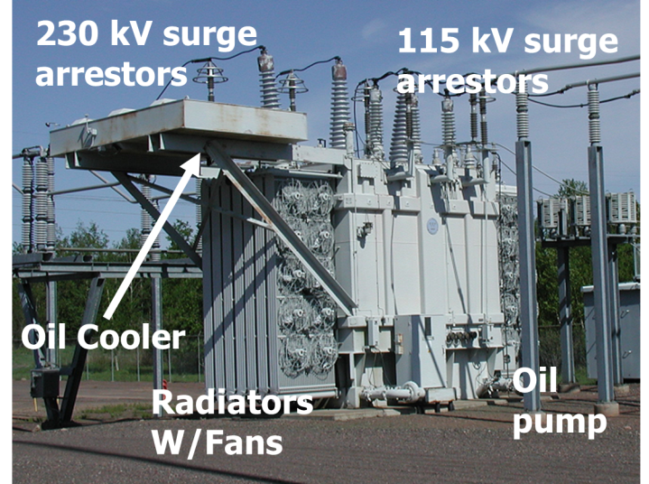
Transmission Level Transformer

Slide 4
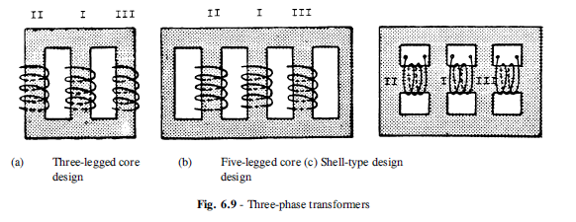
How are Three-Phase Transformers Configured?
Three single-phase transformers
Or three-phase, three-limb
Or three-phase, five-limb
Or autotransformer
Each side either wye or delta
Grounding impedance

Slide 5
What Model Do We Have So Far?
Ideal transformer
Adding in winding resistance and leakage inductance
Adding in core losses and magnetizing inductance

Slide 6
Modeling Core Saturation
Core saturation – nonlinear inductance

Slide 7
The Hysteresis Loop

Slide 8
Stray Capacitances
As higher frequency phenomenon are modeled, stray capacitances become more significant
  Capacitances between turns of the same winding
  Capacitances between two different windings
  Capacitances between the windings, terminals, and the ground

Slide 9
Tap-Changing Transformers

