Slide 1
ECEN 616, Fall 2022 Electromagnetic Transients in Power Systems
Class 22: Switching Transients
Prof. Adam Birchfield
Dept. of Electrical and Computer Engineering
Texas A&M University
abirchfield@tamu.edu

Slide 2
Capacitor Switching
Switching caps
Switching multiple caps in a bank
Tripping cap banks
Resonance with distribution
Restrikes and prestrkes
Autoclosing with precharge
Harmonics
Inrush
Switching duty
Three-phase clearing

Slide 3
Instrument Transformers (CTs, PTs, CCVTs)

Slide 4
Techniques for Switching Capacitors
Resistance switching
Point-on-wave switching

Slide 5
Overvoltage Limits and Temporary Overvoltages
Equipment has a nominal voltage at which it is designed to operate
Maximum voltage is the highest voltage the equipment is designed to be continuously operated at. Normally this is 5-10% above nominal.
There are different categories of temporary overvoltages depending on the expected timing of the overvoltage
Fault overvoltages, which may last 10-100 ms, are typically 25-50% above nominal
Switching overvoltages, lasting only a few ms or less, 2-3 times nominal
Lightning overvoltages, 3-4 times nominal for a few microseconds (basic impulse level or BIL)
Why else may overvoltages occur? Charging an open line, switching a line terminated by a transformer, load shedding, disconnection of inductances, fault clearance

Slide 6
Closing and Reclosing Transmission Lines
Resonance
Compensation, ferro-resonance
Out-of-phase closing
Impact of trapped charge

Slide 7
Arc Current Interruption
When a breaker opens, there will be an arc of ionized air between the terminals, which must be extinguished to fully open the switch
Current-zero breakers extinguish the arc when the current passes through a zero crossing
Breakers usually take 2-5 cycles to interrupt the current fully

Slide 8
Transient Recovery Voltage (TRV)

Slide 9
Short Circuits / Faults

Slide 10
Modeling of System Grounding
Types of grounding
Solid grounded systems: typical for transmission and often distribution. Easier to detect faults and keeps voltages lower.
Resistance grounded systems: occasional for industrial or distribution, and in some other countries. Fault current is more limited
Low-resistance
High-resistance
Ungrounded systems
Grounding safety considerations
Step voltage
Touch voltage
Mesh voltage
Fall of potential outside the grounding grid

Slide 11
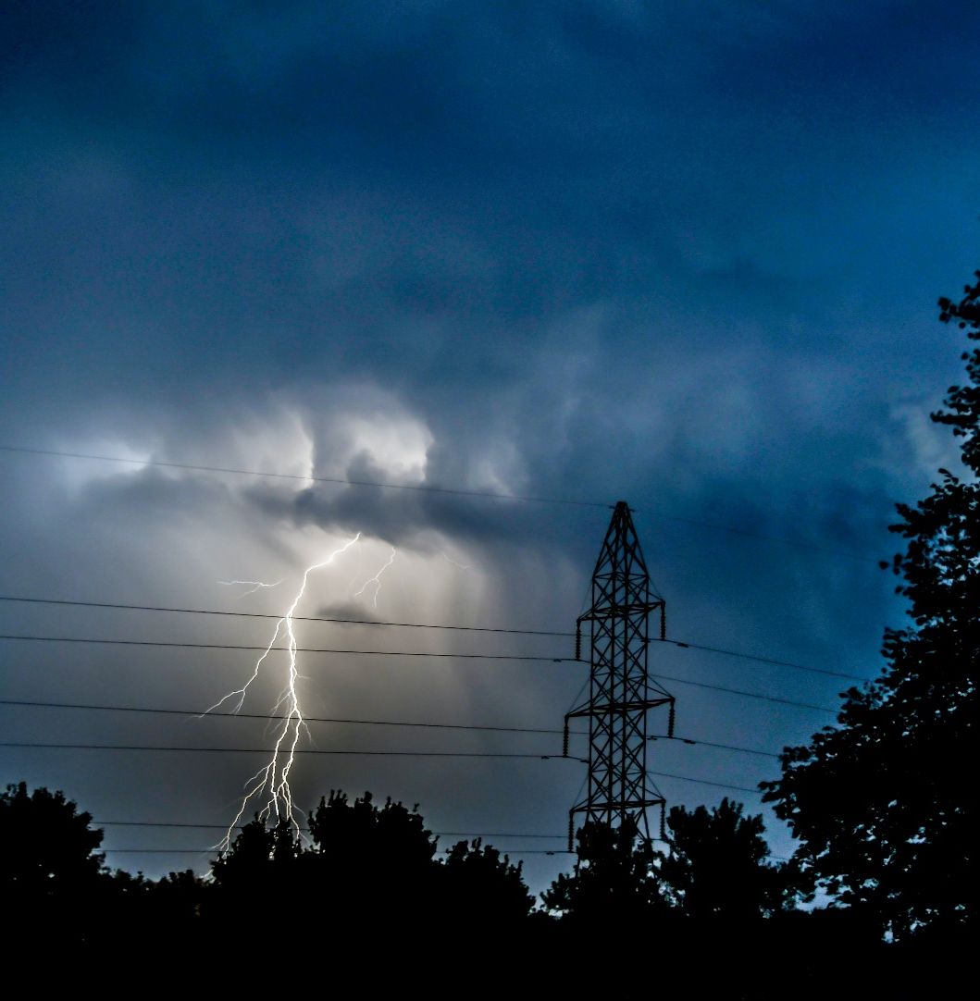
ECEN 616 Class Overview
Electromagnetic Transients Theory
Principles, analytical methods, numerical methods, block element models, transmission line models (overhead/underground, single-phase/multi-phase, frequency dependent)
Electromagnetic Transients Applications
Switching transients (capacitors, reactors, lines, symmetrical and unsymmetrical, grounding)
Transformer modeling and associated transients
Lightning studies and insulation coordination
Motors and generators
Power electronics
Special Topics Lectures
Electric field coupling, etc.

Slide 12
Grades
40% Theory Exam: Class average was 88
20% Class Participation
Continue to attend lectures, send me an email if you need to be absent
Actively participate in class discussion
40% Project
If possible, bring your laptop with EMTP to class on Fridays
Project involves building an EMTP model to run three types of studies, which will be introduce on the next three Fridays: Oct. 28, Nov. 4, Nov 11. We’ll talk about the three studies then (which will build on each other) and have time in class to work on them.
Turn in 2-page report (no shorter or longer) by email to me that describes your model and study results. Deadline 12pm (noon) on Wednesday, November 16th
In-class discussion of projects on Nov. 16th and 18th (not presentations)
Grade is out of 5. (5/5 = 100%, 4/5 = 80%, etc.)
You are not expected to spend a lot of time outside class on this project

