Slide 1
ECEN 616, Fall 2022 Methods of Electric Power System Analysis
Class 17: Transmission Lines, Part 5
Prof. Adam Birchfield
Dept. of Electrical and Computer Engineering
Texas A&M University
abirchfield@tamu.edu

Slide 2
Frequency Dependence of Line Models
Even though the transformation matrix $T$ does depend on frequency, we will assume it can be treated as constant. Hence we have a set of independent single-phase “modes” of the form
$$I_{k}=\frac{V_{k}}{Z_{c}}−\left(\frac{V_{m}}{Z_{c}}+I_{m}\right) e^{−γℓ}$$
$$I_{m}=\frac{V_{m}}{Z_{c}}−\left(\frac{V_{k}}{Z_{c}}+I_{k}\right) e^{−γℓ}$$
Where $Z_{c}$ and $γ$ are complex nonlinear functions of frequency, making a direct conversion to time domain quite difficult
Mode-based frequency dependent (FD) models are based on approximating the effects of $Z_{c}$ and $γ$ that will be valid for many frequencies.
Key paper is J. R. Marti, “Accurate Modeling of FD Transmission Lines in EMT Simulations,” IEEE Trans. PAS, Jan. 1982

Slide 3
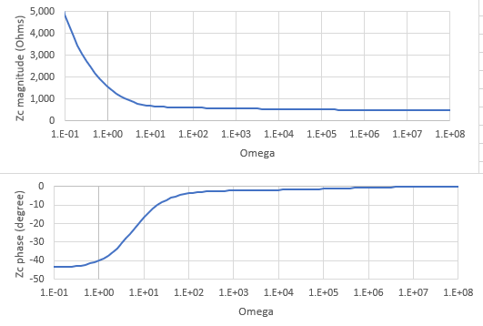
Frequency Dependence of $Z_{c}$
The characteristic impedance $Z_{c}$ depends on frequency for at least three reasons (1) $X=jωL$ (2) both R and L can vary with frequency due to skin effect (3) ground return effects are frequency dependent
$V/Z_{c}$ is the current that would be present entering an equivalent circuit with a total impedance of $Z_{eq}$ that approximates $Z_{c}$
So the approach is to find such a network, where $Z_{eq}$ is close to $Z_{c}$ across frequencies of interest
Rational fraction approximation
$Z_{eq}=H\frac{\left(jω+z_{1}\right)\left(jω+z_{2}\right)(jω+z_{3})…}{\left(jω+p_{1}\right)\left(jω+p_{2}\right)(jω+p_{3})…}$
Where $z_{i}$ and $p_{i}$ are zeros and poles
Example Zc dependence on frequency

Slide 4
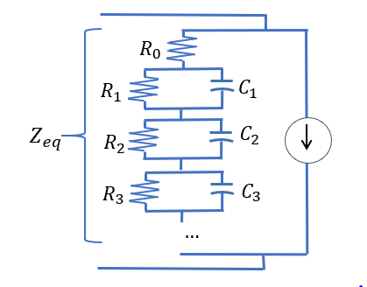
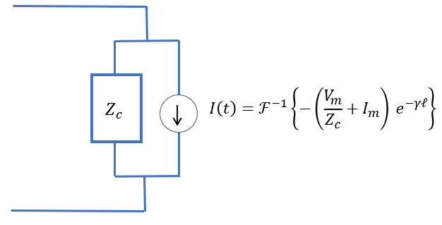
Rational Function Approximation
A curve-fitting optimization is used to approximate $Z_{c}(ω)$ with
$Z_{eq}=H\frac{\left(s+z_{1}\right)\left(s+z_{2}\right)(s+z_{3})…}{\left(s+p_{1}\right)\left(s+p_{2}\right)(s+p_{3})…}=R_{0}+\frac{1/{C_{1}}}{s+1/(R_{1}C_{1})}+$ $\frac{1/{C_{2}}}{s+1/(R_{2}C_{2})}+$ $\frac{1/{C_{3}}}{s+1/(R_{3}C_{3})}+…$
So that we can replace our Bergeron model (which had a constant $R_{0}$ only to approximate $Z_{c}$) with an equivalent RC network

Slide 5
Frequency Dependence of $γ$
Looking at this equation again
$$I_{k}=\frac{V_{k}}{Z_{c}}−\left(\frac{V_{m}}{Z_{c}}+I_{m}\right) e^{−γℓ}$$
Now that we have an approximation for how $Z_{c}$ fits in, we need to know how to get values of the current source ($I_{h}\left(ω\right)=−\frac{V_{m}}{Z_{c}}−I_{m}$)
$$I_{src}\left(ω\right)=I_{h1}\left(ω\right) e^{−γℓ}=I_{h}\left(ω\right) P\left(ω\right) e^{−jωτ}$$
Where $τ$ is time delay of fastest component of $γ$
Now we convert to time domain and get a convolution
$$i_{src}\left(t\right)=i_{h}\left(t\right)∗p\left(t−τ\right)=\int_{τ}^{∞}{i_{h}\left(t−u\right) p\left(u−τ\right) du}$$
Because of the time delay $τ$, the integral only depends on historical values.
$p(t)$ can be precalculated

Slide 6

Reflection Coefficient
Recall the transmission line reflection coefficient, when a line with characteristic impedance $Z_{A}$ is matched with an impedance $Z_{B}$
$$Γ_{r}=\frac{Z_{B}−Z_{A}}{Z_{B}+Z_{A}}$$
This means the reflected voltage $V_{2}$ that travels back will be $Γ_{r}V_{1}$
What does this mean about short circuit, open circuit, matched?
Short circuit: reflected voltage wave exactly matches forward wave, $V_{2}=−V_{1}$. Current builds up and will be doubled.
What can we say about the current and any refracted voltage $V_{3}$?
$I_{1}=\frac{V_{1}}{Z_{A}}$
$I_{2}=−\frac{V_{2}}{Z_{A}}$
$I_{3}=\frac{V_{3}}{Z_{B}}$
1 2 3
$$V_{3}=Γ_{t}V_{1}$$
$$Γ_{t}=\frac{2Z_{B}}{Z_{B}+Z_{A}}$$

Slide 7
Lattice Diagrams
1 2 3
0
$$τ$$
$$2τ$$
$$3τ$$
$$4τ$$
$$5τ$$

Slide 8
Switching Surge Propagation Analysis
Emerald
Wave Path | Time Delay
TD | 162
(TD)² | 324
(TD)³ | 486
RD | 518
(TD)⁴ | 648
ED | 670
TDRD | 680
RDTD | 702
TSTD | 810
(TD)⁵ | 832
62 miles
Switch location
(surge origin)
48 miles
Ruby
Diamond
15 miles
Topaz
50 miles
Sapphire
What will be the next surges to appear?
Remember different modes may have different propagation characteristics, and there will be frequency distortion and attenuation. Later surges may be smaller.

Slide 9
Summary of Transmission Lines
Overhead and underground line characteristics and their relevance to calculating $Z$ and $Y$ matrices, frequency dependence
Numerical models for lossless, single-phase lines (Bergeron)
Adding losses to Bergeron model
Handling multiple conductor lines (elimination, modal analysis)
Frequency dependent line models
Analytical approximations: reflection coefficients, lattice diagrams, propagation analysis

