Slide 1
ECEN 616, Fall 2022 Methods of Electric Power System Analysis
Class 16: Transmission Lines, Part 4
Prof. Adam Birchfield
Dept. of Electrical and Computer Engineering
Texas A&M University
abirchfield@tamu.edu

Slide 2
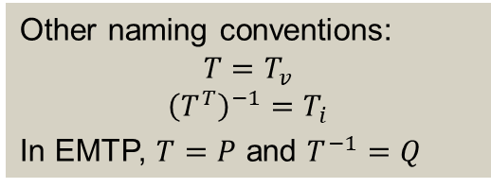
Modal Transformations
The phase-to-phase matrices $Z′$ and $Y′$ (or $Z_{phase}^{′}$ and $Y_{phase}^{′}$), are in general unbalanced, non-diagonal matrices. If it were possible to transform these matrices into diagonal “mode” matrices $Z_{mode}^{′}$ and $Y_{mode}^{′}$, we could solve each mode as a separate single-phase problem.
We do this using eigenvalue decomposition of the matrix $\left[Z_{phase}^{′}Y_{phase}^{′}\right]$, finding eigenvector matrix $T$ and diagonal eigenvalue matrix $Λ$ so that
$$T⋅Λ=\left[Z_{phase}^{′}Y_{phase}^{′}\right]⋅T$$
Now we can find the mode voltages and currents
$V_{phase}=T⋅V_{mode}$ $T^{T}⋅I_{phase}=I_{mode}$
And the mode impedance matrices
$$Z_{mode}^{′}=T^{−1}Z_{phase}^{′}{\left(T^{T}\right)}^{−1}$$
$$Y_{mode}^{′}=T^{T}Y_{phase}^{′}T$$
Other naming conventions:
$$T=T_{v}$$
$${\left(T^{T}\right)}^{−1}=T_{i}$$
In EMTP, $T=P$ and $T^{−1}=Q$

Slide 3
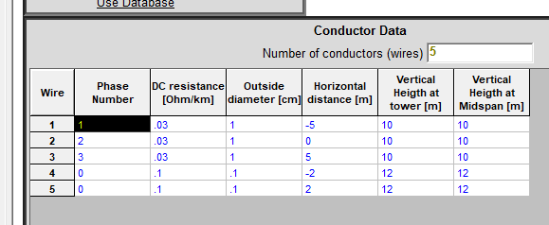
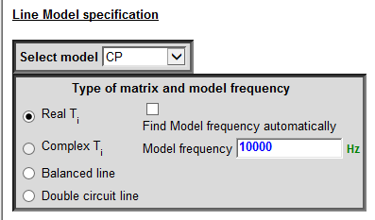
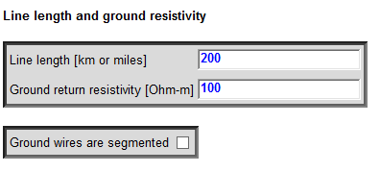
Example of Modal Transformations
We have a 200-km three-phase line with two shield wires. What’s the constant parameter model at 10 kHz?
Put it in EMTP and you will get R’, X’, G’, B’ matrices at the chosen frequency
$$R^{′}=\left[\begin{matrix}3.1 & 2.68 & 2.98 \\ 2.68 & 2.40 & 2.68 \\ 2.98 & 2.68 & 3.10\end{matrix}\right]\frac{Ω}{km};X^{′}=\left[\begin{matrix}109 & 19.7 & 14.2 \\ 19.7 & 103 & 19.7 \\ 14.2 & 19.7 & 109\end{matrix}\right]\frac{Ω}{km};B^{′}=\left[\begin{matrix}448 & −52 & −21 \\ −52 & 471 & −52 \\ −21 & −52 & 448\end{matrix}\right]\frac{μS}{km}$$
(The $G′$ matrix is the identity matrix times 2e-10 S/m)

Slide 4
Example of Modal Transformations, cont.
Get the Z’ and Y’ matrices
$$Z^{′}=R^{′}+jX^{′}=\left[\begin{matrix}3.1+j109 & 2.68+j19.7 & 2.98+j14.2 \\ 2.68+j19.7 & 2.40+j103 & 2.68+j19.7 \\ 2.98+j14.2 & 2.68+j19.7 & 3.10+j109\end{matrix}\right]\frac{Ω}{km}$$
$$Y^{′}=G^{′}+jB^{′}=\left[\begin{matrix}1\text{E}\text{−4}+j448 & −j52 & −j21 \\ −j52 & 1\text{E}\text{−4}+j471 & −j52 \\ −j21 & −j52 & 1\text{E}\text{−4}+j448\end{matrix}\right]\frac{μS}{km}$$
T is the matrix of eigenvectors for $Z^{′}⋅Y′$ (Matlab: [T,~]=eig(Z*Y)); T=real(T)
$$T=\left[\begin{matrix}0.595 & −0.7071 & −0.3644 \\ 0.5404 & 0 & 0.8569 \\ 0.595 & 0.7071 & −0.3644\end{matrix}\right];T^{−1}=\left[\begin{matrix}0.6062 & 0.5156 & 0.6062 \\ −0.7071 & 0 & 0.7071 \\ −0.3823 & 0.8418 & −0.3823\end{matrix}\right]$$
Remember that $V_{mode}=T^{−1}V_{phase}$. How do the three modes relate to the three phases in this case?

Slide 5
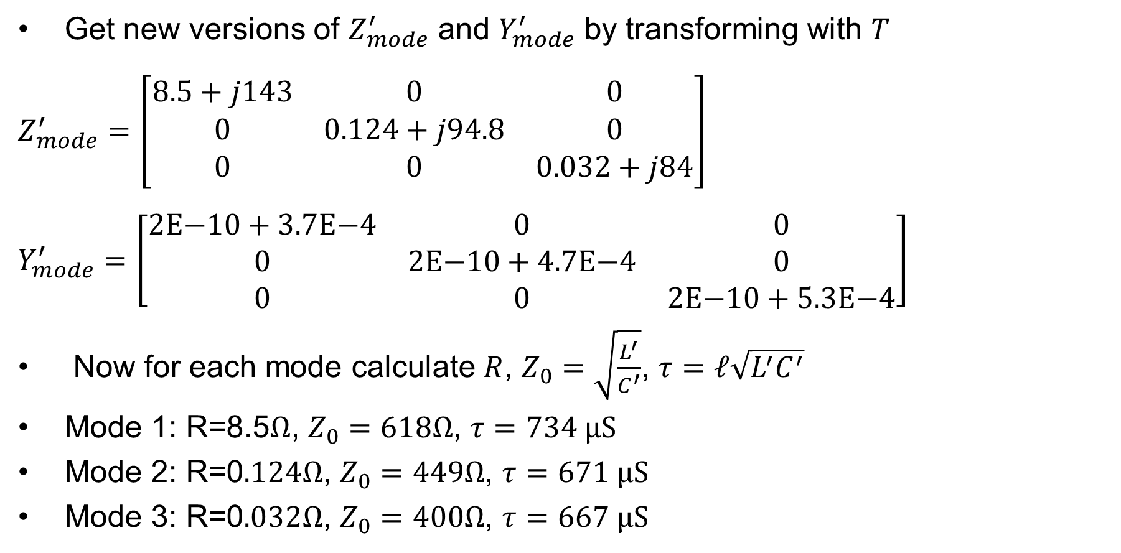
Example of Modal Transformations, cont.
Get new versions of $Z_{mode}^{′}$ and $Y_{mode}^{′}$ by transforming with $T$
$Z_{mode}^{′}=\left[\begin{matrix}8.5+j143 & 0 & 0 \\ 0 & 0.124+j94.8 & 0 \\ 0 & 0 & 0.032+j84\end{matrix}\right]$
$Y_{mode}^{′}=\left[\begin{matrix}2\text{E}\text{−10}+3.7\text{E}\text{−4} & 0 & 0 \\ 0 & 2\text{E}\text{−10}+4.7\text{E}\text{−4} & 0 \\ 0 & 0 & 2\text{E}\text{−10}+\text{5.3}\text{E}\text{−4}\end{matrix}\right]$
Now for each mode calculate $R$, $Z_{0}=\sqrt{\frac{L^{′}}{C^{′}}}$, $τ=ℓ\sqrt{L^{′}C^{′}}$
Mode 1: R=8.5$Ω$, $Z_{0}=618Ω$, $τ=734 \text{μS}$
Mode 2: R=0$.124Ω$, $Z_{0}=449Ω$, $τ=671 \text{μS}$
Mode 3: R=0$.032Ω$, $Z_{0}=400Ω$, $τ=667 \text{μS}$
Why does the first mode have much higher resistance?
Recall $ℓ=200km$
and $ω=2π10\text{kHz}$
$τ$ for speed of light would be
$$\frac{200 \text{km}}{3E8 \text{m}\text{/}\text{s}}=667 \text{μs}$$

Slide 6
Frequency Dependence of Line Models
Even though the transformation matrix $T$ does depend on frequency, we will assume it can be treated as constant. Hence we have a set of independent single-phase “modes” of the form (from last clas)
$$I_{k}=\frac{V_{k}}{Z_{c}}−\left(\frac{V_{m}}{Z_{c}}+I_{m}\right) e^{−γℓ}$$
$$I_{m}=\frac{V_{m}}{Z_{c}}−\left(\frac{V_{k}}{Z_{c}}+I_{k}\right) e^{−γℓ}$$
Where $Z_{c}$ and $γ$ are complex nonlinear functions of frequency, making a direct conversion to time domain quite difficult
Mode-based frequency dependent (FD) models are based on approximating the effects of $Z_{c}$ and $γ$ that will be valid for many frequencies.
Key paper is J. R. Marti, “Accurate Modeling of FD Transmission Lines in EMT Simulations,” IEEE Trans. PAS, Jan. 1982

Slide 7
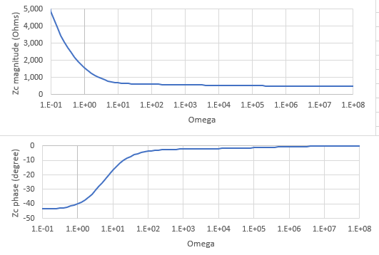
Frequency Dependence of $Z_{c}$
The characteristic impedance $Z_{c}$ depends on frequency for at least three reasons (1) $X=jωL$ (2) both R and L can vary with frequency due to skin effect (3) ground return effects are frequency dependent
$V/Z_{c}$ is the current that would be present entering an equivalent circuit with a total impedance of $Z_{eq}$ that approximates $Z_{c}$
So the approach is to find such a network, where $Z_{eq}$ is close to $Z_{c}$ across frequencies of interest
Rational fraction approximation
$Z_{eq}=H\frac{\left(jω+z_{1}\right)\left(jω+z_{2}\right)(jω+z_{3})…}{\left(jω+p_{1}\right)\left(jω+p_{2}\right)(jω+p_{3})…}$
Where $z_{i}$ and $p_{i}$ are zeros and poles
Example Zc dependence on frequency

Slide 8
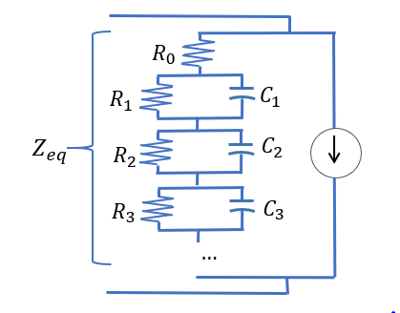
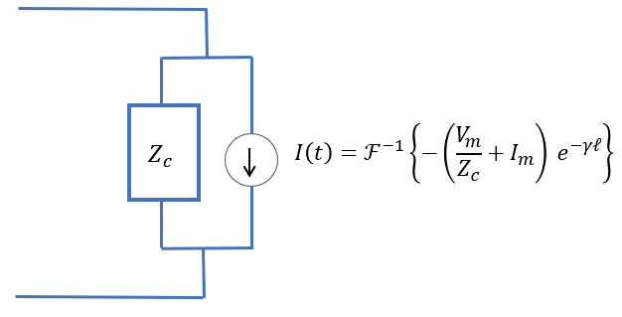
Rational Function Approximation
A curve-fitting optimization is used to approximate $Z_{c}(ω)$ with
$Z_{eq}=H\frac{\left(s+z_{1}\right)\left(s+z_{2}\right)(s+z_{3})…}{\left(s+p_{1}\right)\left(s+p_{2}\right)(s+p_{3})…}=R_{0}+\frac{1/{C_{1}}}{s+1/(R_{1}C_{1})}+$ $\frac{1/{C_{2}}}{s+1/(R_{2}C_{2})}+$ $\frac{1/{C_{3}}}{s+1/(R_{3}C_{3})}+…$
So that we can replace our Bergeron model (which had a constant $R_{0}$ only to approximate $Z_{c}$) with an equivalent RC network

Slide 9
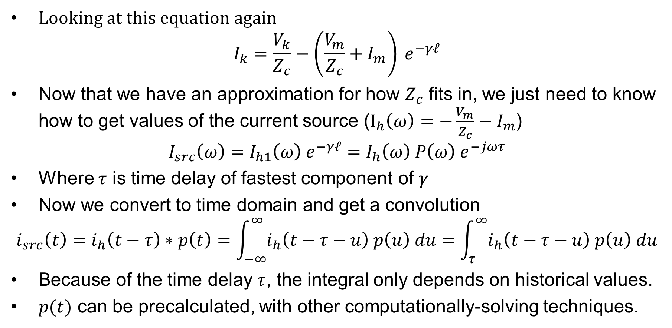
Frequency Dependence of $γ$
Looking at this equation again
$$I_{k}=\frac{V_{k}}{Z_{c}}−\left(\frac{V_{m}}{Z_{c}}+I_{m}\right) e^{−γℓ}$$
Now that we have an approximation for how $Z_{c}$ fits in, we just need to know how to get values of the current source ($I_{h}\left(ω\right)=−\frac{V_{m}}{Z_{c}}−I_{m}$)
$$I_{src}\left(ω\right)=I_{h1}\left(ω\right) e^{−γℓ}=I_{h}\left(ω\right) P\left(ω\right) e^{−jωτ}$$
Where $τ$ is time delay of fastest component of $γ$
Now we convert to time domain and get a convolution
$$i_{src}\left(t\right)=i_{h}\left(t−τ\right)∗p\left(t\right)=\int_{−∞}^{∞}{i_{h}\left(t−τ−u\right) p\left(u\right) du}=\int_{τ}^{∞}{i_{h}\left(t−τ−u\right) p\left(u\right) du}$$
Because of the time delay $τ$, the integral only depends on historical values.
$p(t)$ can be precalculated, with other computationally-solving techniques.

