Slide 1
ECEN 616, Fall 2022 Methods of Electric Power System Analysis
Class 8: Analytical Methods for Transient Analysis, part 4
Prof. Adam Birchfield
Dept. of Electrical and Computer Engineering
Texas A&M University
abirchfield@tamu.edu

Slide 2
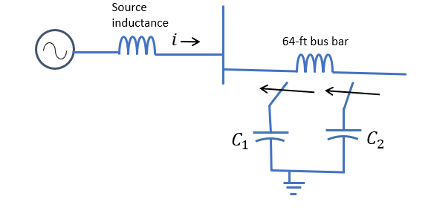
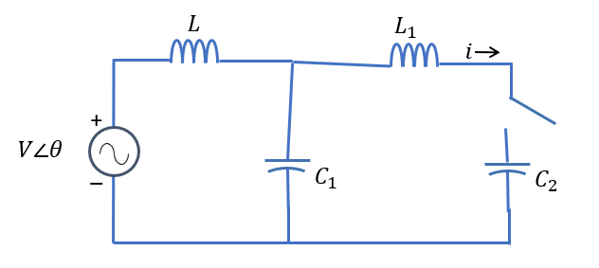
Example 5, part two
Now we consider the case of switching C2 with C1 already in place. Equivalent circuit shown. $L_{1}=19.2 μH$, $C_{2}=22.8 μF$
Differential equation(s) will be even more complicated! What can we neglect for our analytical calculations?
L1 is small compared to L, but important
Current will be coming from both the source and the stored voltage in C1.
Consider characteristic frequency of L1 in parallel with the C1 and C2 combination
C = 1/(1/C1 + 1/C2) = 14.32 $μF$
$ω_{0}=9.6 kHz$(way faster than other two)
$Z_{01}=1.158 Ω$

Slide 3
Example 5, part two, continued
The maximum current coming from the source is about 4 kA
But the inrush current based on the fact that C1 could be charged to peak voltage of 28.2 kV would be
$$i_{peak}=\frac{V_{0}}{Z_{01}}=\frac{28.2 kV}{1.158Ω}=22.33 kA$$
So we can neglect the source and we are back to Example 1 (with L)!!
Sinusoidal transient with peak value of about 22 kA
Let's see if EMTP agrees

Slide 4
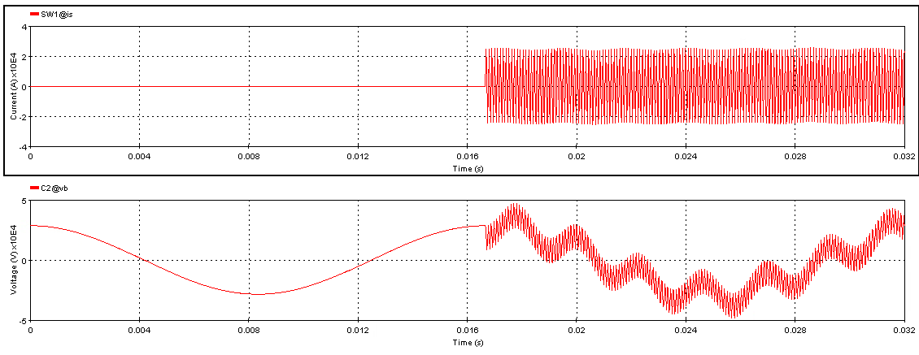
Example 5, part two, EMTP analysis
Note there are three frequencies visible: 60 Hz, 548 Hz, and 9.6 kHz
Maximum current 25 kA

Slide 5
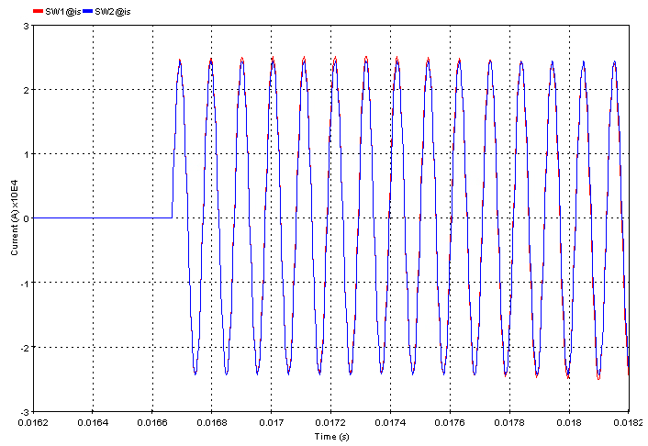
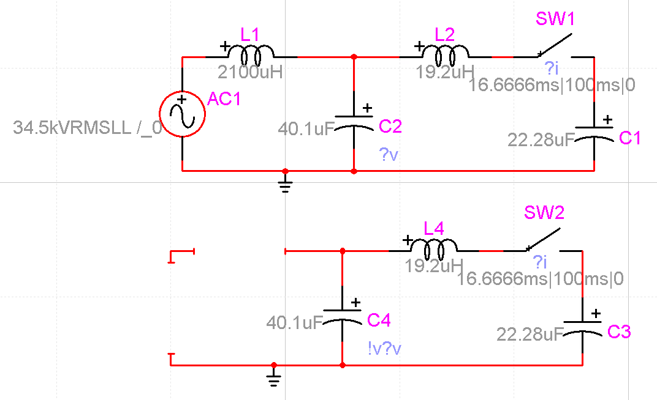
How Justified Is the Assumption?
Compare to the circuit without the AC source
Essentially no difference

Slide 6
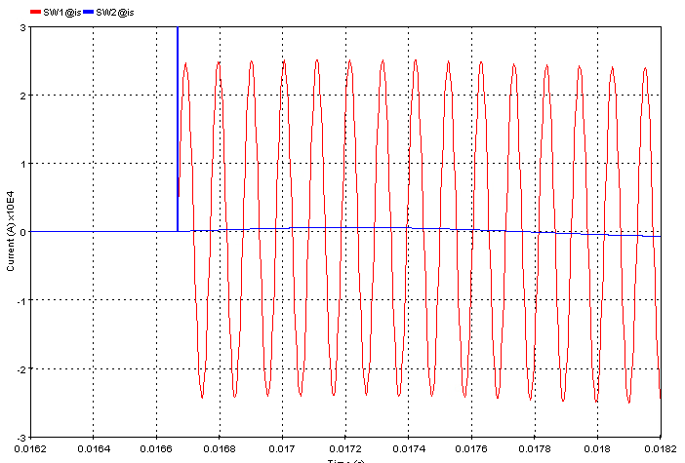
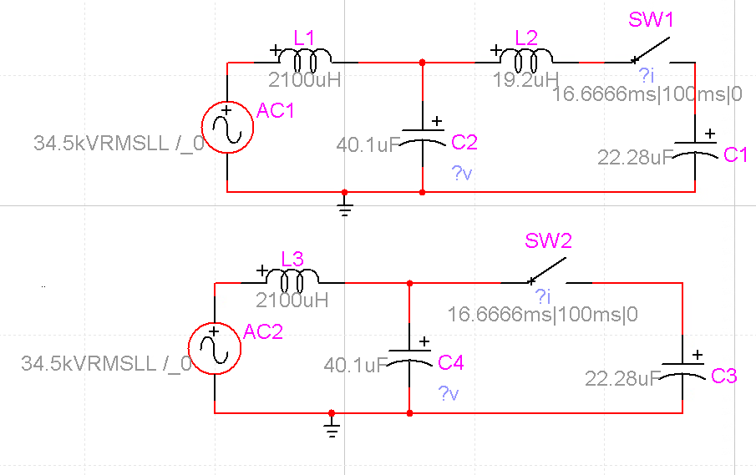
What if We Had Neglected the Busbar Inductance?
A very small inductance, but it matters because it is all that separates the two parallel capacitor banks
Without understanding the problem first, we could make this mistake

Slide 7
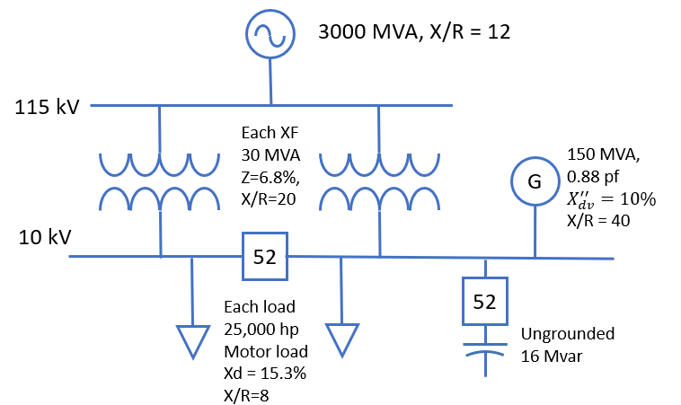
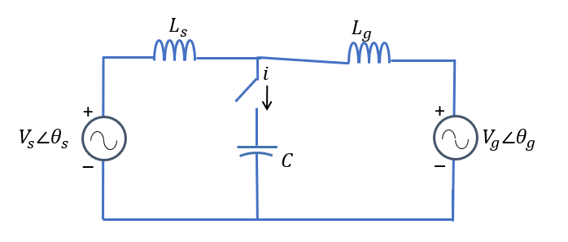
Example 6
For the distribution system shown below, assuming the bus breaker is open, what are the transients associated with switching the capacitor in? (52 means breaker)
Neglect loads, resistances, generator current
For transformer, assume ideal for now and create equivalent source of Vs = 10 kV (three-phase)
$X_{source}=\frac{{\left(115 kV\right)}^{2}}{3000 MVA}=4.41Ω→22.7 \text{mH}$
$X_{XF}=0.068⋅\frac{{\left(10 \text{kV}\right)}^{2}}{30 MVA}=0.23 Ω→601 \text{μH}$
$L_{s}=\frac{L_{source}}{a^{2}}+L_{XF}=773 \text{μH}$
$V_{g}=10 kV$
$L_{g}=0.1⋅\frac{{\left(10 kV\right)}^{2}}{150 \text{MVA}}=66.6 mΩ→177 \text{μH}$
$$C=\frac{{10}^{2}}{16}=6.25Ω→424μF$$

Slide 8
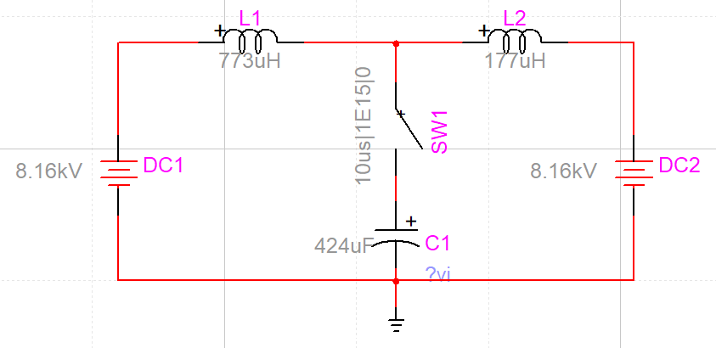
Example 6
Consider this L-C combination, with the two inductors in parallel.
Frequency is $ω=4047$ (644 Hz), $z_{0}=0.583 Ω$
Consider both the sources to be DC at the peak line-to-neutral voltage of 8.16 kV
Solve using Laplace or other method
Peak voltage ends up being 16.32 kV
Peak current ends up being 8.16/z0 = 14000 A
Verify with EMTP

Slide 9
Example 6, Detailed Model
In EMTP, add an ideal transformer model, put in resistances, and model the loads as RL combinations in parallel
Still ignoring the load

Slide 10
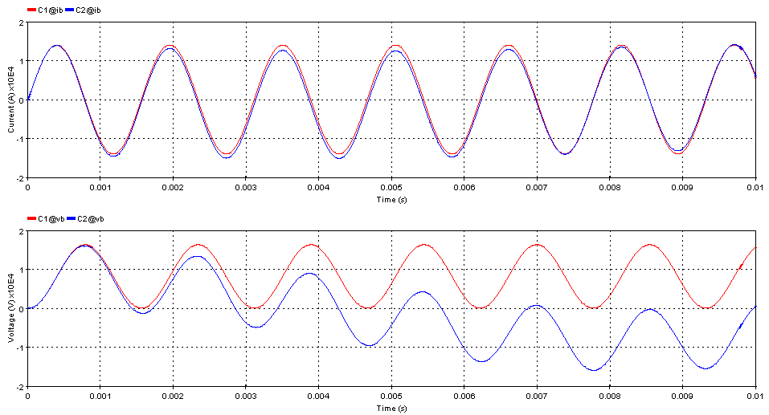
Example 6, Short-Term Comparison
Our assumptions captured the initial transients!

Slide 11
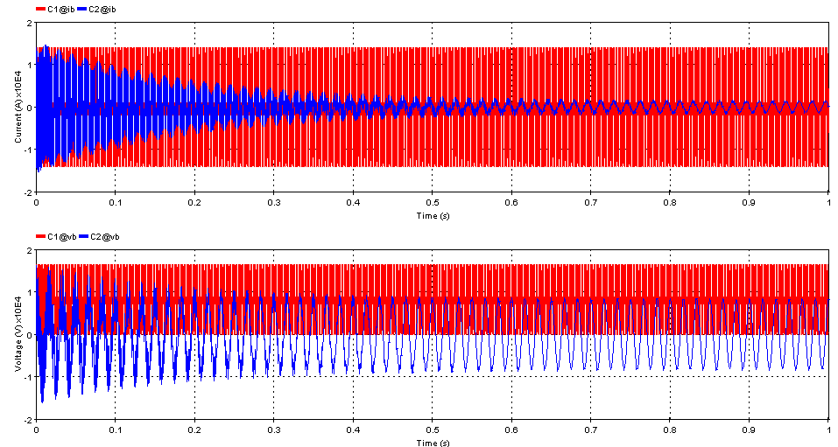
Example 6, Longer-Term Comparison
Eventually, resistances will damp out the transients

Slide 12
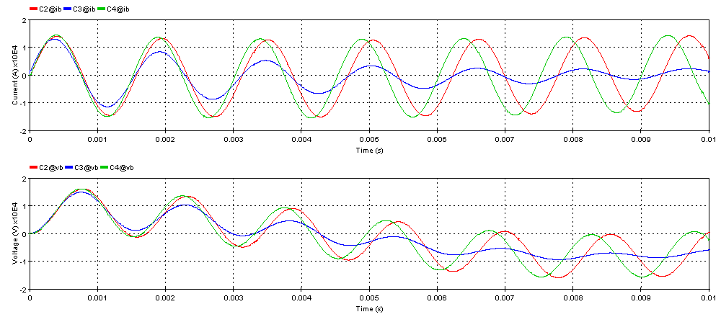

Effect of Load Model
Put in parallel RL for load: 18.7 MW, so R=$5.35Ω$, L=113 mH (blue)
Then try voltage-behind-reactance: 10 kV (RMS/LL), L=2.1 mH, R = .102 $Ω$ (green)

Slide 13
Additional Work on this Problem
What did we not model yet in full detail?
What about if the bus breaker is closed? (Problem 7)

Slide 14
Summary of Analytical Methods
Use the input data to create a full equivalent circuit
Find the expected conditions in steady-state and at $t=∞$
Represent the transient conditions as differential equations
Try to reduce the circuit to all the important (and only the important) components
Think about LC characteristic frequencies, time constants, and surge impedances
Solve with the Laplace transform method
Validate using EMTP

