Slide 1
ECEN 616, Fall 2022 Methods of Electric Power System Analysis
Class 7: Analytical Methods for Transient Analysis, part 3
Prof. Adam Birchfield
Dept. of Electrical and Computer Engineering
Texas A&M University
abirchfield@tamu.edu

Slide 2
Steps for Solving Transient Problems
Find the equivalent circuit for the system
Convert to full three-line diagram
If the fault is balanced, can do an equivalent single phase
What needs to be modeled?
Solve the circuit in steady state before the transient event
By hand or using power flow solution
These will form the initial conditions for the differential equations
Solve the "particular solution" which is the steady-state condition after the transients have died out – again using steady-state techniques
Represent the transient conditions as differential equations
Solve using multiple methods
By hand, simplify circuit RL, RC, or RLC conditions, use Laplace domain
Numerically, using EMTP or similar program
Validate at every step!

Slide 3
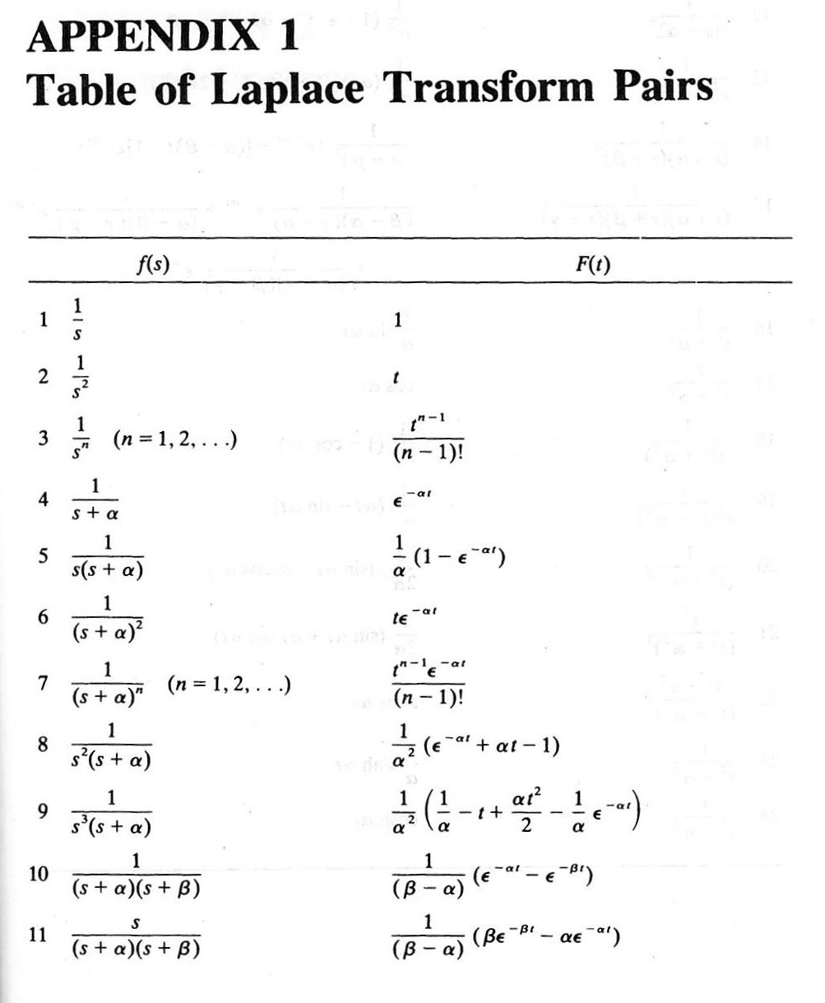
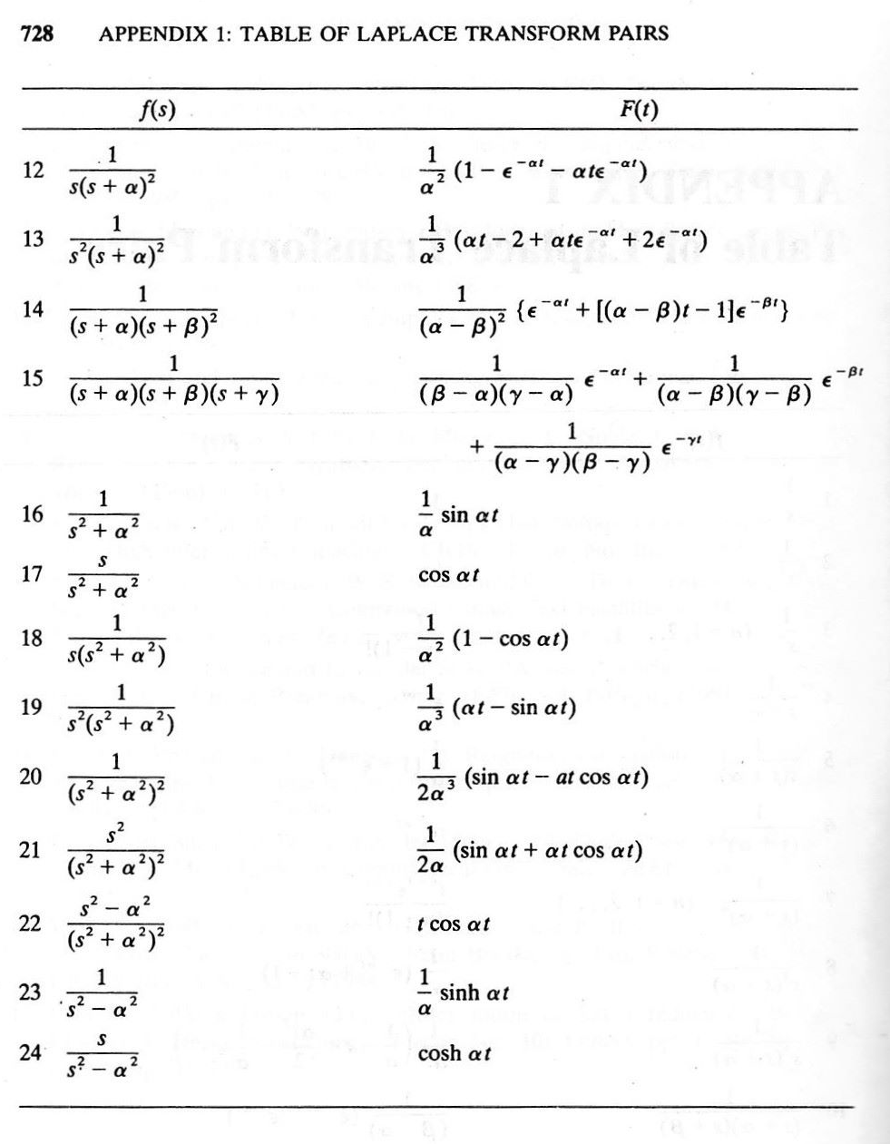
Common Laplace Transform Pairs

Slide 4
Common Laplace Transform Properties
Linearity: multiplying by scalar and adding is not affected
First derivative: multiply by s and subtract initial value
Second derivative: multiply by $s^{2}$, subtract s times initial value – initial first derivative
Integral: multiply by 1/s
Multiplication by t: negative derivative
Time delay by $a$: multiply by $e^{−as}$
Multiplication by $e^{−at}$: shift by a (replace s with s+a)
Time scaling by 1/a: $f\left(\frac{t}{a}\right)→aF\left(as\right)$
Time convolution: s-domain multiplication

Slide 5
Additional Tips for Analytical Methods
RL and RC combinations have a time constant: R*C and R/L
LC combinations have a characteristic frequency: $1/\sqrt{RC}$
They also have a surge impedance of $\sqrt{\frac{L}{C}}$
For analytical calculations, start by making simplified assumptions
Can we ignore load or other currents that are much lower than the main current?
Can we assume slower frequencies are just constant during the transients?
Remember principle 9: our model should be driven by the questions we are trying to answer.
How the phases line up is often important, but sometimes we only care about the worst-case conditions

Slide 6
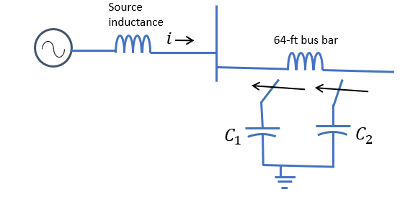
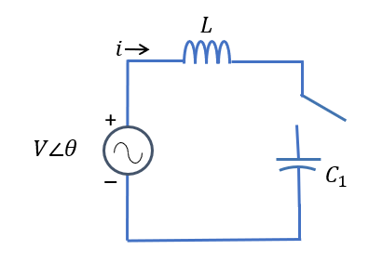
Example 5
Start with the problem of switching in C1
Draw an equivalent circuit (below)
V = 34.5 kV (changed from document)
$X_{L}=\frac{34500}{\sqrt{3}}×25=0.797 Ω$; $L=2100 μH$
$X_{C1}=\frac{{34500}^{2}}{18000000}=66.13 Ω;C=40.1 μF$
Consider the pre-transient steady-state condition. No load is given, so $i=0$.
Particular solution. I = $\frac{V∠θ}{Z_{L}+Z_{C}}=306∠(θ+90°)$ A
Differential equation: $V\cos\left(ωt+θ\right)=L\frac{di}{dt}+\frac{1}{C}\int{i\left(t\right)dt}$
Can solve with Laplace (with much difficulty)! But first consider the characteristic frequency $\frac{1}{\sqrt{LC}}=548 Hz$
This is much faster than the fundamental frequency.

Slide 7
Example 5, continued
So, consider the source to be at constant peak voltage (dc source)
Now the differential equation is much easier to solve: $i\left(t\right)=\frac{V\left(0\right)}{Z_{0}}\sin{(ω_{0}t)}$
For this example: $V\left(0\right)=34.5kV∗\frac{\sqrt{2}}{\sqrt{3}}=28.2 kV$, $Z_{0}=\sqrt{\frac{L}{C}}=7.23 Ω$, and $ω_{0}=3446$
$i\left(t\right)=3900\sin\left(3446t\right)A$ If there were any load current, it would be much smaller.
In building our EMTP model, start with the simplest version and add complexity
Single equivalent phase with DC source and L + C combination
Make it an AC source
Make a three-phase version

Slide 8
Example 5, EMTP single phase

Slide 9
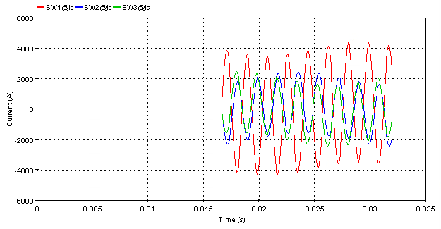
Example 5, EMTP three phase
This is for completeness, each phase is independent in this example. Which phase has the highest transient current depends on the phase angle at which the switches close.

Slide 10
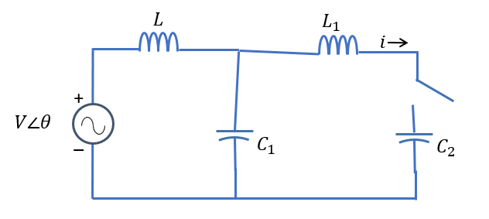
Example 5, part two
Now we consider the case of switching C2 with C1 already in place. Equivalent circuit shown. $L_{1}=19.2 μH$, $C_{2}=22.8 μF$
Differential equation(s) will be even more complicated! What can we neglect for our analytical calculations?
L1 is small compared to L, but important
Current will be coming from both the source and the stored voltage in C1.
Consider characteristic frequency of L1 in parallel with the C1 and C2 combination
C = 1/(1/C1 + 1/C2) = 14.32 $μF$
$ω_{0}=9.6 kHz$(way faster than other two)
$Z_{01}=1.158 Ω$

Slide 11
Example 5, part two, continued
The maximum current coming from the source is about 4 kA
But the inrush current based on the fact that C1 could be charged to peak voltage of 28.2 kV would be
$$i_{peak}=\frac{V_{0}}{Z_{01}}=\frac{28.2 kV}{1.158Ω}=22.33 kA$$
So we can neglect the source and we are back to Example 1 (with L)!!
Sinusoidal transient with peak value of about 22 kA
Let's see if EMTP agrees

Slide 12
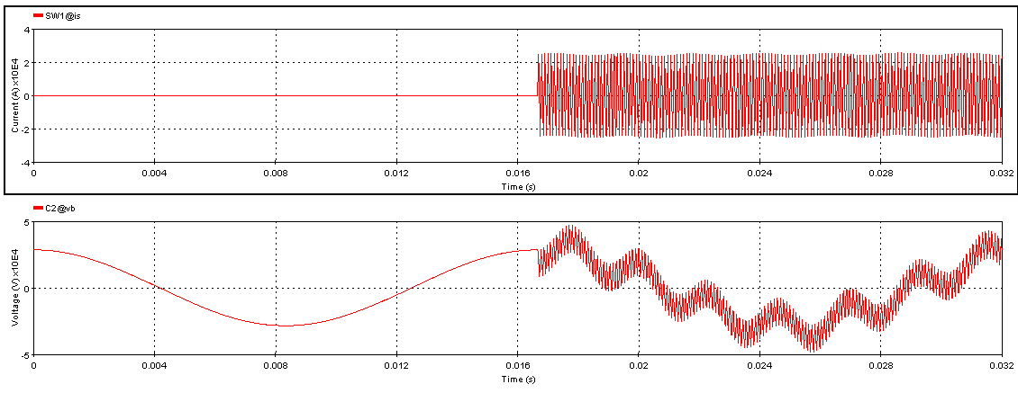
Example 5, part two, EMTP analysis
Note there are three frequencies visible: 60 Hz, 548 Hz, and 9.6 kHz
Maximum current 25 kA

Slide 13
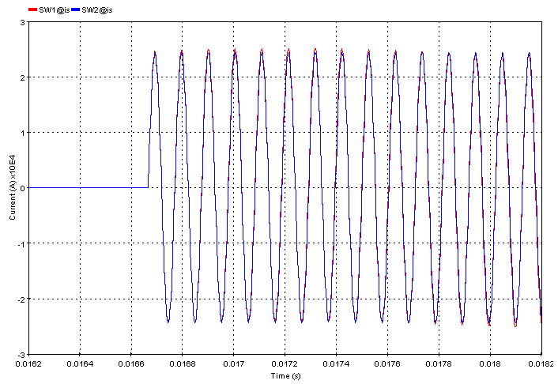
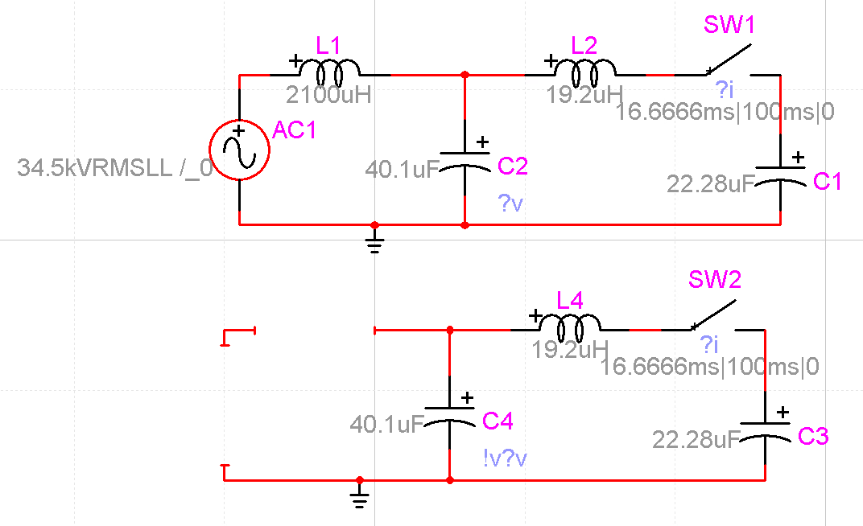
How Justified Is the Assumption?
Compare to the circuit without the AC source
Essentially no difference
This is the value of analytical analysis!

Slide 14
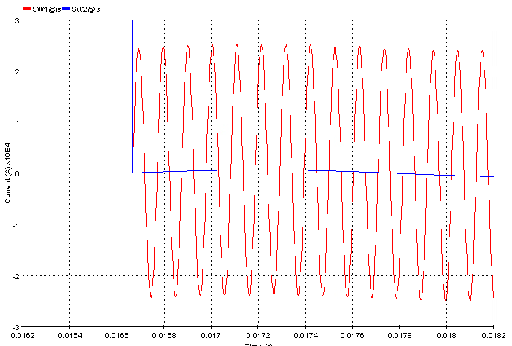
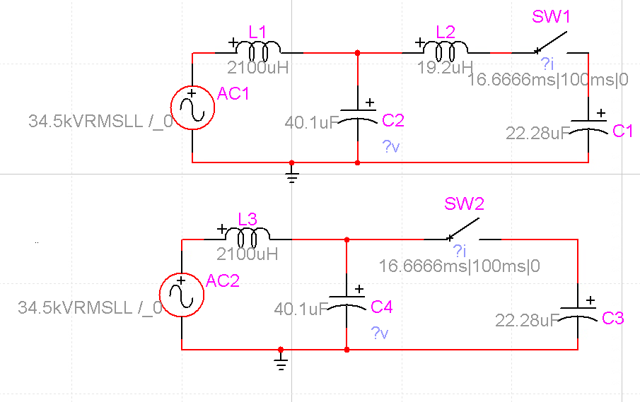
What if We Had Neglected the Busbar Inductance?
A very small inductance, but it matters because it is all that separates the two parallel capacitor banks
Without understanding the problem first, we could make this mistake

Slide 15
Assignments
Keep working on the 7 examples on your own
Understand the modeling assumptions
Do appropriate hand calculations
Check with EMTP modeling

