Slide 1
ECEN 616, Fall 2022 Methods of Electric Power System Analysis
Class 14: Transmission Lines, Part 2
Prof. Adam Birchfield
Dept. of Electrical and Computer Engineering
Texas A&M University
abirchfield@tamu.edu

Slide 2
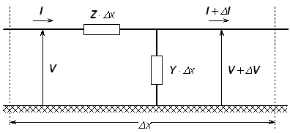
Modeling Transmission Lines
Transmission lines are characterized by a distributed complex impedance matrix $Z′$ and an admittance matrix $Y′$.
$$\frac{dV}{dx}=−Z′⋅I$$
$$\frac{dI}{dx}=−Y^{′}⋅V$$
Both $Z′$ and $Y′$ are frequency-dependent
The first step in modeling transmission lines is being able to get $Z′$ and $Y′$ from the line configuration
https://www.pscad.com/webhelp/ol-help.htm

Slide 3
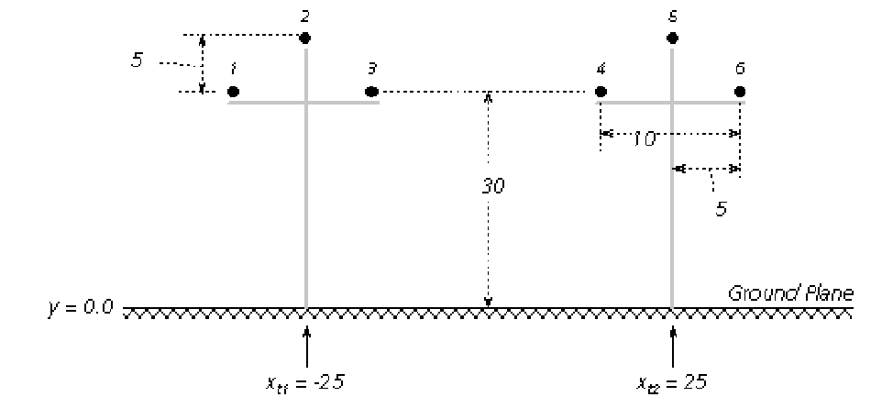
Conductor Input Data
Overhead conductor data
Phase or neutral
Horizontal position (relative)
Vertical position (0 is considered earth)
Radius
DC resistance
Bundling
Sag
Underground conductor data
Ground resistivity $ρ_{g}$ and relative permeability $μ_{g}$
Line length
https://www.pscad.com/webhelp/ol-help.htm

Slide 4
Conductor Sag
Conductor sag is approximated by reducing the effective height of the conductor by a value 2/3 of the maximum sag.
h = height at midspan + 1/3 sag
Dommel

Slide 5
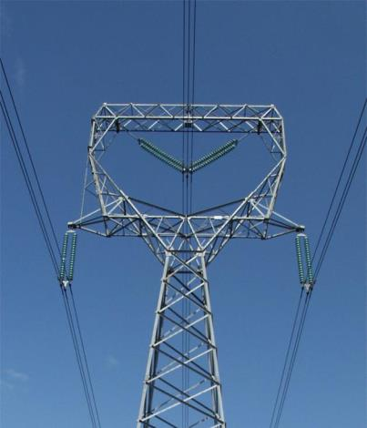
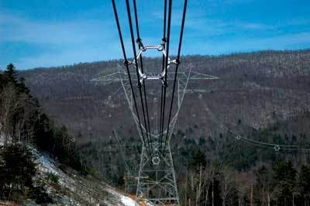
Bundled Conductor Pictures
The AEP Wyoming-Jackson Ferry 765 kV line uses 6-bundle conductors. Conductors in a bundle are at the same voltage!
Photo Source: BPA and American Electric Power

Slide 6
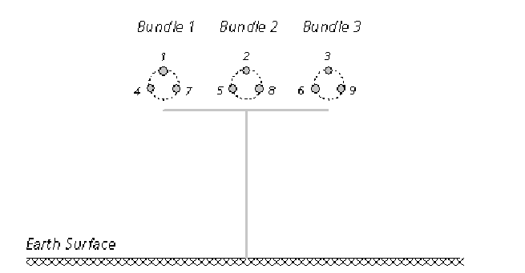
Bundling
Bundling can be handled one of two ways
(1) each conductor in the bundle can be separately modeled, then eliminated assuming the voltages are the same and current evenly split
(2) Use an equivalent radius GMR $= (r′d_{12}…d_{1b})^{\frac{1}{b}}$
https://www.pscad.com/webhelp/ol-help.htm

Slide 7
Transposition
Transposed lines can be handled in detail, by modeling the actual transposed sections (either by rotating the phases or changing the X, Y coordinates within the line model
It is also possible to make the assumption that lines are fully transposed, which results in perfectly symmetric $Z′$ and $Y′$ matrices, thus balanced operation
https://www.pscad.com/webhelp/ol-help.htm

Slide 8
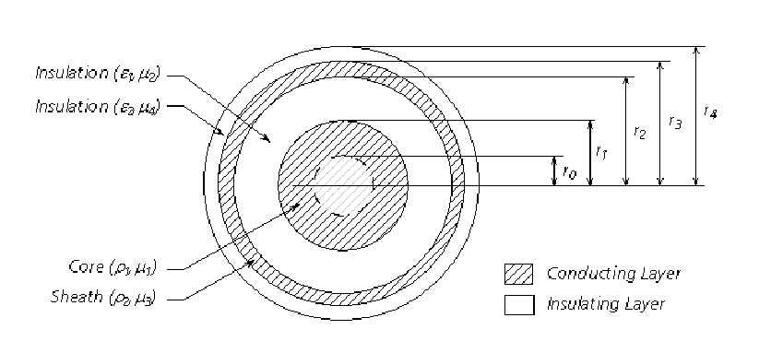
Underground Cables
Underground cables may have multiple concentric layers
Each layer has its own permittivity, permeability, and conductivity
Alternating conducting and insulating layers
https://www.pscad.com/webhelp/ol-help.htm

Slide 9
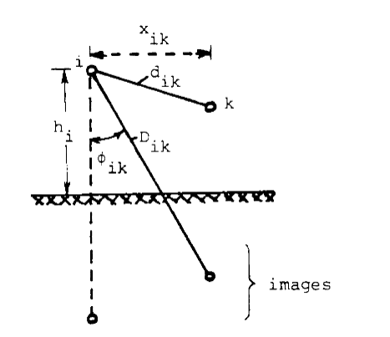
Earth Return
Including the effect of the earth plane requires knowledge or assumptions about the ground’s electrical properties
One method is Carson’s method, which is fairly accurate for homogeneous earth
It uses “images” of the conductors reflected across the ground plane
Adds correction terms to R and X
There is a lot of uncertainty in ground properties
Details are in Dommel
Dommel

Slide 10
Skin Effect
The basic calculations give R and L for dc conditions
Due to skin effect, R will be higher for higher frequencies, and L will be lower
Tables and formulas are given in Dommel to correct for these

Slide 11
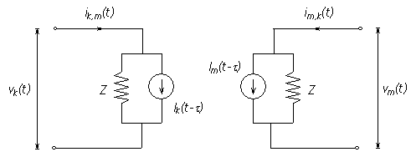
Bergeron Model
Line decouples due to propagation delay
Model line as Norton source on each end
Current source is constant and depends on voltage and current on other end of the line $τ$ in the past
$$I_{k}\left(t−τ\right)=−i_{m}\left(t−τ\right)−\frac{1}{Z}v_{m}(t−τ)$$
$$I_{m}\left(t−τ\right)=−i_{k}\left(t−τ\right)−\frac{1}{Z}v_{k}(t−τ)$$
How would you implement losses (resistance of conductor or ground)?
https://www.pscad.com/webhelp/ol-help.htm

Slide 12
Bergeron Model, with Losses
The Bergeron model approximates losses by splitting the resistance (including resistance associated with ground earth return) into fourths
¼ at each end, ½ in the middle
Approximate the line as two lossless lines with ½ length each
Again, we require just one frequency

