Slide 1
ECEN 616, Fall 2022 Methods of Electric Power System Analysis
Class 13: Transmission Lines, Part 1
Prof. Adam Birchfield
Dept. of Electrical and Computer Engineering
Texas A&M University
abirchfield@tamu.edu

Slide 2
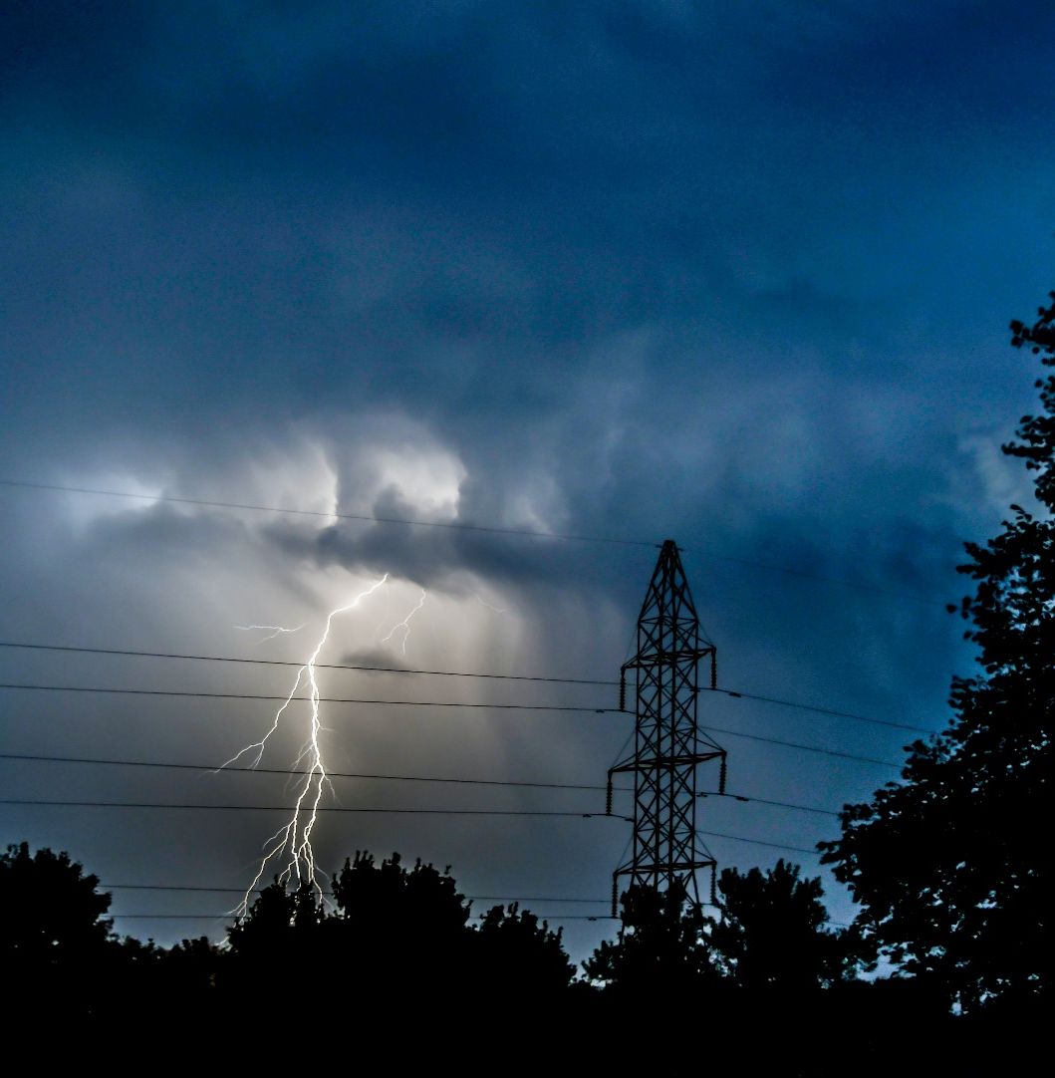
What This Class Will Cover
Electromagnetic Transients Theory
Principles of transient analysis
Analytical methods for solving transient problems
Numerical methods for solving transient problems
Block element models
Transmission line models (overhead/underground, single-phase/multi-phase, frequency dependent)
Transformer models
Electromagnetic Transients Applications
Capacitor and reactor switching
Transmission line switching
Lightning studies and insulation coordination
Transients with power-electronics components
Electric field coupling

Slide 3
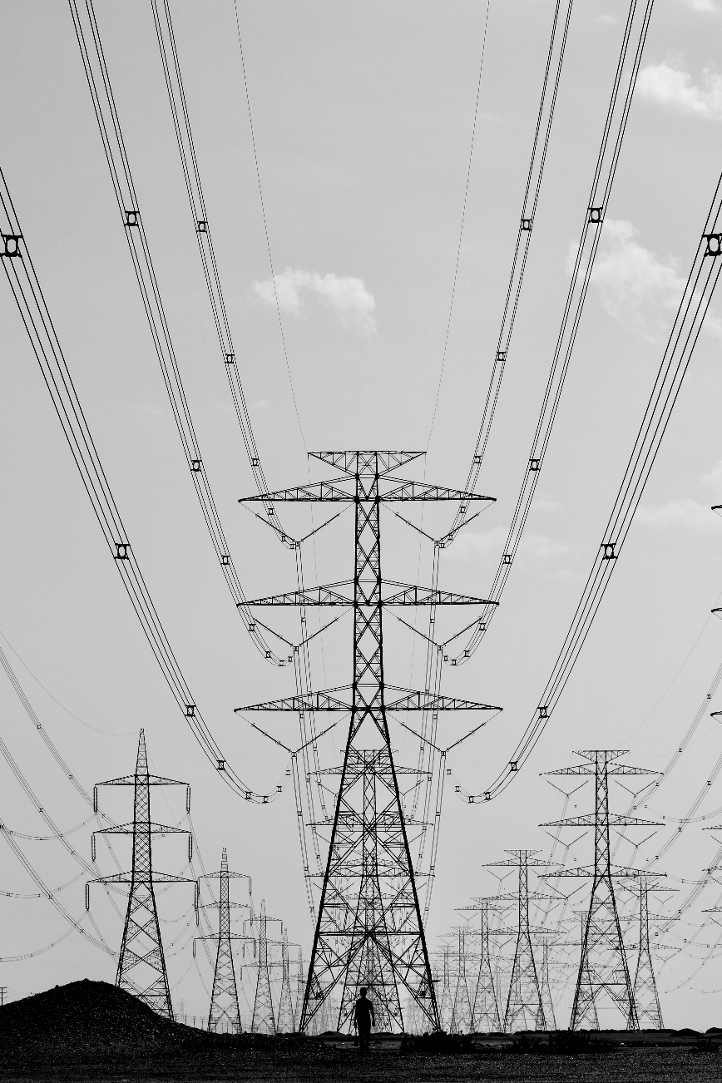
Transmission Line Characteristics
Multiple Conductors: Three phases, neutral wires, multiple circuits on the same tower or nearby towers, earth returns
Mutual inductances and capacitances
Overhead vs underground
Bundled conductors
Transposed or not
Segmented ground wires, periodic grounding
Sagging at midpoint between tower span
Frequency dependent parameters—introducing high degrees of nonlinearity
Skin effect

Slide 4
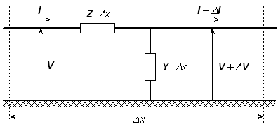
Basic Equations
Transmission lines are basically characterized by a distributed complex impedance matrix $Z′$ and an admittance matrix $Y′$.
Both of these are $n×n$, where $n$ is the number of conductors (including neutrals and ground approximations), and are distributed along the length of the line.
Telegraphers equations
$$\frac{dV}{dx}=−Z′⋅I$$
$$\frac{dI}{dx}=−Y^{′}⋅V$$
Both $Z′$ and $Y′$ are frequency-dependent and may be asymmetric, full matrices
https://www.pscad.com/webhelp/ol-help.htm

Slide 5
Types of Line Modeling
PI model: $Z=Z^{′}⋅d$, $Y=Y^{′}⋅d$
Inductor + resistor in series, capacitor in shunt
R, L, C values evaluated for single frequency
Does not account for propagation delay
Can work for very short lines and when only a narrow band of frequencies is important
Single Frequency, Constant Parameters
Uses propagation delay, distributed-parameter model
Also known as Bergeron Model
Again, you must pick a single frequency for validity
Frequency-Dependent Model
Approximates the nonlinear frequency dependence by calculating different models per frequency level

Slide 6
Single-Phase, Lossless Example
Let’s consider a single-phase, lossless line Z and Y imaginary numbers
$\frac{dv}{dx}=−L\frac{di}{dt}$; $\frac{di}{dx}=−C\frac{dv}{dt}$
Which, for a two-port line has the solution
$$i_{1}\left(t\right)=\frac{1}{Z_{0}}v_{1}\left(t\right)+I_{1}(t−τ)$$
$$i_{2}\left(t\right)=\frac{1}{Z_{0}}v_{2}\left(t\right)+I_{2}(t−τ)$$
Where history terms $I_{1}$ and $I_{2}$ are
$$I_{1}\left(t−τ\right)=−\frac{1}{Z_{0}}v_{2}\left(t−τ\right)−i_{2}(t−τ)$$
$$I_{2}\left(t−τ\right)=−\frac{1}{Z_{0}}v_{1}\left(t−τ\right)−i_{1}(t−τ)$$
$$Z_{0}=\sqrt{\frac{L}{C}}$$
$$τ=ℓ \sqrt{L⋅C}$$
Where $ℓ$ is the line length
$i_{1}$ and $v_{1}$ are current and voltage at the sending end
$i_{2}$ and $v_{2}$ are current and voltage at the receiving end

Slide 7
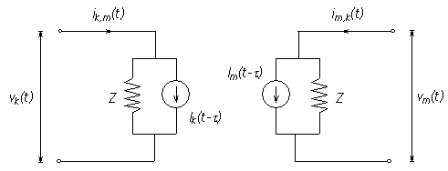
Bergeron Model (Lossless, Single-Phase)
Line decouples due to propagation delay
Model line as Norton source on each end
Current source is constant and depends on voltage and current on other end of the line $τ$ in the past
https://www.pscad.com/webhelp/ol-help.htm

