Slide 1
ECEN 616, Fall 2022 Methods of Electric Power System Analysis
Class 4: Principles of Electromagnetic Transient Analysis, Part 4
Prof. Adam Birchfield
Dept. of Electrical and Computer Engineering
Texas A&M University
abirchfield@tamu.edu

Slide 2
Friday – Practice Oral Exam
Review material so far
Exercise 1: Analytical and numerical analysis
Two NERC event reports
Principles of EMT analysis
Show up to WEB 215-E at your selected time block
It’s not for an exam grade, but it can contribute toward class participation credit
Theory exam will have written part (tentatively Oct 19) and oral part (tentatively Oct 21)

Slide 3
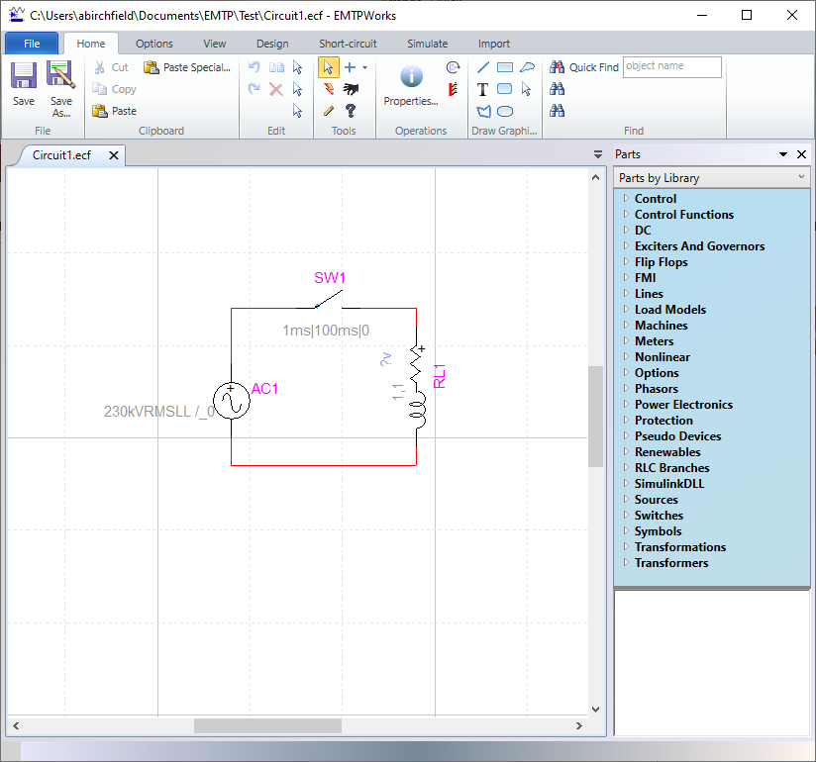
EMTP-RV
The Electromagnetic Transients Program—Revised Version (EMTP-RV) will be used throughout the semester for exercises and for the final projects
TAMU has obtained educational licenses for this software for university computers.
You can access this software on the computers in the basement lab of Wisenbaker 061, or through the TAMU Engineering VDI
Make sure you can get access

Slide 4
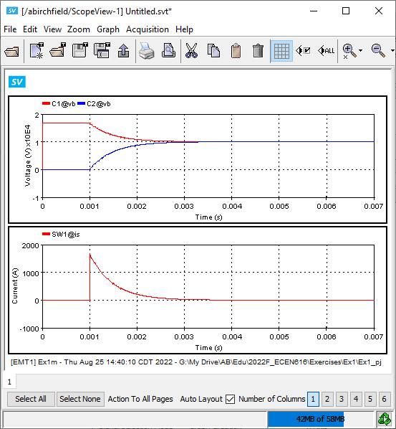
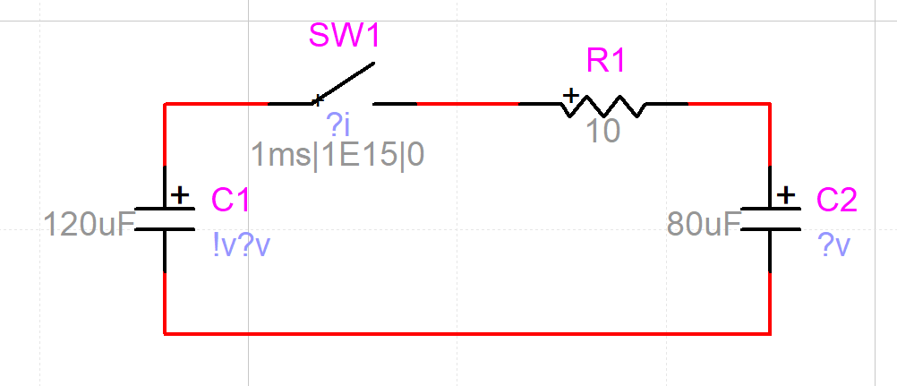
Exercise 1 in EMTP
Any issues with setting up and running model?
Do results match your hand calculations?
Effect of timestep?

