Slide 1
ECEN 616, Fall 2022 Methods of Electric Power System Analysis
Class 2: Principles of Electromagnetic Transient Analysis, Part 2
Prof. Adam Birchfield
Dept. of Electrical and Computer Engineering
Texas A&M University
abirchfield@tamu.edu

Slide 2
Announcements
Course website: https://birchfield.engr.tamu.edu/616f22/
Syllabus on website gives detailed course info
Textbooks: Greenwood and Dommel
Make sure you can get access to EMTP in the basement lab of Wisenbaker 061, or through the TAMU Engineering VDI
For next Wednesday (8/31), try to do Example 1 using EMTP

Slide 3
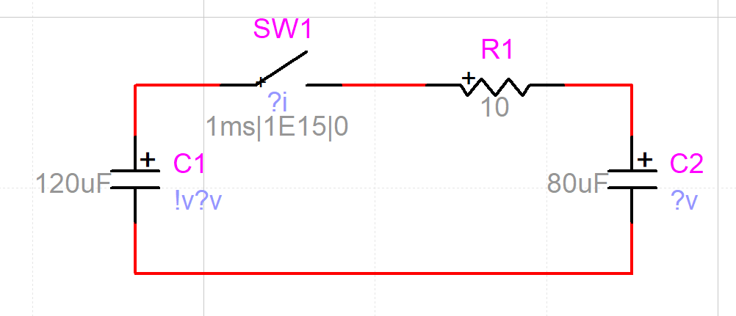
Exercise 1 in EMTP
For next Wednesday (8/31) try to build the Exercise 1 circuit in EMTP and run it with initial conditions
Make sure to solve it by hand first
Get started soon so we can discuss any issues on Monday

Slide 4
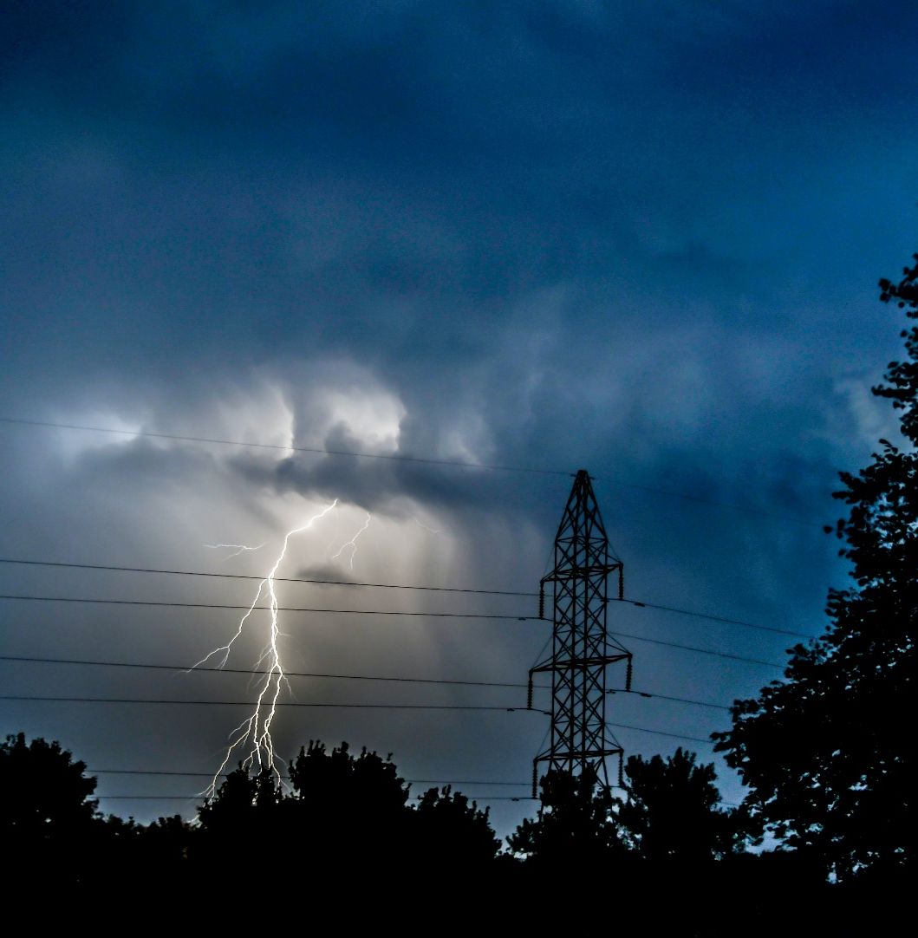
What This Class Will Cover
Electromagnetic Transients Theory
Principles of transient analysis
Analytical methods for solving transient problems
Numerical methods for solving transient problems
Block element models
Transmission line models (overhead/underground, single-phase/multi-phase, frequency dependent)
Transformer models
Electromagnetic Transients Applications
Capacitor and reactor switching
Transmission line switching
Lightning studies and insulation coordination
Transients with power-electronics components
Electric field coupling

Slide 5
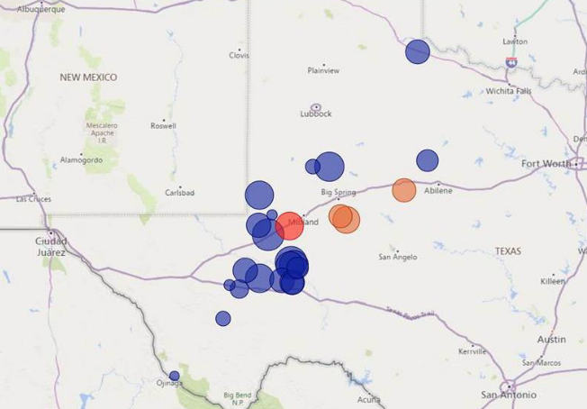
Case Study #1: Odessa Disturbance
What happened?
Why?
What kinds of modeling studies were needed?
NERC, Odessa Disturbance: Joint NERC and Texas RE Staff Report, Sept. 2021

Slide 6
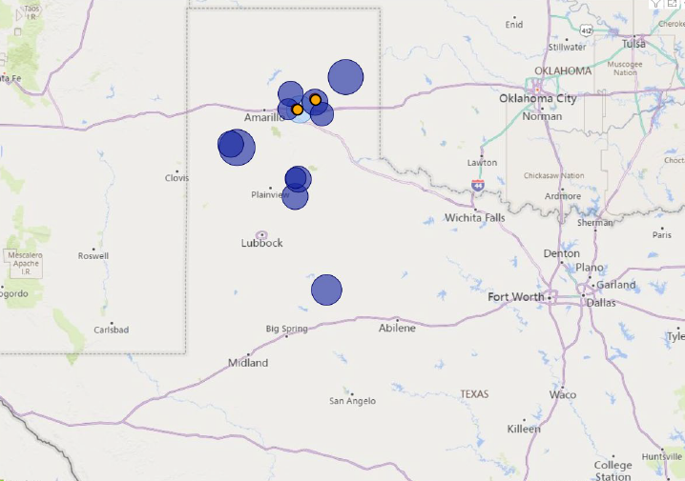
Case Study #2: Panhandle Wind Disturbance
What happened?
Why?
What kinds of modeling studies were needed?
NERC, Panhandle Wind Disturbance: Joint NERC and Texas RE Staff Report, Aug. 2022

