Slide 1
ECEN 214, Spring 2022
Electrical Circuit Theory
Class 25: Advanced Topics 4
Prof. Adam Birchfield
Dept. of Electrical and Computer Engineering
Texas A&M University
abirchfield@tamu.edu

Slide 2

End-of-Semester Feedback
If you haven’t already, please fill out the official university course assessment online at tamu.aefis.net
End-of-semester student survey is used by instructors, TAs, ECEN department, College of Engineering, and the university for improving this course
We greatly value your feedback!
There is no grade associated with any of the student surveys, and they are anonymous

Slide 3
One-Page Course Outline
Unit 1. Steady-State DC Circuits
1. Voltage, current, resistance, Ohm’s Law, KVL, KCL
2. Power, energy, independent sources, dependent sources
3. Open, short, parallel, series, voltage dividers, current dividers
4. Wye-delta transformation
5. Node-voltage circuit analysis method
6. Mesh-current circuit analysis method
7. Thevenin and Norton equivalents
8. Superposition, source transformations
9. Maximum power transfer
10. Ideal Op-Amp equations, linear and saturation regions
Unit 2. Transient DC Circuits
1. Capacitor and inductor equations, steady-state behavior, transient behavior
2. Writing and solving first-order RL and RC circuit differential equations
3. Writing and solving second-order RLC circuit differential equations
Unit 3. Steady-State AC Circuits
1. Phasors for AC voltage and current, complex algebra applied to AC circuits
2. Impedance for R, L, and C in AC circuits
3. AC Power: Complex power, real power, reactive power, power factor
4. AC Thevenin equivalents and maximum power transfer
Unit 4. Advanced Topics
1. Non-linear devices
2. Circuit software
3. Three-phase
4. Transformers

Slide 4
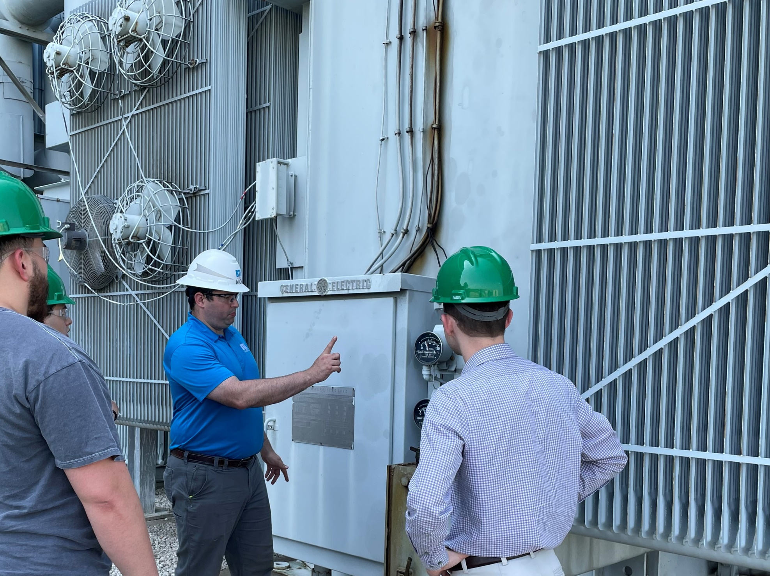
Transformers
A transformer is used to step-up or step-down the voltage on an AC system
Why would we want to do this?
Giant step-up transformer from power plant tour

Slide 5
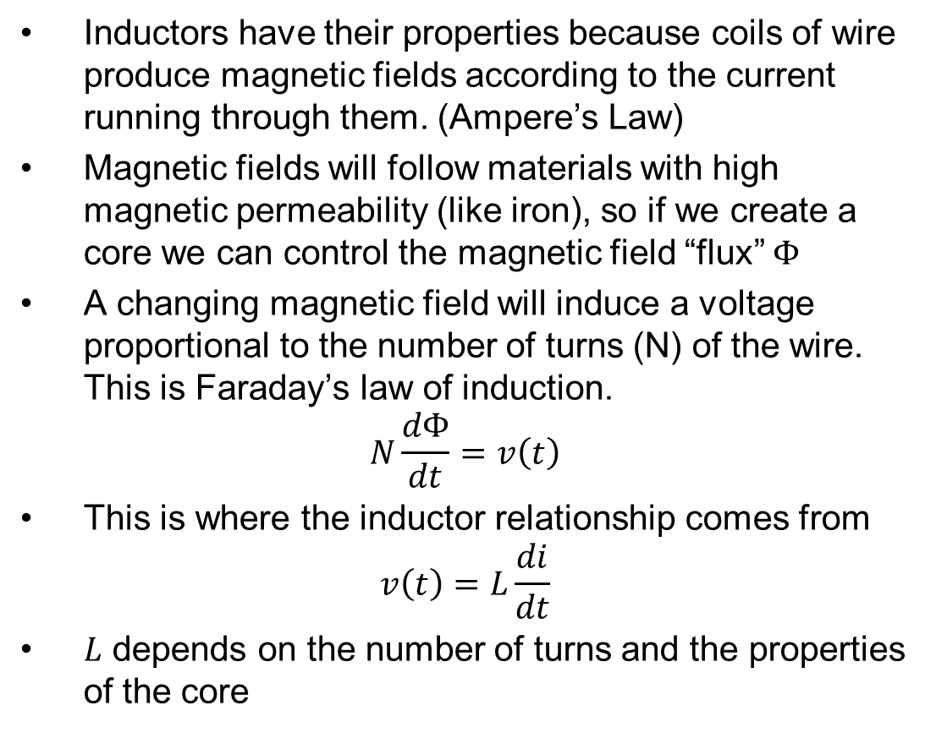
Magnetic Fields and a Coil of Wire
Inductors have their properties because coils of wire produce magnetic fields according to the current running through them. (Ampere’s Law)
Magnetic fields will follow materials with high magnetic permeability (like iron), so if we create a core we can control the magnetic field “flux” $Φ$
A changing magnetic field will induce a voltage proportional to the number of turns (N) of the wire. This is Faraday’s law of induction.
$$N\frac{dΦ}{dt}=v\left(t\right)$$
This is where the inductor relationship comes from
$$v\left(t\right)=L\frac{di}{dt}$$
$L$ depends on the number of turns and the properties of the core
Coil
Magnetic field
Majority of the magnetic field stays inside the core
Coil

Slide 6
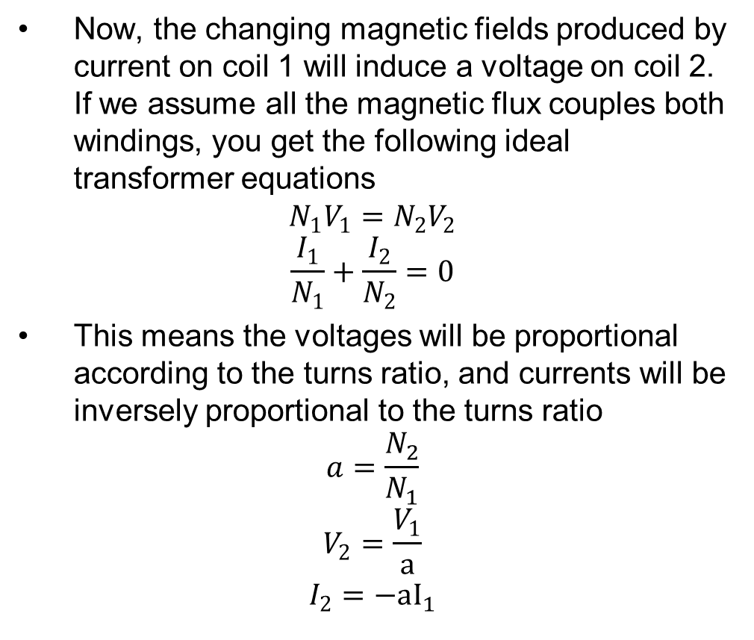
Transformers are Like Two or More Inductors Coupled Together
Now, the changing magnetic fields produced by current on coil 1 will induce a voltage on coil 2. If we assume all the magnetic flux couples both windings, you get the following ideal transformer equations
$$N_{1}V_{1}=N_{2}V_{2}$$
$$\frac{I_{1}}{N_{1}}+\frac{I_{2}}{N_{2}}=0$$
This means the voltages will be proportional according to the turns ratio, and currents will be inversely proportional to the turns ratio
$$a=\frac{N_{2}}{N_{1}}$$
$$V_{2}=\frac{V_{1}}{a}$$
$$I_{2}=−aI_{1}$$
Majority of the magnetic field stays inside the core
Coil 1
Coil 2

Slide 7
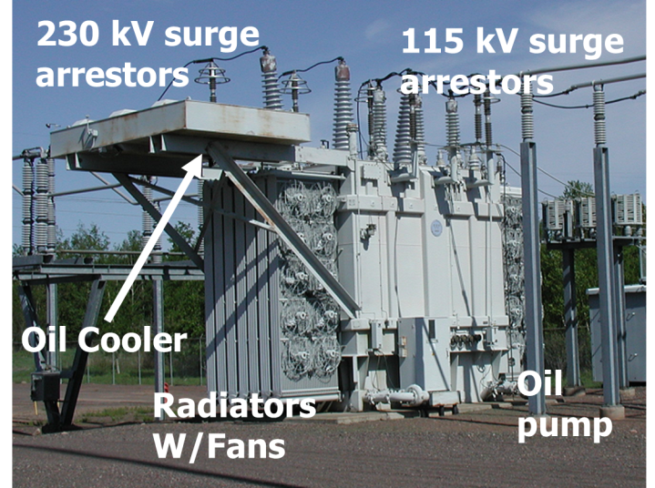
Transmission Level Transformer

Slide 8



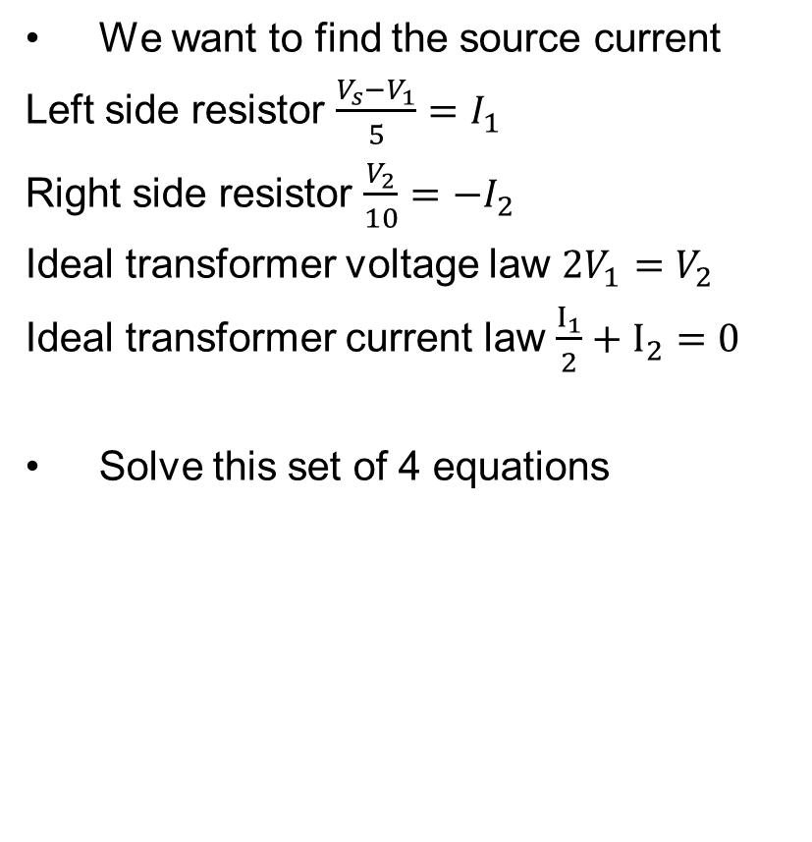
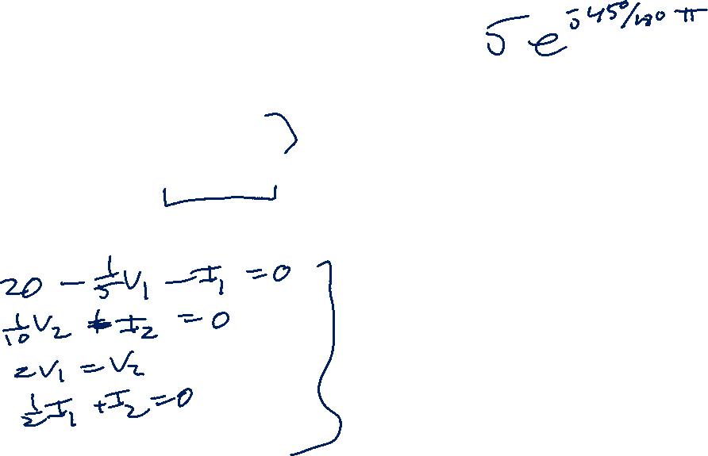






Example Circuit with a Transformer
We want to find the source current
Left side resistor $\frac{V_{s}−V_{1}}{5}=I_{1}$
Right side resistor $\frac{V_{2}}{10}=−I_{2}$
Ideal transformer voltage law $2V_{1}=V_{2}$
Ideal transformer current law $\frac{I_{1}}{2}+I_{2}=0$
Solve this set of 4 equations
$$I_{1}$$
Turns ratio
2:1
$$I_{2}$$
$$5Ω$$
$$+$$
$$+$$
+
$$V_{1}$$
$$V_{2}$$
$$10Ω$$
$$100∠0° V$$
_
$$−$$
$$−$$

Slide 9






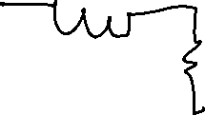


























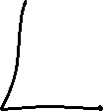







Slide 10



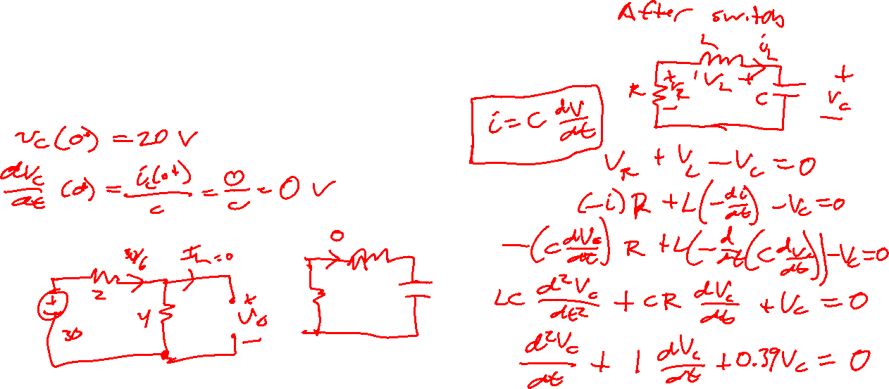




Slide 11
