Slide 1
ECEN 214, Spring 2022 Electrical Circuit Theory
Class 24: Advanced Topics 3
Prof. Adam Birchfield
Dept. of Electrical and Computer Engineering
Texas A&M University
abirchfield@tamu.edu

Slide 2
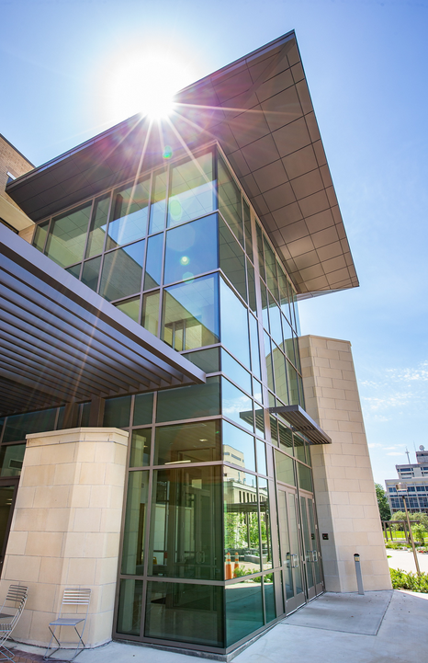
End-of-Semester Feedback
If you haven’t already, please fill out the official university course assessment online at tamu.aefis.net
End-of-semester student survey is used by instructors, TAs, ECEN department, College of Engineering, and the university for improving this course
We greatly value your feedback!
There is no grade associated with any of the student surveys, and they are anonymous

Slide 3
One-Page Course Outline
Unit 1. Steady-State DC Circuits
1. Voltage, current, resistance, Ohm’s Law, KVL, KCL
2. Power, energy, independent sources, dependent sources
3. Open, short, parallel, series, voltage dividers, current dividers
4. Wye-delta transformation
5. Node-voltage circuit analysis method
6. Mesh-current circuit analysis method
7. Thevenin and Norton equivalents
8. Superposition, source transformations
9. Maximum power transfer
10. Ideal Op-Amp equations, linear and saturation regions
Unit 2. Transient DC Circuits
1. Capacitor and inductor equations, steady-state behavior, transient behavior
2. Writing and solving first-order RL and RC circuit differential equations
3. Writing and solving second-order RLC circuit differential equations
Unit 3. Steady-State AC Circuits
1. Phasors for AC voltage and current, complex algebra applied to AC circuits
2. Impedance for R, L, and C in AC circuits
3. AC Power: Complex power, real power, reactive power, power factor
4. AC Thevenin equivalents and maximum power transfer
Unit 4. Advanced Topics
1. Non-linear devices
2. Circuit software
3. Three-phase
4. Transformers

Slide 4
Engineering Grad School at Texas A&M
Graduate school is…
…pursuing an advanced degree – Masters or Doctorate
…taking advanced courses to gain more specialized knowledge in a field
…learning about research and cutting-edge technology
…collaborating with experts at Texas A&M and around the world
…presenting your research at technical conferences, and hopefully publishing in top engineering research journals
…opening up doors for more interesting, exciting, challenging, and rewarding career paths

Slide 5
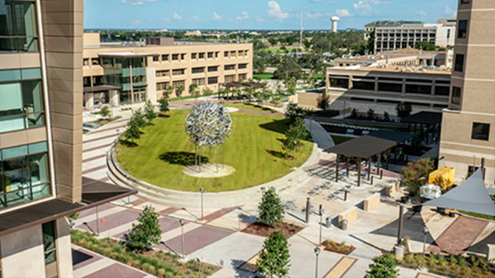
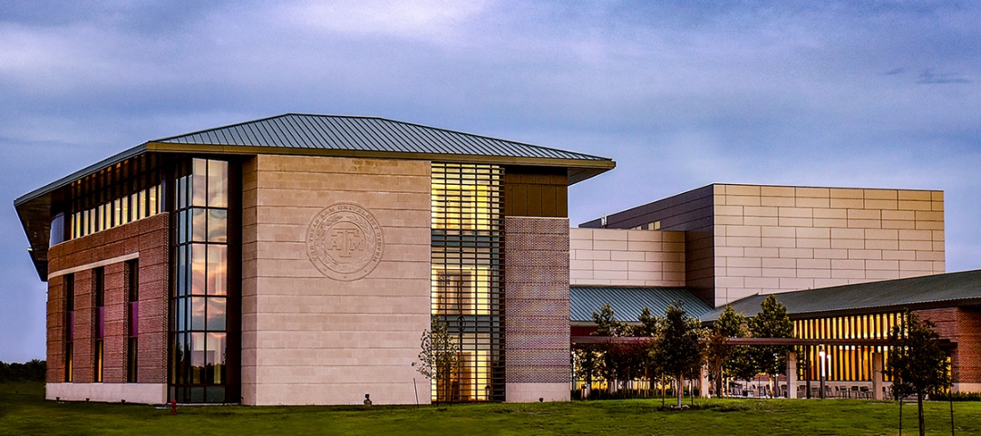
TAMU ECEN Department
70 Faculty members including 5 NAE members, 32 IEEE Fellows
741 Graduate Students, 1314 Undergraduate Students
12th ranked public EE grad program
8 ECEN areas of specialization:
Analog & Mixed Signal
Biomedical Imaging, Sensing and Genomic Signal Processing
Computer Engineering & Systems
Device Science and Nanotechnology
Energy and Power
Electromagnetics and Microwaves
Information Science and Systems
Our newly-upgraded home in Wisenbaker
Center for infrastructure renewal (CIR) labs at RELLIS campus

Slide 6
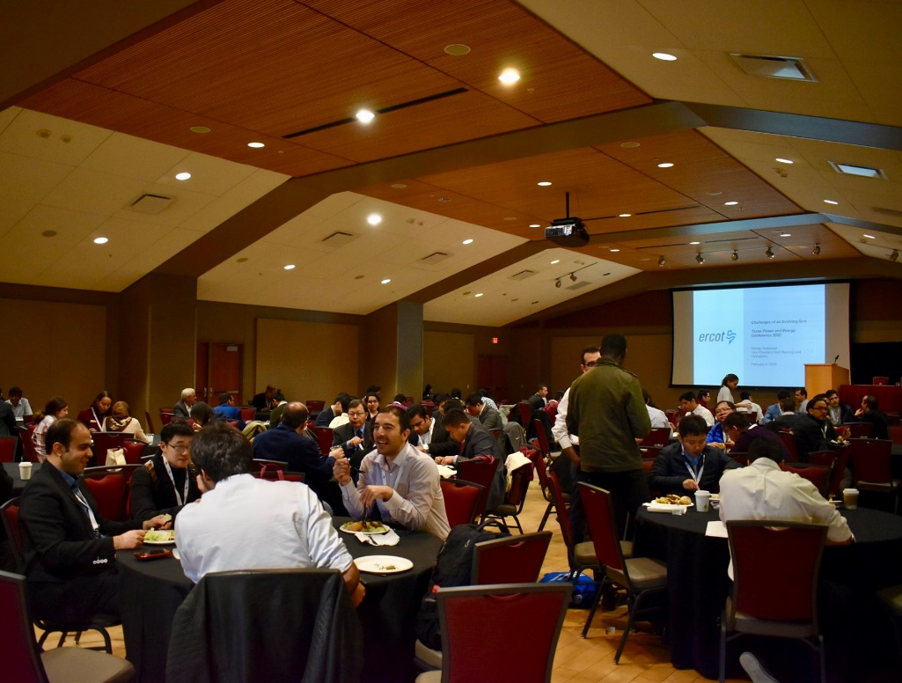
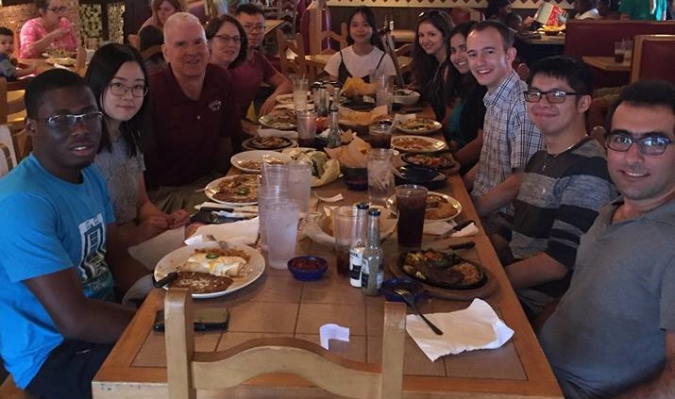
Energy and Power Group
Texas A&M is a leader in power and energy research!
13+ Faculty members in various expertise areas of power systems, power electronics, and electric machines
Tom Overbye, Robert Balog, Miroslav Begovic, Adam Birchfield, Karen Butler-Purry, Kate Davis, Mehrdad Ehsani, Prasad Enjeti, Mladen Kezunovic, Don Russell, Chanan Singh, Hamid Toliyat, Le Xie
Left: Graduate students plan and operate a sponsored IEEE technical conference every year, TPEC
Top: smart grid control center facility in the center for infrastructure renewal on the RELLIS campus
Right: end of semester research group lunch

Slide 7
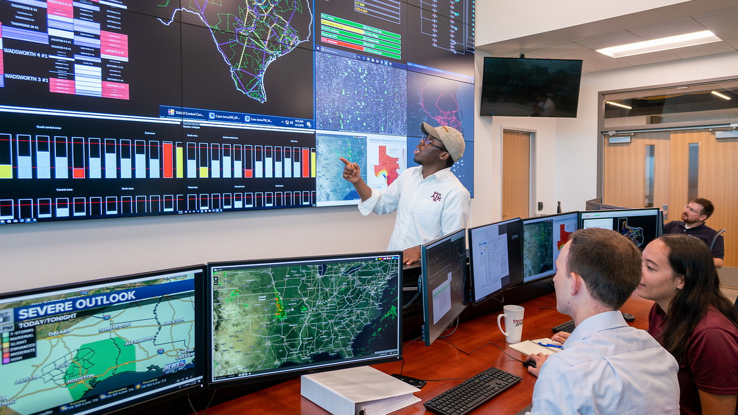
Why Graduate School?
Demand
There is an acute shortage of US engineers with advanced degrees.
Companies are highly motivated to help attract more engineers into advanced studies.
Career paths
Industry research and development
Research jobs, such as at national labs
Start-up: even commercialize your grad work!
Academic: teach, lead research at a university
Curious and want to learn more on certain topics from undergrad
Want to try out or continue with research
Interested in career options that involve working on hard, interesting problems

Slide 8
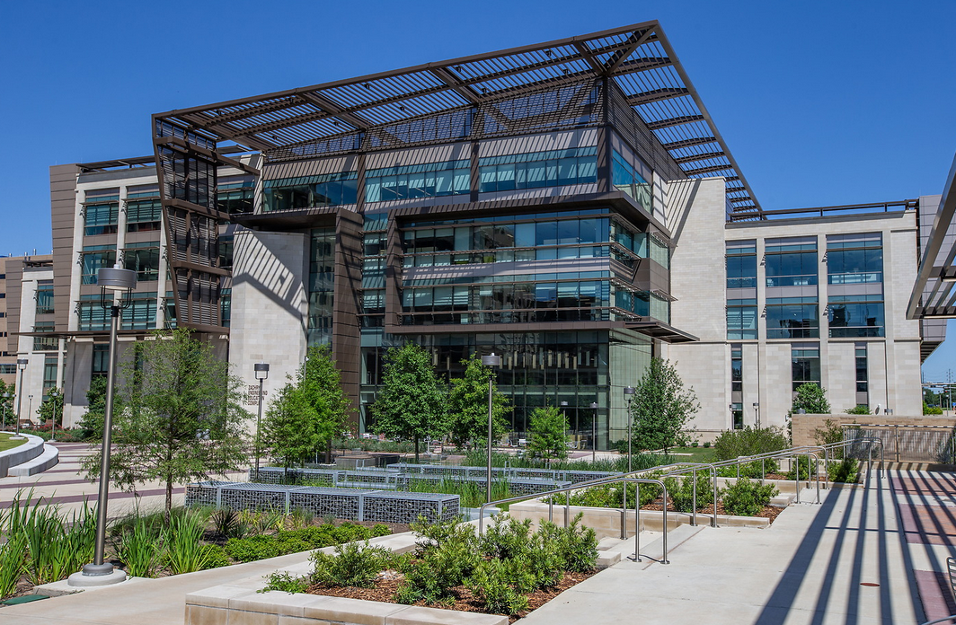
Graduate Programs
Masters of Science
Building on Bachelor's degree with additional, more specialized classes, plus optionally an introduction to research work
Non-Thesis: 1-2 years (TAMU students can fast-track)
Thesis: typically 2 years
Ph.D.
Working towards expertise in a specific topic, learning to do independent research
Typically 4-5 years beyond Bachelor's
Many graduate students get a research or teaching assistantship, covering tuition, fees, and a monthly stipend through graduate school
For more information, see the ECEN graduate student handbook
https://engineering.tamu.edu/electrical/_files/_documents/_content-documents/ECEN-Grad-Handbook-2020-2021-10Nov2020.pdf

Slide 9
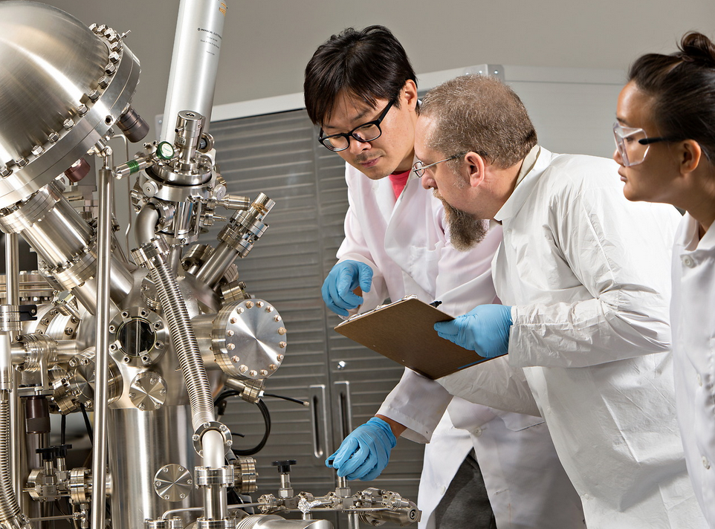
Undergraduate Research
If you might be interested in graduate school, undergraduate research can be a great way to learn more about it and get some initial experience
Reach out to a faculty member in the area you’re interested in and see what opportunities there are available
My group has openings for research related to electric grid modeling and analysis, and the impact of extreme events on the power grid
There are several ways undergrad research can be done
Student worker position (paid)
ECEN 491 class credit as undergraduate researcher
Do an undergraduate thesis project
Summer research grants: https://engineering.tamu.edu/admissions-and-aid/undergraduate-summer-research-grants/index.html

Slide 10
Balanced Three-Phase (3φ) AC Circuits
A balanced three-phase (φ) system has
three voltage sources with equal magnitude, but with an angle shift of 120°
equal loads on each phase
equal impedance on the lines connecting the generators to the loads
Bulk power systems are almost exclusively 3φ
Single-phase is used primarily only in low voltage, low power settings, such as residential and some commercial
Advantages
Can transmit more power for same amount of wire (twice as much as single phase)
Torque produced by 3φ machines is constant
Three-phase machines use less material for same power rating
Three-phase machines start more easily than single-phase machines

Slide 11
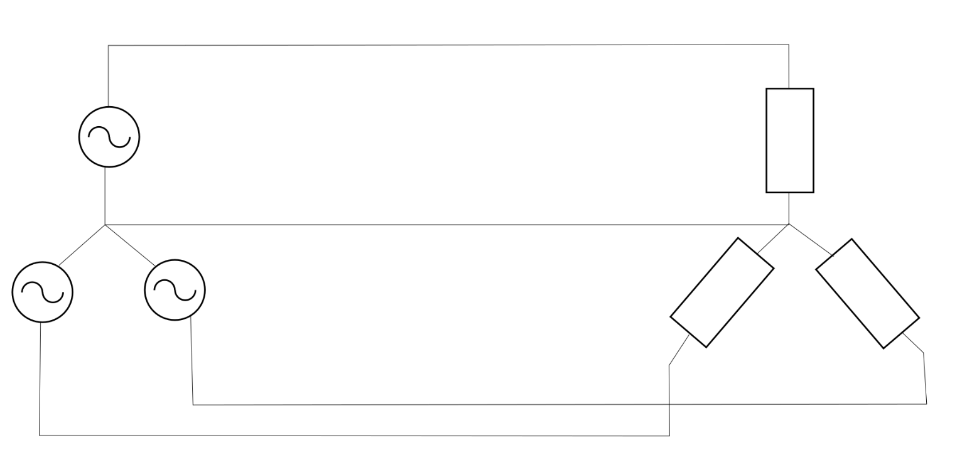
Balanced 3φ -- No Neutral Current
Phase “a”
$$I_{a} →$$
+
$$V_{an}=V∠0°$$
$$Z$$
–
Neutral “n”
$$←I_{n}$$
–
–
$$V_{cn}=V∠120°$$
$$(=V∠−240°)$$
$$V_{bn}=V∠−120°$$
$$Z$$
$$Z$$
+
+
Phase “b”
$$I_{b}→$$
Phase “c”
$$I_{c}→$$
$I_{n}=I_{a}+I_{b}+I_{c}$
$I_{n}=\frac{V}{Z}\left(1∠0°+1∠−120°+1∠120°\right)=0$
$S=V_{an}I_{an}^{∗}+V_{bn}I_{bn}^{∗}+V_{cn}I_{cn}^{∗}=3V_{an}I_{an}^{∗}$

Slide 12
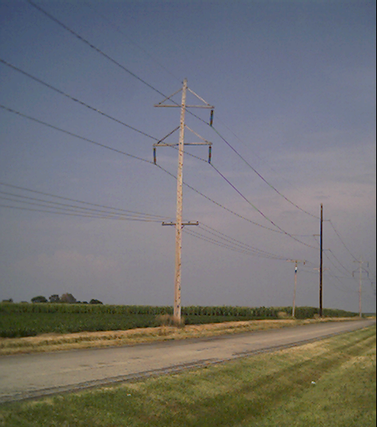
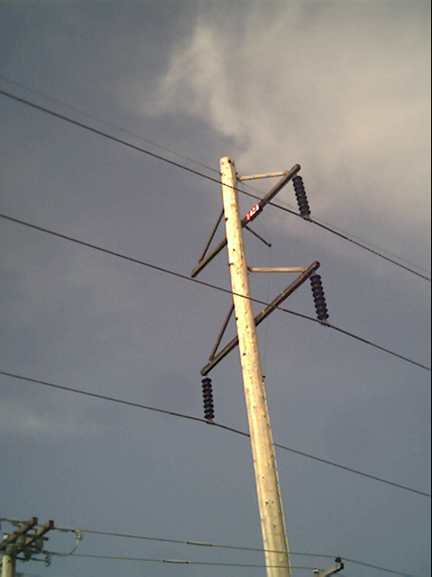
Three-Phase Transmission Line
Small neutral wire at the top
A phase
B phase
C phase

Slide 13
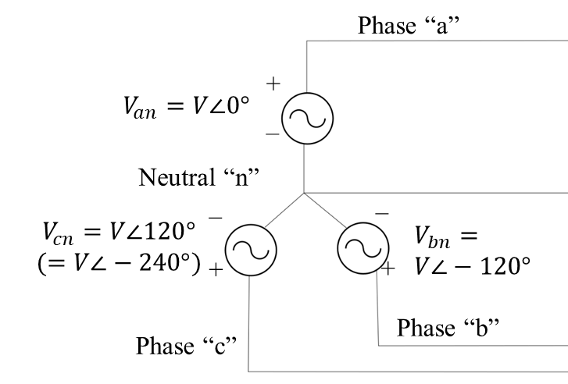
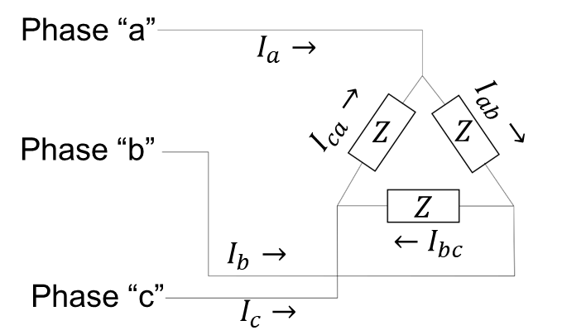
Three-Phase AC Analysis
The three phases are out-of-phase by $120°$.
There are mutual impedances connecting the phases, such as the capacitance between two lines
Generators, loads, transformers can be connected Wye or Delta (see diagrams at left)
Voltages phase-to-phase are greater than phase-to-neutral voltages by factor of $\sqrt{3}$, and also have a $30°$ phase shift
If the three-phase system is completely balanced, we can represent the three-phase system with an equivalent, decoupled, single-phase system
This is known as positive sequence analysis
Unbalanced systems can be analyzed this way as well, adding in negative sequence and zero sequence analysis

Slide 14
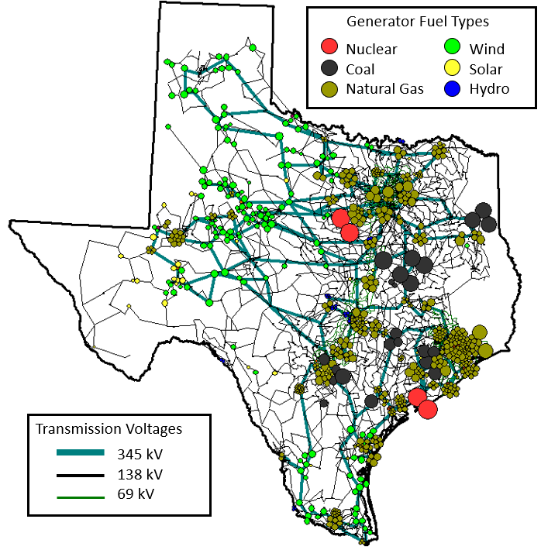
Three Phase (Synthetic) Circuit Model for the Texas Transmission Network
This circuit has 7000 nodes! (In power we call them buses)
Transmission voltages are line-to-line RMS. What are the line-to-neutral values? What are the peak values?
The transmission network is essentially always modeled as a balanced three-phase system
This means we can use positive sequence analysis and consider it an equivalent single-phase system.
Real and reactive power must balance at all buses!
We have labs associated with this circuit in ECEN 460

Slide 15
