Slide 1
ECEN 214, Spring 2022 Electrical Circuit Theory
Class 23: Advanced Topics 2
Prof. Adam Birchfield
Dept. of Electrical and Computer Engineering
Texas A&M University
abirchfield@tamu.edu

Slide 2
One-Page Course Outline
Unit 1. Steady-State DC Circuits
1. Voltage, current, resistance, Ohm’s Law, KVL, KCL
2. Power, energy, independent sources, dependent sources
3. Open, short, parallel, series, voltage dividers, current dividers
4. Wye-delta transformation
5. Node-voltage circuit analysis method
6. Mesh-current circuit analysis method
7. Thevenin and Norton equivalents
8. Superposition, source transformations
9. Maximum power transfer
10. Ideal Op-Amp equations, linear and saturation regions
Unit 2. Transient DC Circuits
1. Capacitor and inductor equations, steady-state behavior, transient behavior
2. Writing and solving first-order RL and RC circuit differential equations
3. Writing and solving second-order RLC circuit differential equations
Unit 3. Steady-State AC Circuits
1. Phasors for AC voltage and current, complex algebra applied to AC circuits
2. Impedance for R, L, and C in AC circuits
3. AC Power: Complex power, real power, reactive power, power factor
4. AC Thevenin equivalents and maximum power transfer
Unit 4. Advanced Topics
1. Non-linear devices
2. Circuit software
3. Three-phase
4. Transformers

Slide 3
Where You Go From Here
Two more classes with advanced topics and review (conceptually may be on final)
Wed 27 April – Advanced topics 3: Three-phase AC power systems
Mon 2 May – Advanced topics 4: Ideal Transformers
Final Exam Friday 6 May at 3:30pm
The door to the rest of your major is now open:
What’s next?
Internships, industry job opportunities, entrepreneurship
Undergraduate research, graduate school for Masters or PhD
314 Signals
325 Electronics
Electives (21 hours)
214 Circuits
322 E-mag
350 Comp. Arch.
460 Power Systems Elective
Birchfield Spring 2023
403/404 Capstone
248 Digital
340 Power
303 Random
370 Materials (Required)

Slide 4
Brief History of Computer Simulation of Electric Circuits
Initial development of ECAP program at IBM in mid-1960s
SPICE developed at UC-Berkeley in early 1970s
SPICE stands for Simulation Program with Integrated Circuit Analysis
Improved version SPICE2 is in the public domain and has become industry standard
1984, MicroSim introduced Pspice, similar to SPICE for personal computers instead of mainframe, for industry and educational use
Many additional version have been developed since, including developing a circuit by drawing the elements onto a graphical user interface (GUI)
LTSpice was introduced in 1999 and is a standard freeware program for circuit simulation
Source: Muhammad H. Rashid and Hasan M. Rashid, SPICE for Power Electronics and Electric Power, Taylor & Francis Group 2012.

Slide 5
How Can We Get a Computer to Solve this Circuit?
$$5 Ω$$
$$15 Ω$$
_
+
$$12 Ω$$
$$3 V$$
$$4 A$$
_
+
$$22 V$$
$$6 A$$
$$8 Ω$$

Slide 6
End-of-Semester Feedback
First, fill out the official university course assessment online at tamu.aefis.net
Next, fill out the internal feedback survey for this class (same as the one we did in February)
End-of-semester student survey is used by instructors, TAs, ECEN department, College of Engineering, and the university for improving this course
We greatly value your feedback!
There is no grade associated with any of the student surveys, and they are anonymous

Slide 7
Netlists
First, we have to describe the circuit in a way the computer can understand (systematically)
Use the Node-Voltage method notation: choose a reference node, number the other nodes. Devices now are listed by what they are connected to.
This is known as a netlist
1
$$5 Ω$$
$$15 Ω$$
2
3
4
_
+
5
$$12 Ω$$
$$3 V$$
$$4 A$$
_
+
$$22 V$$
$$6 A$$
$$8 Ω$$
Node 1 | Node 2 | Device Type | Parameter(s)
1 | 2 | Resistor | $5 Ω$
1 | 3 | Resistor | $15 Ω$
3 | 4 | Resistor | $12 Ω$
0 | 2 | Current source | 6 A
2 | 5 | Voltage source | 3 V
5 | 3 | Current source | 4 A
5 | 0 | Resistor | $8 Ω$
0 | 4 | Voltage source | 22 V

Slide 8
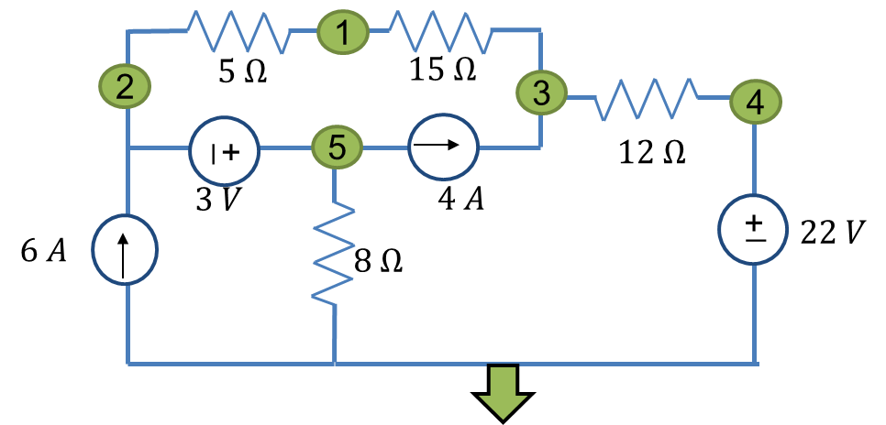
Matrix Solution – Resistors
A matrix is created know as the conductance matrix (G matrix), which will represent all the equations of the circuit.
KVL is already satisfied because of the way the node-voltage method is formulated
We need to make sure we satisfy KCL and the equation for each element
Types of equations
KCL for single node or supernode
Voltage equation for voltage sources
For example, the KCL for node 1 (which will go on row 1) is
$$I_{r12}+I_{r13}=0$$
$$\left(\frac{1}{R_{12}}\right)\left(V_{1}−V_{2}\right)+\left(\frac{1}{R_{13}}\right)\left(V_{1}−V_{3}\right)=0$$
See g and I values on the right
$$GV=I$$
$$\left[\begin{matrix}g_{11} & g_{12} & g_{13} & g_{14} & g_{15} \\ g_{21} & g_{22} & g_{23} & g_{24} & g_{25} \\ g_{31} & g_{32} & g_{33} & g_{34} & g_{35} \\ g_{41} & g_{42} & g_{43} & g_{44} & g_{45} \\ g_{51} & g_{52} & g_{53} & g_{54} & g_{55}\end{matrix}\right]\left[\begin{matrix}V_{1} \\ V_{2} \\ V_{3} \\ V_{4} \\ V_{5}\end{matrix}\right]=\left[\begin{matrix}I_{1} \\ I_{2} \\ I_{3} \\ I_{4} \\ I_{5}\end{matrix}\right]$$
$$g_{11}=\frac{1}{R_{12}}+\frac{1}{R_{13}}$$
$$g_{12}=−\frac{1}{R_{12}}$$
$$g_{13}=−\frac{1}{R_{13}}$$
$$g_{14}=g_{15}=I_{1}=0$$
For resistors, add the conductance (1/R) to the diagonal elements and subtract from the off-diagonal elements

Slide 9
Matrix Solution – Current Sources
For current sources, we just need to add the currents into the KCL equations
For example, node 3 KCL
$$I_{R13}+I_{R34}+I_{35}=0$$
$$\left(\frac{1}{R_{13}}\right)\left(V_{3}−V_{1}\right)+\left(\frac{1}{R_{34}}\right)\left(V_{3}−V_{4}\right)=4$$
$$g_{33}=\left(\frac{1}{R_{13}}\right)+\left(\frac{1}{R_{34}}\right)$$
$$g_{31}=−\frac{1}{R_{13}};g_{34}=−\frac{1}{R_{34}}$$
$$g_{32}=g_{35}=0$$
$$I_{3}=4$$
The 4 A current source will be added to the node 3 KCL equation and subtracted from the node 5 one
$$GV=I$$
$$\left[\begin{matrix}g_{11} & g_{12} & g_{13} & g_{14} & g_{15} \\ g_{21} & g_{22} & g_{23} & g_{24} & g_{25} \\ g_{31} & g_{32} & g_{33} & g_{34} & g_{35} \\ g_{41} & g_{42} & g_{43} & g_{44} & g_{45} \\ g_{51} & g_{52} & g_{53} & g_{54} & g_{55}\end{matrix}\right]\left[\begin{matrix}V_{1} \\ V_{2} \\ V_{3} \\ V_{4} \\ V_{5}\end{matrix}\right]=\left[\begin{matrix}I_{1} \\ I_{2} \\ I_{3} \\ I_{4} \\ I_{5}\end{matrix}\right]$$
1
$$5 Ω$$
$$15 Ω$$
2
3
4
_
+
5
$$12 Ω$$
$$3 V$$
$$4 A$$
_
+
$$22 V$$
$$6 A$$
$$8 Ω$$

Slide 10
Matrix Solution – Voltage Sources
Voltage sources are more complicated because we can’t use the KCL equations
Need to create a “supernode”
For the 22 V source, just add one equation instead of KCL for bus 4
$$g_{44}=1;g_{41}=g_{42}=g_{43}=g_{45}=0;I_{4}=22$$
For the 3 V source, add an equation for voltage to replace node 2 KCL
$$g_{25}=1;g_{22}=−1;g_{21}=g_{23}=g_{24}=0;I_{2}=3$$
Now since we have a supernode, we make a KCL equation on row 5 that adds the currents for the supernode
$$g_{51}=−\left(\frac{1}{R_{12}}\right);g_{52}=\frac{1}{R_{12}};g_{53}=g_{54}=0;g_{55}=\frac{1}{R_{50}}$$
$I_{5}=6A −4A$
$$GV=I$$
$$\left[\begin{matrix}g_{11} & g_{12} & g_{13} & g_{14} & g_{15} \\ g_{21} & g_{22} & g_{23} & g_{24} & g_{25} \\ g_{31} & g_{32} & g_{33} & g_{34} & g_{35} \\ g_{41} & g_{42} & g_{43} & g_{44} & g_{45} \\ g_{51} & g_{52} & g_{53} & g_{54} & g_{55}\end{matrix}\right]\left[\begin{matrix}V_{1} \\ V_{2} \\ V_{3} \\ V_{4} \\ V_{5}\end{matrix}\right]=\left[\begin{matrix}I_{1} \\ I_{2} \\ I_{3} \\ I_{4} \\ I_{5}\end{matrix}\right]$$
1
$$5 Ω$$
$$15 Ω$$
2
3
4
_
+
5
$$12 Ω$$
$$3 V$$
$$4 A$$
_
+
$$22 V$$
$$6 A$$
$$8 Ω$$

Slide 11
Matrix Solution – Final Matrix
$$GV=I$$
$$\left[\begin{matrix}\frac{1}{5}+\frac{1}{15} & −\frac{1}{5} & −\frac{1}{15} & 0 & 0 \\ 0 & −1 & 0 & 0 & 1 \\ −\frac{1}{15} & 0 & \frac{1}{15}+\frac{1}{12} & −\frac{1}{12} & 0 \\ 0 & 0 & 0 & 1 & 0 \\ −\frac{1}{5} & \frac{1}{5} & 0 & 0 & \frac{1}{8}\end{matrix}\right]\left[\begin{matrix}V_{1} \\ V_{2} \\ V_{3} \\ V_{4} \\ V_{5}\end{matrix}\right]=\left[\begin{matrix}0 \\ 3 \\ 4 \\ 22 \\ 6−4\end{matrix}\right]$$
1
$$5 Ω$$
$$15 Ω$$
2
3
4
_
+
5
$$12 Ω$$
$$3 V$$
$$4 A$$
_
+
$$22 V$$
$$6 A$$
$$8 Ω$$
Solve for final voltages:
$$\left[\begin{matrix}0.267 & −0.2 & −0.067 & 0 & 0 \\ 0 & −1 & 0 & 0 & 1 \\ −0.067 & 0 & 0.15 & −0.083 & 0 \\ 0 & 0 & 0 & 1 & 0 \\ −0.2 & 0.2 & 0 & 0 & 0.125\end{matrix}\right]\left[\begin{matrix}V_{1} \\ V_{2} \\ V_{3} \\ V_{4} \\ V_{5}\end{matrix}\right]=\left[\begin{matrix}0 \\ 3 \\ 4 \\ 22 \\ 2\end{matrix}\right]$$
$$\left[\begin{matrix}V_{1} \\ V_{2} \\ V_{3} \\ V_{4} \\ V_{5}\end{matrix}\right]=\left[\begin{matrix}31.53 \\ 24.4 \\ 52.9 \\ 22 \\ 27.4\end{matrix}\right]$$
Once we have these we can get anything else we want

Slide 12
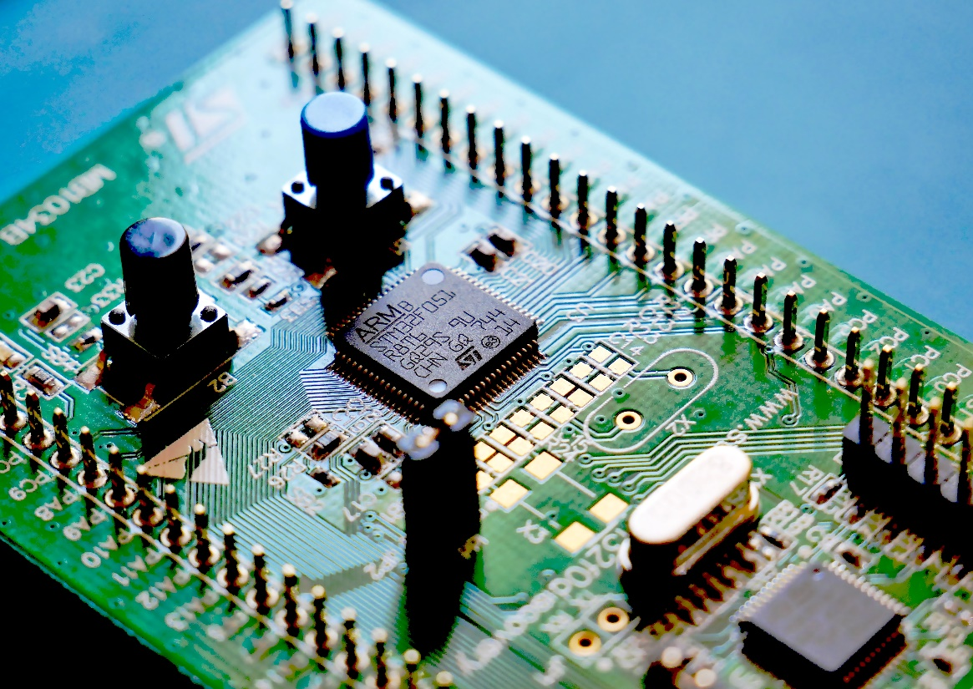
Types of Analysis in SPICE Programs
DC operating point – what we just did, solve the DC circuit in steady state
DC sweep – change a parameter over a range of values and get the solution for each one (for example, what if we increase or decrease the current source from 4 A)
Small-signal transfer function – like a Thevenin equivalent
Transient analysis – how the circuit behaves in response to time-varying devices, including switches
Frequency analysis – results of the transient simulation at DC and after a Fourier transform
AC circuit response – at a single frequency or a range of frequencies

