Slide 1
ECEN 214, Spring 2022 Electrical Circuit Theory
Class 21: AC Review and Op-Amps
Prof. Adam Birchfield
Dept. of Electrical and Computer Engineering
Texas A&M University
abirchfield@tamu.edu

Slide 2
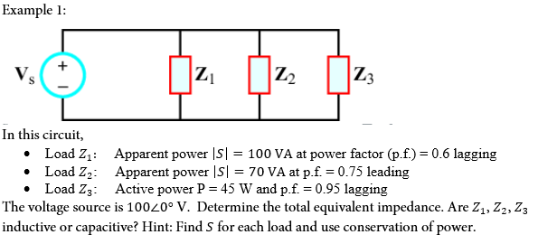
Example 1

Slide 3
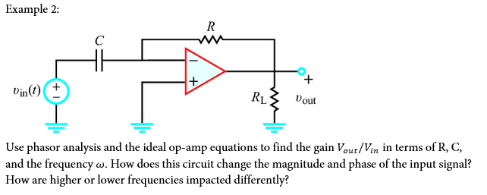
Example 2

