Slide 1
ECEN 214, Spring 2022 Electrical Circuit Theory
Class 20: AC Thevenin Equivalents and Maximum Power Transfer
Prof. Adam Birchfield
Dept. of Electrical and Computer Engineering
Texas A&M University
abirchfield@tamu.edu

Slide 2
Review: Phasor Analysis
A phasor is a complex number that represents a cosine-valued AC function
The Root Mean Square (RMS) for cosine is found by dividing the maximum value by $\sqrt{2}$
In polar form,$R∠θ$, a phasor represents the RMS voltage or current and phase angle
$R∠θ→\sqrt{2} R\cos{(2πft−θ)}$
Conversions to rectangular form: a+jb, and back can be done with these identities:
$R=\sqrt{a^{2}+b^{2}} θ=aTan\left(\frac{b}{a}\right) a=R\cos{θ} b=R\sin{θ}$
Complex number addition can be done in rectangular form, and complex number multiplication can be done in polar form.
Phasor diagrams have the real part on the x axis and imaginary part on the y axis.
The angular frequency is $ω=2πf$.
KVL, KCL, and Ohm’s law all apply with AC phasor analysis exactly as with DC.
This means you can use Node-Voltage and Mesh-Current analysis methods too.

Slide 3
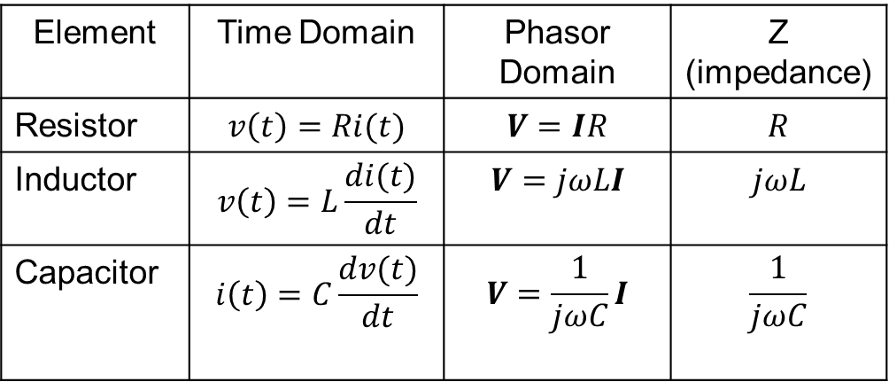
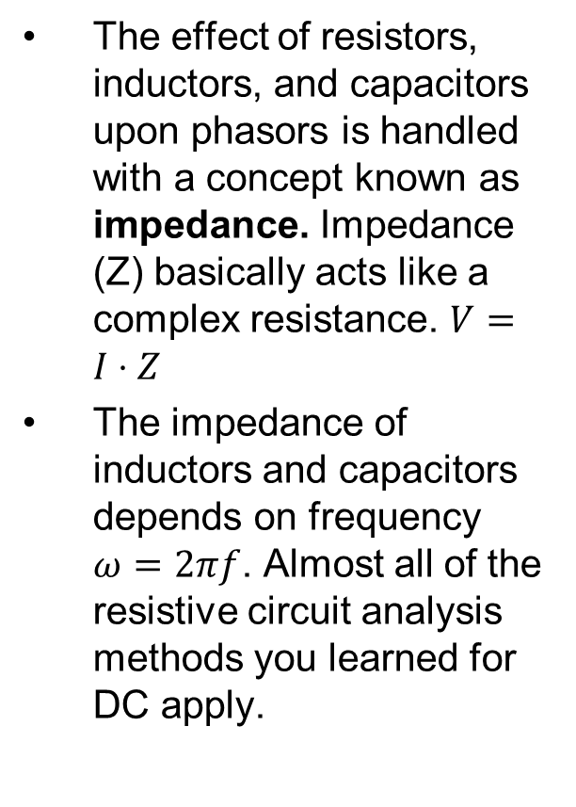
Review: Impedance
The effect of resistors, inductors, and capacitors upon phasors is handled with a concept known as impedance. Impedance (Z) basically acts like a complex resistance. $V=I⋅Z$
The impedance of inductors and capacitors depends on frequency $ω=2πf$. Almost all of the resistive circuit analysis methods you learned for DC apply.

Slide 4
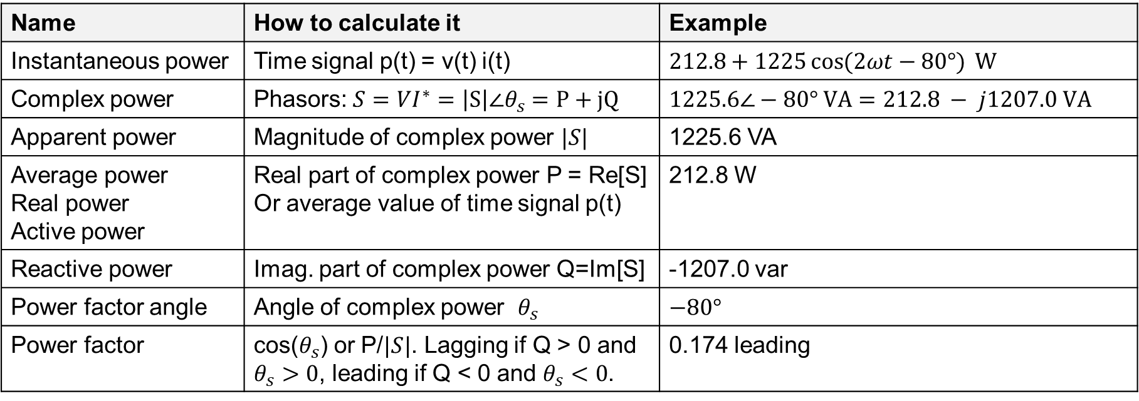
Review: AC Power
Name | How to calculate it | Example
Instantaneous power | Time signal p(t) = v(t) i(t) | $212.8+1225\cos{(2ωt−80°)} \text{W}$
Complex power | Phasors: $S=VI^{∗}=\left|S\right|∠θ_{s}=P+jQ$ | $1225.6∠−80° \text{VA}=212.8 − j1207.0 \text{VA}$
Apparent power | Magnitude of complex power $|S|$ | 1225.6 VA
Average power Real power Active power | Real part of complex power P = Re[S] Or average value of time signal p(t) | 212.8 W
Reactive power | Imag. part of complex power Q=Im[S] | -1207.0 var
Power factor angle | Angle of complex power $θ_{s}$ | $−80°$
Power factor | cos($θ_{s}$) or P/$|S|$. Lagging if Q > 0 and $θ_{s}>0$, leading if Q < 0 and $θ_{s}<0$. | 0.174 leading

Slide 5
Example 1
We want to find
The Thevenin equivalent for this circuit, as shown.
The maximum power that could be delivered to a load with impedance $Z_{load}$
$$0.6 Ω$$
$$Z_{L}=j0.8$$
$$4 Ω$$
+
5$0∠0° \text{V}$
_
$$Z_{c}=−j20$$
$$Z_{th}$$
+
$$V_{th}$$
Maximum power transfer occurs when $Z_{load}=Z_{th}^{∗}$
_

Slide 6
AC Equivalents
Thevenin and Norton Equivalents can be found for AC circuits with phasors the same way they can for DC circuits
Open circuit voltage is the Thevenin equivalent voltage
Short circuit current is the Norton equivalent current
Zero out the sources and find the equivalent resistance for Thevenin or Norton equivalent
Maximum power transfer occurs when $Z_{load}=Z_{th}^{∗}$
Match an inductive source with a capacitive load and vice versa

Slide 7
Assignments
Zybook Chapter 7 and 8
HW 7A and 7B and 7C
Review in-class examples and notes
Practice, practice, practice!
Don’t forget, you need to go to office hours at least once in either March or April. Bring at least one technical question!

