Slide 1
ECEN 214, Spring 2022 Electrical Circuit Theory
Class 19: Working AC Problems
Prof. Adam Birchfield
Dept. of Electrical and Computer Engineering
Texas A&M University
abirchfield@tamu.edu

Slide 2
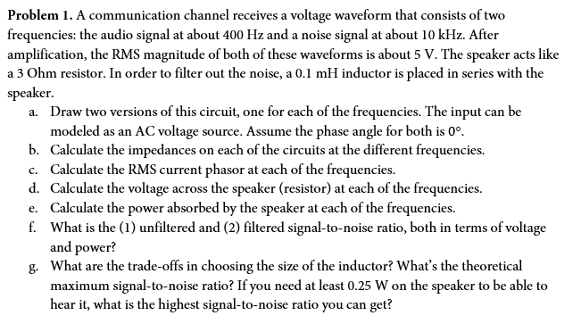
Example 1

Slide 3
Example 1, Continued

Slide 4
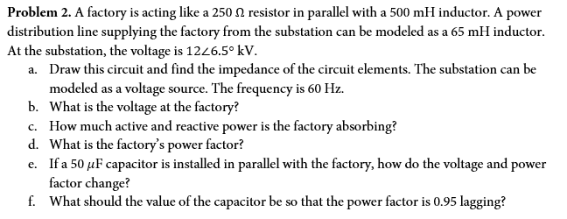
Example 2

Slide 5
Example 2, Continued

