Slide 1
ECEN 214, Spring 2022 Electrical Circuit Theory
Class 18: AC Power
Prof. Adam Birchfield
Dept. of Electrical and Computer Engineering
Texas A&M University
abirchfield@tamu.edu

Slide 2
Review: Phasor Analysis
A phasor is a complex number that represents a cosine-valued AC function
The Root Mean Square (RMS) for cosine is found by dividing the maximum value by $\sqrt{2}$
In polar form,$R∠θ$, a phasor represents the RMS voltage or current and phase angle
$R∠θ→\sqrt{2} R\cos{(2πft−θ)}$
Conversions to rectangular form: a+jb, and back can be done with these identities:
$R=\sqrt{a^{2}+b^{2}} θ=aTan\left(\frac{b}{a}\right) a=R\cos{θ} b=R\sin{θ}$
Complex number addition can be done in rectangular form, and complex number multiplication can be done in polar form.
Phasor diagrams have the real part on the x axis and imaginary part on the y axis.
The angular frequency is $ω=2πf$.
KVL, KCL, and Ohm’s law all apply with AC phasor analysis exactly as with DC.
This means you can use Node-Voltage and Mesh-Current analysis methods too.

Slide 3
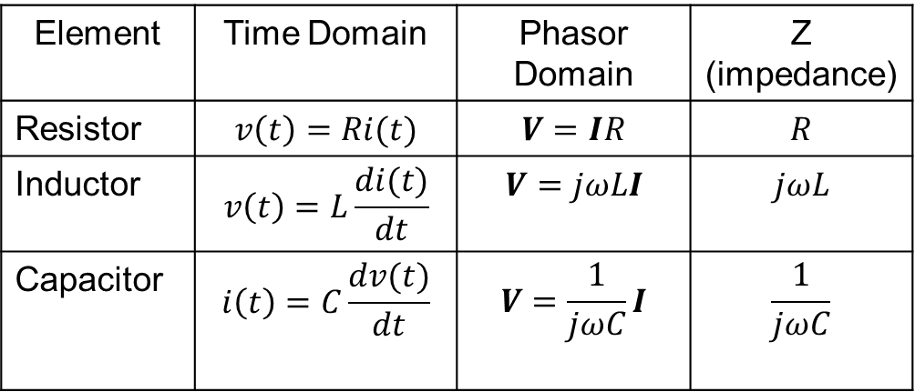
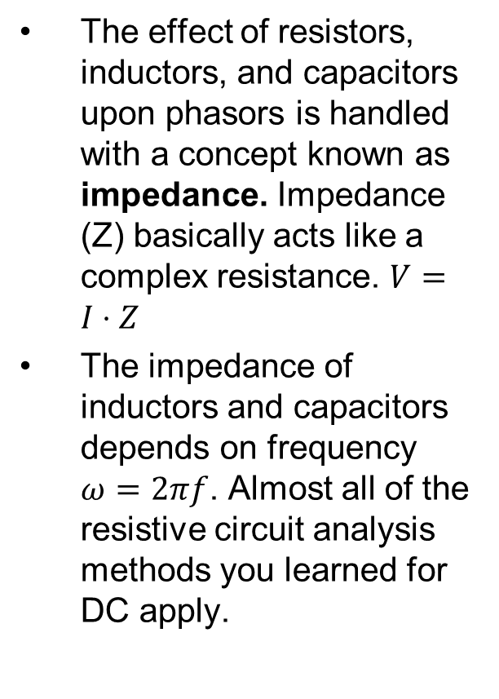
Review: Impedance
The effect of resistors, inductors, and capacitors upon phasors is handled with a concept known as impedance. Impedance (Z) basically acts like a complex resistance. $V=I⋅Z$
The impedance of inductors and capacitors depends on frequency $ω=2πf$. Almost all of the resistive circuit analysis methods you learned for DC apply.

Slide 4
Instantaneous and Average AC Power
Example from last time ($ω=2π1000$)
$$v(t)=113.1\cos{(ωt}) \text{V}$$
$$i\left(t\right)=21.7\cos\left(ωt−80°\right)\text{A}$$
Instantaneous power p(t)=v(t) i(t)
$$p\left(t\right)=2451\cos{(ωt})\cos\left(ωt−80°\right) \text{W}$$
Use the product-to-sum identity
$$p\left(t\right)=\frac{2451}{2}\left(\cos\left(80°\right)+\cos\left(2ωt−80°\right)\right) \text{W}$$
$$=212.8+1225\cos{(2ωt−80°)} \text{W}$$
The sum of two parts
Constant power part
Cosine part at double frequency
Average power over time is 0 for the cos part
Average power = 212.8 W
$$I$$
+
40$∠0° \text{kV}$
$$15 Ω$$
$$j5 Ω$$
_
Average power

Slide 5
Complex Power
For phasors, use $S=VI^{∗}$ (Star means complex conjugate.)
S is the complex power.
In the prior example, $S=\left(80\right)⋅{\left(15.32∠80°\right)}^{∗}=1225.6∠−80°$
The magnitude is called the "apparent power" which is just V times I (1225.6 VA)
Units are "VA" rather than Watts
Write the complex power in rectangular for P + jQ
In this example, 212.8 - j1207.0 VA
The real part P is 212.8 W. That is the "real" or "average" or "active" power
Compare to the previous slide for average power
This is what we normally think of as power, the useful delivery of energy
Must be conserved
The imaginary part Q is -1207 var. It is called "reactive power"
Units are "var" which stand for volts-amps-reactive
Does not correspond to actual delivery of useful energy
BUT it must be conserved nonetheless

Slide 6
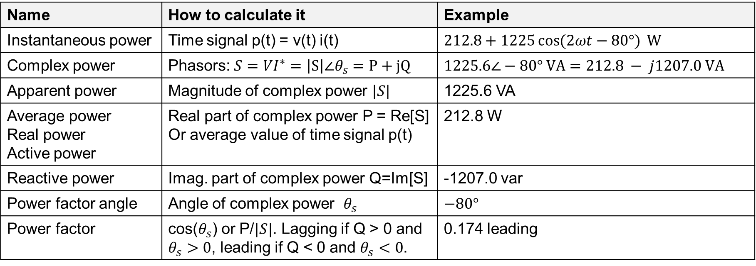
Summary of Power Terms
The power factor somewhat quantifies how much P there is compared to S. Need to specify if it is leading or lagging
Name | How to calculate it | Example
Instantaneous power | Time signal p(t) = v(t) i(t) | $212.8+1225\cos{(2ωt−80°)} \text{W}$
Complex power | Phasors: $S=VI^{∗}=\left|S\right|∠θ_{s}=P+jQ$ | $1225.6∠−80° \text{VA}=212.8 − j1207.0 \text{VA}$
Apparent power | Magnitude of complex power $|S|$ | 1225.6 VA
Average power Real power Active power | Real part of complex power P = Re[S] Or average value of time signal p(t) | 212.8 W
Reactive power | Imag. part of complex power Q=Im[S] | -1207.0 var
Power factor angle | Angle of complex power $θ_{s}$ | $−80°$
Power factor | cos($θ_{s}$) or P/$|S|$. Lagging if Q > 0 and $θ_{s}>0$, leading if Q < 0 and $θ_{s}<0$. | 0.174 leading

Slide 7
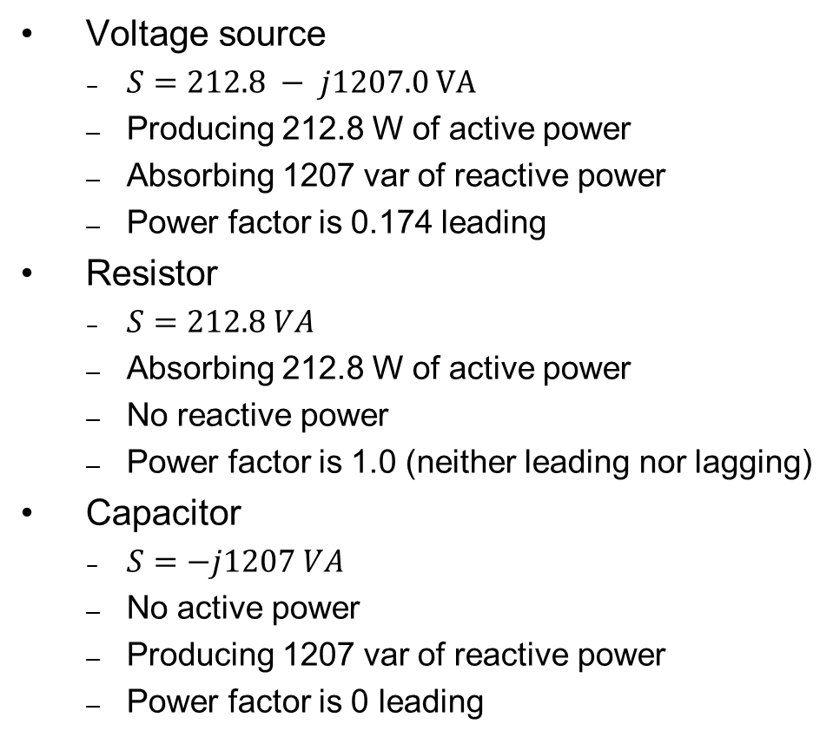
Power Balance in this Example
Voltage source
$S=212.8 − j1207.0 \text{VA}$
Producing 212.8 W of active power
Absorbing 1207 var of reactive power
Power factor is 0.174 leading
Resistor
$S=212.8 VA$
Absorbing 212.8 W of active power
No reactive power
Power factor is 1.0 (neither leading nor lagging)
Capacitor
$S=−j1207 VA$
No active power
Producing 1207 var of reactive power
Power factor is 0 leading
$$I$$
+
$$30 μF$$
80$∠0° \text{V}$
$$30 Ω$$
_
Resistors absorb real power
Inductors absorb reactive power
Capacitors produce reactive power

Slide 8
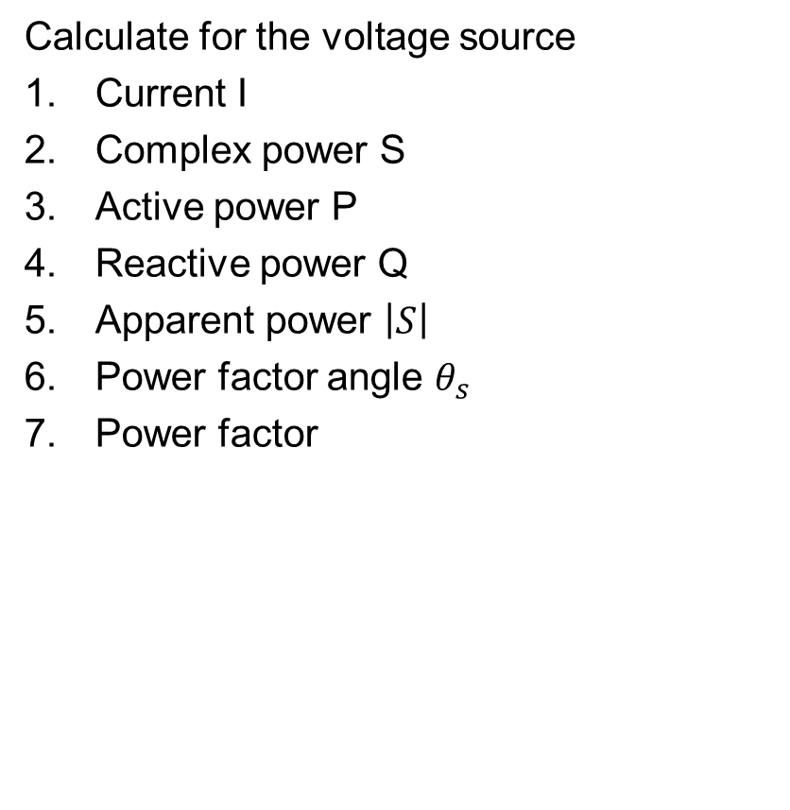
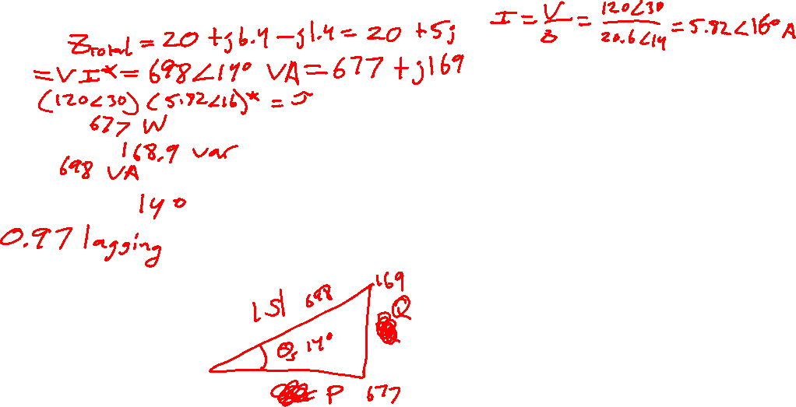
Example 1
Calculate for the voltage source
Current I
Complex power S
Active power P
Reactive power Q
Apparent power $\left|S\right|$
Power factor angle $θ_{s}$
Power factor
$$I$$
$$20 Ω$$
$$Z_{L}=j6.4$$
+
120$∠30° \text{V}$
_
$$Z_{c}=−j1.4$$
Bonus: Can you verify conservation of both active and reactive power?

Slide 9
Assignments
All the major concepts in the class have now been covered! We’ll address a few smaller new concepts and work a bunch of examples over the next few weeks.
Zybook Chapter 7
Quiz next class on AC power
HW 7A and 7B and 7C
Review in-class examples and notes
Practice, practice, practice!
Don’t forget, you need to go to office hours at least once in either March or April. Bring at least one technical question!

