Slide 1
ECEN 214, Spring 2022
Electrical Circuit Theory
Class 16: Phasor Analysis of AC Circuits
Prof. Adam Birchfield
Dept. of Electrical and Computer Engineering
Texas A&M University
abirchfield@tamu.edu

Slide 2

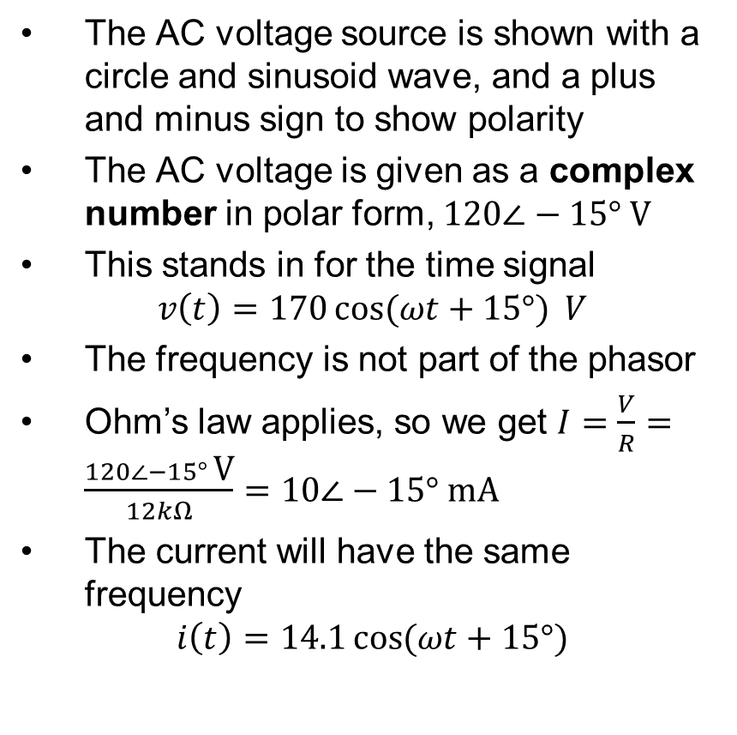


What is AC Phasor Analysis?
The AC voltage source is shown with a circle and sinusoid wave, and a plus and minus sign to show polarity
The AC voltage is given as a complex number in polar form, $120∠−15° \text{V}$
This stands in for the time signal
$$v\left(t\right)=170\cos{(ωt+15°)} V$$
The frequency is not part of the phasor
Ohm’s law applies, so we get $I=\frac{V}{R}=\frac{120∠−15° \text{V}}{12kΩ}=10∠−15° \text{mA}$
The current will have the same frequency
$$i\left(t\right)=14.1\cos{(ωt+15°)}$$
+
$$120∠−15° \text{V}$$
$$I$$
$$12kΩ$$
_

Slide 3
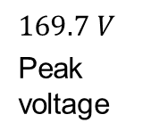


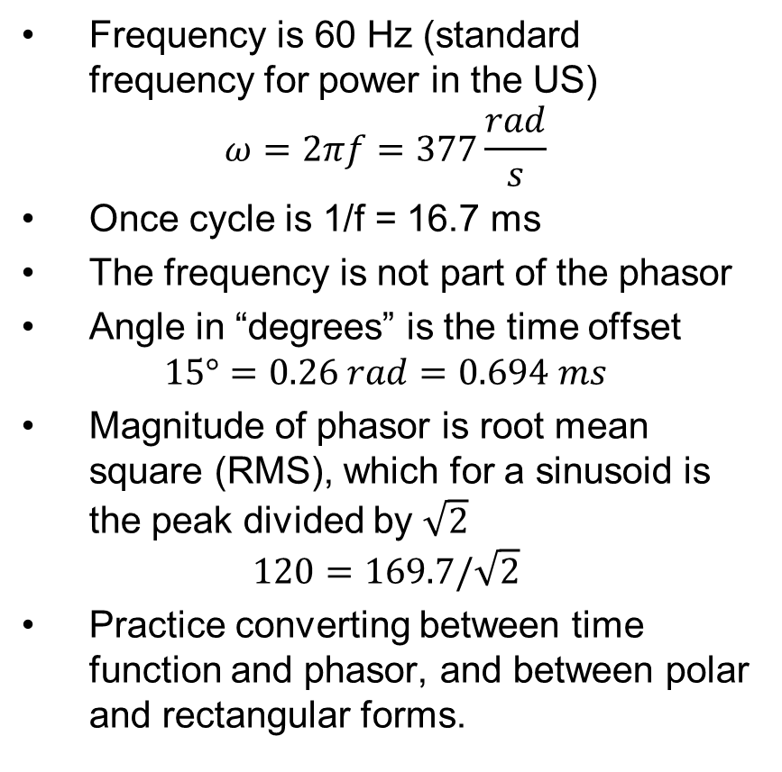


Converting to and from a Phasor
Frequency is 60 Hz (standard frequency for power in the US)
$$ω=2πf=377\frac{rad}{s}$$
Once cycle is 1/f = 16.7 ms
The frequency is not part of the phasor
Angle in “degrees” is the time offset
$$15°=0.26 rad=0.694 ms$$
Magnitude of phasor is root mean square (RMS), which for a sinusoid is the peak divided by $\sqrt{2}$
$$120=169.7/\sqrt{2}$$
Practice converting between time function and phasor, and between polar and rectangular forms.
$120∠−15°=120e^{j\left(−0.26\right)}=115.9−j31.1$ V
$$−15°=0.694 ms$$
$169.7 V$
Peak voltage
$$16.7 ms$$
$$v\left(t\right)=169.7\cos{(2π60t+15°)} V$$

Slide 4










Phasor Diagrams
It is common to view these phasors as vectors in a complex plane.
$$−sin⁡(ωt)$$
$$Im[V]$$
$$V_{3}=2j$$
$$V_{2}=−3$$
$$V_{1}=2$$
$$Re[V]$$
$$−cos⁡(ωt)$$
$$cos⁡(ωt)$$
$$V_{4}=−j$$
$$sin⁡(ωt)$$

Slide 5
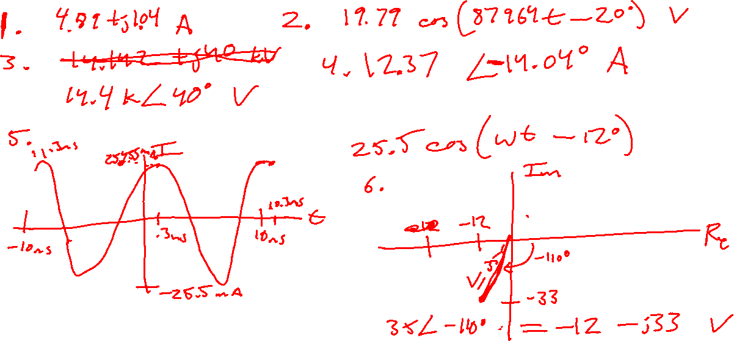

Slide 6






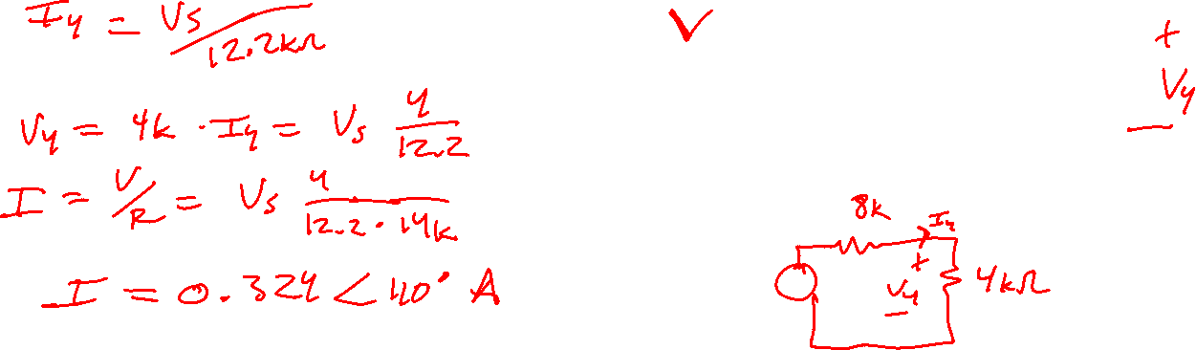
KVL, KCL, Ohm’s Law, Node-Voltage, Mesh-Current All Still Apply!!
Example 1
Solve for $I$ as a phasor using any method
Assuming the frequency is 1 kHz, write the time signals for V and I
$$8kΩ$$
+
$$I$$
$$14kΩ$$
$$13.2∠110° k\text{V}$$
$$6kΩ$$
_

Slide 7

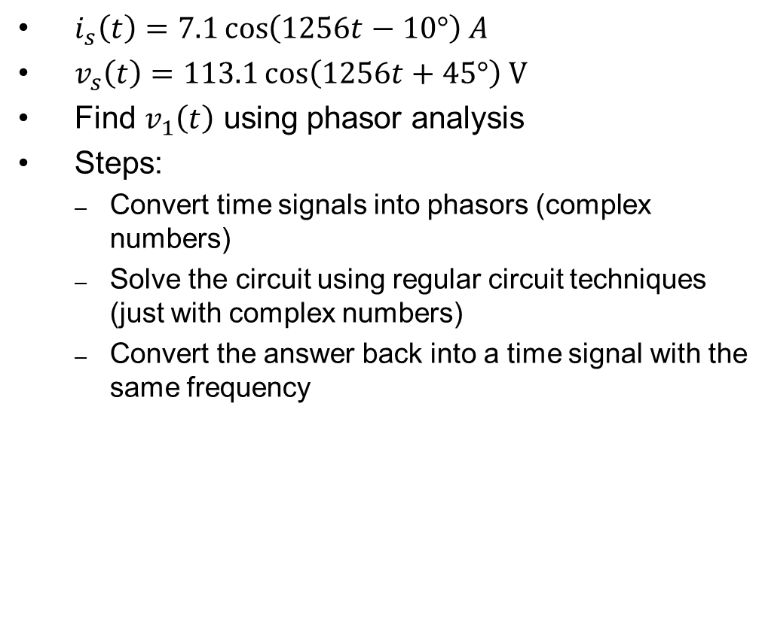


Example 2
$i_{s}\left(t\right)=7.1\cos\left(1256t−10°\right) A$
$v_{s}\left(t\right)=113.1\cos\left(1256t+45°\right) \text{V}$
Find $v_{1}\left(t\right)$ using phasor analysis
Steps:
  Convert time signals into phasors (complex numbers)
  Solve the circuit using regular circuit techniques (just with complex numbers)
  Convert the answer back into a time signal with the same frequency
$$i_{s}$$
5Ω
2Ω
+
+
$$v_{s}$$
$$v_{1}$$
10Ω
12Ω
_
_

Slide 8
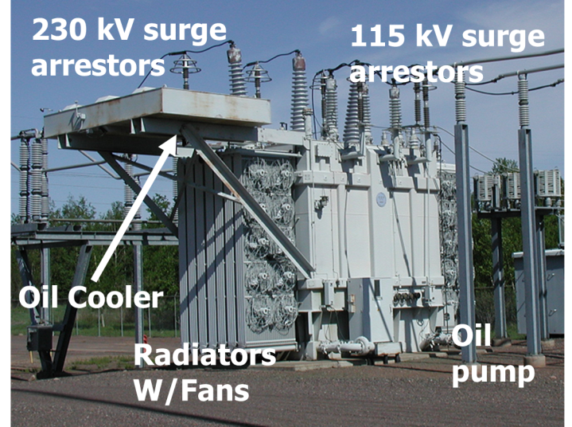
Why is AC used?
For power systems
  AC motors are easier to build and have historically been cheaper than DC motors.
  AC allows the use of transformers so that voltage can be stepped up and down—much more difficult with DC
For communications and computing
  Electromagnetic radiation is sinusoidal, so wireless communication with antennas necessitates the use of AC
  Information signals, including in computing, carry information in the frequency components
Historical note: some engineers strongly prefer using lowercase “ac” and “dc” rather than uppercase—either is fine in this class.
A large, 230 kV to 115 kV AC power transformer

Slide 9
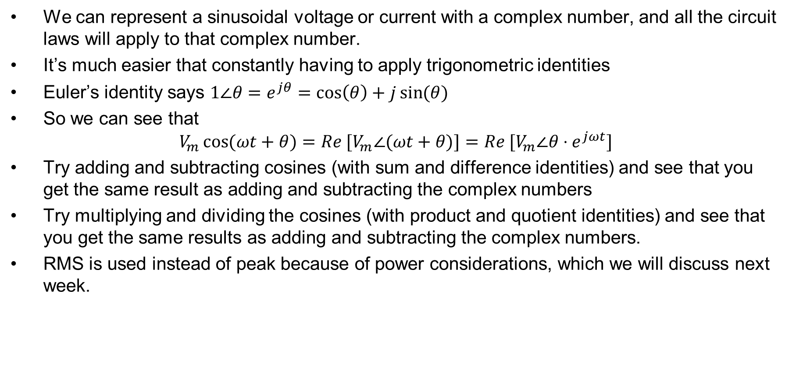
Why Does Phasor Analysis Work?
We can represent a sinusoidal voltage or current with a complex number, and all the circuit laws will apply to that complex number.
It’s much easier that constantly having to apply trigonometric identities
Euler’s identity says $1∠θ=e^{jθ}=\cos\left(θ\right)+j\sin{(θ)}$
So we can see that
$$V_{m}\cos{(ωt+θ)}=Re [V_{m}∠(ωt+θ)]=Re [V_{m}∠θ⋅e^{jωt}]$$
Try adding and subtracting cosines (with sum and difference identities) and see that you get the same result as adding and subtracting the complex numbers
Try multiplying and dividing the cosines (with product and quotient identities) and see that you get the same results as adding and subtracting the complex numbers.
RMS is used instead of peak because of power considerations, which we will discuss next week.

Slide 10
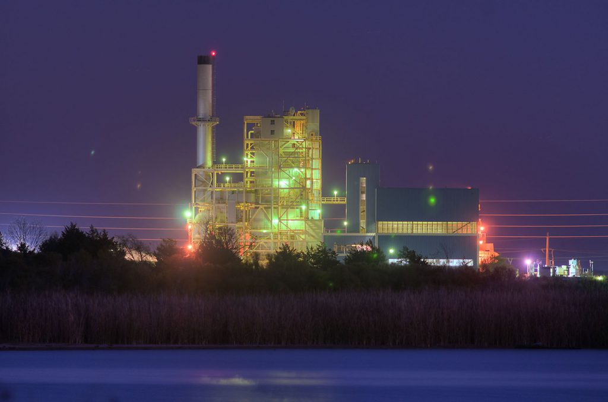
Assignments
Zybook Chapter 7
Quiz next class on phasor conversions
Start working on HW 7A
Sign up for the power plant tour April 5th
Review in-class examples and notes
  Practice, practice, practice!
Don’t forget, you need to go to office hours at least once in either March or April. Bring at least one technical question!
Source: https://www.btutilities.com/about-btu/btu-history/

