Slide 1
ECEN 214, Spring 2022 Electrical Circuit Theory
Class 17: Impedance
Prof. Adam Birchfield
Dept. of Electrical and Computer Engineering
Texas A&M University
abirchfield@tamu.edu

Slide 2
Review: Phasor Analysis
A phasor is a complex number that represents a cosine-valued AC function
The Root Mean Square (RMS) for cosine is found by dividing the maximum value by $\sqrt{2}$
In polar form,$R∠θ$, a phasor represents the RMS voltage or current and phase angle
$R∠θ→\sqrt{2} R\cos{(2πft−θ)}$
Conversions to rectangular form: a+jb, and back can be done with these identities:
$R=\sqrt{a^{2}+b^{2}} θ=aTan\left(\frac{b}{a}\right) a=R\cos{θ} b=R\sin{θ}$
Complex number addition can be done in rectangular form, and complex number multiplication can be done in polar form.
Phasor diagrams have the real part on the x axis and imaginary part on the y axis.
The angular frequency is $ω=2πf$.
KVL, KCL, and Ohm’s law all apply with AC phasor analysis exactly as with DC.
This means you can use Node-Voltage and Mesh-Current analysis methods too.

Slide 3
Resistors and AC Phasors
Resistors still have Ohm’s law, which applies with phasors
$I=\frac{V}{R}=\frac{120∠−15° \text{V}}{12kΩ}=10∠−15° \text{mA}$
Frequency is not involved
+
$$120∠−15° \text{V}$$
$$I$$
$$12kΩ$$
_

Slide 4
Inductors and AC
Remember the equation for inductors?
$$v\left(t\right)=L\frac{di}{dt}$$
If v(t) and i(t) are cosine functions
$$i\left(t\right)=I_{M}\cos\left(ωt+θ\right)$$
$$\frac{di}{dt}=I_{M}ω\cos{(ωt+θ−90°)}$$
So for phasor analysis we need to multiply by $ω$ and have a +90 degree phase shift (cos to sin)
$$V=jωL⋅I$$
No differential equations! Just multiply by $jωL$
For this example
$$I=\frac{V}{jωL}=\frac{120∠−15°}{j2π60⋅0.005}=63.7∠−105° A$$
What if frequency was really high? Really low?
60 Hz is the frequency
+
$$120∠−15° \text{V}$$
$$I$$
$$5 mH$$
_

Slide 5
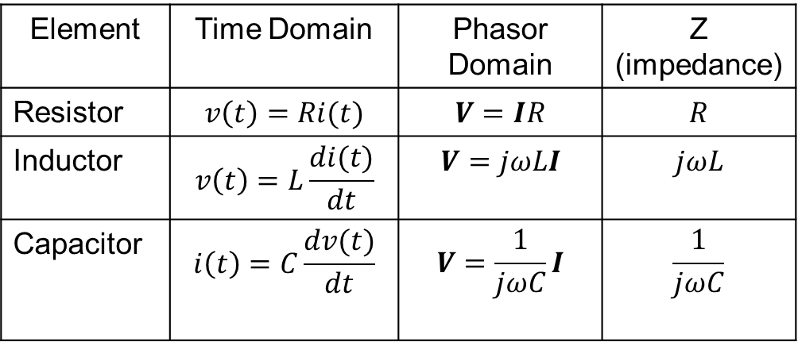
Impedance
You can do a similar analysis and find the following equation for capacitors
$$V=\frac{1}{jωC}I$$
Both inductors and capacitors are algebraic rather than differential in AC
We use the concept of “impedance” which is like a complex resistance, to represent resistors, inductors, and capacitors
$$V=Z⋅I$$
Z is a complex number, the impedance, that depends on the inductors, resistors, and capacitors
Units of impedance are Ohms for all three!
Element | Time Domain | Phasor Domain | Z (impedance)
Resistor | $$v\left(t\right)=Ri(t)$$ | $$V=IR$$ | $$R$$
Inductor | $$v\left(t\right)=L\frac{di(t)}{dt}$$ | $$V=jωLI$$ | $$jωL$$
Capacitor | $$i\left(t\right)=C\frac{dv(t)}{dt}$$ | $$V=\frac{1}{jωC}I$$ | $$\frac{1}{jωC}$$
How do inductors and capacitors behave differently in high and low frequencies?
Remember, DC steady-state is sort of like $ω=0$

Slide 6
Example 1
Find the current phasor I for this 1 kHz circuit
Impedance of the resistor?
$$Z=30 \text{Ω}$$
Impedance of the capacitor?
$$Z=\frac{1}{jωC}=\frac{1}{j2π1k⋅30μ}=−j5.3Ω$$
You can treat impedances just like complex resistances! The capacitor and resistor are in parallel
$$Z=\frac{1}{\frac{1}{30}+\frac{1}{−j5.3}}=(0.91−j5.14) Ω$$
$$I=\frac{V}{Z}=\frac{80}{0.91−j5.14}=15.32∠80°A$$
$$I$$
+
$$30 μF$$
80$∠0° \text{V}$
$$30 Ω$$
_
What would this be as a time function?
What would it be in a lower frequency?

Slide 7

Example 2
Solve for the phasor $V_{c}$ for this circuit if it is operated at 400 Hz
$$50 Ω$$
$$5 mH$$
+
$$500 nF$$
+
40$∠30° \text{V}$
$$V_{c}$$
_
_

Slide 8
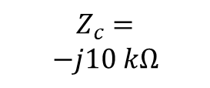

Example 3
Solve for current $I_{1}$. The impedance $Z_{c}$ is already given, so you don’t need the frequency
$$10 kΩ$$
$$Z_{c}=$$
$$−j10 kΩ$$
+
$$I_{1}$$
100$∠0° \text{k}\text{V}$
80$\text{V}$
$$30 kΩ$$
_

Slide 9

Example 4
$$i_{s}\left(t\right)=7.1\cos\left(1256t−10°\right) A$$
$$v_{s}\left(t\right)=113.1\cos\left(1256t+45°\right) \text{V}$$
Find the time signal $v_{1}\left(t\right).$ (Try using mesh-current analysis and node-voltage analysis.)
$$i_{s}$$
4 mH
2Ω
+
+
$$v_{s}$$
$$v_{1}$$
10Ω
_
_
300$μF$

Slide 10
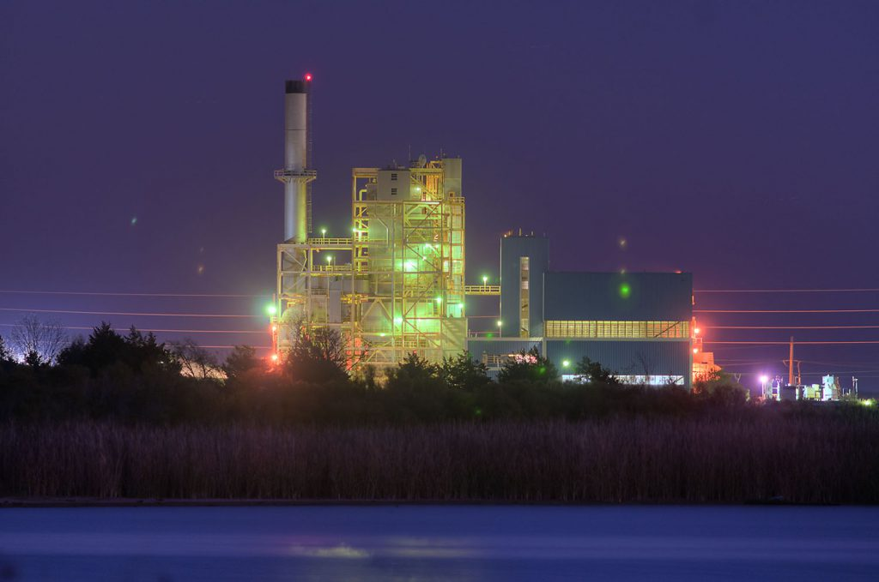
Assignments
Zybook Chapter 7
Quiz next class on AC circuits and impedance
Start working on HW 7A
Sign up for the power plant tour April 5th
Review in-class examples and notes
Practice, practice, practice!
Don’t forget, you need to go to office hours at least once in either March or April. Bring at least one technical question!
Source: https://www.btutilities.com/about-btu/btu-history/

