Slide 1
ECEN 214, Spring 2022 Electrical Circuit Theory
Class 15: Review of Second-Order Circuits, Brief Overview of Electric Energy Systems
Prof. Adam Birchfield
Dept. of Electrical and Computer Engineering
Texas A&M University
abirchfield@tamu.edu

Slide 2
Assignments
Wednesday is Exam 2: Make your note sheet and study!
Office hours Wednesday 1:30pm – 4:00pm

Slide 3
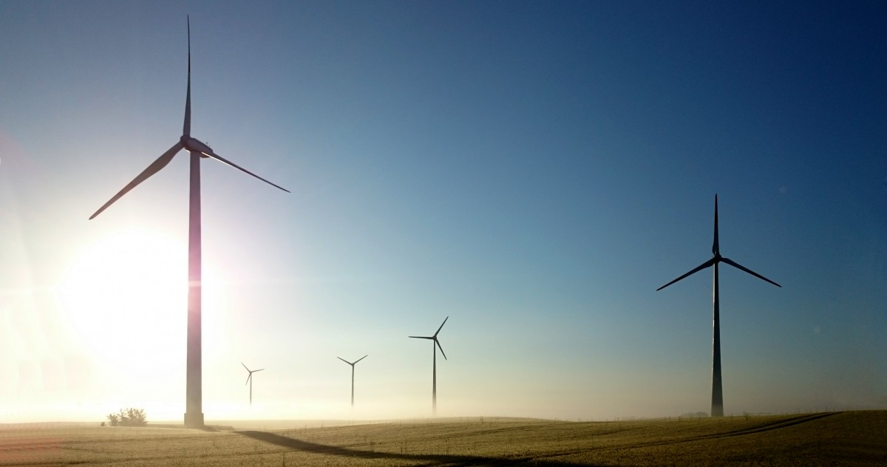
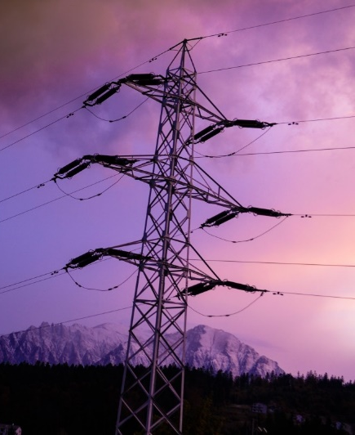
AC Electric Circuits Used to Transport Bulk Energy
The next major topic in this class is AC circuit theory
One main use of electricity is as a means for energy transportation
Use other sources of energy to create it, and it is usually converted into another form of energy when used
About 40% of US energy is transported in electric form
A number of concerns, including fossil fuel depletion, air and water pollution, and the greenhouse effect of carbon dioxide, are driving significant change in world energy infrastructure.
Goal of this discussion is to provide some context for energy usage and the role of the bulk electric transmission grid, to set the stage for our study of AC circuits starting next week.

Slide 4
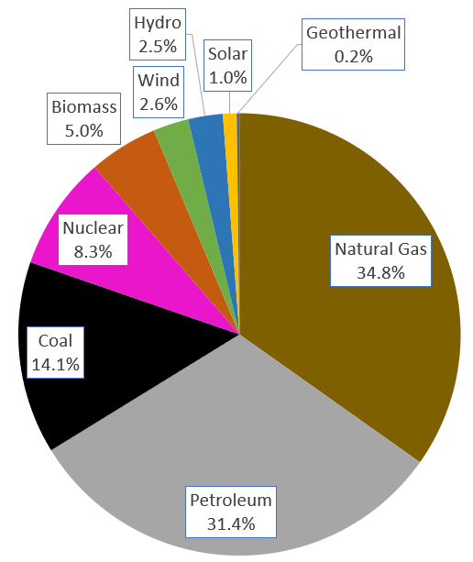
The Overall 2019 Energy Pie
About 40% of our energy is consumed in the form of electricity, a percentage that is gradually increasing. The vast majority on the non-fossil fuel energy is electric.
Total of 100.3 Quad; 1 Quad = 293 billion kWh (actual), 1 Quad = 98 billion kWh (used, taking into account efficiency)
Most of the petroleum usage is in the transportation and industrial sectors, not the electric sector
Source EIA Monthly Energy Review (EIA is US DOE Energy Information Administration)
https://www.eia.gov/

Slide 5
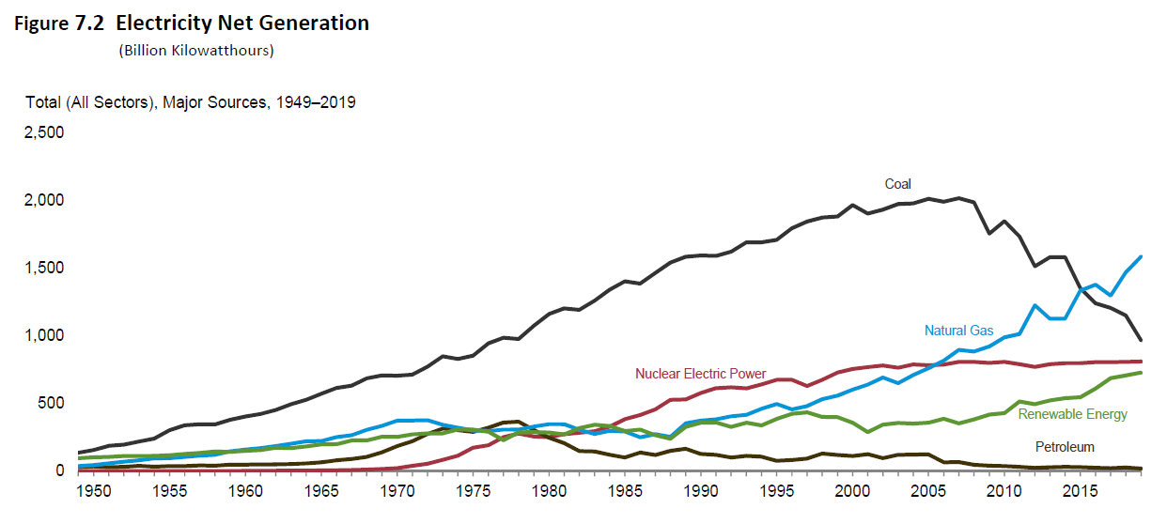
US Electricity Generation
In 2020, top sources were Natural Gas (41%), Nuclear (20%), Coal (19%), Wind (7.9%), Hydro (7.5%), Solar (2.4%).
1-year changes from 2018 to 2019 were Natural Gas (+8%), Nuclear (0%), Coal (-16%), Wind (+8%), Hydro (-2%), Solar (+13%).
Source: EIA Monthly Energy Review, December 2020

Slide 6
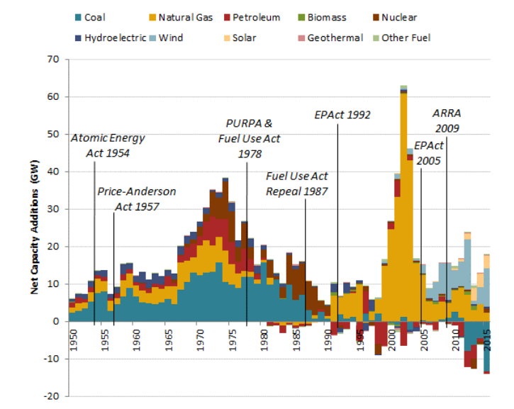
Historical Generator Additions and Retirements
Source: NREL Electricity Generation Baseline, 2017.

Slide 7
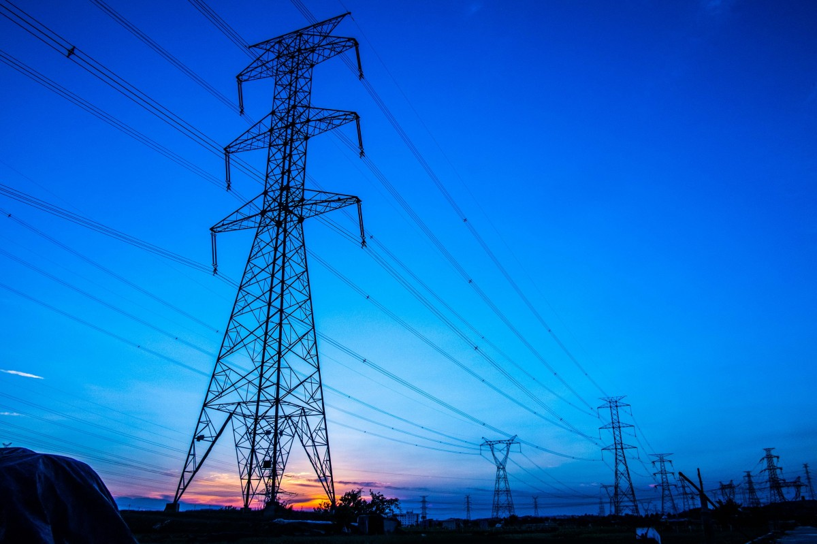
Electric Power Systems
Electricity has many advantages for delivering the energy used by humankind
Conversion to and from other forms is convenient and efficient (such as motors and generators)
Transmission in bulk can be done quickly and efficiently over long distances (power lines)
About 40% of U.S. energy consumption is electric
Power systems range in size
Large: four major interconnections in North America
Medium: islands, militarily installations, ships
Small: airplanes, automobiles, portable battery systems

Slide 8
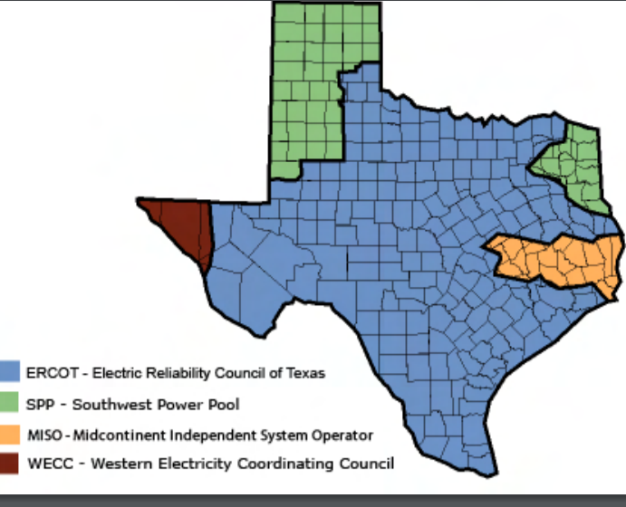
North America 60 Hz Synchronous Interconnections
Source: www.puc.texas.gov/industry/maps/maps/ERCOT.pdf

Slide 9
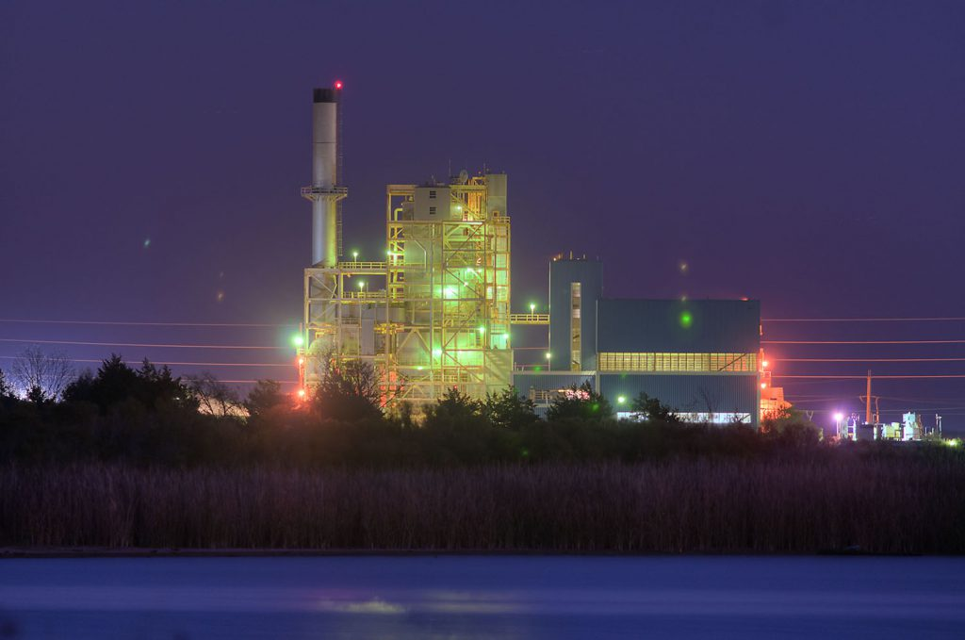
Power Plant Tour!
There will be a power plant tour for our class, hosted by Bryan Texas Utilities (BTU), on Tuesday, April 5 at 3pm.
I sent a Google Form by email. You need to sign up (there may be limited space).
This is optional and will not affect your grade.
The plant is the largest one in our area, with a generation capacity of about 115 MW.
The plant is undergoing a shutdown this week (common in off-peak months like April), so the noise levels should be lower.
Source: https://www.btutilities.com/about-btu/btu-history/

Slide 10
Back to RLC Circuits – How to Find Initial Conditions
Find the initial conditions by looking at the circuit in steady-state before the switch, and then looking at the circuit immediately after the switch.
If you need to find an initial condition for the derivative (such as $\frac{dv_{c}}{dt}$), use the differential equation.
Don’t assume capacitor current or inductor voltage will be zero following the switch.
Note: Voltage dividers only apply to two resistors in series. Current dividers only apply to two resistors in parallel. Don’t use these equations for capacitors or inductors.
 | Capacitors | Inductors
Always True | $$i_{c}=C\frac{dv_{c}}{dt}$$ | $$v_{L}=L\frac{di_{L}}{dt}$$
True in steady state | $$i_{c}=0$$ (Open circuit) | $$v_{c}=0$$ (Short circuit)
True instantly following a switch | Voltage does not change instantaneously (but current can) | Current does not change instantaneously (but voltage can)

