Slide 1
ECEN 214, Spring 2022 Electrical Circuit Theory
Class 14: Oral and Written Communication
Prof. Adam Birchfield
Dept. of Electrical and Computer Engineering
Texas A&M University
abirchfield@tamu.edu

Slide 2

Example Problem
Describe how to find $I_{y}$
$$4Ω$$
$$V_{1}$$
Solution:
$$V_{1}=−8I_{y}$$
$$−I_{y}−2I_{y}+\frac{V_{1}−20}{4}=0$$
$$I_{y}=−1 A$$
+
$$I_{y}$$
$$20V$$
_
$$8Ω$$
$${2I}_{y}$$

Slide 3
Good Oral Communication
Talk loudly and clearly, not too fast
Consider things from your audience’s point of view
Be clear and concise
Focus on and state the big-picture goal or message
“In this problem, we want to…”
Be specific
“The voltage across resistor 1” instead of “the voltage”
Be logical: use deduction from what you know to what you found
“We know the current through this source is X”
Because A, therefore B
Applying X law to Y, we can find Z
You can see that C and D are in parallel, therefore the voltage across them is equal

Slide 4
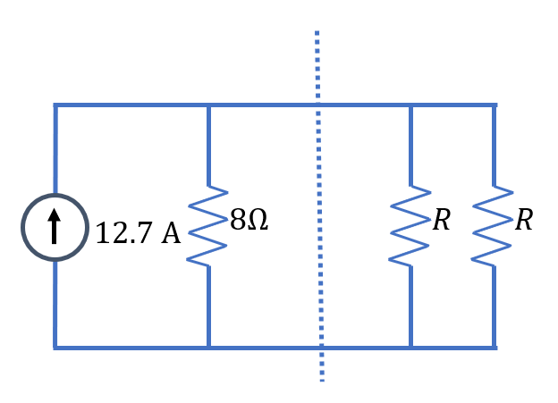
Another Example Problem
Explanation 1:
First I converted it to a voltage and got 101.6 and the same resistance, not including the part to the right of the dotted line for that part. It has to be the same thing on the right, and you have to double it, since there’s two of them and it’s parallel. So the final answer is 16.
Explanation 2:
The left side of the circuit is a Norton equivalent with a resistance of $8Ω$. Maximum power transfer occurs when the load resistance is equal to the Thevenin or Norton equivalent resistance. The combination of the two load resistors in parallel would be $R/2$. Therefore, to maximize power transferred to the load, each resistor $R$ should be 16$Ω$.
In the circuit below, what should the value of R be so that the maximum power is transferred across the dotted line to the pair of resistors on the right?

Slide 5
Good Written Communication
Use clear, large fonts or handwriting
Include a header with the title, author, date, overall subject
Consider your reader’s point of view
Organize so the reader gets the main structure at a glance
Be clear and concise
Pay attention to “arcs of coherence” – how much does the reader have to remember to understand you? And consider “chunking”
Have a clear logical flow to your text that the reader can follow
Label all relevant variables, axes, scales, and objects in any equations, diagrams, or graphs
Use appropriate precision, units, and labeling with any numbers

Slide 6
Oral and Written Communication
Good Oral Communication
Talk loudly and clearly, not too fast
Consider things from your audience’s point of view
Be clear and concise
Focus on and state the big-picture goal or message
Be specific
Be logical: use deduction from what you know to what you found
Good Written Communication
Use large, legible fonts or handwriting
Include a header with the title, author, date, overall subject
Consider your reader’s point of view
Organize so the reader gets the main structure at a glance
Be clear and concise
Have a logical flow to your text that the reader can follow
Label all relevant variables, axes, scales, and objects in any equations, diagrams, or graphs
Use appropriate precision, units, and labeling with any numbers

Slide 7
Assignments
Have a great spring break!
When we get back:
Monday we’ll have a quiz and homework due, then we’ll do some more review
Wednesday is Exam 2: Make your note sheet and study!
In the future, apply these oral and written communication skills every chance you get!
Email
Elevator pitches
Memos and technical reports
Explaining course material to other students
Exam answers
Talking to professors and supervisors
Published articles
Public presentations

