Slide 1
ECEN 214, Spring 2022 Electrical Circuit Theory
Class 12: Second Order Transients, Continued
Prof. Adam Birchfield
Dept. of Electrical and Computer Engineering
Texas A&M University
abirchfield@tamu.edu

Slide 2
Main Topics For Exam 2
Wednesday, March 23rd in class
Topics from Exam 1
Voltage, current, and resistance
Ohm’s law, KVL, KCL
Power and sources
Open, short, parallel, series
Voltage dividers, current dividers
Wye-delta transformation
Node-voltage circuit analysis method
Mesh-current circuit analysis method
Superposition
Thevenin and Norton equivalents
Source transformations
Maximum power transfer
New Topics
Op-Amps
Capacitors and inductors
First-order circuits (RL or RC)
Second-order circuits (RLC)
Exam 2
Mar 23rd, 2022 at 4pm in class
75 minutes
Covers anything through today’s class, including problem solving and conceptual material
You may have one handwritten 8.5”x11” notesheet front and back
Aggie Honor Code
Next two classes are quizzes, more example problems, and review exercises

Slide 3
Example 4 from last class
Find $v_{C}(t)$, assuming no initial charge on the capacitor
$$i_{C}(t)$$
$$t=0$$
$$400mH$$
+
+
$$100nF$$
$$4V$$
_
$$1250Ω$$
$$v_{C}(t)$$
_

Slide 4
Example 4, Continued
$$i_{C}(t)$$
$$t=0$$
$$400mH$$
+
+
$$100nF$$
$$4V$$
_
$$1250Ω$$
$$v_{C}(t)$$
_

Slide 5
Example 4, Continued

Slide 6
Example 4, Continued

Slide 7
Solution to Example 4

Slide 8
What if We Change the Resistance?
$$i_{C}(t)$$
$$t=0$$
$$400mH$$
+
+
$$100nF$$
$$4V$$
_
$$1250Ω$$
$$v_{C}(t)$$
_
A lower resistance in this case gives the circuit more damping (closer to shorting out the capacitor). An extremely high resistance would cause very wild oscillations.

Slide 9
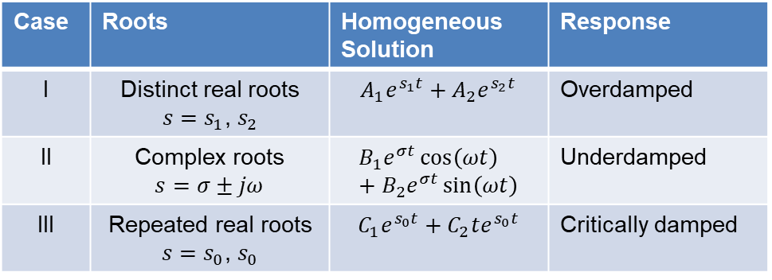
Important Terms to Know for RLC Circuits
Resonant frequency: this is the natural frequency of a combined inductor and capacitor (regardless of whether they are in parallel or series)
$$ω_{0}=\frac{1}{\sqrt{LC}}$$
The type of roots of the characteristic equation will indicate the damping of the system
Overdamped – relatively slow to reach steady state value.
Underdamped – reacts to change in input quickly, but response rings.
Critically damped – quickest approach to steady state values without overshoot.
Case | Roots | Homogeneous Solution | Response
I | Distinct real roots $s=s_{1}$, $s_{2}$ | $$A_{1}e^{s_{1}t}+A_{2}e^{s_{2}t}$$ | Overdamped
II | Complex roots $$s=σ±jω$$ | $$B_{1}e^{σt}\cos\left(ωt\right)+B_{2}e^{σt}\sin\left(ωt\right)$$ | Underdamped
III | Repeated real roots $s=s_{0}$, $s_{0}$ | $$C_{1}e^{s_{0}t}+C_{2}te^{s_{0}t}$$ | Critically damped

Slide 10
Example 5
Find the value of $i_{0}(t)$ at $t=1m\text{s}$
$$t=0$$
$$200mA$$
$$100Ω$$
$$300Ω$$
$$i_{0}(t)$$
$2.5μ$F
$100$mH
Answer: -100mA

Slide 11
Plot of Answer to Example 5
How would this look if the damping were higher? lower?

Slide 12
Assignments
Quizzes March 9 and March 21
Stay ahead of homework assignments and reading
Homework 6A on second-order circuits is due Wednesday, March 9
Homework 6B due Monday, March 21
Not assigning Homework 6C
Exam 2 Wednesday, March 23
Review in-class examples and notes
Practice, practice, practice!
Don’t forget, you need to go to office hours in either March or April. Bring at least one technical question!

