Slide 1
ECEN 214, Spring 2022 Electrical Circuit Theory
Class 12: Second Order Transients
Prof. Adam Birchfield
Dept. of Electrical and Computer Engineering
Texas A&M University
abirchfield@tamu.edu

Slide 2
Capacitors and Inductors
Capacitors
Fundamental equation: $i=C\frac{dv}{dt}$, where C is capacitance in Farads
Add in parallel, combine in series the way resistors do in parallel
In steady-state, they act like an open circuit
Energy stored is $Cv^{2}$/2
Inductors
Fundamental equation: $v=L\frac{di}{dt}$, where L is inductance in Henries
Combine in series and parallel the same way as resistors
In steady-state, they act like a short circuit
Energy stored is $Li^{2}$/2
Transient circuit solutions
We are solving for $v$ and $i$ as a function of time, $v\left(t\right)$ and $i(t)$
Write the differential equations using KVL and KCL
Get initial conditions based on knowledge of steady-state conditions
Solve the differential equations

Slide 3
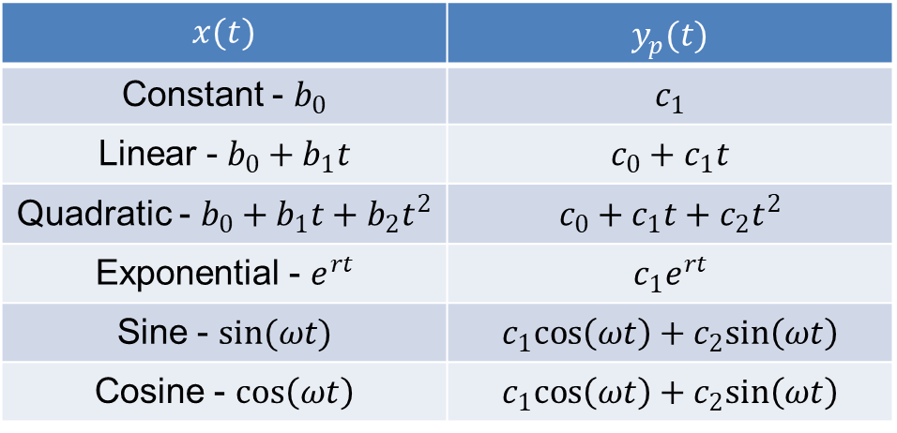
Solving First-Order Differential Equations in this Class
Solving differential equations of the form
$$a\frac{dy}{dx}+by\left(t\right)=x\left(t\right)$$
Along with initial conditions
$$y\left(0\right)=y_{0}$$
Find the homogenous solution of the form $Ae^{−\frac{bt}{a}}$ by setting $x\left(t\right)=0$, with an arbitrary constant A.
Guess the particular solution based on the form of $x(t)$, using the table at right.
Combine the two solutions to find the general solution $y\left(t\right)=y_{h}\left(t\right)+y_{p}\left(t\right)$
Apply initial condition $y_{0}$ to find the unknown constant.
Particular solution table for this class
$$x(t)$$ | $y_{p}(t)$
Constant - $b_{0}$ | $$c_{1}$$
Linear - $b_{0}+b_{1}t$ | $$c_{0}+c_{1}t$$
Quadratic - $b_{0}+b_{1}t+b_{2}t^{2}$ | $$c_{0}+c_{1}t+c_{2}t^{2}$$
Exponential - $e^{rt}$ | $$c_{1}e^{rt}$$
Sine - $sin(ωt)$ | $$c_{1}cos\left(ωt\right)+c_{2}sin\left(ωt\right)$$
Cosine - $cos\left(ωt\right)$ | $$c_{1}cos\left(ωt\right)+c_{2}sin\left(ωt\right)$$

Slide 4
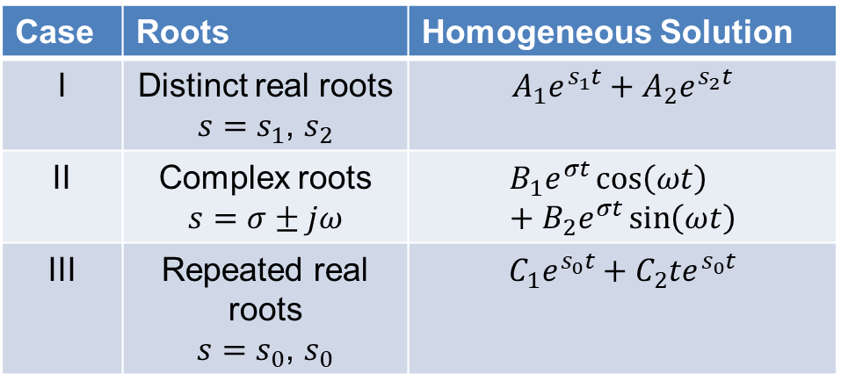
Solving Second-Order Differential Equations
1) For the homogenous solution
$$a\frac{d^{2}y}{dx^{2}}+b\frac{dy}{dx}+cy\left(t\right)=x\left(t\right)$$
We need to find the roots of the characteristic equation
$$as^{2}+bs+c=0$$
Use the table on right to determine the homogenous solution, depending on the roots
2) The particular solution is the same
3) The general solution is the same
4) We will have two initial conditions we will need to find the unknowns, such as
$$y\left(0\right)=y_{0}$$
$$\frac{dy}{dt}\left(0\right)=y_{1}$$
Case | Roots | Homogeneous Solution
I | Distinct real roots $s=s_{1}$, $s_{2}$ | $$A_{1}e^{s_{1}t}+A_{2}e^{s_{2}t}$$
II | Complex roots $$s=σ±jω$$ | $$B_{1}e^{σt}\cos\left(ωt\right)+B_{2}e^{σt}\sin\left(ωt\right)$$
III | Repeated real roots $s=s_{0}$, $s_{0}$ | $$C_{1}e^{s_{0}t}+C_{2}te^{s_{0}t}$$

Slide 5
Example 1
$\frac{d^{2}y}{dt^{2}}+3\frac{dy}{dt}+2y\left(t\right)=4, y\left(0\right)=1, \frac{dy}{dt}\left(0\right)=0$.
Step 1 – Find the Homogeneous solution
$$\frac{d^{2}y}{dt^{2}}+3\frac{dy}{dt}+2y\left(t\right)=0$$
$y=e^{st}$→ $s^{2}+3s+2=0$
$(s+1)(s+2)=0$
$s=−1, −2$
$$y_{H}\left(t\right)=A_{1}e^{−t}+A_{2}e^{−2t}$$

Slide 6
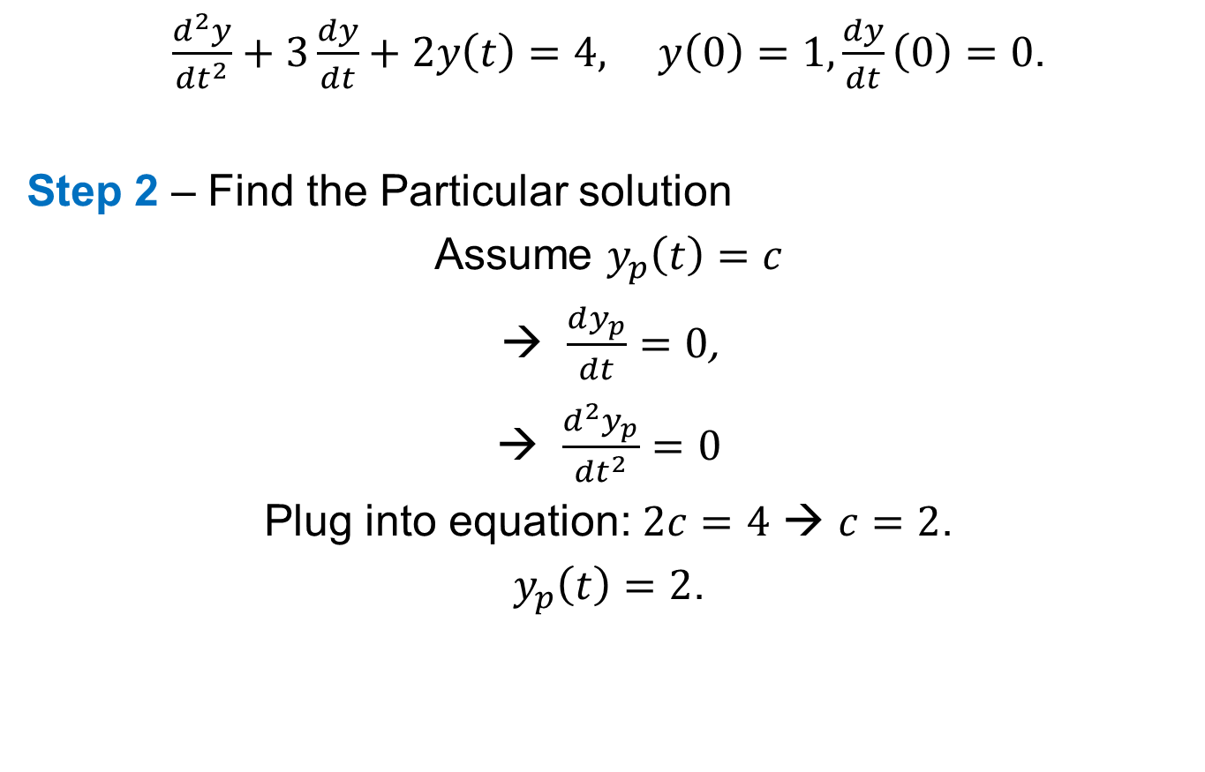
Example 1
$\frac{d^{2}y}{dt^{2}}+3\frac{dy}{dt}+2y\left(t\right)=4, y\left(0\right)=1, \frac{dy}{dt}\left(0\right)=0$.
Step 2 – Find the Particular solution
Assume $y_{p}\left(t\right)=c$
$\frac{dy_{p}}{dt}=0$,
$\frac{d^{2}y_{p}}{dt^{2}}=0$
Plug into equation: $2c=4$ → $c=2$.
$y_{p}\left(t\right)=2$.

Slide 7
Example 1
$\frac{d^{2}y}{dt^{2}}+3\frac{dy}{dt}+2y\left(t\right)=4, y\left(0\right)=1, \frac{dy}{dt}\left(0\right)=0$.
Step 3 – Combine homogeneous and particular solution to form complete solution.
$y\left(t\right)=y_{H}\left(t\right)+y_{P}\left(t\right)=A_{1}e^{−t}+A_{2}e^{−2t}+2$.
Step 4 – Apply ICs to the complete solution to find the unknown constants.
$y\left(0\right)=1$ →$A_{1}+A_{2}+2=1$
$$\frac{dy}{dt}\left(0\right)=0 → {−A}_{1}−2A_{2}=0$$
→$A_{1}=−2$, $A_{2}=1$ → $y\left(t\right)=−2e^{−t}+e^{−2t}+2$

Slide 8
Practice Problems

Slide 9
How to Solve Transient Problems
Write a differential equation using KVL and KCL.
Use the initial state of the circuit to write the initial conditions.
Solve the differential equations with the initial conditions.
Use the solution to find other related quantities: voltage, current, energy, power.

Slide 10

Example 3
Solve for $i(t)$
$$i(t)$$
$$t=0$$
$$500Ω$$
+
$$625nF$$
$$10mA$$
$$25mH$$
$$v_{L}(t)$$
_

Slide 11
Example 3, Continued
$$i(t)$$
$$t=0$$
$$500Ω$$
+
$$625nF$$
$$10mA$$
$$25mH$$
$$v_{L}(t)$$
_

Slide 12
Example 4
Find $i_{C}(t)$
$$i_{C}(t)$$
$$t=0$$
$$400mH$$
+
+
$$100nF$$
$$4V$$
_
$$1250Ω$$
$$v_{C}(t)$$
_

Slide 13
Example 4, Continued
$$i_{C}(t)$$
$$t=0$$
$$400mH$$
+
+
$$100nF$$
$$4V$$
_
$$1250Ω$$
$$v_{C}(t)$$
_

Slide 14
Assignments
Quizzes next week on RC, RL, RLC circuits
Stay ahead of homework assignments and reading
Homework 5B on RC and RL circuits is due Monday, March 7
Homework 6A on second-order circuits is due Wednesday, March 9
Review in-class examples and notes
Practice, practice, practice!
Don’t forget, you need to go to office hours in either March or April. Bring at least one technical question!

