Slide 1
ECEN 214, Spring 2022 Electrical Circuit Theory
Class 11: RC and RL Circuits
Prof. Adam Birchfield
Dept. of Electrical and Computer Engineering
Texas A&M University
abirchfield@tamu.edu

Slide 2
Capacitors and Inductors
Capacitors
Fundamental equation: $i=C\frac{dv}{dt}$, where C is capacitance in Farads
Add in parallel, combine in series the way resistors do in parallel
In steady-state, they act like an open circuit
Energy stored is $Cv^{2}$
Inductors
Fundamental equation: $v=L\frac{di}{dt}$, where L is inductance in Henries
Combine in series and parallel the same way as resistors
In steady-state, they act like a short circuit
Energy stored is $Li^{2}$
Transient circuit solutions
We are solving for $v$ and $i$ as a function of time, $v\left(t\right)$ and $i(t)$
Write the differential equations using KVL and KCL
Get initial conditions based on knowledge of steady-state conditions
Solve the differential equations

Slide 3
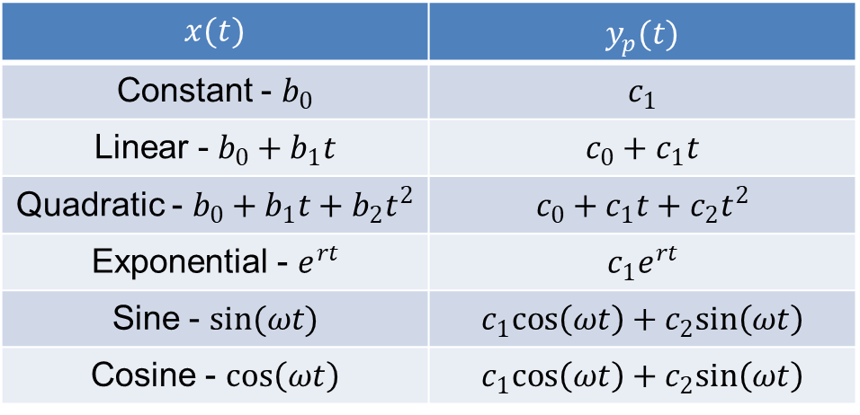
Solving First-Order Differential Equations in this Class
Solving differential equations of the form
$$a\frac{dy}{dx}+by\left(t\right)=x\left(t\right)$$
Along with initial conditions
$$y\left(0\right)=y_{0}$$
Find the homogenous solution of the form $Ae^{−\frac{bt}{a}}$ by setting $x\left(t\right)=0$, with an arbitrary constant A.
Guess the particular solution based on the form of $x(t)$, using the table at right.
Combine the two solutions to find the general solution $y\left(t\right)=y_{h}\left(t\right)+y_{p}\left(t\right)$
Apply initial condition $y_{0}$ to find the unknown constant.
Particular solution table for this class
$$x(t)$$ | $y_{p}(t)$
Constant - $b_{0}$ | $$c_{1}$$
Linear - $b_{0}+b_{1}t$ | $$c_{0}+c_{1}t$$
Quadratic - $b_{0}+b_{1}t+b_{2}t^{2}$ | $$c_{0}+c_{1}t+c_{2}t^{2}$$
Exponential - $e^{rt}$ | $$c_{1}e^{rt}$$
Sine - $sin(ωt)$ | $$c_{1}cos\left(ωt\right)+c_{2}sin\left(ωt\right)$$
Cosine - $cos\left(ωt\right)$ | $$c_{1}cos\left(ωt\right)+c_{2}sin\left(ωt\right)$$

Slide 4
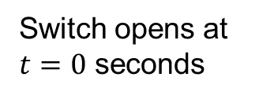
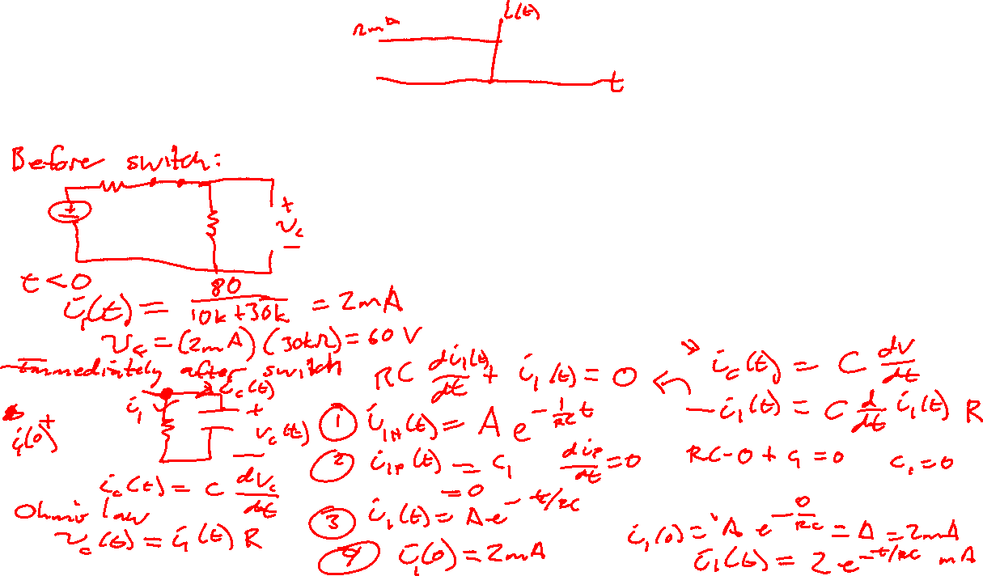
Example 1
What is $i_{1}(t)$?
Switch opens at $t=0$ seconds
$$10 kΩ$$
$$i_{1}(t)$$
+
80$\text{V}$
$$30 μF$$
_
$$30 kΩ$$

Slide 5
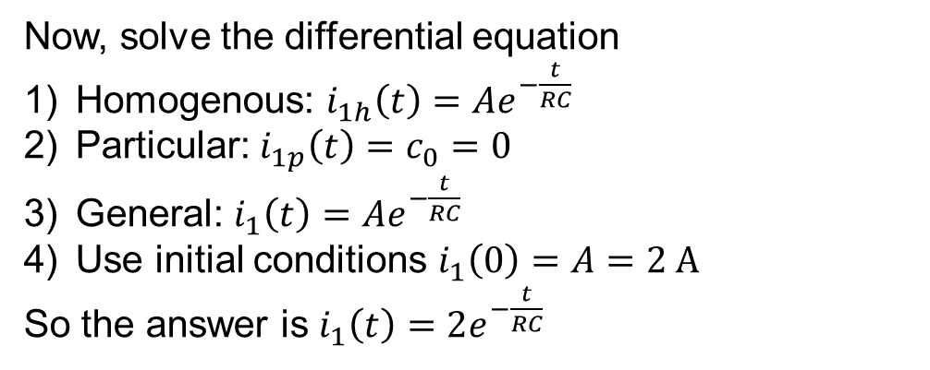
Example 1
First, look at the steady-state values
Before the switch, $i_{1}\left(t\right)=2 \text{A}$
Immediately after the switch, capacitor maintains the voltage across the resistor, so $i_{1}{\left(0\right)}^{+}=2 \text{A}$
After the circuit reaches a new steady-state, $i_{1}\left(∞\right)=0$
Differential equation for capacitor
$$i_{c}\left(t\right)=C\frac{dv_{c}\left(t\right)}{dt}$$
$$−i_{1}\left(t\right)=C\frac{d}{dt}R_{1}i_{1}\left(t\right)$$
$$R_{1}C\frac{di_{1}}{dt}+i_{1}\left(t\right)=0$$
Switch opens at $t=0$ seconds
$$10 kΩ$$
$$i_{1}(t)$$
+
80$\text{V}$
$$30 μF$$
_
$$R_{1}=30 kΩ$$
Now, solve the differential equation
Homogenous: $i_{1h}\left(t\right)=Ae^{−\frac{t}{RC}}$
Particular: $i_{1p}\left(t\right)=c_{0}=0$
General: $i_{1}\left(t\right)=Ae^{−\frac{t}{RC}}$
Use initial conditions $i_{1}\left(0\right)=A=2 \text{A}$
So the answer is $i_{1}\left(t\right)=2e^{−\frac{t}{RC}}$

Slide 6
Examining Solution to Example 1
$$i_{1}\left(t\right)=2e^{−\frac{t}{RC}}$$
Current decays as energy stored in capacitor is absorbed by resistor $R_{1}$
This is an “RC” circuit
The time constant is RC = $30 kΩ⋅30 μF=0.9 s$
After one time constant, it’s 63% towards the steady-state answer. After two, 86%. After five, 99.3%

Slide 7

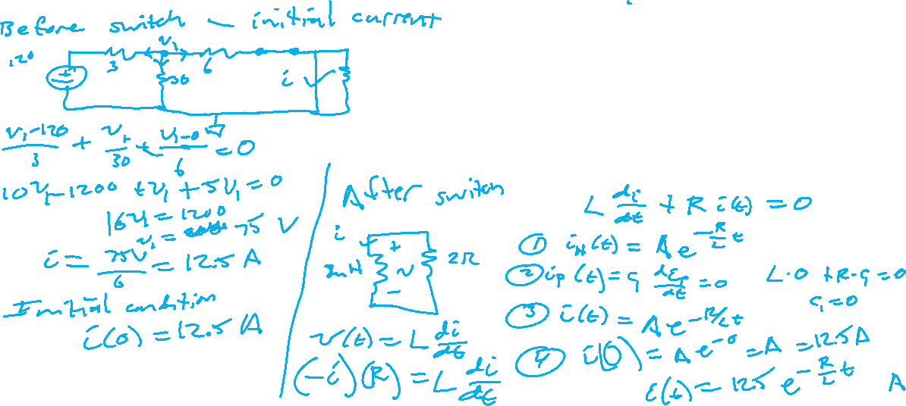
Example 2
Find $i(t)$
$$t=0$$
$$3Ω$$
$$6Ω$$
$$i(t)$$
120V
+
_
$$30Ω$$
8mH
$$2Ω$$

Slide 8

Example 3
$V_{cc}=20 V$, and there is zero initial voltage on the capacitor. How long will it take the op-amp to saturate?
$$10 nF$$
5 kΩ
$$V_{CC}$$
_
+
$$v_{o}\left(t\right)$$
_
+
$$−V_{CC}$$
+
3 V
_

Slide 9
Assignments
Quiz Wednesday Mar 2 on first-order RC and RL circuits
Stay ahead of homework assignments and reading
Homework 5A on Inductors, Capacitors, first-order circuits is due Wednesday, March 2
Homework 5B on RC and RL circuits is due Monday, March 7
Review in-class examples and notes
Practice, practice, practice!
Don’t forget, you need to go to office hours once in either January or February and again in either March or April. Bring at least one technical question!

