Slide 1
ECEN 214, Spring 2022
Electrical Circuit Theory
Class 10: Solving First-Order Differential Equations for RC and RL Circuits
Prof. Adam Birchfield
Dept. of Electrical and Computer Engineering
Texas A&M University
abirchfield@tamu.edu

Slide 2
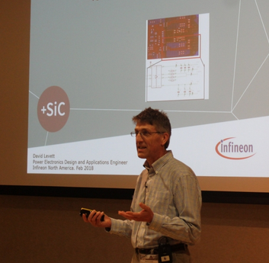
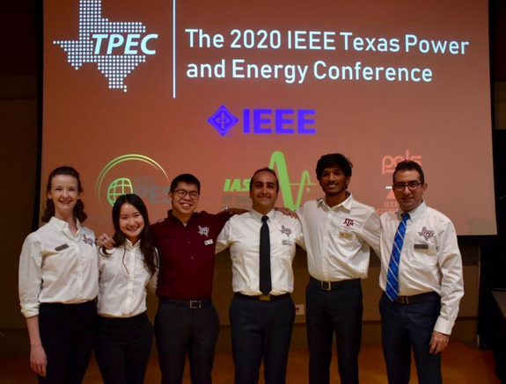
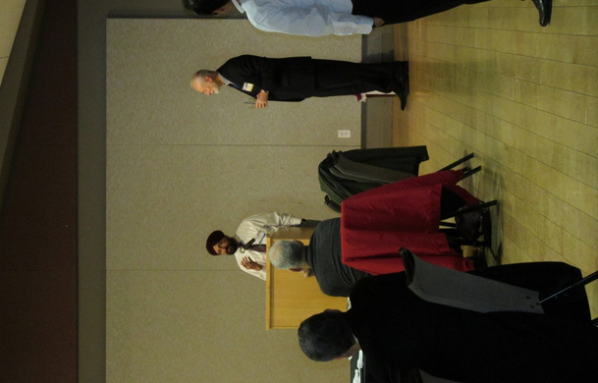
TPEC 2022: Texas Power and Energy Conference
Feb 28 and Mar 1 in the MSC
Research presentations in the power and energy area
Free for Texas A&M students
See more at tpec.engr.tamu.edu
Office hours only until 2:30pm on Monday due to this

Slide 3
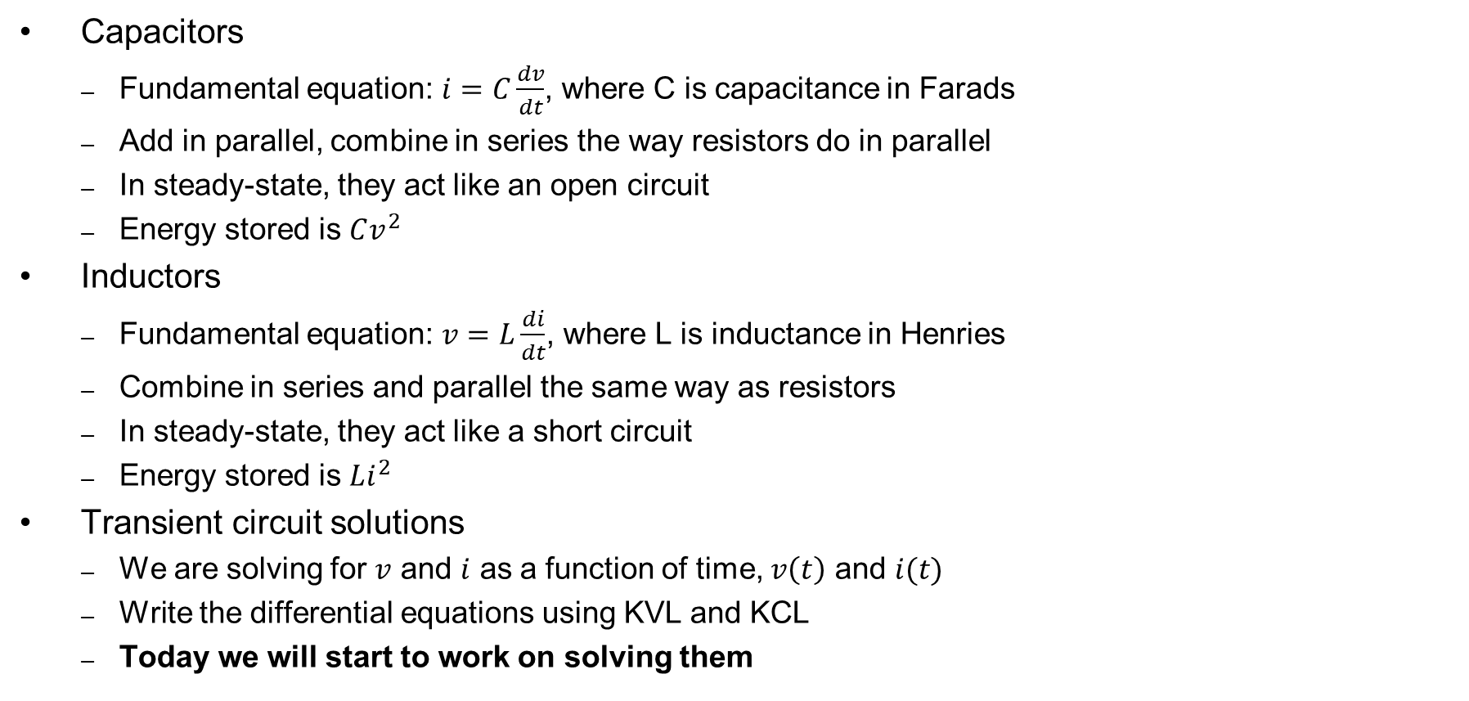
What We Learned Last Time
Capacitors
  Fundamental equation: $i=C\frac{dv}{dt}$, where C is capacitance in Farads
  Add in parallel, combine in series the way resistors do in parallel
  In steady-state, they act like an open circuit
  Energy stored is $Cv^{2}$
Inductors
  Fundamental equation: $v=L\frac{di}{dt}$, where L is inductance in Henries
  Combine in series and parallel the same way as resistors
  In steady-state, they act like a short circuit
  Energy stored is $Li^{2}$
Transient circuit solutions
  We are solving for $v$ and $i$ as a function of time, $v\left(t\right)$ and $i(t)$
  Write the differential equations using KVL and KCL
  Today we will start to work on solving them

Slide 4
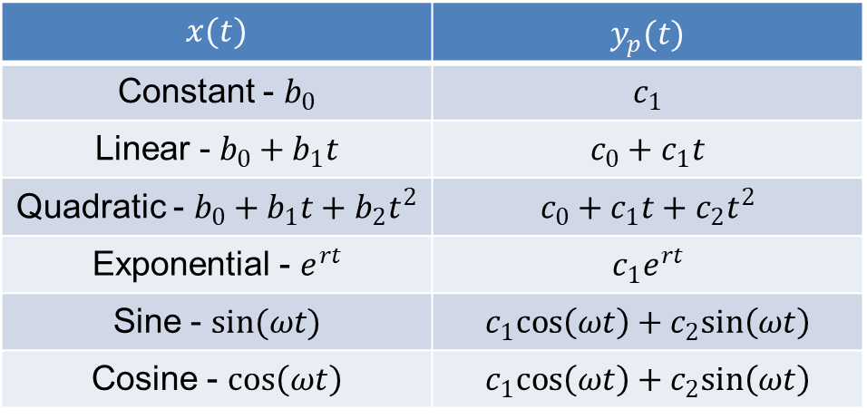
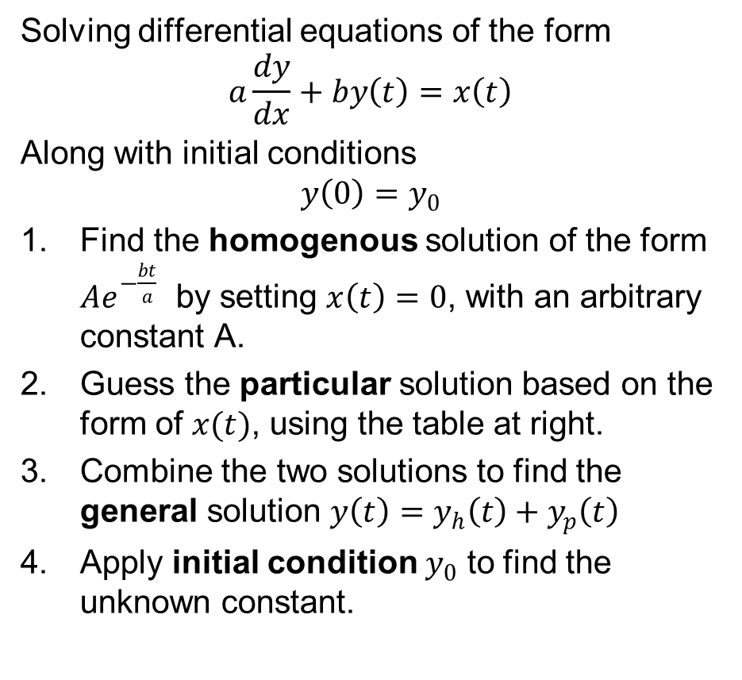
Solving First-Order Differential Equations in this Class
Solving differential equations of the form
$$a\frac{dy}{dx}+by\left(t\right)=x\left(t\right)$$
Along with initial conditions
$$y\left(0\right)=y_{0}$$
Find the homogenous solution of the form $Ae^{−\frac{bt}{a}}$ by setting $x\left(t\right)=0$, with an arbitrary constant A.
Guess the particular solution based on the form of $x(t)$, using the table at right.
Combine the two solutions to find the general solution $y\left(t\right)=y_{h}\left(t\right)+y_{p}\left(t\right)$
Apply initial condition $y_{0}$ to find the unknown constant.
Particular solution table for this class
$$x(t)$$ | $y_{p}(t)$
Constant - $b_{0}$ | $$c_{1}$$
Linear - $b_{0}+b_{1}t$ | $$c_{0}+c_{1}t$$
Quadratic - $b_{0}+b_{1}t+b_{2}t^{2}$ | $$c_{0}+c_{1}t+c_{2}t^{2}$$
Exponential - $e^{rt}$ | $$c_{1}e^{rt}$$
Sine - $sin(ωt)$ | $$c_{1}cos\left(ωt\right)+c_{2}sin\left(ωt\right)$$
Cosine - $cos\left(ωt\right)$ | $$c_{1}cos\left(ωt\right)+c_{2}sin\left(ωt\right)$$

Slide 5

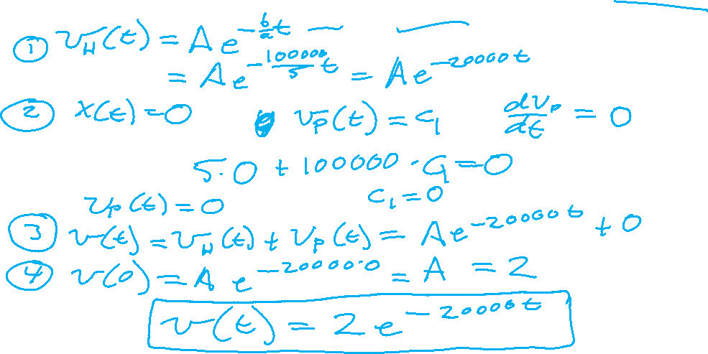
Example 1
Solve this differential equation for $v\left(t\right)$ for $t≥0$, given initial condition $v\left(0\right)=2 \text{V}$
$$5\frac{dv\left(t\right)}{dt}+100,000 v\left(t\right)=0$$

Slide 6
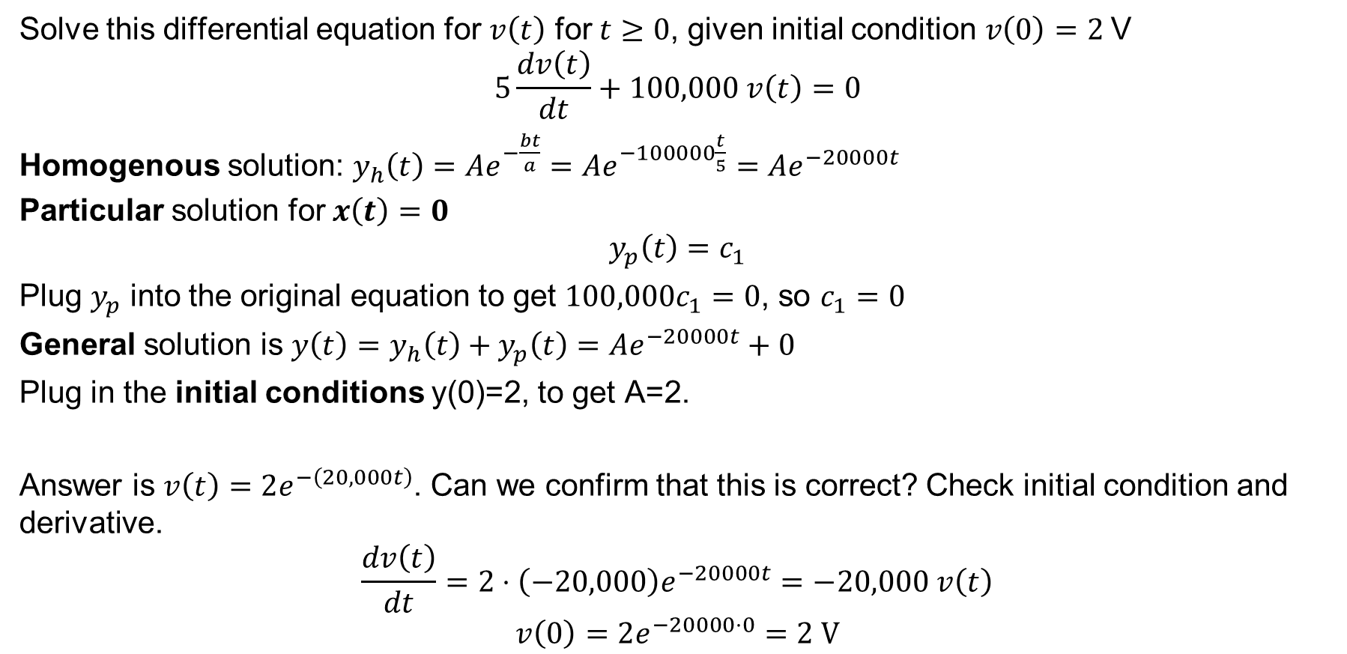
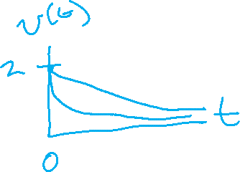
Example 1
Solve this differential equation for $v\left(t\right)$ for $t≥0$, given initial condition $v\left(0\right)=2 \text{V}$
$$5\frac{dv\left(t\right)}{dt}+100,000 v\left(t\right)=0$$
Homogenous solution: $y_{h}\left(t\right)=Ae^{−\frac{bt}{a}}=Ae^{−100000\frac{t}{5}}=Ae^{−20000t}$
Particular solution for $x\left(t\right)=0$
$$y_{p}\left(t\right)=c_{1}$$
Plug $y_{p}$ into the original equation to get $100,000c_{1}=0$, so $c_{1}=0$
General solution is $y\left(t\right)=y_{h}\left(t\right)+y_{p}\left(t\right)=$ $Ae^{−20000t}+0$
Plug in the initial conditions y(0)=2, to get A=2.
Answer is $v\left(t\right)=2e^{−\left(20,000t\right)}$. Can we confirm that this is correct? Check initial condition and derivative.
$$\frac{dv\left(t\right)}{dt}=2⋅\left(−20,000\right)e^{−20000t}=−20,000 v\left(t\right)$$
$$v\left(0\right)=2e^{−20000⋅0}=2 \text{V}$$

Slide 7

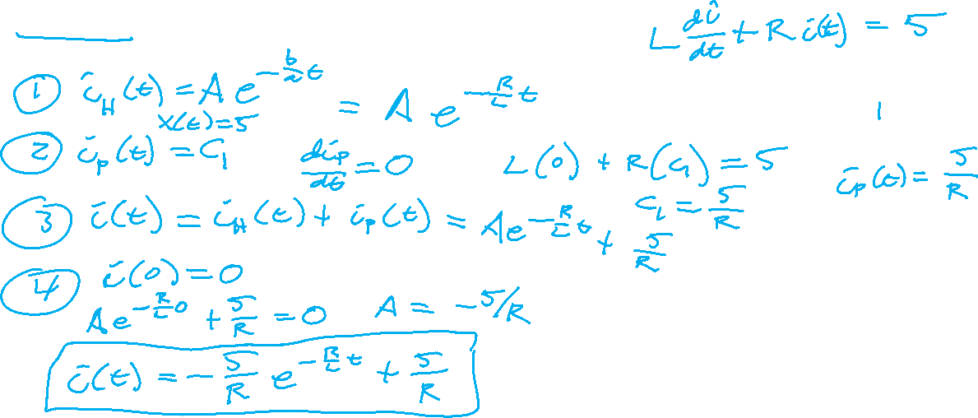
Example 2
Solve this differential equation for $i\left(t\right)$ for $t≥0$, in terms of $R$ and $L$, given initial condition $i\left(0\right)=0$.
$$L\frac{di\left(t\right)}{dt}=5−i\left(t\right)⋅R$$

Slide 8

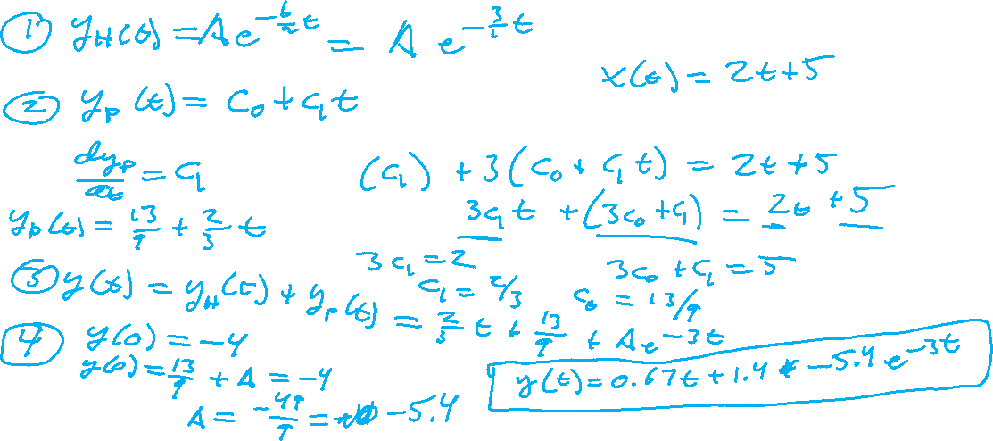
Example 3
$$\frac{dy}{dt}+3y\left(t\right)=2t+5, y\left(0\right)=−4$$

Slide 9
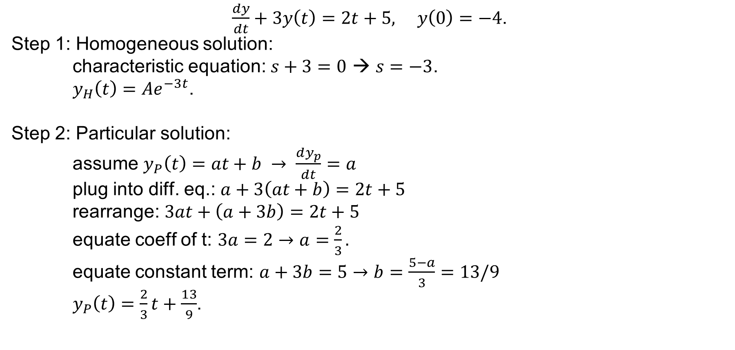
Solution to Example 3
$\frac{dy}{dt}+3y\left(t\right)=2t+5, y\left(0\right)=−4$.
Step 1: Homogeneous solution:
characteristic equation: $s+3=0$ → $s=−3$.
$y_{H}\left(t\right)=Ae^{−3t}$.
Step 2: Particular solution:
assume $y_{P}\left(t\right)=at+b → \frac{dy_{p}}{dt}=a$
plug into diff. eq.: $a+3\left(at+b\right)=2t+5$
rearrange: $3at+\left(a+3b\right)=2t+5$
equate coeff of t: $3a=2→a=\frac{2}{3}.$
equate constant term: $a+3b=5→b=\frac{5−a}{3}=13/9$
$y_{P}\left(t\right)=\frac{2}{3}t+\frac{13}{9}$.

Slide 10

Solution to Example 3
$\frac{dy}{dt}+3y\left(t\right)=2t+5, y\left(0\right)=−4$.
Step 3: Form complete solution:
$y\left(t\right)=Ae^{−3t}+\frac{2}{3}t+\frac{13}{9}$.
Step 4: Apply initial condition:
$y\left(0\right)=A+\frac{13}{9}=−4→A=−\frac{49}{9}$.
Final answer:
$$y\left(t\right)=−\frac{49}{9}e^{−3t}+\frac{2}{3}t+\frac{13}{9}$$

Slide 11


Example 4
$$2\frac{dy}{dt}+5y\left(t\right)=1, y\left(0\right)=3$$

Slide 12

Solution to Example 4
$$2\frac{dy}{dt}+5y\left(t\right)=1, y\left(0\right)=3$$
Step 1 – Find the Homogeneous solution
$$2\frac{dy}{dt}+5y\left(t\right)=0$$
$y=e^{st}$→ $2s+5=0$→ $s=−5/2$
$$y_{H}\left(t\right)=Ae^{−5t/2}$$
Step 2 – Find the Particular solution
Guess $y\left(t\right)=c$ → $2(0)+5c=1$ → $c=1/5$.
$y_{P}\left(t\right)=1/5$.

Slide 13
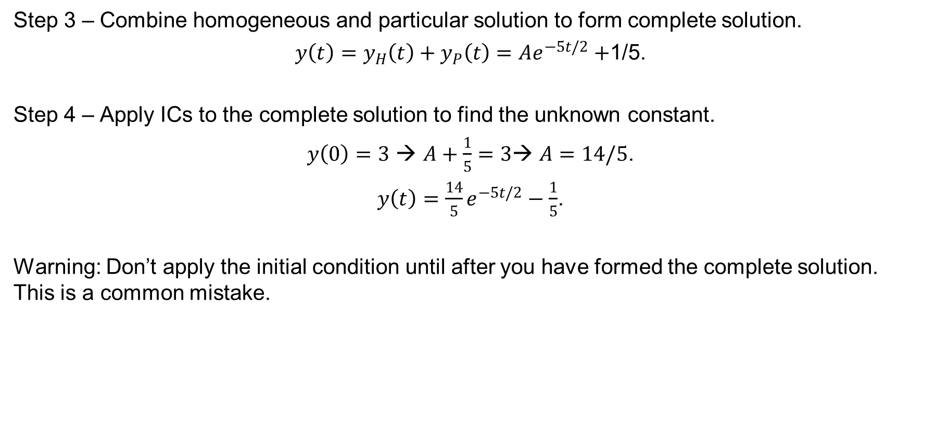
Solution to Example 4
Step 3 – Combine homogeneous and particular solution to form complete solution.
$y\left(t\right)=y_{H}\left(t\right)+y_{P}\left(t\right)=Ae^{−5t/2}+$1/5.
Step 4 – Apply ICs to the complete solution to find the unknown constant.
$y\left(0\right)=3$ → $A+\frac{1}{5}=3$→ $A=14/5$.
$y\left(t\right)=\frac{14}{5}e^{−5t/2}−\frac{1}{5}$.
Warning: Don’t apply the initial condition until after you have formed the complete solution. This is a common mistake.

Slide 14

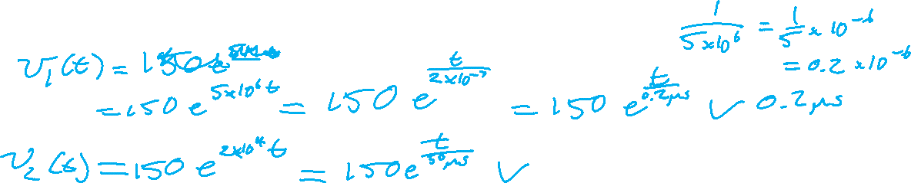
Example 5
Solve for both of the following voltages for $t>0$, given that they both begin at 150 V at t=0. The values of the capacitances are $C_{1}=1μF$ and $C_{2}=100μF$. (Note this is example 3 from last class.)
$$C_{1}\frac{dv_{1}}{dt}=\frac{v_{1}}{0.2} C_{2}\frac{dv_{2}}{dt}=\frac{v_{2}}{0.5}$$

Slide 15
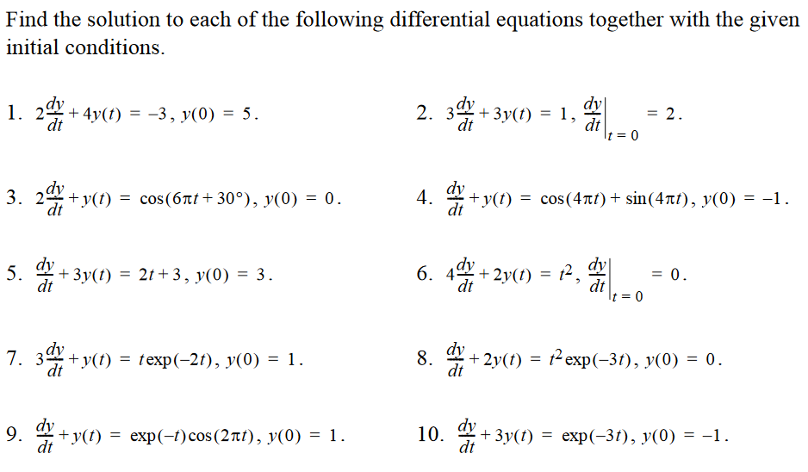
If You Need More Practice, Try Some of These

Slide 16
Assignments
Quiz Monday Feb 28 on capacitors and inductors
Quiz Wednesday Mar 2 on first-order RC and RL circuits
Stay ahead of homework assignments and reading
  Homework 4 on Op-Amps is due Monday, Feb 28
  Homework 5 on Inductors, Capacitors, first-order circuits is due Wednesday, March 2
Review in-class examples and notes
  Practice, practice, practice!
Don’t forget, you need to go to office hours once in either January or February and again in either March or April. Bring at least one technical question!

