Slide 1
ECEN 214, Spring 2022 Electrical Circuit Theory
Class 8: The Operational Amplifier
Prof. Adam Birchfield
Dept. of Electrical and Computer Engineering
Texas A&M University
abirchfield@tamu.edu

Slide 2
Main Topics for Exam 1
Voltage, current, and resistance
Ohm’s law, KVL, KCL
Power and sources
Open, short, parallel, series
Voltage dividers, current dividers
Wye-delta transformation
Node-voltage circuit analysis method
Mesh-current circuit analysis method
Superposition
Thevenin and Norton equivalents
Source transformations
Maximum power transfer
Exam 1
Feb 16th, 2022 at 4pm in class
75 minutes
Covers anything through today’s class, including problem solving and conceptual material
You may have one handwritten 8.5”x11” notesheet front and back
Aggie Honor Code
Next class, Feb 9th, is a review class
Monday, Feb 14th, is new material that won’t be on Exam 1

Slide 3
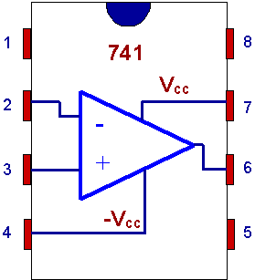
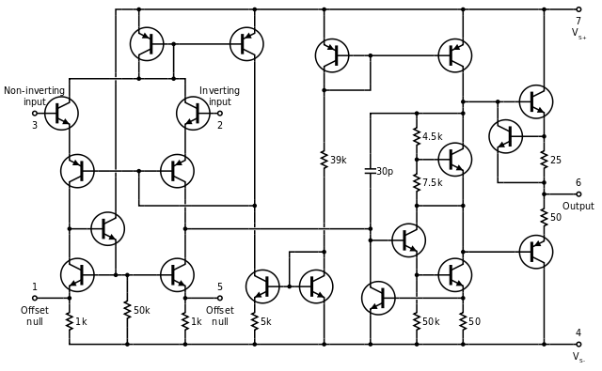
Operational Amplifiers (Op-Amps)
An operational amplifier (Op Amp) is an amplification circuit that is commonly used in a wide variety of applications. Its schematic diagram is as shown and has 5 terminals:
Inverting input (-)
Non-inverting input (+)
Positive power supply
Negative power supply
Output
Op amps are typically integrated onto a chip like the one shown here.
Internally, they consist of a number of transistors, but we will not concern ourselves with the internal workings in this course.
Positive
Power
Supply
Non-inverting
Input
+
_
Output
Inverting
Input
Negative
Power
Supply
Notes:
=+IV

Slide 4
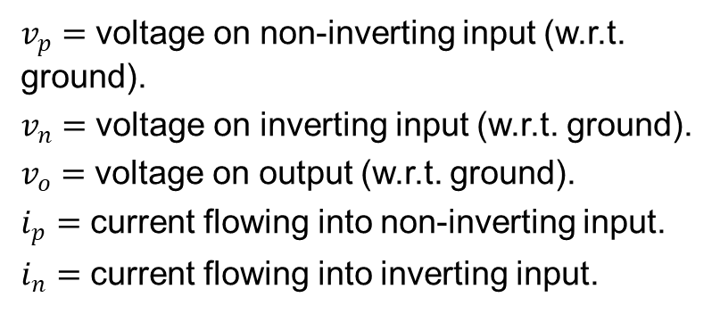
Op-Amp Voltages and Currents
The voltages and currents associated with an op-amp are defined as shown (assuming supply voltages of $+V_{CC}$ and $−V_{CC}.)$
$$i_{p}$$
$v_{p}=$ voltage on non-inverting input (w.r.t. ground).
$v_{n}=$ voltage on inverting input (w.r.t. ground).
$v_{o}=$ voltage on output (w.r.t. ground).
$i_{p}=$ current flowing into non-inverting input.
$i_{n}=$ current flowing into inverting input.
$$i_{n}$$
+
+
_
+
+
+
_
$$v_{CC}$$
$$v_{p}$$
_
$$v_{n}$$
$$v_{CC}$$
$$v_{o}$$
_
_
+
_
Notes:
=+IV

Slide 5
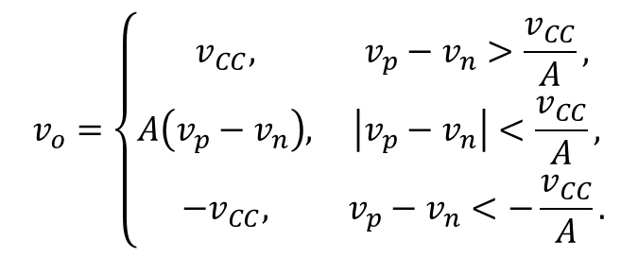
Op-Amp Regions of Operation
The op-amp is essentially an amplifier that produces an output which is proportional to the voltage difference between the input terminals:
$v_{o}=A(v_{p}−v_{n})$
Where $A$ is a large positive number ($A\sim {10}^{6}$).
If the input gets too large, the op amp cannot produce an output larger than $v_{CC}$ and the op amp output is saturated at $v_{o}=v_{CC}$. Similarly, if the input is too negative, the output saturates at $v_{o}=−v_{CC}$.
The behavior of the op amp is characterized by the picture shown…
… or by the piecewise mathematical equation given →
$$v_{o}$$
$$v_{CC}$$
$$−\frac{v_{CC}}{A}$$
$$\frac{v_{CC}}{A}$$
$$v_{p}−v_{n}$$
$${−v}_{CC}$$
negative saturation region
linear region
positive saturation region
$$v_{o}=\left\{\begin{matrix}v_{CC}, & v_{p}−v_{n}>\frac{v_{CC}}{A}, \\ A\left(v_{p}−v_{n}\right), & \left|v_{p}−v_{n}\right|<\frac{v_{CC}}{A}, \\ {−v}_{CC}, & v_{p}−v_{n}<−\frac{v_{CC}}{A}.\end{matrix}\right.$$
Notes:
=+IV

Slide 6
Ideal Op-Amp Equations
Virtual Short Condition
Using typical numbers, $A\sim {10}^{6}$, $v_{CC}=20V$ (upper limit), then the linear region occurs when $\left|v_{p}−v_{n}\right|<20μV$. Hence, for an op-amp operating in its linear mode,$\left|v_{p}−v_{n}\right|≈0$.
$v_{p}=v_{n}$.
Infinite Input Resistance Condition
For op amps, the equivalent resistance seen looking into the input terminals is very large $\sim 1MΩ$ (ideally infinite). In which case, the current flowing into (or out of) the input terminals is very small (ideally zero) resulting in the ideal constraint that
$i_{n}=i_{p}=0$.
These equations form the starting point from which we analyze any op amp circuit.
Notes:
=+IV

Slide 7


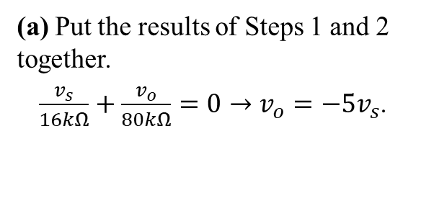
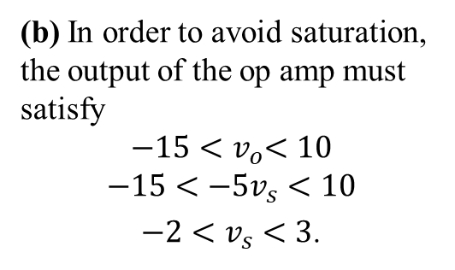
Analyzing Op-Amp Circuits
Example 1
Assuming ideal operation of the op amp,
(a) Find $v_{o}$ as a function of $v_{s}$.
(b) Specify the range of $v_{s}$ to avoid saturation of the op amp.
$$i_{f}$$
80kΩ
$$i_{s}$$
16kΩ
$$i_{n}$$
10V
_
$$v_{n}$$
$$v_{s}$$
+
+
+
Step 1: Use the infinite input resistance condition ($i_{n}=0$) and KCL at the inverting input.
$i_{n}=i_{s}+i_{f}=0$.
_
$$v_{p}$$
-15V
$$v_{o}$$
_
Step 2: Use the virtual short condition ($v_{p}=v_{n}$) and the fact that the non-inverting input terminal is connected to ground ($v_{p}=0$).
$v_{n}=0→i_{s}=\frac{v_{s}}{16kΩ}$ and $i_{f}=\frac{v_{o}}{80kΩ}$.
(a) Put the results of Steps 1 and 2 together.
$\frac{v_{s}}{16kΩ}+\frac{v_{o}}{80kΩ}=0→v_{o}=−5v_{s}$.
(b) In order to avoid saturation, the output of the op amp must satisfy
$${−15<v}_{o}<10$$
$$−15<−5v_{s}<10$$
$−2<v_{s}<3$.
Notes:
=+IV

Slide 8
Example 2
Find $i_{L}$, the current flowing through the load resistor.
5kΩ
10kΩ
_
6kΩ
+
$$i_{L}$$
+
5V
_
+
3V
_
3k$Ω$
4k$Ω$

Slide 9
Example 3
Find ${v_{1}, v_{o}, i}_{2}, i_{o}.$
40kΩ
50kΩ
$$i_{2}$$
+
$$v_{1}$$
20kΩ
2kΩ
15V
_
_
$$i_{o}$$
+
+
-15V
+
150mV
_
$$v_{o}$$
25k$Ω$
_

Slide 10
Op Amp Configurations
The name “operational amplifier” stems from the fact that by adding various external components to the op amp, we can make it perform a variety of useful mathematical operations including:
Addition
Multiplication
Linear combinations
Differentiation
Integration
The next few slides illustrate a few of these configurations that can be achieved with purely resistive circuitry.
For this course, it is not necessary that you memorize these configurations. Rather, just take these as examples of op amp circuits and make sure that you understand how these configurations are analyzed.
In all cases, we start the analysis from the ideal op amp equations.
Notes:
=+IV

Slide 11
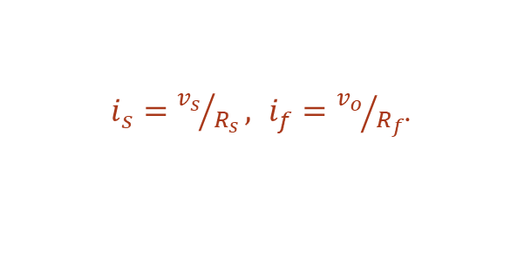
Inverting Amplifier
This configuration produces an output which is a negative multiple of the input signal.
$$i_{f}$$
$$R_{f}$$
$$i_{s}$$
$$R_{s}$$
$$i_{n}$$
$$V_{CC}$$
_
$v_{p}=v_{n}=0$.
$$v_{n}$$
$$v_{p}$$
+
$$−V_{CC}$$
+
$i_{s}={v_{s}}/{R_{s}},$ $i_{f}={v_{o}}/{R_{f}}$.
$$v_{s}$$
+
_
$$v_{o}$$
_
${i_{n}=i}_{s}+i_{f}=0$.
$\frac{v_{s}}{R_{s}}+\frac{v_{o}}{R_{f}}=0$.
$$v_{o}=−\frac{R_{f}}{R_{s}}v_{s}.$$
Notes:
=+IV

Slide 12

Summing Amplifier
By adding multiple inputs we can produce a linear combination (inverted) of the source voltages at the output.
$$i_{f}$$
$$R_{f}$$
$$i_{a}$$
$$R_{a}$$
$$i_{n}$$
$$V_{CC}$$
_
$$i_{b}$$
$$R_{b}$$
$$v_{n}$$
$v_{p}=v_{n}=0$.
+
_
$$i_{c}$$
$$R_{c}$$
$$v_{p}$$
+
$$v_{a}$$
$$−V_{CC}$$
+
$i_{a}={v_{a}}/{R_{a}},$
$i_{b}={v_{b}}/{R_{b}}$,
$i_{c}={v_{c}}/{R_{c}}$,
$i_{f}={v_{o}}/{R_{f}}$.
+
$$v_{o}$$
_
$$v_{b}$$
+
_
_
$$v_{c}$$
${i_{n}=i}_{a}+i_{b}+i_{c}+i_{f}=0$.
$$v_{o}=−\left(\frac{R_{f}}{R_{a}}v_{a}+\frac{R_{f}}{R_{b}}v_{b}+\frac{R_{f}}{R_{c}}v_{c}\right).$$
$\frac{v_{a}}{R_{a}}+\frac{v_{b}}{R_{b}}+\frac{v_{c}}{R_{c}}+\frac{v_{o}}{R_{f}}=0$.
Notes:
=+IV

Slide 13

Non-Inverting Amplifier
This configuration produces an output which is a positive multiple of the input signal.
$$i_{f}$$
$$R_{f}$$
$$i_{s}$$
$$R_{s}$$
$$i_{n}$$
$$V_{CC}$$
_
$$i_{g}$$
$$v_{n}$$
$i_{g}=0$. $v_{p}=v_{g}.$
+
$$v_{p}$$
$$−V_{CC}$$
+
$$R_{g}$$
+
$$v_{o}$$
$v_{p}=v_{n}=v_{g}$.
_
$$v_{g}$$
_
$i_{s}=−{v_{g}}/{R_{s}},$ $i_{f}={v_{o}−v_{g}}/{R_{f}}$.
${i_{n}=i}_{s}+i_{f}=0$.
$$v_{o}=\frac{R_{f}+R_{s}}{R_{s}}v_{g}.$$
$−\frac{v_{g}}{R_{s}}+\frac{v_{o}−v_{g}}{R_{f}}=0$.
Notes:
=+IV

Slide 14

Difference Amplifier
This configuration produces an output which is a linear combination (with opposite signs) of two input signals.
$$i_{f}$$
$$R_{f}$$
$$i_{s}$$
$$R_{a}$$
$$i_{n}$$
$$V_{CC}$$
_
$$v_{n}$$
$v_{p}=v_{b}\frac{R_{g}}{R_{g}+R_{b}}.$
+
$$v_{p}$$
$$−V_{CC}$$
+
+
$$R_{b}$$
_
+
$$v_{o}$$
$v_{n}=v_{p}=v_{b}\frac{R_{g}}{R_{g}+R_{b}}$.
$$v_{a}$$
_
$$R_{g}$$
$$v_{b}$$
_
$i_{s}=\frac{v_{a}−v_{n}}{R_{s}},$ $i_{f}={v_{o}−v_{n}}/{R_{f}}$.
${i_{n}=i}_{s}+i_{f}=0$.
$$v_{o}=\frac{\left(R_{f}+R_{a}\right)R_{g}}{{\left(R_{g}+R_{b}\right)R}_{a}}v_{b}−\frac{R_{f}}{R_{a}}v_{a}.$$
$\frac{v_{a}−v_{n}}{R_{a}}+\frac{v_{o}−v_{n}}{R_{f}}=0$.
Notes:
=+IV

Slide 15
Voltage Comparator
Without any feedback resistor to connect the output to the input, the op amp acts as a digital logic device.
If $v_{in}>v_{ref}$, the op amp will try to produce a very large (positive) output voltage and the output will saturate at $v_{o}=V_{CC}$.
If $v_{in}<v_{ref}$, the op amp will try to produce a very large (negative) output voltage and the output will saturate at $v_{o}={−V}_{CC}$.
$$V_{CC}$$
_
+
+
$$−V_{CC}$$
+
_
+
$$v_{o}$$
$$v_{ref}$$
_
$$v_{in}$$
_
$$v_{o}$$
$$V_{CC}$$
$$v_{in}$$
$$v_{o}=\left\{\begin{matrix}V_{CC}, & {if v}_{in}>v_{ref}, \\ {−V}_{CC}, & {if v}_{in}<v_{ref}.\end{matrix}\right.$$
$$v_{ref}$$
$${−V}_{CC}$$
Notes:
=+IV

Slide 16
Assignments
Exam 1 Next Class, Wednesday Feb 16
After Exam, read Zybook chapter 5
Due 4pm on Monday, Feb 21
Review in-class examples and notes
Practice, practice, practice!
Don’t forget, you need to go to office hours once in either January or February and again in either March or April. Bring at least one technical question!
Next quiz will be Wednesday, Feb 23 on Op-Amps

