Slide 1
ECEN 214, Spring 2022
Electrical Circuit Theory
Class 6: Thevenin and Norton Equivalents
Prof. Adam Birchfield
Dept. of Electrical and Computer Engineering
Texas A&M University
abirchfield@tamu.edu

Slide 2
Main Topics for Exam 1
Voltage, current, and resistance
Ohm’s law, KVL, KCL
Power and sources
Open, short, parallel, series
Voltage dividers, current dividers
Wye-delta transformation
Node-voltage circuit analysis method
Mesh-current circuit analysis method
Superposition
Thevenin and Norton equivalents
Source transformations
Maximum power transfer
Exam 1
Feb 16th, 2022 at 4pm in class
75 minutes
Covers anything through today’s class, including problem solving and conceptual material
You may have one handwritten 8.5”x11” notesheet front and back
Aggie Honor Code
Next class, Feb 9th, is a review class
Monday, Feb 14th, is new material that won’t be on Exam 1

Slide 3



Thevenin Equivalent Circuits
A complicated circuit of sources and resistive elements can be reduced to a single voltage source in series with a resistor to study how the circuit will behave with respect to a load. This is known as a Thevenin equivalent circuit.
Q: How do we find the values of $V_{TH}$ and $R_{TH}$ so the equivalence holds?
A: Since there are only two unknowns, any two measurements that we can make on our circuit, should provide enough information to infer the Thevenin Equivalent circuit.
$$R_{TH}$$
a
a
Network of resistors and sources (both independent and dependent)
+
$$V_{TH}$$
_
b
b
Notes:
=+IV

Slide 4









Thevenin Equivalent Circuits
In order to find the appropriate values of $V_{TH}$ and $R_{TH}$, consider loading the circuit with either an open circuit or a short circuit.
From the two relationships above, the Thevenin equivalent circuit can be found from the open circuit voltage, $V_{OC}$, and the short circuit current, $I_{SC}$.
$V_{TH}=V_{OC}$ and $R_{TH}=\frac{V_{OC}}{I_{SC}}$
$$R_{TH}$$
$$R_{TH}$$
a
a
+
$$=\frac{V_{TH}}{R_{TH}}$$
$$V_{OC}$$
$${=V}_{TH}$$
+
$$I_{SC}$$
+
$$V_{TH}$$
_
$$V_{TH}$$
_
_
b
b
Open circuit load
Short circuit load
Notes:
=+IV

Slide 5





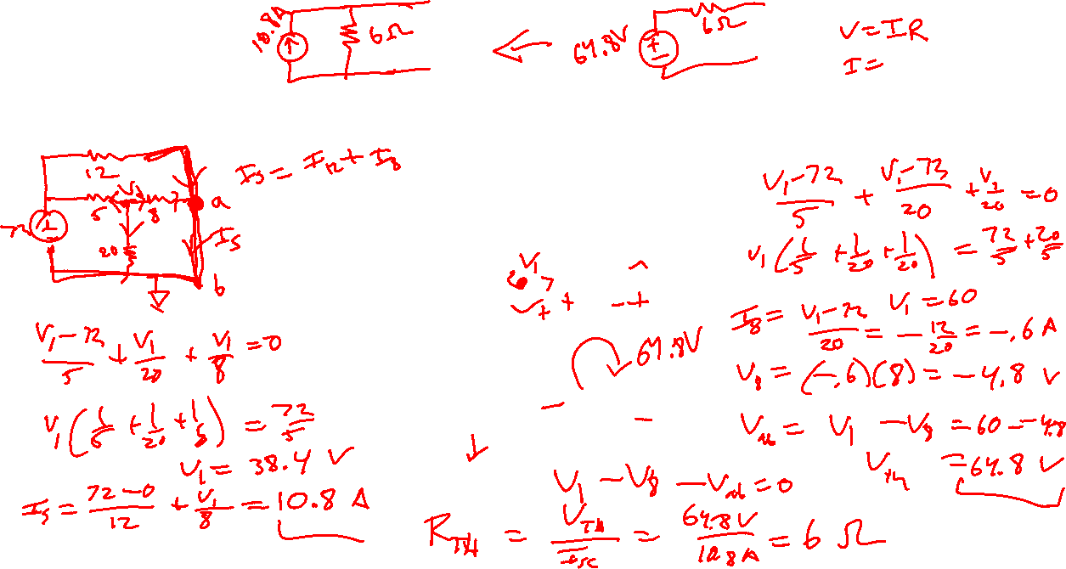
Example 1
Find the Thevenin equivalent with respect to the terminals a-b.
$$12Ω$$
$$5Ω$$
$$8Ω$$
a
+
$$72V$$
_
$$20Ω$$
b
Notes:
=+IV

Slide 6







Norton Equivalent Circuits
Similar to a Thevenin equivalent circuit, we can also construct a Norton equivalent circuit which consists of a current source in parallel with a resistor.
a
a
Network of resistors and sources (both independent and dependent)
$$I_{N}$$
$$R_{N}$$
b
b
$$V_{OC}=I_{N}R_{N}$$
$$I_{N}=I_{SC}$$
$$R_{N}=\frac{V_{OC}}{I_{SC}}$$
$$I_{SC}=I_{N}$$
same as $R_{TH}$
Notes:
=+IV

Slide 7
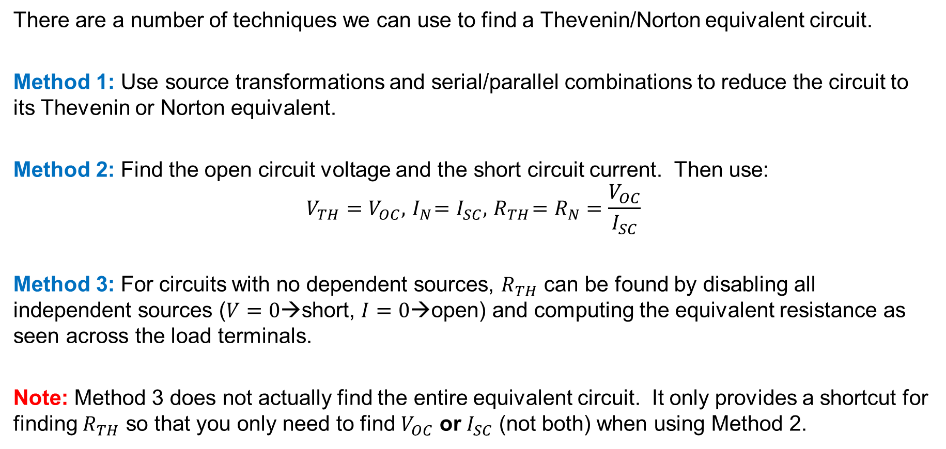
Thevenin and Norton Equivalent Circuits
There are a number of techniques we can use to find a Thevenin/Norton equivalent circuit.
Method 1: Use source transformations and serial/parallel combinations to reduce the circuit to its Thevenin or Norton equivalent.
Method 2: Find the open circuit voltage and the short circuit current. Then use:
$$V_{TH}=V_{OC},{ I}_{N}=I_{SC},{ R}_{TH}=R_{N}=\frac{V_{OC}}{I_{SC}}$$
Method 3: For circuits with no dependent sources, $R_{TH}$ can be found by disabling all independent sources ($V=0$→short, $I=0$→open) and computing the equivalent resistance as seen across the load terminals.
Note: Method 3 does not actually find the entire equivalent circuit. It only provides a shortcut for finding $R_{TH}$ so that you only need to find $V_{OC}$ or $I_{SC}$ (not both) when using Method 2.
Notes:
=+IV

Slide 8





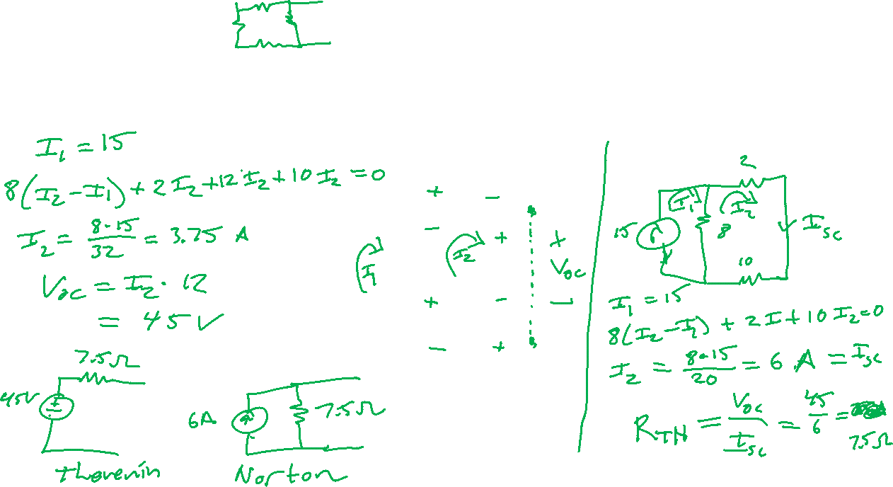
Example 2
Find the Thevenin and Norton equivalent circuits with respect to the terminals a-b.
$$2Ω$$
a
$$15A$$
$$8Ω$$
$$12Ω$$
$$10Ω$$
b
Notes:
=+IV

Slide 9




Thevenin and Norton Equivalent Circuits
For circuits with dependent sources, a modified version of Method 3 can be used.
Method 3 (modified): Disable all independent sources. Apply a test source to the load (either $V_{T}$ or $I_{T}$) and then find $I_{T}$ or $V_{T}$ so that $R_{TH}=\frac{V_{T}}{I_{T}}$.
a
Circuit with dependent sources in place and all independent sources disabled.
$$I_{T}$$
Solve for test current
$$R_{TH}=\frac{V_{T}}{I_{T}}$$
+
_
$$V_{T}$$
Apply test voltage source
b
Notes:
=+IV

Slide 10






Example 3
Find the Thevenin equivalent with respect to the terminals a-b.
$${3I}_{x}$$
$$2Ω$$
a
$$I_{x}$$
+
$$24V$$
_
$$4A$$
$$8Ω$$
b
Notes:
=+IV

Slide 11





Source Transformations
Often it is useful to transform a Thevenin Equivalent (series combination of a voltage source and a resistor) to a Norton Equivalent (parallel combination of current source and a resistor) or vice versa as shown below.
These two are equivalent if $V_{s}=I_{s}∙R$
$$R$$
a
a
+
$$V_{s}$$
_
$$I_{s}$$
$$R$$
b
b
Notes:
=+IV

Slide 12





















Example 4
Example: Find the current, $I_{o}$, in the $5kΩ$ resistor.
$$15kΩ$$
$$7kΩ$$
$$15kΩ$$
$$I_{o}$$
+
$$75V$$
_
$$30kΩ$$
$$4mA$$
$$100kΩ$$
$$5kΩ$$
$$8kΩ$$
First, transform voltage source
$$7kΩ$$
$$15kΩ$$
$$I_{o}$$
$$5mA$$
$$15kΩ$$
$$30kΩ$$
$$4mA$$
$$100kΩ$$
$$5kΩ$$
$$8kΩ$$
Notes:
=+IV

Slide 13



















Example 4, cont.
$$7kΩ$$
$$15kΩ$$
$$I_{o}$$
$$5mA$$
$$15kΩ$$
$$30kΩ$$
$$4mA$$
$$100kΩ$$
$$5kΩ$$
$$8kΩ$$
Combine parallel resistors
$$7kΩ$$
$$15kΩ$$
$$I_{o}$$
$$5mA$$
$$10kΩ$$
$$4mA$$
$$100kΩ$$
$$5kΩ$$
$$8kΩ$$
Notes:
=+IV

Slide 14













Example 4, cont.
$$7kΩ$$
$$15kΩ$$
$$I_{o}$$
$$5mA$$
$$10kΩ$$
$$4mA$$
$$100kΩ$$
$$5kΩ$$
$$8kΩ$$
Transform current source
$$10kΩ$$
$$7kΩ$$
$$15kΩ$$
$$I_{o}$$
+
$$50V$$
_
$$4mA$$
$$100kΩ$$
$$5kΩ$$
$$8kΩ$$
Notes:
=+IV

Slide 15
















Example 4, cont.
$$10kΩ$$
$$7kΩ$$
$$15kΩ$$
$$I_{o}$$
+
$$50V$$
_
$$4mA$$
$$100kΩ$$
$$5kΩ$$
$$8kΩ$$
Combine series resistors
$$25kΩ$$
$$15kΩ$$
$$I_{o}$$
+
$$50V$$
_
$$4mA$$
$$100kΩ$$
$$5kΩ$$
Notes:
=+IV

Slide 16














Example 4, cont.
$$25kΩ$$
$$15kΩ$$
$$I_{o}$$
+
$$50V$$
_
$$4mA$$
$$100kΩ$$
$$5kΩ$$
Transform voltage source
$$15kΩ$$
$$I_{o}$$
$$2mA$$
$$25kΩ$$
$$4mA$$
$$100kΩ$$
$$5kΩ$$
Notes:
=+IV

Slide 17














Example 4, cont.
$$15kΩ$$
$$I_{o}$$
$$2mA$$
$$25kΩ$$
$$4mA$$
$$100kΩ$$
$$5kΩ$$
Rearrange parallel elements
$$15kΩ$$
$$I_{o}$$
$$2mA$$
$$4mA$$
$$25kΩ$$
$$100kΩ$$
$$5kΩ$$
Notes:
=+IV

Slide 18












Example 4, cont.
$$15kΩ$$
$$I_{o}$$
$$2mA$$
$$4mA$$
$$25kΩ$$
$$100kΩ$$
$$5kΩ$$
Combine parallel current sources
Combine parallel resistors
$$15kΩ$$
$$I_{o}$$
$$6mA$$
$$20kΩ$$
$$5kΩ$$
Notes:
=+IV

Slide 19
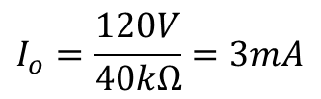







Example 4, cont.
$$15kΩ$$
$$I_{o}$$
$$6mA$$
$$20kΩ$$
$$5kΩ$$
Transform current source
$$20kΩ$$
$$15kΩ$$
$$I_{o}$$
+
$$I_{o}=\frac{120V}{40kΩ}=3mA$$
$$120V$$
_
$$5kΩ$$
Notes:
=+IV

Slide 20



Example 4, cont.
Before we present some examples, it is worth mentioning that we DO NOT use source transformations on the following circuits. WHY NOT?
Q: What can we do with the above circuits to simplify them? Hint: What role does the resistor $R$ play in each circuit above?
$$R$$
a
a
+
$$I_{s}$$
$$V_{s}$$
_
$$R$$
b
b
Notes:
=+IV

Slide 21




Example 5
Find $V_{x}$ by applying a sequence of source transformations.
Note: If the circuit has dependent sources, we need to make sure to preserve the element with the control voltage/current.
+
$$V_{x}$$
_
3Ω
6Ω
+
+
12V
_
6Ω
$$2V_{x}$$
_
Notes:
=+IV

Slide 22
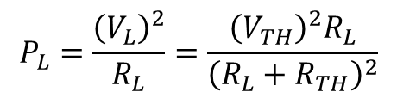

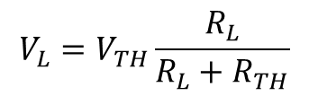




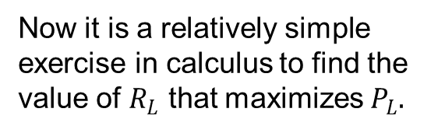
Maximum Power Transfer
We are often concerned with delivering the most amount of power that we can to a load. We can easily see how to achieve this by using the Thevenin equivalent.
$$R_{TH}$$
a
a
Circuit of sources and resistors delivering power to a load
+
$$R_{L}$$
$$V_{TH}$$
_
$$R_{L}$$
b
b
$$V_{L}=V_{TH}\frac{R_{L}}{R_{L}+R_{TH}}$$
Now it is a relatively simple exercise in calculus to find the value of $R_{L}$ that maximizes $P_{L}.$
$$P_{L}=\frac{{\left(V_{L}\right)}^{2}}{R_{L}}=\frac{{\left(V_{TH}\right)}^{2}R_{L}}{{\left(R_{L}+R_{TH}\right)}^{2}}$$
Notes:
=+IV

Slide 23

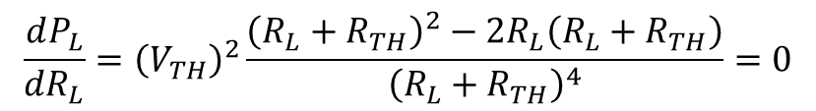
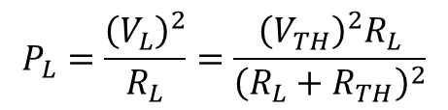

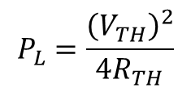

Maximum Power Transfer
$$R_{TH}$$
a
$$P_{L}=\frac{{\left(V_{L}\right)}^{2}}{R_{L}}=\frac{{\left(V_{TH}\right)}^{2}R_{L}}{{\left(R_{L}+R_{TH}\right)}^{2}}$$
+
$$V_{TH}$$
_
$$R_{L}$$
$$\frac{dP_{L}}{dR_{L}}={\left(V_{TH}\right)}^{2}\frac{{\left(R_{L}+R_{TH}\right)}^{2}−2R_{L}\left(R_{L}+R_{TH}\right)}{{\left(R_{L}+R_{TH}\right)}^{4}}=0$$
b
To maximize power delivered to a load, we should choose the load resistance equal to the Thevenin equivalent resistance of the circuit.
$$\left(R_{TH}+R_{L}\right)\left(R_{TH}−R_{L}\right)=0$$
$$P_{L}=\frac{{\left(V_{TH}\right)}^{2}}{{4R}_{TH}}$$
$R_{L}$=$R_{TH}$
Notes:
=+IV

Slide 24

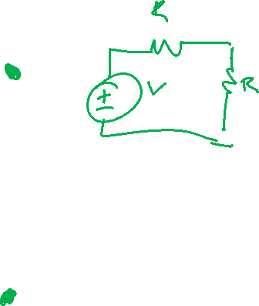








Example 6
(a) Find $R_{L}$ that maximizes power transfer to the load.
(b) What is the maximum power transferred to the load?
$$4kΩ$$
_
+
$$V_{x}$$
$$4kΩ$$
$$4kΩ$$
+
$$4kΩ$$
$$V_{x}$$
_
+
$$R_{L}$$
_
$$100V$$
+
$$20V$$
_
Notes:
=+IV

Slide 25







Example 6, cont.
(a) Find $R_{L}$ that maximizes power transfer to the load.
(b) What is the maximum power transferred to the load?
$$4kΩ$$
_
+
$$V_{x}$$
Open Circuit Voltage
$$4kΩ$$
$$4kΩ$$
+
$$4kΩ$$
$$V_{x}$$
_
+
_
$$100V$$
+
$$20V$$
_
Notes:
=+IV

Slide 26







Example 6, cont.
(a) Find $R_{L}$ that maximizes power transfer to the load.
(b) What is the maximum power transferred to the load?
$$4kΩ$$
_
+
$$V_{x}$$
$$4kΩ$$
$$4kΩ$$
Short Circuit Current
+
$$4kΩ$$
$$V_{x}$$
_
+
_
$$100V$$
+
$$20V$$
_
Notes:
=+IV

Slide 27







Example 6, cont.
(a) Find $R_{L}$ that maximizes power transfer to the load.
(b) What is the maximum power transferred to the load?
$$4kΩ$$
Alternatively (Method 3)
Disable Independent Sources and Apply Test Source
_
+
$$V_{x}$$
$$4kΩ$$
$$4kΩ$$
$$I_{T}$$
+
+
$$4kΩ$$
$$V_{x}$$
_
$$V_{T}$$
_
Notes:
=+IV

Slide 28
Assignments
Get the Zybook and complete chapter 4
  Due 4pm on Monday, Feb 14
  Note: this material on Op-Amps will not be on the first exam, but will be on future exams
Homework 3A and 3B on Canvas
  Also due 4pm on Monday, Feb 14
  Take as many times as needed, your best score will count. It is different each time, so it is good for additional practice.
Review in-class examples and notes
  Practice, practice, practice!
Don’t forget, you need to go to office hours once in either January or February and again in either March or April. Bring at least one technical question!
Wednesday: review exercise for an easy 100 quiz grade

