Slide 1
ECEN 214, Spring 2022 Electrical Circuit Theory
Class 5: Mesh-Current Circuit Analysis Method
Prof. Adam Birchfield
Dept. of Electrical and Computer Engineering
Texas A&M University
abirchfield@tamu.edu

Slide 2
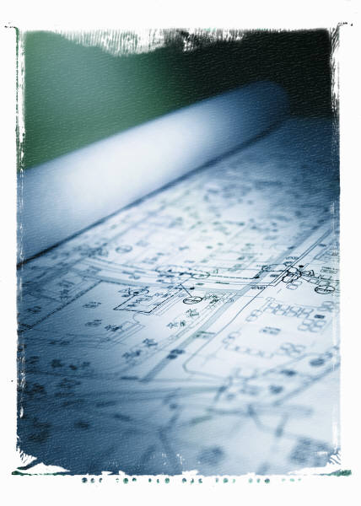
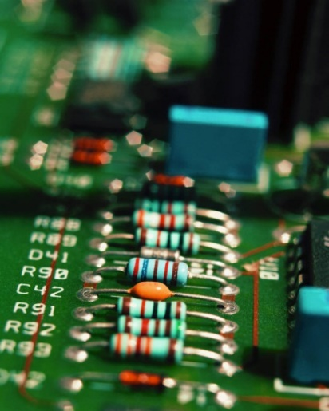
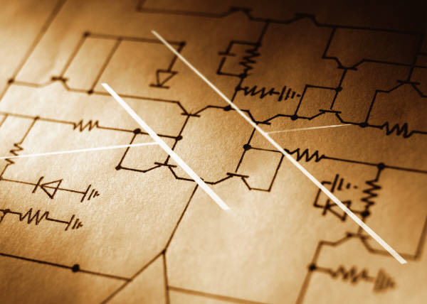
Solving Larger Circuits
When we attempt to analyze circuits involving several elements, the number of equations and corresponding unknowns we have to solve for can quickly get out of hand.
Last class we looked at the Node-Voltage method for solving large circuits.
In this section we will present a second systematic techniques for finding voltages and currents in circuits, the mesh-current method.

Slide 3
Mesh-Current Circuit Analysis Method
Here are the steps:
Step 1 – Identify all meshes (loops that do not enclose any other loops) and label a mesh current for each loop.
Step 2 – Identify voltages across all resistors in each mesh and write in terms of mesh currents.
Step 3 – Use KVL to write an equation for each mesh.
Step 4 – Solve for unknowns
Step 5 – Write actual currents through various elements in terms of mesh currents.

Slide 4
Example 1
2Ω
6Ω
4Ω
8Ω
6Ω
+
+
40V
_
_
20V

Slide 5
Example 1, Step 1
2Ω
6Ω
4Ω
8Ω
6Ω
+
+
40V
_
$$I_{1}$$
$$I_{2}$$
$$I_{3}$$
_
20V
Step 1 – Identify all meshes (loops that do not enclose any other loops) and label a mesh current for each loop.
Notes:
Mesh currents are not necessarily actual currents that you can measure anywhere in the circuit.
You can make your mesh currents go clockwise or counterclockwise, or some CW and others CCW. It doesn’t matter.

Slide 6
Example 1, Step 2
2Ω
6Ω
4Ω
_
+
_
+
$$V_{c}$$
_
+
$$V_{a}$$
$$V_{b}$$
8Ω
+
6Ω
+
+
$$I_{1}$$
$$I_{2}$$
$$I_{3}$$
+
40V
_
$$V_{d}$$
$$V_{e}$$
_
20V
_
_
$$V_{a}=2(I_{1})$$
$$V_{b}=6(I_{2})$$
$$V_{c}=4(I_{3})$$
$$V_{d}=8(I_{1}−I_{2})$$
$$V_{e}=6(I_{2}−I_{3})$$
Step 2 - Identify voltages across all resistors in each mesh and write in terms of mesh currents.

Slide 7
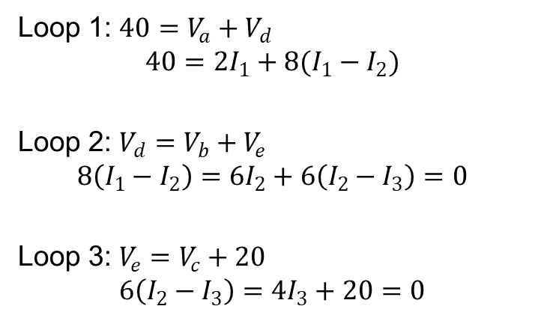
Example 1, Step 3
2Ω
6Ω
4Ω
+
$$V_{a}$$
_
+
$$V_{b}$$
_
+
$$V_{c}$$
_
8Ω
+
6Ω
+
+
$$I_{1}$$
$$I_{2}$$
$$I_{3}$$
+
40V
_
$$V_{d}$$
$$V_{e}$$
_
20V
_
_
Loop 1: $40=V_{a}+V_{d}$
$$40=2I_{1}+8(I_{1}−I_{2})$$
Loop 2: $V_{d}=V_{b}+V_{e}$
$$8\left(I_{1}−I_{2}\right)=6I_{2}+6\left(I_{2}−I_{3}\right)=0$$
Loop 3: $V_{e}=V_{c}+20$
$$6\left(I_{2}−I_{3}\right)=4I_{3}+20=0$$
$$\left[\begin{matrix}10 & −8 & 0 \\ 8 & −20 & 6 \\ 0 & −6 & 10\end{matrix}\right]\left[\begin{matrix}I_{1} \\ I_{2} \\ I_{3}\end{matrix}\right]=\left[\begin{matrix}40 \\ 0 \\ −20\end{matrix}\right]$$
Step 3 – Use KVLs to write an equation for each mesh.

Slide 8
Example 1, Step 4
2Ω
6Ω
4Ω
+
$$V_{a}$$
_
+
$$V_{b}$$
_
+
$$V_{c}$$
_
8Ω
+
6Ω
+
+
$$I_{1}$$
$$I_{2}$$
$$I_{3}$$
+
40V
_
$$V_{d}$$
$$V_{e}$$
_
20V
_
_
$$\left[\begin{matrix}10 & −8 & 0 \\ 8 & −20 & 6 \\ 0 & −6 & 10\end{matrix}\right]\left[\begin{matrix}I_{1} \\ I_{2} \\ I_{3}\end{matrix}\right]=\left[\begin{matrix}40 \\ 0 \\ −20\end{matrix}\right]$$
$I_{1}=5.6$, $I_{2}=2$, $I_{3}=−0.8$
Step 4 – Solve for unknowns

Slide 9
Example 1, Step 5
$$2Ω$$
6$Ω$
4$Ω$
+
$$V_{a}$$
_
+
$$V_{b}$$
_
+
$$V_{c}$$
_
$$I_{8}$$
$$I_{6}$$
8$Ω$
+
6$Ω$
+
+
$$I_{1}$$
$$I_{2}$$
$$I_{3}$$
+
40V
_
$$V_{d}$$
$$V_{e}$$
_
20V
_
_
$$I_{8}=I_{1}−I_{2}=5.6−2=3.6A$$
$I_{1}=5.6A$, $I_{2}=2A$, $I_{3}=−0.8A$
$$I_{6}=I_{2}−I_{3}=2−\left(−0.8\right)=2.8A$$
Step 5 – Write actual currents through various elements in terms of mesh currents.

Slide 10
Example 2
Use the mesh-current method to find the power dissipated in the $2Ω$ resistor.
3Ω
8Ω
+
30V
_
2Ω
5Ω
16A
6Ω
4Ω

Slide 11
Super-meshes
For circuits where a current source falls in a mesh where we need to use KVL, we can run into problems since the voltage across the current source may not be known. We can use a “supermesh” to avoid needing to know the voltage across a current source.
Within the supermesh: $I_{s}=I_{2}−I_{1}$
Around the supermesh: Do KVL
supermesh
$$I_{1}$$
$$I_{2}$$
$$I_{s}$$

Slide 12
Example 3
Find the power dissipated in the 1Ω resistor.
2Ω
2A
2Ω
+
+
_
10V
2Ω
6V
_
1Ω

Slide 13
Superposition
For a circuit with multiple independent sources, we can find the response of the circuit by summing the responses to each individual source.
Example: Find $V$ in the circuit shown
Solution: first solve with just the current source, then with just the voltage source.
4A
5Ω
2Ω
+
+
_
110V
$$V$$
10Ω
12Ω
_

Slide 14
Just the Voltage Source (Assume Current = 0)
First find the response of the circuit to the 110V source (remove the current source).
4A
5Ω
2Ω
5Ω
+
+
+
+
_
110V
_
110V
$$V$$
10Ω
12Ω
$$V_{1}$$
5.833Ω
_
_
$$V=110∙\frac{5.833}{5+5.833}=59.23$$

Slide 15
Just the Current Source (Assume Voltage = 0)
Next find the response of the circuit to the 4A source alone (remove the voltage source).
4A
4A
_
$$I_{2}$$
$$V_{2}$$
+
5Ω
2Ω
3.33Ω
2Ω
+
+
_
110V
$$V$$
10Ω
12Ω
_
12Ω
$$I_{2}=4\frac{12}{12+2+3.33}=2.7692$$
$$V_{2}=−\left(2.7692\right)∙\left(3.33\right)=−9.23$$

Slide 16
Solving with Superposition
Finally, the desired voltage in the original circuit is just the sum of the voltages found in the two simplified circuits (with only one independent source present).
$V=V_{1}+V_{2}=59.23−9.23=50 V$
Note 1: When using superposition, we must keep any dependent sources in place.
Note 2: Superposition allows us to analyze a complicated circuit by analyzing several simpler circuits. Often, it is easier to just analyze the single (more complicated) circuit rather than trying to analyze multiple circuits. So…before using superposition, be sure it is really going to make your life easier. Often it does not.
Note 3: The real power of the superposition technique often comes in design type problems as shown in the next slide.

Slide 17
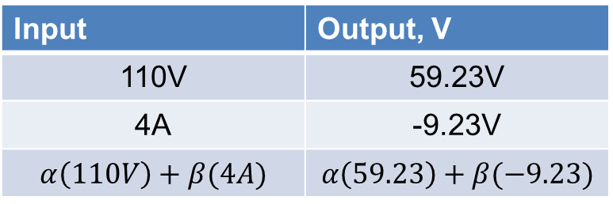
Applying Superposition to Circuit Design
Suppose in the circuit from the previous example, we were asked to find the value of the current source so that the voltage across the 10$Ω$ resistor is 40V. The concept of superposition allows us to easily do this.
Input | Output, V
110V | 59.23V
4A | -9.23V
$$α\left(110V\right)+β(4A)$$ | $$α\left(59.23\right)+β(−9.23)$$
??
5Ω
2Ω
+
+
Since we are only adjusting the current source, we will use $α=1$ (leave the voltage source alone). Then we want:
$$59.23−9.23β=40→β=2.0834$$
_
110V
$40$V
10Ω
12Ω
_
Therefore, we should replace the 4A current source with a 2.0834(4A) = 8.33A current source.

Slide 18
Assignments
Get the Zybook and complete sections 3.6, 3.8, 3.10
Due 4pm on Monday, Feb 7
If you haven’t done the earlier sections that were due today, do these as well
Homework #2 on Canvas
Also due 4pm on Monday, Feb 7
Take it as many times as needed, your best score will count. It is different each time, so it is good for additional practice.
Review in-class examples and notes
Practice, practice, practice!
Don’t forget, you need to go to office hours once in either January or February and again in either March or April. Bring at least one technical question!
Quiz #5 on Monday

