Slide 1
ECEN 214, Spring 2022 Electrical Circuit Theory
Class 4: The Node-Voltage Circuit Analysis Method
Prof. Adam Birchfield
Dept. of Electrical and Computer Engineering
Texas A&M University
abirchfield@tamu.edu

Slide 2
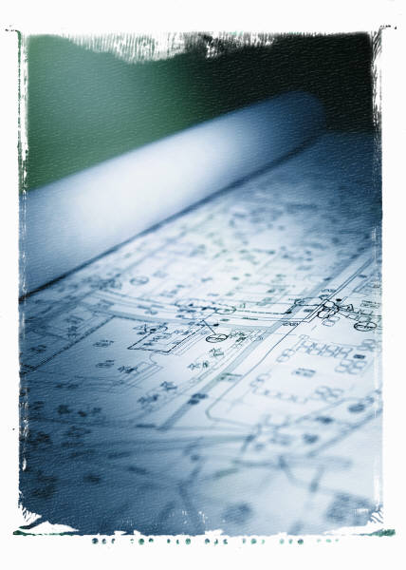
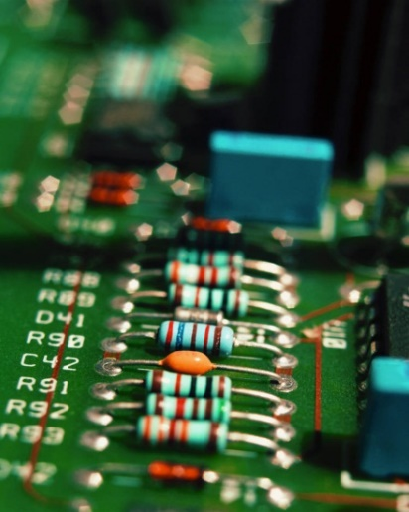
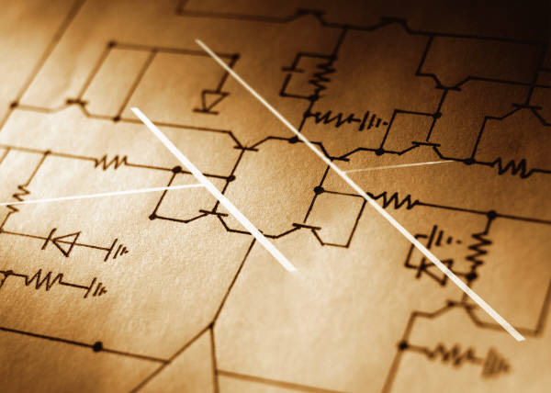
Solving Larger Circuits
When we attempt to analyze circuits involving several elements, the number of equations and corresponding unknowns we have to solve for can quickly get out of hand.
In this section and the next we will present two systematic techniques for finding voltages and currents in circuits that help to keep the amount of work we have to perform down to a minimum.

Slide 3
Node-Voltage Circuit Analysis Method
Here are the steps:
Step 1 – Identify all essential nodes in the circuit (where three or more elements are connected).
Step 2 – Choose one node as a reference node (usually the one with the most elements connected). Label that node with a and treat the voltage at that point as zero. (Ground)
Step 3 – Label unknown voltages at all other essential nodes: $V_{1}$, $V_{2}$, . . . etc.
Step 4 – Identify currents entering/leaving essential nodes in terms of $V_{1}$, $V_{2}$, …
Step 5 – Use KCL at each essential node to set up equations to solve for the unknown voltages.
Step 6 – Solve equations for unknown voltages.

Slide 4
Example of Node-Voltage Method
Solve this circuit for all voltages and currents
1Ω
2Ω
+
10V
_
5Ω
10Ω
2A

Slide 5
Example of Node-Voltage Method, Step 1
1Ω
2Ω
+
10V
_
5Ω
10Ω
2A
Step 1 – Identify all essential nodes in the circuit (where three or more elements are connected).

Slide 6
Grounding and Reference Nodes
The earth is a fairly good electrical conductor
Wet soil conducts better than rock
Therefore it all has (about) the same voltage
Often we use it as a “reference node” and measure other voltages with respect to it
For safety, it’s normally good to keep buildings, circuit boards, and other metal structures “grounded” or connected by conductors to the earth. This avoids static buildup, elevated voltages unexpectedly.
In our circuits, we’ll be picking a node to be the reference node. It doesn’t necessarily have to be grounded, but often (especially in high-voltage power systems) the ground is the reference node.

Slide 7
Example of Node-Voltage Method, Step 2
1Ω
2Ω
+
10V
_
5Ω
10Ω
2A
Step 2 – Choose one node as a reference node (usually the one with the most elements connected). Label that node with a and treat the voltage at that point as zero.

Slide 8
Example of Node-Voltage Method, Step 3
1Ω
$$V_{1}$$
2Ω
$$V_{2}$$
+
10V
_
5Ω
10Ω
2A
Step 3 – Label unknown voltages at all other essential nodes: $V_{1}$, $V_{2}$, . . . etc.

Slide 9
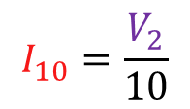
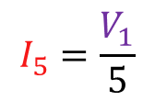
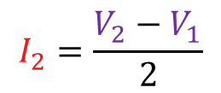
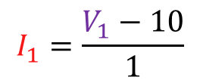
Example of Node-Voltage Method, Step 4
1Ω
$$V_{1}$$
2Ω
$$V_{2}$$
$$I_{1}$$
$$I_{2}$$
+
$$I_{5}$$
$$I_{10}$$
10V
_
5Ω
10Ω
2A
$$I_{1}=\frac{V_{1}−10}{1}$$
$$I_{2}=\frac{V_{2}−V_{1}}{2}$$
$$I_{5}=\frac{V_{1}}{5}$$
$$I_{10}=\frac{V_{2}}{10}$$
Step 4 – Identify currents entering/leaving essential nodes in terms of $V_{1}$, $V_{2}$, …

Slide 10
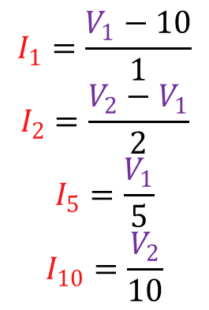
Example of Node-Voltage Method, Step 5
1Ω
$$V_{1}$$
2Ω
$$V_{2}$$
$$I_{1}=\frac{V_{1}−10}{1}$$
$$I_{2}=\frac{V_{2}−V_{1}}{2}$$
$$I_{5}=\frac{V_{1}}{5}$$
$$I_{10}=\frac{V_{2}}{10}$$
$$I_{1}$$
$$I_{2}$$
+
$$I_{5}$$
$$I_{10}$$
10V
_
5Ω
10Ω
2A
At node 1: $I_{1}+I_{5}=I_{2}$
At node 2: $I_{2}+I_{10}=2$
$$V_{1}−10+\frac{V_{1}}{5}=\frac{V_{2}−V_{1}}{2}$$
$$\frac{V_{2}−V_{1}}{2}+\frac{V_{2}}{10}=2$$
Step 5 – Use KCL at each essential node to set up equations to solve for the unknown voltages.

Slide 11
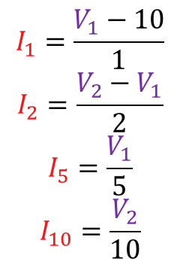
Example of Node-Voltage Method, Step 6
1Ω
$$V_{1}$$
2Ω
$$V_{2}$$
$$I_{1}=\frac{V_{1}−10}{1}$$
$$I_{2}=\frac{V_{2}−V_{1}}{2}$$
$$I_{5}=\frac{V_{1}}{5}$$
$$I_{10}=\frac{V_{2}}{10}$$
$$I_{1}$$
$$I_{2}$$
+
$$I_{5}$$
$$I_{10}$$
10V
_
5Ω
10Ω
2A
$$V_{1}−10+\frac{V_{1}}{5}=\frac{V_{2}−V_{1}}{2}$$
$$17V_{1}−5V_{2}=100$$
$$V_{1}=9.09$$
$$\frac{V_{2}−V_{1}}{2}+\frac{V_{2}}{10}=2$$
$$−5V_{1}+6V_{2}=20$$
$$V_{2}=10.91$$
Step 6 – Solve equations for unknown voltages.

Slide 12
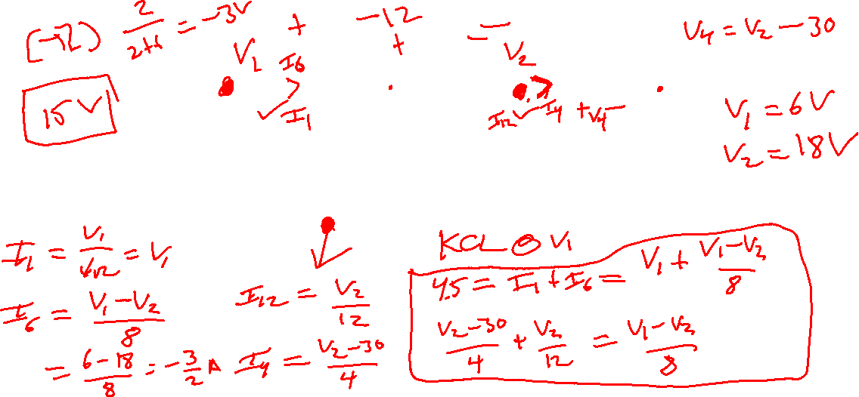
Example 2
Use the node-voltage method to find $V$ in the circuit.
6Ω
2Ω
4Ω
+
$$V$$
+
4.5A
1Ω
12Ω
30V
_
_

Slide 13
A Special Case
If a circuit contains a branch with only a voltage source between two nodes, the standard node voltage technique can break down.
$$V_{s}$$
We run into the same problem if we try to perform a KCL at node 2.
→ We are missing two equations needed to solve for the unknown node voltages.
If we tried to perform a KCL at node 1, the current flowing through the voltage source is unknown and cannot be written in terms of the various node voltages.
$$V_{1}$$
$$V_{2}$$
+
_
$$I_{s}=??$$
We will replace the missing equations as follows:
1) The voltage source will force a relationship between the two node voltages ($V_{1}−V_{2}=V_{s}$ in this case).
2) By introducing the idea of a “supernode”, we can construct that last needed equation.

Slide 14
Supernodes
The two nodes connected by the voltage source are combined into what is called a supernode.
A KCL performed at the supernode allows us to specify an equation without needing to know the current through the voltage source.
$I_{1}+I_{2}+I_{3}+I_{4}=0$
supernode
$$V_{1}$$
$$V_{2}$$
+
_
$$I_{1}$$
$$I_{4}$$
$$I_{2}$$
$$I_{3}$$

Slide 15
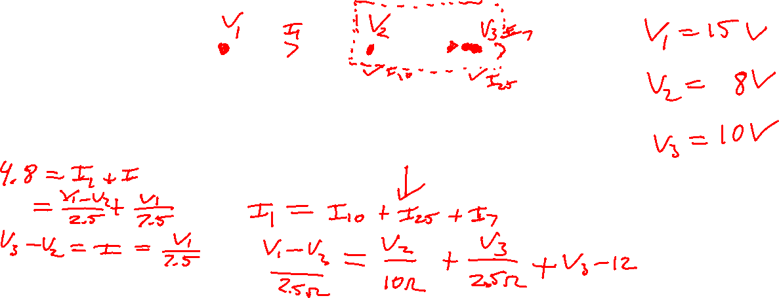
Example 3
Solve for voltage V
$$I$$
+
_
2.5Ω
1Ω
+
+
4.8A
7.5Ω
$$I$$
10Ω
$$V$$
2.5Ω
12V
_
_

Slide 16
Assignments
Get the Zybook and complete sections 3.6, 3.8, 3.10
Due 4pm on Monday, Feb 7
If you haven’t done the earlier sections that were due today, do these as well
See the syllabus for details on how to get the Zybook
Homework #2 on Canvas
Also due 4pm on Monday, Feb 7
Take it as many times as needed, your best score will count. It is different each time, so it is good for additional practice.
Review in-class examples and notes
Practice, practice, practice!
Don’t forget, you need to go to office hours once in either January or February and again in either March or April. Bring at least one technical question!
Quiz #4 on Wednesday

