Slide 1
ECEN 214, Spring 2022 Electrical Circuit Theory
Class 3: Resistive Circuits
Prof. Adam Birchfield
Dept. of Electrical and Computer Engineering
Texas A&M University
abirchfield@tamu.edu

Slide 2
Review: Parallel or Series?
Elements in series share one junction, with nothing else connected to the same junction, and they have the same current (KCL)
Elements in parallel share two junctions, regardless of what else is connected, and they have the same voltage (KVL)
Which resistors in these circuits are in series and parallel?
D
E
+
_
F
G
A
B
H
+
+
_
C
_
I
J

Slide 3

Example with Resistors in Series
Solve for $I_{s}$ and the voltage across each resistor
+
$$V_{1}$$
_
+
_
$$11 Ω$$
$$5 Ω$$
+
+
$$100 V$$
_
$$8 Ω$$
_
_
$$V_{5}$$
_
+
+
$$13 Ω$$
$$13 Ω$$

Slide 4
Resistors in Series
Consider a circuit with two or more resistors connected in series.
The current through each resistor must be the same.
The current through each resistor must be the same.
By virtue of Ohm’s law, we then get:
$$V_{1}=I_{s}R_{1}$$
$$V_{2}=I_{s}R_{2}$$
…
$$V_{m}=I_{s}R_{m}.$$
+
_
+
_
+
+
_
_
_
$$V_{m}$$
_
+
+
$$R_{m}$$
Using Kirchoff’s Voltage Law (KVL) around the loop:
$$V_{s}=V_{1}+V_{2}+…+V_{m}$$
$=I_{s}R_{1}+I_{s}R_{2}$+…+$I_{s}R_{m}$
$$=I_{s}\left(R_{1}+R_{2}+…+R_{m}\right)$$
$$=I_{s}R_{eq}$$
$R_{eq}$=$R_{1}+R_{2}+…+R_{m}$
Notes:
=+IV

Slide 5
Resistors in Series
+
_
+
_
For the purposes of finding the current flowing through the circuit, the series connection of the multiple resistors can be replaced by a single equivalent resistor whose resistance is the sum.
$$R_{eq}=R_{1}+R_{2}+…+R_{m}$$
+
+
+
_
_
_
_
$$V_{m}$$
_
+
+
$$R_{m}$$
Notes:
=+IV

Slide 6
Example with Resistors in Parallel
Solve for $I_{s}$ and the current through each resistor
$$I_{1}$$
$$I_{2}$$
$$I_{3}$$
+
$$20 Ω$$
$$7 Ω$$
$$5 Ω$$
$$90 V$$
_

Slide 7

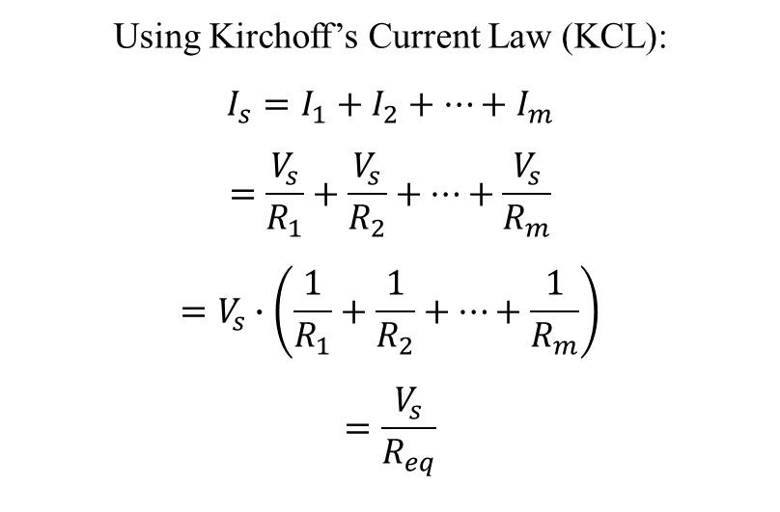
Resistors in Parallel
Consider a circuit with two or more resistors connected in parallel.
Now the current in each branch is different but the voltage across each resistor is the same.
By virtue of Ohm’s law, we then get:
$$I_{1}$$
$$I_{2}$$
$$I_{m}$$
+
$$R_{1}$$
$$R_{2}$$
. . .
$$R_{m}$$
_
$$V_{s}=I_{1}R_{1}=I_{2}R_{2}=⋯=I_{m}R_{m}$$
Using Kirchoff’s Current Law (KCL):
$$I_{s}=I_{1}+I_{2}+⋯+I_{m}$$
$$=\frac{V_{s}}{R_{1}}+\frac{V_{s}}{R_{2}}+⋯+\frac{V_{s}}{R_{m}}$$
$$=V_{s}∙\left(\frac{1}{R_{1}}+\frac{1}{R_{2}}+⋯+\frac{1}{R_{m}}\right)$$
$$=\frac{V_{s}}{R_{eq}}$$
$\frac{1}{R_{eq}}=\frac{1}{R_{1}}+\frac{1}{R_{2}}+⋯+\frac{1}{R_{m}}$
or equivalently
$$R_{eq}=\frac{1}{\frac{1}{R_{1}}+\frac{1}{R_{2}}+⋯+\frac{1}{R_{m}}}$$
Notes:
=+IV

Slide 8
Equivalent Resistances
Resistors in Parallel
For the purposes of finding the current flowing through the source, the parallel connection of resistors can be replaced with a single equivalent resistor such that:
$$I_{1}$$
$$I_{2}$$
$$I_{m}$$
+
+
$$R_{1}$$
$$R_{2}$$
. . .
$$R_{m}$$
_
_
$$\frac{1}{R_{eq}}=\frac{1}{R_{1}}+\frac{1}{R_{2}}+⋯+\frac{1}{R_{m}}$$
$$R_{eq}=\frac{1}{\frac{1}{R_{1}}+\frac{1}{R_{2}}+⋯+\frac{1}{R_{m}}}$$
Notes:
=+IV

Slide 9

Equivalent Resistances
Most often, we use these concepts with just two resistors at a time. In that case, the formulas simplify to:
Parallel combination
$$R_{eq}=\frac{R_{1}R_{2}}{R_{1}+R_{2}}$$
Series combination
$$R_{eq}=R_{1}+R_{2}$$
Note that:
Series equivalent resistances are always larger than each individual component, and
Parallel equivalent resistances are always smaller than each individual component,
Notes:
=+IV

Slide 10
Example
For the circuit shown:
(a) Find the voltage $V$,
(b) Find the power delivered to the circuit by the current source,
(c) Find the power dissipated in the $10Ω$ resistor.
Notes:
=+IV

Slide 11


Voltage Dividers
If a voltage is applied across a series resistance combination, the voltage is divided (unequally) across the resistors.
$V_{s}=V_{1}+V_{2}=IR_{1}+IR_{2}$ $I=\frac{V_{s}}{R_{1}+R_{2}}$
The voltage is split proportionally according to the resistance values. Higher voltage goes to the larger resistor.
Note: This kind of configuration occurs so frequently that it is worthwhile committing this result to memory.
+
$$I$$
$$R_{1}$$
$$V_{1}$$
_
$$V_{1}=IR_{1}=V_{s}\frac{R_{1}}{R_{1}+R_{2}}$$
$$V_{2}=IR_{2}=V_{s}\frac{R_{2}}{R_{1}+R_{2}}$$
+
_
$$V_{S}$$
+
$$R_{2}$$
$$V_{2}$$
_
These ratios are known as voltage dividers
Notes:
=+IV

Slide 12
Example of Voltage Dividers
For the voltage divider circuit shown:
If $R_{1}=1kΩ$ and $R_{2}=2kΩ$, determine the voltages $V_{1}$ and $V_{2}$. Also determine the power generated by the source.
Suppose we want $V_{2}=9V$ and that the source is capable of producing no more than 250mW of power. What are the smallest resistors that can be used to achieve these specifications?
+ $V_{1}$ -
$$R_{1}$$
+
+
$$V_{2}$$
_
$$12V$$
$$R_{2}$$
_
Notes:
=+IV

Slide 13
Current Dividers
If a current is applied to a parallel resistance combination, the current is divided (unequally) through the resistors.
$I_{1}R_{1}=I_{2}R_{2}=I_{s}R_{eq}=I_{s}\frac{R_{1}R_{2}}{R_{1}+R_{2}}$
The current is split proportionally according to the resistance values. Higher current goes to the smaller resistor. Again, commit this result to memory.
Beware: The current dividers are the opposite of the voltage dividers. This will be a source of great confusion to some.
$$I_{1}$$
$$I_{2}$$
$$I_{S}$$
$$R_{1}$$
$$R_{2}$$
$$I_{1}=I_{s}\frac{R_{2}}{R_{1}+R_{2}}$$
$$I_{2}=I_{s}\frac{R_{1}}{R_{1}+R_{2}}$$
These ratios are known as current dividers
Notes:
=+IV

Slide 14
Example of Current Dividers
Find the current $I$ in the circuit shown.
$$2kΩ$$
$$I$$
$$24mA$$
$$4kΩ$$
$$4kΩ$$
$$4kΩ$$
Notes:
=+IV

Slide 15

Voltage and Current Dividers
The concepts of voltage and current division can be applied to more than two resistors.
+
_
+
_
+
. . .
$$V_{k}=V_{s}\frac{R_{k}}{R_{1}+R_{2}+⋯+R_{m}}$$
+
$$V_{k}$$
_
$$R_{k}$$
_
_
$$V_{m}$$
_
+
+
$$V_{m−1}$$
$$R_{m}$$
$$R_{m−1}$$
$$I_{k}=I_{s}\frac{R_{eq}}{R_{k}}$$
$$=I_{s}\frac{\frac{1}{R_{k}}}{\frac{1}{R_{1}}+\frac{1}{R_{2}}+…+\frac{1}{R_{m}}}$$
$$I_{1}$$
$$I_{2}$$
$$I_{m}$$
$$R_{1}$$
$$R_{2}$$
. . .
$$R_{m}$$
$$I_{S}$$
Notes:
=+IV

Slide 16
Δ-Y (Π-T) Equivalent Circuits
Sometimes we encounter a triangular configuration of resistors. These cannot be simplified by series or parallel equivalents.
$$R_{c}$$
$$R_{c}$$
a
b
a
b
$$R_{b}$$
$$R_{a}$$
$$R_{b}$$
$$R_{a}$$
c
c
“Delta (Δ)” configuration
“Pi (Π)” configuration
Notes:
=+IV

Slide 17
Δ-Y (Π-T) Equivalent Circuits
Δ/Π configurations can be transformed to a Y (or T) configuration. Sometimes by doing so, the resulting circuit can be further simplified.
a
b
a
b
$$R_{1}$$
$$R_{2}$$
$$R_{2}$$
$$R_{1}$$
$$R_{3}$$
$$R_{3}$$
c
c
“Y” configuration
“T” configuration
Notes:
=+IV

Slide 18
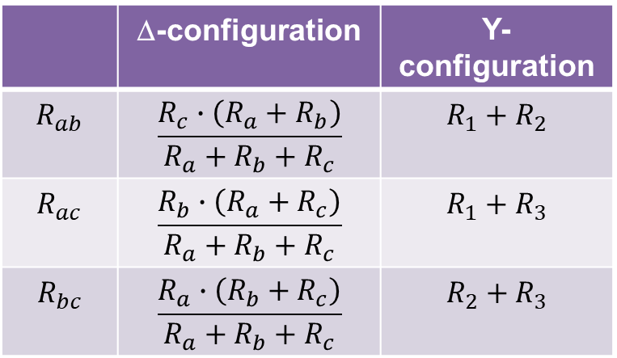
Δ-Y (Π-T) Equivalent Circuits
For the Δ and Y configurations to be equivalent, the resistances between each pair of nodes must be equivalent.
a
b
a
b
$$R_{c}$$
$$R_{1}$$
$$R_{2}$$
$$R_{b}$$
$$R_{a}$$
$$R_{3}$$
c
c
 | Δ-configuration | Y-configuration
$$R_{ab}$$ | $$\frac{R_{c}∙\left(R_{a}+R_{b}\right)}{R_{a}+R_{b}+R_{c}}$$ | $$R_{1}+R_{2}$$
$$R_{ac}$$ | $$\frac{R_{b}∙\left(R_{a}+R_{c}\right)}{R_{a}+R_{b}+R_{c}}$$ | $$R_{1}+R_{3}$$
$$R_{bc}$$ | $$\frac{R_{a}∙\left(R_{b}+R_{c}\right)}{R_{a}+R_{b}+R_{c}}$$ | $$R_{2}+R_{3}$$
Notes:
=+IV

Slide 19
Δ-Y (Π-T) Equivalent Circuits
With some straightforward algebra, we can solve for $R_{a}$, $R_{b}$, and $R_{c}$ in terms of $R_{1}$, $R_{2}$, and $R_{3}$ or vice-versa. The following relationships result.
See if you can derive these equations on your own…then put them on your note sheet for the exam!
$$R_{1}=\frac{R_{b}∙R_{c}}{R_{a}+R_{b}+R_{c}}$$
$$R_{a}=\frac{R_{1}R_{2}+R_{2}R_{3}+R_{1}R_{3}}{R_{1}}$$
$$R_{2}=\frac{R_{a}∙R_{c}}{R_{a}+R_{b}+R_{c}}$$
$$R_{b}=\frac{R_{1}R_{2}+R_{2}R_{3}+R_{1}R_{3}}{R_{2}}$$
$$R_{3}=\frac{R_{a}∙R_{b}}{R_{a}+R_{b}+R_{c}}$$
$$R_{c}=\frac{R_{1}R_{2}+R_{2}R_{3}+R_{1}R_{3}}{R_{3}}$$
These 3 equations allow us to replace a Δ structure with an equivalent Y structure.
These 3 equations allow us to replace a Y structure with an equivalent Δ structure.
Notes:
=+IV

Slide 20
Example of delta-wye transformation
Find the voltage $V$ in the circuit shown.
Convert delta to wye | Convert wye to delta
$$R_{1}=\frac{R_{b}∙R_{c}}{R_{a}+R_{b}+R_{c}}$$ $$R_{2}=\frac{R_{a}∙R_{c}}{R_{a}+R_{b}+R_{c}}$$ $$R_{3}=\frac{R_{a}∙R_{b}}{R_{a}+R_{b}+R_{c}}$$ | $$R_{a}=\frac{R_{1}R_{2}+R_{2}R_{3}+R_{1}R_{3}}{R_{1}}$$ $$R_{b}=\frac{R_{1}R_{2}+R_{2}R_{3}+R_{1}R_{3}}{R_{2}}$$ $$R_{c}=\frac{R_{1}R_{2}+R_{2}R_{3}+R_{1}R_{3}}{R_{3}}$$
Notes:
=+IV

Slide 21
A Word on Making Measurements
Measure voltage with a voltmeter: probes across the two nodes you want to measure
Measure current with an ammeter: break the circuit and place meter in series so that you can measure the current through it
Measuring voltage: one way is to use a Wheatstone bridge. The resistance of the potentiometer is varied until the ammeter shows no current flowing between nodes a and b.
Therefore, the voltage $V_{ab}=0$, and $I_{1}=I_{3}$, $I_{2}=I_{x}$. Hence you can substitute and find $R_{x}=R_{3}\left(\frac{R_{2}}{R_{1}}\right)$

Slide 22
Wheatstone Bridge Example
Say $R_{1}=1 Ω$, $R_{2}=2 Ω$. You put an unknown resistor $R_{x}$ as shown, and then you adjust $R_{3}$ until the Ammeter shows 0 A. This occurs with $R_{3}=4.3 Ω$. What’s the unknown resistance?

Slide 23
Assignments
Get the Zybook and complete sections 2.4, 2.6, 2.7, 2.8, 3.2, 3.3, 3.5
Due 4pm on Monday, Jan 31
If you haven’t done the earlier sections that were due today, do these as well
See the syllabus for details on how to get the Zybook
Homework #1 on Canvas
Also due 4pm on Monday, Jan 31
Take it as many times as needed, your best score will count. It is different each time, so it is good for additional practice.
Review in-class examples and notes
Practice, practice, practice!
Quiz #3 on Monday

